Slide 1
Mental health

Slide 2
Mental health
Physical, social and mental health are important aspects of one’s life. If any one of these aspects is affected, then a person cannot be called a healthy being.
Compared to physical health, mental aspect of health is often neglected by people.

Slide 3
The higher mental functions of brain such as emotional, thinking, judgement capacity et cetera should be intact to work as a normal human being.
Minor mental illnesses such as depression, anxiety or insomnia are very common.
But the understanding of mental health is completely wrong here in the country. “Mental illness is referred to as being mad and the person suffering from mental illness is referred to as an unfit for family and society because of the loss of control over self.
Here people with mental illness are referred to as being possessed by the spirit or black magic. In addition, people (and family) with mental disorders suffer discrimination and they hesitate to come forward for treatment.

Slide 4
Any person from any age group can suffer from mental illnesses. But in Nepal, women of the reproductive age between 15 to 49 years have the highest rates of suicide and mental health problems
“Suicide rate within this group has increased from 22 per 100,000 in 1998 to 28 per 100,000 in 2008 as per a report by National Health Sector Support Program, DFID

Slide 5
What one must understand is that mental illnesses aren’t permanent. “When one’s relationship doesn’t go well, or someone is stressed because of jobs, there are chances for one to suffer from mental illness.
When you are pregnant, your hormones changes, your status in the family changes, losing a job and a not good relationship lead to depression in people and this is quite common here in Nepal,”

Slide 6
Factors such as cultural hierarchy, generation gap and high expectation of parents are some of the reasons to blame for growing mental illnesses.
Here the normal behaviour such as befriending the opposite sex too is taken as abnormal activity.
Globalisation, separation of family, husbands living far from wives, extra-marital affairs, separation and migration are some other reasons. In addition, lack of care especially in rural areas is another reason.
Women of ages between 15 to 49 years have the highest rates of suicide and mental health problems… Suicide rate within this group has increased from 22 per 100,000 in 1009 to 28 per 100,000 in 2008

Slide 7
It is estimated that four out of five people with mental illness in Low and Middle Income Countries (LMIC) receive no effective treatment and mental health is often one of the lowest health priorities in those settings.

Slide 8
The prevalence and disease burden of mental disorders have remained incredibly high globally. The treatment gap for mental illness is significant all over the world.
Around 76% and 85% of people with severe mental disorders in low and middle-income countries receive no treatment for their mental health conditions.
The magnitude, suffering, and burden regarding disability and costs for individuals, families, and societies due to mental disorders are staggering in Nepal.

Slide 9
First epidemiological field survey conducted in the Kathmandu Valley in 1984 estimated the prevalence of mental illness around 14 percent.
Multi-sectoral action plan for the prevention and control of non-communicable diseases (2014-2020) estimated the 18% of the NCD burden is due to mental illness.

Slide 10
Seven different mental disorders, including Depression, Psychosis, Anxiety or stress(coded as Neurosis), Intellectual Disability (coded as Mental Retardation), Conversion Disorder (Hysteria), Alcohol Use Disorder (Alcoholism) and Epilepsy are recorded in the OPD register and reported to the District Health Data Bank located at health facility

Slide 11
Stress
Stress is the body's reaction to harmful situations -- whether they’re real or perceived. When you feel threatened, a chemical reaction occurs in your body that allows you to act in a way to prevent injury.
During stress response, your heart rate increases, breathing quickens, muscles tighten, and blood pressure rises. You’ve gotten ready to act. It is how you protect yourself.

Slide 12
Depression
Depression is a common and debilitating mood disorder. More than just sadness in response to life’s struggles and setbacks, depression changes how you think, feel, and function in daily activities.
It can interfere with your ability to work, study, eat, sleep, and enjoy life. The feelings of helplessness, hopelessness, and worthlessness can be intense and unrelenting, with little, if any, relief.

Slide 13
Eye health
They say the eyes are the windows to the soul. We don't know if that's true, but what we do know is that having perfectly healthy eyes—excellent vision and clear eyes, free of pain or other symptoms—are crucial to your health and wellbeing.
The good news is that it's easy to learn more about eye problems, symptoms, and the treatments that will keep you in tip-top shape.

Slide 14
Although many people start developing eye diseases in middle age, their symptoms may not appear until later on, when the condition is more advanced and harder to treat.
In fact, some people may not realize they have a vision problem at all until their eye doctor detects it during a routine screening or a comprehensive dilated eye exam, which checks your retina, optic nerve, eye pressure, and more

Slide 15
Symptoms of eye disease
In some cases, the symptoms of certain eye diseases can overlap with others. For example, watery eyes could be a sign of pink eye (conjunctivitis), allergies, or a sty; likewise, light sensitivity could indicate a cataract, migraine, or chalazion (a bump on the eyelid).Resting your eyes might help ease symptoms, but in general, if you’re experiencing severe or lasting pain, you should call a doctor right away.

Slide 16
Below, some of the most common symptoms of eye diseases:
• Blurriness
• Discharge
• Flashes of light
• Irritation
• Light sensitivity
• Pain
• Tearing
• Vision loss

Slide 17
Treatment for eye disease
Eye doctors will usually treat refractive errors like nearsightedness and farsightedness with glasses or contacts. But more serious eye diseases may be treated with a combination of medications or surgery. In many cases, the best way to protect your vision is to have regular screenings, including comprehensive dilated eye exams. By detecting eye conditions in their early stages, it’s possible to prevent vision loss from becoming worse with age.

Slide 18
Here are some eye issues you can develop:
• Refractive errors
• Cataracts
• Optic neuritis, an inflammation of the optic nerve
• Retinal diseases, such as a retinal tear or detachment
• Macular degeneration
• Glaucoma
• Conjunctivitis
• Diabetic eye problems, such as diabetic retinopathy and diabetic macular edema

Slide 19
RTA, introduction
An accident that occurs in a road or in a place to which the public has an access is known as road traffic accident.
It is a occurrence of events that usually produces unintended injury, damage or death.
Road traffic accident is a new “epidemic” of public health importance.
Road traffic accident is due to crashes originating, terminating or involving a vehicle partly or fully on a public highway. (WHO-1992)

Slide 20
Risk Factors
Vehicles
Poor vehicle condition
E.g.: Tyres : Where tyres have exposed to excessive heat either from fire or over heating brake drums etc; there is a risk of the tyres flying off the rim with explosive force.
Loads on commercial vehicle/ overloading
Driver’s negligence
Over speed
Over taking the critical place
Poor road condition
Neglecting safety practices E.g.: belts/helmet

Slide 21
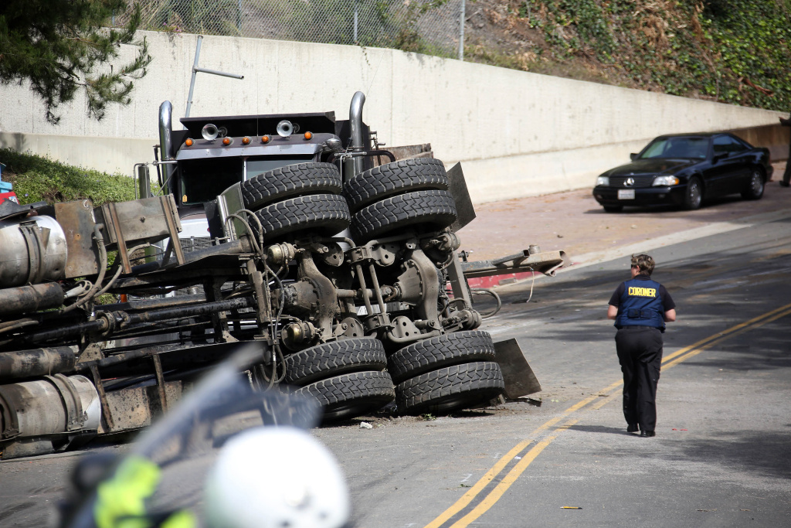
Human factors
Age:
Younger age groups due to over excitements.
Older age groups due to poor sight and hearing.
Education: High in illiterate due to ignorance
Medical condition: Sudden illness

Slide 22
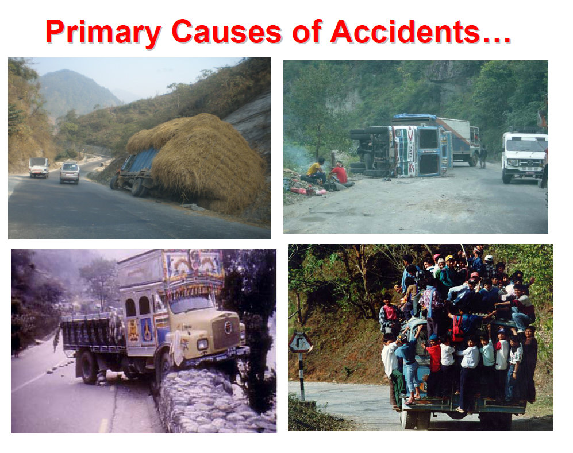
Contd..

Slide 23
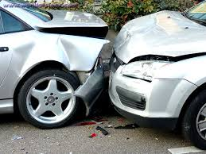
Psychological Factors:
Aggressive nature
Risk taking
Selfishness behavior
Lack of self respect and respect to others
Lack of attention while driving like using mobile phones.

Slide 24
Environment Factors
Leaving animals on the road
Weather
Defective narrow roads, turning curving roads of mountains and poorly maintained roads.
Defective layout of roads and speed breakers
Poor lighting and divider of the road
Landslides, fog, Earthquakes
Unattended children on road.

Slide 25
World scenario
Road traffic accident is serious global problem. Each year over 1 million people are killed and 50 million injured on roads around the world.
Children, pedestrians, cyclists and the elderly are among the most vulnerable of road users.
RTA now kills 3000 people every day.
One child is killed in road accidents, every three minutes in the world.
Developing countries account for 90% of global road traffic deaths.

Slide 26
The Word Health Organization's (WHO) most recent Global Burden of Disease study reported road traffic accidents as one of the fastest-growing "epidemics" in the south-east Asian region. Most of the world's road fatalities occur in low and middle-income countries, which have fewer registered vehicles, according to WHO.
Majorities of death occur on productive age groups (15-44 yrs)
Among all the accidents, RTAs are the leading cause for morbidity and mortality in the world and in Nepal.

Slide 27
In context of Nepal
RTA is an emerging problem in Nepal as it is a Developing country where number of vehicles is growing.
Around 130 major accidents and thousands of minor ones are reported every day in Kathmandu valley.
In present study out of 229 autopsy cases in one year, 110 deaths were due to road traffic accident (R.T.A.) which shows the magnitude of the problem in Chitwan and adjacent districts in Nepal. (a report on medicolegal autopsies in Bharatpur hospital)

Slide 28
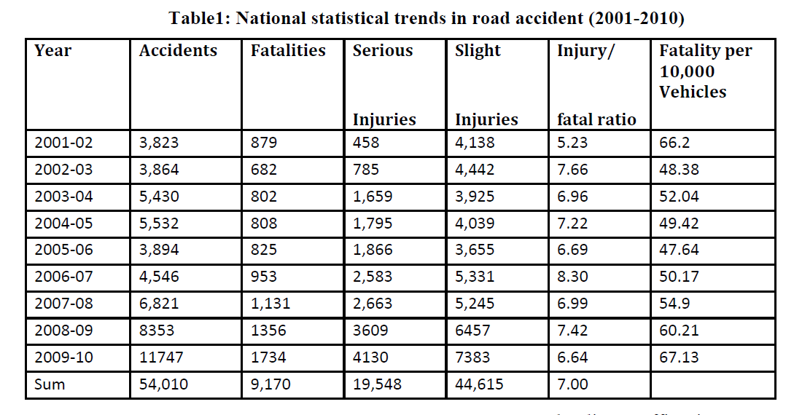

Slide 29
Prevention and control
Safety education should be provided to everyone.
Zebra crossing should be provided for pedestrians
for safe road crossing at appropriate place.
Construction, size and shape of the speed breaker
should be scientific.
Prohibition of Alcohol and Other Drugs during
driving.
Fuel or vehicle fires should be tackled immediately to
protect causalities.
Immediate Primary Care should be available to
reduce morbidity and mortality.

Slide 30
Elimination of Causative Factors
Example: improvement of road, imposition of
speed limits, marking of danger points.
Television and other media should be
effectively used for public safety awareness.
Personal safety should be maintained. E.g:
protective gloves to protect from sharp edge,
use of helmets/ belts.

