Slide 1
General outline and classification of arthropods and rodents
Pramod Mehta
M.Sc. Public Health Entomology

Slide 2
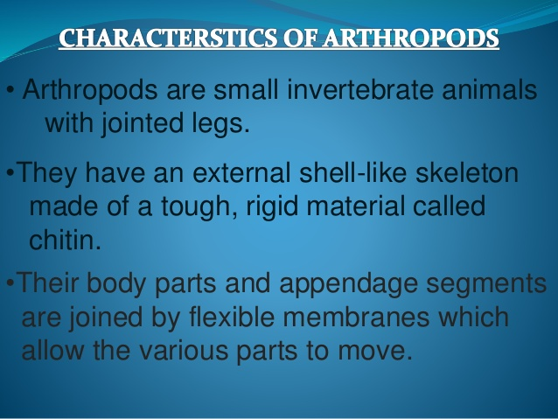

Slide 3
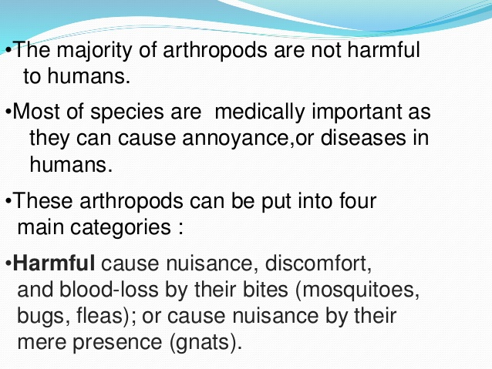

Slide 4
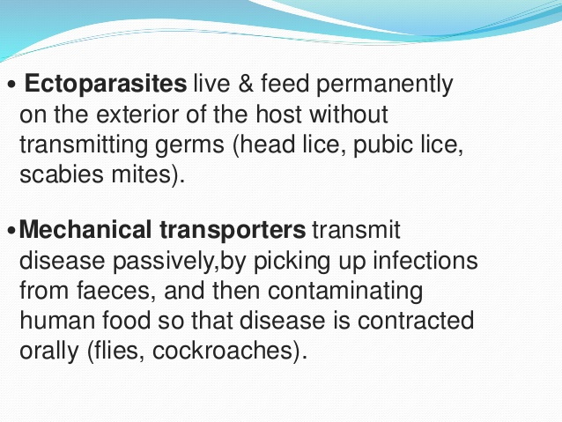

Slide 5
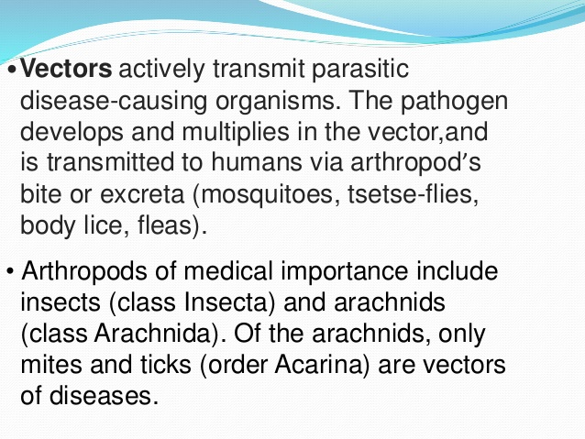

Slide 6
Taxonomical classification
Kingdom-Animalia
Phylum-Arthropoda
Class- Arachnida
- Crustacea
- Insecta ( order- Diptera, Hemiptera, Anoplura, siphonaptera, Dictyoptera.

Slide 7
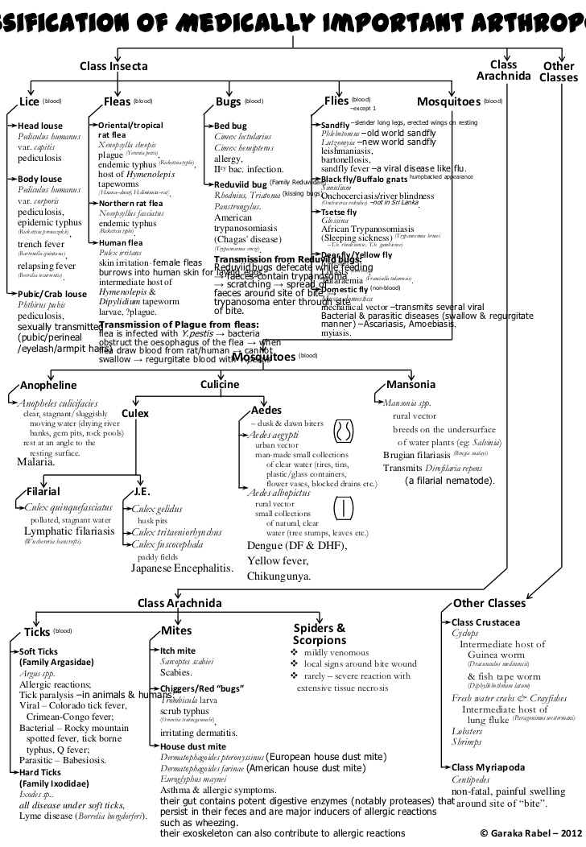

Slide 8
Classification of medically important Arthropods
Class
Insecta
Arachnida
Other classes

Slide 9
Cont..
Insecta
fleas
Bugs-bed bugs
Flies- black flies, sand fly, tsetse fly,Domestic fly
Lice- head louse, body louse, pubic louse.
Mosquitoes- Anopheles, Culex, Aedes, Mansonia

Slide 10
Cont..
Arachnida
Ticks- Hard ticks (Ixodidae), Soft ticks (Argasidae)
Mites- itch mite, chigger mite, house dust mite
Scorpion and spider

Slide 11
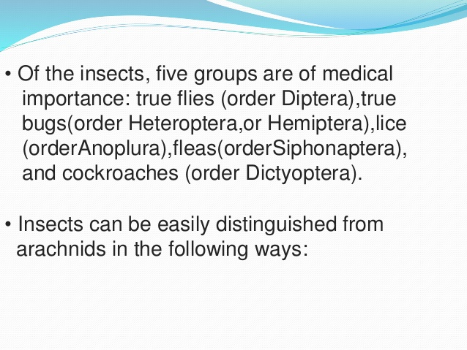

Slide 12
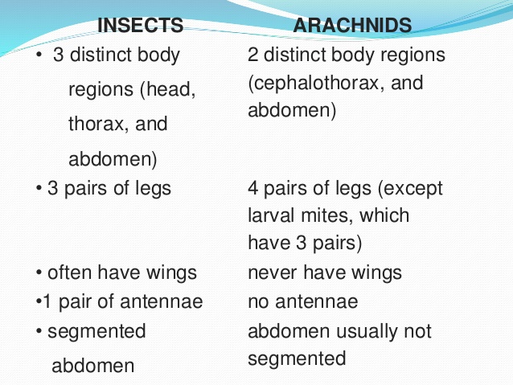

Slide 13
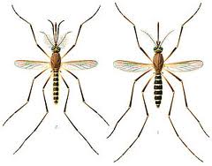
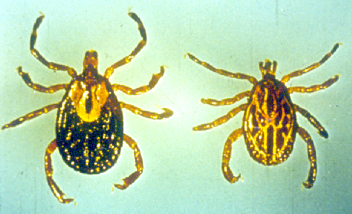

Slide 14
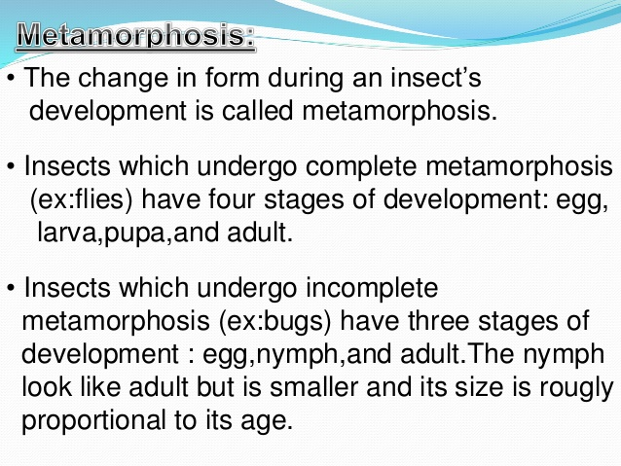

Slide 15
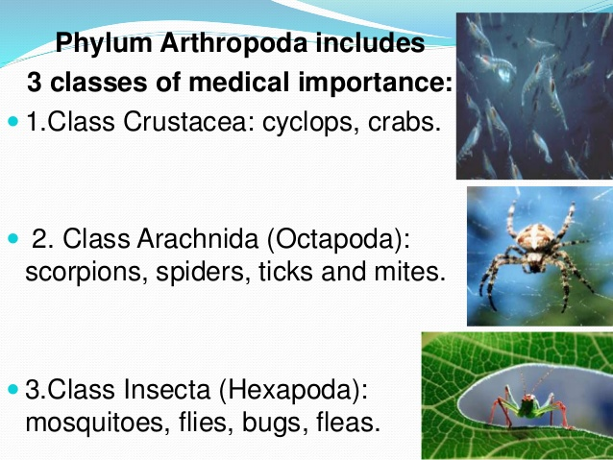

Slide 16
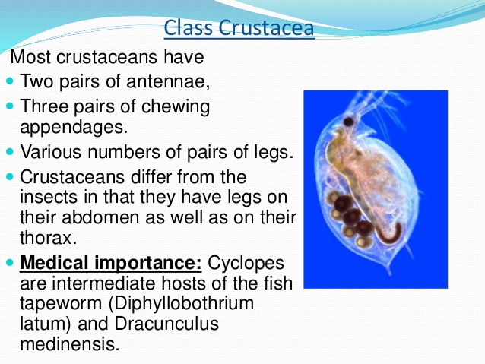

Slide 17
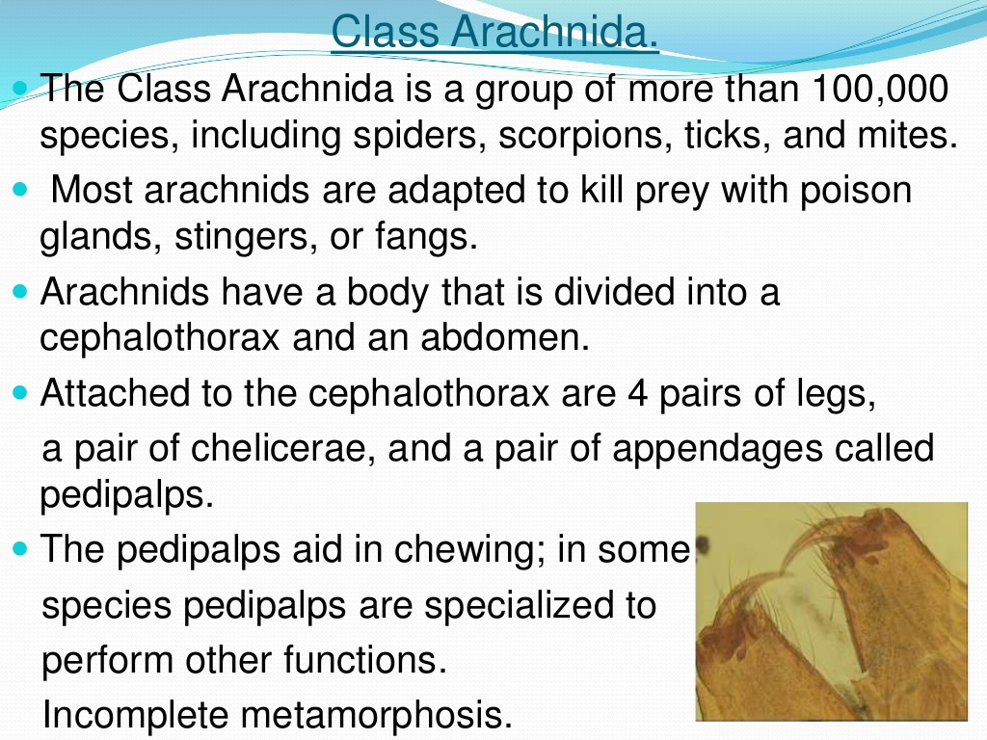

Slide 18
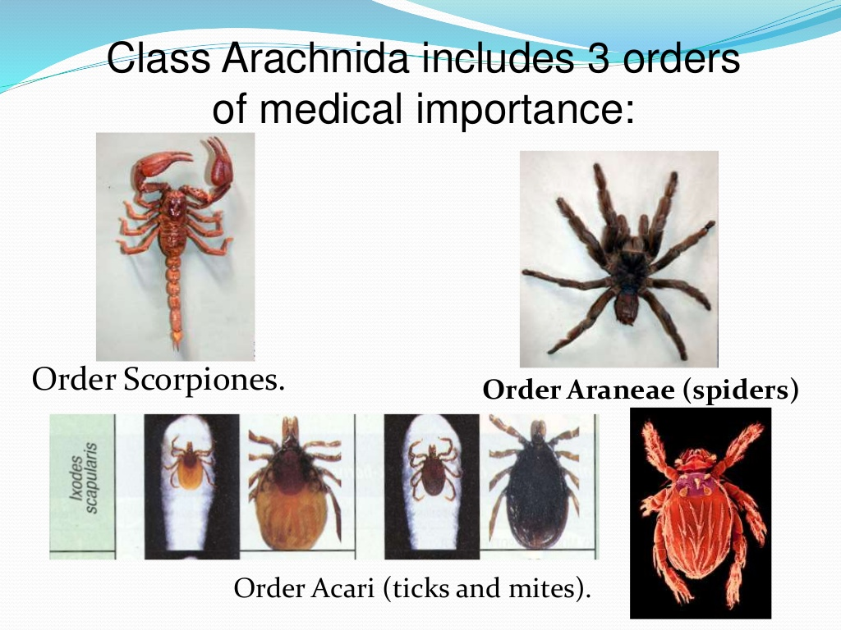

Slide 19
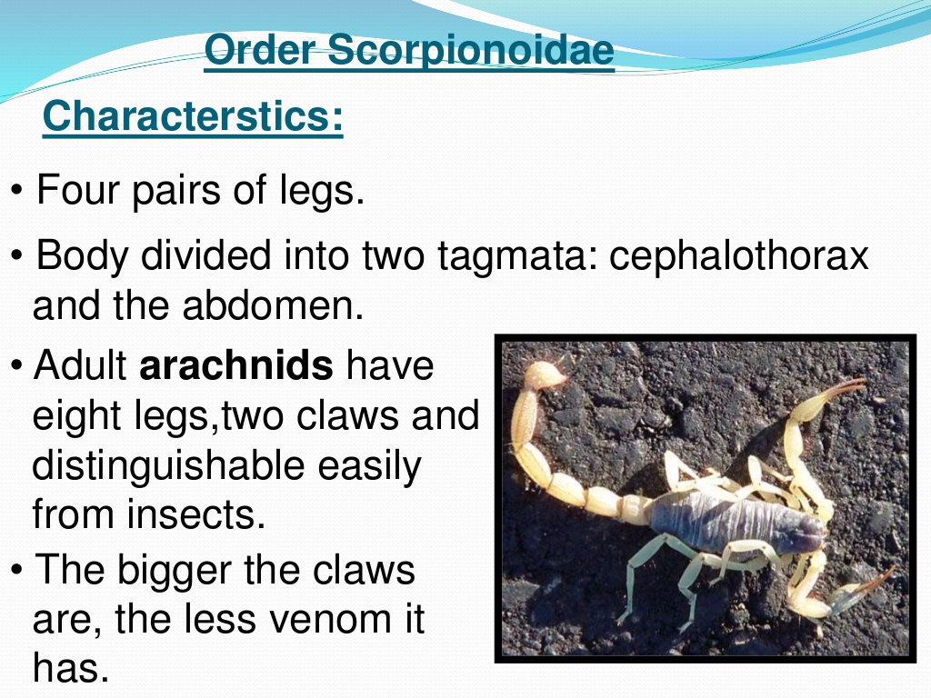

Slide 20
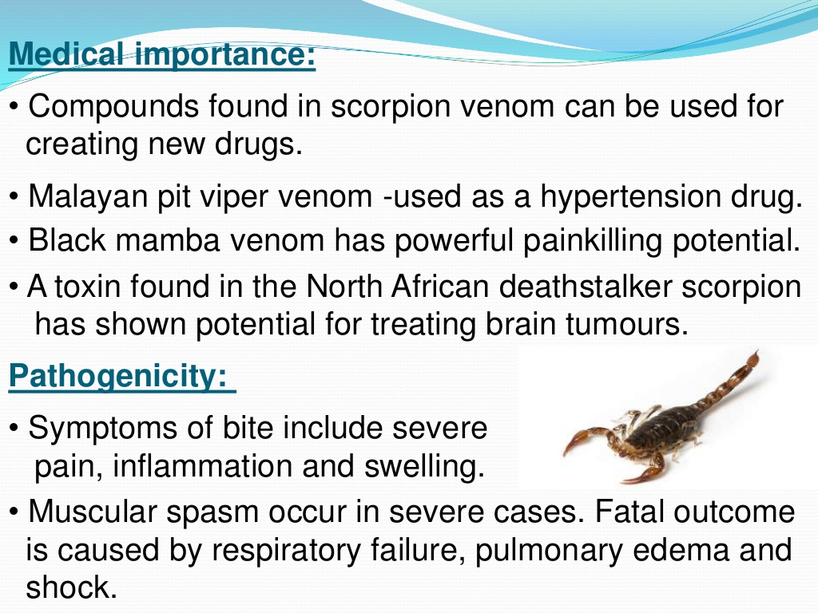

Slide 21
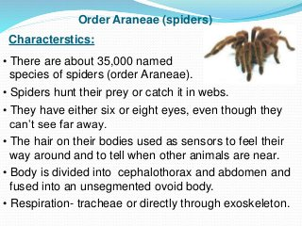

Slide 22
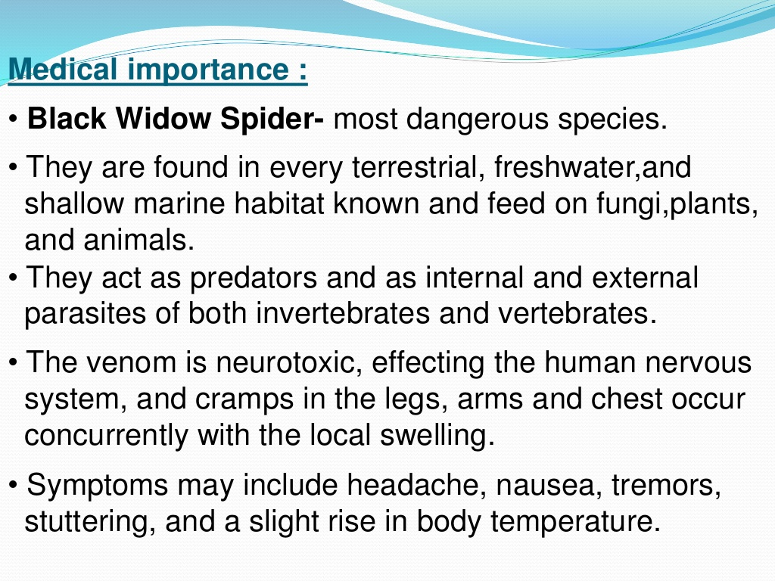

Slide 23
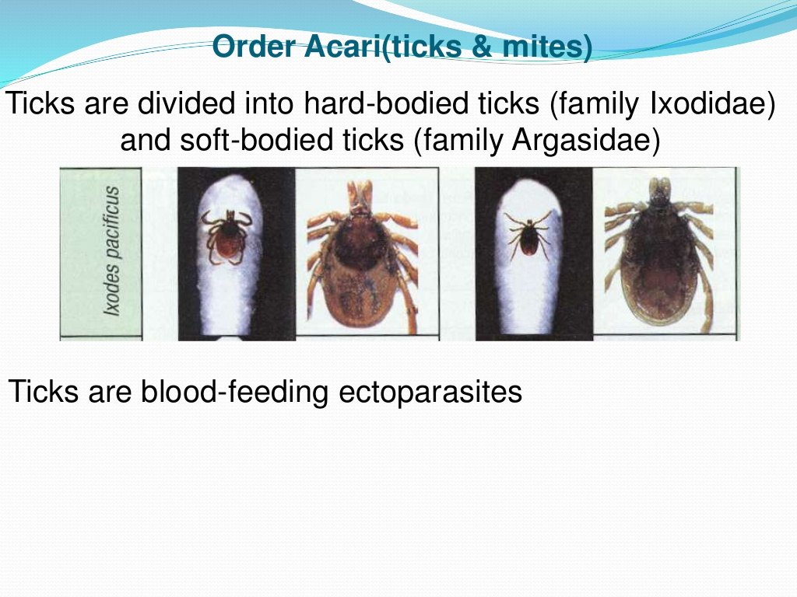

Slide 24
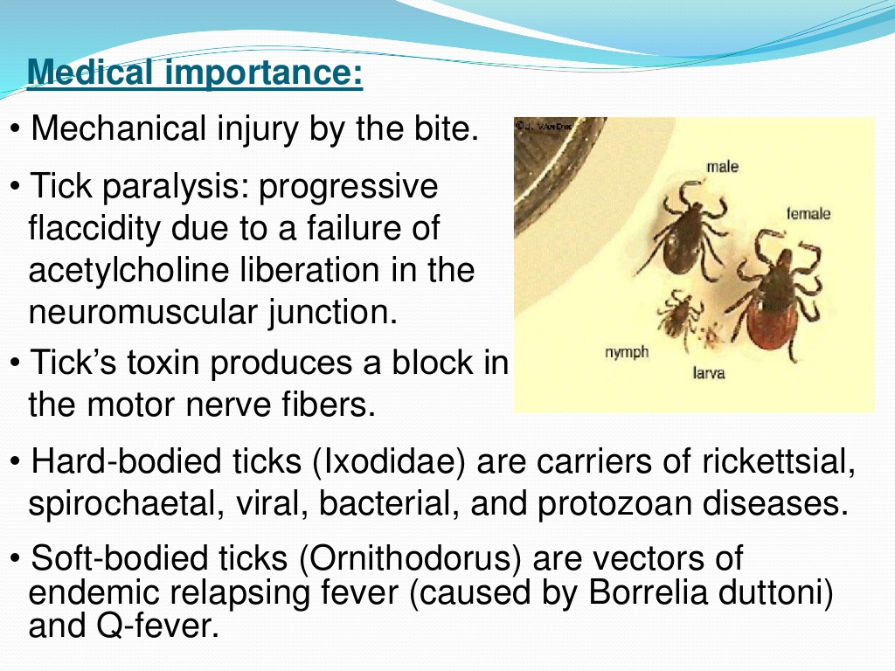

Slide 25
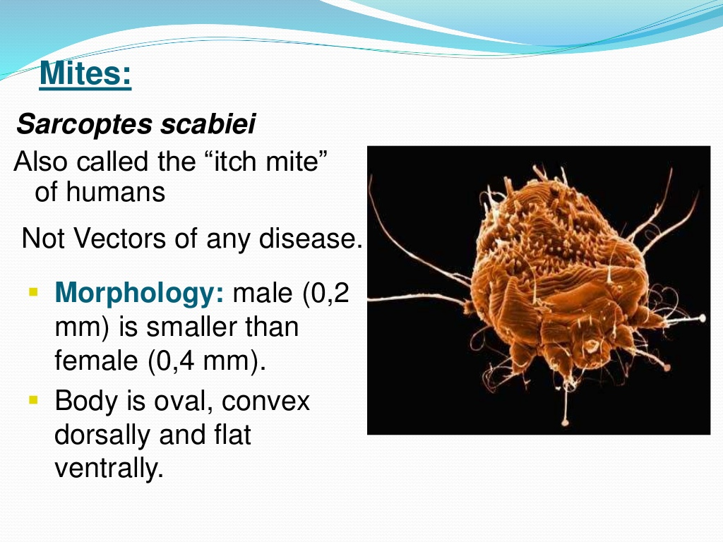

Slide 26
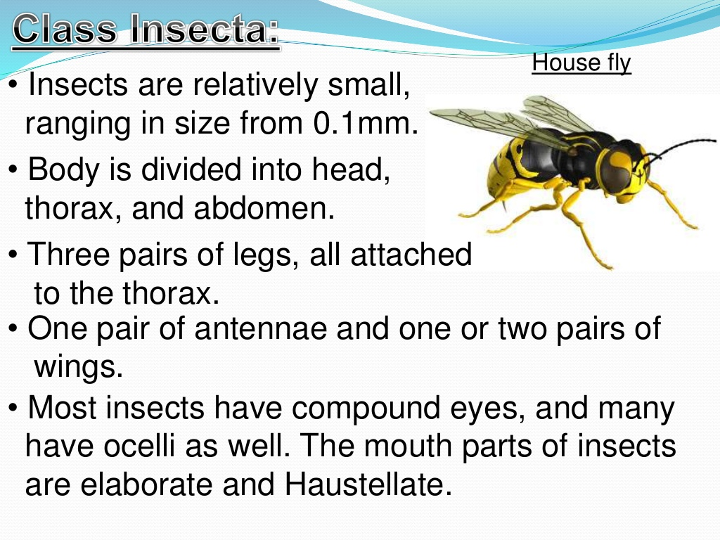

Slide 27
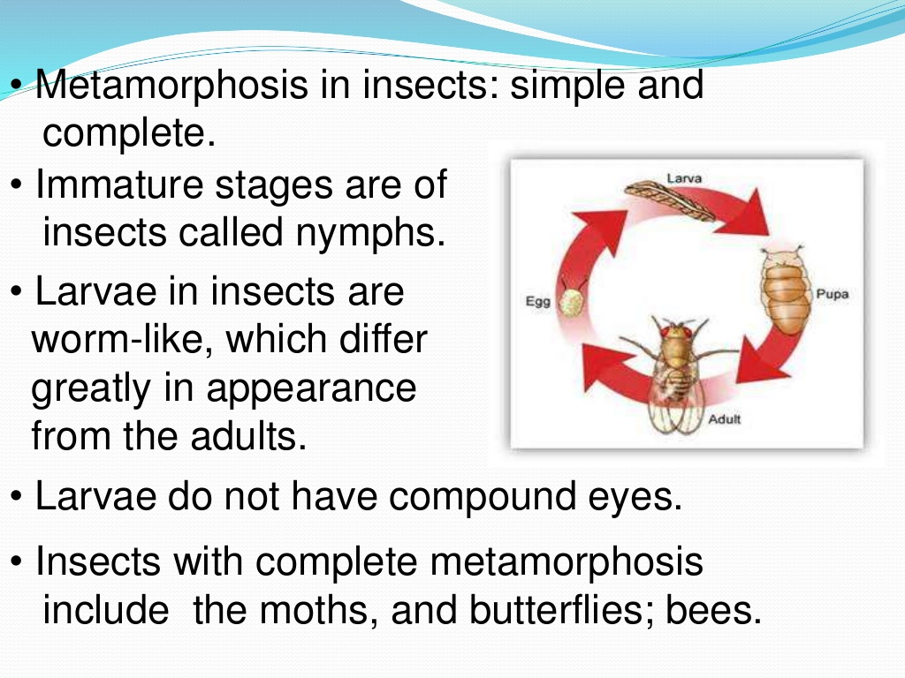

Slide 28
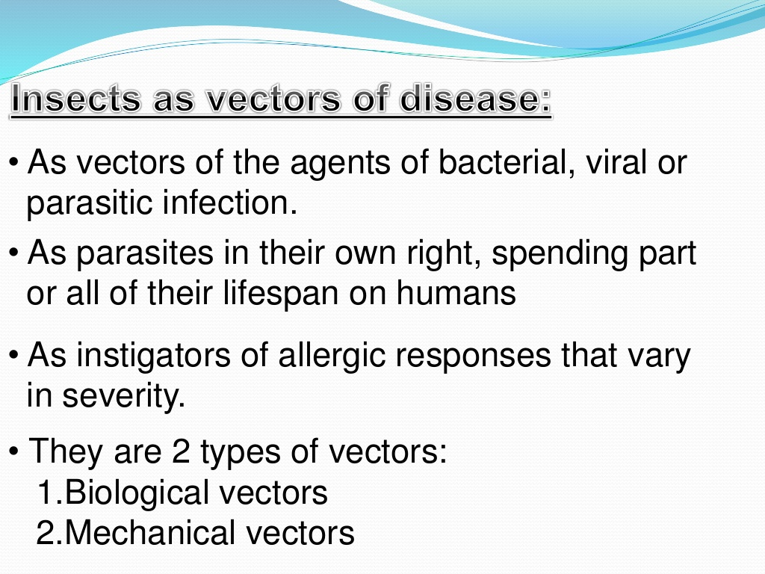

Slide 29
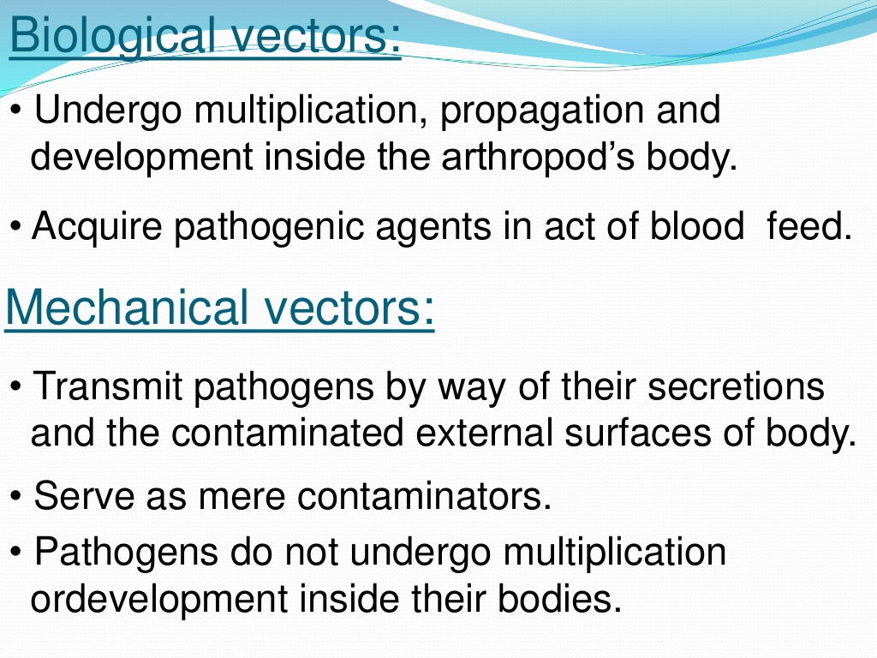

Slide 30
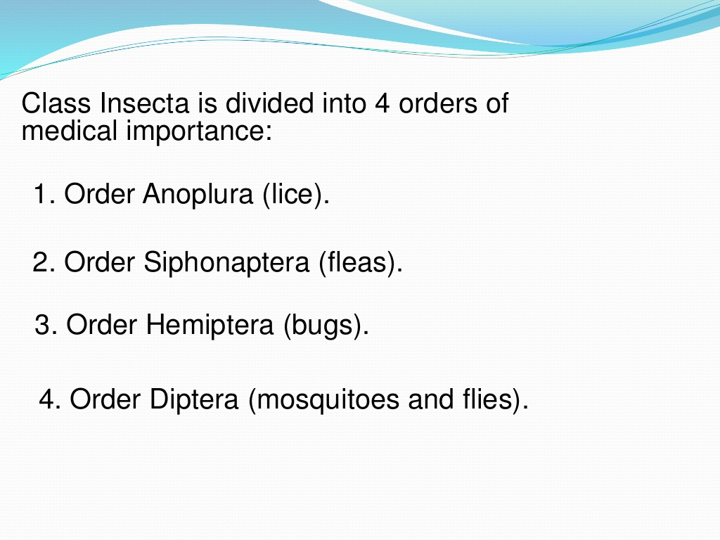

Slide 31
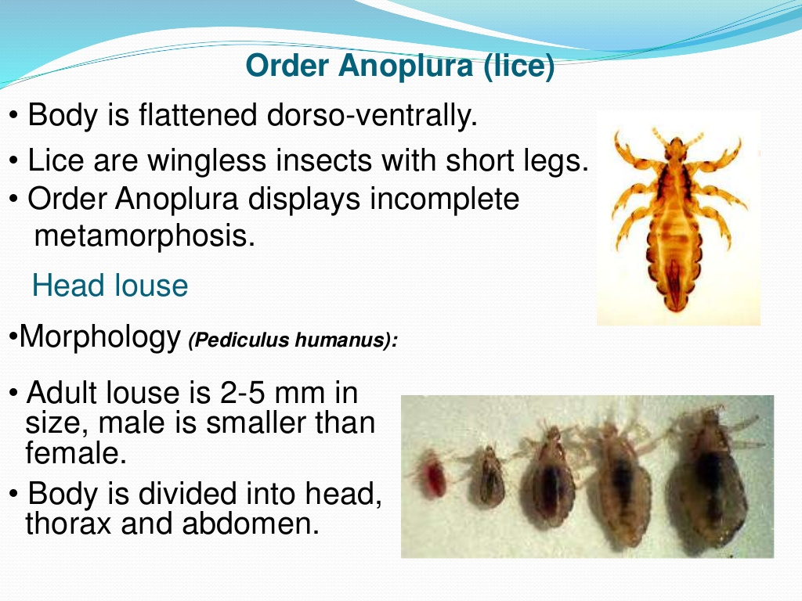

Slide 32
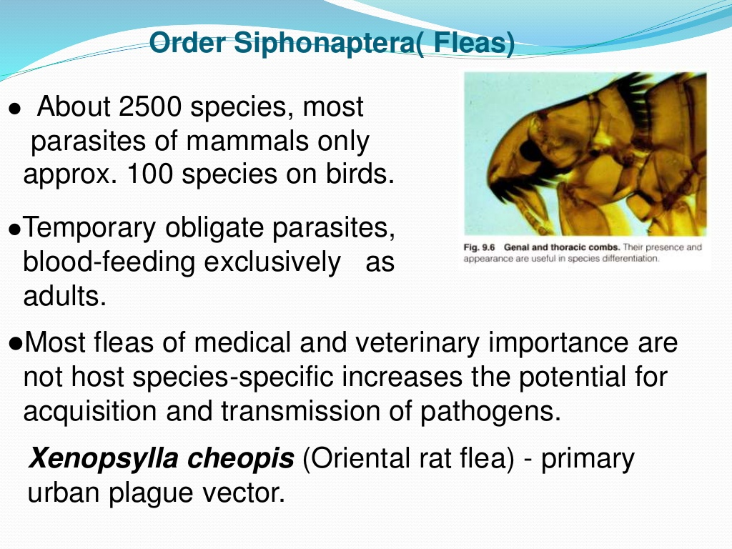

Slide 33
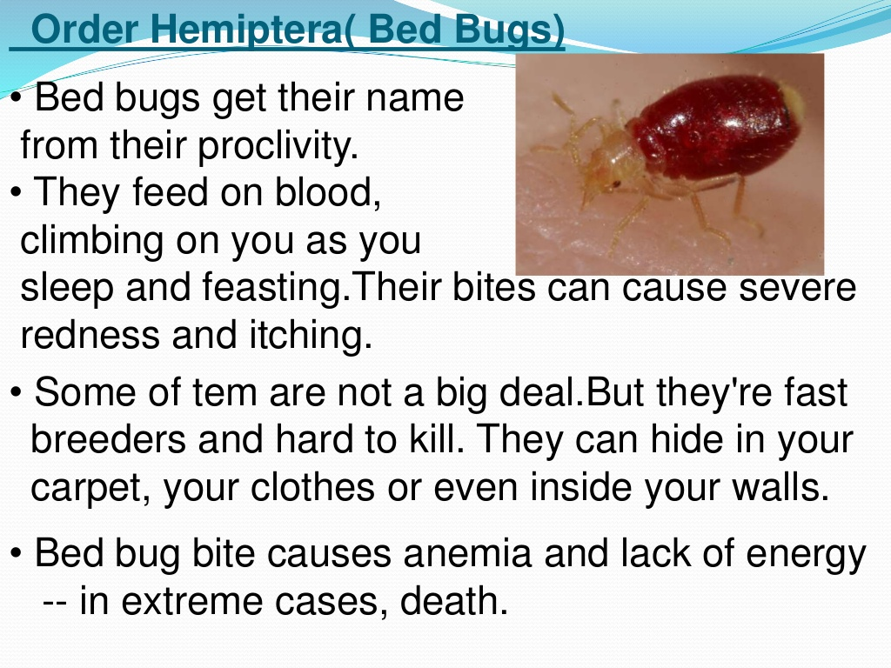

Slide 34
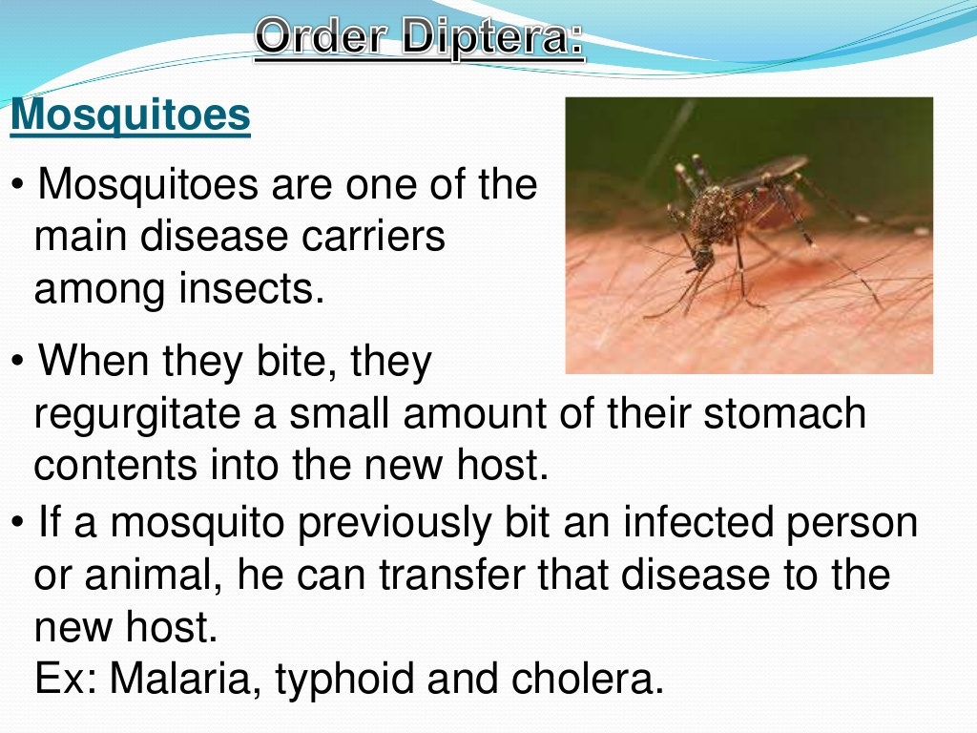

Slide 35
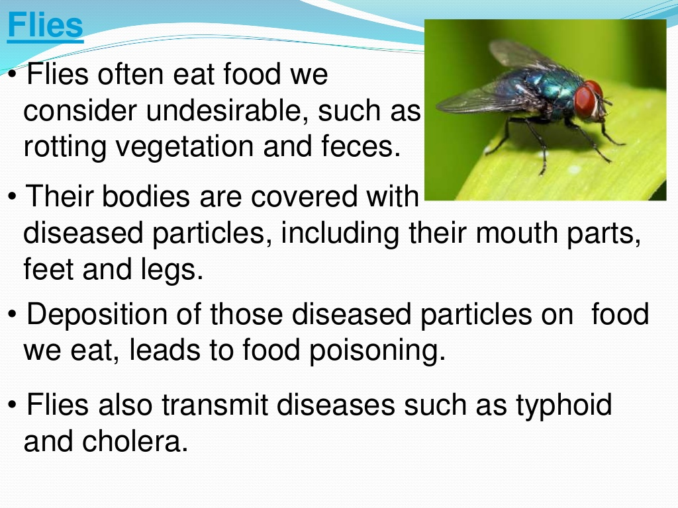

Slide 36
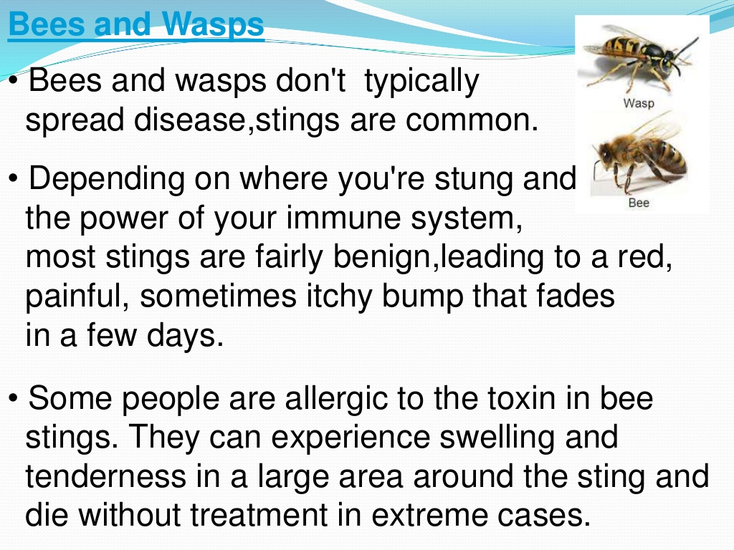

Slide 37


