Slide 1
Infectious Disease
Infectious diseases are disorders caused by organisms — such as bacteria, viruses, fungi or parasites. Many organisms live in and on our bodies.
  Some infectious diseases can be passed from person to person. Some are transmitted by bites from insects or animals.
  And others are acquired by ingesting contaminated food or water or being exposed to organisms in the environment.
.

Slide 2
Infectious disease cont…
Signs and symptoms vary depending on the organism causing the infection, but often include fever and fatigue.
Mild infections may respond to rest and home remedies, while some life-threatening infections may require hospitalization.
Many infectious diseases, such as measles and chickenpox, can be prevented by vaccines.
Frequent and thorough hand-washing also helps protect you from most infectious diseases

Slide 3
Step 1
With both hands gloved, grasp the outside of one glove at the top of your wrist, being careful not to touch your bare skin.

Slide 4
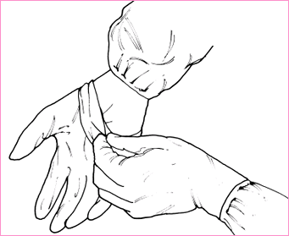
Proper Removal Contaminated Gloves

Slide 5
Step 2
Peel off this first glove, peeling away from your body and from wrist to fingertips, turning the glove inside out.

Slide 6
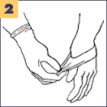

Slide 7
Step 3
Hold the glove you just removed in your gloved hand.

Slide 8
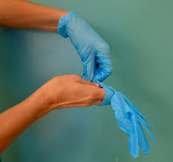

Slide 9
Step 4
With your ungloved hand, peel off the second glove by inserting your fingers inside the glove at the top of your wrist.

Slide 10
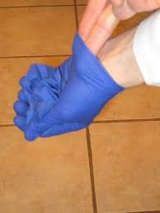

Slide 11
Step 5
Turn the second glove inside out while tilting it away from your body, leaving the first glove inside the second.

Slide 12
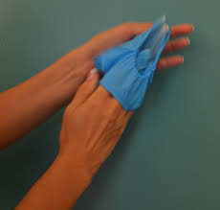

Slide 13
Step 6
Dispose of the gloves safely. Do not reuse the gloves.

Slide 14
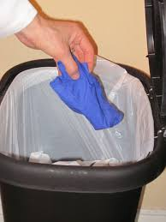

Slide 15
Step 7
Clean your hands immediately after removing gloves and before touching any objects or surfaces.

Slide 16
