Slide 1
Food taboos & fads

Slide 2
Concept of food
FOOD is culturally specific concept.
In general, anything can function as food if it is not immediately toxic. But what is edible in one culture may not be in another.
The concept of food is determined by three factors:
biology,
geography,
and culture.

Slide 3
Concept of food
Certain plants and animals are not consumed because they are indigestible. Geography also plays a role. For example, dairy products are not part of the food culture of the humid tropical regions since the geographical conditions for keeping cattle are unfavorable.
Milk is often a taboo food in such cultures. Insects are not considered food in Europe and most of the United States despite attempts to introduce them in the late twentieth century.
This is because there are few edible insects in regions with temperate climates. In Mexico, by contrast, insects are packaged in plastic sachets, cans, or jars for sale.
Cultural reasons for food taboos often have a geographical basis—unknown or exotic foods will be rejected as unfit for consumption.

Slide 4
Food Faddism
Derived from ‘fad’- it is an idea about food that has no factual basis and interest people for short time
Food fads: scientifically unsubstantiated beliefs about certain foods that may persist in a given time or community
It exists because of confusion , fear and quest(search) for simple solution to health problems.
It also inhabits due to ignorance of the science of nutrition or from faulty interpretation due to lack of evidence
Food faddism may be labeled as an ice-berg phenomenon occurring in our population.

Slide 5
Unscientific statements may mislead consumers and contribute to poor food habits.
The solutions for making slim posture(esp. in women) is ‘engender’(provoking) food fads.
Arise due to ignorance of the science of nutrition or from faulty interpretation due to lack of evidence.
“Food faddism is a dietary practice based upon an exaggerated belief in the effects of food or nutrition on health and disease.”

Slide 6
Aspects of faddism and faulty food Aspects of faddism and faulty food habits habits
Geographic Area
Religious Belief
Traditional Beliefs
Hot and cold food
Pica
03/06/2021
6

Slide 7
Aspects of faddism and faulty food habits h
Geographic
Soil,climate ,water & local agricultural practices determined the types of foods that can be grown in the locality.
Consumption of diet based on staple foods give rise to PEM among children in many countries of africa,central & south America over past centuries.
Pellegra is common among poor maize eaters.
Rice is main food crop where rainfall is high whereas millets grow in areas of low rainfall.

Slide 8
Religious beliefs
Various religions of the world have had some influence on the food habits
For.exMuslims are forbidden from eating pork & hindus from eating beef.

Slide 9
Traditional beliefs
Traditional beliefs in food habits are still prevalent with a large majority of the population who are illiterate or ignorant regarding the nutritive value of foods .
In Ethiopia , a pregnant women must avoid roasted meat as it is believed to induce abortion.
In some part of west Bengal, it was believed that consumption of milk & fish at same meal will lead to the development of leprosy & leucoderma.
Notes:
<number>

Slide 10
Consumption of pig’s stomach by girls & young women will darken their complexion

Slide 11
Hot & cold foods
‘Hot’ foods are believed to produce more heat in the body & lead to the development of boils.
‘Colds’ foods are supposed to lower the heat produced & lead to the development of cold , sore throat,etc.meat,eggs,legumes,nuts & oilseed are supposed to be hot foods while fruits & vegetables & milk are supposed to be ‘cold’foods

Slide 12
Pica
Pica is common practice among pregnant women & children in many countries.
Pica is habit of eating dirt,clay,chalk,limestone,plaster,ashes ,starch etc.This habit has been reported since ancient times from asia, Africa, Europe,North,central & south America.
There is belief that to be a normal baby pregnant women should eat clay or starch etc.

Slide 13
Food Fad Claims
Food fad claims may center on
  Food cures for specific conditions/illnesses
  “Harmful” foods to be omitted from the diet
  Certain food combinations may promote health, weight loss
  “Natural” foods can prevent disease
Food fad claims tend to focus on foods, not the specific nutrients in food
Slide <number>
Notes:
<number>
Food quackery is exploitative and entrepreneurial.
Health fraud shares many of the characteristics of food faddism and food quackery.
According to the ADA’s Complete Food and Nutrition Guide, “Health fraud means promoting, for financial gain, a health remedy that doesn’t work—or hasn’t yet been proven to work.”
Consumers are taking greater responsibility for self-care.
Nutrition products are among the most commonly misused.

Slide 14
Food fads
Food fads of various kinds have persisted ever since. For eg.Bitterguard is reputed to have cure diabetes mellitus, but without any scientific basis.
Fruits & vegetables cultivated by organic manure are believed to possess greater nutritive value than food grown with inorganic fertilizers.

Slide 15
A survey made by American Dietitics Association in USA showed :
Garlic cures high BP
Raw cucumbers without salt are poisonious
Fruits esp.citrus fruits, tomato are too acid to handled by body ,
Honey is not flattening
A good way to diet is to skip breakfast

Slide 16
Adults need no milk
Natural foods are the only ones that are safe for the consumers
Changes due to technology:Milled rice & white flour are preffered to undermilled rice & whole meal flour because of their eye appeal.
Cults : vegetarinism has been practiced on religious grounds by hindus,buddhists,jains & others.
Notes:
cults :“a religious group that denies one or more of the fundamentals of biblical truth.”
<number>

Slide 17
Examples of food fads:
Cabbage soup diet
Morning banana diet
Low carbs diet: Dr .Atkin’s diet.

Slide 18
Thank you !!!

Slide 19
Changing Food Habits :Food FADS
Food fads & faulty food habits are the important contributory causes for the wide prevalence of malnutrition(preschool children,expectant & nursing mothers in developing countries.
This can be overcome by education in nutrition:
Change cannot be superimposed but must have integrated into the existing cultural pattern
Proposed changes should be acceptable to individuals concerned
Participation of representatives of the group in implementing the proposed change is essential &
The individual should be satisfied that the changes in food habits have improved their health.

Slide 20
Dangers of Food Fads
Danger to health/failure to seek appropriate medical care
Money wasted on fad supplements
Lack of sound knowledge that counteracts scientifically based health information
Distrust of the food market/unwarranted rejection of all modern food production
Slide <number>
Notes:
<number>
Americans spend $33 billion annually on weight-loss foods, products, and services.
Fewer than half of obese patients have reported receiving any advice from health care professionals to lose weight.
Qualified professionals need to be more proactive in providing sound information about appropriate weight-loss methods.
Herbal, botanical, and sports supplements and other products now comprise over half the dietary supplement industry.
Consumer spending on supplements, natural/organic food and personal care products totaled $128 billion in 2000.

Slide 21
Vulnerable Groups
Elderly persons
Young persons
Obese persons
Athletes and coaches
Entertainers
All rights reserved to Vinayak Mehetre
Slide <number>
Notes:
<number>
The health consequences of food quackery, faddism, misinformation, or the misuse or misinterpretation of emerging science may include:
Delay or failure to seek legitimate medical care or continue essential treatment
Undesirable drug-nutrient interactions
Effects of nutrient toxicities or toxic components of products
Interference with sound nutrition education and practices

Slide 22
How these food fads can affect our bodies?!
Weight gain
These diets will lead to weight loss but this loss won’t last long because it is not from the accumulated fats, but it is mostly from water and muscles tissues.
Slow metabolism
Loosing muscles mass lowers your basil metabolic rate,and that is because muscle tissue is metabolically more active than fat tissue.
Nutritional deficiencies
Since fads limits individuals food choices leading to vitamins & minerals deficiencies.

Slide 23
Food Faddism can be postive or negative.
Food Faddism consists of following elements:
Food beliefs
Food taboos
Food habits

Slide 24
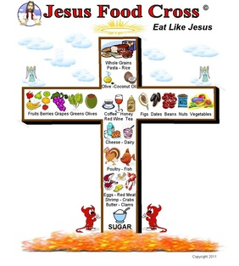
1.Food Beliefs
Culture has a strong impact on the food behaviour of people.
The food, habits and practices are closely related to the typical behaviour of a particular group of people or culture.
Such behaviour follows codes of conduct in relation to food choice, methods of food preparation and eating, number of meals eaten per day, time of eating, and the size of the portion eaten.

Slide 25
Food beliefs in Nepal
In case of Hindus , the spiritual aspect dominates all food beliefs.
The concept of re-incarnation and the sanctity of life lies at the root of these food beliefs, but resource conservation and safe-guarding health play a role as well.

Slide 26
Before a man takes his morning meal, he will make an offering of the food to his gods and ancestors.
Hindus do believe that plants also have life, though in a more sedate and sedentary form. The use of plants as food is considered less sinful than taking the lives of animals, but they must not be broken or harvested after dark.
In Muslim society taking pork meat is said to contrast their religion and thus is prohibited.

Slide 27
Taboos
A restriction on behavior imposed by social custom.

Slide 28
Food Taboos:
Also called Food avoidances.
Prohibition against consuming certain foods.
Food avoidance are associated with aversion due to unfamiliarity, culturally determined taste preferences, or health concepts.
Food avoidance most frequently relates to animal meat, since in most cultures human being have emotional relationships with the animals they have to kill and eat

Slide 29
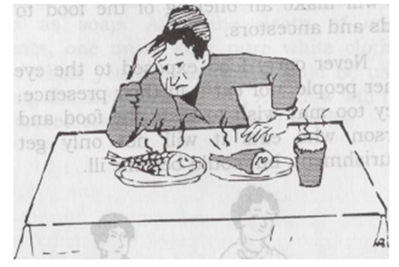
2. Food Taboos
The word "taboo" (also spelled "taboo") is Polynesian and means 'sacred' or 'forbidden'; it has a quasi-magical or religious overtone.
In the field of food and nutrition, food taboos are not necessarily connected with magical-religious practices, and some nutritionists prefer to speak of "food avoidance."

Slide 30
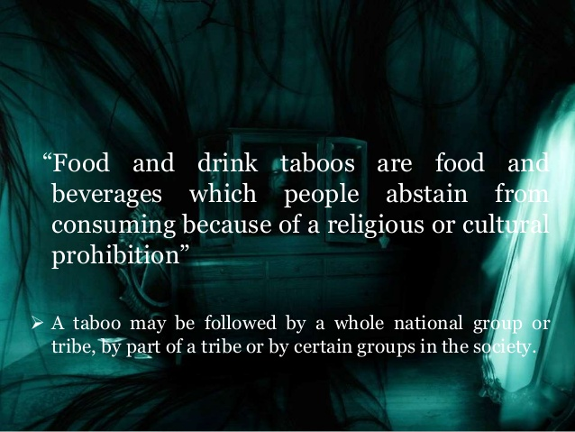

Slide 31
food taboos
Most food taboos apply to animal resources
There are two types of food taboos
applies to all individuals of a culture
applies to a subset of individuals in a culture
Unwritten social rules that regulate the human behaviour and define ‘in group’ certain foods are dirty ,predatory .eg.pig

Slide 32
Reasons for food taboos
Early anthropologists - quirk of culture
Environment - not suitable for area or scarce
Medical reasons - unhealthy
Economic reasons - more value alive
Symbolic reasons - unnatural
Social reasons - to increase cohesion or reinforce differences
Notes:
Dhun or turn of : quirk
<number>

Slide 33
Types of Food Taboos
I. Permanent Food Taboos
Foods that are permanent taboos or avoidances are always prohibited for a specific group.
The classic example of a permanent food taboo is the prohibition against pork by Muslims. According to the Quran, Muslims should not only avoid pork, but also blood, non-ritually slaughtered animals, and cadaver and alcohol.
Similarly Brahmans, Chhetris and Magars do not take the meat of the buffalo; they however drink buffalo milk.
Notes:
शव : cadavers
<number>

Slide 34
II. Temporary Food Taboos or Avoidances
Some foods are avoided for certain periods of time. These restrictions often apply to women and relate to the reproduction cycle. For e.g. during;
Pregnancy
Birth
Lactation
Infancy
Initiation
Periods of illness or sickness
Some examples are never carry food exposed to the eyes of other people, nor eat it in their presence. For they too may wish to taste the food and the person who eats it will not only get no nourishment, but could become ill.

Slide 35
THANK YOU >>>>>>>>>>>>>>

