Slide 1
Dimension of health
7 dimensions

Slide 2
It is the full integration of states of physical, mental, social, spiritual, emotional, vocational and other related to well-being. Each of these seven dimensions act and interact in a way that contributes to our own quality of life.

Slide 3
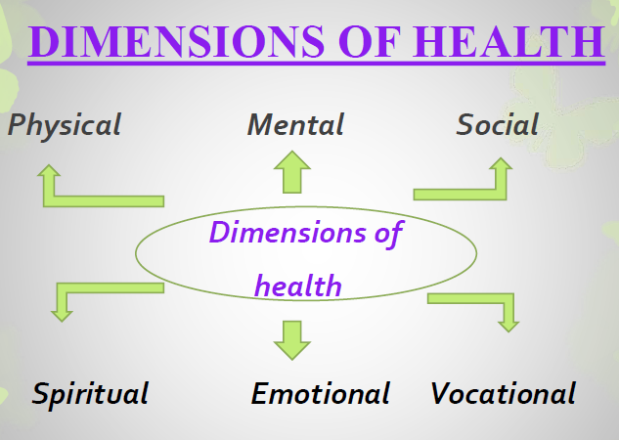

Slide 4
Physical dimension
Physical health means perfect functioning of the body in which each organ is working in harmony with the maximum capacity.
Physical health is achieved by the exercise, healthy diet, adequate rest and sleep and no smoking or alcohol intake.
To maintain proper physical health, there is need for taking safety precautions, and regular follow up with the health care providers.
Signs of physical health :
A good complexion.
A clean skin.
Bright eyes.
Not too fatty.
A sweet breath.
A good appetite.
Sound sleep.
Regular activities of bowels and bladder.
Smooth, easy, and coordinated bodily movements.

Slide 5
Evaluation of Physical Health :
1. Self assessment of overall health.
2. Inquiry about ill health and risk factors.
3. Inquiry in to medications.
4. Standardized questionnaire for cardiovascular and respiratory diseases.
5. Clinical examinations.
6. Nutritional and dietary history.
7. Biochemical and laboratory investigations.

Slide 6
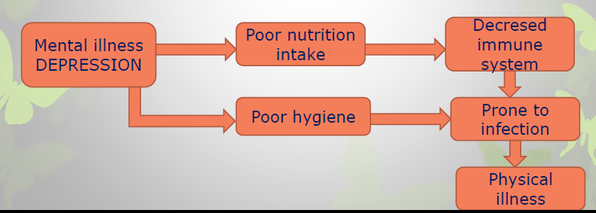
2.Mental Dimensions :
Mental health is a state of balance between body and mind .
Earlier the body and mind were considered two separate entities.
But these are interrelated as physical illness can result mental illness and vice versa.
How mental illness influence physical health has been shown in fig;

Slide 7
Characteristics of mentally healthy person :
1. Mentally healthy person will be capable of making personal and social adjustment.
2. Mentally healthy person is free from internal conflicts.
3. He faces problems and tries to solve them intelligently.
4. He has good self control balances rationally and emotionally.
5. He knows him self his needs problems and goals.
6. He has strong sense of self esteem.
7. He searches for identity.
8. He lives a well balanced life means able to maintain the balance between work rest and recreation.

Slide 8
3.Social Dimensions
An individual is socially healthy if he is able to maintain harmonious relationship with other members of society in which he lives.
Social health rooted in “positive material environment” and “positive human environment” which is concerned with the social network of the individual.
The social dimensions of health includes;
Communication
Intimacy
Respect
Equality
Social functioning

Slide 9
4. Spiritual Dimensions :
Spirituality means in touch with deeper self and exploration the purpose of life, as people believe in some force that transcend physiology and psychology of human beings.
It includes love , charity, purpose , principles , ethics, intigrity, hope of life.
Meditations ,prayers, or spiritual gatherings are organized to maintain spiritual health.

Slide 10
5. Emotional Dimensions :
Emotional health is closely related to the mental health and is considered as an important element of health.
Mental and emotional aspects of health are now viewed as two separate entities for human life.
Cognition is related to the mental health whereas emotional health is related to the feelings of a person.
Emotional health includes;
  An emotionally healthy person has a positive thinking and is capable of coping and adjusting self.
  An emotionally healthy person participates in all the activities which are related to personal growth and his self esteem.
  Emotionally well people have the ability to express feelings freely and manage feelings effectively.
  They are also aware of and accept a wide range of feelings in themselves and others.

Slide 11
6. Vocational Dimension:
The choice of profession, job satisfaction, career ambitions and personal performance are all important components of this dimension.
To be occupationally well, a person is ultimately doing exactly with what they want to do in life and are comfortable with their future plans.
Vocational dimension of health can be assessed by;
  Assessing the satisfaction level at job,
  Facilities attached to the job,
  Behaviour of the management and administrator and of colleagues at job.

Slide 12
7.Other dimensions :
A few other dimensions also suggested such as ;
Cultural dimensions
Socio-economic dimensions
Environmental dimensions
Educational dimensions
Nutritional dimensions
Preventive dimensions

Slide 13
EMOTIONAL DIMENSION
Emotional health relates to feelings. Some negative feelings leads to diseases.

Slide 14
SOCIAL DIMENSION
It refers the ability to make and maintain relationships with other people or communities.
It states that harmony and integration within and between each individuals and other members of the society.
Social dimension of health includes the level of social skills one possesses, social functioning and the ability to see oneself as a member of a larger society.

Slide 15
SPIRITUAL DIMENSION
Spiritual health is connected with religious beliefs and practices. It also deals with personal creeds, principles of behavior and ways of achieving peace of mind and being at peace with oneself.
It includes integrity, principle and ethics, the purpose of life, commitment to some higher being, belief in the concepts that are not subject to “state of art” explanation.

Slide 16
VOCATIONAL DIMENSION
Is a new dimension
The importance of this dimension is exposed when individual suddenly lose their jobs or faced retirement. For individuals vocational dimension may be a merely source of income.

Slide 17
Changing concepts of health
Health has evolved over centuries from an individual concern to worldwide social goal and new concepts have emerged based on new patterns of thought.
Changing concept of health till now are:
Biomedical concept
Ecological concept
Psychosocial concept
Holistic concept

Slide 18
BIOMEDICAL CONCEPT
Traditionally, health has been viewed as an “absence of disease”, and if one was free from disease, then the person was considered healthy.
This concept was based on the “germ theory of disease", which dominated medical thought at the turn of the 20th century.
The medical profession viewed the human body as a machine, disease as a consequence of the breakdown of the machine and one of the doctor’s task as repair of the machine
This model was found inadequate to solve the major problems such as the population problem, problems of malnutrition.

Slide 19
The biomedical model, for all its spectacular success in treating disease, was found inadequate to solve some of the major health problems of mankind (e.g., malnutrition, chronic diseases, Accidents drug-abuse, mental illness, environmental pollution, population explosion) by elaborating the medical technologies.

Slide 20
ECOLOGICAL CONCEPT
Form ecological point of view; health is viewed as a dynamic equilibrium between human being and environment, and disease a maladjustment of the human organism to environment.
According to Dubos(A French-born American Microbiologist and Environmentalist), “Health implies the relative absence of pain and discomfort and a continuous adaptation and adjustment to the environment to ensure optimal function.”
The ecological concept raises two issues, viz. imperfect man and imperfect environment.

Slide 21
Human ecological and cultural adaptations do determine not only the occurrence of disease but also the availability of food and the population explosion.

Slide 22
PSYCHOSOCIAL CONCEPT
According to psychosocial concept “health is not only biomedical phenomenon, but is influenced by social, psychological, cultural, economic and political factors of the people concerned.”
It tends to take a preventive approach
In recent years, doctors have begun to acknowledge the importance of social influences on health, such as stress factors and lifestyle, and it is now recognized that good health is more than merely an absence of disease.

Slide 23
HOLISTIC CONCEPT
Synthesis of all views and concepts
Realizes the importance of social, economic, political and environmental influences on health
Describes health as a unified or multi dimensional process involving the well-being of the whole person in the context of his environment
A sound mind-in a sound body-in a sound family- in sound environment

Slide 24
HOLISTIC CONCEPT
All sectors of the society(industry, agriculture, housing, etc) have an effect on health and the emphasis should be given on the promotion and protection of health.
Emphasizes intersectoral and participatory concept of “all for health” in addition to the human right concept of “health for all”

Slide 25
Social
economic
Health
protection
Health promotion
Health
Environmental
Political
Holistic concept

Slide 26
Thanks

