Slide 1


BHS 151 Environmental Science
BPH I Year, II semester
By
Kalpana Jnawali
Lecturer, BPH Program
La Grandee International College, Pokhara

Slide 2
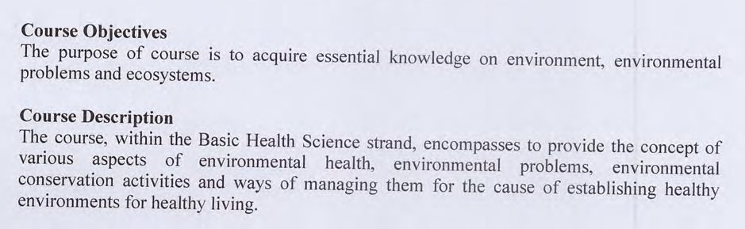

Slide 3
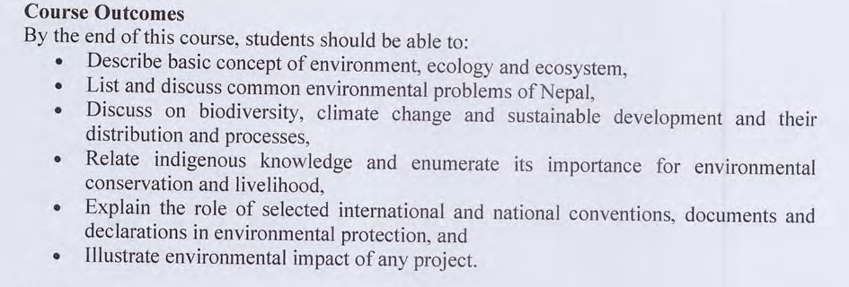

Slide 4
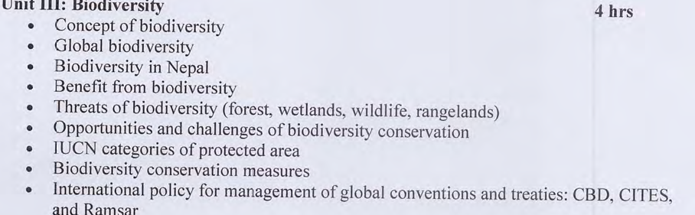

Slide 5
Concept of Biodiversity
Bio + diversity= Biodiversity
    What does Bio means?
      Bio= life
    What does Diversity means?
    Diversity= Variety
    Biodiversity is the variety of life forms on earth and the essential interdependence of all living things.

Slide 6
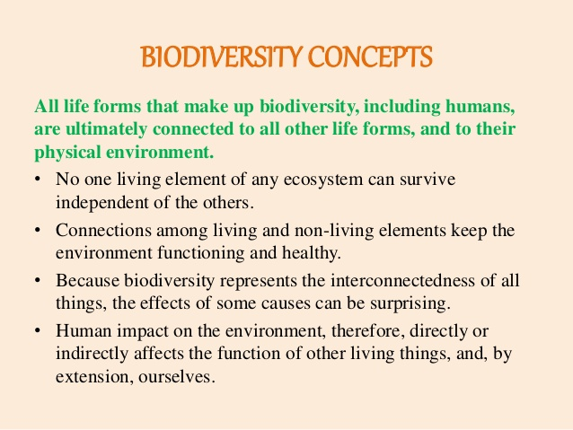

Slide 7
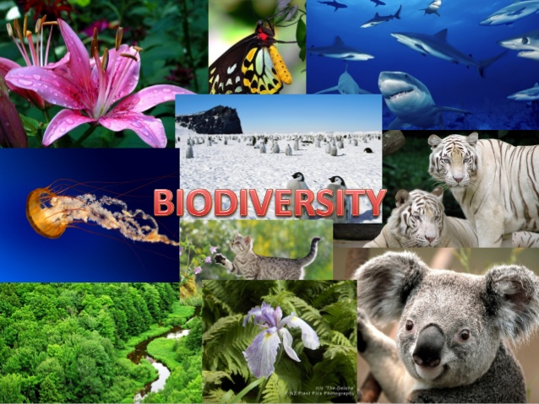
Cotd….
The term Biodiversity was first coined by Walter G. Rosen in 1986.
The biosphere comprises of a complex collections of innumerable organisms, known as the Biodiversity, which constitute the vital life support for survival of human race.
Biological diversity, abbreviated as biodiversity, represent the sum total of various life forms such as unicellular fungi, protozoa, bacteria, and multi cellular organisms such as plants, fishes, and mammals at various biological levels including gens, habitats, and ecosystem

Slide 8
DEFINITION OF BIODIVERSITY
As defined in convention on Biological diversity singed at Rio De Jenerio (Brazil) in 1992 by 154 countries, the Biodiversity defined as “the variability among living organisms from all sources including, inter alia, terrestrial, marine and other aquatic eco-systems and the ecological complexes of which the area part- this include diversity with in species, between species and of ecosystem.”
According to IUCN(International Union for Conservation of Nature) in 1998, “the variety and variability of species of their population, the variety of species of their life forms, the diversity of the complex association with species with their interaction and their ecological process which influences perform.”

Slide 9
Contd..
‘Biological diversity’ or biodiversity is that part of nature which includes the differences in genes among the individuals of a species, the variety and richness of all the plant and animal species at different scales in space, locally, in a region, in the country and the world, and various types of ecosystems, both terrestrial and aquatic, within a defined area.

Slide 10
Types of Biodiversity
Biological diversity deals with the degree of nature’s variety in the biosphere.
This variety can be observed at three levels;
  the genetic variability within a species,
  the variety of species within a community,
  the organization of species in an area into distinctive plant and animal communities constitutes ecosystem diversity.
BIODIVERSITY HOTSPOTS: A region with high biodiversity with most of spices being Endemic.

Slide 11
BIODIVERSITY AND BALANCE OF NATURE
Tropic Level: Elimination of species from tropic level can cause destruction of ecosystem as well as biodiversity
Complex Ecosystem: In a complicated ecosystem having several tropic levels, loss of one or more spices do not cause any serious problem because the alternative available.
Keystone Species: Loss or addition of species causes detectable changes in ecosystem rates i.e. species make unique contribution to ecosystem functioning
Niche(Place) Complementary: Difference among species in their requirements for different resources will cause complementary interaction so that a species could obtain more resources.

Slide 12
Global Biodiversity
Global biodiversity is the measure of biodiversity on planet Earth and is defined as the total variability of life forms.
More than 99 percent of all species, that ever lived on Earth are estimated to be died out.

Slide 13
Global Biodiversity

Slide 14
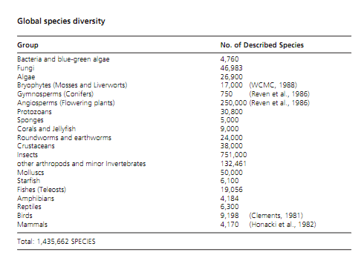

Slide 15
Biodiversity in Nepal
A total of 118 different ecosystems have been identified in Nepal, including 112 forest ecosystems, four cultivation ecosystems, one water body ecosystem and one glacier/snow/rock ecosystem.
Nepal is ranked 25th and 11th positions in biodiversity richness in the world and Asia, respectively.
A total of 284 species of flowering plants, 160 animal species are reportedly endemic to Nepal.
The diverse climatic and topographic conditions have also favoured maximum diversity of agricultural crops, their wild relatives and animal species.

Slide 16
Contd….
Biodiversity relates to almost every aspect of Nepalese life, including
      agricultural productivity,
      food security,
      building materials,
      human health and nutrition,
      indigenous knowledge,
      gender equality,
      culture,
      climate,
      water resources and
      aesthetic value for society.
The economy of Nepal is very much dependent on the use of natural resources.
The country’s biodiversity is also an important source of revenue.

Slide 17
BENEFITS OF BIODIVERSITY
Consumptive value:
  Food/Drink
  Fuel
  Medicine
  Crop varieties
  Industrial Materials
2. Non-Consumptive Value:
  Recreation
  Education and Research
  Traditional value

Slide 18
3. Ecological services
  Balance of nature
  Biological productivity
  Regulation of climate
  Degradation of waste
  Cleaning of air and water
  Cycling of nutrients
  Control of potential pest and disease causing species
  Detoxification of soil and sediments
  Stabilization of land against erosion
  Carbon balancing and global climate change
  Maintenance of Soil fertility

Slide 19
THREATS TO BIODIVERSITY
1. Natural causes
  Narrow geographical area
  Low population
  Low breeding rate
  Natural disasters
2. Anthropogenic causes:
  Habitat modification
  Overexploitation of selected species
  Innovation by exotic species
  Pollution
  Hunting
  Global warming and climate change
  Agriculture

Slide 20
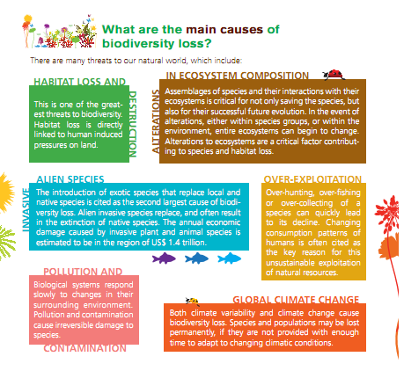

Slide 21
IUCN categories of Protected areas

Slide 22
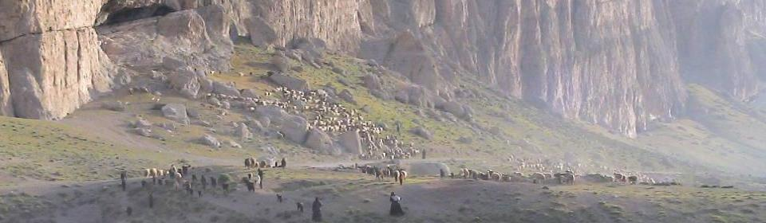
The definition of a protected area: A clearly defined geographical space, recognised, dedicated and managed, through legal or other effective means, to achieve the long-term conservation of nature with associated ecosystem services and cultural values

Slide 23

One key principle is: For IUCN, only those sites where the main goal or outcome is conserving nature should be considered protected areas. Note that this would include many sites which can have other goals as well, at the same level, such as cultural or spiritual, but in the case of conflict nature conservation has to be the priority

Slide 24
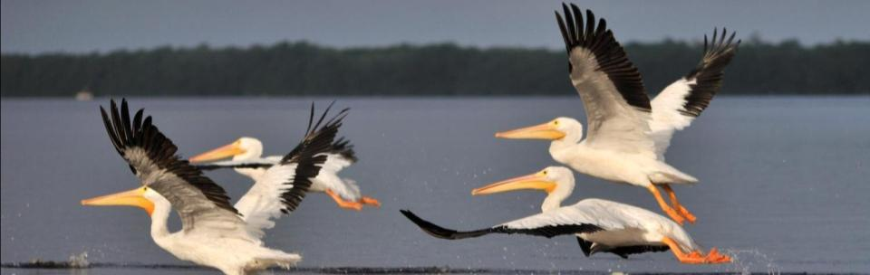
Categories of protected areas
The categories were not changed in the 2008 edition but the guidance associated with them was clarified, harmonised and standardised

Slide 25
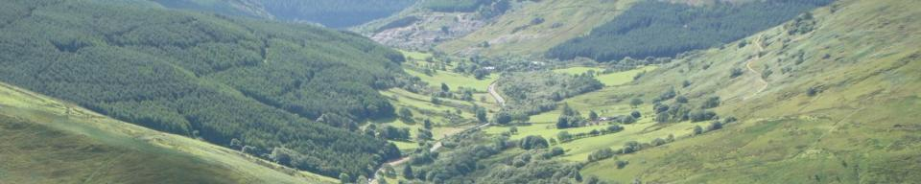
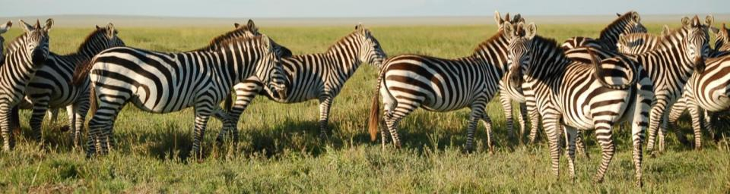
An important note: The names of the categories used by IUCN do not necessarily reflect the names used at national or sub-national levels
Serengeti National Park (category II) Tanzania
Serengeti National Park (category II) Tanzania

Slide 26
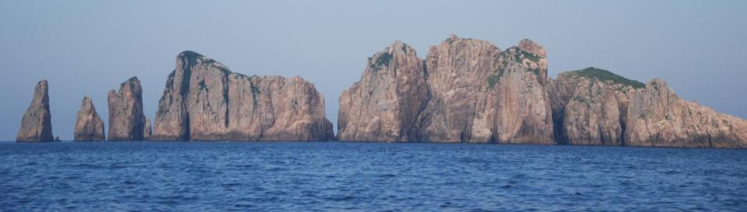
Category Ia (strict nature reserve) set aside to protect biodiversity and also possibly geological features, where human visitation, use and impacts are strictly controlled and limited to ensure protection of the conservation values

Slide 27
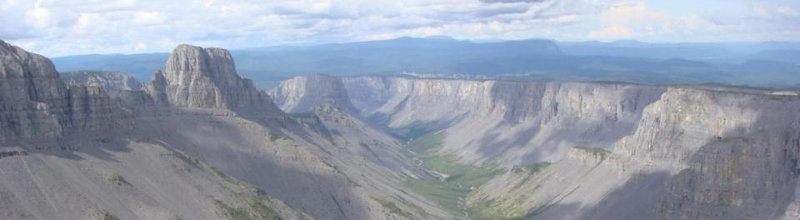
Category Ib (wilderness area) usually large unmodified or slightly modified areas, retaining their natural character and influence, without permanent or significant human habitation, protected and managed to preserve their natural condition

Slide 28
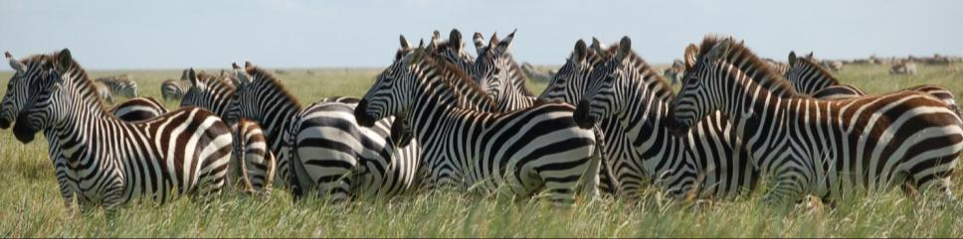
Category II (national park) protect large-scale ecological processes, along with the complement of species and ecosystems characteristic of the area, which also provide a foundation for environmentally and culturally compatible spiritual, scientific, educational, recreational and visitor opportunities

Slide 29
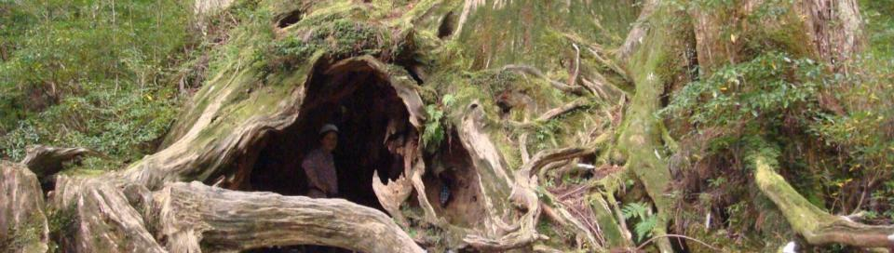
Category III (natural monument or feature) protect a specific natural monument, which can be a landform, sea mount, submarine cavern, geological feature such as a cave or even a living feature, such as an ancient grove

Slide 30

Category IV (habitat/species management area) protect particular species or habitats, where management reflects this priority. Many will need regular active interventions to address the requirements of particular species or to maintain habitats, but this is not a requirement of the category

Slide 31
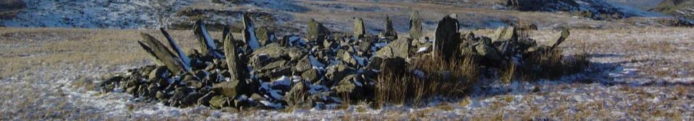
Category V (protected landscape) protect areas where the interaction of people and nature over time has produced an area of distinct character with significant ecological, biological, cultural and scenic value and where safeguarding the integrity of this interaction is vital to protecting and sustaining the area and its associated values

Slide 32
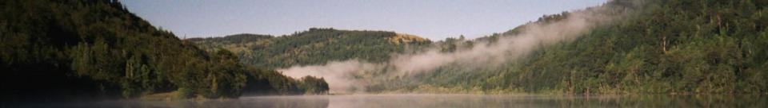
Category VI (protected areas with sustainable use of natural resources) protects ecosystems and habitats, and associated cultural values and traditional natural resource management systems. Generally large areas, with most of the area in a natural condition, where a proportion is under sustainable natural resource management with low-level non-industrial use of natural resources compatible with nature conservation

Slide 33
BIODIVERSITY CONVENSIONS
  The first convention on biodiversity organized at Rio De Janerio, capital of Brazil from June 5 to 16, 1992 named as United Nation Conference On Environment and Development (UNCED), batter known as Rio Summit to maintain ecological balance and enrich biodiversity.
  The agreement on biodiversity signed by 150 countries including three programmes.
  To ensure conservation of biodiversity sustainable use of biodiversity

Slide 34
Contd….
  Rational and equitable share of profit to accrue from use of genetic resources.
  The second convention organized at Johannesburg in 2002 called World Summit On Sustainable Development (WSSD) where the Biodiversity and Sustainable ecosystem Management was the issue.

Slide 35
Contd..
The International Conference held on Biodiversity in Relation to Food & Human Security in a warming planet 15-17 February, 2010 in Chennai.
International Conference on Wildlife & Biodiversity Conservation held on 3 to 5 June, 2010 at Dal lake, Srinagar, Kashmir.
Indian Biodiversity Congress (IBC) & Indian Biodiversity Expo(IBE) will be held on 27-31 December at Thriuvananthapuram, Kerala

Slide 36
International policy for management of global convention and treaties
      Convention on Biological Diversity (CBD)
      Convention on International Trade in Endangered Species of Wild Fauna and Flora (CITES)
      Ramsar Convention on Wetlands

Slide 37
The six global biodiversity-related conventions
Convention on Biological Diversity (CBD)
Convention on International Trade in Endangered Species of Wild Fauna and Flora (CITES)
Convention on Migratory Species (CMS)
International Treaty on Plant Genetic Resources for Food and Agriculture (ITPGRFA)
Ramsar Convention on Wetlands
World Heritage Convention (WHC)
World Summit on Sustainable Development (1992),
Johannesburg Plan of Action (2002),
Rio+20 (2012)

Slide 38
Opportunities and challenges for biodiversity conservation
Opportunities
    Local, regional and national conservation priorities
    Risks and benefits to the community and the country
    Availability of local partners
    Biodiversity richness of an area
    Degree of threat to biodiversity
    Status of protected areas system
    Strengthening protected areas
    Campaigns to save endangered species
    Support for scientific research and analysis
    Support for environmental education and awareness building
    Sharing of information on biodiversity

Slide 39
Challenges
  Poor financial investment in conservation
  lack of environmental awareness and motivation
  Lack of resources/structure to manage protected areas
  Lack of government/scientific capacity to study and manage biodiversity
  Lack of public awareness of or involvement in conservation

Slide 40
Lab 151 Environmental Science Lab
Forest conversation -Policy and its present status in Nepal.
Soil and land planning in Nepal- A situation analysis
Land slides in Nepal- Review
Initiations for conservation of Biodiversity in Nepal
Common Environmental problem in Nepal and related policies
Policies for environmental management in Nepal
Climate Change Adaptation strategies in Nepal
Climate change in Nepal and government’s response to maintain in Nepal.

Slide 41
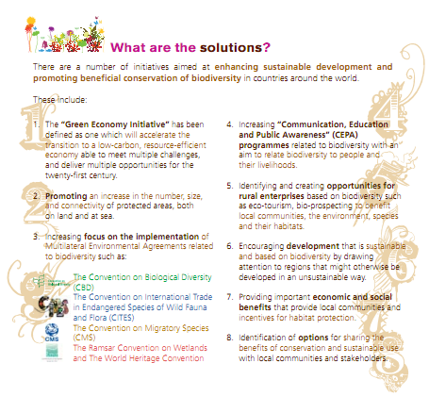

Slide 42
THANK YOU

