Slide 1
Leishmania donovani
(Kala-azar)

Slide 2
Introduction
The casusative agent of Kala-azar is Leishmania donovani.
Kala-azar is also known as Visceral leishmaniasis.
It is a protozoal infection transmitted by the bite of infected Sandfly.

Slide 3
Geographical distribution:
Endemic in may places of India, China, Africa, Southern Europe, South America and Russia. Also found in the terai belt of Nepal .
Habitat:
Vertebrate host(Man): Intracellular occurring in the amastigote form. It is a parasite of Reticuloendothelial system.

Slide 4
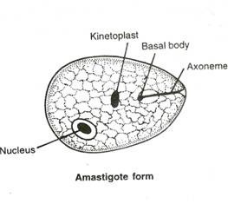
Morphology
Amastigote Stage:
Resides in the reticulo-endothelial system of vertebrates.
Round and oval measuring 2-4μm along the longitudinal axis.
Nucleus (1μm) is present in the middle of the cells or along the side of the cell wall.
Kinetoplast lies tangentially or at right angle to the nucleus. Consists of DNA containing body and mitochondria.
Axoneme: Filament extending from the basal body to the margin of the body. Represent the root of flagella.
Vacuole: clear unstained space alongside of axoneme.

Slide 5
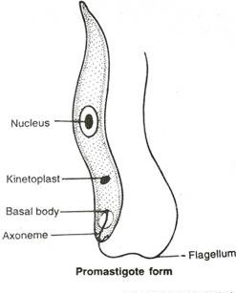
Promastogote Stage:
Present in the culture and in insect vectors (sand fly)
Early one are 5-10μm in length by 2-3μm in breadth. Later are 15-20μm long by 1-2μm breadth.
Nucleus is located centrally.
Kinetoplast lies transversely near the anterior end.
Flagellum may be of the same length as the body or even longer, projecting from the front.

Slide 6
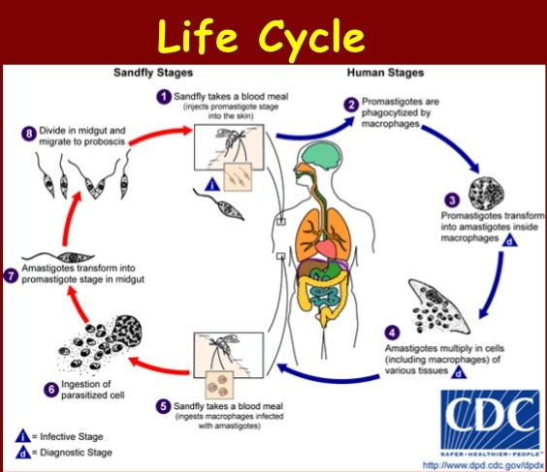

Slide 7
Pathogenicity
Incubation period: 3 to 6 months.
Clinical features:
Produces a disease known as kala-azar or visceral leishmaniasis characterized by the following:
Pyrexia.
Splenic enlargement.
Enlargement of liver.
Lymphadenopathy.
The skin over the entire body is dry, rough and harsh and is often pigmented(darkened).
If untreated 75-95% of the patient die within 2 yrs.

Slide 8
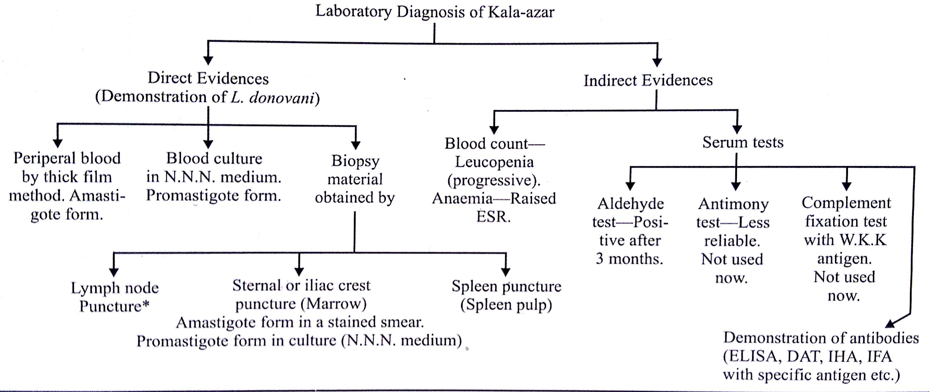
Laboratory Diagnosis of Kala-azar

Slide 9
Treatment and Prophylaxis
Treatment:
Chemotherapeutic agent includes:
1. Antimony compounds- Sodium antimony gluconate 600mg daily for 6-10 days IV route.
2. Synthetic non-metallic compounds- Pentamidine isethionate (4gms/kg/day IM for 10 days).
Prophylaxis:
1. Attack on the parasite. (Dog)
2. Attack on the vector.
3. Personal prophylaxis.

