Slide 1
SPECTRUM OF HEALTH

Slide 2
SPECTRUM OF HEALTH
Health and disease lie along a continuum, and there is no
single cut-off point. The lowest point on the health-disease
spectrum is death and the highest point corresponds to the
WHO definition of positive health
Different stages are positive health, better health, freedom from sickness, unrecognized sickness, mild sickness, severe sickness, and death.
The spectral concept of health emphasizes that the health of an individual is not static: it is a dynamic phenomenon and a process of continuous change, subject to frequent subtle variations

Slide 3
SPECTRUM OF HEALTH
Positive health
Better health
Freedom from sickness
Unrecognised sickness
Health
Mild sickness
Severe sickness
Death

Slide 4
Iceberg phenomena of disease
A concept closely related to the spectrum of disease is iceberg phenomenon of disease.
According to this concept ,Disease in a community may be compared to an iceberg.
Floating tip of the iceberg represents what the physician sees in the community as clinical cases.
Vast submerged portion represents the hidden mass of the cases, i.e. latent, inapparent, pre-symptomatic, undiagnosed cases and carriers.
The waterline represents the demarcation between apparent and inapparent disease.

Slide 5
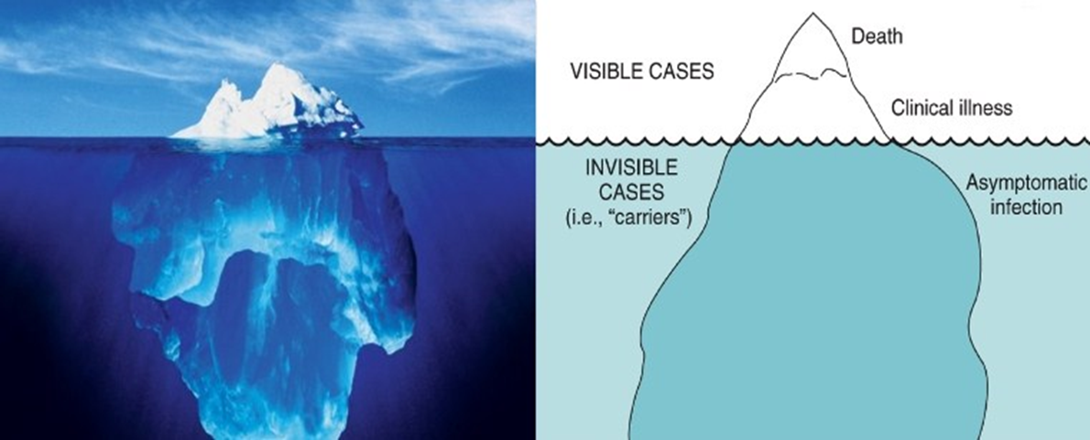

Slide 6
In some diseases the hidden morbidity far exceeds the known morbidity, e.g. hypertension, diabetes, anaemia, malnutrition, mental illness, etc.
The hidden part is the undiagnosed reservoir of infection or disease in community, and its detection and control is a challenge to modern techniques in preventive medicine. New techniques of SCREENING have to be developed to find such cases.

Slide 7
RESPONSIBILITY FOR HEALTH

Slide 8
1. Individual responsibility
Although health is now recognized a fundamental human right, it is essentially an individual responsibility. It is not a commodity that one individual can bestow on another.
No community or state programme of health services can give health.
In large measure, it has to be earned and maintained by the individual himself, who must accept a broad spectrum of responsibilities, now known as "self care".

Slide 9
2. Community responsibility
Health can never be adequately protected by health services without the active understanding and involvement of communities whose health is at stake.
The individual and community responsibility are balancing.
This implies a more active involvement of families and communities in health matters, viz. planning, implementation, utilization, operation and evaluation of health services.
In other words, the emphasis has shifted from health care for the people to health care by the people.

Slide 10
There are three ways in which a community can participate
the community can provide in the shape of facilities, manpower, logistic support, and possibly funds
it also means the community can be actively involved in planning, management, and evaluation, and
an equally important contribution that people can make is by joining in and using the health services.

Slide 11
3. State responsibility
In all civilized societies, the State assumes responsibility for the health and welfare of its citizens.
Interim constitution and constitution of Nepal describe health as fundamental human right, and provision of free health service
In Nepal, central level formulate plan, policy, and program and local level implement them from community hospital at Rural municipality, and municipality

Slide 12
International responsibility
The health of mankind requires the cooperation of governments the people, national and international organizations both within and outside of the United nations system to achieving our health goals
This cooperation covers such subjects as exchange of experts, provision of drugs and
Supplies border meetings with regard to control of communicable diseases and achievement of "Health for All" – through the primary health care

Slide 13
Eradication of smallpox, and polio free program, the pursuit of "Health for All“ and the campaign against smoking, and AIDS are a few recent examples of international responsibility for the control of disease and promotion of health
Different international organization such as WHO, UNICEF, and other renounced organization have their own responsibly for promotion of health
The WHO is a major factor in fostering international cooperation in health.
In keeping with its constitutional mandate, WHO acts as a directing and coordinating authority on international health work.

Slide 14
Assignment 2
What are the dimensions of health? Discuss each dimension in brief with example.
What is spectrum and iceberg phenomena of health and disease? Discuss individual, community state and international responsibility for promotion of health.

Slide 15
Thanks

