Slide 1
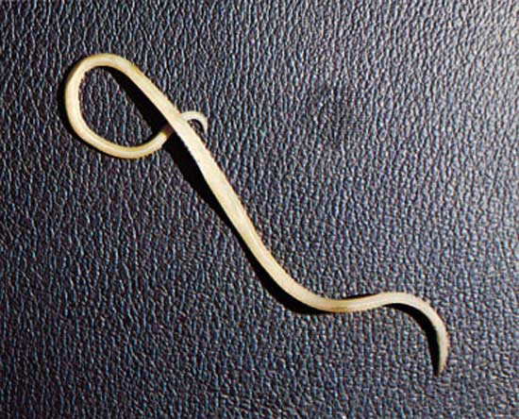

Ascaris lumbricoides

Slide 2
Introduction
Ascariasis is caused by the parasitic roundworm Ascaris lumbricoides.
Perhaps as many as one quarter of the world's people are infected.
It is the largest of the intestinal parasite in humans. “Giant Intestinal Roundworms"
It is the most common worm found in human

Slide 3
Geographical Distribution
Worldwide in destruction.
Specially high prevalence in tropical and sub-tropical countries
Habitat:
Small intestine of man, mainly in the jejunum and upper part of illeum.

Slide 4
Morphological forms
Adult worms : male
: female
Eggs : fertilised
:unfertilised
:decorticated
Rhabditiform larva .

Slide 5
MORPHOLOGY
Adult worms : cylindrical in shape with tapering ends.
Creamy white or pinkish.
Mouth of the worm is surrounded by 3 lips (1 dorsal and 2 ventral) with minute teeth.
Life span is <1 yr.

Slide 6
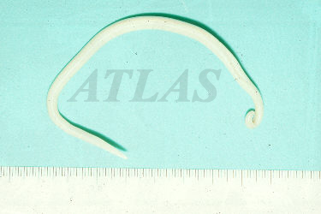
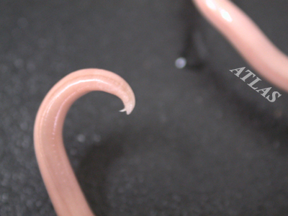
Adult male
smaller than female .
Size : 15-30 cm in Length
3-4 mm in Diameter .
Curved tail contains a pair of ‘copulatory spicules’ .
Adult male
Copulatory spicules

Slide 7
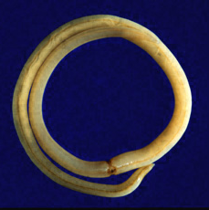
Adult female
Size : 20-40 cm in Lenght
2-6 mm in Diametre .
Tail is straight and conical but are curved or pointed.
The minute vulva opens at the junction of anterior and middle third of the body.
Eggs : >2,00000/day .
Adult female

Slide 8
Egg
3 kinds : Fertilised, Unfertilised and Decorticated.
Fertilised egg :-
oval in shape measures 45 x 70 µm in L 35 x 50 µm in W.
Golden brown , Bile stained .
The egg is surrounded by thick Shell with albuminous outer coat(i.e. corticated egg).
The egg without this outer coat is also found called decorticated egg.
Each egg contains large conspicuous unsegmented ovum with a clear semicircular space at each pole .
Floats in saturated salt solution.

Slide 9
Unfertilised egg :-
They are oval in shape, measures 78 x 105 µm in L 38 x 50 µm in B .
They are brown in color , bile stained , thin shelled .
Heaviest of all helminthic eggs , hence it doesn’t float in saturated salt solution .
Decorticated egg :- Both fertilised and unfertilised eggs sometimes may lack their albuminous coat and are colorless. .

Slide 10
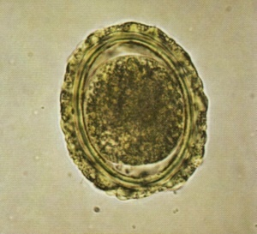
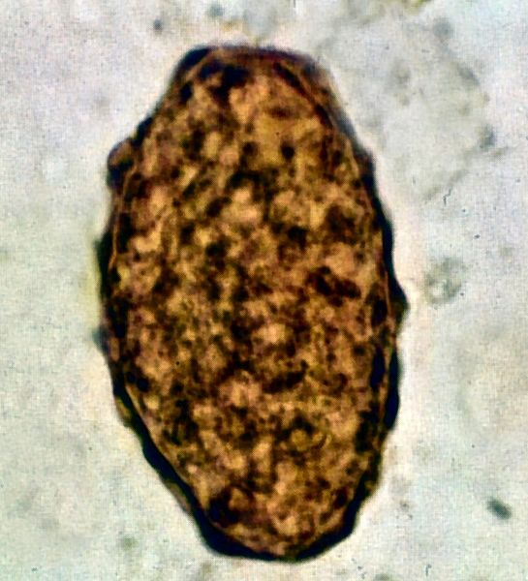
Egg shell
Ovum
Albuminous layer
Fertilised egg
Unfertilised egg

Slide 11
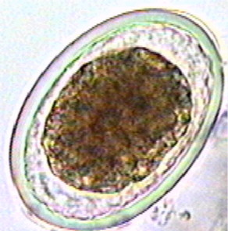
Decorticated egg

Slide 12
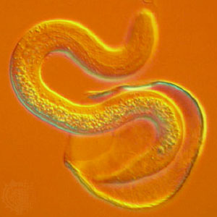
Rhabditiform larva :
size : 250 µm in L and 14 µm in D
They are actively motile
larvae hatch out in jejunum
penetrates the intestinal mucosa
Hatching out larva

Slide 13
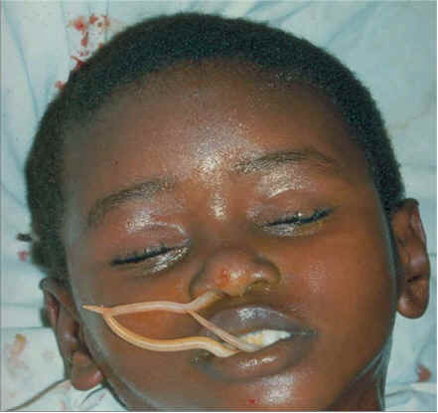
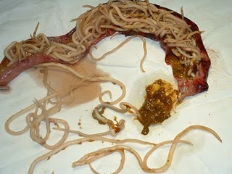

Slide 14

II. Life Cycle
1. Site of inhabitation: small intestine
2. Infective stage: Embryonated eggs in soil.
3. Route of infection: Fecal Oral route
4. Life span of the adult: 10 months to 2 years.

Slide 15
Life Cycle
Egg are passes in small intestine of human by fecal oral route.
Hatches to release larva.
Larva penetrate mucosa and reach portal circulation.
Reside in liver for 3-4 days.
Enter systemic circulation and reach the lungs.
Penetrate through the capillary and reaches alveoli, bronchial tree, trachea, larynx, pharynx.

Slide 16
Cont…
Re-swallowed with saliva.
Larva grow to adult in intestine.
Adult worm lay the egg and pass in the stool.
Life cycle continue again.

Slide 17
Pathogenesis and clinical feature
Causes the clinical condition called Ascariasis.
Patient develop the non-productive cough.
Occasionally blood seen with sputum and fever, eosinophilia may accompany due to penetration of alveoli such a condition is known as Loffler's pneumonia.

Slide 18
Cont…
It may also produce protein energy malnutrition and vitamin A deficiency and cause conjunctivitis.
Large number of intestinal worm may cause intestinal obstruction.
The worm may enter appendix to cause the appendicitis and ampulla of vater leading to billary tract obstruction and also cause pancreatitis.

Slide 19
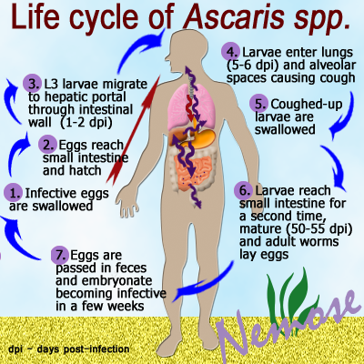

Slide 20
Laboratory Diagnosis
Direct evidence:
-finding of adult worm in stool and vomits
-Findings of eggs- in stool examination
Indirect evidence:
-Eosinophilia
-Dermal allergy
-Serology

Slide 21

Treatment
Mebendazole
Albendazole
Levamizole

Slide 22
Prevention & control
Proper disposal of human faeces
Food and water safety measures
Treatment of infected individuals
Health education
Personal hygiene

Slide 23
Thank you

