Slide 1
Basic Life Support and CPR

Slide 2
Emergency management
Triage
Primary Survey
A- Airway
B- Breathing
C- Circulation
D- Disability
E- Exposure
Secondary Survey

Slide 3
Cardiopulmonary Resuscitation
emergency procedure for providing artificial respiration and blood circulation when normal breathing and circulation have stopped, usually as a result of trauma such as heart attack or near drowning.
buys time for the trauma victim by supplying life-sustaining oxygen to the brain and other vital organs until fully equipped emergency medical personnel arrive on the scene.

Slide 4
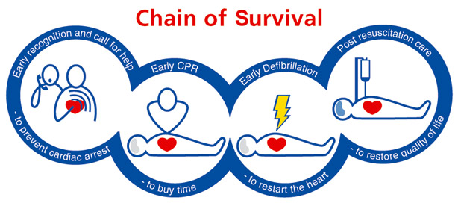
Chain of survival

Slide 5
Early recognition and call for help
If untreated, cardiac arrest occurs in a quarter to a third of patients with myocardial ischaemia within the first hour after onset of chest pain.
Once cardiac arrest has occurred, early recognition is critical to enable rapid activation of the ambulance service and prompt initiation of bystander CPR.

Slide 6
Early bystander CPR
The immediate initiation of bystander CPR can double or quadruple survival from out-of-hospital cardiac arrest.
Despite this compelling evidence, only 40% of victims receive bystander CPR in the UK.

Slide 7
Early defibrillation
Defibrillation within 3–5 min of collapse can produce survival rates as high as 50–70%.
This can be achieved through public access defibrillation, when a bystander uses a nearby AED to deliver the first shock.
Each minute of delay to defibrillation reduces the probability of survival to hospital discharge by 10%.
In the UK, fewer than 2% of victims have an AED deployed before the ambulance arrives

Slide 8
Early advanced life support and standardised post-resuscitation care
Advanced life support with airway management, drugs and the correction of causal factors may be needed if initial attempts at resuscitation are unsuccessful.
The quality of treatment during the post-resuscitation phase affects outcome and is depends in the Adult advanced life support and Post – resuscitation care.

Slide 9
Basic Life Support Algorithm

Slide 10
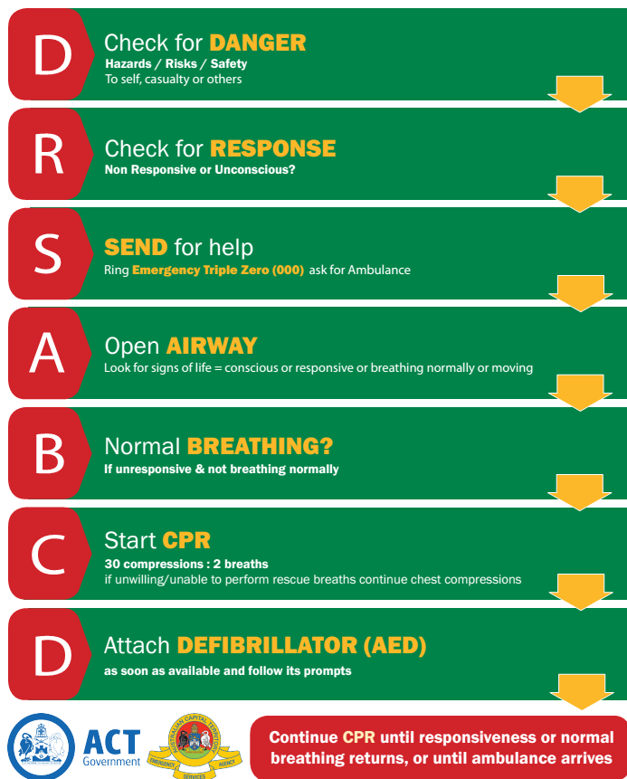

Slide 11
Steps of CPR

Slide 12
Unresponsive
No Breathing or normal breathing
(i.e. only gasping)
1
2
Activate Emergency Response team
Get AED/Defibrillator
Or send second rescuer (if available) to do this
3A
Give 1 breath every 5 – 6 sec
Recheck Pulse every 2 min
3
Check Pulse :
DEFINITE pulse
Within 10 sec?
Definite pulse
NO Pulse
4
Begin cycles of 30 compression and 2 breath
AED / Defibrillator arrives
5

Slide 13
Check Rhythm
Shockable Rhythm?
6
Non-shockable
7
shockable
8
Give 1 shock
Resume CPR immediately for 2 minutes
Resume CPR immediately for 2 minutes
Check rhythm every 2 min; continue until AlS providers take over or victim starts to move

Slide 14
High Quality CPR
Rate at least 100/min
Compression depth at least 2 inches (5 cm)
Allow complete chest recoil after each compression
Minimize interruption in chest compression
Avoid excessive ventilation

Slide 15
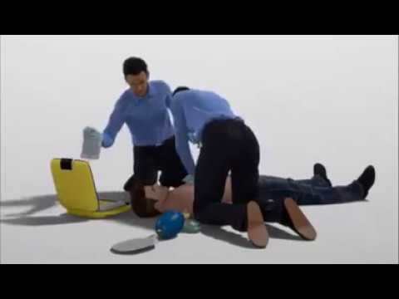

Slide 16
Thank You

