Slide 1


BHS 151 Environmental Science
BPH I Year, II semester
By
Kalpana Jnawali
Lecturer, BPH Program
La Grandee International College, Pokhara

Slide 2
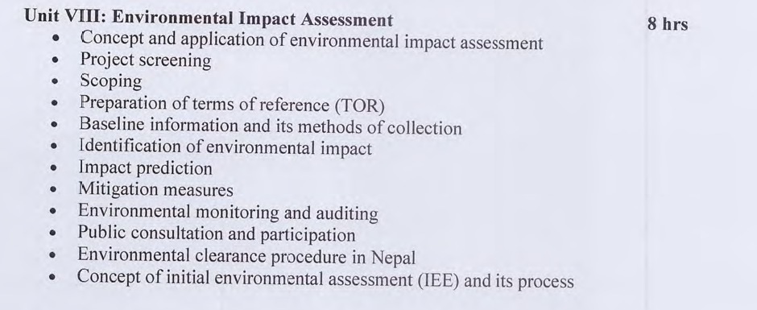

Slide 3
Environmental Assessment (EA)
“It is an amalgamation (merge) of art and science of identifying/predicting and evaluating the results of interactions between environmental variables and human activities in nature.”

Slide 4
Environmental Assessment
EA as an art or a management tool
reflects sensitivity towards nature
carries out environmental analysis of actions
ensures compliance with the policy and legal provisions
influences decision-making process

Slide 5
Environmental Assessment
EA as a science deals with methodologies and techniques for identifying, predicting and evaluating the environmental impacts associated with a particular proposal

Slide 6
Environmental Assessment…..
ensures public consultation and participation of affected community
helps to judge environmental performance of the proponent
provides inputs into decision-making

Slide 7
EIA in Nepal
National Concerns
Increasing sectoral outlook on development
Destruction of natural resource base
Realization of the need for a tool that helps to link development and the environment

Slide 8
EIA in Nepal
Before 1950
species conservation and forest use
1950-1980
natural resources conservation and utilization
1985 (from Seventh Plan) onwards
focus on EIA, EIA guidelines

Slide 9
EIA in Nepal
Initiation of EA in Nepal
since 1980’s through policies
in 1990’s through laws
use ramified along with development of guidelines and manuals

Slide 10
Legal measures-EIA in Nepal
1. Local Self-Governance Regulations, 1999 (2057 BS)
2. Water Resources Act, 1992
3. Water Resources Regulations, 1993
4. Electricity Act, 1992
5. The Nepal Water Supply Corporation Act, 1989
6. Water Resources Regulation, 1993
7. Local Self-governance Act (LSGA), 1998
8. Irrigation Regulation, 2003
9. Drinking Water Regulations, 1998
The Forest Act, 1993
11. Forest Rules, 1995 (2051 BS) amended in 1999 and 2001
12. Soil and Watershed Conservation Act, 1982

Slide 11
13. National Parks and Wildlife Conservation Act (NPWCA) 1973
14. Aquatic Life Protection Act, 1961 (Amendment 1999)
15. Explosive Act, 1962
16. Food Act, 1970
17. Food Regulations, 1970
18. Labor Act, 1992
19. Citizen Rights Act, 2102 (1955).
20. Land Acquisition Act, 2034 (1977)
21. Land Acquisition Regulations, 1996
22. Land Revenue Act, 1977 (2034 BS)
23. Public Road Act, 2031 (1974)

Slide 12
EIA in Nepal
Institutional effort
Advisory bodies such as EPC
Environment Divisions, Sections and Units in sectoral agencies
Ministry of Population and Environment (MoPE) in September 1995
MoPE dissolved and Ministry of Environment, Science and Technology (MoEST) established in February 2005
MoEnv in 2066 B. S.
Announcement of Deptt. of Env. In 2069 B. S.

Slide 13
EIA in Nepal
Human Resources Development
Seminar, workshop, training, and EIA courses offered by academic institutions

Slide 14
Need for a tool realized
A tool that
is constructive and not restrictive
assesses environmental impacts to minimise engineering biases
ensures integration of conservation and management of natural resources and reduction of pollution

Slide 15
Need for a tool realized
A tool that
uses environmental data/information into the project planning and decision-making
acts as a bridge between economic prosperity and environmental sustainability

Slide 16
Environmental impact assessment principles and process

Slide 17
Aims of EIA
An application of EIA has the following aims in common:
  provides decision-makers with complete and balanced information,
  technical reports,
  provides a source of information on a proposal to the public,
  formalizes the consideration of alternatives to a proposal being considered, and
  improves the design of development and safeguards the environment
  through the application of mitigation and avoidance measures.

Slide 18
Principles of EIA
Under the three core values (Sustainability, Integrity, Utility), the following eight guiding principles govern the entire process of EIA in its implementation:
participation: All interested parties have appropriate and timely access to the process,
transparency: All assessment decisions and their basis are open and accessible,
certainty: The process and timing of the assessment are agreed upon in advanced and adhered to by all participants,
accountability: Decision-makers are responsible to all parties for their actions and decisions under the assessment process,
credibility: Assessment is carried out with professionalism and objectivity

Slide 19
Contd….
cost-effectiveness: The assessment process and its outcomes ensure environmental protection at the least cost to society,
Flexibility: The assessment process is able to adapt so that it can deal effectively with proposals and decision making situations.
practicality: The information and outputs provided by the assessment process are readily usable in decision-making and planning

Slide 20
The EIA process: the sequence of steps in its application
Project screening: determines whether the project requires an EIA
Scoping: project as well as a basis for developing terms of reference
Project description and consideration of alternatives: seeks to describe all reasonable alternatives, including preferred and ‘no action’ options (project location, scale, process, layout and operating conditions).

Slide 21
Contd….
Prediction of impacts: possible in terms of characteristics such as magnitude, extent, and duration
Evaluation of impacts: predicted impacts
Mitigation measures: designs systems and/or processes to avoid, reduce, and minimize adverse impacts.
Stakeholders’ involvement
Monitoring and auditing measures
EIA report

Slide 22
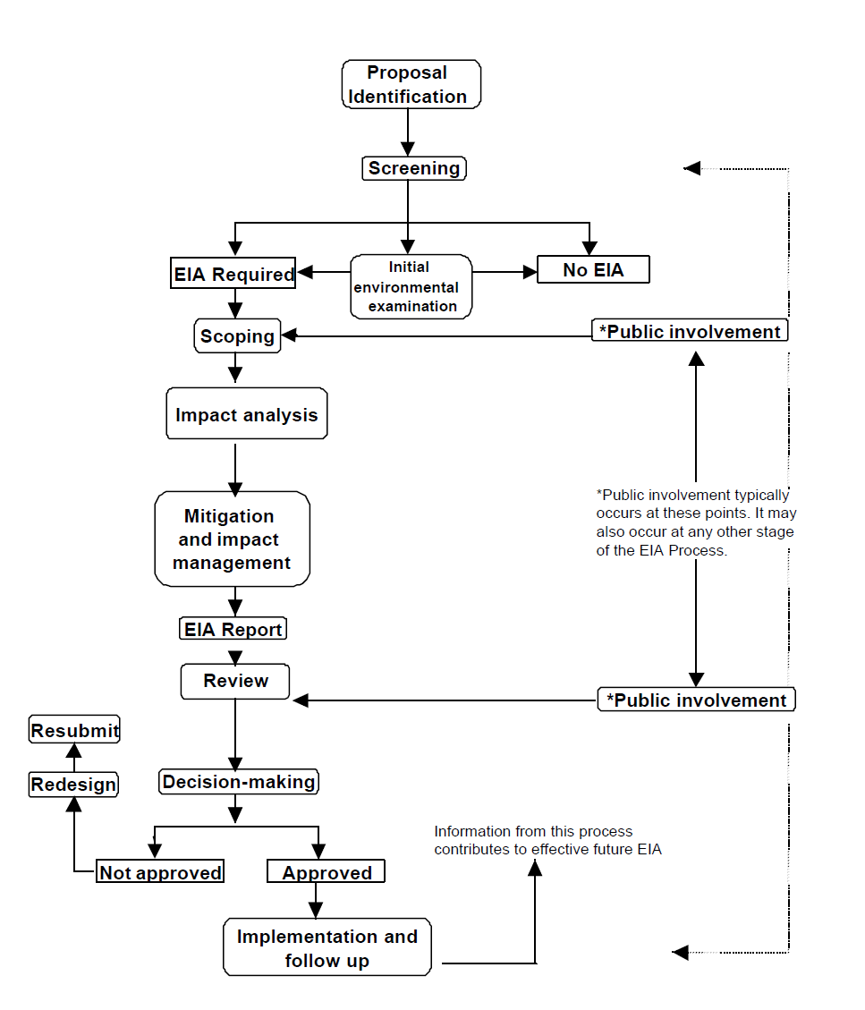
Steps of EIA

Slide 23
The four procedural stages are followed for EIA in Nepal
i) Screening,
ii) Scoping and ToR submission,
iii) EIA report submission, and
iv) Public consultation (public hearing).

Slide 24
Project Screening

Slide 25
Project Screening
Project screening includes completing a preliminary examination of the project opportunity (project application) to obtain an idea of whether the more time-consuming and costly effort for further business case development is reasonable.
Project screening focus on the preliminary indications for decision-making on pursuing the project opportunities, so the next stage after screening is the project selection where the most advisable projects are chosen.

Slide 26
Project Screening
An early and open process for determining the scope of issues to be addressed and for identifying the significant issues related to a proposed action/proposal
A two-way communication process between the promoter and the public prior to EIA study

Slide 27
Objective
To make EIA study focused & efficient
To ensure contextual relevance of EIA
To provide basis for preparation of ToR for EIA
To facilitate an early agreement on contentious issues
To find out all the aspects likely to be affected by the proposal
To provide an opportunity for public involvement in determining factors to be assessed
To identify possible alternatives to the proposal

Slide 28
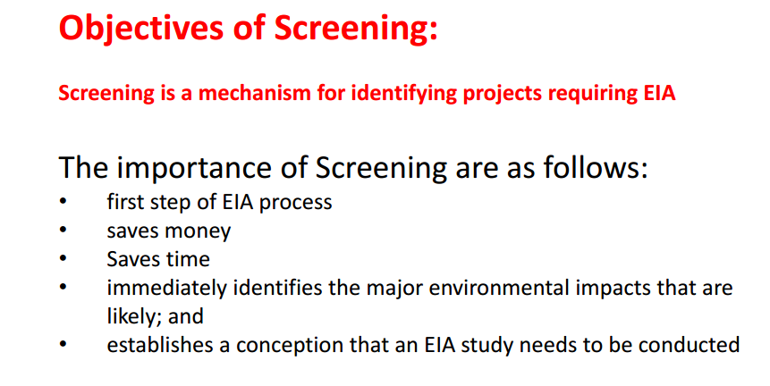

Slide 29
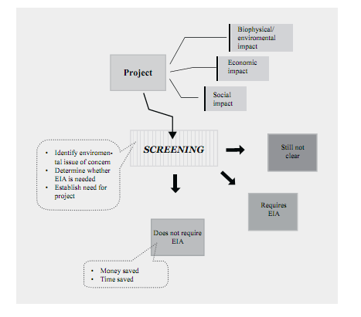
Project Screening Process

Slide 30
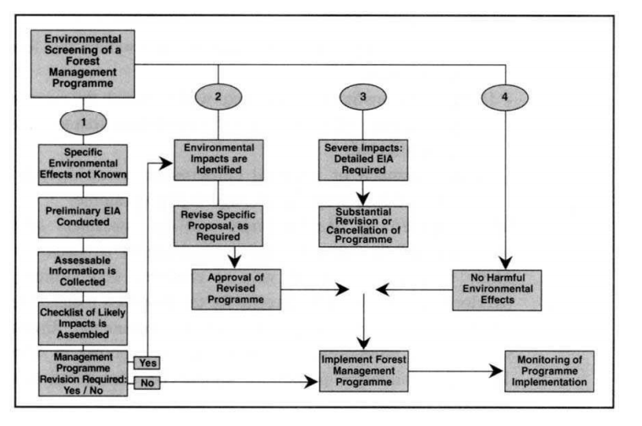

Slide 31
Project screening in Nepal is a simple process. Environmental Protection regulation 1997 has classified the projects into three categories:
  1. Projects clearly requiring an application of Environmental Impact Assessment (EIA),
  2. Projects not requiring an application of EIA,
  3. Projects where an application of EIA is not known or requiring an application of Initial Environmental Examination (IEE).

Slide 32
Scoping

Slide 33
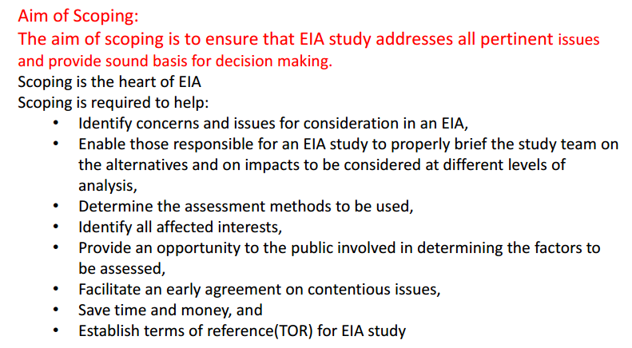
Scoping
Notes:
Contentious- argumentative

Slide 34
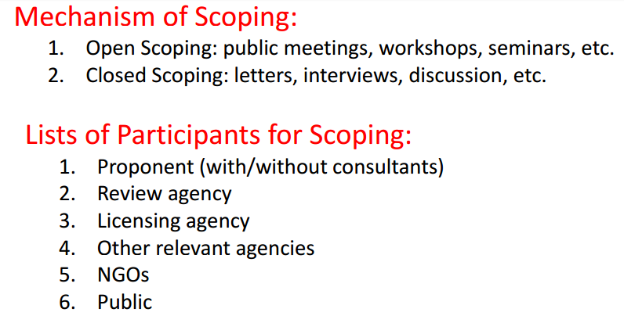

Slide 35
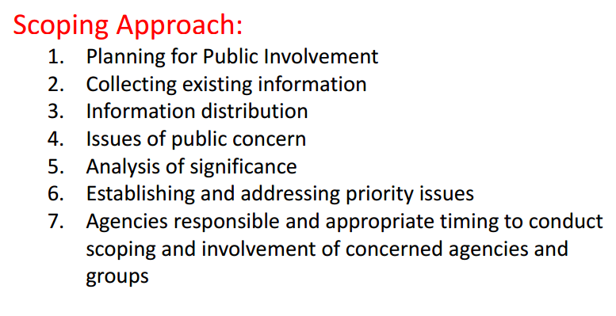

Slide 36
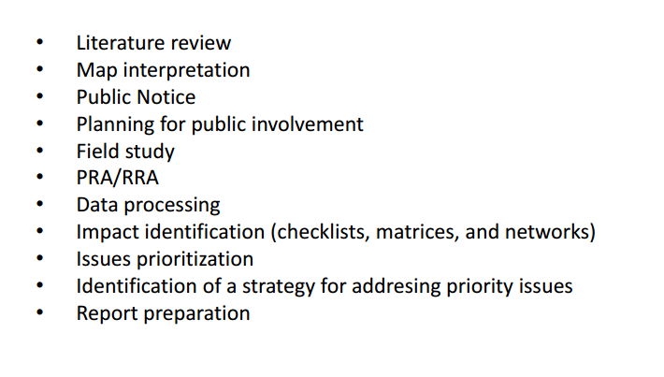
Method used in scoping

Slide 37
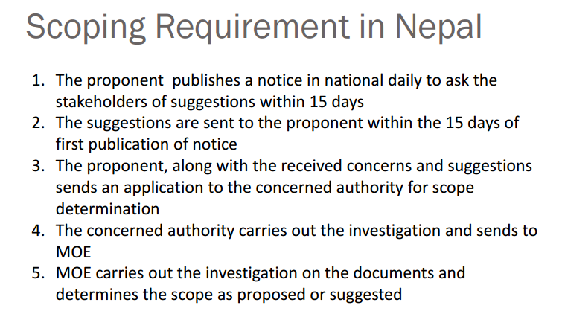

Slide 38
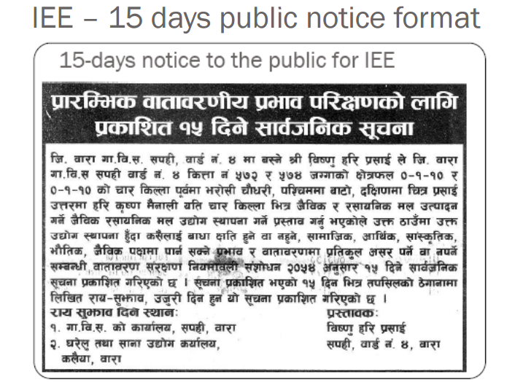

Slide 39
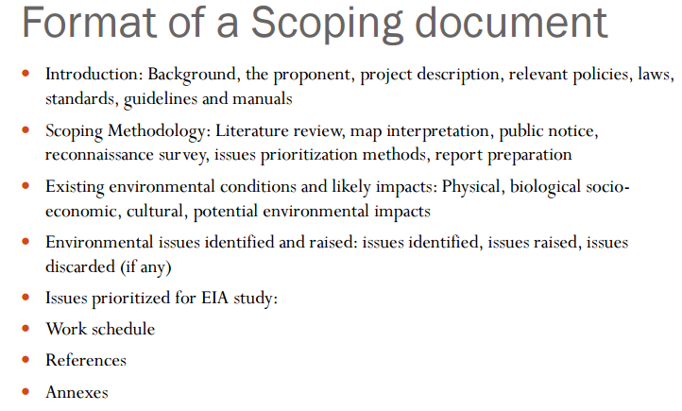

Slide 40
Terms of Reference (TOR)

Slide 41
Terms of Reference (TOR)
In the EIA process of Nepal, Terms of Reference (TOR) is a document to be prepared by the project proponent, and submitted to the authorizing agency for approval.

Slide 42
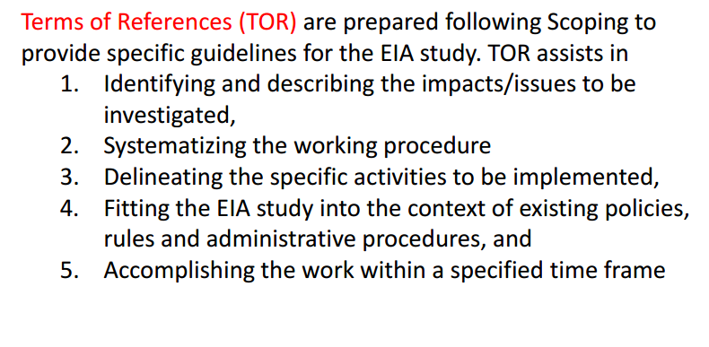
Terms of Reference…

Slide 43
Objective
To systematize the study procedure
To define major activities to be implemented
To fit EIA with the existing policy, rules and administrative procedures
To accomplish the study within a specified time limit
To ensure involvement of appropriate and adequate professionals in the EIA study
To indicate the nature and extent of data/information to be collected
To specify the most relevant/pertinent study method/procedure

Slide 44
GOOD PRACTICE CRITERIA FOR THE PREPARATION OF TERMS OF REFERENCE (TOR)
What will be done?
Why will it be done?
How will it be done?
When will it be done?
Who will do it?
How much will it cost?

Slide 45
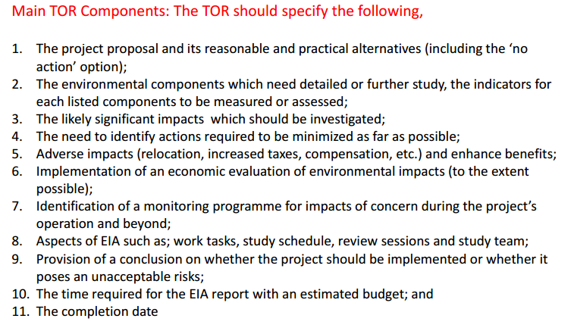

Slide 46
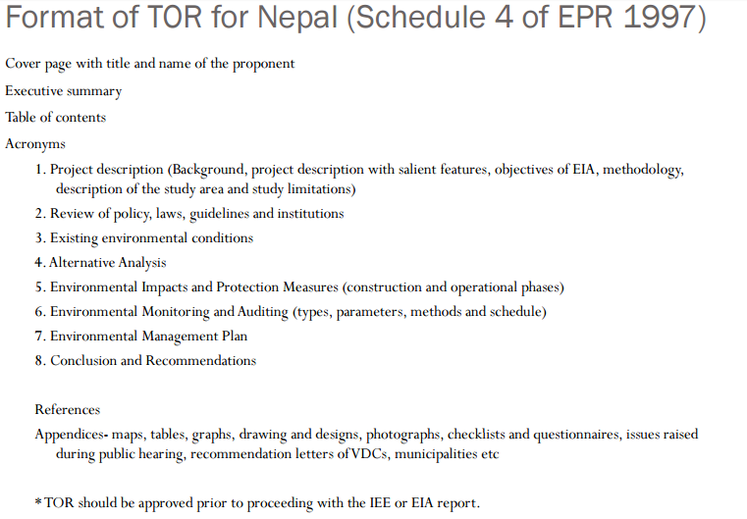

Slide 47
Baseline Data Collection
It deals with three aspects
  Baseline Condition
  Description of affected environment
  Methods of collecting baseline information

Slide 48
1. Baseline Condition
A baseline study is the collection of background information on the existing physical, biological, socio-economic and cultural environment of a proposed project area, including changes that are expected due to any new projects already planned for implementation or under implementation.
There is often a great deal of information available on existing environmental condition.

Slide 49
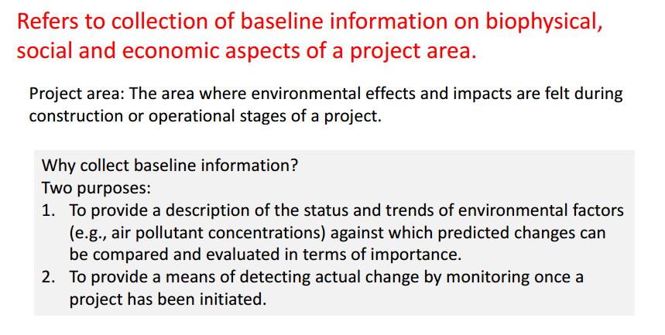
Baseline information……

Slide 50
2. Description of the affected environment
The description of the affected environment includes the characteristics of the area in which the proposed project activities (during construction and operation ) will take place.

Slide 51
3. Methods to collect and supplement baseline information
There are two broad methods to collect and supplement baseline information:
  A review of published literature (secondary data collection) and
  Field work (primary data collection)

Slide 52
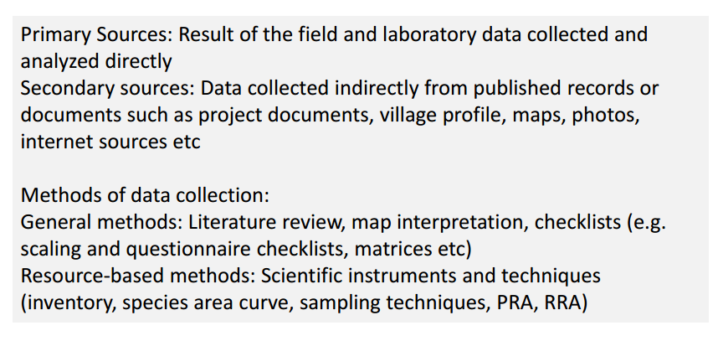
Data source and method of collection

Slide 53

Identification of environmental impact

Slide 54
Definition
An environmental impact is a change to the environment, either adverse or beneficial, wholly or partially resulting from an organization’s activities, products, or services.
Types of Impact identification:
  Biological and Physical- chemical impacts
  Social Impacts
  Cultural Impacts
  Health Impacts
  Economic Impacts
  Cost – benefit analysis ( Valuation of environmental resources, discounting, irreversibility and future option, Sustainable development)

Slide 55
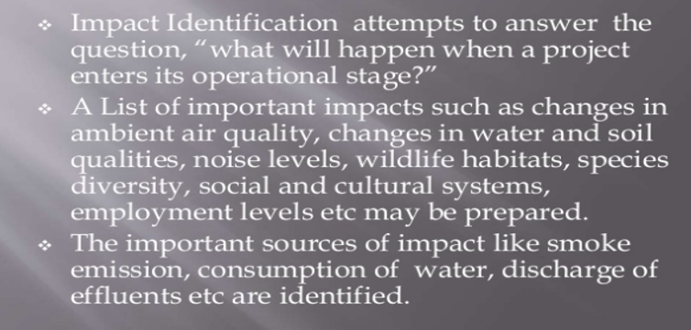
Identification of environmental impact

Slide 56
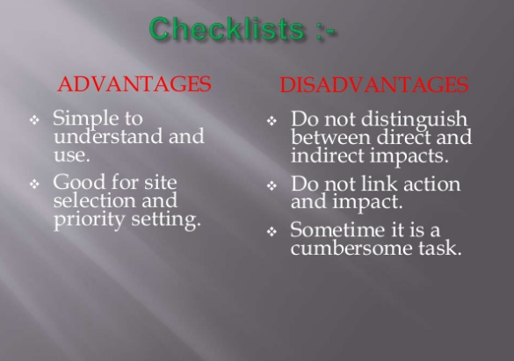

Slide 57
Impact Prediction
Prediction should be based on the available environmental baseline data.
  Predictions can be described in quantitative or qualitative terms. They should, at the least:
    determine the initial reference of baseline conditions,
    estimate the future state if the proposed action is carried out, and
    estimate the future state if the proposed action is not carried out.

Slide 58
Impact prediction should focus on the following considerations
Magnitude of impact : (High, medium, low)
Extent of impact: local, Regional, national, international
Duration of impact: short term, medium term, long term

Slide 59
Methods of impact prediction
Mathematical models
Statistical models
Geographic information system
Field and laboratory experimental method
Expert judgment

Slide 60
Mitigation Measures
Mitigation measures are actions recommended to reduce, avoid, or offset the potential adverse impacts on the environment resulting from proposed development activities.
The objectives of mitigation measures are either to minimize and remove undesirable impacts or maximize project benefits.

Slide 61
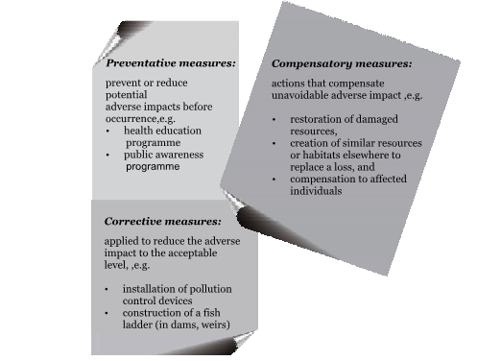
Types of mitigation measures

Slide 62
Environmental auditing and monitoring
Definition
The term environmental auditing is broad. Private sector environmental auditing has been variously defined as:
A management tool comprising a systematic, documented, periodic and objective evaluation of the performance of the organization , management system and processes designed to protect the environment with the aim of:
  1. Facilitating management control of practices which may have impact on the environment and
  2. Assessing compliance with company policies.

Slide 63
ENVIRONMENTAL AUDITING PRACTICE AND PROCEDURES
The more specific type of environmental audit involves the collection, collation, analysis, interpretation and presentation of information which is used to assess performance against a set of requirements or targets, related to specific issues.

Slide 64
TYPES
1. Liability audit :- Liability audit assess compliance with legal obligations.
2. Management audit :- Management audit verify that an environmental strategy meet its stated objectives.
3. Functional audit (activity or issue audit):- An activity audit may investigate specific area such as energy or water use

Slide 65
Basic steps in Environmental Audit Criteria
Typical criteria for audit are:
Company policies and procedures on environmental matters
Applicable legislation and regulations;
Good management practices

Slide 66
Public consultation and participation

Slide 67
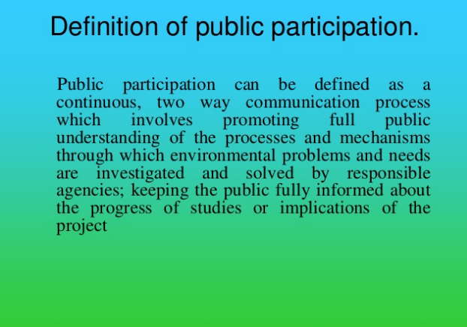

Slide 68
The purpose of public audit
It should not be just to assess impacts and complete an environmental impact statement (EIS);
it is to improve the quality of decisions
Another purpose of EIA is to inform the public of the proposed project and its impacts.
Through informing the public the project proponent can make environmentally sensitive decision by being aware of a project's potential adverse impacts on the environment.

Slide 69
Contd….
Through their participation the project proponent will be able to take advantage of the information that citizens contribute concerning values, impacts, innovative solutions and alternatives.
Public participation in decision making is an essential part of the environmental impact assessment (EIA) process, which has become a widely applicable tool for environmental decision making in the world since 70-75ies, ensuring consideration of environmental concerns within the planning.
Different countries practice different levels of public involvement.

Slide 70
There are four basic reasons why public should be involved in EIA
  First, public participation is regarded as proper, fair conduct of democratic government in public decision-making activities .
  Second, public participation is widely accepted as a way to ensure that projects meet citizens' needs and are suitable to the affected public
  Third, the project carries more legitimacy, and less hostility, if potentially affected parties can influence the decision-making process
  Finally, the final decision is `better' when local knowledge and values are included and when expert knowledge is publicly examined

Slide 71
OBJECTIVES OF PUBLIC INVOLVEMENT
  Objectives of public involvement Screening Identification of significant impacts Scoping
  Identification of public's interest and values
  Identification of priorities for assessment
  Encouraging public understanding of the proposed project Assessment
  The public can contribute local knowledge and values to the prediction, evaluation and mitigation of impacts
  Improvement in quality and acceptability of EIA report EIA Report Review Public contribute to evaluation of quality and acceptability of report Decision Public comment on acceptability of project impacts Monitoring Public evaluate impacts that occur and support project environmental management process

Slide 72
Environmental clearance procedure in Nepal
In 1997, the MoE developed the Environmental Protection Rules(EPR), which were initially approved by parliament in 1997, and later amended in 1999.
The EPR define the types of projects that require an IEE and those that require a full scale EIA.
Rule 3 specifies that projects in schedule 1 require an IEE, while those in Schedule 2 require an EIA. The EPR also outlines the basic procedures for EIA approval.

Slide 73
Screening is the initial stage of the EIA process
a decision is made about whether or not an EIA is required for a particular project.
Screening is usually carried out by the developer
To make the screening decision, a certain amount of basic information about the project is required, such as its location, scale, and the processes involved in the project.
These schedules of financial thresholds were determined on the basis of past experiences with similar forms of development.

Slide 74
The developer is responsible for preparing scoping and ToR documents, but they must be approved by the MoE.
Once the scoping report is completed, the ToR for an EIA is developed, integrating the issues identified in scoping, describing alternatives, outlining the contents of the EIA study, and the time and finances required to complete it.
The study team will conduct the study and prepare the EIA report. The project proponent should follow the outline and format of ToR requirements
The final scoping document and the ToR are submitted to the concerned ministry, which sends them to the MoE for approval.

Slide 75
As provided for in the EPR, the concerned ministry can grant final approval for the ToR for and IEE, but for an EIA, it has to forward the scoping document and the ToR to the MoE for final authorization.
Once the MoE has approved the documents, the project proponent should start collecting baseline information, particularly on biological, physical, socio-economic, and cultural components of the environment of the proposed project area.
To decide whether to approve an EIA, the MoE establishes a project-specific EIA report review committee under the chairmanship of the joint-secretary of the Environment Division to seek expert opinion on a case-by –case basis.
The committee members include concerned experts and government representatives. It conducts meetings, may inspect the site, and provide suggestions to the government.

Slide 76
At least one meeting is conducted to consider the scoping and the ToR, and a meeting is held to consider the final EIA report. The committee is mandated to provide suggestions on the scoping report, the ToR, and the final EIA report.
Based on the suggestions of the committee, the MoE issues Environmental Clearance Certificate with compliance conditions. The developer is responsible for monitoring the project and should submit monthly monitoring reports to the concerned ministry and information the MoE of its progress.
After the project has been in operation for two years, the concerned ministry may conduct an audit to determine whether or not the compliance conditions have been fulfilled.

Slide 77
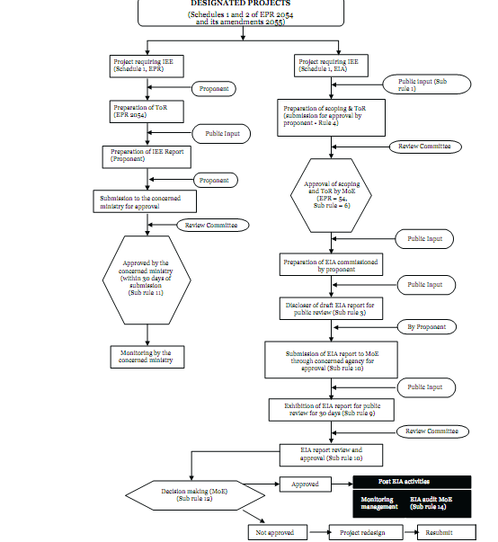
Environmental Impact Assessment in Nepal

Slide 78
Initial Environmental Assessment and its process

Slide 79
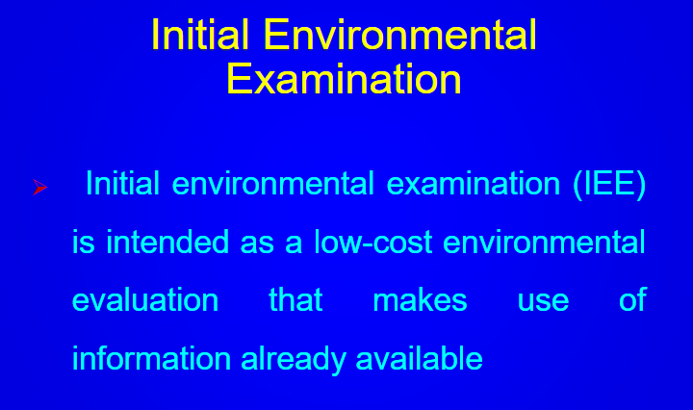

Slide 80
Purpose of IEE
Describes the proposed project or activity and examine alternative
Identifies and addresses community concerns to extent possible
Identifies and assesses potential environmental effects
Directs future action

Slide 81
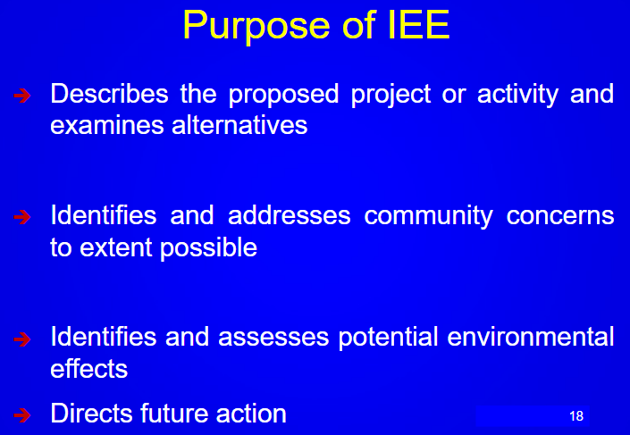

Slide 82
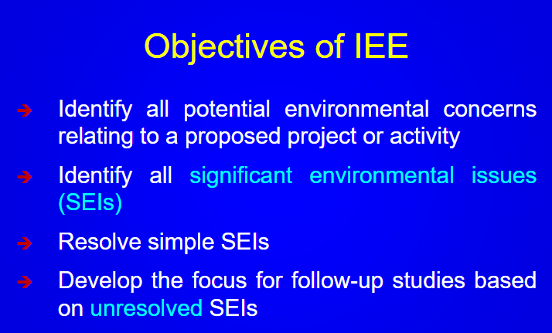

Slide 83
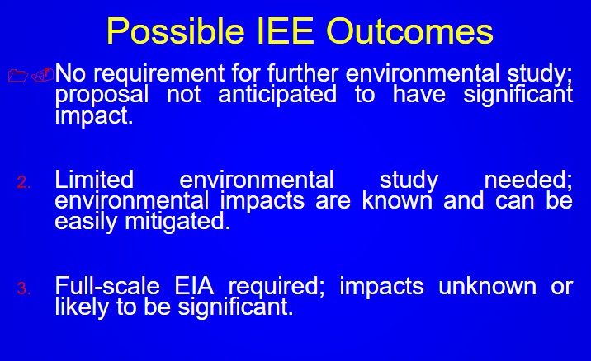

Slide 84
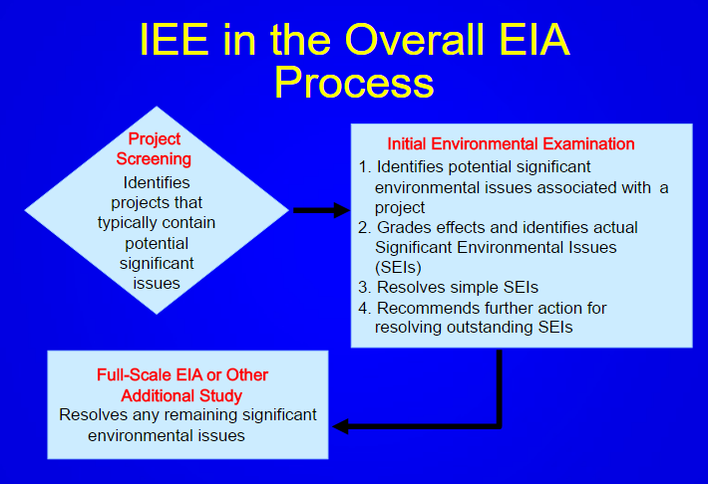

Slide 85
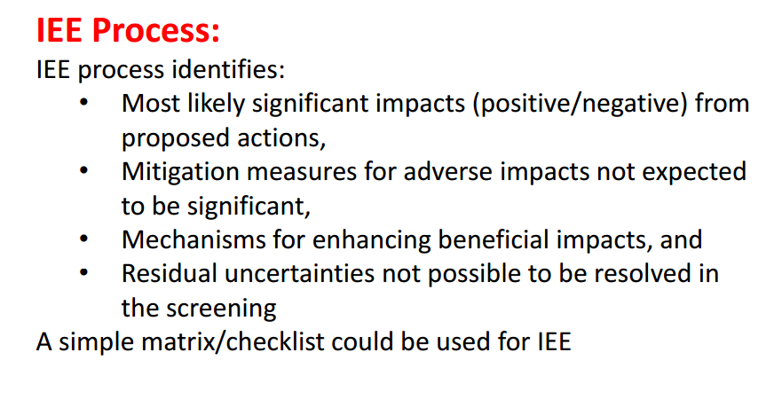

Slide 86
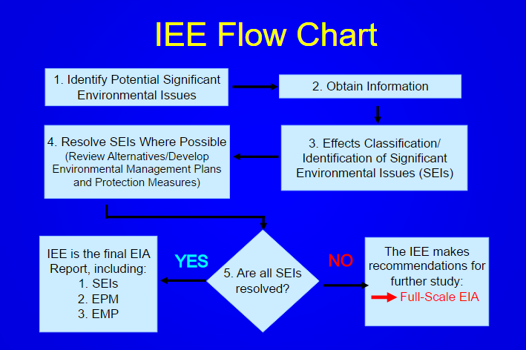

Slide 87
Thank you

