Slide 1





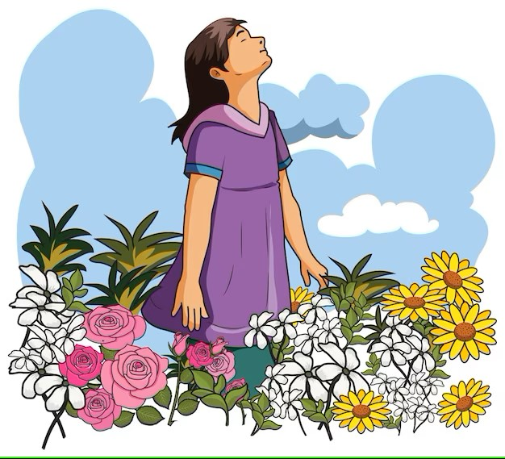
Air Quality
Monitoring
Presented By
Aashma Upadhya Pratikshya Thapa
Aruna Subedi Resham Karki
Mamata Gharti Sushmita Thapa
BPH 3rd Sem, SHAS,PU
Presented To :
Environmental Health
Asst. prof. Rajendra Lamichhane
School of Health and Allied Sciences Pokhara University

Slide 2
Air Quality
Air quality refers to the degree to which the air is suitable or clean enough for humans or the environment.
The air we breathe is made up of 78% nitrogen, 21% oxygen, and 1% other gases such as hydrogen and carbon dioxide.
Air quality is determined by the concentration of foreign substances in the atmosphere, which come from sources like transport vehicles, agriculture, residential cooking and heating, and factories. Thus, the lower the concentration of pollutants in the air we breathe, the better the air quality.
Key pollutants include
Ammonia (NH3), 5. Carbon monoxide (CO)
Nitrogen oxides (NOx) 6. Ground-level ozone (O3)
Particulate matter (PM) 7. Sulphur dioxide (SO2)
and volatile organic compounds (VOCs)
-What Is Air Quality? | Center for Science Education (ucar.edu)

Slide 3
Particulate matter (PM) PM is a common proxy indicator for air pollution. There is strong evidence for the negative health impacts associated with exposure to this pollutant. The major components of PM are sulfates, nitrates, ammonia, sodium chloride, black carbon, mineral dust and water.
-who

Slide 4
Air Quality Monitoring
Air quality monitoring is the process of measuring and assessing the quantity and types of pollutants in the atmosphere.
Air Quality Monitoring allow the measurement, and predictive analysis of the evolution of air pollution in different areas.
"Air Quality Monitoring" means the collection and use of measurement data or other information to control the operation of a process or pollution control device or to verify a work practice standard relative to assuring compliance with applicable requirements.
Ambient air quality monitoring collects and measures samples of ambient air pollutants to evaluate the status of the atmosphere as compared to clean air standards and historical information

Slide 5
History Of Air Quality Monitoring System of Nepal
Nepal started its air quality monitoring activities in 1990 AD as campaign monitoring.
The fixed monitoring stations were established in 2002 and data were collected until 2007. The monitoring gap remained in between 2008 to 2016 except few campaign monitoring.
In 2015 Department of Environment in coordination with ICIMOD prepared a report named 'A Plan for Nepal's Air Pollution Monitoring Network" which identified 56 locations for the establishment of Air Quality Monitoring Stations.
On the basis of this study Department of Environment started to establish real time monitoring stations throughout the country. Since 2016, Department of Environment in collaboration with various government as well as intergovernmental organisation, established 27 Air Quality Monitoring Stations in various parts of the country
Source : https://doenv.gov.np/progressfiles/Status-of-Air-Quality-in-Nepal-Annual-Report_2021-1676438644.pdf

Slide 6
CURRENT SCENARIO
World's most polluted cities 2017-2022
Most polluted city ranking based on annual average PM2.5 concentration (μg/m³) Kathmandu has been ranked in 232 and in top 50 rank 39 cities were from india and 2 from china.
-World Live Air Quality Map | IQAir

Slide 7
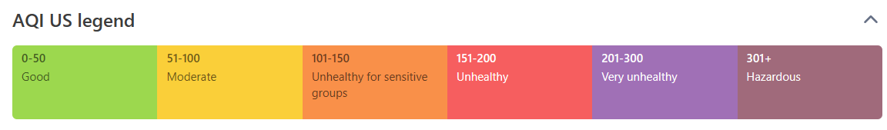
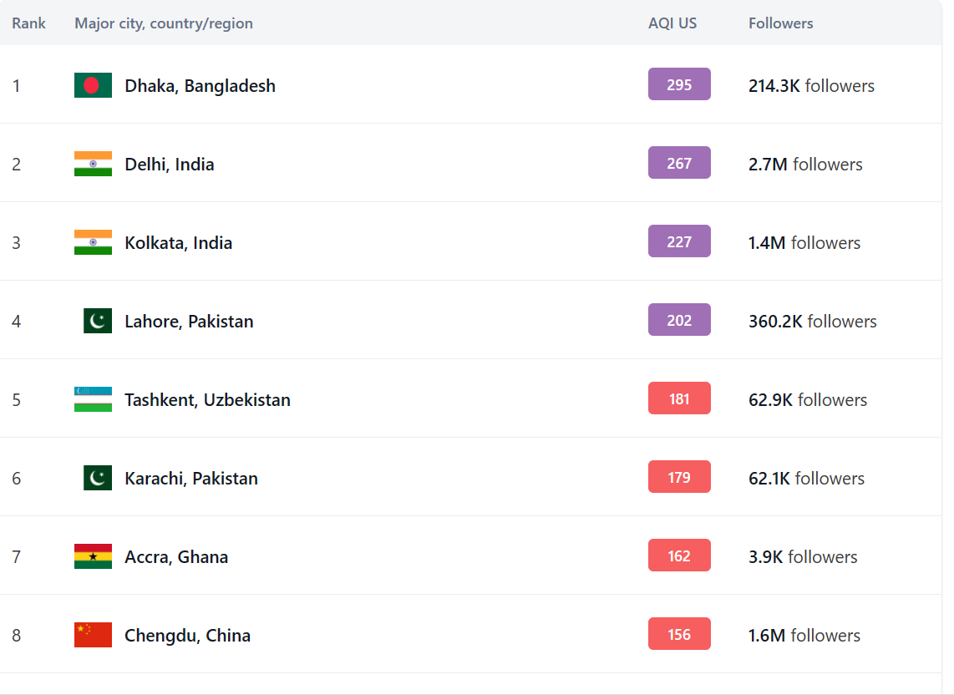

Live most polluted
major city ranking
19:51 (local time)

Slide 8
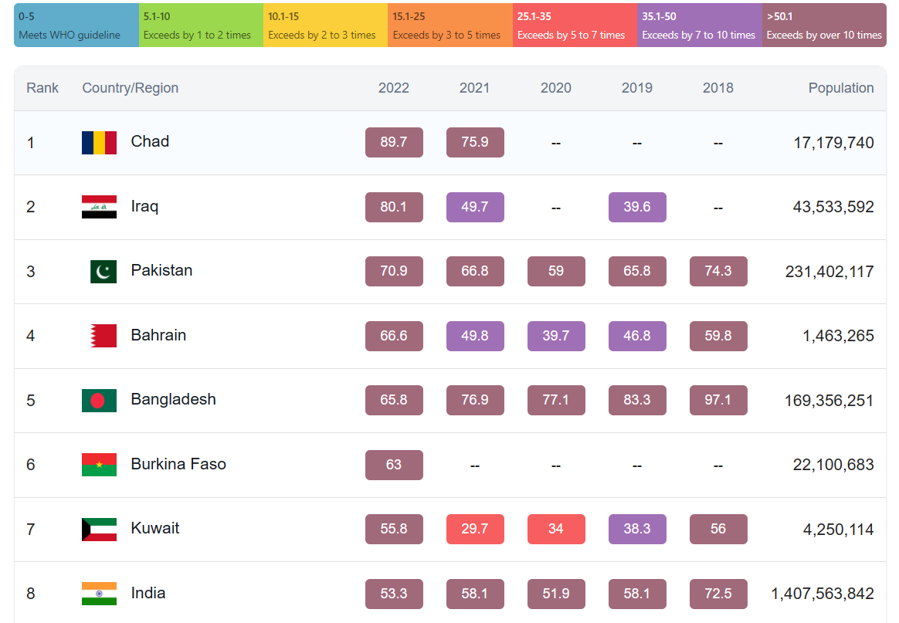
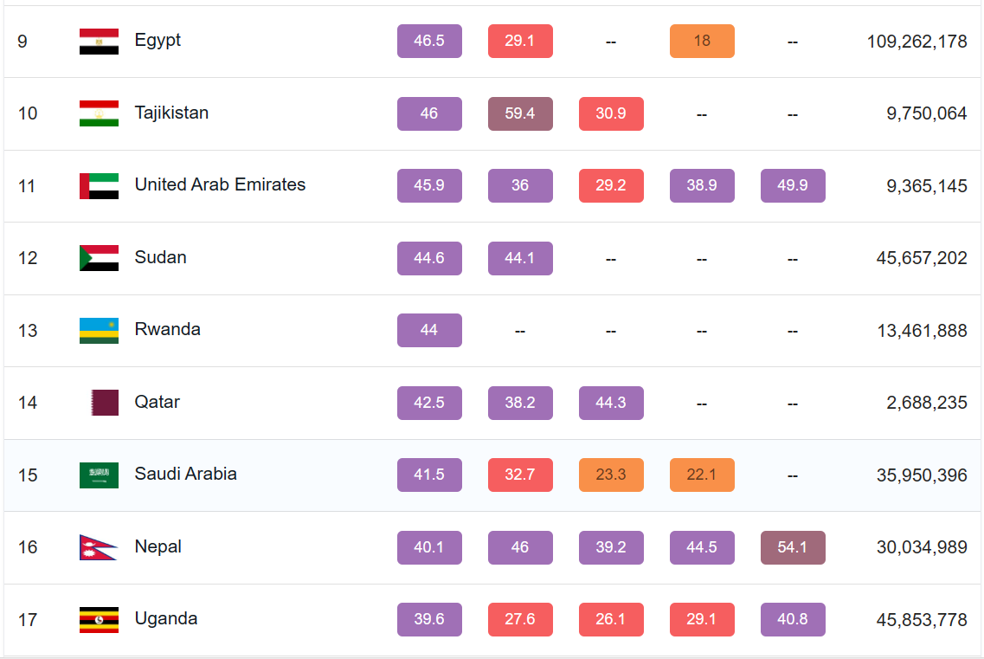
World's most polluted countries & regions 2018-2022
Most polluted country and region ranking based on annual average PM2.5 concentration (μg/m³)
PM2.5 legend

Slide 9
Air quality Guidelines
The current guidelines state that annual average concentrations of PM2.5 should not exceed 5 µg/m3, while 24-hour average exposures should not exceed 15 µg/m3 more than 3 - 4 days per year.
PM10 (particulate matter with a diameter of 10 microns or less) concentrations of 15 µg/m3 annual mean, 45 µg/m3 24-hour mean.
Ozone (O3) concentrations of 100 µg/m3 8-hour mean.
Nitrogen dioxide (NO2) concentrations of 10 µg/m3 annual average and 25 µg/m3 24-hour mean.
Sulphur dioxide (SO2) concentrations of 40 µg/m3 24-hour mean.
Carbon monoxide (CO) concentrations of 7 µg/m3 24-hour mean.
Source-https://www.c40knowledgehub.org/s/article/WHO-Air-Quality-Guidelines? language=en_US#:~:text=The%20current%20guidelines%20state%20that,3%20%2D%204%20days%20per%20year.

Slide 10
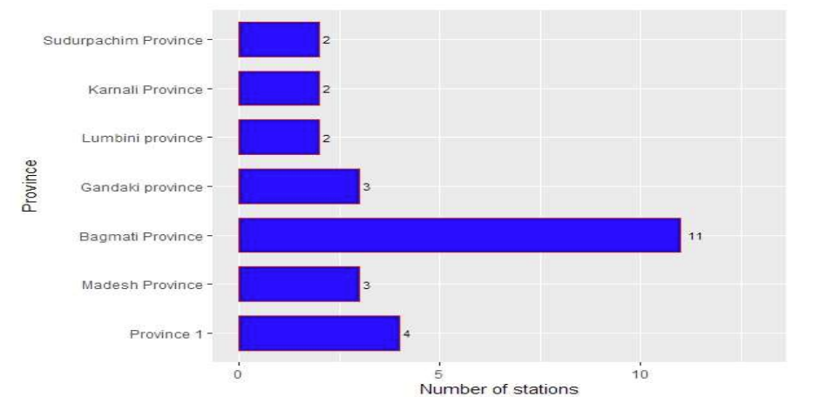
Air Quality Monitoring System of Nepal
Nepal Government has set and enforced National ambient air quality standard (NAAQS) and has a legal obligation to maintain this standard.
All the monitoring stations measure PM1, PM2.5, PM10 and Total Suspended Particulate Matter.
Source : https://doenv.gov.np/progressfiles/Status-of-Air-Quality-in-Nepal-Annual-Report_2021-1676438644.pdf

Slide 11
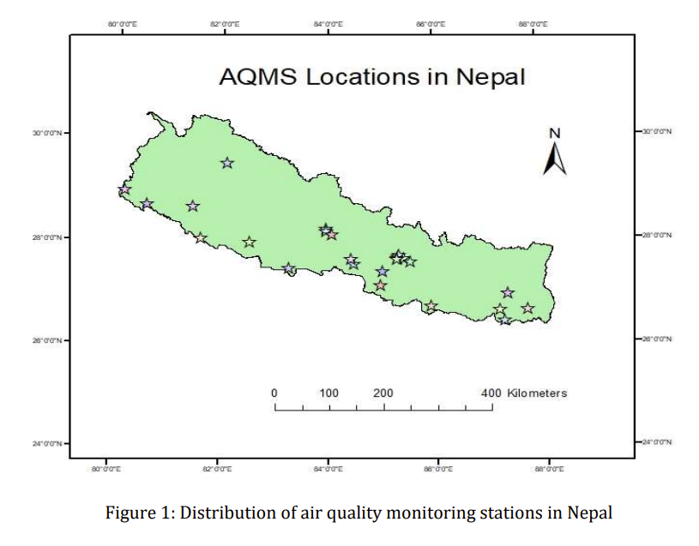
contd.
The Department of Environment under the Ministry of Forests and Environment, in collaboration with other organizations, established the real-time air quality monitoring station in 2016. The The International Centre for Integrated Mountain Development (ICIMOD) and Asian Development Bank (ADB) have significantly contributed to the establishment of Air Quality Monitoring Stations (AQMS).
source : https://doenv.gov.np/progressfiles/Main-report-60120-1660561765.pdf

Slide 12
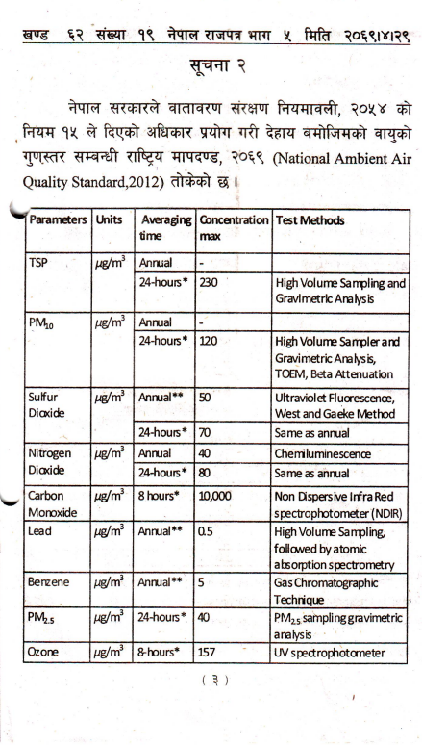
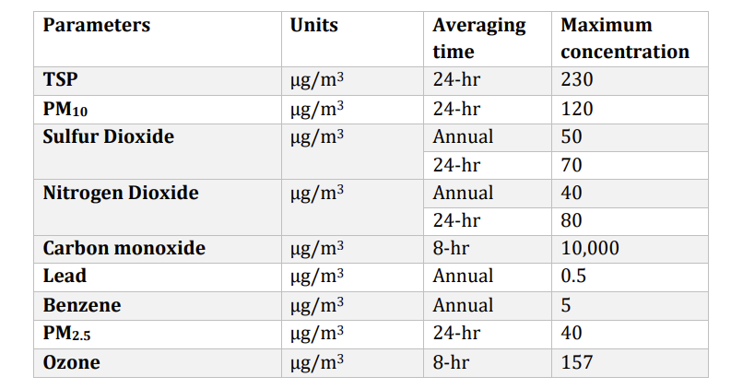
National Ambient Air Quality Standards, 2012 (NAAQS)
Government of Nepal has published National Ambient Air Quality Standards in 2012. The NAAQS gives maximum concentration for major nine parameters including particulate matters and trace gases, heavy metal and others.
source : https://doenv.gov.np/progressfiles/Main-report-60120-1660561765.pdf

Slide 13
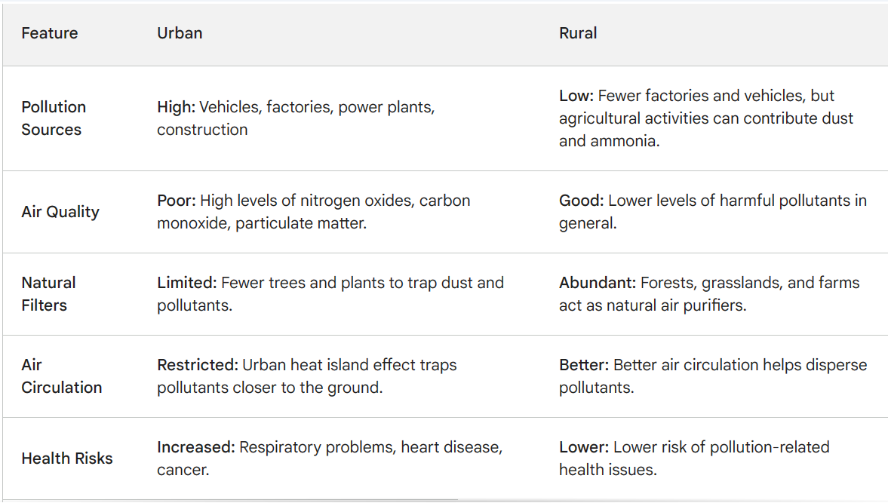
DIFFERENCE IN AIR QUALITY OF URBAN AND RURAL SETTING

Slide 14
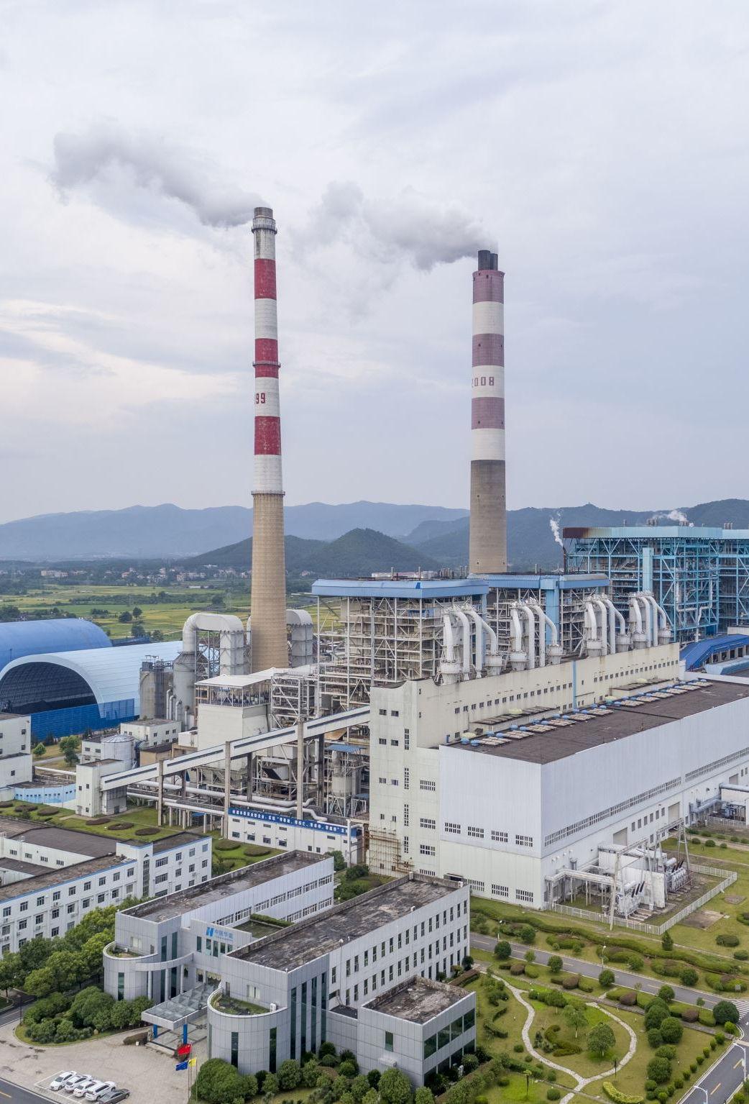
ACTION TAKEN TO MONITOR AIR QUALITY
Department of Environment (DoE) is primarily responsible for air quality monitoring. They collaborate with various organizations and NGOs to address environmental issues, including air quality. Additionally, the International Centre for Integrated Mountain Development (ICIMOD) plays a role in monitoring and researching environmental changes in the region, including air quality.

Slide 15
Some NGOs collaborating to manage and improve air quality in Nepal include:
Clean Energy Nepal (CEN): Focuses on promoting clean and sustainable energy solutions, including initiatives related to air quality improvement.
The Air Quality Network Nepal (AQN-Nepal): An organization dedicated to monitoring air quality and raising awareness about the impact of air pollution.
Several International Non-Governmental Organizations (INGOs) collaborate on air quality improvement initiatives in Nepal. Some examples include:
The World Health Organization (WHO): Provides technical assistance and support to the Nepalese government in addressing health-related aspects of air quality.

Slide 16
The United Nations Environment Programme (UNEP): Works towards promoting sustainable environmental practices, including initiatives related to air quality monitoring and improvement.
The Asian Development Bank (ADB): Supports projects that aim to enhance environmental sustainability, including those focused on air quality management.
The United States Agency for International Development (USAID): Engages in various programs and projects related to environmental conservation and sustainable development, including efforts to address air quality issues.
These INGOs collaborate with local organizations and government agencies to implement strategies for managing and improving air quality in Nepal.

Slide 17
Air Quality Index
The AQI is an index for reporting daily air quality. It tells you how clean or polluted your air is, and what associated health effects might be a concern for you.
The AQI focuses on health effect you may experience within a few hours or days after breathing polluted air.
EPA calculates the AQI for five major air pollutants regulated by the Clean Air Act: ground-level ozone, particle pollution (also known as particulate matter), carbon monoxide, sulfur dioxide, and nitrogen dioxide. For each of these pollutants,
EPA has established national air quality standards to protect public health .Ground-level ozone and airborne particles are the two pollutants that pose the greatest threat to human health in this country.
source : https://pollution.gov.np/portal/files/Air%20Quality%20Index%20(%20AQI%20)%20Basics.pdf

Slide 18
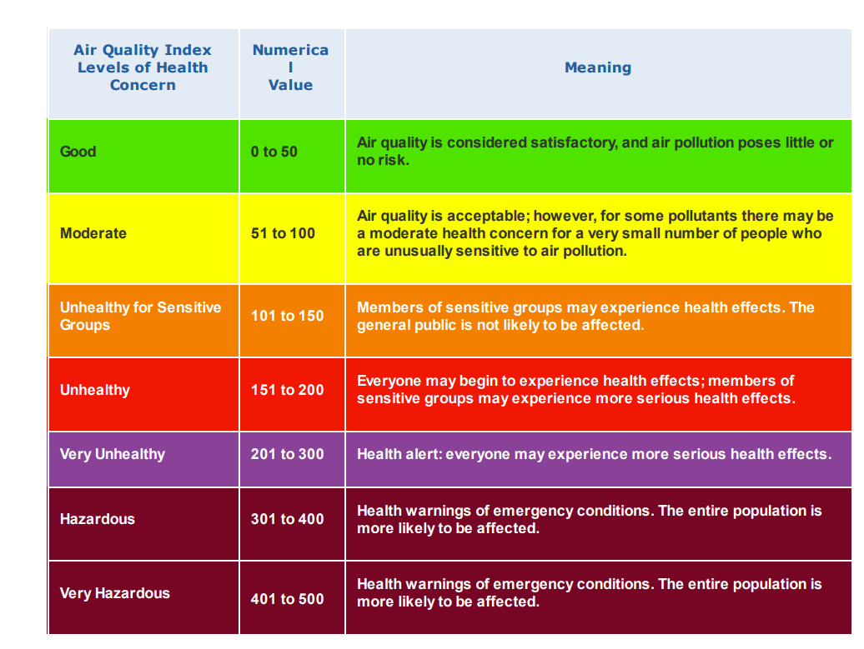
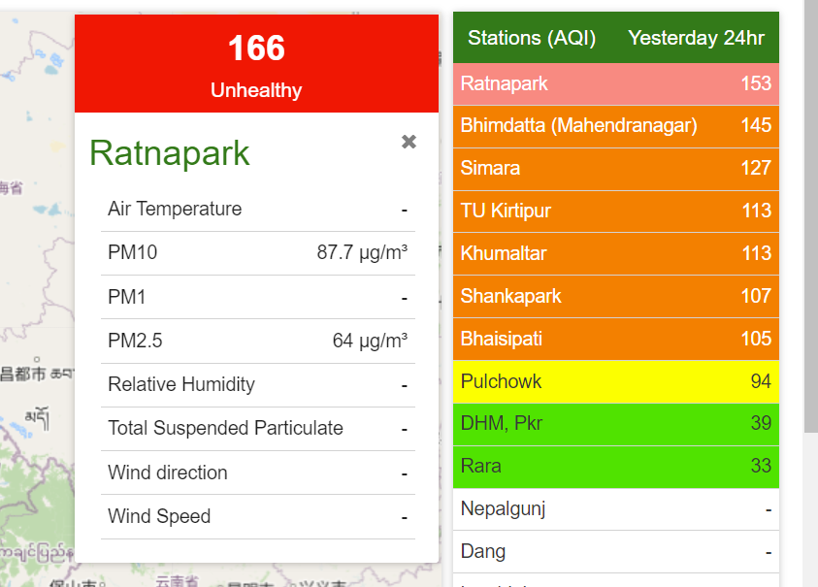
Air Quality Index of Nepal
What Should Be.....?
What is...!
source :1) https://pollution.gov.np/portal/files/Air%20Quality%20Index%20(%20AQI%20)%20Basics.pdf
2) https://pollution.gov.np/portal/#/home?_k=gvrq98

Slide 19
Air Quality And Health
WHO estimates that in 2019, some 37% of outdoor air pollution-related premature deaths were due to ischaemic heart disease and stroke, 18% and 23% of deaths were due to chronic obstructive pulmonary disease and acute lower respiratory infections respectively, and 11% of deaths were due to cancer within the respiratory tract.
The combined effects of ambient air pollution and household air pollution are associated with 6.7 million premature deaths annually Ambient (outdoor) air pollution is estimated to have caused 4.2 million premature deaths worldwide in 2019.Some 89% of those premature deaths occurred in low- and middle-income countries, and the greatest number in the WHO South-East Asia and Western Pacific Regions.(https://www.who.int/news-room/fact-sheets/detail/ambient-(outdoor)-air-quality-and-health)
Air pollution is also responsible for climate change.(The link between air pollution and climate change - Breeze Technologies (breeze-technologies.de) Carbon dioxide (CO₂), which comes from the extraction and burning of fossil fuels, is responsible for 64% of man-made global warming. (Causes of climate change - European Commission (europa.eu)) Other contributors are compounds such as black carbon (BC), a component of particulate matter, methane (CH₄), and ground-level ozone (O₃).
According to the World Bank, welfare losses from premature deaths as a result of air pollution was more than US$5 trillion in 2013. This includes $225 billion in lost labour income(Air Pollution Deaths Cost Global Economy US$225 Billion (worldbank.org) And, according to the Organization for Economic Co-operation and Development (OECD), healthcare costs incurred from air pollution were US$21 billion in 2015, and are expected to rise to an annual US$176 billion by 2060.(The Economic Consequences of Outdoor Air Pollution | en | OECD)

Slide 20
WHERE IS THE GAP??
In 2019,99% of the world population was living in places where the WHO’s strictest 2021 air quality guideline levels were not met Government actions on air quality are steadily growing, but implementation and capacity gaps hinder progress towards clean air.(Ambient (outdoor) air pollution (who.int)
Limited Monitoring Stations: Despite recent improvements, the network of air quality monitoring stations in Nepal is still not dense enough, particularly outside the Kathmandu Valley. This leads to limited data from various regions, hindering accurate assessment of the national air pollution picture.
(SOURCE: Department of Environment, Nepal: https://pollution.gov.np/portal/)
Missing Rural Data: Existing stations are often concentrated in urban areas, neglecting rural areas where significant pollution sources like brick kilns and agricultural burning exist. This creates a blind spot in understanding the full scope of air pollution exposure for rural populations.
(SOURCE: WHO report on Kathmandu: Kathmandu, Nepal (who.int)
Insufficient Real-time Data: Real-time air quality data availability is inconsistent across stations, hindering public awareness and timely response to pollution spikes.
(SOURCE: IQAir report on Nepal: https://www.iqair.com/nepal)
Outdated Monitoring Equipment: Some stations use outdated equipment with lower accuracy and reliability, leading to potentially inaccurate data.
(SOURCE: IQAir report on Nepal)

Slide 21
Lack of Long-term Data Analysis: Historical data analysis and trend studies are crucial for understanding long-term air quality changes and assessing the effectiveness of pollution mitigation efforts. However, such analysis is often limited due to data inconsistencies and gaps.
(SOURCE: Department of Environment, Nepal)
Limited Maintenance and Calibration: Regular maintenance and calibration of monitoring equipment is crucial for ensuring data accuracy. However, resource constraints sometimes lead to lapses in this aspect.
(SOURCE: Department of Environment, Nepal)
Public Awareness Deficits: Public awareness about air pollution dangers and preventive measures is often low, particularly in rural areas. This hinders community engagement and adoption of cleaner practices.
(SOURCE: WHO report on Kathmandu)
Limited Health Impact Studies: Comprehensive studies on the health burden of air pollution in Nepal are still scarce, making it difficult to quantify the full impact on public health and healthcare systems.
(SOURCE: WHO report on Kathmandu)
Air pollutants can travel across borders and impact the air quality and ecosystems of neighbouring countries, not just where they originate. (SOURCE :Actions on Air Quality: A Global Summary of Policies and Programmes to Reduce Air Pollution | UNEP - UN Environment Programme)

Slide 22
RECOMMENDATION
Expanding the Monitoring Network
Increase station density.
Utilize diverse technologies.
Collaborate with local communities.
2. Improving Data Quality and Availability:
Standardize data collection and reporting protocols.
Invest in real-time data infrastructure.
Establish a centralized data repository: Create a national air quality database accessible to researchers, policymakers, and the public. This facilitates comprehensive data analysis, trend identification, and informed policy development.

Slide 23
3. Building Capacity and Public Awareness:
Train personnel in air quality monitoring and data analysis: Equip government agencies, research institutions, and local communities with the skills and knowledge needed to operate and maintain monitoring equipment, analyze data, and interpret air quality information.
Raise public awareness about air pollution:
Promote citizen science initiatives: Encourage citizen participation in air quality monitoring through projects like low-cost sensor deployments or community air quality mapping.
4. Investing in Research and Policy Development:
Conduct comprehensive health impact studies.
Develop and implement effective air quality regulations.
Promote regional and international collaboration.
SOURCE: World Health Organization: https://www.who.int/about
IQAir: https://www.iqair.com/world-air-quality-ranking/
Department of Environment, Nepal: https://www.npmjs.com/package/dotenv

Slide 24

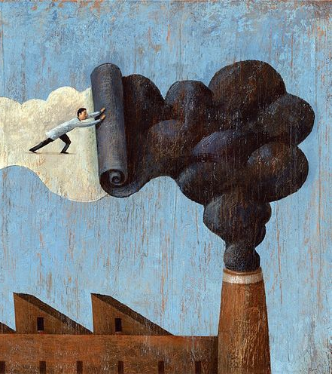
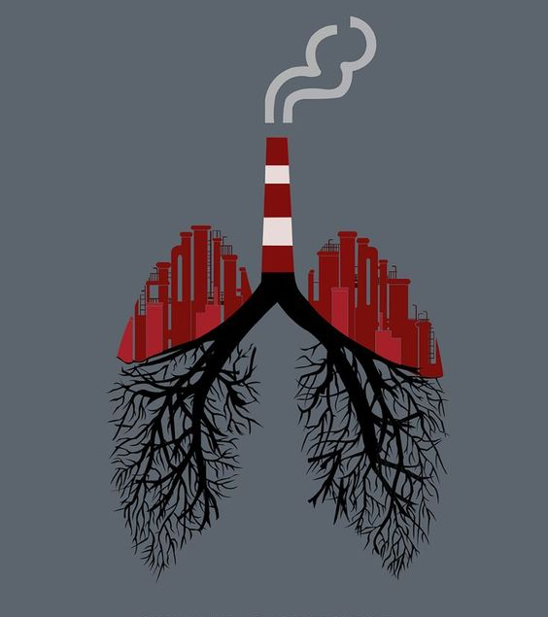
THANK YOU

Slide 25
Laws and Regulations
Environmental Protection Act 2076
National Ambiant Air Quality Standard 2069

