Slide 1

Assessment on
BMI, WHR, MUAC

Slide 2
Presented by Presented to
Abhinash Adhikari
Bikram Singh Dhami
Aayasha Bhattrai
Prabin Wagle
Abisha Basaula
Dr. Dipendra Kumar Yadav
Lecturer
Food and Nutrition
School Of Health And Allied Science, PU

Slide 3
INTRODUCTION
Body mass index(BMI)
Body mass index (BMI) is the latest tool to assess the amount of body fatness in a person
BMI is an effective screening tools; it is not a diagnostic tool
It is the calculation using a person’s height and weight.
BMI can provide an indication of weight categories that could lead to the future health problems

Slide 4
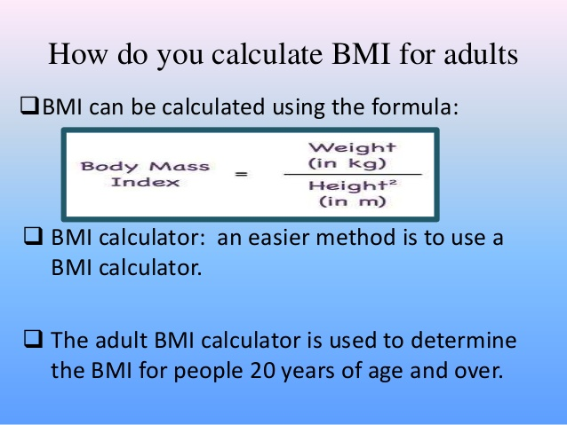
BMI calculation for Adult

Slide 5
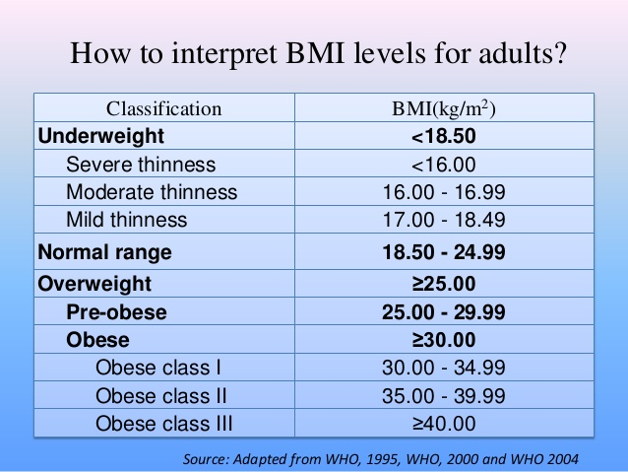
BMI level interpretation

Slide 6
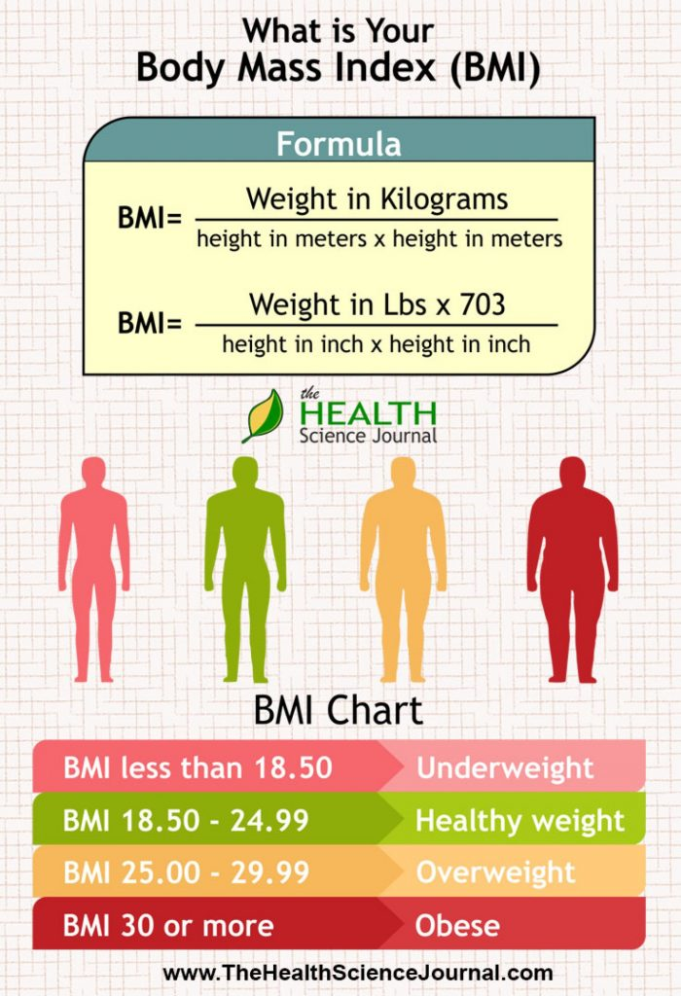

Slide 7
What is BMI used for ?
Height weight charts- BMI is now used in place of old height/weight charts
BMI- health professionals use the BMI to determine a person is a healthy weight for their height
BMI is a number used to determine one’s level of fatness.

Slide 8
Fast Facts
According to data from the National Health and Nutrition Examination Survey (NHANES), 2013–2014
More than 1 in 3 adults were considered to be overweight.
More than 2 in 3 adults were considered to be overweight or have obesity.
More than 1 in 3 adults were considered to have obesity.
About 1 in 13 adults were considered to have extreme obesity.
About 1 in 6 children and adolescents ages 2 to 19 were considered to have obesity.

Slide 9
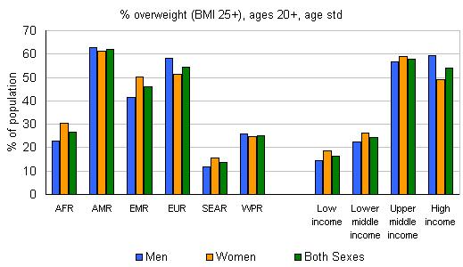
http://www.who.int/redirect-pages/mega-menu/health-topics

Slide 10
Risk of being underweight
If you are underweight (BMI less than 18.5), you may be malnourished and develop
Compromised immune function
Respiratory disease
Digestive disease
Cancer
osteoporosis

Slide 11
Risk of being overweight
If you are overweight (with a BMI over 25) and physically inactive, you may develop;
Cardiovascular (Heart and blood circulation) disease
Gall bladder disease
High blood pressure (Hypertension)
Type 2 diabetes
Depression and other mental disorder

Slide 12
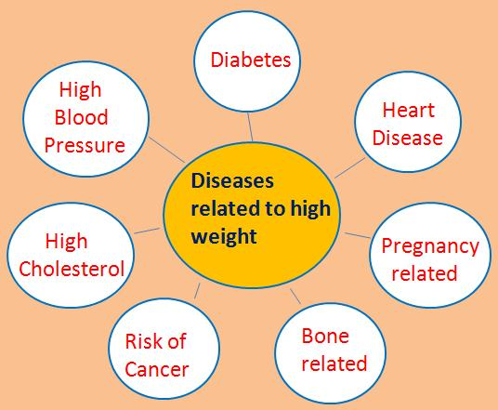

Slide 13
WHR (waist hip ratio)
The WHR has been used as an
indicator or measure of the health of a person, and
risk of developing serious health condition
WHR is used as a measurement of obesity which in turn is a possible indicator of other more serious health conditions
WHR has been shown to be better predictor of cardiovascular disease than waist circumference and body-mass index.

Slide 14
How to measure WHR ?
According to WHO the waist circumference should be measured at the mid point between the lower margin of the last palpable rib and top of the iliac crest
Hip circumference should be measured around the widest portion of the buttocks, with the tape parallel to the floor
WHR has been found to be a more efficient predictor of mortality in older people than waist circumference or BMI

Slide 15
WHR Contd..
WHR is dimensionless ratio of the circumference of the waist to that of the hips.
This is calculated as waist measurement divided by hip measurement (w÷H).
For example, a person with a 30” (76 cm) waist and 38” (97 cm) hips has a waist-Hip ratio of about 0.78.

Slide 16
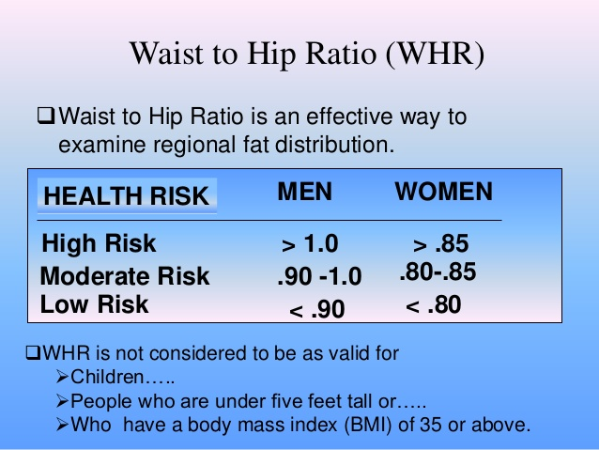

Slide 17
Mid Upper Arm Circumference
MUAC is defined as the circumference taken at the mid-point between the shoulder and elbow of bare left arm using an insertion tape.
This measurement help to asses the nutritional status of younger children.
There is growth due to inadequate nutritional which can be this simple particle and useful measurement

Slide 18
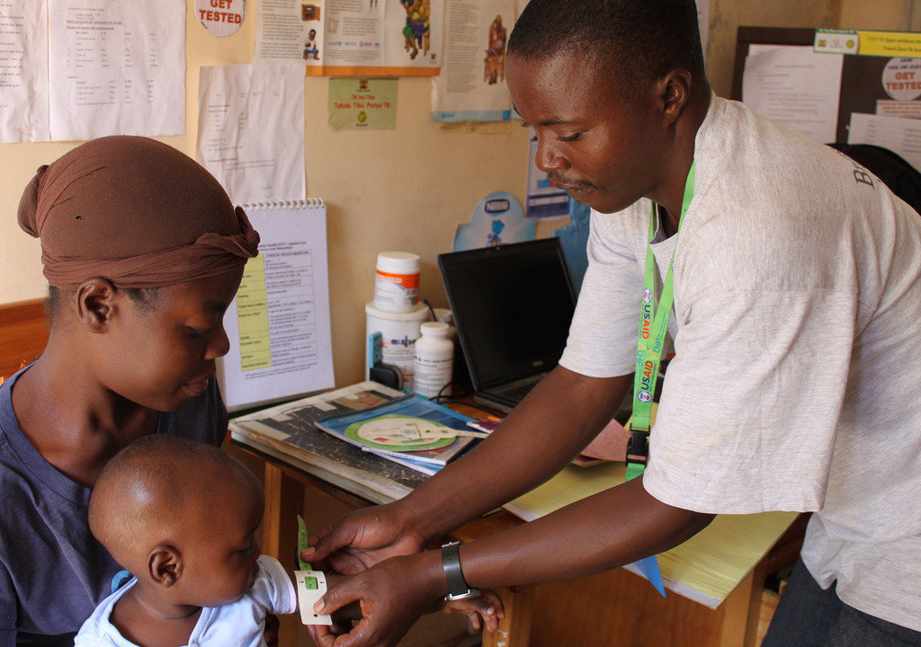

Slide 19
Contd..
MUAC is measured with a fiber glass or steel tape.
If it is less than 11.5 cm it is suggestive of severe malnutrition.
if it is between 11.5-12.5 cm it is indicative of moderate malnutrition

Slide 20
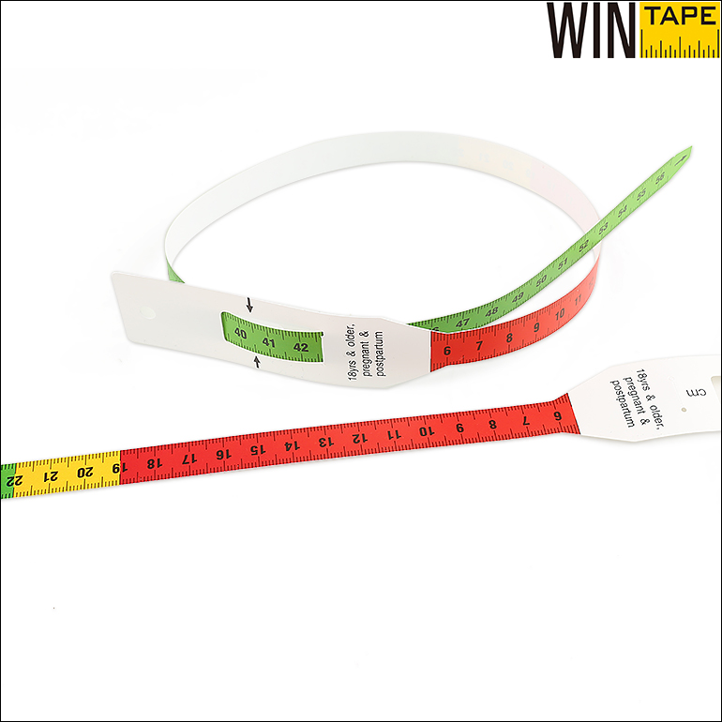
Shakir Tape
Is a fiber glass with
Red- less than 12.5 cm
Yellow- 12.5-13.5 cm
Green- greater than 13.5 cm

Slide 21
Interpretation of MUAC Indicators
MUAC less than 115mm (11.5cm), RED COLOUR, indicates Severe Acute Malnutrition (SAM). The child should be immediately referred for treatment.
MUAC of between 115mm (11.5cm) and 125mm (12.5cm), RED COLOUR (3-colour Tape) or ORANGE COLOUR (4-colour Tape), indicates Moderate Acute Malnutrition (MAM). The child should be immediately referred for supplementation.
MUAC of between 125mm (12.5cm) and 135mm (13.5cm), YELLOW COLOUR, indicates that the child is at risk for acute malnutrition and should be counseled and followed-up for Growth Promotion and Monitoring (GPM).
MUAC over 135mm (13.5cm), GREEN COLOUR, indicates that the child is well nourished.

Slide 22
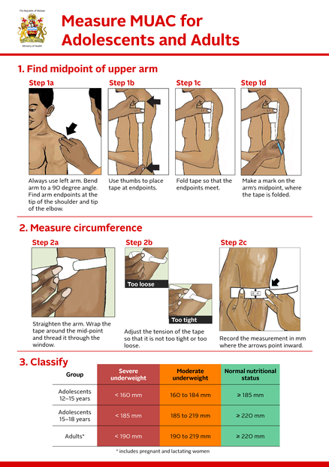

Slide 23
Advantage of MUAC
It Is Simple And Cheap
It Is More Sensitive
It Is Less Prone To Mistake
It Increase The Link With Beneficiary Community

Slide 24
The average MUAC at birth is 11 to 12 cm, at one year of age it is 12 to 16 cm, at 12 years it is 17 to 18 cm and at 15 years it is 20 to 21 cm.

Slide 25
Sources
https://www.slideshare.net/jamesmacroony/body-mass-index-waist-hip-ratio
https://www.slideshare.net/kteach/bmi-13865621
http://www.who.int/redirect-pages/mega-menu/health-topics
http://motherchildnutrition.org/early-malnutrition-detection/detection-referral-children-with-acute-malnutrition/interpretation-of-muac-indicators.html

Slide 26


