Slide 1
BIODIVERSITY

Slide 2
Biodiversity
Biodiversity generally refers to the variety and variability of life on Earth.
Biodiversity is defined as “the variability among living organisms from all sources including terrestrial, marine and other aquatic ecosystems and the ecological complexes of which they are part; this includes diversity within species, between species and of ecosystems.
According to the United Nations Environment Programme, biodiversity typically measures variation at the genetic, the species, and the ecosystem level

Slide 3
Global biodiversity
Global biodiversity is the measure of biodiversity on planet Earth and is defined as the total variability of life forms.
Category | Species | Total
Vertebrate Animals
Mammals | 5500
Birds | 10,000
Reptiles | 10,000
Amphibians | 15,000
Fishes | 40,000
Total Vertebrates |  | 80,500

Slide 4
Invertebrate Animals
Insects | 5,000,000
Arachnids | 600,000
Molluscs | 200,000
Crustaceans | 150,000
Echinoderms | 14,000
Others | 791,830
Total Invertebrates |  | 6,755,830

Slide 5
Plants
Flowering plants (angiosperms) | 352,000
Conifers (gymnosperms) | 1,050
Ferns and horsetails | 15,000
Mosses | 22,750
Total Plants |  | 390,800
TOTAL SPECIES |  | 7,227,130

Slide 6
Biodiversity in Nepal
Biodiversity Profiles of Nepal (BPN) 1996 is a scientific milestone in the methodical documentation.
In the profiles, Nepal’s flora and fauna are categorised by physiographic zones and protected areas. The documents recorded in total 181 mammal species belonging to 12 orders and 39 families (Suwal and Verheugt 1995).
BPN 1996 recorded numerous other fauna of various orders including 844 species of birds, 100 species of reptiles, 43 species of amphibians, 185 species of freshwater fish, and 635 butterfly species

Slide 7
Of the 635 butterfly species, four species and 25 subspecies are possibly endemic. In the context of flora, BPN recorded 5,160 species of flowering plants and 1,120 species of nonflowering plants (bryophytes and pteridophytes) (BPN 1995).
BPN ranks Nepal as the 10th richest flowering plant diversity in Asia, and the 31st in the world.

Slide 8
Status of Plants Diversity
In 1997 A.D, The Ministry of Forest and Soil Conservation has published the statistics on the plant species. According to this, the status of vegetation by comparing the statistics of algae, fungi, bryophytes and pteridophytes of species in the world. Comparing with the global scenario, algae (1.72 percent), fungi (2.38 percent), lichen (2.07 percent), bryophytes (6.09 percent), pteridophytes (3.19 percent), flowering plants (2.07 percent) are available in Nepal.

Slide 9
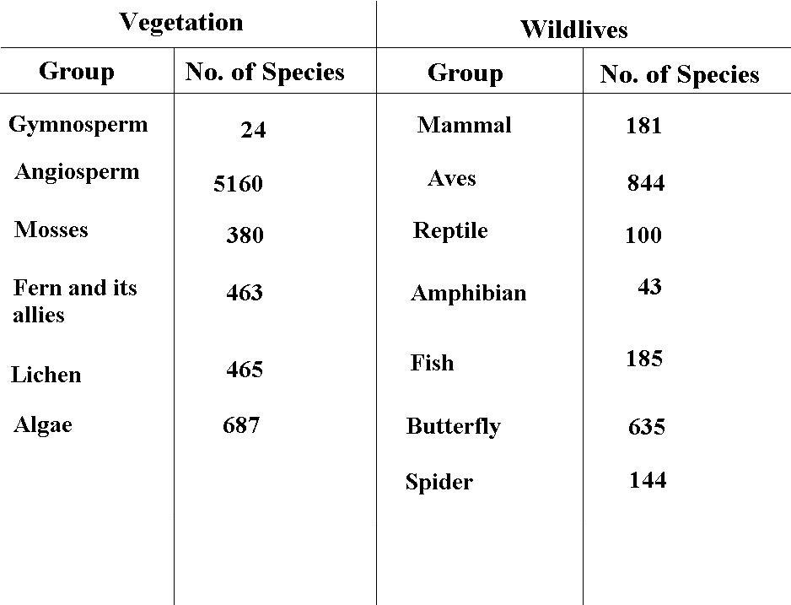

Slide 10
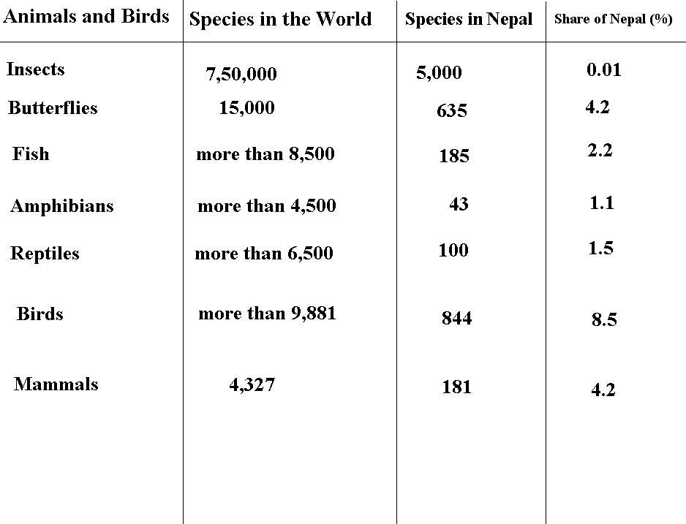
Comparative Situation of Animals and Birds

Slide 11
IMPORTANT/BENEFITS OF BIO-DIVERSITY
1.Agricultural Production
Agricultural products such as rice, maize, wheat, green vegetables and fruits are the basic sources of food for human beings. Their source is agriculture biodiversity. Crops of various species such as rice, maize, fruits and green vegetables are found in Nepal. Such crops and plants were found in the forest in the beginning but human beings started to cultivate them as useful plant. They selected good seeds and their plants. Such activities resulted in development of crops and plants. These are the major sources of food for human beings.

Slide 12
2.Animal Production
The sources of production required for human beings such as milk, curd, ghee, meat and fish are available for the bio-diversity. Similarly, horses and camel are used to transport goods from one place to another. Dogs are kept for security of houses. Various raw materials such as bones, hair, wool and leather are available from the animals. People make clothes, cosmetic goods and other by using them. The raw materials essential for medicines and also available from animals, birds and plants. Such goods can be produced and distributed. These are the sources of income.

Slide 13
3.Plant Production
Roots and fruits are also available from plants. These are the sources of raw materials for the timber industries. herbs, clothes, medicines, colors and paper.
4. Improvement in Breeds
People keep animals and birds for their uses. The production capacity of local species and immunity against disease can be improved through their use. Therefore, bio-diversity helps to improve the existing living beings of various places. Wild species can be used to breed the domestic animals and birds. Important plants should be identified through studies and research works and be preserved.

Slide 14
5.Soil Conservation
Various plants appear in different places. Large and small plants keep the particles of soil by pressing them. They protect soil erosion. Therefore, the physical condition of a place is distributed if the plants and the grasses are destroyed. The structure of land becomes weak and soil erosion and landslide can occur. Thus, bio-diversity helps to preserve land, soil and physical feature.

Slide 15
6. Watershed Conservation
The vegetation such as plants and grasslands help to conserve sources of water and watershed. The area of green belts is less evaporated and the water is collected in the land. Bio-diversity and sources of water and watershed areas are related to each other. One cannot exist in the absence of other. For examples, if sources of water are dry, there will be a loss in bio-diversity. Thus, biodiversity plays a significant role in the conservation and promotion of watershed areas.

Slide 16
7. Natural beauty and scenes
Bio-diversity makes environment and nature beautiful. Natural environment is created by plants, animals and birds, their size and types, colour, adaptation and responses. The habitat of animals and birds in the forest, their sound/noise and responses and life styles maintain natural beauty. Such beauty provides entertainment to men. There are a number of such places in the Himalayan, Hilly and the Terai regions of Nepal.

Slide 17
Threats of Biodiversity/Challenges of biodiversity conservation
Habitat degradation
Overexploitation
Invasive species
Anthropogenic Climate change
Pollution
Loss of wetlands

Slide 18
Habitat destruction
Habitat loss occurs when natural environments are transformed or modified to serve human needs. It is the most significant cause of biodiversity loss globally. Common types of habitat loss include cutting down forests for timber and opening up land for agriculture, draining wetlands to make way for new development projects, or damming rivers to make more water available for agriculture and cities.
Habitat loss can also cause fragmentation, which occurs when parts of a habitat become separated from one another because of changes in a landscape, such as the construction of roads. Fragmentation makes it difficult for species to move within a habitat, and poses a major challenge for species requiring large tracts of land such as the African forest elephants living in the Congo basin.

Slide 19
Though some habitat loss is necessary to meet human needs, when natural habitats are changed or modified with little concern for biodiversity the results can be very negative.

Slide 20
Climate change, which is caused by a build-up of greenhouse gases such as carbon dioxide in the Earth’s atmosphere, is a growing threat to biodiversity.
Climate change alters the climate patterns and ecosystems in which species have evolved and on which they depend. By changing the temperature and rain patterns species have become habituated to, climate change is changing the traditional ranges of species. This forces species to either move in order to find favourable conditions in which to live, or to adapt to their new climate. While some species may be able to keep up with the changes created by climate change, others will be unable to do so. Biodiversity in the polar regions and mountain ranges is especially vulnerable to climate change.

Slide 21
Overexploitation, or unsustainable use, happens when biodiversity is removed faster than it can be replenished and, over the long term, can result in the extinction of species.
For example: • the once-plentiful cod fishery of the coast of Newfoundland, Canada has all but disappeared because of overfishing;
• freshwater snakes in Cambodia are declining from hunting pressure;
• Encephalartos brevifoliolatus, a cycad, is now extinct in the wild after being overharvested for use in horticulture;
• Overexploitation, especially when combined with destructive harvesting practices, is a major cause of biodiversity loss in certain ecosystems.

Slide 22
Invasive species that have spread outside of their natural habitat and threaten biodiversity in their new area, are a major cause of biodiversity loss. These species are harmful to native biodiversity in a number of ways, for example as predators, parasites, vectors (or carriers) of disease or direct competitors for habitat and food.
In many cases invasive species do not have any predators in their new environment, so their population size is often not controlled.
The introduction of invasive species can be either intentional, as with the introduction of new crop or livestock species, or accidental.

Slide 23
The troublesome toad
It all started with some beetles that were destroying sugarcane crops in Australia. A type of toad called the cane toad was brought in from Hawaii, with the hope that they would eat the beetles and solve the problem. Well, the toads left the beetles alone, but ate practically everything else, becoming full-fledged pests in their own right. Now they are preying on small animals and poisoning larger ones that dare to try eating them. Scientists are still trying to figure out what to do.

Slide 24
Pollution, in particular from nutrients, such as nitrogen and phosphorus, is a growing threat on both land and in aquatic ecosystems. While the large-scale use of fertilisers has allowed for the increased production of food, it has also caused severe environmental damage, such as eutrophication.
In eutrophic water bodies, such as lakes and ponds, the concentration of chemical nutrients is so high that algae and plankton begin to grow rapidly. As these plants grow and decay, the water quality and the amount of oxygen in the water decline. These conditions make it difficult for many species to survive. The excess nutrients that cause this situation mostly come from fertilisers, erosion of soil containing nutrients, sewage, atmospheric nitrogen deposition and other sources.

Slide 25
Loss of wetland:
Nepal’s wetland biodiversity is under serious threat from encroachment, unsustainable harvesting, industrial pollution, agricultural runoff, silting, and the introduction of exotic and invasive species. Encroachment results in the reduction in the area of wetlands, deposition of silt, and eutrophication caused by agricultural runoff and/or industrial effluents. Silting is a serious threat to wetland. About 66% of the wetlands in the hills and mountains are seriously affected by silting. Similarly, empirical evidence from a survey of 163 wetland sites revealed that those in the Tarai are vulnerable, in particular, to the proliferation of exotic species. Most of the lakes in Nepal have been colonized by non-native species (IUCN 1996). Heavy use of fertilizers in agricultural areas has resulted in the eutrophication of wetlands. Water hyacinth (Eichhornia crassipes) threatens the survival of several wetland ecosystems in terai region.

Slide 26
Unsustainable Livestock Farming Practices
Rangelands (grasslands) are an important habitat for many wildlife species and is importance for biodiversity. The consequences of livestock grazing range from soil erosion to degradation of this habitat for wildlife.
Rearing livestock for dung and benefits other than meat is traditional and has had a negative effect on biodiversity. The adverse effect of grazing by livestock is severe both in and outside protected areas, as in mountain pastures and the Tarai grasslands. Cattle grazing in Koshi Tappu Wildlife Reserve, for example, may result in a serious conservation problem as it triggers cross breeding between domestic and wild water buffaloes

Slide 27
Environmental Pollution
Pollution is a major problem for humans and biodiversity. Untreated industrial and domestic waste released directly into the aquatic and terrestrial habitats of wildlife is a serious threat to biodiversity. Some rivers passing through major cities in Nepal are badly polluted by untreated industrial and domestic waste. The decline in the numbers of river dolphin in the Narayani River is believed to be due to the effect of waste discharged by the paper industry (WWF 2006).
The increased use of pesticides and introduction of high yielding varieties of crop plants is the main cause of agro-ecosystem pollution. Insecticides can have an adverse effect on mammals and other vertebrates and their persistent use has seriously affected livestock and wildlife. The use of pesticides over a large area may diminish the overall population of invertebrates, which are the source of food for many birds, especially migratory species. The effect of pesticides may be direct (increase in mortality) or indirect (reduction in reproduction).

Slide 28
IUCN Categories of protected areas
Objectives of a protected area is to fulfill the following purposes:
To alert governments to the importance of protected areas
To encourage governments to develop systems of protected areas with management aims tailored to national and local circumstances
To establish universal terminology in describing protected areas; in order to reduce the confusion which arises from the adoption of many different classifications
To create an international standard to help global and regional accounting and comparisons between countries
To provide a framework for the collection, handling and dissemination of data about protected areas
To generally improve communication and understanding between all those engaged in the conservation of protected areas

Slide 29
Ia Strict Nature Reserve: Category Ia are strictly protected areas set aside to protect biodiversity and also possibly geological features, where human visitation, use and impacts are strictly controlled and limited to ensure protection of the conservation values. Such protected areas can serve as indispensable reference areas for scientific research and monitoring
Ib Wilderness Area: Category Ib protected areas are usually large unmodified or slightly modified areas, retaining their natural character and influence without permanent or significant human habitation, which are protected and managed so as to preserve their natural condition.

Slide 30
II National Park: Category II protected areas are large natural areas set aside to protect large-scale ecological processes, along with the complement of species and ecosystems characteristic of the area, which also provide a foundation for environmentally and culturally compatible, spiritual, scientific, educational, recreational, and visitor opportunities
III Natural Monument or Feature: Category III protected areas are set aside to protect a specific natural monument, which can be a landform, geological feature such as a cave or even a living feature such as an ancient grove. They are generally quite small protected areas and often have high visitor value.

Slide 31
IV Habitat/Species Management Area: Category IV protected areas aim to protect particular species or habitats and management reflects this priority. Many Category IV protected areas will need regular, active interventions to address the requirements of particular species or to maintain habitats
V Protected Landscape/ Seascape: A protected area where the interaction of people and nature over time has produced an area of distinct character with significant, ecological, biological, cultural and scenic value: and where safeguarding the integrity of this interaction is vital to protecting and sustaining the area and its associated nature conservation and other values.

Slide 32
VI Protected area with sustainable use of natural resources:
Category VI protected areas conserve ecosystems and habitats together with associated cultural values and traditional natural resource management systems. They are generally large, with most of the area in a natural condition, where a proportion is under sustainable natural resource management and where low-level non-industrial use of natural resources compatible with nature conservation is seen as one of the main aims of the area
Notes:
https://www.iucn.org/theme/protected-areas/about/protected-areas-categories

Slide 33
Biodiversity conservation measures
1. Ex-situ conservation:
Ex-situ conservation involves maintenance and breeding of endangered plants and animals under partially or wholly controlled conditions in specific areas like zoo, gardens, nurseries etc. That is, the conservation of selected plants and animals in selected areas outside their natural habitat is known as ex-situ con­servation.
The stresses on living organisms due to competition for food, water, space etc. can be avoided by ex-situ conservation there by providing conditions necessary for a secure life and breeding.

Slide 34
2. In situ conservation:
The conservation of species in their natural habitat or natural ecosystem is known as in situ conservation. In the process, the natural surrounding or ecosystem is protected and maintained so that all the constituent species (known or unknown) are conserved and benefited. The factors which are detrimental to the existence of species concerned are eliminated by suitable mechanism.

Slide 35
1. Protected Areas:
Protected areas (PAs) are vital for biodiversity conservation. They provide safe habitats for many endangered plants and animals.
Nepal has an extensive network of protected areas. It includes ten national parks, three wildlife reserves, one hunting reserve and six conservation areas. Protected areas and buffer zones account 23.23% of the country’s total area.
Further Pas is divided into

Slide 36
a) Strict Nature Reserve: A strict nature reserve is an area of unusual ecological significance, set aside for the purpose of scientific study. It is an IUCN category I protected area. No national park in Nepal is a strict nature reserve. However, an area in the lower Barun Valley, which is in the Makalu-Barun National Park in eastern Nepal, is designated as a strict nature reserve

Slide 37
b) National park: According to the NPWC act, a national park is an area set aside for the conservation and management of the natural environment, including the ecological, sociocultural, biological and geomorphologic associations of aesthetic importance. The ten national parks of Nepal are IUCN category II protected areas. Among them, five are in the Himalayan region, two in the midlands and three in the Tarai and Siwalik regions.

Slide 38
National parks | Area
Chitwan National Park | 932 km²
Sagarmatha National Park | 1,148 km²
Langtang National Park | 1,710 km²
Rara National Park | 106 km²
Khaptad National Park | 225 km²
Shey Phoksundo National Park | 3,555 km²
Bardiya National Park | 968 km²
Makalu Barun National Park | 1,500 km²
Shivapuri Nagarjun National Park | 159 km²
Banke National Park | 550 km²

Slide 39
Wildlife reserve
Koshi Tappu Wildlife Reserve – 175 km²
Parsa Wildlife Reserve – 637 km²
Suklaphanta Wildlife Reserve- 305 km²
Conservation areas
Annapurna Conservation Area – 7,629 km²
Kanchenjunga Conservation Area – 2,035 km²
Manaslu Conservation Area – 1,663 km²
Blackbuck Conservation Area – 15.95 km²
Api Nampa Conservation Area – 1,903 km²
Gaurishankar Conservation Area – 2,179 km²

Slide 40
c)Wildlife Reserve
A Wildlife Reserve is an area established for the conservation of flora and fauna and their habitats. There are three wildlife reserves in Nepal: Koshi Tappu, Parsa and Shuklaphanta. All are located in the lowland region of eastern, central and western Nepal, respectively. They occupy 2.9% of total protected area. Wildlife reserve regulations provide guidelines for conservation and management

Slide 41
d) Hunting Reserve: Hunting Reserve is an area set aside for the conservation and management of wildlife and provides opportunities for legal recreational hunting. Blue sheep (Pseudois nayaur) and Himalayan tahr (Hemitragus jemlahicus) can be hunted at Dhorpatan, the only hunting reserve in Nepal. It covers 3.9% of the total protected area.

Slide 42
e) Conservation Area: Conservation area is an area in which conservation and the sustainable use of the natural resources are integrated. There are three conservation areas in Nepal, namely, Annapurna Conservation Area, Kanchenjunga Conservation Area and Manaslu Conservation Area. They make up 45.4% of the total protected area. Annapurna Conservation Area (ACA) was the first in this category. It was officially gazetted in 1992 and responsibility for management was given to National Trust for Nature Conservation with aim of conserving biodiversity. It was very successful in gaining the support of local people for conservation.

Slide 43
International policy for management of global conventions and treaties
Ramsar Convention
The Ramsar Convention is an international treaty for the conservation and sustainable use of wetlands. It is also known as the Convention on Wetlands. It is named after the city of Ramsar in Iran, where the Convention was signed in 1971.
The List of Wetlands of International Importance included 2,266 Ramsar Sites in March 2016 covering over 2.1 million square kilometres. The country with the highest number of Sites is the United Kingdom with 170,

Slide 44
Ramsar sites in Nepal
Nepal showed its conservation commitment by singing the Ramsar Convention on April 17, 1988. The Koshi Tappu wetland is considered of international significance and was added to the Ramsar list of wetlands of global importance on December 17, 1987.

Slide 45
Ramsar Sites | Area (hectares | Location (districts) | Zone | Elevation (m) approx.
Koshi Tappu | 17500 | Koshi | Terai | 90
Beeshazar and Associated Lakes | 3200 | Chitwan | Terai | 285
Ghodaghodi Lake Area | 2563 | Kailali | Terai | 205
Gokyo and Associated Lakes | 7770 | Solukhumbu | Himal | 5000
Gosaikunda and Associated Lakes | 1030 | Rasuwa | Himal | 4700
Jagadishpur Reservoir | 225 | Kapilvastu | Terai | 195
Mai Pokhari | 90 | Ilam | Mid Hills | 2100
Phoksundo Lake | 494 | Dolpa | Himal | 3610
Rara Lake | 1583 | Mugu | Himal | 2990
Total | 34455
Notes:
Source: Modified from Wetlands International/Ramsar 2009.

Slide 46
A Glimpse on biodiversity values of Ramsar sites in Nepal
Beeshazar and Associated Lakes provide excellent habitat as water holes and corridor for endangered wildlife species, including the critically endangered Whiterumped Vulture, endangered Tiger, Rhinoceros and Fish-eating Crocodile, vulnerable Smooth-coated Otter, Sloth Bear, Broad-snouted Crocodile, Ferruginous Duck and Pallas’s. The aquatic vegetation in the lake is represented by extensive coverage of floating leafed species mainly Water Hyacinth (Eichhornia crassipes)
Ghodaghodi Lake and associated thirteen lakes support critically endangered Red-crowned Roofed Turtle, the endangered Tiger, Leopard and Three-striped Roof Turtle, and the vulnerable Smooth-coated Otter, Eurasian Otter, Barasingha, and Broad-snouted Crocodile. Threatened plant species include the endangered Orchid (Aerides odorata), religiously important and threatened Lotus (Nelumbo nucifera), and rare Wild Rice (Hygrorhiza aristata). They support six threatened bird species namely White-rumped Vulture and Slender-billed Vulture; Indian Spotted Eagle; and Near threatened: Oriental Darter

Slide 47
Jagadishpur Reservoir provides shelter for an assemblage of some threatened species of conservation importance. These include plants such as endangered Serpentine, rare Pondweed, threatened and religiously important Lotus, Wild Rice, as well as the IUCN red-listed and tallest flying bird species Indian Sarus Crane.
Koshi Tappu wetland offers an important habitat for a large variety of wildlife. The threatened Gharial, birds Bengal Florican and Spotbilled Pelican and Leopard occur in the site. Koshi Tappu forms an ideal habitat for resident as well as migratory water birds. Out of these 485 species of birds recorded in the area, 12 species are globally threatened and 101 species are nationally threatened. It is the only area in Nepal where Water Cock and Abbott's Babbler are found. Of the 31 species of mammals recorded, Nepal's last remaining population of Indian Water Buffalo inhabits the area and the South Asian River Dolphin has been recorded in the Koshi river. 514 species of plants have been recorded in the area including threatened species: Rauwolfia serpentina,

Slide 48
Gokyo and Associated lakes support a number of threatened species, such as the Himalayan tahr, the Snow Leopard, Wood Snipe, endemic species like the flowering plant Kobresia fissiglumis, and many important birds like Ferruginous Duck and Demoiselle Crane.
Gosainkunda and Associated Lakes support a considerable number of IUCN Red listed endangered and vulnerable species of fauna and flora. The site has religious associations for Hindus and Buddhists and is the locus of the important Gangadashahara and Janaipurnima festivals. Wetlands birds recorded in Gosaikunda are Ruddy Shelduck and Common Teal. This site is one of the most important sites for collection of type specimens of plants for botanical purpose including 100 species of flowering plants with threatened and endemic species.

Slide 49
Phoksundo Lake provide habitat for a number of rare and vulnerable plants and animals, including the Snow Leopard, Alpine Musk deer and Grey Wolf. About 155 species of flowering plants have been recorded from the catchments including threatened species N. scrophulariifolia, Dactylorhiza hatagirea, Dioscorea deltoidea, Aconitum spicatum, Nardostachys grandiflora.
Rara Lake and adjacent areas have developed unique floral and faunal assemblages with a number of rare and vulnerable faunal and floral species. The endemic frog Rara Paha is found at only one other location in the Central region, and three endemic species of Snow Trout - Asala Fish are found only here out of eight endemic fish species of Nepal. It is the habitat and resting site of winter visitor water birds such as Gadwall, Mallard, Tufted Duck.

Slide 50
Mai Pokhari wetland provides habitat for significant epiphytic orchids as well as for protected species such as White-rumped Vulture, Leopard cat and Eurasian Otter and endemic species like Hariya Cheparo

Slide 51
CITES (the Convention on International Trade in Endangered Species of Wild Fauna and Flora)
CITES is an international agreement adopted in March 1973 to regulate worldwide commercial trade in wild animal and plant species and came into force on 1st July 1975. The goal of CITES is to ensure that international trade does not threaten the survival of any species. Since 1973 the number of state parties to the convention has grown 180.
In addition to plants and animals and their parts, the agreement also restricts trade in items made from such plants and animals, such as clothing, food, medicine

Slide 52
Roughly 5600 species of animals and 29000 species are protected by CITIES against over exploitation through international trade. Each protected species is included in one of three lists, called appendices. species or population. The appendix that list a species or population reflects the extent of the threat to it and the controls that apply to the trade.
CITES classifies plants and animals according to three categories, or appendices, based on how threatened they are. It regulates international trade in species by including species on one of three Appendices

Slide 53
Appendix I - species cannot be traded internationally for primarily commercial purposes.
Appendix I lists species that are the most endangered among CITES-listed animals and plants. They are threatened with extinction and CITES prohibits international trade in specimens of these species except when the purpose of the import is not commercial, for instance for scientific research. In these exceptional cases, trade may take place provided it is authorized by the granting of both an import permit and an export permit.
Example of species under Appendix I: tiger, Himalayan brown bear, elephant, and Tibetan antelope

Slide 54
Appendix II
Appendix II lists species that are not necessarily now threatened with extinction but that may become so unless trade is closely controlled. International trade in specimens of Appendix-II species may be authorized by the granting of an export permit or re-export certificate. No import permit is necessary for these species under CITES (although a permit is needed in some countries that have taken stricter measures than CITES requires). Permits or certificates should only be granted if the relevant authorities are satisfied that certain conditions are met, above all that trade will not be detrimental to the survival of the species in the wild.
Example of species under Appendix II: Hippopotamus, gray wolf)

Slide 55
Appendix III is a list of species included at the request of a Party that already regulates trade in the species and that needs the cooperation of other countries to prevent unsustainable or illegal exploitation. International trade in specimens of species listed in this Appendix is allowed only on presentation of the appropriate permits or certificates.
Species may be added to or removed from Appendix I and II, or moved between them, only by the Conference of the Parties, either at its regular meetings or by postal procedures. But species may be added to or removed from Appendix III at any time and by any Party unilaterally

Slide 56
Convention on Biological Diversity(CBD)
The Convention on Biological Diversity is the first global agreement on the conservation and sustainable use of biological diversity. A total of 190 parties have so far signed the convention since the opening of it for signature at the Earth Summit in Rio de Janerio in 1992. Nepal signed CBD during the Earth Summit on 12 June 1992, ratified it on 23 november 1993, and became a party to the conservation serves as the national focal point on the convention.

Slide 57
CBD has three main goals:
The conservation of biodiversity
Sustainable use of its components
Equitable sharing of the benefits arising from the utilization of genetic resources
Other important issues raised by CBD include
Access to genetic resources and benefit sharing
Impact assessment
Benefit sharing of research and technology and
Financial resources and mechanism to achieve conservation goals

Slide 58
The Nagoya Protocol on Access to Genetic Resources and the Fair and Equitable Sharing of Benefits Arising from their Utilization to the Convention on Biological Diversity is a supplementary agreement to the Convention on Biological Diversity. It provides a transparent legal framework for the effective implementation of one of the three objectives of the CBD: the fair and equitable sharing of benefits arising out of the utilization of genetic resources. The Protocol was adopted on 29 October 2010 in Nagoya, Aichi Province, Japan, and entered into force on 12 October 2014

