Slide 1
Cardiopulmonary Resuscitation

Slide 2
Cardiopulmonary resuscitation
Introduction-
Sudden death occur when heart beat & breathing stop suddenly or unexpectedly. the major role of CPR is to provide oxygen to heart, brain, & the other vital organ until medical treatment (advance cardiac life support-ACLS) can restore normal heart action.
Cardiopulmonary resuscitation (CPR) is a lifesaving technique useful in many emergencies, including heart attack or near drowning, in which someone breathing or heartbeat has stopped

Slide 3
Cardiopulmonary resuscitation
Definition-
Angela Morrow RN Cardiopulmonary resuscitation (CPR) is a procedure used when a patient's heart stops beating and breathing stops. It can involve compressions of the chest or electrical shocks along with rescue breathing.
Mosby medical dictionary CPR is a basic emergency procedure for life support consisting of artificial and manual external cardiac massage

Slide 4
Cardiopulmonary resuscitation
Cardio Pulmonary Resuscitation is a technique of basic life support for oxygenating the brain and heart until appropriate, definitive medical treatment can restore normal heart and ventilatory action.

Slide 5
Purpose of CPR
To maintain an open and clear airway (A).
To maintain breathing by external ventilation (B).
To maintain Blood circulation by external cardiac massages (C).
To save life of the Patient.
To provide basic life support till medical and advanced life support arrives.

Slide 6
Sudden Cardiac Arrest
Causes- | Indication of CPR
- Heart disease - Electrical shock - Severe blood loss - Drug overdose - Severe allergic reaction - Drowning | Ventricular fibrillation (VF) Ventricular tachycardia (VT) Asystole Pulse less electrical activity

Slide 7
Indication of CPR
Respiratory Arrest: This may be result of following:
Drowning
Stroke
Foreign body in throat
Smoke inhalation
Drug overdose
Suffocation
Accident, injury
Coma
Epiglottis paralysis.

Slide 8
Sudden Cardiac Arrest
Chain of Survival for Adult-
The Chain of Survival is used to describe the most effective approach for treating sudden cardiac arrest. It consists of five interdependent links:
Immediate recognition and activation of EMS quickly initiates the treatment process.
Early CPR with effective chest compressions buys time for accessing an AED and improves the chance that defibrillation will work.
Rapid defibrillation provides the best chance to return the heart to a normal rhythm.
Effective advanced life support procedures and medications used by paramedics, nurses, or doctors help sustain the chance for recovery and survival.
And finally, integrated post-cardiac arrest care increases the likelihood of long-term survival.
If any one of the links is weak or missing, the chances for survival are greatly reduced. The greatest chance for survival exists when all links are working together.

Slide 9
Sudden Cardiac Arrest
Chain of Survival for Children-
The Chain of Survival for children includes the following links:
Effective prevention of the typical causes for airway and breathing
emergencies,
Early CPR and defibrillation with an AED to reverse the effects of a weakened heart,
Prompt activation of EMS to quickly get professional care,
Rapid pediatric advanced life support procedures and medications used by paramedics, nurses, or doctors to help sustain the chance for recovery and survival, and
Integrated post-cardiac arrest care to increase the likelihood for long-term survival.

Slide 10
Sudden Cardiac Arrest
Other Considerations on Heart Disease-
Heart disease, through heart attacks and strokes, is the leading cause of death for men and women in the United States also in Nepal. Statistics indicate more than one in four deaths was related to heart disease; half of these deaths were women. Lower risk for heart disease with a healthy lifestyle:
A healthy diet can prevent or reduce high blood pressure and high blood cholesterol.
Maintain a healthy weight.
Control alcohol intake.
Don’t smoke.
Exercise regularly.

Slide 11
Principles of CPR
To restore effective circulation and ventilation.
To prevent irreversible cerebral damage due to anoxia. When the heart fails to maintain the cerebral circulation for approximately four minutes the brain may suffer irreversible damage.

Slide 12
CPR Procedure
Sequences of procedures performed to restore the circulation of oxygenated blood after a sudden pulmonary and/or cardiac arrest
Chest Compressions and pulmonary ventilation performed by anyone who knows how to do it, anywhere, immediately, without any other equipment

Slide 13
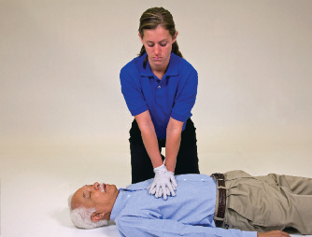
CPR Procedure
Chest Compressions for Adult
Position person face up on flat, firm surface. Kneel close to chest. Place heel of one hand on center of chest.
Place heel of second hand on top of first. You can interlace your fingers to help keep off chest.
Position your shoulders directly above your
hands. Lock your elbows and use upper body
weight to push.
Push hard, straight down at least 2 inches. Lift hands and allow chest to fully rebound.
Without interruption, push fast at a rate of at least 100 times per minute.
Do not compress over lowest part of breastbone. Keep up the force and speed of compressions.

Slide 14
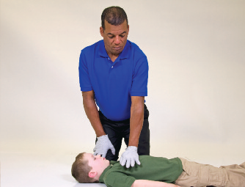
CPR Procedure
Chest Compressions for Child
Position child face up on flat, firm surface.
Place heel of one hand on lower half of breastbone, just above the point where the ribs meet.
Position your shoulder directly above your hand. Lock your elbow and use upper body weight to push.
Push hard, straight down at least 1⁄3 the diameter of the chest, or about 2 inches. Lift hand and allow chest to fully rebound.
Without interruption, push fast at a rate of at least 100 times per minute. Keep up the force and speed of compressions.
Compressions can be tiring. If desired, use two hands, as with adults.

Slide 15
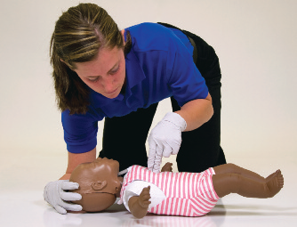
CPR Procedure
Chest Compressions for Infant
Position infant face up on flat, firm surface.
Place tips of two fingers on the breastbone just below the nipple line.
Push hard, straight down at least 1/3 the
diameter of the chest, or about 1 1/2 inches. Lift fingers and allow chest to fully rebound.
Without interruption, push fast at a rate of at least 100 times per minute. Keep up the force and speed of compressions.

Slide 16
CPR Procedure
Approach safely
Check response
Shout for help
Open airway
Check breathing
30 chest compressions
2 rescue breaths

Slide 17
Rescue Breath
Pinch the nose
Take a normal breath
Place lips over mouth
Blow until the chest rises
Take about 1 second
Allow chest to fall
Repeat

Slide 18
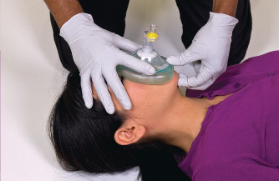
Rescue Breaths — CPR Mask
Position Mask
Inspect mask to make sure one-way valve is in place.
Place mask flat on person’s face by laying top of mask over bridge of nose.
Use thumb and forefinger to control the top of mask.
Use thumb of other hand to control the bottom of mask.

Slide 19
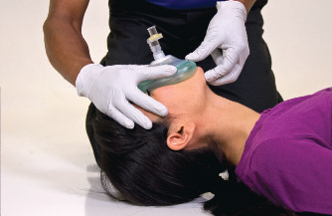
Rescue Breaths — CPR Mask
Open Airway-
Hook fingertips of hand controlling bottom of mask under bony part of chin.
Tilt head and lift chin. This brings the face up into the mask, creates an airtight seal, and opens the

Slide 20
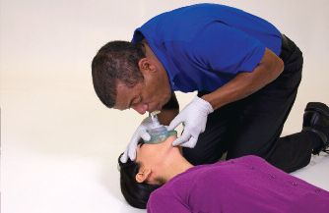
Rescue Breaths — CPR Mask
Give Breath-
Take a normal breath and blow through valve opening to deliver breaths.
Each breath should be 1 second in length. Create a visible rise of chest, but no more.
Remove your mouth and let person exhale completely. Take a fresh breath in between breaths.

Slide 21
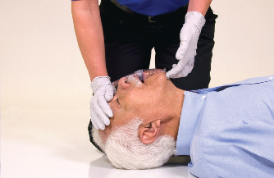
CPR Procedure
Airway-
Kneel next to their neck and shoulders.
Open the person’s airway by putting your palm on their forehead and gently tilting their head back, if cervical injury is not.
Then gently lift their chin forward to open their airway, if cervical injury is not.
Look for chest movement, and listen for breath sounds. If the person is not breathing, begin Mouth-to-Mouth with chest compressions .

Slide 22
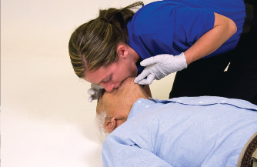
CPR Procedure
Breathing-
Can be performed mouth-to-mouth or mouth-to-nose if mouth is seriously injured.
With the air way open, pinch the nostrils shut, then cover the victim’s mouth with your mouth, making a good seal.
Prepare to give two rescue breaths
Give the first rescue breath, lasting 1 second---watch to see if the chest rises.
If their chest does rise, give a second breath.
If their chest does not rise, repeat head/chin tilt, as the airway may still be blocked. Give the second breath.

Slide 23
CPR Procedure
Begin chest compressions to restore circulation.
Circulation-restore circulation with chest compressions.
Position your body directly over your hands.
Give 15 fast chest compressions.
Give the person 2 slow breaths watching to make sure the chest rises.
Repeat chest compressions and breaths until help arrives.

Slide 24
Importance Of CPR
10-20% of normal blood flow to the heart
20-30% of normal blood flow to the brain

Slide 25
Thank You

