Slide 1
Unit 1
Concept of Environmental Science and Ecology
Kirti Sagar Baral, MPH, MA

Slide 2
Contents
Concept of environment (with environmental segments) and environmental science
Historical development, objectives and scope of environmental science
Ecosystem
Major types of ecosystem (terrestrial and aquatic)
Structure of ecosystem: trophic categories, trophic relationships, trophic level, abiotic factors
Principles of ecosystem function: energy flow in ecosystem and biogeochemical cycles (water, carbon, nitrogen and phosphorous cycle and their significance in environment)
Concept of ecosystem services (provisioning, regulating, cultural and supportive services)
Concept of payment for ecosystem services (PES)
Human Impact on ecosystem

Slide 3
Meaning of Environment
  “Environs” (French word) - to around, encircle or encompass.
  The word environment means surroundings
  The environment is everything around us. It includes all of the living and the nonliving things with which we interact. And it includes a complex web of relationships that connect us with one another and with the world we live in.

Slide 4
Meaning of Environment
  Environment refers to both abiotic (physical or non-living) and biotic (living) environment.
  Generally, environment refers to the materials and forces that surrounds the living organism.

Slide 5
Environment (Contd….)
the sum total of conditions that surrounds us at a given point of time and space.
The sum total of conditions in which an organism has to survive or maintain its life process. It influences the growth and development of living forms.
Aggregate of all external conditions and influences affecting the life and development of an organism, human behavior or society

Slide 6
Environment (Contd….)
Comprised of the interacting systems of physical, biological and cultural elements which are interlinked both individually and collectively.
It can also be defined as the “surrounding in which organisation operates including air, water, land and natural resources, flora and fauna, humans and their inter relations”.

Slide 7
Environment..Contd
Definition of environment
“Environment is anything immediately surrounding an object and exerting a direct influence on it.”
  P. Gisbert
“Environment is an external force which influences us.”
  E. J. Ross

Slide 8
The “environment”
Consists of both:
Biotic factors (living things) and
Abiotic factors (nonliving things) that surround us and with which we interact.

Slide 9
In its modern concept, environment includes not only the physical and biological conditions, but also the social and economic conditions under which we live.
Physical condition: water, soil, temperature, air etc.
Biological condition: plants, animal, microbes
Concept of environment
Socio-cultural conditions, eg. Traditions, customs, beliefs etc.

Slide 10
Classification of Environment
External environment
  physical , biological and social components
  all that which is external to the individual human host
Internal environment
  Inner physiological environment of the human organism
  Each and every component part, every tissue, organ and organ-system and their harmonious functioning within the system.

Slide 11
Classification contd..

Slide 12
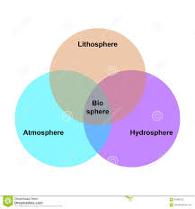
Environmental segments of earth
The earth’s life-support system consists of four main spherical systems that interact with one another- another—the atmosphere (air), the hydrosphere, (water), the lithosphere (rock, soil, sediment), and the biosphere (living things)

Slide 13
Environmental segments of earth
1. Atmosphere (air):
  The air surrounding the earth
  protective envelop - protect us from unfriendly environment of outer space.
  consists of life saving gases - O₂ (for human beings and animals) and CO₂ (for plants).
  plays a major role in maintaining the heat balance of the earth

Slide 14
Environmental segments of earth
Troposphere : start from earth's surface and extends 8 to 14.5 kilometers high (5 to 9 miles)., most dense, almost all weather is in this region.
Stratosphere: starts just above the troposphere and extends to 50 kilometers (31 miles) high. The ozone layer, which absorbs and scatters the solar ultraviolet radiation, is in this layer.
Mesosphere : starts just above the stratosphere and extends to 85 kilometers (53 miles) high. Meteors burn up in this layer
Thermosphere: starts just above the mesosphere and extends to 600 kilometers (372 miles) high. Aurora and satellites occur in this layer.
Ionosphere: abundant layer of electrons and ionized atoms and molecules that stretches from about 48 kilometers (30 miles) above the surface to the edge of space at about 965 km (600 mi), overlapping into the mesosphere and thermosphere. This dynamic region grows and shrinks based on solar conditions and divides further into the sub-regions: D, E and F; based on what wavelength of solar radiation is absorbed. The ionosphere is a critical link in the chain of Sun-Earth interactions. This region is what makes radio communications possible.
Exosphere: This is the upper limit of our atmosphere. It extends from the top of the thermosphere up to 10,000 km (6,200 mi).
Credit: NASA/Goddard
Aug. 7, 2017

Slide 15
Contd…..
2. Hydrosphere (water):
  covers > 75% of the earth surface either as oceans or as fresh water.
  includes sea, rivers, oceans, lakes, ponds, streams etc.
  Different forms: Liquid water, ice and water vapour
3. Lithosphere (land):
  The solid component of the earth - includes soil, earth, rocks and mountains etc.
  mainly contains three layers – Crust, Mantle and Core

Slide 16
Contd….
4. Biosphere (flora, fauna, microbes):
The biosphere occupies those parts of the atmosphere, hydrosphere, and geosphere where life exists.
This component comprise of living or non living organisms, flora and fauna, plants and animal species including one-cell organisms.
This thin layer of the earth extends from about 9 kilometers (6 miles) above the earth’s surface down to the bottom of the ocean, and it includes the lower part of the atmosphere, most of the hydrosphere, and the uppermost part of the geosphere (lithosphere).

Slide 17
Historical Development
Ancient period
  Concept of environment is as old as our first human ancestors
  It had its beginning in the anciet civilizations of Babylonia and Egypt where observations of the environment were carried out primarily for practical reasons such as planting crops or for religious purposes. They considered science as natural philospohy
  Indoaryan life and environment
  Arya community close to environment
  Hippocrates(wrote an essay-on air water and place),
  Aristotle and others talked about this. Aristotle classified animals according to their habits and habitats

Slide 18
Historical Development
  In 1972, human environment conference organized from June 5 to 16 at Sweeden (Stockholm conference)
  133 countries participated and declared June 5 as World environment day
  1972, UN Assembly established Unites Nation’s Environment Program (UNEP), office at Nairobi, Kenya.
  It coordinates the organization's environmental activities and assists developing countries in implementing environmentally sound policies and practices.

Slide 19
Environmental science
Environmental Science – The interdisciplinary study of humanity’s relationship with other organisms and the nonliving physical environment.

Slide 20
Environmental science
The systematic and scientific study of our environment and our role in it. This branch includes knowledge of pure sciences and social sciences.
An interdisciplinary study of how the earth works, how we interact with the earth, and how we can deal with the environmental problems we face.

Slide 21
Environmental science….
It integrates information and ideas from the natural sciences( such as biology, chemistry, and geology), the social sciences (such as geography, economics, political science, and demography (the study of populations) and the humanities) including philosophy and ethics
The study of the effects of natural and unnatural processes, and of interactions of the physical components of the planet on the environment.

Slide 22
Environmental science….
An interdisciplinary academic field that integrates various academic fields (particularly sciences) to study the structure and function of our life-supporting environment and to understand causes, effects, and solutions of different environmental problems.
The goals of environmental science are to learn how nature works, how the environment affects us, how we affect the environment, and how to deal with environmental problems and live more sustainably.

Slide 23
Scope of environment in various applied disciplines
Agriculture
Forestry
Population
Industry
Health and sanitation
Science and Technology
Meteorology
Hydrology

Slide 24
Importance of Environmental science
  Solving the issues related to environmental pollution
  Over exploitation of non-renewable sources
  Maintain the ecological balance
  Eco friendly products
  Conservation of natural sources
  Understand the food chain
  Inculcating attitude and value
  Encouraging Environment protection
  Reservation of Cultural Heritage
  Food problem
  Sustainable development

Slide 25
Environment Science
Clarifies modern environmental concepts - eg conserve biodiversity, lead more sustainable lifestyles and the use resources more equitably.
Changes the way in which we view our own environment by a practical approach based on observation and self learning.
Creates concern for our environment that will trigger pro-environmental action, including activities we can do in our daily life to protect it.

Slide 26
Scope of Environmental Science
  Natural Resources
  Ecology
  Biodiversity and its conservation
  Environment pollution and control
  Natural disaster
  Development
  Social issues in relation to development and environment
  Human population and environment

Slide 27
Ecology
Ecology- Greek words Oikos (house or dwelling place) + logos (study of)
Study of organism with respect to their house or dwelling
A key sub-discipline of environmental science that studies how organisms, or living things, interact with their environment and with each other.

Slide 28
Ecology (Contd….)
The study of living organisms in the natural environment: how they interact with one another and how they interact with their non living environment
Ecology is the scientific study of interactions between different organisms and their environment or surroundings
Ecology is the study of ecosystems.
Ecologists focus on organisms, populations, communities, ecosystems, and the biosphere.

Slide 29
Some definitions of ecology
“The total relations of animal to both its organic and incorganic environment”. Ernst Haeckel (1869)
“Science of community”- Frederick Clements (1916)
“The science of interrelationships between living organisms and their environment (both physical and biotic)”- Allee (1949)

Slide 30
Some definitions of ecology
“Ecology is the study of the structure and function of nature”- Eugene Odum (1963)
“Ecology is the scientific study of the distribution and abundance of organisms.”- Andrewarth (1961)
“A multidisciplinary science which deals with organism and its place to live and focus on ecosystem.”- Smith (1977)

Slide 31
Ecology (Contd….)
The goal of ecology is to understand the interactions in the this thin layer of air, water, soil, and organisms.
Ecology is subdivided into different fields so as to understand the subject in more profitable way.

Slide 32
Ecology (Contd….)
Major Subdivisions of Ecology
Plant ecology and animal ecology
Autecology (deals with study of individual species in relation to the environment) and synecology (study of group of organisms in relation to environment)

Slide 33
Ecology (Contd….)
Autecology
Study of individual species in relation to their environment
Also called as population ecology
Unit of study is individual species
Includes the study of geographical distributions, taxonomic position, morphological characters, reproduction, life cycle, behavior wrt ecological factors
Eg study of zebra population in relation to their environment
Synecology
Study of groups of organisms in relation to their environment
Also called as population ecology
Unit of study is groups of species(many population in an area). Study of ecosystem
Eg Study of entire grass land system

Slide 34
Sub-disciplines of ecology
  The subject can be studies through the following sub divisions of ecology:
  Population ecology : – studies the dynamics of populations of single species.
  Community ecology : (or synecology) focuses on the interactions between species within an ecological community
  Taxonomic ecology: deals with the ecology of different taxonomic groups viz microbial ecology, mammalian ecology, insect ecology etc
  Human Ecology: Deals with the effects of human activities on environment and vice versa
  Habitat ecology: Study of animals and plants in different habitats eg freshwater ecology, marine ecology, terrestrial ecology, forest ecology, desert ecology etc

Slide 35
Sub-disciplines of ecology
  Behavioral ecology : – examines the roles of behavior in enabling an animal to adapt to its environment.
  Eco-physiology : – examines how the physiological functions of organisms influence the way they interact with the environment, both biotic and abiotic.
  Ecosystem ecology : studies the flows of energy and matter through the abiotic and biotic components of ecosystems.
  Pedology: deals with the study of soil and refers to its nature like acidity, alkalinity, humus contents, mineral contents ect
  Eco-geography: studies the geographical distribution of plants and animals in different environments- collectively called as biomes.

Slide 36
Contd…..
  Systems ecology : is an interdisciplinary field focusing on the study, development, and organization of ecological systems from a holistic perspective.
  Landscape ecology: examines processes and relationships across multiple ecosystems or a very large geographic areas.
  Evolutionary ecology: deals with evolutionary histories of species and their interactions.
  Political ecology : connects politics and economy to problems of environmental control and ecological change.

Slide 37
Scope of Ecology
  Ecology is the study of organisms, populations, and communities as they relate to one another and interact in the ecosystems they comprise.
  Organismal and population ecology study the adaptations that allow organisms to live in a habitat and organisms' relationships to one another.

Slide 38
Scope of ecology
Animal Ecology
Aquatic Ecosystem
Biogeochemistry
Community Ecology
Cultural Ecology
Ecological Impact of Climate Changes
Ecosystem Services
Environmental Ecology
Evolutionary Ecology

Slide 39
Scope of ecology
Human Ecology
Industrial Ecology
Landscape Ecology (Scenery)
Marine Ecology (oceanic)
Microbial Ecology
Molecular Ecology
Physiological Ecology
Plant Ecology
Population Ecology
Terrestrial Ecology

Slide 40
Ecosystem

Slide 41
Ecosystem
Proposed by British ecologist- Tansley
Eco- environment, System- Interactions
The term ecosystem is coined form a Greek word meaning study of home.
Ecosystem is the basic functional unit of ecology. It is the major focus of ecology.

Slide 42
Ecosystem
  A group of organisms interacting among themselves and with environment is known as ecosystem.
  An ecosystem is a set of organisms interacting with one another and with their environment of nonliving matter and energy within a defined area or volume.
  Thus an ecosystem is a community of different species interacting with one another and with their non living environment exchanging energy and matter.

Slide 43
Ecosystem
Ecosphere: more broader concept, composed of a variety of ecosystems and thus represent a super system
Ecosystems do not have clear boundaries and are not isolated from one another.
Matter and energy move from one ecosystem to another. For example, soil can wash from a grassland or crop field into a nearby river or lake. Water flows from forests into nearby rivers

Slide 44
Characteristics of ecosystem (Smith 1966)
Ecosystem is a major structural and functional unit of ecology
The structure of an ecosystem is related to its species diversity in the sense that complex ecosystems have high species diversity
The function of ecosystem is related to energy flow and material cycles within and outside the system
The relative amount of energy needed to maintain an ecosystem depends on its structure. Complex ecosystems need less energy to maintain themselves

Slide 45
Characteristics of ecosystem (Smith 1966)
Young ecosystems develop and change from less complex to more complex ecosystems.
Each ecosystem has its own energy budget
Adaptation to local environmental conditions is the important feature of the biotic components of an ecosystem failing which they might perish
The function of every ecosystem involves a series of cycles eg water cycle, nitrogen cycle, oxygen cycle etc. A continuation or existence of ecosystem demands exchange of materials/nutrients to and from different components

Slide 46
Types of ecosystem
Ecosystem
Natural Ecosystems
Man-made Ecosystems
Terrestrial Ecosystem
Aquatic Ecosystem
Fresh water Ecosystem
Marine Ecosystem

Slide 47
TYPES OF ECOSYSTEM
A. Natural ecosystem
Natural ecosystems are capable of operating and maintaining themselves under natural conditions.
1. Terrestrial ecosystem
ecosystem is related to land.
Example: grassland ecosystem, forest ecosystem, desert ecosystem, etc.,
2. Aquatic Ecosystem
It can be further classified into :
I. Fresh water Ecosystem
Pond Ecosystem, Lake Ecosystem, River Ecosystem
II. Marine Ecosystem : Ocean, sea.

Slide 48
B. Artificial (man made) Ecosystems :
These are maintained by man for different purposes. where by addition of energy and planned manipulation, natural balance is disturbed regularly e.g., crop fields, tree farms, and reservoirs, towns and cities

Slide 49
C. Incomplete Ecosystems :
According to Southwick (1976), those ecosystems that do not contain all the 4 basic components i.e. abiotic substances, producers, consumers and decomposers are called incomplete ecosystems.
Example: caves lack producers but contain only consumes and decomposers. They are incomplete ecosystems

Slide 50
STRUCTURE OF AN ECOSYSTEM
Every ecosystem has a non living (abiotic) and living (biotic) component.
Inorganic aspects – C, N, CO2 , H2O.
Physical elements – Temperature, Moisture, Light & Topography.
Organic compounds – Protein, Carbohydrates, Lipids – link abiotic to biotic aspects.
Producers – Plants.
Micro consumers – Saprotrophs, absorbers – fungi.
Macro consumers – Large animals.

Slide 51
Structure of an Ecosystem
Living (Biotic) Components
Non-Living (Abiotic) Components
Chemical
Physical
Producers
Consumers
Decomposers

Slide 52
A. Abiotic components (non-living)
The non-living components (physical and chemical)
of ecosystem collectively form a community called
abiotic components (or) abiotic community.
1. Physical components
They include the energy, climate, raw materials and
living space that the biological community needs. They are useful for the growth and maintenance of its member.
Example
Air, water, soil, sunlight, etc.,

Slide 53
2. Chemical Components
Basic inorganic compounds of organism, habitat or area. They are the sources of essential nutrients
Examples
Co2, water, nitrogen, calcium, phosphorous etc

Slide 54
B. Biotic components (biological components)
  From the trophic point of view, some organisms produce food while others consume foods. They are called biotic communities.
  Examples
  Plants (producers), animals (consumers), and microorganisms (decomposers).

Slide 55
i) Producers (Autotrophs)
Producers synthesize their food themselves through photosynthesis. Example : All green plants, algae, trees. They manufacture food from simple inorganic substances by fixing energy.
The green pigments called chlorophyll, present in the leaves of plants, converts CO₂ and H₂O in the presence of sunlight into
carbohydrates. This process is called photosynthesis
6CO₂ + 12H₂O ----------------------> C₆H₁₂O₆ + 6O₂+6H₂O

Slide 56
ii. Consumers (heterotrophs): they can not make their own food
and consume food built by producers
Examples : Plant eating species
Classification of consumers
  Consumers are further classified as
  (i) Primary consumers (Herbivores) (Plant eaters)
  Primary consumers are also called herbivores,
  they directly depend on the plants for their food.
  So they are called plant eaters.
  Examples :
  Insects, rat, goat, deer, cow, horse, etc.,

Slide 57
(ii) Secondary consumers (meat eater)
  Secondary consumers are primary carnivores, they feed on primary consumers. They directly depend on the herbivores for their food.
Example
Frog, cat, snakes, foxes, etc.,
(iii) Tertiary consumers (Meat eaters)
Tertiary consumers are secondary carnivores, they feed on secondary consumers. They depend on the primary carnivores for their food.
Examples
Tigers, lions, etc.,

Slide 58
3. Decomposers
Examples : virus and bacteria
Microorganisms like bacteria and fungi called decomposers attack the dead bodies of producers and consumers and decompose them into simpler compounds. The simple organic matters are then attacked by another kind of bacteria which change these organic compounds into the inorganic forms that are suitable for reuse by producers or green plants. Thus decomposers and transformers play very important role in maintaining the dynamic nature of ecosystems.

Slide 59
Functions of ecosystem
Productivity – producers producing energy through photosynthesis by the use of physical substances
Energy flow across various levels – food chain, food web
The cycling of nutrients- biogeochemical cycles
Diversity (interlinkages between organisms) and evolution are also functional aspects of ecosystem
Energy flows directionally through ecosystems, entering as sunlight (or inorganic molecules for chemoautotrophs) and leaving as heat during the many transfers between trophic levels. However, the matter that makes up living organisms is conserved and recycled.

Slide 60
Food Chain
A food chain is the path by which energy and essential materials passes from one living thing to another.
The transfer of food energy from the source in plants through series of organisms with repeated stages of eating and being eaten up is know as food chain.
A food chain is a simplified way to look at the energy that passes from producers to consumers.

Slide 61
Food Chain
Food chain in rice field
Solar energy - Grass - Insects - Rats - Rice snakes - Decomposers.
Food Chains in Marine Ecosystems
Solar energy - algae - small fish - big fish - sharks – decomposers
Food Chain In Forest
Solar energy - grass - goats - tigers - decomposers

Slide 62
Trophic levels in food chain
Trophic levels are different stages of feeding position in a food chain such as primary producers and consumers of different types. Organisms in a food chain are categorized under different groups called trophic levels.

Slide 63
Trophic levels in food chain
Producers (first trophic level)
Consumers
  Primary (second trophic level)
  Secondary (third trophic level)
  Tertiary (fourth trophic level)
  Decomposers

Slide 64
Producers
The first level of every food chain
Producers make their own food
Green plants use energy from the sun to make food through photosynthesis

Slide 65
Consumers
Consumers hunt, gather, and store food because they cannot make their own.

Slide 66
Three Types of Consumers
Primary consumers (Herbivores): Animals who eat plants such as: Eg Deer, turtle, and many types of birds
Secondary consumers (Carnivores and Omnivores):
  Carnivores: Animals who only eat other animals. In a desert ecosystem, a secondary consumer may be a snake that eats a mouse.
  Omnivores: Animals who eat both plants and animals such as: humans, bears

Slide 67
Three Types of Consumers
  3. Tertiary Consumers (Carnivores eating other carnivores): Tertiary consumers are animals eating other carnivores. The King Cobra specialize in killing and eating other snakes

Slide 68
Decomposers
Microorganisms that are able to break down large molecules into smaller parts
Decomposers return the nutrients that are in a living thing to the soil

Slide 69
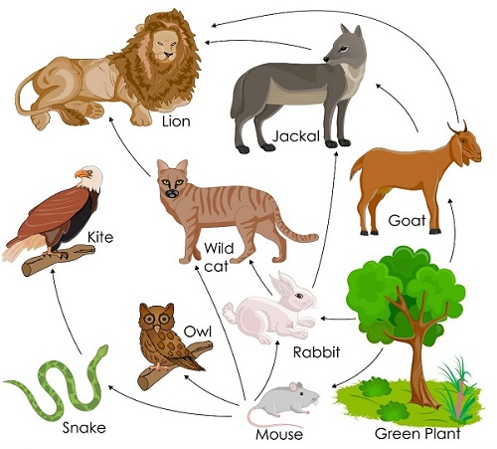
Food Web
  a network of interconnected food chains so as to form a number of feeding relationships amongst different organism of a biotic community.

Slide 70
Food Web
A food chain cannot stand isolated in an ecosystem.
The same food resource may be a part of more than one chain. This is possible when the resource is at the lower tropic level.
A food web comprises all the food chains in a single ecosystem. It is essential to know that each living thing in an ecosystem is a part of multiple food chains.

Slide 71
Principles of Ecosystem Functions
    Energy flow in ecosystem
    Biogeochemical cycles

Slide 72
Energy flow in ecosystem
When an organism eats, it obtains energy. The organism uses a lot of energy in life process like growth and movement.
So, only part of their energy is available to the next organism in the food web.
The greatest amount of energy is available at the producer level
Only about 10% of the trophic level’s energy is transferred to the next level.
The least amount of energy available going to be a the top of the food chain.

Slide 73
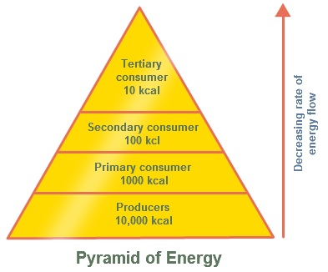
Contd…..

Slide 74
Biogeochemical cycle
A biogeochemical cycle or an inorganic-organic cycle is a circulating or repeatable pathway by which either a chemical element or a molecule moves through both biotic (biosphere) and abiotic (lithosphere, atmosphere and hydrosphere) components of an ecosystem.
These chemicals are the building blocks of life, they are the raw materials all living organisms use as nutrients to produce energy.

Slide 75
Biogeochemical cycle
The six most common elements associated with organic molecules—carbon, nitrogen, hydrogen, oxygen, phosphorus, and sulfur—take a variety of chemical forms and may exist for long periods in the atmosphere, on land, in water, or beneath the Earth’s surface.
The recycling of inorganic matter between living organisms and their environment is called a biogeochemical cycle.
Thus, mineral nutrients are cycled, either rapidly or slowly, through the entire biosphere, from one living organism to another, and between the biotic and abiotic world

Slide 76
Biogeochemical cycle
Describes the flow of essential elements from the environment through living organisms and back into the environment.

Slide 77
Biogeochemical cycles
Water cycle
Carbon cycle
Nitrogen cycle
Oxygen cycle
Phosphorous cycle

Slide 78
Water Cycle or Hydrologic Cycle
Interchange of water between earth’s surface and atmosphere is governed by a cycle known as hydrologic cycle.
It is the continuous circulation of water within the earth’s hydrosphere, and is powered by solar energy.
The cycle that collects, purifies, distributes and recycles the earth’s fixed supply of water
Hydrological cycle encompasses the movement of water from the ocean to the atmosphere and back to the ocean again by way of evaporation., run off in streams and rivers and ground water flow.
Only a small amount of water in the ocean is active in the cycle at one tie and yet is very important in the movement and sorting of chemical elements, shaping the landscapes, weathering the rocks, transporting and depositing the sediments and providing us with water resources.

Slide 79
Water Cycle or Hydrologic Cycle
Water is found as reservoirs on the earth in the atmosphere and hydrosphere
Incoming solar energy causes evaporation of water from the oceans, lakes, rivers, and soil. Evaporation changes liquid water into water vapor in the atmosphere, and gravity draws the water back to the earth’s surface as precipitation (rain, snow, sleet (frozen rain), and dew).

Slide 80
Water Cycle
As water moves through the cycle, it changes the state between liquid, solid, and gas phases.
Water changes into various forms as a result of precipitation- glaciers, rivers, streams, lakes, underground, oceans, sea
Small amount of water is absorbed by living beings

Slide 81
Water Cycle

Slide 82
Major processes in water cycle
Evaporation -Water changes from liquid to gas
Transpiration -Water evaporates from the leaves into the atmosphere.
Condensation - Water vapor (gas) turns into liquid water forming clouds.
Precipitation -Water droplets become large enough to fall to Earth
-Rain, snow, or hail
Surface Runoff - Rain, snow, that flows
  into streams, rivers, or canals.

Slide 83
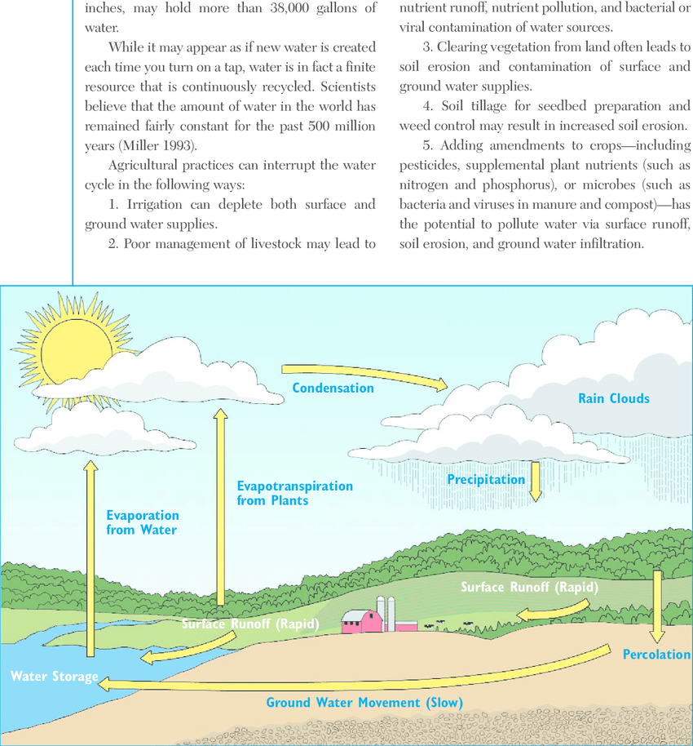
Contd….
Figure : Simplified model of water cycle

Slide 84
Effect of human activities on water cycle
Human Activities
Effects
Withdraw of large amount of fresh water from streams, lakes, and underground sources
Clearing the vegetation from land for agriculture, mining, road, building construction etc
Destroy the wet land which acts as sponge to absorb and hold overflow of water
Polluting surface and underground water with pollutants
Increased run off
Increased risk of flooding
Accelerated soil erosion and landslides
Impairment of natural ecological processes that impair water purification

Slide 85
Carbon Cycle
The carbon cycle is the biogeochemical cycle by which carbon is exchanged between the biosphere, lithosphere, hydrosphere, and atmosphere of the earth.
Carbon is required for building organic compounds
Major reservoirs of carbon interconnected by pathways of exchange: the atmosphere (CO2), fossil fuels ( oil, coal), fresh water (CO2), ocean (CO2)
Major processes through which co2 released into the atmosphere: fossil fuel burning, photosynthesis, decay of residues, plant respiration, land sea gas exchange

Slide 86
Processes of the carbon cycle
Photosynthesis: During photosynthesis, plants use co2 along with water and solar energy.
Respiration: Both autotrophs and heterotrophs use oxygen to break down carbohydrates during cellular respiration.
Decomposition: Carbon is returned to the environment through decomposers and respiration.
Combustion: When wood or fossil fuels are burned, the chemical reaction releases carbon dioxide back into the atmosphere.
Volcanic Eruptions : carbon from deep within the earth's interior is brought back to the surface during eruptions of steam, gasses
Deposition: Coal, petroleum, and calcium carbonate rock are deposited in sediment and underground.

Slide 87
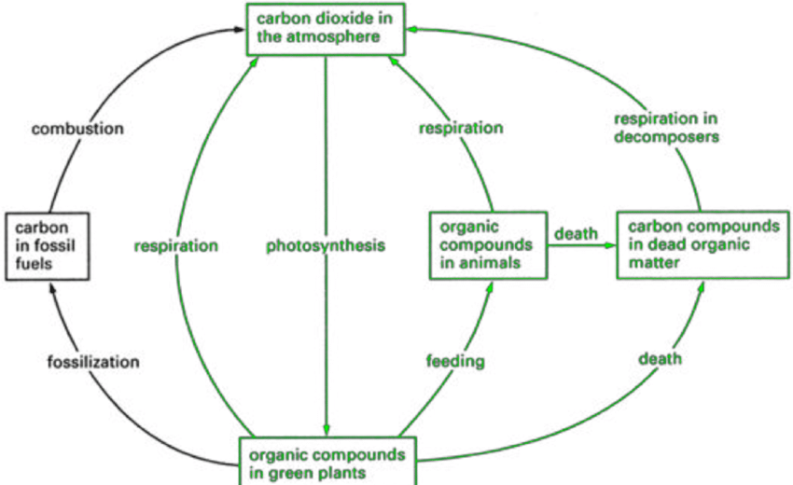
Carbon Cycle

Slide 88
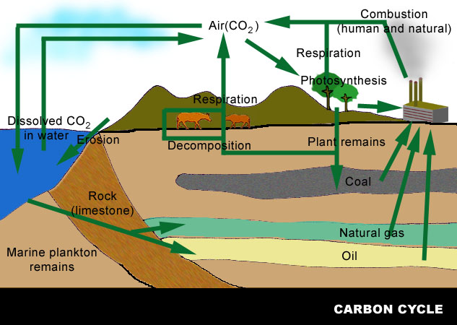
Carbon Cycle

Slide 89
Carbon Cycle…
Carbon enters the biosphere during photosynthesis:
CO₂ + H₂O (carbon dioxide+ water)--->
C₆H₁₂O₆ + O₂ + H₂O(sugar+oxygen+water)
Carbon is returned to the biosphere in cellular respiration
O₂ +H₂O + C₆H₁₂O₆ ---> CO₂ +H₂O + energy

Slide 90
Carbon Cycle
(carbon is required for building organic compounds)
1. Reservoir – atmosphere (as CO₂), fossil fuels (oil, coal), durable organic materials (for example: cellulose).
2. Assimilation – plants use CO₂ in photosynthesis; animals consume plants.
3. Release – plants and animals release CO₂ through respiration and decomposition; CO₂ is released as wood and fossil fuels are burned.

Slide 91
Effects of Human Activities on Carbon Cycle
We alter the carbon cycle by adding excess CO₂ to the atmosphere through:
  Burning fossil fuels.
  Clearing vegetation faster than it is replaced.

Slide 92
Oxygen Cycle (Photosynthesis)
The oxygen cycle is the cycle that helps move oxygen through the three main regions of the Earth, the Atmosphere, the Biosphere, and the Lithosphere
Reservoirs of oxygen:
  Atmosphere- free gases
  Biosphere- free oxygen produced from photosynthesis and life processes
  Lithospheres- chemical compound for- silicates and oxides

Slide 93
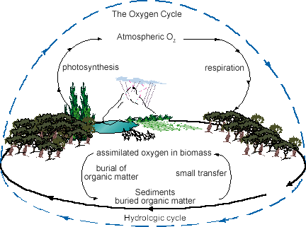
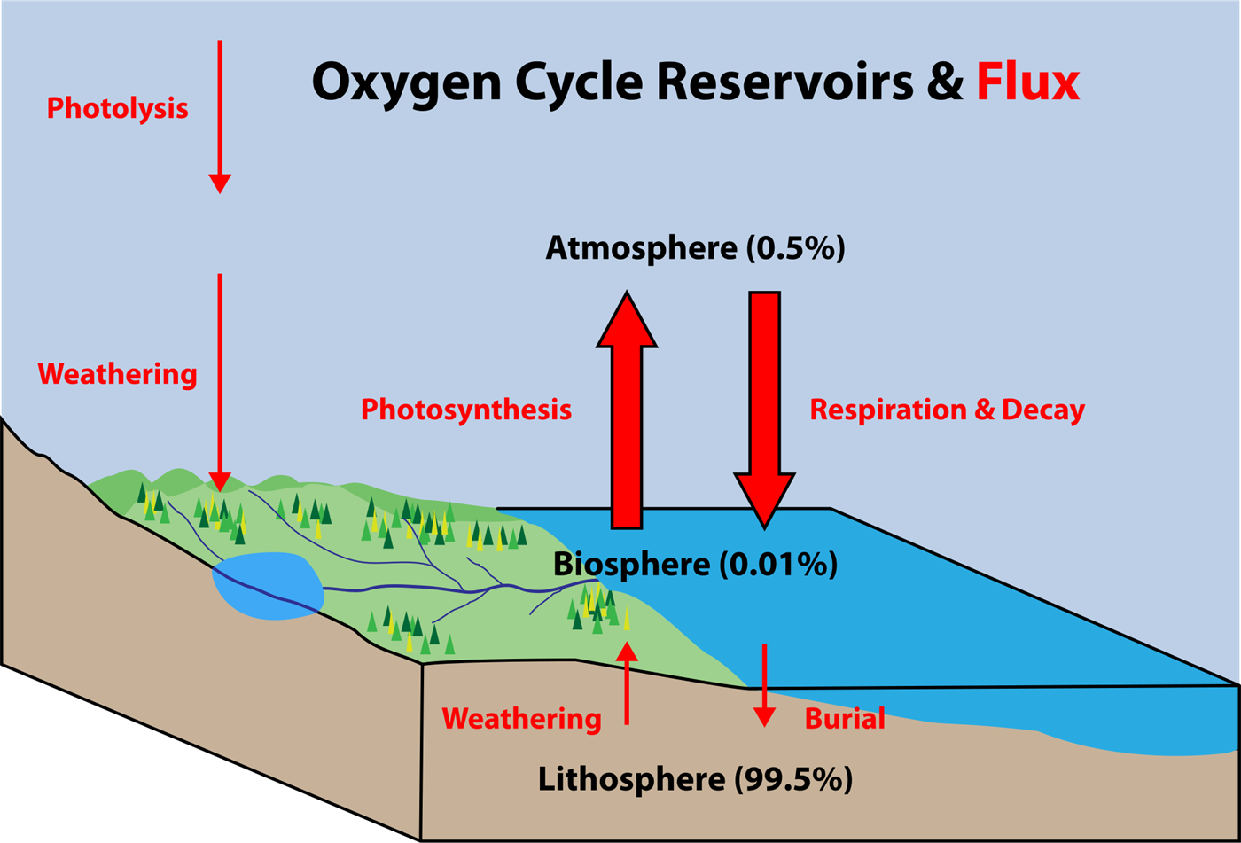
Oxygen Cycle (Photosynthesis and Respiration)

Slide 94
Oxygen Cycle Steps
Atmosphere:
Only a small percentage of the world’s oxygen is present in the atmosphere, only about 0.35 %. This exchange of gaseous oxygen happens through Photolysis.
  Photolysis: This is the process by which molecules like atmospheric water and nitrous oxide are broken down by the ultraviolet radiation coming from the sun and release free oxygen.

Slide 95
Oxygen Cycle Steps
Biosphere:
The exchange of oxygen between the living beings on the planet, between the animal kingdom and the plant kingdom.. It mainly occurs through 2 processes.
Photosynthesis:
The process by which plants make energy by taking in carbon dioxide from the atmosphere and give out oxygen
Respiration:
The process by which animals and humans take in oxygen from the atmosphere and use it to break down carbohydrates and give out carbon dioxide.

Slide 96
Oxygen Cycle Steps
Lithosphere:
The part of the planet containing most of the oxygen content through biomass, organic content and mineral deposits. This trapped oxygen (in the form of silicates and oxides) is released back due to several weathering processes. Also, animals and plants draw nutrient materials from the from the lithosphere and free some of the trapped oxygen.
Hydrosphere:
Oxygen dissolved in water is responsible for the sustenance of the aquatic ecosystem present beneath the surface. The hydrosphere has oxygen present mainly as a component of water molecules , carbonic acids and free oxygen.

Slide 97
Nitrogen Cycle
Most nitrogen is found in the atmosphere (78%) as N₂, and most living things cannot use it.
All organisms need nitrogen as an important nutrient, to make proteins and nucleic acids.
All organisms rely on the actions of bacteria that are able to transform nitrogen gas into a usable form.
Nitrogen-fixing bacteria play a key role in the nitrogen cycle.
They live in the soil and in the roots of some kinds of plants, such as beans, peas, etc

Slide 98
Sources of Nitrogen
Inorganic fertilizers
Nitrogen Fixation
Animal Residues
Crop residues
Organic fertilizers

Slide 99
Forms of Nitrogen
Urea → CO(NH2)2
Ammonia → NH3 (gaseous)
Ammonium → NH4⁺
Nitrate → NO3 ⁻
Nitrite → NO2 ⁻
Atmospheric nitrogen →N2

Slide 100
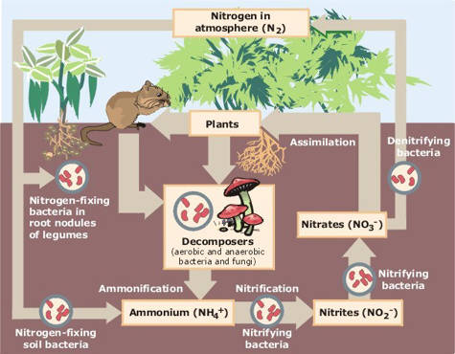
NITROGEN CYCLE
The nitrogen cycle is the process by which nitrogen is converted into various chemical forms of nitrogen
The nitrogen cycle consist of several major steps.
  Nitrogen fixation
  Nitrification
  Ammonification
  Denitrification

Slide 101
NITROGEN CYCLE
  Nitrogen fixation- specialized bacteria in soil and water convert (or fix) gaseous nitrogen (N2) to ammonia (NH3) that can be used by plants.
  Nitrification- Ammonia not taken up by plants may undergo nitrification. In this two step process, specialized soil bacteria convert most of the ammonia in soil first to toxic nitrite ions (NO2⁻) and then to nitrate ions (NO3⁻) which is the easily taken up by plants.
  Animals in turn get their nitrogen by eating plants or plant eating animals.
  Plants and animals return nitrogen rich organic compounds to the environment as wastes, cast – off particles and dead bodies.

Slide 102
NITROGEN CYCLE
Ammonification-Decomposers return the nitrogen from the remains of dead plants and animals back to the soil. Vast armies of specialized decomposer bacteria convert this waste into simpler nitrogen- containing inorganic compounds such as ammonia (NH3) and water-soluble salts containing ammonium ions (NH4⁺ ).
  Denitrification- In denitrification, nitrogen leaves the soil as specialized bacteria in wet soil and in the bottom sediments of lakes, oceans, wetlands convert ammonia (NH3) and ammonium ions (NH4⁺ ) into nitrogen gas (N2) and nitrous oxide gas (N20).
  These gases are released to the atmosphere to begin the nitrogen cycle again.
  Autotrophs (plants) are therefore dependent on nitrogen-fixing bacteria, and all other organisms are dependent on autotrophs

Slide 103
Nitrogen Cycle (Contd…)
1. Reservoir – atmosphere (as N₂); soil (as NH₄⁺ or ammonium, NH₃ or ammonia, N0₂⁻ or nitrite, N0₃⁻ or nitrate
2. Assimilation – plants absorb nitrogen as either NH₄⁺ or as N0₃⁻, animals obtain nitrogen by eating plants and other animals.
3. Release – Denitrifying bacteria convert N0₃⁻ back to N₂; bacteria convert organic compounds back to NH₄⁺ ; animals excrete NH₄⁺, urea, or uric acid.

Slide 104
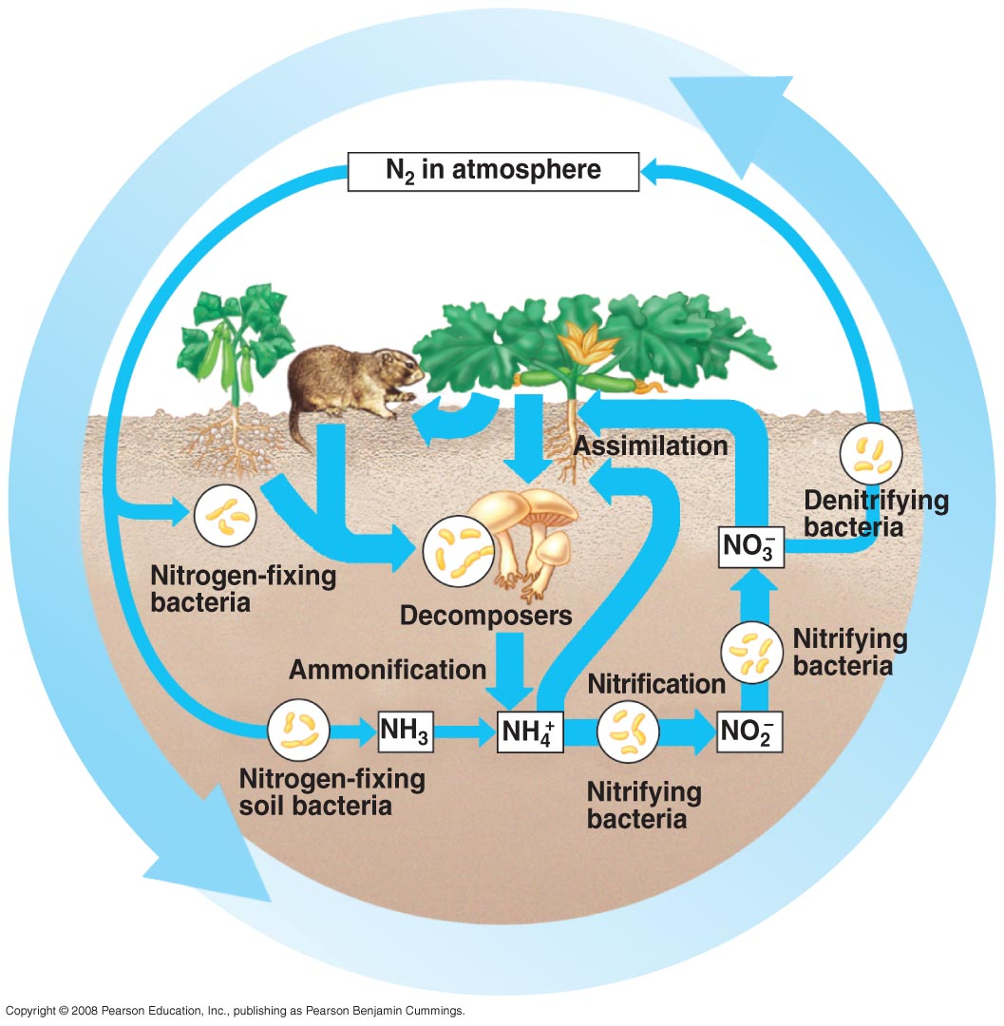
Processes of the Nitrogen Cycle:

Slide 105
Effects of Human Activities on the Nitrogen Cycle
We alter the nitrogen cycle by adding large amount of nitrogen containing compounds to the earth’s air and water and remove nitrogen from the soil
  Adding large amount of nitric oxide (NO) by burning fuels as N2 and 02 combine at high temperature. This gas will converted into nitrogen dioxide gas (NO2) and nitric acid (HNO3) which return to earth as acid rain.
  Adding nitrous oxide (N2O) to the atmosphere through farming practices because of the livestock wastes and commercial inorganic fertilizers which can warm the atmosphere and deplete ozone.
  Nitrate ions (NO3⁻) in inorganic fertilizers leach through the soil and destroy aquatic ecosystem
  Releasing large amount of nitrogen stored in soil and plants into the atmosphere through deforestation.

Slide 106
Phosphorous Cycle
Phosphorous is an essential nutrient of both plants and animals. It is part of DNA molecules which carry genetic information. It is part of ATP and ADP that store chemical energy for use by organisms in cellular respiration. Phosphorous forms phospholipids in cell membranes of plants and animal cells. It also forms bones, teeth, and shells of animals as calcium phosphate compounds.

Slide 107
Phosphorus Cycle
The phosphorus cycle, is the circulation of phosphorous among the rocks, soils, water, and plants and animals of the earth.
Unlike in other cycles, phosphorous is not found in atmosphere in gaseous state.
In nature, most phosphorus occurs in phosphate rock, which contains phosphate ions combined with calcium, magnesium, chlorine, and fluorine. Phosphorous and phosphorous compounds are in solid form at earth at normal temperature.

Slide 108
Contd…..
The source of Phosphorus (P) is rock. As water runs over phosphorus containing rocks, it slowly erodes away inorganic compounds that contain phosphate ions.
Phosphorus is soluble in H2O as phosphate (PO4) ion.
Phosphorus is taken up by plant roots, then travels through food chains.
It is returned to sediment. The phosphorous carried to the sea by streams and rivers may be trapped there for millions of years also.

Slide 109
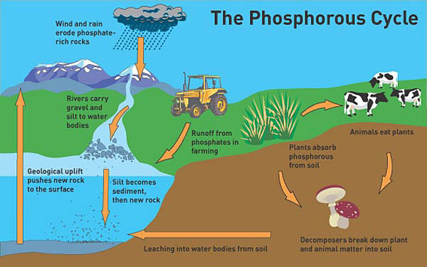
Phosphorus Cycle

Slide 110
Phosphorus Cycle
Reservoir – erosion transfers phosphorus to water and soil; sediments and rocks that accumulate on ocean floors return to the surface as a result of uplifting by geological processes
Assimilation – plants absorb inorganic PO₄³⁻ (phosphate) from soils; animals obtain organic phosphorus when they plants and other animals
Release – plants and animals release phosphorus when they decompose; animals excrete phosphorus in their waste products

Slide 111
Effects of human activities on the phosphorous cycle
Removal of large amounts of phosphate rocks from the earth to make fertilizer.
Reduction of phosphorous in tropical soils by clearing forests.
adding excess phosphates to aquatic systems from runoff of animal wastes and fertilizers.

Slide 112
Concept of ecosystem services
Ecosystem services
The benefits people derive from ecosystems
The many and varied benefits that humans freely gain from the natural environment and from properly-functioning ecosystems.
These ecosystems functioning properly provides such things like agricultural products, timber, and aquatic organisms such as fishes and crabs. Collectively, these benefits are becoming known as 'ecosystem service

Slide 113
Concept of ecosystem services
Therefore, ecosystem services are grouped into four broad categories:
Provisioning services
Regulating services
Cultural services
Supportive services

Slide 114
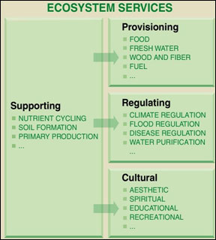
Ecosystem services

Slide 115
Concept of ecosystem services
Provisioning services
food, crops, wild foods,
raw materials (including skins, fuel wood, organic matter, fodder, and fertilizer)
genetic resources (including crop improvement genes, and health care)
water
medicinal resources
energy (hydropower, biomass fuels)
ornamental resources (including fashion, handicraft, jewelry, pets, worship, decoration and souvenirs like furs, feathers, ivory, orchids, butterflies, aquarium fish, shells, etc.)

Slide 116
Concept of ecosystem services
Regulating services
climate regulation
Predation regulates prey populations
Waste decomposition and detoxification
Purification of water and air
pest and disease control

Slide 117
Concept of ecosystem services
Cultural services
cultural (including use of nature as theme in books, film, painting, folklore, national symbols, architect, advertising, etc.)
spiritual and historical (including use of nature for religious or heritage value or natural)
recreational experiences (including ecotourism, outdoor sports, and recreation)
science and education (including use of natural systems for school excursions, and scientific discovery)

Slide 118
Concept of ecosystem services
Supportive services
nutrient recycling,
primary production,
soil formation,
habitat provision and pollination.
These services make it possible for the ecosystems to continue providing services such as food supply, flood regulation, and water purification.

Slide 119
Concept of payment for ecosystem services (PES)
Ecosystems provide a wide range of direct and indirect services to society.
Payment for ecosystem services (PES) has received global attention to provide incentives for local actors for sustained supply of ecosystem services and adoption of sustainable management practices.
It is also seen as an instrument for promoting conservation and addressing rural poverty

Slide 120
Concept of payment for ecosystem services (PES)
PES is a method of internalizing the positive externalities associated with a given ecosystem.
PES operates according to the logic of the ‘free market,’ which says that if ecosystem services are given economic values and assigned property rights, the rational behavior of buyers and sellers in the market environment will produce efficient ecosystem outcomes (Engel et al. 2008, Wunder 2005).
The provider, often a resource manager, of a service is paid to maintain or enhance that service.

Slide 121
Concept of payment for ecosystem services (PES)
PES is an innovative market-based mechanism, which stands on twin principles: those who benefit from environmental services should pay to those who provide environmental services (World Bank, 2007).
"a mechanism of providing an economic incentive from benefit recipients to those who provide services to ensure sustained supply of services“
PES involves transfer of financial resources from beneficiaries of certain environmental services to those who provide these services.

Slide 122
Concept of payment for ecosystem services (PES)
Sharing of protected area income between park owner and local communities is one of the examples of PES like mechanism.
Income received from protected area in terms of entry free and its utilization for conservation and management of protected area or hunting and PES policy, operational guideline along with appropriate institutional mechanism should be developed and strengthened license fee obtained from game hunting are some form of PES practices, which are operational in protected area of Nepal

Slide 123
References
Rana, SVS. Essentials of Ecology and Environmental Science, Third edition
Miller, G. Environmental Science, Eleventh edition (Indian edition)
Miller,G & Spoolman, S. Living in the environment- concept, connections and solutions, 16th edition (online book)
Jnawali, K. Lecture notes
Various internet websites and learning materials

Slide 124
THANK YOU

