Slide 1
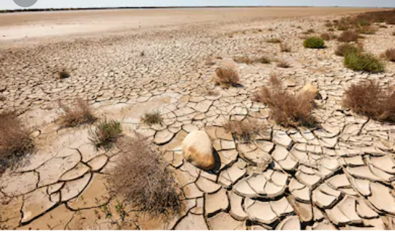
DESERTIFICATION
Amita Bhattrai (Joshi)
1ST Year, 2nd SEM
Roll No 7

Slide 2
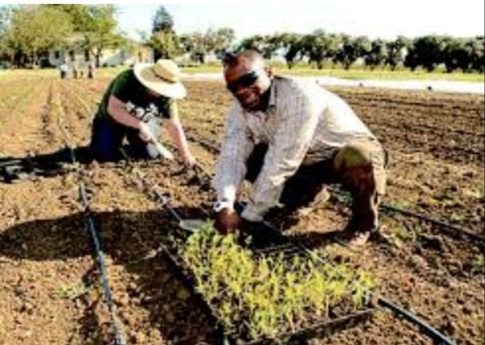
DEFINATION
It is a process by which fertile land becomes desert , typically as a result of drought ,deforestation , or inappropriate agriculture.

Slide 3
CAUSES OF DESERTIFICATION
1.Natural causes
Climate change
Drought
Moisture loss on a global level
2. Human activities
Overgrazing
Deforestation
Overpopulation
Over cultivation

Slide 4
CAUSES
Overgrazing
Deforestation
Farming practices
Urbanization and other types of land development
Climate change
Natural disaster

Slide 5
EFFECTS
Farming becomes next to impossible
Hunger
Flooding
Poor water quality
Poverty
Soil erosion
Adverse effects on human life.

Slide 6
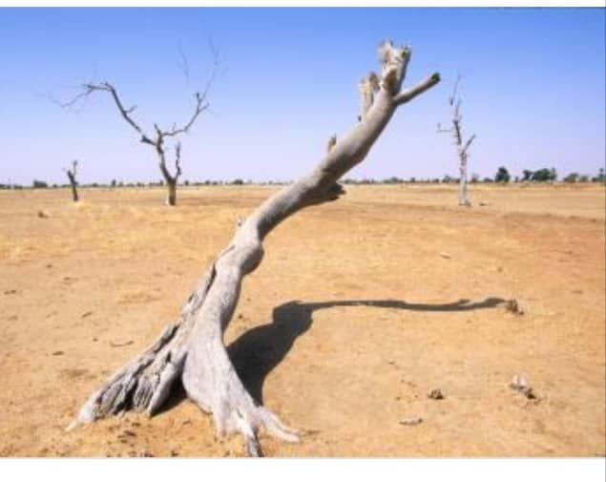
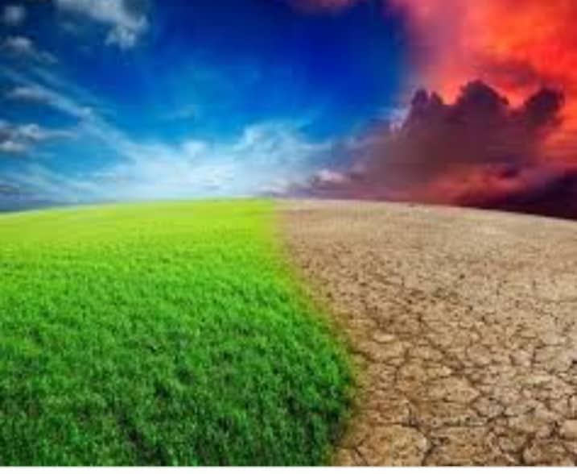

Slide 7
GLOBAL SCENARIO
According to the UNEP (United Nation Environment Program)(1997) about 5172 million ha(M ha) area of the world (39.7% of the worlds land area) is under the drylands , and is susceptible to desertification.
This excludes 978 million ha area of the hyper-arid zone (7.5%)
The Sonoran desert of northwestern Mexico, and its continuation in the desert basins of the southwestern united states.
The deserts are confined mostly to the five major belts.
Most of the continent of Australia.
In Asia, out of the 19.49 million km2 area under drylands, an estimated 10.75 millions km2 (excluding the hyper-arid areas) is susceptible to desertification.

Slide 8
FACTORS AFFECTING DESERTIFICATION
Desertification involves interplay of climatic, edaphic , and biotic factors.
Climatic changes ,human and livestock population pressure, socio-economic conditions modify the process.

Slide 9
FOURS STATES OF DESERTIFICATION
1.None to slight- with the biological production largely intact;
2.moderate-loss of production up to 25% of that expected;
3.severe-loss of production between 25% and 50% of that expected and
4.Very severe-loss of production more than 50% of that expected (UNEP,1997) have been identified.

Slide 10
MEASURES TO PREVENT( REDUCE DESERTIFICATION
Policy changes related to how people can farm
Policy changes to other types of land
Education
Technology advancement
Sustainable practices to prevent desertification from happening

Slide 11
REFERENCE
https://helpsavenature.com/causes-and-effects-of-desertification/
Google

Slide 12


