Slide 1
DROUGHT
NAME : Ashmita Adhikari
ROLL NO: 6
SUBJECT : Environmental Science

Slide 2
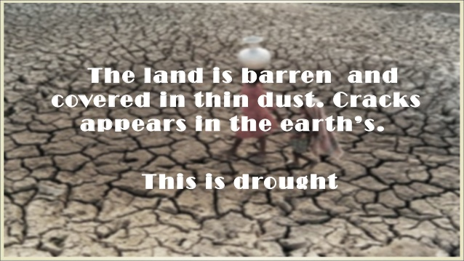

Slide 3
CONTENT OF THE PRESENTATION
INTRODUCTION
TYPES OF DROUGHT
RELATIONSHIP BETWEEN DROUGHT AND CLIMATE CHANGE
CAUSES OF DROUGHT
IMPACT OF DROUGHT
WATER RESOURCES MANAGEMENT IN DROUGHT
DROUGHT IN NEPAL
CONCLUSION

Slide 4
INTRODUCTION
Drought is a period of drier-than-normal conditions that lead to water-related problems.
A drought can last for months or years, or may be declared after as few as 15 days.
Drought is a deficit of water that results when the soil moisture is not enough to meet the demands of potential evaporation.

Slide 5
TYPES OF DROUGHT
1) Meteorological:- Meteorological drought is brought about when there is a prolonged time with less than average precipitation.
2) Agricultural :-It is drought occurs when there is not enough water available for a particular crop to grow at particular time.
It doesn't depend only on the amount of rainfall but also on the correct use of water.
It affect crop production.

Slide 6
3)Hydrological:- drought is brought about when the water reserves available in sources such as aquifers, lakes and reservoirs fall below the statistical average.
It is associated with the effects of periods of precipitation shortfall on surface and sub surface water supply rather then with precipitation shortfall.
4) Socioeconomic :- it is associates the supply and demand of sum economics good or service with element Hydrological, Meteorological, Agricultural.

Slide 7
The most common type of disaster in particularly Africa and South Africa in general is drought. It is also the most dangerous and severe natural disaster. Majority of rural dwellers and farmers, their living depend entirely on rain fed agriculture. Sub- Saharan Africa is the most vulnerable region to the impact of climate change. The severity of impact of climate change in Africa is widely captured among different studies . Drought is climate change induced. Climate change is caused by external and internal forces. External forces occur as a result of human actions. The well known cause of climate change is warming of the earth which is worsening by the release of greenhouse gases (GHG) into the atmosphere. The following Figure 1 shows the relationship between climate change variability and drought.

Slide 8
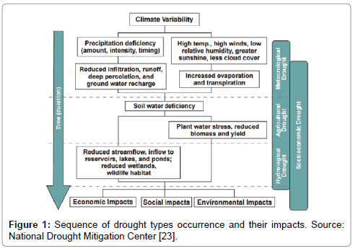

Slide 9
CAUSES OF DROUGHT
Droughts are the resultant of acute water shortage due to lack of rains over extended periods of time affecting various human activities and lead to problems like
    widespread crop failure,
    un-replenished ground water resources,
    depletion in lakes/ reservoirs water,
    shortage of drinking water
    reduced fodder availability etc.

Slide 10
IMPACT OF DROUGHT
seasonal food deficit,
death of certain rare plants,
disappearance of rare animals
large-scale migration

Slide 11
WATER RESOURCES MANAGEMENT IN
DROUGHT

Slide 12
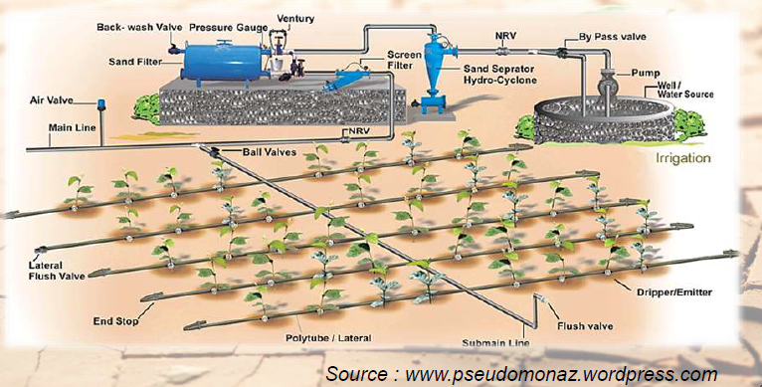
1. Better irrigation practices
Micro Irrigation System
- Drip Irrigation & Sprinkler Irrigation

Slide 13
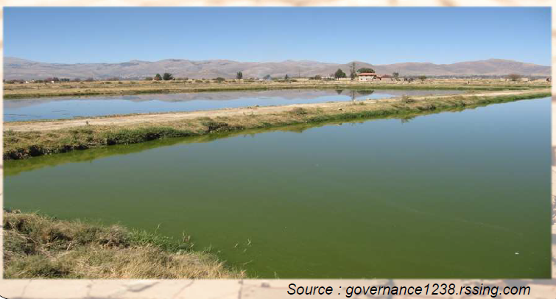
Farm Ponds:
About 11-37 % run-off is generated even by the delayed monsoon and should be stored in the farm ponds.
These will recharge ground water during normal or excessive rainfall year.

Slide 14
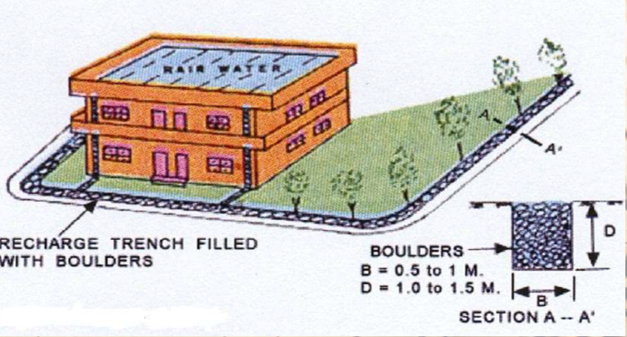
2. Ground Water harvesting and conservation structures

Slide 15
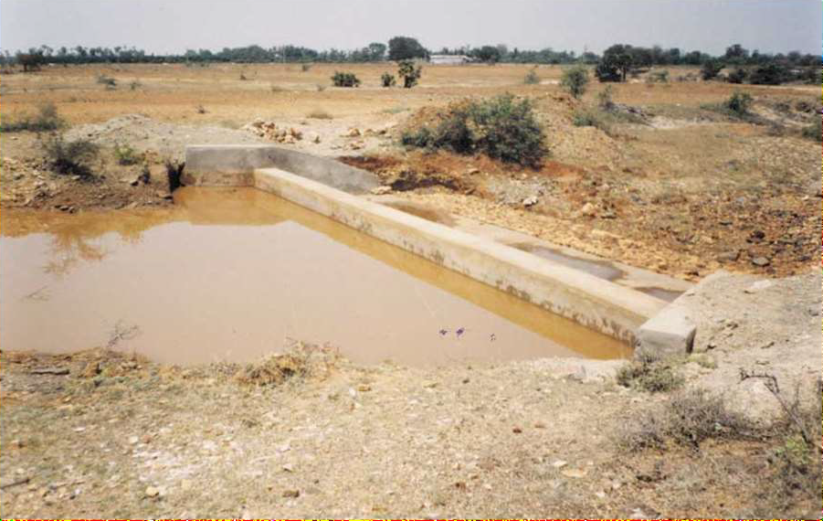
Check Dams

Slide 16
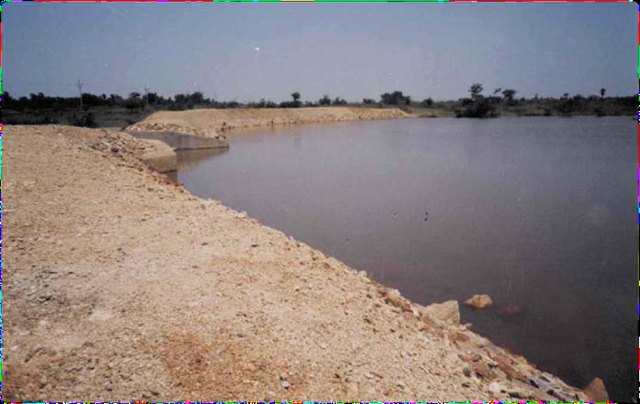
Percolation Tanks

Slide 17
3. INDIRECT WATER CONSERVATION METOHDS
These aim at augmenting soil moisture retention and preventing soil erosion and land degradation. These are :

Slide 18
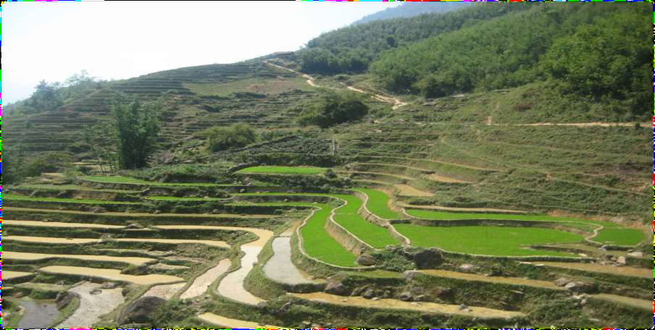
Contour Bunding

Slide 19
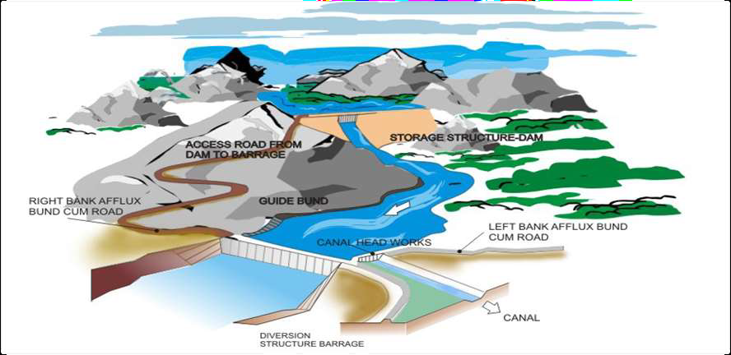
4. Surface Water management
Reservoirs
Inter basin water transfer ( Interlinking of Rivers )

Slide 20
DROUGHT IN NEPAL
The Standardized Precipitation Index (SPI) designed by McKee et al. (1993) is used to quantify drought in central Nepal. SPI is widely used around the world for drought forecasting, frequency analysis, spatio-temporal analysis and climate impact studies (Mishra and Singh 2010). SPI is also recommended as a meteorological drought index by the World Meteorological Organization (Hayes et al. 2011). In this study, the SPI was calculated on 3-, 4- and 12-month time scales, which correspond to the past 3, 4, 12 months of observed precipitation totals, respectively. SPI calculated for September on 4-month time scale is used to analyze monsoon drought, and SPI calculated for February on 3-month time scale is used to analyze winter drought over central Nepal.

Slide 21
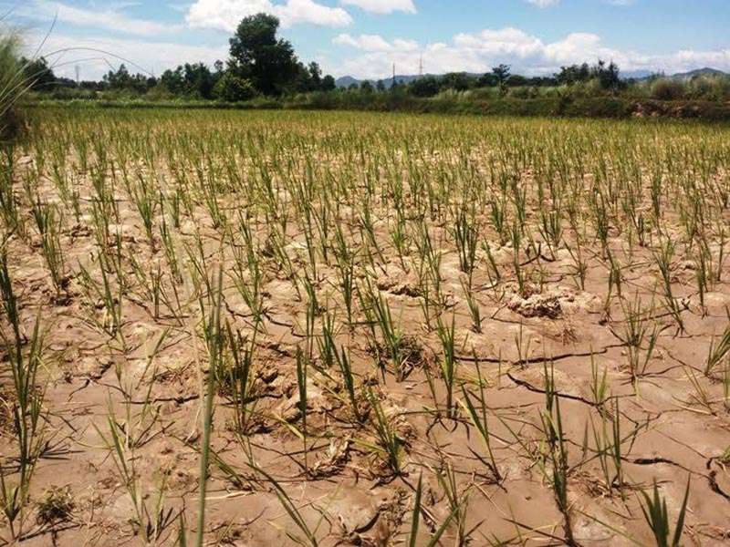
A view of a paddy field that developed cracks due to lack of irrigation, in Siraha, on Wednesday, July 19, 2017.

Slide 22
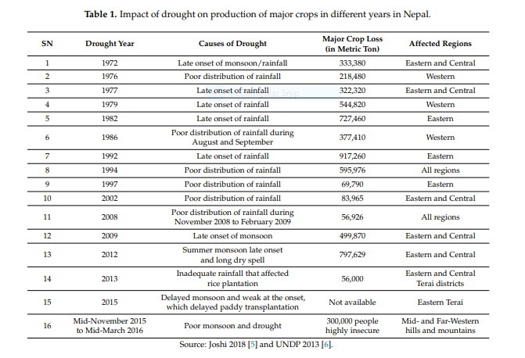

Slide 23
CONCLUSION
Depending upon the situation of the area there should be Integrated management proceeded for its effective mitigation approach.
Every household and community has to become involved in the provision of water and in the protection of water resources.

Slide 24
REFERENCE
Journal of Earth Science & Climatic Change
www.pseudomonaz.wordpress.com
Governance1238.rssing.com
National drought mitigating centre
UNDP

Slide 25


