Slide 1
Demography
Bimala Bhatta
School of Health and Allied Sciences
Pokhara University

Slide 2
DEMOGRAPHY BPH
DEMOGRAPHY
1. Concept and definition
Demography is the branch of social sciences concerned with the study of human populations, their structure and change (through births, deaths, and migration), and their relationship with the natural environment and with social and economic change. Demographic indicators could include population size, population growth rate, crude birth rate, crude death rate, total fertility rate, life expectancy and infant mortality. As well, it would include estimated and projected gender and age distributions according to medium, high, low and constant fertility variants. In short, demographic changes affect all areas of human activity: economic, social, cultural and political.
Study of human population can be categorized into two terms
Population studies
Demography:
Population studies simply study of population variables and also study the relationship between population changes and other variables such as social, economic, political , biological, geographical etc.
Demography Derived from Greek word
Meaning
Demo Graphy
: people
: science
So demography is the science of people or it is defined as the study of characteristics of human population or it is a collective study of mankind. Study of the components of population variation and change. So Demography is broadly defined as – scientific study of characteristics and dynamics pertaining to the human population.
It encompasses the study of the size, structure, distribution and composition of human populations and how populations change over time due to births, deaths, migration and aging. It can be related to the education, nationality, religion, and ethnicity. It is also regarded as a branch of either economics or sociology. So population studies and demography are interchangeable to

Slide 3
DEMOGRAPHY BPH
each other.A theory of population is an explanation of the phenomenon of population growth. It tries to explain the rise and fall, the growth and decrease of population in different countries.
Demography can be divided into two parts:
-Static Demography
-Dynamic Demography
STATIC DEMOGRAPHY: it is concerned with the characteristic of the population at a fixed time. e.g. census.
DYNAMIC DEMOGRAPHY: it is concerned with the changing nature of the population e.g.
vital events like birth, death, migration etc.
The value of the study of demography is clear from the scope of this important field of study.
Since the scope is constantly increasing, therefore, it shows the growing recognition of its importance. Demography helps in the understanding of population problems particularly of the less developed regions of the world. It also helps in planning the population of developed and undeveloped countries. International agencies are publishing data in this connection from time to time. The importance of demographical studies is clarified by the observation of the implications of rapid population growth. The chief problem concerning population in a country is to control population growth in correlation with the growth of health amenities, food supplies employment, education and housing. Demographical studies point out the conditions and requirements in these areas so that future development and growth may be planned accordingly. In brief, the following points may be noted about the importance of demography:
Health planning
Planning of Food Supply
Employment Planning
Educational Planning
Housing Planning
Political advantages
Economic advantages
Social advantages
Advantages of administration
Types of Demography

Slide 4
DEMOGRAPHBPH
Geneology – individual ancestries
Human Eugencies- Heredity
Population studies- study of population, social, physical, economic, education etc
Biometrics- anthropometric studies
Statistical pathology-study of disease and their relation
Vital Statistics-registration of vital events like birth, death, marriage and migration

Slide 5
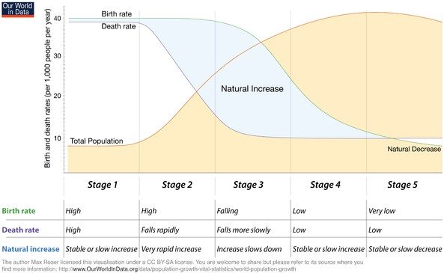
DEMOGRAPHY BPH
2. Theories
Demographic Transition Theory
The increase in population size of a particular area or country is called the population growth. Demographic transition is such process in which countries move from condition of high
mortality and fertility with slow growth rate to condition of low mortality and fertility and result to a condition of balanced population.
The demographic transition theory is based on the actual demographic experience of western (developed) counties, which have moved from a condition of high fertility and high mortality to low fertility and low mortality levels. It also provides a tool to study the relationship between demographic process and socio economic development .C.P. Blacker (1947) had identified the five phases of demographic transition.
Population Transition Phases

Slide 6
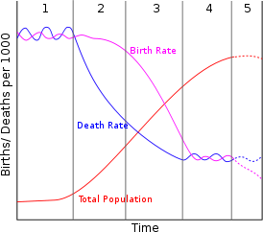
DEMOGRAPHY BPH
Fig: C.P. Blacker‟s Stages of Population Growth
High Stationary Stage
High birth & death rates, moderately high population growth, primitive health and medical conditions, low life expectancy rate, very poor standard of living, least developed countries
(LLDCs).
Reasons
Agriculture depended countries so fertility is high (agrarian )
Death was high due to famine, epidemics, lack of medicine
Under developing Countries like Nigeria, Tanzania, Ethiopia fall under this stage.
Early Expanding Stage
High birth rate, death rate drops dramatically, improved medical conditions, largely agricultural
and rural population, large families, explosive population growth, less developed countries (LDCs).
Reasons
Nation provides better public health and medical services, education ,awareness etc.

Slide 7
DEMOGRAPHYBPH
Starts urbanization and industrialization modernization in agriculture,
So birth rates remains high but death starts to decrease.
Nepal, Pakistan, India, Bangladesh etc (Developing countries)
Late Expanding Stage
Birth rate drops in response to high growth of stage 2, death rate continues to drop slowly,
improved standard of living & change in societal values, birth control improved, women join the labour force, more urban nation (less rural), more manufacturing & industry, smaller families, total population growth is moderate and lowering.
Reasons
Nation provides better public health and medical services, education ,awareness etc. Starts urbanization and industrialization modernization in agriculture.
Nepal, Pakistan, India, Bangladesh etc (Developing countries)
Low stationary state (Zero Growth):
Low birth & death rates, good medical & health conditions, long life expectancy, high standard of living, little population growth occurs-approaching zero population growth rate, more developed countries (MDCs).
Reasons
Both fertility and mortality decreases
So population again becomes stationary because of low growth rate
Fertility is lower than the mortality in some where.
Highly industrialized and increased per capita income
Modern health facilities, greater social and economic change
Declining Stage
Characterized by deaths exceeding births ( low death and low birth rate)
Beginning from stage II and III indicates the population explosion stage where the gap between birth rate and death rate are wide. Blacker has not given any substantive explanation as to why such changes took place.
Earlier to Blacker , in 1945Notestien described three stages of Demographic Transition. He pointed out that the increase in population growth was mainly due to the decline in the death rate,

Slide 8
DEMOGRAPHY BPH
resulting from the modernization, better medical knowledge and improved sanitation. These were also the causes for fertility decline but there was some time lag as fertility decline was not spectacular in the beginning.
The process of demographic transition as experienced by the developed countries may be summarized as follows: “All nation in the modern era, which have moved from a traditional agrarian based economic system to a largely, urbanized base, have also moved from a condition of high mortality and fertility to low mortality and fertility.”
Criticism
It is the experiences of western population changes so it is responsible only to the developed countries but not developing countries because most of the third world countries are basically
agrarian. Secondly it does not fulfill the criteria of theory so it may not be theory.
According to theory, reduction of birth rate is a by-product of industrialization and
modernization but the countries launch the family planning program to reduce the fertility for reducing poverty and increasing living standard living.
Furthermore it took European countries 150 to 200 years to reduce their death rate below 15 but this is being done by some developing countries now in 15 to 20 years. What is happening in the developing countries is not a “Transition”. It is, as Kingsley Davis has said , an “explosion”.
Demographic Transition Theory
In both condition the population growth is slow. The population transition is called population cycle or revolutions. It is an outstanding theory in the population study.
Old balance: population remains stationary (growth rate is low) even though birth rates and death rates were high.
New balance: population again remains stationary (growth rate is low) when birth rates and death rates both are very low.
Phases of Demographic Transition
1. Pre transitional stage (first stage) or
-High stationary stage

Slide 9
DEMOGRAPHY BPH
Transitional stage (second stage) or
-Early expanding stage
-Late expanding stage
Post transitional stage (third stage) or
-Low stationary state
-Declining stage
Pre transitional stage
Population growth is almost stationary. Both fertility and mortality rate are very high. Agriculture depended countries so fertility is high. Death was high due to famine, epidemics,
lack of medicine. Fertility is more than 35 per1000 and death is 30 per 1000. Countries like Nigeria, Tanzania, Ethiopia fall under this stage. (Under developing )
Transitional Stage
Both birth and death rate are decreasing. But death rate is decreasing more as compared to the
birth rate. So population increases rapidly. Nation provides better public health and medical services, education, awareness etc. Starts urbanization and industrialization modernization are started in agriculture. Nepal, Pakistan, India, Bangladesh etc (Developing countries)
Post transitional Stage
Both fertility and mortality are decreased. So population again becomes stationary because of
low growth rate. Fertility is lower than the mortality in somewhere. Industrialization increases and increased per capita income. Modern health facilities, greater social and economic change were done. Example: Britain, Australia, USA, Germany, France etc (Developed Countries)
Malthusians Theory
Thomas Robert Malthus was born in United Kingdom on 1766. He published “An essay on the Principles of Population” in 1798.The most well known theory of population is the Malthusian
theory. The important work of Malthus is a landmark in the history of population studies and has became one of the most famous and, at the same time one of the most controversial books of
modern times. For many years to come, all views on population were classified as pre Malthusian, Malthusian, anti-Malthusian and neo-Malthusian.

Slide 10
DEMOGRAPHY BPH
Features of Malthusian Theory
Fecundity of human beings is constant and permanent
There is direct relationship between level of life and population growth
Human beings have great potentialities to produce children
In agriculture, law of diminishing returns operates
Human beings will need food grains to survive
Passion between sexes is necessary and unavoidable
Population increases rapidly than food grains
Human beings have natural and instinct sexual desire
Major Postulates of Malthusian Theory of Population
Rapidness of Population growth: geometrically increased
Slow increase in food production: Arithmetically increased (Law of diminishing returns)
Imbalance between population and food production
Measures to control Imbalance
Positive checks: Famine, Flood, War, Earthquake, Diseases and epidemics, Misery Preventive Checks: Delayed Marriage, Celibacy, Moral restraints
Neo- Malthusians Theory
Neo-Malthusian is term used to describe the general view of Thomas Malthus‟s theory on Population and resources. Neo-Malthusians on population growth and control, the neo- Malthusian theorists may be presented as a group of comments essentially which agree with
Malthus that control of population is inevitable. However they disagree with Malthus that factors like war and famine are the key to population control and reject such notions. Instead they
promote a number of ideals for planned parenthood as a method of population control. Mustapha, Nasser (2006). A group of modern economists who hold the Malthusian doctrines that permanent
betterment of the general standard of living is impossible without limitation of the number of births. Neo-Malthusian was originally used to mean population limitation by birth control/or
abortion. A Malthusian check was originally foreseen to be a forced return to subsistence level conditions.

Slide 11
DEMOGRAPHY BPH
According to neo- Malthusian, the population can be controlled by artificial family planning and even by abortion. Such type of methods was not mentioned in the Malthusian theory. The present economists, doctors, politicians also support the neo- Malthusian theory .
According to neo- Malthusian, this increase in fertility will lead to hyper-exponential population growth that will eventually outstrip growth in economic production. This appears to make any sort of voluntary fertility control in the long run.
Cornucopian
The opposite of the Malthusian school of thought is termed as Cornucopian thought. The term
has come from the cornucopia, the mythical “horn of Plenty” of the Greek mythology which supplied its owners with endless food and drink magically. The cornucopians are sometimes known as “Boomsters” , and their philosophic opponents- Malthus and his school – are called “Doomsters.”
A cornucopian is someone who believes that continued progress and provision of material items for mankind can be met by advance technology. Fundamentally there is enough matter and energy on the Earth to provide plenty for the estimated peak population of about 9 billion in 2050. However, this must also mean that there is enough for the current world population but starvation and fuel poverty have not been eradicated, suggesting that the problem is not a lack of resources but the distribution of said resources by the current economic and political system.
A cornucopian is someone who posits that there are few intractable natural limits to growth and believes the world can provide a practically limitless abundance of natural resources. The term
„cornucopian‟ is sometimes used derogatorily, specially by those who are skeptical of the views that technology can solve or overcome the problem of an exponentially increasing human population living off a finite base of natural resources.
In practice, the cornucopian view relies upon the economic law of supply and demand which has
the following implication. As long as the price of a good is free to adjust all consumers who wish to purchase the good at the going price are able to do so. Resources don not rum out the simply become more expansive

Slide 12
DEMOGRAPHY BPH
In the peak oil debate, cornucopian posit that rising prices make oil deposits which were previously considered too expansive to extract and produce become profitable, and also spurs the development of alternative fuels. Peak oil critics of the Cornucopian view stress that liquid petroleum is a finite resource and production cannot be increased above a set amount no matter how much demand increases, because a Hubbert‟s Peak. They also urge that alternative energy cannot simply be plugged , since they lack the fungibility and energy , density of liquid hydrocarbon fuels.
Cornucopian versus New Malthusian perspectives
Some people think that our supply of resources is basically infinite. They argue that we could exploit outer space, or use as resources things that we can't imagine now. For example, they cite the fact that when humans first struck oil, they had no idea how useful it could be. They point out that, in the past, every time we have feared that we are about to run out of something, we have found more of it, or have found a substitute, and that that will continue. Thus, we can continue infinitely to support an infinitely growing population, in part because people are our ultimate resource -- resources are inexhaustible, owing at least in part to the infinite capacity of humans to think and thus to make substitutions of one resource for another.
Julian Simon, a noted econimist, claimed in 1994, "We now have in our hands - in our libraries really - the technology to feed, clothe, and supply energy to an ever-growing population for the next 7 billion years." (N. Myers and J. Simon. 1994. Scarcity or Abundance: A Debate on the Environment. WW Norton, NY, pg 65). What optimism! (You can read a bit of Simon if you'd like check out the supplementary reading list for this point in the course.)
Calculations by Paul and Anne Ehrlich (see their "Betrayal of Science and Reason" on the supplementary reading list) indicated that it would take only 774 years for the 1994 population of 5.6 billion to increase to the point where there were 10 human beings for each square meter of ice free land on the planet! (The calculation assumes the 1994 rate of natural increase ("r") for the population.) After 1900 years at the 1994 rate of growth, the mass of the human population would equal the mass of Earth, and after 6000 years, the mass of the human population would equal the estimated mass of the universe! Even if population rates decreased

Slide 13
DEMOGRAPHY BPH
dramatically to one millionth of their 1994 levels (a tiny, but non-zero, growth rate) the mass of humans would exceed the estimated mass of the universe before the 7 billion years was up. Clearly, Simon is quite an optimist!
This optimistic perspective is often referred to as "cornucopian," in reference to cornucopia, or the horn of plenty, a symbol of abundance dating from the ancient Greeks. Most adherents to this philosophy have roots in economics, which seems to believe that infinite growth is possible.
A contrasting perspective is termed NeoMalthusian, and it argues that limits are imposed by the
environment. This school of thought is named after the Reverend Thomas Malthus, whose essay from the mid-1800's "An Essay on the Principle of Population" argued that populations can grow faster than food production can increase, with starvation the consequence if growth isn't limited. (The same essay influenced Charles Darwin in his development of the concept of natural selection as a driving force for evolution.)
Basically, to many people (me included), it seems that even if somehow we could meet energy
and food needs, eventually the world would fill up. We would have to live stacked in huge towers, with no privacy, no nature... That is, it may be possible to feed far more people than we presently have on Earth, but is it desirable to turn Earth essentially into a giant feedlot for humans? Is it ethical to do so?
We must also remember that, as humans we depend on naturally functioning ecosystems for much more than aesthetic pleasure, we depend on intact ecosystems for accomplishing decomposition and driving nutrient cycles, maintaining the balance of gases in the atmosphere, pollinating crops, natural pest control, and much more. If those intact ecosystems were all gone, it seems obvious to me, as an ecologist that we would be too!
It is also important to remember that the current standard of living is poor for most people in
world right now. If our population doubles in the next 58 or so years (as it would at current rates), food and energy production and other necessaries of life must at least double as well just to maintain the current standard of living, which is already poor for so many. Such a doubling of production (which is minimalist in terms of life style quality) would be very difficult to do even in a rich nation like the US, and seems impossible for many lesser developed nations, less well- endowed with natural resources than the US. Further, we are already running into many environmental problems that are related to overexploitation of resources, excessive production of wastes, etc. If the population doubled, many of these problems would increase greatly as well.

Slide 14
DEMOGRAPHY BPH
The UN has projected that the world population will eventually stabilize at something between 7 and 13 billion persons, or, potentially, more than nearly double today's population. How is this possible, when even now, one person in five lives in poverty, with insufficient food, and one in ten is suffering from severe malnutrition?
Muir's perspective is that exponential growth of anything cannot continue indefinitely on a finite planet. (Some argue, of course, that we are not stuck with a finite planet!)

Slide 15
DEMOGRAPHY BPH
3. Fertility, Mortality and Migration
Fertility
There are three basic components of population change, namely, fertility, mortality and migration which is one of the main factors in determining the age structure of a population and distribution of population with respect to various characteristics. The study of fertility is complex because it is affected by host factors including biological as well as behavioral.
It is defined as child bearing performance of a couple measured in terms of actual number of
children alive. In other way it refers to the actual birth performance of a group of women i.e. number of live birth given by women. The analysis of fertility in the field of demography is of vital interest.
The proportion of a population that is young or old depends mainly on the birth rate and the
death rate. If the population has an increasing proportion of older people, it is essentially because the birth rates have fallen and not because the death rates have fallen. The interest in the study of fertility also arises because it is a quite complex phenomenon, whose mechanism is not yet fully understand. It is affected by number of socio psychological and economic variables because the biological capacity of reproduction.
The total fertility rate of Nepal is 2.1 (NDHS 2022) and CBR was 20 per thousand (NDHS 2022)
Fertility is one of the major social indicators. Fertility level is used to categorize the country as
well as society whether developed or developing. High level of fertility remains in developing countries where as low in developed countries.
Determinants of Fertility
Children are taken for economic and social factor.
Old age security
Age at marriage
Occupation
Education
Demands of children
Status of women

Slide 16
DEMOGRAPHY BPH
Religious and social values
Economic determinants
Less social awakening
High death rate
Nutrition
Family planning
The commonly used measures of fertility are given and discussed below:
Measurement of Fertility
Crude Birth Rate (CBR)
General Fertility rate (GFR)
General Marital Fertility Rate (GMFR)
Age Specific Fertility Rate (ASFR)
Total Fertility Rate(TFR)
Gross Reproduction Rate (GRR)
Net Reproduction Rate(NRR)
Crude Birth Rate (CBR)
The birth rate simply is called crude birth rate. It is defined as the ratio of number of live birth in
a year to the total number of population expressed in thousand. It is the simplest and commonest method of fertility. It is affected by age, sex, and other characteristics so it cannot be compared directly.
Formula
_{CBR =} Totalnumber of live birth ₌ B _{×1000} Totalmid year population P
CBR (Nepal, 2022) = 20/1000. It means that there were 20 live births per 1000 population.
Advantage:
It is easy to calculate and east to compare.
For short period of time it can meaningfully be used to depict the change in fertility of a population.

Slide 17
DEMOGRAPHY BPH
Disadvantage:
It is affected by age and sex structure of the population
It can feed to wrong conclusions in comparing, the populations with varying age sex structure.
It can be used for comparison after standardization process
CBR cannot taken as a probability measure because it considers the population in eh middle of the year as the persons that are exposed to the risk of giving births, which is not so.
In denominator part since not all persons of all ages are exposed to the risk of child bearing (only the women of aged 15 to 49 years are exposed to the child bearing).
Trend of CBR for Nepal from different censuses and sample survey for comparison
Year | CBR
1961(Census) | 44.6
1971(Census) | 42.8
1981(Census) | 44.0
1991(Census) | 41.6
2001(Census) | 33.0
NDHS 2006 | 28.6
NDHS 2011 | 24.3
NDHS 2016 | 33
NDHS 2022 | 20
It is observed that the population of Nepal is declining slightly from 1981

Slide 18
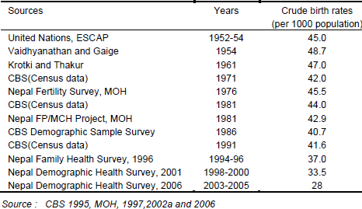
DEMOGRAPHYBPH
General Fertility Rate (GFR):
88 (NDHS 2016) 78 (NDHS 2022)
It is an improvement method than CBR because it takes that population which is exposure for giving the birth i.e. female population of aged 15 to 49 years. It is the annual number of live births divided by the total midyear population of women of child bearing age (15- 49years)
multiplied by 1000. The general fertility rate is much more indicative of changes in fertility behavior than the crude birth rate.
GFR =
Totalnumber of live birth B
= ×1000
Totalpopulationof women of 15 - 49yrs P^{F}15-49
So it is type of standardized rate.
Advantages of GFR
It removes from the denominator most of the population that is not directly exposed to childbearing namely all males and children and women population who passed menopause are not exposed to pregnancy and child bearing risk.
It is easy to calculate.
Disadvantages of GFR

Slide 19
DEMOGRAPHY BPH
All unmarried women of aged 15 to 49 years are included in the denominator
It does not consider variations in age composition.
All types of births whether it is legitimate or ill legitimate are included.
General marital fertility rate(GMFR)
All the women in the fertile ages are not participate in reproductive. So it is preferable to
consider only the currently married women in reproduction ages and not all women. This formula is less used in practice because it is not easy to calculate the denominator part.
It is expressed as
Totalnumber of live birth given by married women
_{B}m
GFR = = ×1000
Totalpopulationof married women of aged 15 - 49yrs P
F
_{m} 15-49
Advantages
It removes all the births from unmarried women
It ignores the unmarried women from the denominator part.
It gives the real picture of fertility pattern
Disadvantages
It is less used because it is difficult to find out the married women of aged 15 to 49 years.
Age Specific Fertility Rate (ASFR)
This method is more practicable than previous two methods. It is the number of live births to the women in a particular age group divided by the number of women in that age group. For a
detailed analysis of fertility in the age group 15 to 49 years, these are divided into seven international standard class intervals namely 15-19,20-24, 25-29, 30-34,35 -39, 40-44 and 45-49 years. Thus ASFR can be calculated separately for each convention age groups. In UN and
developed countries, the intervals are considered from 15 to 44 years because less number of women are exposed to the childbearing age.
_{ASFR =} No. of live births to women specific age group _{×1000(K )} No. of women of same age group

Slide 20
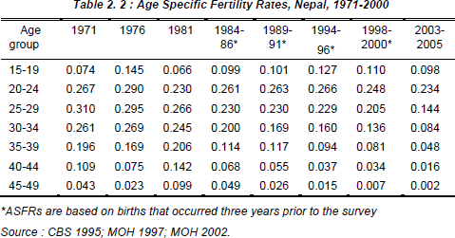
DEMOGRAPHY BPH
Advantages:
It gives the clear picture of fertility according to each child bearing years.
Fertility rate can be calculated for any age group.
Can be used in monitoring of the family planning program
Can be compared the ASFR according to age group.
Disadvantages
Difficult to comparison in between two populations Example
Age | Total no. of woman | Total Births
15-19 | 91000 | 8500
20-24 | 85700 | 2450
25-29 | 72000 | 1900
30-34 | 60100 | 1200
35-39 | 51100 | 770
40-44 | 4300 | 330
45-49 | 3590 | 100

Slide 21
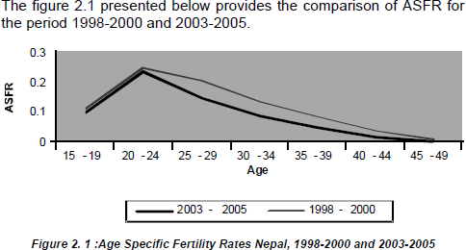
DEMOGRAPHYBPH
Total Fertility Rate( TFR)
Another measure commonly used to describe the level of fertility is Total Fertility Rate (TFR). Verbally TFR is defined as the number of children of a woman would bear during her
childbearing period under prevailing age specific fertility rates (i.e. ASFRs).
The TFR is calculated as the sum of ASFRs. As we have used ASFR for 5 year age groups, the
sum of ASFRs need to be multiplied by 5 to obtain the TFR. Although, defined as a cohort measure, in fact, it is a synthetic cohort measure based on period data. It is the most commonly used summary measure of fertility as it is free from age distribution of a population. This measure is also widely understood and used by policy makers and planners.
TFR = 5X Σ ASFR
If it is computed by single year, then it is TFR = Σ ASFR

Slide 22
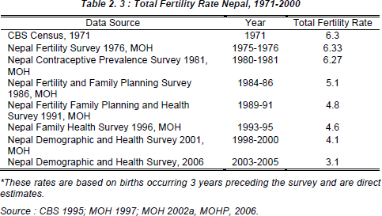
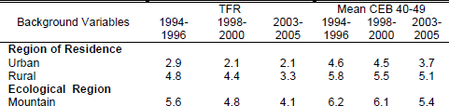
DEMOGRAPHYBPH
This table shows that the estimate of TFR for Nepal was more or less constant till mid eighties and thereafter it started to decline. The level of TFR till mid eighties was around 6.3. A substantial reduction in fertility can be seen during the period 1999 to 2004 when a decline of one child was observed. The Nepal Demographic and Health Survey 2006 provided an estimate of TFR for Nepal to be 3.1. Although a detailed analysis of causes of decline in fertility has not been done, possible causes for this decline after mid-eighties could be include a) increased use of family planning methods b) increased age at marriage c) improved level of education d) increased urbanization and e) spousal separation due to conflict and employment etc.

Slide 23
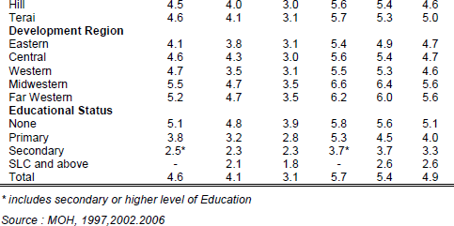
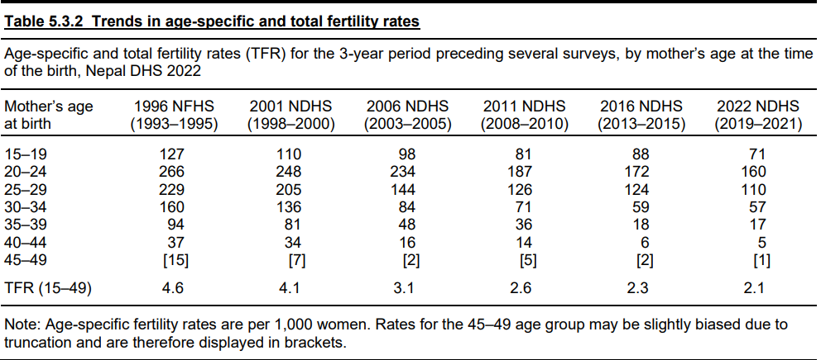
DEMOGRAPHYBPH
TFR of SAARC members and some developed countries are given below
Country | TFR (2000 -2005)
Bangladesh | 3.2
Bhutan | 2.9
Afghanistan | 7.5
India | 3.1
Srilanka | 2.0
Maldives | 2.6
Pakistan | 4.0

Slide 24
DEMOGRAPHYBPH
Nepal | 3.7
Other countries
Canada | 1.5
USA | 2.0
UK | 1.7
China | 1.7
Iceland | 2.0
Hongkong | 0.9 (lowest)
Niger | 7.4 (highest)
Source: UNDP 2007-2008
Advantages
It is effective summary rate for describing fertility because it gives single figure which is easy to compare in between two populations.
It is standardized measure of fertility
It is independent of the age distribution of female population
It shows the average size of completed family
Disadvantages
It is based on ASFR
Gross Reproduction Rate
It may be defined as the average number of daughters that would be given by a woman during her reproductive life span, if none of them died before age 50. It is computed as
GRR= Female Birth x TFR
Total Birth
GFR of Nepal in 2006 was 1.6. It means that a women would produce 1.6 daughters , on an average, during her lifetime.
Net Reproduction Rate (NRR)
It is an improved method over GRR. It is also called Replacement Index. It may be defined as the number of daughters replaced by their mother during their reproductive life span if they

Slide 25
DEMOGRAPHYBPH
follow the current fertility and mortality schedules. In other word it is the average number of daughters that would be born to a woman or group of women if she passed through her lifetime from birth conforming to the age specific fertility and mortality rate of a given year.
NRR = 1 the population is maintaining
NRR>1 the population is increasing
NRR<1 the population is decreasing
The NRR of Nepal was 1.7 and 1.4 in the year 2001 and 2006 respectively.
Replacement Level of fertility
It is the average number of children sufficient to replace their parents. The replacement level of fertility is measured by GRR (Gross Reproductive Rate) and NRR (net Reproductive Rate).If the
NRR=1, then we called it as the replacement level of fertility. Actually it is the level of fertility at which women in the same cohort have exactly enough daughters on average to replace
themselves in the population.
Population momentum
It refers to the tendency of the population to continue to grow after replacement level of fertility
has been achieved. A population that has achieved replacement of below replacement level of fertility may still continue to grow for some decades because past high fertility leads to a high concentration of people in the youngest ages. Total births continue to exceed the total deaths as these youth becomes parents. Eventually, however, this large group becomes elderly then deaths increase to equal or out number of births. Thus it may take two or three generations before each new birth is upset by a death in the population.
Replacement level fertility and Population Momentum
Replacement level fertility is the level of fertility at which cohorts of women , on the average, have only enough daughters to “Replace” themselves in the population. That is replacement of

Slide 26
DEMOGRAPHY BPH
population means flow of birth sufficient to maintain the population. Net reproduction rate (NRR) of 1 is equal to replacement level. Sometimes total fertility rate (TFR) is also to indicate replacement level fertility. In USA and other industrial countries, the TFR of 2.1 is considered as replacement level.
We generally think once replacement level fertility has been reached, birth will gradually reach
equilibrium with death, and in the absence of immigration and migration, a population will ultimately stop growing and becomes a stationary population but this is not the case as it was expected. Today some developed are at or below replacement level fertility. But population is still growing in these countries. Births are more than deaths. This scenario occurs for some decades because of past high fertility that may have led to a high concentration of women of child bearing age. Thus it may take two or three generations before each new birth is offset by a death in the population.
In brief. “The tendency of a population continues to grow even after replacement level fertility
has been achieved is known as population momentum”. The two child family or replacement fertility is of particular interest because couples averaging two children are only replacing themselves in the population. At this level of fertility, the population will eventually stop growing , since the number of births equals the number deaths.
Population momentum refers to population growth at the national level which would occur even if levels of childbearing immediately declined to replacement level. For countries with above-replacement fertility (greater than 2.1 children per woman), population momentum represents natural increase to the population. For below-replacement countries, momentum corresponds to continued population decline.
Momentum occurs because older cohorts differ in absolute size from those cohorts currently
bearing children, which impacts the immediate birth and death rates in the population which determine the intrinsic rate of growth
Formal demographers refer to population momentum as the size of the resulting stationary- equivalent population relative to the current size of the population. Population momentum has implications for population policy for a number of reasons.
First with respect to high-fertility countries in the developing world, population momentum
instructs us that these countries will continue to grow despite large and rapid declines in fertility. Second with respect to lowest-low fertility countries in Europe, momentum implies that these

Slide 27
DEMOGRAPHY BPH
countries may experience population decline even if they bring their fertility levels up to replacement.
In fact, population momentum can become negative if fertility rates are under replacement for
long enough; in coming decades, for example, some Eastern European countries would show population shrinkage even if their birth rates recovered to replacement level.
Finally, population momentum shows us that replacement level fertility is a long term concept rather than an indication of current population growth rates. Depending on the extant age structure, a fertility rate of 2 children per woman may correspond to either short-term growth or decline.
Child Women Ratio
It is sometimes referred to as the general fertility ratio or the ratio of children to women is measure of fertility commonly used. It is the ratio of number of children to the no. of women of
ages 15-49 years multiplied by 1000. According to CBS, child women ratio was 549 and 537 in the year 2001 and 2006 respectively. The three most common are:
CWR =
No.of children of aged 0 to 4 years
×1000
No.of women of 15 to 49 years of age
No.of children of aged 5 to 9 years
CWR =
No.of women of 15 to 49 years of age
No.of children 0 to 9 years
×1000
CWR =
No.of women of15 to 49 years of age
×1000
It can be used to compare the fertility pattern of different groups like race wise, residence wise (urban/rural), socioeconomic, etc. It is affected by mortality.
Measures of Mortality
It is also one of the most important factors of population change. Mortality refers to death in the population. According to UN and WHO, It is defined as” the permanent disappearance of all evidence of life at any time after birth has taken place.” The probability of dying during a given time period is affected by many factors such as age, sex, race, occupation and social class. It can

Slide 28
DEMOGRAPHY BPH
reveal peoples‟ standard of living and health care. The mortality statistics are useful for comparative study of community health, evaluation of health programs, demand of health services in the community, to know the efficacy of vaccine and drug. It can be measured by
Crude death rate
Age specific death rate
Cause specific mortality rate
Infant mortality rate
Neonatal death rate
Under five mortality rate
Still birth rate
Maternal mortality rate
Maternal Mortality ratio
Case fatality rate
Proportional mortality rate
The main source of mortality data is vital registration system. But it is still not effective and there
is a serious under registration of vital events. Direct and indirect techniques can be used to estimate the mortality.
Crude Death Rate (CDR)
It is the simplest and commonest measure of mortality. Crude Death Rate (CDR) is defined as the ratio of annual number of deaths to the person years of exposure to death during that period
multiplied by a constant (usually 1000). It should be noted that for simplicity and ease of approximation, person-years of exposure is usually approximated by mid-year population. Like
crude birth rate this is usually widely understood and is very frequently used summary measure of mortality.
However, like CBR, CDR is also heavily affected by age and other compositional structure of the population. For example, it should be noted that age specific death rate at age 15-19 is very
low compared to age specific death rate at 0-4 or 60-64 years of age. Therefore, combining all the deaths into one group and calculating the rate for all the population combined, ignores the
age composition of the population.

Slide 29
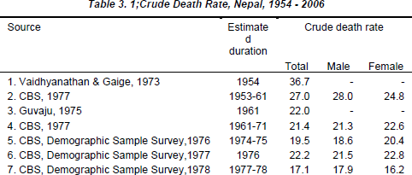
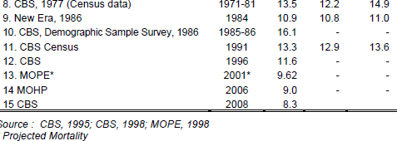
DEMOGRAPHY BPH
In two populations even if, the age specific death rates are exactly the same, if age-sex structure is different then they will have different crude death rates (CDR). Different estimates of CDR for Nepal available since 1954 are provided in Table 3.1. Because most of these estimates are based on Table population techniques, these estimates do not present a very consistent trend. Moreover, this could be also due to the use of different data that come either from censuses or surveys. It should be borne in mind that both of these sources of data suffer from inherent errors. CDR = Number of deaths x 1000
Total population CDR = D/P*1000
Total population is considered as for denominator but it is heavily affected by age and other
compositional structure of the population. So it can‟t be used for comparison without standardization.
According to CBS, CDR of Nepal was 9.6 and 8.3 per 1000 in 2001 and 2006 (NDHS) respectively .

Slide 30
DEMOGRAPHY BPH
Country | CDR
Bangladesh | 9
Bhutan | 9
India | 8
Maldives | 4
Nepal | 10
Pakistan | 10
Sri Lanka | 6
CDR of some other countries
China | 6
USA | 9
UK | 10
Sweden | 11
Germany | 10
Sierra Leone | 28
Kuwait | 2
Age specific death rate (ASDR)
It is defined as the number of deaths of persons in a given age group during a year to the 1000
mid year population of the same age group. It is noted that ASDR at 10 to14 years is very low compared to age specific death rate at 0-4 or 60-64 years of age. Deaths rated can be calculated for specific age groups in order to compare the mortality at different ages or at the same age over time. Since mortality varies greatly by sex, race, ethnicity, ASDR are often calculated separately for males and females for different racial groups in a population. The age specific death rate can be calculated by considering different standard ae intervals such as
< 1 year | 1- 4 years | <1year
1-4 years | 5-14 years | 1-14 years
5-9 years | 15- 24 years | 15+ years
10-14 years | ………. | ……
15-19 years

Slide 31
DEMOGRAPHY BPH
And so on
ASDR = Total Death in a certain age group total x1000 Population in the same age group
The lowest mortality is observed in 14 years from the age group 10-14. The information regarding mortality according to age is very useful specially for those organization who are providing life insurance services.
There were 28452 deaths in 8948587 population in the age group of 0-14 years in 2001 in Nepal. So ASDR for 0-14 years in Nepal was 3.71.
Infant mortality rate (IMR)
The IMR is the number of deaths under one year of age per 1000 live births during a year. Although it is called a rate, in fact, it is the probability of dying before the first birthday.
_{IMR =} deaths within 1 year _{×1000} totallive births
Several factors affect the IMR of a country:
Nutrition of mothers and children
Birth intervals
Parity
Age of mother at child‟s birth
Mother‟s education and economic status
Basic health services including:
Immunization
ARI
Diarrhea
Safe motherhood program
Environment etc;
In other words, IMR usually declines with a certain level of socio-economic development as
reflected by the above mentioned factors. Therefore IMR has been commonly considered as an indicator to assess socio-economic development and general health condition of a society. However the adult mortality is relatively lower even in developing countries and a smaller proportion of population is in the older group, a substantial number of deaths occur during the

Slide 32
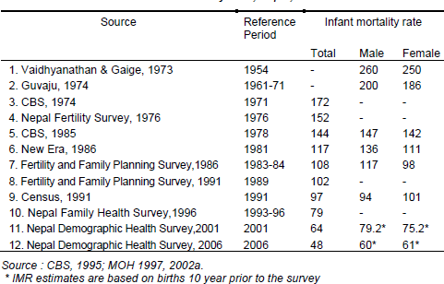
DEMOGRAPHY BPH
first five years of life. In developing countries where health system is not fully developed, infant death is a substantial part of under five deaths. Therefore, reduction in IMR is a fundamental strategy to achieve a significant reduction in the overall mortality. Moreover, the interdependent relationship between fertility and infant mortality suggests that a reduction in infant mortality will trigger a subsequent decline in fertility. It has also been found that a lower IMR motivates couples to produce fewer number of children.
The children under their first year of age are called infants. It is the most universally accepted
indicators of health status. It is the ratio of number of deaths under one year of age to the total number live births expressed per 1000 live births.
In 2001, Nepal, IMR = 64/1000.
In 2006,NDHS survey, IMR = 48 per 1000
In 2011,NDHS survey, IMR = 46 per 1000
In 2022 NDHS survey, IMR = 28 per 1000

Slide 33
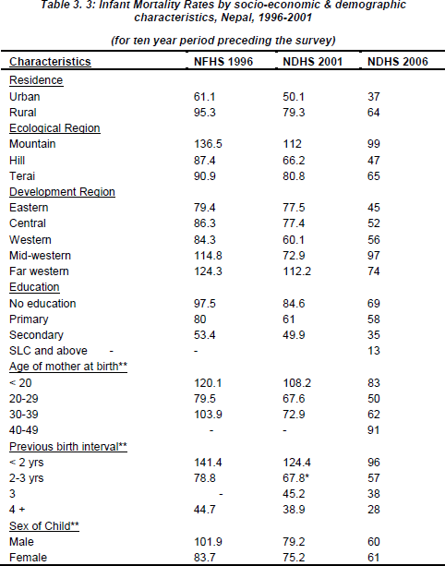
DEMOGRAPHYBPH
Neonatal Mortality Rate (NMR)
The neonatal death rate is defined as the number of deaths under 28 days of life to the total
number of live birth per year. According to NDHS2006, it was 33/1000 live births and same in 2011NDHS.
deaths within 28 days
Neonatal mortality Rate = ×1000
totallive births

Slide 34
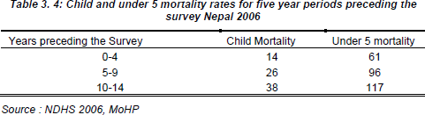
DEMOGRAPHY BPH
Post neonatal mortality
Within the infants deaths we can observe high proportion of infant deaths occurring after 28 days of life to one year, the termed as Post Neonatal Mortality Rate (PNMR). It is defined as the
number of deaths of infants after 28 days of life to < 1 year during a year per 1000 live births during the same year and calculated as
deaths of infants inbetween 28 daysand 1 year
Post neonatal mortality = ×1000
totallive births
NDHS 2011,Nepal = 13 per live births
Under five mortality
It is defined as the annual deaths of children under 5 years of age to the 1000 live births.
UNICEF considers this is the best single indicator to social development. According to NDHS 2006, Nepal‟s CMR was 61 per 1000 live births and 54 in 2011(NDHS)
Under
_{5 mortality =} deaths under 5 years of life _{×1000}
totallive births
This means that one in 19 children born in Nepal dies before their fifth birthday. Eighty-five percent of deaths among children under five occur during the first year of life: infant mortality is 46 deaths per 1,000 live births. During infancy, the risk of neonatal deaths and post neonatal deaths is 33 and 13 deaths per 1,000 live births, respectively.
The Table indicates that the child mortality 0-4 years preceding the survey is 38 percent of what it was 10-14 years preceding the survey. In other words there has been a remarkable decline in child mortality during the last 15 years. A very similar picture in decline in under five mortality can also be seen.

Slide 35
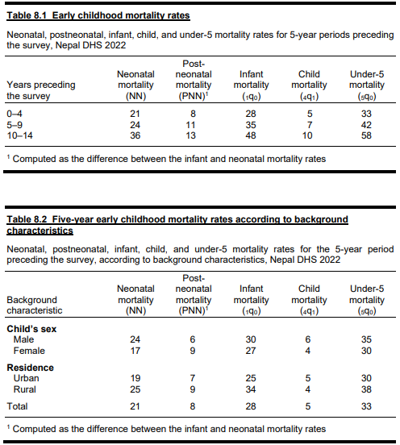
DEMOGRAPHYBPH
Child Mortality Rate
It is defined as the annual deaths of children of aged 1 to 4 years to the 1000 live births.
_{CMR =} deaths1- 4 years of life _{×1000} total live births

Slide 36
DEMOGRAPHY BPH
The current (2006) estimate of child mortality in Nepal is 13 indicating that of the 1000 babies surviving to age one, 13 die before they reach the age of five. In a likewise manner, under-five mortality is 61 indicating that of the 1000 children born today 61 will die before they reach the age of five. Table 3.5 provides the differentials in child and under-five mortality for Nepal obtained from NDHS 2001 and NDHS 2006 surveys. It should be noted that for the differentials in infant child mortality, births that occurred during the last ten-year period have been taken into account.
The same factors, which were important in the differentials of infant mortality are also important for child and under-five mortality. These are mother‟s education, mother‟s age, previous birth interval and ecological regions etc. Like the infant mortality the differentials in child and under- five mortality has decreased over the last five years again suggesting that the programs aimed
at reducing child mortality is also reaching those groups where child and under-five mortality used to be higher, however the differentials still persist in child and under 5 mortality.
Maternal mortality ratio (MMR)
Maternal deaths are defined as any death that occurred during pregnancy, childbirth or within six weeks after the birth or termination of pregnancy. Maternal mortality is defined as the ratio of
maternal deaths and number of live births during the same period multiplied by 100000. NDHS 2006 collected data on maternal mortality through sisterhood method. In other words, ever
married women of reproductive age were asked whether they had any sisters, if yes, whether they are still alive, if dead whether the death was a maternal death. The maternal mortality
usually not estimated frequently due to the lack of sufficient cases of deaths in the sample, however some surveys and studies done in Nepal has estimated it.
Estimation of maternal mortality ratio utilizing the sisterhood method yielded a ratio of 281 deaths per 100000 live births. This ratio is one of the highest in the world indicting that a large
number of mothers die due to causes related to childbirth. Even though the Maternal Mortality and Morbidity Study 2008/9 conducted in eight districts of Nepal is not a national representative
survey, it revealed that the maternal mortality ratio is 229 deaths per 100000 live births.
In order to combat this high ratio of maternal mortality Government of Nepal has embarked on a
number of programs under Family Health Division‟s Safe Motherhood Program. In this effort the government is also supported by different donor agencies such as UNICEF, DFID, USAID, GTZ

Slide 37
DEMOGRAPHY BPH
and other INGOs. Maternal mortality ratio is defined as the ratio of any death that occurred during pregnancy, childbirth, or within six weeks after the birth or termination of pregnancy and is expressed as 100,000 or 10,000.
It can be calculated as:
_{MMR=} no. of maternal deaths as a result of childbeari ng _{×100,000} Total no. live births
In Nepal, the MMR was 539 and 281 per 100,000 live birth in the year 1996 and 2006 respectively. In 2011(NDHS), it was 229 per lakh live birth
Maternal mortality ratio of Nepal in different period are given below
Types of information | Year | MMR
Hospital based | 1986 | 189/100,000
Fertility Mortality survey | 1986 | 850/100,000
Fertility FH survey | 1991 | 551/100,000
Nepal family health survey | 1996 | 539/100,000
Nepal demographic health survey | 2006 | 281/100,000
Nepal demographic health survey | 2011 | 229/100,000
Some other countries’ MMR(Adjusted)
Country | MMR | Country | MMR | Country | MMR | Country | MMR
Bangladesh | 570 | Nepal | 830 | Canada | 7 | SierraLeone | 2100
Bhutan | 440 | Pakistan | 320 | USA | 11 | Iceland | 1
India | 450 | Sir Lanka | 58 | Japan | 6
Maldives | 120 | China | 45 | UK | 8
Source: Human development report ,2007.
Maternal Mortality Rate
It is defined as the MMR is
No of deaths due to puerperalcauses in women
×10000
No of women of reproductive age group

Slide 38
DEMOGRAPHYBPH
Nepal’99-MMR = 875/10,000
Foetal death
It is deaths prior to the complete expulsion or extraction from its mother of a product of conception, irrespective of duration of pregnancy. It is the deaths below 28 weeks of
gestation.
Still birth
Foetus deaths after 28 completed weeks of gestation is called still birth.
Still birth rate
Still birth rate is the ratio of still birth to total birth ( live birth + still birth) According to NDHS 2001, Nepal‟s still birth rate was 26.86 per 1000 pregnancies.
Case Fatality Rate
It is the ratio of deaths of particular disease to the number of persons who suffered from the same disease.
No. of deaths due to particular disease
Case fatality rates= ×100
Total no. cases of thesame disease
This is an indicator used to know quality of care and compare severity of disease. There were 2 deaths per 1000 cases of gastro-enteritis in Nepal in 2003.
Cause Specific Death Rate(CSDR)
Cause specific deaths rates are usually expressed in deaths per 10,000 or 100,000 instead of 1000 because deaths due to most of the causes are generally very low.
_{CSDR =} No.of deaths due to particular disease _{×100,000}
Mid year population
Deaths from a specific cause can also be expressed as a percentage of total deaths which is know as proportion dying of specific cause such as
Proportion dying due to kidney failure = ^{No. of deakidney failureths} ×100,000
totaldeath

Slide 39
DEMOGRAPHY BPH
The information regarding cause of deaths in eh case of Nepal as well as many developing countries is available from hospital records only. In the case of developed countries every death is to be diagnosis so the cause of deaths is identified.
Standardization of Death Rates
Mortality patterns are varied according to time period in developed or developing countries.
Mortality rates are affected by many factors such as environmental differences, social, economical and cultural factors. The death rate is greatly affected by age structure of the population. If the age structure of two populations is different and if the CDR are compared then wrong conclusion may be drawn.
Hence CDR should be standardized before drawing conclusion of making comparison from place to place or country to country. The process of removing the effect caused by different age structure is called age standardization. Standardization allows for comparison when the population structures differ. Health professionals are always interested to compare the mortality rates of different places to find the influences of these factors.
Standardized death rates can be calculated by two methods:
Direct Method
Indirect Method
Direct Standardization
In this method, average weighted age- specific mortality rates (ASDR) a study population are calculated, where weight represents the age specific population of the standard
population.
The reference population usually the population of whole country if we are making comparison of rates in two communities within the country.
However, international standard population is preferred for comparison of rates within
countries.
Step1- A standardized population has to be selected (It is defined as one for which the number in each age and sex groups are known.)

Slide 40
DEMOGRAPHY BPH
Step 2- The ASDR is computed separately for each age group whose crude death rate is to be adjusted or standardized.
Step 3- Select the reference ( standard) population with age wise distribution.
Step 4 – the ASDR is multiplied by the respective population of the same age group of the standard population and divide them by 1000. As a result, an expected number of deaths for each group in the standard population are obtained.
Step 5- The final step is to divide the expected total number of deaths by the total number of standard population which will give the adjusted or standardize death rates.
_{Now, expected death =} standard population× ASDR
1000
Standard crude death rate =
Sum of expected death
×1000
Totalstandard population
Example 1
Age group | Population “A” |  |  | Population “B” |  |  | Standard population
 | Pop 1 | Deaths 2 | ASDR 3 | Pop 4 | Deaths 5 | ASDR 6 | 1+4 =7
0-4 | 1500 | 120 | 80 | 500 | 40 | 80 | 2000
5-49 | 4000 | 40 | 10 | 5000 | 50 | 10 | 9000
50+ | 500 | 40 | 80 | 500 | 40 | 80 | 1000
Total | 6000 | 200 |  | 6000 | 130 |  | 12000
CDR for population A = (200÷6000)×1000 = 33.3 and CDR for population B = (130÷ 6000)
×1000 = 21.7
The crude death rate of population A and B are different. Now if we apply the age standardized death rates for each population using the method described above.
Total expected deaths
= (80×2000)+ (10 ×9000) +(80 ×1000) = 330000
Standard crude death rate =
Sum of expected death
330000
= = 27.5 per1000
Totalstandard population 12000

Slide 41
DEMOGRAPHY BPH
Similarly we can compute standard death rate for city B .
Conclusion
The higher CDR of population A can be seen to be high due to the higher proportion of children
in its population. Because children have a high ASDR the inflect the CDR for population as a whole. That is to say one population has low proportion of elderly who have low ASDR and the other population has a high proportion of children who have large ASDR
Example 2
Age | ASDR-1996 | ASDR- 2006
15-19 20-24 25-29 30-34 35-39 40-44 45-49 | 2.03 2.35 1.89 2.42 2.46 4.55 8.53 | 1.52 1.3 1.47 2.09 2.27 4.96 6.75
Calculation of standardized death rate
Age | Standard Pop^{n} | ASDR -1996 | ASDR - 2006 | Expected Deaths 1996 2006
15-19 | 1185826 | 2.03 | 1.52 | 2407 | 1802
20-24 | 946742 | 2.35 | 1.3 | 2224 | 1231
25-29 | 821014 | 1.89 | 1.47 | 1551 | 1207
30-34 | 726040 | 2.42 | 2.09 | 1757 | 1517
35-39 | 651351 | 2.46 | 2.27 | 1602 | 1479
40-44 | 539993 | 4.55 | 4.96 | 2457 | 2678
45-49 | 469695 | 8.53 | 6.75 | 4006 | 3170
Total | 5340661 |  |  | 16004 | 13084
SDR |  |  |  | 3 | 2.45

Slide 42
DEMOGRAPHY BPH
Here, standard mortality rate for 1996abd 2006 are 3 and 2.45 per 1000 population respectively. It indicates that adult deaths were reduced by 18.33% in ten years period.
Indirect Standardization
Above direct method becomes difficult in the use of when many time ASDR‟s of population are not available. In such situation we apply the technique of indirect standardization. In this
method, age wise distribution and crude death of the population are compared with the ASDR of standard population.
In this method, age specific death rates (ASDR) of standard population are used to derive expected deaths in the country or region‟s population.
Steps
ASDR of standard population is taken
Age wise population from the study area are taken.
Find expected deaths by multiplying age wise population and population.
Find the total of expected death
Find the ratio of observed deaths and expected deaths.
ASDR of standard
Age | Pop to be standardized | ASDR of standard population | Expected death
15-19 | 22341 | 1.09 | 24
20-24 | 23855 | 1.53 | 36
25-29 | 21713 | 1.74 | 38
30-34 | 17737 | 1.79 | 32
35-39 | 13243 | 2.45 | 32
40-44 | 8672 | 3.39 | 29
45-49 | 5337 | 4.32 | 23
Total | 112898 |  | 215
Given observed death rate = 243

Slide 43
DEMOGRAPHYBPH
_{Expected death rate =} ASDR of standard×populationof same age group
1000
Standardized mortality ratio (SMR)=
No. of observed deaths ₌ 243 _{= 1.13}
No. of Expected deaths 215
If the ratio value is greater than 1, there is greater mortality risk than the whole population
Standardized Birth Rate
Standardized birth rate is similar to standardized death rate.
Birth rate is also standardized by
Direct method
Indirect method
Direct method
Now, expected birth
₌ standard population×ASBR
1000
Direct standard birth rate (DSBR) =
Sum of expected birth
×1000
Totalstandard population
Indirect method
_{Expected birth rate =} ASBR of standard×populationof same age group
1000
Standardized fertility ratio (SFR)= ^{No of observed Births}
No of Expected Births
If the ratio value is greater than 1, there is more fertility rate.
Migration Introduction
Migration is the third basic factor affecting change in population of an area along with fertility
and mortality. It can be defined as the movement of people from one clearly define place to another. According to Shryock et al. (1975) “Migration as a form of geographic or spatial

Slide 44
DEMOGRAPHY BPH
mobility involving a change of usual residence between clearly defined geographic units. It should be noted that in present definition temporary movements are not included”.
It is one of the three important component of population growth. It changes the volume of
population of any area. The size of population, growth and any other characteristic of population can be affected by migration in sending and receiving area. It is defined as movement of population from one defined area to another during on given interval and involved in change of usual place of residence.
It is the movement of people across a specified boundary for the purpose of establishing a new residence. It is more complex than fertility and mortality because it is purely a socio economic phenomenon and involving social, psychological, economy, political and other determinants.
Migration has a profound effect on structure, composition and growth of population in a country
therefore it is an important component of population analysis, migration. For the demographic purpose migration is defined in two broad types; internal and international migration. In this chapter we will deal with these two components of Migration.
Definitions of some terminology
Migrants: Persons or group of people who moves from one place to another place are known as migrants
Place/Area of origin: The place/area from which a migrant moves
Place of destination: the place/area to which a migrant moves
Migration period: period in which migration occurs
In-migrants/Immigrants
In-migrant: A person who enters in the place of destination from the residence within the country Immigrant: a person comes to the country from another by crossing the international boundaries
Out-migrant/Emigrant
Out-migrant: A person who departs from the place of residence to another within the country Emigrant: a person departs from native country to another countries by crossing the international
boundaries
Net migration: It is the difference between out migration and in migration in any defined geographical areas within a specified period of time migration.

Slide 45
DEMOGRAPHY BPH
Life time migration: Life time migration is one who has moved from his place of birth to the present place of destination where he is enumerated at the time of the census irrespective of the number of times he migrates.
Non migration: not changing the birth place and die in the place of birth
Return migration: moved back to the area where he resided.
Mobility: the temporary geographic movement of people.
Migration stream
Migration Stream is the number of migrants identified on the basis of their volume within a given period of time from one geographical area to another such as mountain to hill, hill to Terai
or Terai to mountain and hill and mountain to Terai. Another typical migration stream is usually measured on the basis of migration from rural to rural, urban to rural and urban to rural areas.
Internal Migration: Movement of population from one political unit to another within the country
International Migration: Movement of population from one country to another across the international boundaries
Gross migration: It indicates the magnitudes of total mobility in a defined geographical area within a specified period of time
Period Migration refers to the those people whose place of residence is different from the place of enumeration for the specified period.
Determinants of Migration
When difficulties or problems occur in usual place of residence, then people tend to migrate. People migrate from one place to another to gain easy life. The types of problems may exist due
to several causes which are known as determinants of migration. Some determinates influence for migration but some stop to do so.
Some determinants
Social determinants: Marriage, Education, Family conflict, Social respect etc,
Economic determinants: Better position, better job opportunity, better economic welfare, better return etc

Slide 46
DEMOGRAPHY BPH
Political determinants: Political conflict, e.g. Mao conflict in Nepal, Bhutanese from Bhutan to Nepal, Afghani from Afghanistan to Pakistan, Tibetan from Tibet to Nepal, Syrian from Syria to Turkey, etc.
Natural determinants: Natural resources, natural calamities, natural disaster, earthquake, flood, dissert. They determine the migration stream.
Development determinants: better position and more facility
Religious determinants: Hindus visit to Pashupati, Buddhist migrate to Lumbini and Muslims go to Maka Madina
Pull and push Determinants: Pull factors are those determinants which attract at the destination and push factors force to move
Determinants of migration can be divided as
Push factors:
Political instability and political conflict
Lack of security
Unemployment, low wage, low payment
No freedom
Loss of job opportunity
No education facility
Lack of development
Pull factors
Opportunity
Better quality of life
Free society
Better job opportunity
Education opportunity
Availability of facilities
Skilled technical manpower
Demand of skill and educated manpower
Transportation
Government policy
Social security

Slide 47
DEMOGRAPHYBPH
Types of migration
There are different types of migration such as one move from rural to urban area. Similarly one
goes to study or work and return back after study and work. Basically it can be categorize into two types
According to time migration
Migration according to destination
According to time migration
People migrate for few months to long life. So by using time or period, it can be divided as:
i.
ii.
Permanent Migration: reside more than 10 years
Temporary migration: migrants return to place of residence before 10 years. ( 5 to 10 years)
Seasonal migration: migration occur for six months
iii.
Migration according to destination
On the basis of place of departure, migration is divided into two groups:
Internal migration
Rural to rural migration
Rural to urban migration
Urban to urban migration
Urban to rural migration
International migration
Emigration
Immigration
Measure of migration
Measurement of migration deals the flow of migration. It gives the migration rate within the country , outside the country . There are 4 types of measurement of migration.
In migration rate
Out migration rate

Slide 48
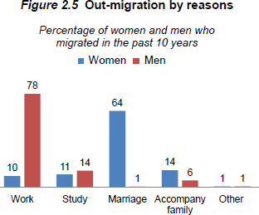
DEMOGRAPHY BPH
Net migration rate
Gross migration rate
In migration rate
Number of people received by a area at a specific time per 1000 population is in migration for that place. It is expressed as,
_{In migration rate =} No. of in - migrant in a area during a given year _{×1000 =} I _{×1000}
Mid year populationof thearea P
Where I = total no. of in-migrants and P = total population at the place of destination.
Example
According to 2001 census of Nepal, the mid year population of Terai was 11212453
(P)and number of people who migrate from Mountain and Hill region were 1326860(I). Calculate in migration rate for Terai who entered Terai region of Nepal. Then
In migration rate for terai region = 1326860x1000
11212453
= 118.3 per 1000
Out migration rate
Number of people departure or leaving their place of origin at a specific time per 1000 population. It is expressed as,

Slide 49
DEMOGRAPHY BPH
_{Out migration rate =} No. of out migrant during a given year _{×1000 =} O _{×1000}
Mid year populationat theorigin P
Where O = total no. of out migrants from origin and P = total population at the origin
2. Example
According to 2001 census of Nepal, there were 295422(O) people who migrated out of mountain
region and shifted to Terai and Hilly region for permanent residence and mid year population of mountain was 1687859(P) . Calculate out migration for mountain.
The out migration rate for mountain for that particular period is Out migration rate for mountain=295422x1000
1687859
=175 per 1000
Thus , this result shows that out of every 1000 people residing in mountain area 175 migrated to Terai and Hilly region of Nepal.
It should be clear that in-migrant and out-migrant are calculated from the place of birth information, which is asked in every census and the region of enumeration. In case of Nepal, there are three ecological divisions Mountain, Hill and Terai. Although there are 75 districts and
5 development region by administrative, it is difficult to calculate in and out migrant
accordingly. So population is classified according to Region of Enumeration and Region of Birth for three regions only.
Let us assume that three subdivisions A,B and C in a country and population are classified by Region of Birth and Region of Enumeration as shown below
Region of Birth | Region of Enumeration |  |  | Total
 | A | B | C
A | NAA | NAB | NAC | N_{A}
B | NBA | NBB | NBC | N_{B}
C | NCA | NCB | NCC | N_{C}
Total | N._{A.} | N.B. | N.C. | N
Where

Slide 50
DEMOGRAPHY BPH
N_{AB} + N_{AC} = O_{A} = Out migrants from A N_{BA} + N_{BC} = O_{B} = Out migrants from B N_{CA} + N_{CB} = O_{C} = Out migrants from C And
N_{BA} + N_{CA} = I_{A} = In migrants to A
N_{AB} + N_{CB} = I_{B} = In migrants to B N_{AC} + N_{BC} = I_{C} = In migrants to C
N_{AA} ,N_{BB} and N_{CC} denoted non migrants for the region A, B and C respectively Now,
NM_{A} = I_{A} – O_{A} Net migrants to the region A NM_{B} = I_{B} – O_{B} Net migrants to the region B NM_{C}= I_{C} – O_{C} Net migrants to the region C Source: Pathak et. al. 1992:211-12
Example of life time migrants by place of birth and place of enumeration according to ecological regions of Nepal, 2001
Place of origin | Place of enumeration |  |  |  | % out migration | Net migration
 | Mountain | Hill | Terai | Total
Mountain |  | 125597 | 169825 | 295422 | 17.1 | -255103
Hill | 33895 |  | 1157035 | 1190930 | 68.9 | -830759
Terai | 6424 | 234574 |  | 240998 | 14 | +1085862
Total | 40319 | 360171 | 1326860 | 1727350 | 100
% in migration | 2.3 | 20.9 | 76.8 | 100
Source : CBS,2003
Trend of net migration seen from four censuses(1971 to 2001)
Year/ Zone | Net Migration
 | Mountain | Hill | Terai
1971 | -39959 | -359966 | +399925
1981 | -26467 | -424711 | +686178

Slide 51
DEMOGRAPHYBPH
1991 | -161655 | -753923 | +915578
2001 | -255103 | -830759 | +1085862
Source : CBS,1993 and 2003
For estimating the net migration for any area between two censuses we can use direct method by considering the survival of the in as well as out migrants by using the formula.
Net migration = (I _{t+n} – O_{t+n})- (S_{I}I_{t} –S₀O_{t})
= (I _{t+n} – S_{I}I_{t}I_{t+n}) + (S_{O}O_{t} –O_{t+n}) = M₁+M₂
Where
I_{t+n} =no of life time in migrants at time t +n
I_{t} = no of life time in migrants at time t O_{t+n} = no. of out migrants at time t+n O_{t} = no. of out migrants at time t
S_{I} = inter-censal survival ratios for in-migrants at time t
So = intercensal survival ratios for out- migrants at time t M1 = Net migrants for persons born outside area
M2 = Net migrants for persons born inside area
So birth place data at two censuses can also analyze the net migration among persons both outside the area (M1) and that among persons born inside the area(M2).
Gross Migration Rate
It is computed as:
Gross migration rate
= out migrants + in migrants x 1000 =O+I x 1000 total mid year population P
Net migration rate
The net effect of immigration and emigration on an area‟s population (increase or decrease) is defined as net migration.
= Number of immigrants – Number of emigrants x1000
Total mid year population for the same period

Slide 52
DEMOGRAPHY BPH
Population Estimates and Projections
Why projection?
To help the policy makers by providing consequences of current population trends and guide them to select the appropriate actions
Population Projection Computation of future changes in population numbers, given certain assumptions about future trends in the rates of fertility, mortality, and migration. Demographers often issue low, medium, and high projections of the same population, based on different assumptions of how these rates will change in the future.
Types of estimation
Inter-censal estimates
Post –censal estimates
Future estimates and projections
- Demographic method(natural increase)
-Component method
-Mathematical method Assumptions
The socio economic setting affecting the population size is fairly unchaining.
No allowance is made for the irregular fluctuations in the population growth.
Linear growth model (Arithmetical Progression
Population can be estimated on the assumption that the annual change in population remains the same.
The estimated population at any time is
1 ⎛ p_{t} ⎞
P_{t} = P₀(1 + r t) and r =
⎜
t ⎝ p_{o}
−1⎟
⎠
Where P_{t} = Population of any time, P_{o} = Last census population , r = growth rate t = time period between two census
Geometric method
Population is estimated on the assumption that population increase in geometric progression.
Page 55

Slide 53
DEMOGRAPHY BPH
The formula is
1
t
⎛ p_{t} ⎞^{t}
P_{t} = P₀ (1+r) and r = ⎜ ⎟ −1
p
⎝ o ⎠
Where Pt = Population of any year (current population) Po = Last census population(base population)
R = yearly increase
T = period in years and months after the last census month and year.
Exponential method
This another important method to estimate the population P_{t} = P₀e^{rt}
Example
The population of Nepal as per 1991 census was 1,84,91097 and 2001 census was 231,51,423
.Estimate the mid year population of Nepal for the year 1995 , 2006 and 2011 by arithmetic , geometric and exponential function.
Population Doubling Time
The doubling time is the period of time required for a quantity to double in size or value. It
helps to give a picture of just how fast a population is growing at the present time .So it gives when present population will be double at present population growth rate. A country with a constant PGR of 1% would double its population in 70 years. So doubling time is formulated as:
When the relative growth rate (not the absolute growth rate) is constant, the quantity undergoes exponential growth and has a constant doubling time or period which can be calculated directly from the growth rate.
This time can be calculated by dividing the natural logarithm of 2 by the exponent of growth, or approximated by dividing 70 by the percentage growth rate.
Doubling time = 70/r, where r is the rate and t is the doubling time.

Slide 54
DEMOGRAPHY BPH
The doubling time is a characteristic unit (a natural unit of scale) for the exponential growth equation, and its converse forexponential decay is the half-life.
For example, given Canada's net population growth of 0.9% in the year 2006, dividing 70 by 0.9
gives an approximate doubling time of 78 years. Thus if the growth rate remains constant, Canada's population would double from its 2006 figure of 33 million to 66 million by 2084.
Effect of Population Growth
Economy: Economy development is a process by which a country‟s real national income increases over a period and is associated with structural changes, work forces,
consumption , exports and imports. Overpopulation affects the following areas:
Food scarcity
Low employment opportunity
Low productivity
Low savings
Unequal distribution of population in farmland
Environment
Deforestation
Excess pressure on land
Water , air and noise population
Unplanned urbanization
Health
Low availability of essential health care
Improper distribution of resources
Population Doctor ratio high
Health facilities are restricted only in urban area
Lack of health promotion services
Low preventive measures priorities
High mortality and morbidity rates
Education
Not affordable for poor population
Education gap

Slide 55
DEMOGRAPHY BPH
Low quality of education
Occupation
Unemployment rate increase
Increased unskilled manpower
Migration effect

Slide 56
DEMOGRAPHY BPH
6. Sources of demographic data
Population census
Sample surveys
Vital registration system
Population register
Records from health institution
National and international publications
-Demographic year book, Epidemiological and vital records, Statistical year book etc.
Population Census
Derived from Latin „Censere‟- meaning „value or tax‟
United Nations (1958) defines as „ A census of population may be defined as the total
process of collecting, compiling and publishing demographic, economic and social data pertaining at a specified time or times to all persons in a country or delimited territory.
To study the health statistics, census provides vital events (birth, death) and other health statistics (disease pattern, incidence of different types of disease in community
Census
The word „Census‟ comes from the Latin “Censere” which means to value or tax. In other words, earlier censuses were carried out either for taxation or for military purposes. The evidence of
censuses have been available in earlier times i.e. 17th century , however, it is difficult to decide where and when the first scientific census was carried out.
United Nations (1958) defines census as “ A census of population may be defined as the total process of collecting, compiling and publishing demographic, economic and social data
pertaining , at a specified time or times to all persons in a country or delimited territory.” A modern census has following four essential characteristics (UN,1970)
Each individual is enumerated separately and the characteristics of each person are recorded separately.
The census covers a precisely defined territory and includes every person present or residing within its scope.

Slide 57
DEMOGRAPHY BPH
Population is enumerated with a well defined point of time and date is in terms of a well defined reference period.
The census is taken at regular intervals.
American constitution made a provision of carrying out a census every ten years. Since then censuses have been carried out in USA in every ten years. Likewise, most European and Asian countries also started taking national census every ten years since 19th century. However there are some countries where census is also conducted every 5 years such as Japan and South Korea.
The first census was conducted in Nepal census in 1911. First scientific census was conducted in 1952/54 with the assistance of United Nations (eastern half was enumerated in 1952 and western half in 19540 and Latest census 2011. It can be conducted in every 10 years but some countries like south Korea and Japan conduct census in every 5 years. Mainframe computer was used to process the census data in 1971. The census of 2001 is the first census where desk top personal computers were used to process the census data.
The Member of Parliament of Nepal and for its constituency is determined by using the population census report.
Features of Census
Complete coverage of defined political or administrative territories.
Taken in every regular interval.
Two types of enumeration
De facto- person is counted whenever that person is found
De jure- person is enumerated in the usual or legal place of residence Questionnaire: a) Household schedule and individual schedule.
Censuses suffer two types of errors
Coverage errors: refers to errors in undercount or over count of population.
content errors: refers to faulty transcription of data during collection, processing and tabulation of data
Advantages and disadvantages

Slide 58
DEMOGRAPHY BPH
Can be used as a feedback to the national development planning, demographic and socio economic studies
To determine important health indicators
To run administration and political activates.
Main disadvantages are costly, difficult to manage, time consuming,
Population trend of Nepal
Census year | Population | Annual exponential growth rate (r) | DT | Pop. Density
1911 | 56,38,749 | - | - | 38.31
1921 | 55,63,788 | -0.13 | - | 37.87
1931 | 55,32,574 | -0.07 | - | 37.59
1941 | 62,83,649 | 1.16 | 60 | 42.69
1951-53 | 82,56,625 | 2.60 | 31 | 56.1
1961 | 94,12,996 | 1.65 | 42 | 63.96
1971 | 1,15,55,983 | 2.07 | 34 | 78.52
1981 | 1,50,20,839 | 2.66 | 26 | 102.07
1991 | 1,84,91,097 | 2.08 | 33 | 125.64
2001 | 2,31,51,423 | 2.24 | 31 | 157.3
2011 | 2,66,20,809 | 1.4 | 50 | 181
Registration of vital Events
The system recording or registration of vital events such as birth, death, marriage and divorce in a legal institution is known as vital registration. It is the routine process. It is done daily and
easily. Registration of vital events has been the foundation of vital statistics. Registration of vital event keeps a continuous check on demographic changes. If registration of vital events is
complete and accurate, it can serve as a reliable source of health information. It is the precursor of healthy statistics. The vital events should be registered within 35 days in municipality and
VDC. In Nepal, it covers birth, death, marriage migration and divorce.
Features
Legal certification of events as well as for statistical purpose
Continuous recording with perfection can replace the survey and census.
Recording system is poor in developing countries like Nepal.

Slide 59
DEMOGRAPHY BPH
Sample survey
When the data are not available from routinely kept records, the alternative best source is sample
survey. It involves the selection of people which represent the whole population. It is a scientific process of collecting information through interviews. It may give detailed and high quality information than a census because more time and effort can be spent on each interview. World fertility survey, demographic and health surveys contraceptive prevalence surveys are the examples of international surveys.
Major population surveys conducted in Nepal are:
1966 National health survey(MOH)
1976 Nepal fertility survey(MOH)
1984 Fertility and mortality survey(New Era)
1991 Nepal fertility, family planning and health status survey (NFFPHS)
1996, 2001, 2006 and 2011 Nepal demographic and health surveys (MOH and New Era)
Population Registers
It is another process of collecting the population data such as birth, death, marriage, divorce,
separation childbirth, migration etc. It provides a continuous record of changes in population movements by maintain the personal file. It is possible only in developed countries like Netherland, Denmark, South Korea, Japan, and Israel etc
Record from health institution
Population related data are also available through administrative records/officials records. These
records are maintained as a part of service delivery by government. Family health division records the number of sterilization cases. Epidemiological department records the overall epidemic cases
National and international publications
Journals, articles, annual reports, official and unofficial textbook statistical year book, monthly bulletin of statistics
statistical pocket book
Page 59

Slide 60
DEMOGRAPHY BPH
Population monograph
District profile
Page 60

Slide 61
DEMOGRAPHY BPH
7.Population growth distribution and trend in Nepal
Age and sex composition
Structure and characteristics of population is an important things in study of population
Also known as study of the composition of population
it covers all aspects of population studies
Population composition
The distribution of population according to the various demographic attributes such as age, sex, religion, language, urban rural residence, ethnicity ,marital status, social and economic characteristic, household and family types educational attainment, employment status etc is known as population composition.
The population composition also covers occupation, income, literacy. Such a study answers several interesting.
The main aims of such study is to find the change of any characteristics over a period of time.
Another aims is to find distribution of population over a period.
For example the population of Nepal age wise in three census is
Age group 1981 |  | 1991 |  | 2001
0 – 14 41.4 15 – 59 | 51.2 | 42.4 | 51.8 | 39.4 | 54.1
60+ 5.7 |  | 5.8 |  | 6.5
Total 100 |  | 100 |  | 100
Uses of study of population structure and characteristics
It helps in an elaborative study of any population and thus makes comparison possible.
Page 61

Slide 62
DEMOGRAPHY BPH
Population of such data are useful in preparation of inventories of human resources.
It provides the material for the study of the social and economic structure and change of population.
Sex and age structure
Sex and age are the basic characteristics or biological attributes
Affect demographic variables as well as social , economical and political structure.
Influence in birth, death, migration, marital status composition, manpower, national product, planning regarding educational and medical services and housing
Sex structure:
It is an easily identifiable characteristics.
Sex structure of any population is used to find
Sex ratio
Percentage of male in population(masculinity proportion)
Age structure:
Whether a population is young or old, or getting older or younger depends on the proportion of people at different age groups.
In general, a population with more than 35 percent under age 15 is considered young and population with more than 10 percent aged 65 and above is considered old.
Age structure is affected by the fertility, mortality and migration. However, under normal situation, the affect of mortality and migration is smaller and proportion of population at each age group is mainly affected by fertility.
Distribution of population by five year age group is shown for males and females based on census data.
Page 62

Slide 63
DEMOGRAPHY BPH
Age Composition:
Age data are usually available in the form of single years like 0,1,2,….9,10,…20, 21,22 etc. For demographic analysis, however, age data are rarely used in this form. The age data is classified in five years age groups such as 0-4, 5-9, 10-14 etc.
Population composition according to age (%) 1981-2001
Age group 1981 |  | 1991 |  | 2001
0 – 14 41.4 15 – 59 | 51.2 | 42.4 | 51.8 | 39.4 | 54.1
60+ Total 100 | 5.7 | 100 | 5.8 | 100 | 6.5
Age structure
0-14 years: 33.5% (male 5,108,258/female 4,918,259)
15-24 years: 22.5% (male 3,350,311/female 3,362,958)
25-54 years: 34.1% (male 4,786,214/female 5,417,777)
55-64 years: 5.4% (male 792,775/female 835,048)
65 years and over: 4.4% (male 613,905/female 705,181) (2012 est.)
(http://www.indexmundi.com/nepal/demographics_profile.html)
Population Pyramids
A Population Pyramid is a graph that shows a country‟s population by age and gender. The shape of the pyramid tells us about a country‟s growth rate and dependency ratio.
Population pyramids have the youngest age cohort at the bottom and females on one side and males on the other.
Page 63

Slide 64
DEMOGRAPHY BPH
Each age-gender group is represented as a % of the total population or in thousands of people
Population pyramids are used to show information about the age and gender of people in a specific country. The shape of the pyramid tells us about a country‟s growth rate and dependency ratio. Population pyramids have the youngest age cohort at the bottom and females on one side and males on the other. Each age-gender group is represented as a % of the total population or in thousands of people.
Age and Sex Pyramid
Age sex pyramid or simply is a diagrammatic presentation the age and sex distribution of
population. It gives detailed picture of age sex structure of population through either single or 5 years age groups like 0-4,5-9,10-14 etc. The basic pyramid consists of horizontal bars along the vertical axes representing in ascending order from the bottom to the top horizontally on one another. The length of the bars indicates the population size. Generally males are given on the left of central vertical axis and for females on the right.
Types of pyramids
Constructive pyramid
Stationary pyramid
Constructive Pyramid: Pyramid for developing countries
Almost triangular in shape.
Relatively broad base of pyramid because of high birth rate.
It would be needle line form at the top indicating lower proportion of population at old ages i.e. low life expectancy.
The population pyramid narrows rapidly from base to triangular shaped top indicating
relatively higher death rate in each age group.
Such type of pyramid is seen in the developing countries like Nepal, India, Philippines and Pakistan etc.
Page 64

Slide 65
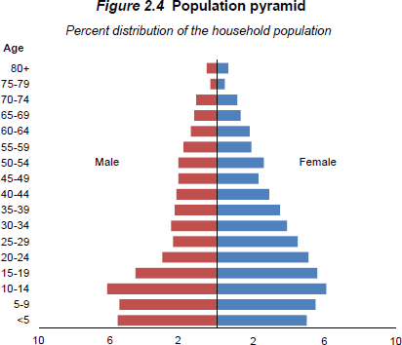
DEMOGRAPHY BPH
Conclusion: population pyramids of developing countries with almost triangular in shape and broad base of the combination of high birth rates and high death rates. Such type of pyramid is called constructive pyramid.
Population Pyramid 2016
Page 65

Slide 66
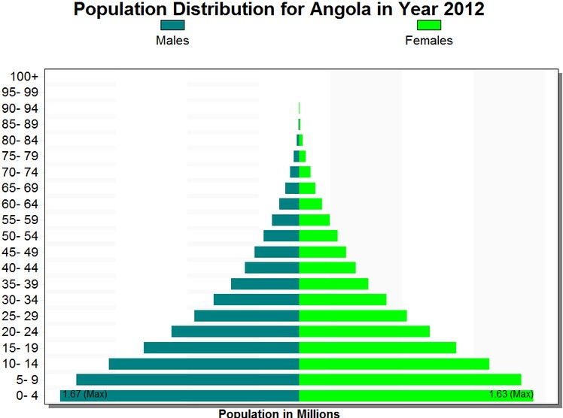
DEMOGRAPHY BPH
Expansive Pyramid
Pyramid for Developed Countries
Roughly rectangular in shape.
Pyramid shows a bulge in the middle and narrower base because of low birth rates.
Pyramid looks some what flat at the top. It indicates that there is higher life expectancy (large proportion of old population)
Conclusion:
These pyramids indicate a lower proportion of children and higher proportion of adults and the elderly in the population. This indicates that there are low fertility rate, more active population
and low death rate .Such types of pyramids are seen in developed countries such as Japan, Britain, America Sweden, Germany, Poland, Russia and France etc. Such type of pyramid is known as Stationary Pyramid
Page 66

Slide 67
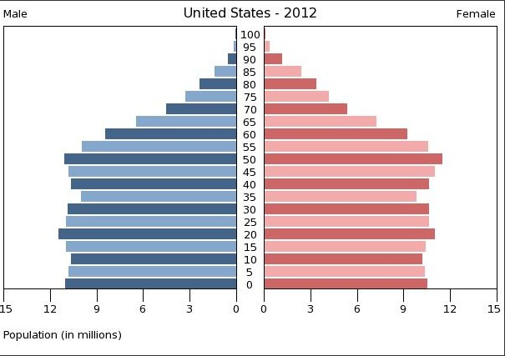
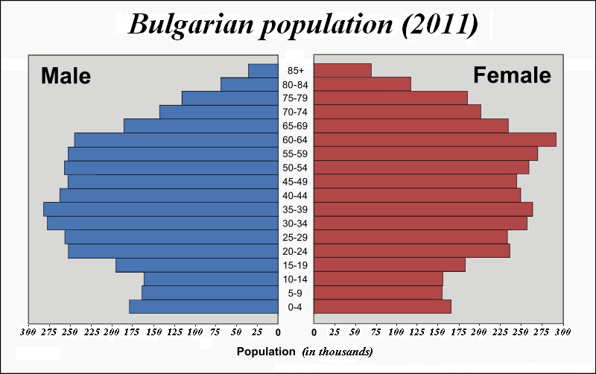
DEMOGRAPHY BPH
Page 67

Slide 68
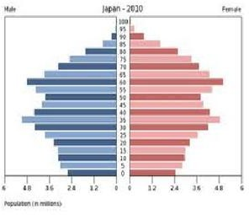
DEMOGRAPHY BPH
Types of Pyramids:
There are generally three types of population pyramids created from age-sex distributions--expansive, constrictive and stationary.
EXPANSIVE population pyramids show larger numbers or percentages of the population in the younger age groups. These types of pyramids are usually found in populations with very large fertility rates and lower than average life expectancies. The age-sex distributions of many Third World countries would probably display expansive population pyramids.
CONSTRICTIVE population pyramids display lower numbers or percentages of younger people. The age-sex distributions of the United States fall into this type of pyramid.
STATIONARY or near-stationary population pyramids display somewhat equal numbers or percentages for almost all age groups. Of course, smaller figures are still to be expected at the oldest age groups. The age-sex distributions of some European countries, especially Scandinavian ones, will tend to fall into this category.
Pyramid for developing countries
Almost triangular in shape.
Page 68

Slide 69
DEMOGRAPHY BPH
Relatively broad base of pyramid because of high birth rate.
It would be needle line form at the top indicating lower proportion of population at old ages i.e. low life expectancy.
The population pyramid narrows rapidly from base to triangular shaped top indicating relatively higher death rate in each age group.
Such type of pyramid is seen in the developing countries like Nepal, India, Philippines and Pakistan etc.
Conclusion: population pyramids of developing countries with almost triangular in shape and broad base of the combination of high birth rates and high death rates. Such type of pyramid is called Expansive Pyramid
Pyramid for Developed Countries:
Roughly rectangular in shape.
Pyramid shows a bulge in the middle and narrower base because of low birth rates.
Pyramid looks some what flat at the top. It indicates that there is higher life expectancy (large proportion of old population)
Conclusion:
These pyramids indicate a lower proportion of children and higher proportion of adults and the elderly in the population. This indicates
that there are low fertility rate, more active population and low
death rate .Such types of pyramids are seen in developed countries such as Japan, Britain, America Sweden, Germany, Poland, Russia and France etc. Such type of pyramid is known as Stationary
Pyramid
Page 69

Slide 70
DEMOGRAPHY BPH
Sex Ratio =
Number of Males
×100
Sex Ratio:
Number of Females
It is the ratio of males to females in the Population.
Sex ratio 100 denotes the point of balance of sexes accuracy to this measure. A sex ratio above 100 denoted an excess of males and a sex ratio below 100 denotes excess of females
Census year Male Female Sex ratio
2001 | 1,15,69,921 | 1,15,87,502 | 99.8
2011 | 1,28,49,041 | 1,36,45,463 | 94.16
Sex ratio
at birth: 1.07 male(s)/female
under 15 years: 1.07 male(s)/female
15-64 years: 1.02 male(s)/female
65 years and over: 0.79 male(s)/female
total population: 1.01 male(s)/female (2011 est.)
(http://www.indexmundi.com/world/demographics_profile.html)
The countries that have the highest proportion of males to females are Armenia – 115:100
Azerbaijan – 114:100
Georgia – 113:100
India – 112:100
Page 70

Slide 71
DEMOGRAPHY BPH
China – 111:100
Albania – 110:100
Some countries with very high proportions of males to females include...
United Arab Emirates Qatar
Kuwait Oman Bahrain Saudi A
– 274:100
– 218:100
– 178:100
– 140:100
– 136:100
(http://geography.about.com/od/populationgeography/a/sexratio.htm )
On the other hand, quite a few countries have far more females than males...
Chad - 84:100 Armenia – 88:100
El Salvador, Estonia, and Macau – 91:100 Lebanon – 92:100
Population size, growth and distribution:
Population of Nepal as of the census stands at 26,494,504. The increment of population during the last decade is recorded as 3,343,081 with an annual average growth rate of
1.35 percent.
Terai constitutes 50.27 percent (13,318,705) of the total population while Hill and Mountain constitutes 43 percent (11,394,007) and 6.73 percent (1,781,792) respectively.
Among the five development regions, Central development region has the highest population ( 36.45 percent) and far western region records the lowest ( 9.63 percent).
Page 71

Slide 72
DEMOGRAPHY BPH
Literacy Rate:
A person who is able to read, write and can do simple mathematical calculation is known as literate.
The census of 2011 had covered the population of aged above 5 years or above of age where as 2001 had took the population of aged 5 years and above.
Census year | Male | Literacy rate Female | Total
2001 | 65.35% | 42.8% | 59.1%
2011 | 75.1% | 57.4% | 65.9%(5yrs and above)
 | 75.9% | 57.7% | 66.5% (6 yrs and above)
The highest literacy rate is reported in Kathmandu district (86.3 %) and lowest in Rautahat (41.7%)
Educational Attainment:
Among the literate population, the maximum population were primary level ( passed i.e. 39% and followed by 20.3% lower secondary level ,10.2 % SLC and above and about 4.2% gained informal education.
Average Household Size:
It is defined as one or more persons who occupy a single housing unit.
Households consist of unrelated persons or persons related by birth, marriage, or adoption.
It is calculated as: No. of persons living in HH Total Households
Page 72

Slide 73
DEMOGRAPHY BPH
For Nepal(2011) HH size = 2,64,94,504
= 4.88
5427302
It was 5.44 in 2001. It is highest in Rautahat (6.44) and lowest in Kaski district(3.92)
Working age population:
The working age population (aged 15 to 59 years) has increased from 54 percent (12,310,968) in 2001 to about 57 Percent (15,091,848) in 2011 showing the population structure is shifting for enjoying demographic dividend in the country.
Age Dependency:
It is the ratio of combined child population(0-14 years) and elder population (above 60 years) to the economically active population(15-60 years).
It is an indicator of the economic burden the productive population .
Country with high birth rate like Nepal has high child dependency ratio.
Dependency ratio = P₀₋₁₄ + P₆₀₊
P15-60
In 2001, it was 85 where as in 2011 the dependency ratio was 75.
Population density:
Population density refers the number of persons per square unit area i.e. km. or miles. Density deals with pressure of population on land. It is an effective index to measure the
pressure of population on land. The population density is calculated as
Totalpopulation
Totalland area
Population density (average number of population per square kilometer) at the national level is 180 compared to 157 in 2001.
Page 73

Slide 74
DEMOGRAPHY BPH
The highest population density is found in Kathmandu district (4,416 person per square km) and lowest (3 person per square km) in Manang district
Urban Population:
The urban population (population residing in 58 municipalities) constitutes 17 % (4,523,820) of the total population compared to 13.94% (3,227,879)
Caste/Ethnicity:
There are 125 caste/ethnic groups reported in the census 2011. Chhetri is the largest caste/ethnic groups having 16.6% (4,398,053) of the total population followed by
Brahman-Hill (12.2% ; 3,226,903)
Magar (7.1% ; 1,887,733)
Tharu (6.6% ; 1,737,470)
Tamang (5.8% ; 1,539,830)
Newar (5.0% ; 1,321,933)
BK (4.8% ; 1,258,554)
Musalman (4.4% ; 1,164,255)
Yadav (4.0% ; 1,054,458) and
Rai (2.3% ; 620,004).
Religion:
There are ten types of religion categories reported in the census. Hinduism is followed by 81.3 percent (21,551,492) of the population while
Buddhism (9.0%; 2,396,099)
Islam (4.4%; 1,162,370)
Page 74

Slide 75
DEMOGRAPHY BPH
Kirat
(3.1%; 807,169)
Christianity
(1.4%; 375,699)
Prakriti
(0.5%; 121,982)
Bon
13,006
Jainism
3,214
Bahai
1,283)and
Sikhism
609.
Disability:
About two percent (1.94%; 513,321) of the total population reported to have some kind of disability.
Physical disability constitutes 36.3 percent of the population with disability followed by Blindness/Low Vision (18.5%), Deaf/Hard to hearing (15.4%), Speech problem (11.5%), Multiple Disability (7.5%).
Mental Disability (6%), Intellectual Disability (2.9%) and Deaf-Blind (1.8%).
Life expectancy:
It is defined as the average number of years a new born baby will survive if he/she is subjected to the current mortality pattern.
Life expectancy like IMR is free from distortions of age composition and this international comparison can readily be made.
So it is considered one of the best indicator of health
It is also most favored indicators of social development and used as one of component s of Human Development Index.
It is denoted by eº. It depends on the mortality pattern.
Page 75

Slide 76
DEMOGRAPHY BPH
Life expectancy, a basic indicator, is closely connected with health conditions which are in turn an integral part of development.
Increase in human longevity reflects the gains of public health and access to primary health care services.
After reducing the mortality and morbidity, it can be increased.
To calculate life expectancy we need the age specific mortality rates which are difficult to obtain. It requires a survey of large sample size. Furthermore, as the coverage of birth and death registration is poor, life expectancy of Nepal and other developing countries can be estimated by using census data employing indirect techniques i.e. life table methods
The situation of life expectancy of Nepal according to 2001 census is 62.20. For male it is
61.76 where as for female 62.50.
Page 76

Slide 77
DEMOGRAPHYBPH
8. Population growth trend: Population change
Population change has three components births, deaths and migration. As people are born, die or move which effects their total population in area.
The change in population over a unit time period is expressed as a percentage of the
population at the beginning of the time period.
There are various methods for measuring change in population size:
Rate of Natural Increase(NIR)
It is the surplus or deficit of births over deaths in population in a given time period
NIR =
Births − Deaths
×100
Mid year population
2. Population growth rate(PGR)
B − D + I − E
It is calculated as: PGR =
Mid year population
×100
Or
PGR = Rate of natural increase ± Net migration rate
3. Balancing equation P₂ = P₁+ (B-D)+(I-E) Where
P1 = population at the earlier date P2 = population at the later date
B= Births between the two dates of P1 and P2 D = Deaths between the two dates of P1 and P2
I = Immigration( in migration) between two dates E = Emigration(out migration) between two dates
4. Decadal growth rate
Growth rate = ^{P2 − P1}×100
P1
P2= population at end of period
Page 77

Slide 78
DEMOGRAPHY BPH
P1 = populaiton at beginning of period
P₂ − P₁
Annual Growth rate =
P₁ (t₂ - t₁ )
×100
Annual population growth rate of Nepal from different census
Census year | APGR | Census year | APGR
1911 | -0.13 | 1971 | 2.07
1921 | -0.70 | 1981 | 2.66
1931 | 1.16 | 1991 | 2.08
1941 | 1.16 | 2001 | 2.25
1952 | 2.30 | 2011 | 1.4
1961 | 1.65
Annual population growth rate of SAARC countries(world bank, 2010)
Country | APGR
Pakistan | 2.1
Bhutan | 1.6
Page 78

Slide 79
DEMOGRAPHY BPH
Nepal | 1.6
Bangladesh | 1.4
Maldives | 1.4
India | 1.3
Sri-Lanka | 0.7
Annual population growth rate of some other countries(Source: world bank, 2010)
Country | APGR
Canada | 1.0
Sweden | 0.8
USA | 0.6
Japan | -0.1
Uk | 0.7
Page 79

Slide 80
DEMOGRAPHY BPH
China | 0.5
Quater | 3.92(2010)
Djibouti | 4.3(UNDP,2007)
Countries with negative APGR
Country | APGR-2005
Belarus | -0.2
Bulgaria | -0.5
Estonia | -0.1
Germany | -0.2
Hungary | -0.2
Latvia | -0.4
Croatia | -0.0
Population trend of Nepal:
Census yrs | Population | r | DT | Pop. Density
1911 | 56,38,749 | - | - | 38.31
1921 | 55,63,788 | -0.13 | - | 37.87
1931 | 55,32,574 | -0.07 | - | 37.59
Page 80

Slide 81
DEMOGRAPHY BPH
1941 62,83,649 1.16
1951-53 82,56,625
60
42.69
2.60
31
56.1
• | 1961 | 94,12,996 | 1.65 | 42 | 63.96
• | 1971 | 1,15,55,983 | 2.07 | 34 | 78.52
• | 1981 | 1,50,20,839 | 2.66 | 26 | 102.07
• | 1991 | 1,84,91,097 | 2.08 | 33 | 125.64
• | 2001 | 2,31,51,423 | 2.24 | 31 | 157.3
• | 2011 | 2,66,20,809 | 1.4 | 50 | 181
Census 2011: Parameter |  | 2001 | 2011
Total population |  | 23151423 | 26620809
Male population |  |  | 12927431(48.56%)
Female population |  |  | 13693378(51.44%)
Annual population growth rate |  | 2.25 | 1.4
Sex ratio(male per hundred female) |  | 99.8 | 94.41
Average household size |  | 5.44 | 4.70
Population by ecological belt
Mountain | 6.75%
Hill | 43.10%
Tarai | 50.15%
Page 81

Slide 82
DEMOGRAPHY BPH
Females outnumber males
Sex ratio is low
Sex ratio is low in several hill districts
Mountain and hilly population decrease
Terai occupy the half of the country‟s population
Negative growth rate has been seen in some districts such as Syangja, Parbat, Gulmi, Arghakhanchi and Khotang.
Population density highest in Kathmandu (4408) and lowest in Manang (3)
The country is in third stage demographic transition
World Population Trends:
At the beginning of the christian era, nearly 2000 years ago, the world population was estimated one billion. The world population in different period is presented in the following table.(UNFPA-2001)
Period | Population (in billion)
1930 | 2
1960 | 3
1975 | 4
1987 | 5
1999 | 6
Page 82

Slide 83
DEMOGRAPHY BPH
2001 | 6.1
2005 | 6.47
2025 | 7 (Expected)
2050 | 9 (Expected)
Most Populous Countries, 2012:
2012 |  | 2050
Country | population(m) | Country | Population(m)
China | 1,350 | India | 1691
India | 1,260 | China | 1,311
United States | 314 | United States | 423
Indonesia | 241 | Nigeria | 402
Brazil | 194 | Pakistan | 314
Pakistan | 180 | Indonesia | 309
Nigeria | 170 | Bangladesh | 226
Bangladesh | 153 | Brazil | 213
Russia | 143 | Congo Rep. | 194
Page 83

Slide 84
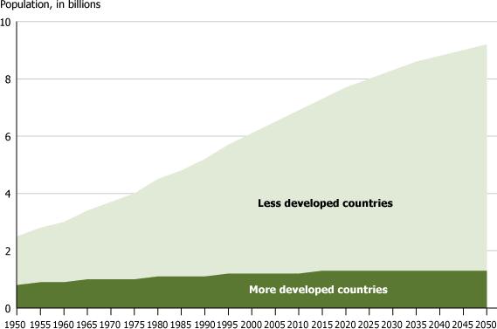
DEMOGRAPH BPH
Japan | 128 | Ethiopia | 166
World Population Growth, 1950–2050
Causes of Rapid Population Growth in developing countries
The populations of developing countries are still growing faster. The main causes of their rapid rates are given below:
Low cost of child bearing
Children are regarded as source of economy.
Page 84

Slide 85
DEMOGRAPHY BPH
High infant mortality and low life expectancy.
Strong feeling on son preference.
Children are regarded as source of recreation.
High fertility rate.
Importing health and medical facilities.
Religion.
Early marriage.
Age structure
Causes of Rapid Population Growth
Low cost of child bearing
Children are regarded as source of economy.
High infant mortality and low life expectancy.
Strong feeling on son preference.
Children are regarded as source of recreation.
High fertility rate.
Importing health and medical facilities.
Urbanization
Industrialization
Education
Occupation
Economic situation
Page 85

Slide 86
DEMOGRAPHY BPH
Geographical variation
Religion.
Early marriage.
Age structure
10.Population Policy and program in Nepal
Page 86

Slide 87
DEMOGRAPHY BPH
Nepal Demographic Health Survey 2022
The 2022 Nepal Demographic and Health Survey (2022 NDHS) was implemented by New ERA under the aegis of the Ministry of Health of Nepal.
Funding for the survey was provided by the United States Agency for International Development (USAID).
ICF provided technical assistance through the DHS Program, which assists countries in the collection of data to monitor and evaluate population, health, and nutrition programs.
The 2022 Nepal Demographic and Health Survey (NDHS) was conducted as a periodic update of the demographic and health situation in Nepal.
The 2022 NDHS was the sixth DHS survey to be conducted in Nepal in collaboration with the worldwide Demographic and Health Surveys Program.
The primary objective of the 2022 NDHS is to present up-to-date estimates of basic demographic and health indicators. The NDHS provides a comprehensive overview of population, maternal, and child health issues in Nepal
Background characteristics (including age, education, and media exposure)
Pregnancy history and child mortality
Knowledge, use, and source of family planning methods Fertility preferences (including desire for more children, ideal number of children)
Antenatal, delivery, and postnatal care
Vaccinations and childhood illnesses
Breastfeeding and infant feeding practices
Women’s work and husbands’ background characteristics
Knowledge, awareness, and behavior regarding HIV and other sexually transmitted infections (STIs)
Fistula
Mental health
Domestic violence
Knowledge, attitudes, and behavior related to other health issues (for example, cancer, smoking, tuberculosis, and COVID-19)

Slide 88
DEMOGRAPHY BPH
Nepal Demographic Health Survey 2022 Key Indicator
Household Water, Sanitation, And Hygiene
In Nepal, almost all of the population (98%) has access to at least basic drinking water service.
25% of the population uses drinking water treated with appropriate methods (boiling, bleaching, filtering, and solar disinfection).
73% of the population has access to at least basic sanitation service.
83% of the population lives in households that appropriately manage household excreta.
72% of the population has a basic handwashing facility, while 27% has a limited handwashing facility.
61% of women were able to wash and change in privacy and used appropriate materials during their last menstruation.
Housing Characteristics And Household Population
41% of the de jure population relies primarily on clean fuels and technologies for cooking, space heating, and lighting.
73% of children under age 5 have their births registered with the civil authorities, and 72% have a birth certificate.
The percentage of residents age 6 and older with no education has declined over time, from 67% in 1996 to 35% in 2022 among females and from 36% in 1996 to 16% in 2022 among males.
13% of the population experienced moderate or severe food insecurity in the 12 months preceding the survey. Food insecurity was highest in Karnali Province, with 36% of the rural population in this province facing moderate or severe food insecurity.

Slide 89
DEMOGRAPHY BPH
Nepal Demographic Health Survey 2022 Key Indicator
Fertility
The total fertility rate for the 3 years preceding the survey is 2.1 births per woman, a decline from 2.3 in 2016.
The median interval between births is 40.7 months, with 20% of births occurring less than 24 months after the preceding birth.
The median duration of postpartum amenorrhea is 6.3 months, the median duration of abstinence from sexual intercourse is 3.5 months, and the median duration of insusceptibility to pregnancy is 7.5 months.
The median age at first birth among women age 25–49 is 20.6 years.
Teenage pregnancy: Among women age 15–19, 14% have ever been pregnant, 10% have had a live birth, and 2% have had a pregnancy loss.
Among women age 15–49, 9% have had a miscarriage and 10% have had an induced abortion.
Fertility Preference
In general, 10% of married women age 15–49 want to have another child soon, 13% want to wait at least 2 years, and 70% want no more children or are sterilized.
The mean ideal number of children is 2.0 among women and 2.2 among men. In general, ideal family size increases with increasing numbers of living children among both women and men.
Among all pregnancy outcomes, 73% of pregnancies in the 3 years preceding the survey were wanted at the time of conception, 16% were mistimed, and 11% were unwanted. Sixty-two percent of pregnancies that ended in abortions were unwanted.
The total fertility rate in Nepal is 2.1 children per woman, while the total wanted fertility rate is 1.7 children per woman. On average, women have 0.4 more children than they desire.

Slide 90
DEMOGRAPHY BPH
Nepal Demographic Health Survey 2022 Key Indicator
Family Planning
Overall, 57% of currently married women age 15–49 use any method of family planning, with 43% using a modern method and 15% using a traditional method.
14% of currently married women age 15–19 use a modern method of family planning.
21% of currently married women age 15–49 have an unmet need for family planning. Unmet need is highest among young women age 15–19 (31%).
55% of the total demand for family planning is satisfied by modern methods.
In the 5 years preceding the survey, the 12-month contraceptive discontinuation rate was 49%. The rate was highest for pills (67%), followed by male condoms (60%) and injectables (59%). The main reasons for discontinuing methods were infrequent sex or the husband being away (44%), desire to become pregnant (15%), and side effects or health concerns (14%).
Infant and Child Mortality
The neonatal mortality rate, infant mortality rate, and under-5 mortality rate are 21, 28, and 33 deaths per 1,000 live births, respectively. This implies that nearly two-thirds of all under-5 deaths occur in the first month of life.
Neonatal mortality fell from 50 to 21 deaths per 1,000 live births between 1996 and 2016 but has since remained unchanged. Infant mortality declined from 78 to 28 deaths per 1,000 live births and under-5 mortality fell from 118 to 33 deaths per 1,000 live births between 1996 and 2022.
The perinatal mortality rate is 27 deaths per 1,000 pregnancies of 28 or more weeks’ duration. Stillbirths account for more than one-third of perinatal mortality.

Slide 91
DEMOGRAPHY BPH
Nepal Demographic Health Survey 2022 Key Indicator
Maternal and Newborn Healthcare
94% of women received antenatal care (ANC) from a skilled provider for their most recent live birth or stillbirth in the 2 years preceding the survey. Eighty percent of women had at least four antenatal care visits.
The median gestational age at the first ANC visit was 3.5 months.
Protection against neonatal tetanus: 93% of the most recent live births to women in the 2 years preceding the survey were protected against neonatal tetanus.
79% of deliveries were conducted in a health facility, and 62% took place in a public sector health facility. Eighteen percent of deliveries in the 2 years preceding the survey were delivered via cesarean section. Overall, 80% of deliveries were conducted by skilled providers.
70% each of women and newborns received a postnatal check during the first 2 days after delivery.
Cancer examinations: 6% of women age 15–49 were tested for cervical cancer and 4% were examined for breast cancer.
Distance to the nearest health facility: 77% of women age 15–49 reported that it takes them less than 30 minutes to travel to the nearest health facility.
Early childhood Mortality
The overall under-5 mortality rate was 33 deaths per 1,000 live births.
The infant mortality rate was 28 deaths per 1,000 live births. The child mortality rate was 5 deaths per 1,000 children surviving to age 12 months.
The neonatal mortality rate was 21 deaths per 1,000 live births, during the 5 years immediately preceding the survey.
Eighty-five percent (85%) of all deaths among children under age 5 in Nepal take place before a child’s first birthday, with 64% occurring during the first month of life

Slide 92
DEMOGRAPHY BPH
Nepal Demographic Health Survey 2022 Key Indicator
Vaccination Coverage
Overall, 80% of children age 12–23 months are fully vaccinated with basic antigens.
Ninety-five percent (95%) of children age 12–23 months received BCG vaccine, 89% received the third dose of DTP-HepB-Hib, 86% received the third dose of OPV, and 89% received a dose of MR.
Slightly more than half of the children age 12–23 months (52%) are fully vaccinated according to the national schedule.
Eighty-five percent (85%) of children received the second dose of fIPV, 81% received the third dose of PCV, 72% received the 2nd dose of RV, and 81% received a dose of JE vaccine.
Four percent (4%) of children age 12–23 months have received no vaccinations
Child Nutritional Status
The nutritional status of children under age 5, according to the three anthropometric indices: 25% of children under age 5 are stunted, 8% are wasted, and 19% are underweight. One percent of children under 5 are overweight.
Infant and young child feeding
Fifty-five percent (55%) of children age 0–23 months engaged in early initiation of breastfeeding.
Seventy-eight percent (78%) of children age 6–23 months met the minimum dietary diversity requirement.
Fifty-six percent (56%) of children under 6 months were exclusively breastfeed

Slide 93
DEMOGRAPHY BPH
Nepal Demographic Health Survey 2022 Key Indicator
Anemia
43% of children age 6–59 months are anemic, including 25% who are mildly anemic, 18% who are moderately anemic, and less than 1% who are severely anemic.
34% of women are anemic, including 18% who are mildly anemic, 15% who are moderately anemic, and 1% who are severely anemic.
HIV
Sixty-five percent (65%) of young women and 88% of young men know that consistent use of condoms can reduce the risk of getting HIV.
Sixty-nine percent (69%) of young women and 85% of young men know that having just one uninfected partner can reduce the chance of getting HIV.
Only 16% of young women and 27% of young men have a thorough knowledge of HIV prevention methods.
Disability
Overall, 71% of the de facto household population age 5 or older have no difficulty in any of the functional domains.
Among the de facto household population age 5 or older 23% have some difficulty in at least one functional domain, 5% have a lot of difficulty, and 1% cannot do at least one domain.
Six percent (6%) of the de facto household members age 5 or older have a lot of difficulty or cannot function at all in at least one of the functional domains.
Among the de facto household population age 5 and older, the most common disability reported is difficulty seeing (15% ) followed by difficulty walking or climbing steps (12%).

Slide 94

DEMOGRAPHYBPH
Application of demography in Public Health:
Page 94

Slide 95

DEMOGRAPHY BPH
Page 95

Slide 96

DEMOGRAPHY BPH
Page 96

Slide 97

DEMOGRAPHY BPH
Page 97

Slide 98

DEMOGRAPHY BPH
Page 98

Slide 99

DEMOGRAPHY BPH
Page 99

