Slide 1
Environmental Impact Assessment
Kirti Sagar Baral, MPH, MA

Slide 2
Background
History of EIA is almost 50 years long.
Environmental Impact Assessment (EIA) emerged as a response to the concern expressed by the environmental movements of 1960s;
Since the 1960s, growing environmental awareness has focused attention on the interactions between development actions and their environmental consequences.
The use of EIA began in 1970 in USA and spread rapidly throughout the world particularly after the UN Earth Summit held in 1992.
To date many of the countries of world have a legal and institutionalized system of EIA.

Slide 3
Definition
A systematic process of identifying, predicting, analyzing, evaluating and mitigating the direct and indirect environmental effects of a proposed activity before permission is given for it to commence.
UNEP defines Environmental Impact Assessment (EIA) as a tool used to identify the environmental, social and economic impacts of a project prior to decision-making.

Slide 4
Definition
A broader definition stresses the need to identify and assess the potential impacts, not only of projects, but also of legislative proposals, policies, programmes and operational procedures, on the environment, human health and well-being, and to communicate information about those impacts to the general public.

Slide 5
Definition
Environmental impact assessment (EIA) is one of the environmental assessment tools being used worldwide to provide decision-makers and the concerned public with essential information to plan for environmentally sustainable economic development.
It is a systematic analysis of projects to determine their potential environmental impacts and the significance of such impacts and to propose measures to mitigate the negative impacts.

Slide 6
Concept
Environmental Impact Assessment (EIA) is a process of evaluating the likely environmental impacts of a proposed project or development, taking into account inter-related socio-economic, cultural and human-health impacts, both beneficial and adverse.

Slide 7
Concept
A tool to minimize negative impact of human activities on the environment.
Assesses environmental impacts to minimize engineering biases
A bridge between economic prosperity and environmental sustainability

Slide 8
Planning and Decision making tool
EIA is both a planning tool and a decision-making tool.
As a planning tool, EIA presents methodologies and techniques for identifying, predicting, and evaluating potential environmental impacts of projects as per the project cycle.
As a decision-making tool, it provides information that promotes policy-making and actions that ensure sustainability in the implemented projects.

Slide 9
What EIA actually do ?
Identifies environmental risks,
Examines the significance of environmental implications
Assesses whether environmental impacts can be mitigated
Recommends preventive and mitigative measures
Advises whether developmental projects should proceed
informs decision-makers and interested parties about environmental implications of the project
lessens conflicts by promoting community participation,
helps lay the base for environmentally sound projects.
minimizes adverse environmental effects,
Reduces the overall cost of the project and maximizes project benefits
Makes development projects environmentally sustainable

Slide 10
Aim

Slide 11
Key Elements
Description of the proposal
Baseline information on existing environment of proposal implementation site
Identification/prediction of impacts and evaluation of their significance
Analysis of alternatives
Adverse impact mitigation measures/benefit
Enhancement measures
Environment management plan
Feedbacks from public concerned/stakeholders

Slide 12
Who are involved in EIA
A range of organizations may be involved, including government agencies, developers, nongovernmental, and public organizations.
The level of involvement may vary significantly depending on the type of project that is assessed.

Slide 13
EIA in Nepal
Environmental Assessment Guideline 1993 was the first “lesson learnt” document in Nepal which has played facilitation role in the EIA process.
Until than, international obligations, conventions, guideline, treaties applied for the environmental and biodiversity conservation measures at the policy level.

Slide 14
EIA in Nepal
EPR 1997 made IEE/EIA mandatory for the governmental as well as the private sector.
Prior to this, IEE/EIA was mandatory only for the governmental sector, ever since the enforcement of the National Guidelines (1993)
Sixth Five Year Plan (1980-1985) had for the first time mentioned the need for EIA for major infrastructure projects.

Slide 15
Law related to IEE/EIA
The Convention on Biological Diversity (CBD) , 1992 obliges the Party countries to introduce appropriate procedures for EIA
The government of Nepal enacted the Environment Protection Act (EPA) 1997 and the Environment Protection Rules (EPR), 1997, which makes the integration of IEE and EIA legally binding to the prescribed projects.
Proposals requiring IEE and EIA study are included in Schedules 1 and 2 of the EPR, 1997 respectively.

Slide 16
Some other Sectoral Laws
Forest Act, 1993
The Water Resources Act 1993
Public Road Act, 2031,
Road Board Act 2002,
Land Acquisition Act 2034 and Land Acquisition Regulations 2026,
Buffer Zone Management Regulation 1996,
Himalayan National Park Regulations, 1979
Mines and Minerals Rules, 2000
Explosive Material Act, 2018,
Road Board Act 2002,
Local Self-Governance Act (1999) and Rules (2000),

Slide 17
National EIA Guideline
The National EIA Guidelines for Nepal was drafted, tested and finalized through a participatory approach and endorsed on 27 September 1992.
The National EIA Guidelines contains objectives, methods of screening projects requiring the level of environmental assessment (IEE or EIA), scoping, impact identification and prediction, report review, monitoring and evaluation and impact auditing.

Slide 18
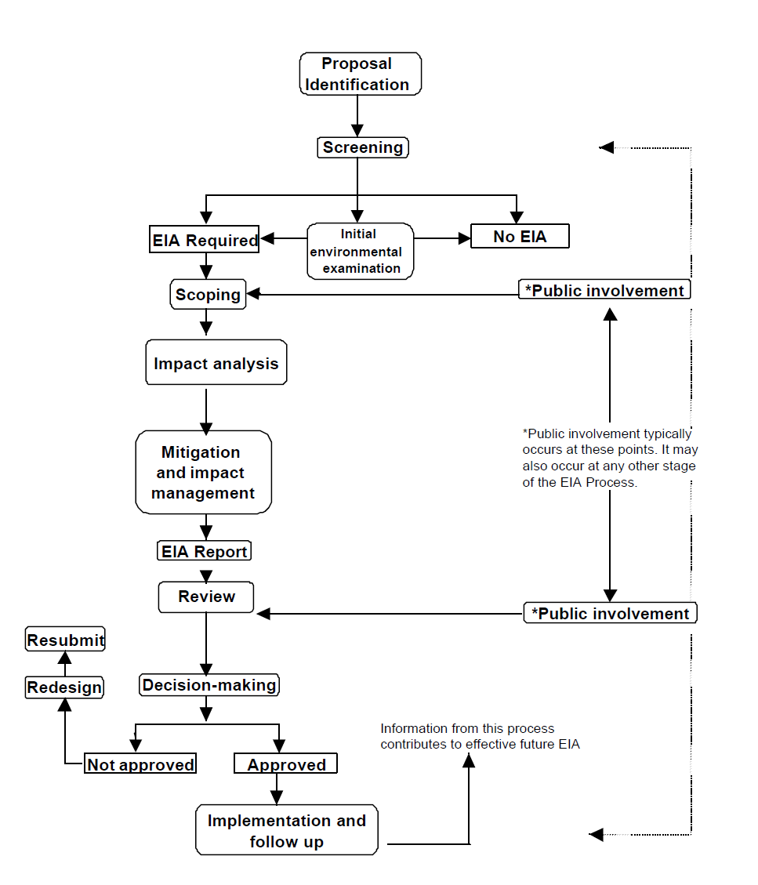
Steps of EIA

Slide 19
Steps of EIA
1. Screening
  to determines whether a particular project require EIA or not. That is which projects or developments require a full or partial impact assessment study;
2. Scoping
  to identify which potential impacts are relevant to assess (based on legislative requirements, international conventions, expert knowledge and public involvement),
  to identify alternative solutions that avoid, mitigate or compensate adverse impacts on biodiversity (including the option of not proceeding with the development, finding alternative designs or sites which avoid the impacts, incorporating safeguards in the design of the project, or providing compensation for adverse impacts), and
  finally to derive terms of reference for the impact assessment;

Slide 20
Steps
3. Assessment and evaluation of impacts and development of alternatives,
  to predict and identify the likely environmental impacts of a proposed project or development, including the detailed elaboration of alternatives;
4. Reporting the Environmental Impact Statement (EIS) or EIA report, including an environmental management plan (EMP), and a non-technical summary for the general audience.

Slide 21
Steps
5. Review of the Environmental Impact Statement (EIS), based on the terms of reference (scoping) and public (including authority) participation.
6. Decision-making on whether to approve the project or not, and under what conditions; and
7. Monitoring, compliance, enforcement and environmental auditing. Monitor whether the predicted impacts and proposed mitigation measures occur as defined in the EMP. Verify the compliance of proponent with the EMP, to ensure that unpredicted impacts or failed mitigation measures are identified and addressed in a timely fashion.

Slide 22
Steps (sum up)
Screening (Is an environmental impact necessary ?)
Scoping (What should be included in the study?)
Impact identification and prediction (What aspects of the project will cause what impacts in the environment ?)
Impact mitigation (What are the alternatives, preventive measures and modifications to reduce the predicted impact of the project ?)
Reporting (What are the key issues to be taken by decision makers ?)
Decision making (Do the benefits of the project (social and economic) outweigh the environmental cost ?)
Monitoring, compliance and auditing (Were the environmental impacts correctly predicted?)

Slide 23
Project Screening

Slide 24
Screening
Screening is the process undertaken to decide which environmental assessment method is required to be undertaken for a given project.
The first step of EIA done to check its requirement.
While screening, we check scale, location and type of project. This gives an early assessment of major environmental impacts that are likely to occur.

Slide 25
Project Screening
To determine whether environmental impact assessment is necessary
Saves time and money
Inform about the need and scale of the project
Immediately identify environmental issues of major concern
Determine whether EIA needs to be conducted

Slide 26
Project Screening
Screening divides the project into 3 components:
Clearly requiring an EIA
Not requiring an EIA
The need for EIA is not clear

Slide 27
Project screening criteria
In the course of project screening, it shall be determined whether or not EIA is necessary generally based upon indicators such as prescribed parameters, financial threshold and sensitive area. For eg
  If land requirement large,
  if affected area extends beyond immediate locality and impacts surrounding population,
  construction is highly visible and disrupts aesthetic values,
  high capital investment and costly land,
  expensive machinery and processing plants required

Slide 28
Project screening criteria
An initial environmental examination (IEE) report must be prepared for those projects which may cause significant impact on environment, whose impact may be known easily and for which mitigation measures may be discovered easily
An EIA report must be prepared for the proposed projects if deemed necessary

Slide 29
Initial Environmental Examination
A rapid analysis using simple tools
conducted to determine whether or not significant impacts are likely and whether such impact may be removed by adopting appropriate measures.
However, in case IEE is sufficient to provide definite solutions to identified environmental problems likely to appear by the implementation of the project, an EIA shall not be necessary.

Slide 30
Timing for Project Screening and Initial Environmental Examination
Project screening and initial environmental examination should be usually undertaken during the pre-feasibility stage of a project.

Slide 31
Difference between IEE and EIA

Slide 32
Scoping

Slide 33
Scoping for Environmental Impact Assessment
Scoping done after completing the work for project screening
Scoping helps in understanding the extent of environmental impacts and identifies significant environmental issues for further study. An open process for determining scope of the study.
Two way communication between proponents and public
The aim of scoping is discovering the alternatives to the proposed activities of the project identified as having potentially significant impacts on the environment, selecting appropriate alternatives, and determining the issues to be considered during the EIA.
Scoping for EIA should be done continuously during the project planning and designing phases as required.

Slide 34
Objectives of scoping
To Identify the issues and relevant aspects to be considered for EIA.
To make EIA focused and efficient
To ensure contextual relevance of EIA
To provide basis for preparation of ToR for EIA
TP find out all the aspects likely to be affected by the project.
TO provide an opportunity for public involvement
To facilitate early agreement on contentious issues.

Slide 35
Methods for Scoping
Public Involvement, collect suggestions in return, hold meetings, field observation, form task forces
Collecting relevant data and information
Providing necessary notification and information to the people likely to be affected by the project
Identifying major Issues of public concern
Evaluating the seriousness of the Issues on the basis of available information
Establishing priorities for EIA (prioritization of the issues)
Developing a strategy for addressing priority issues (immediate and long term)

Slide 36
Scoping requirement in Nepal
The proponent publishes notice in national daily to ask the stakeholders for suggestions within 15 days
The suggestions are sent to the proponent within 15 days of the notice
The proponent along with the received suggestions and concerns sends an application to the concerned authority for scope determination
The concerned authority carries out investigation and sends to the MoE
MOE carries out investigation on the document and determines the scope as proposed or suggested

Slide 37
Public Notice for Scoping
The EIA process starts with the publication of public notice for scoping.
The purpose of public notice is to inform the stakeholders particularly of the project influence area about the project.
The proponent has to publish a 15 day public notice in Nepali in the national daily newspaper.
The copies of the public notice should also be pasted at the offices of the concerned VDCs of the project area for providing local people an opportunity to offer their comments and suggestions.
The notice calls upon the concerned parties, project affected people, and in broader sense stakeholders to offer suggestions and concerns about natural systems, cultural practices, social systems, economic and human activities and interrelationships of environmental components.

Slide 38
Public Notice for Scoping

Slide 39
Who is involved in scoping ?
Relevant authorized agency
Concerned agencies of GON associated with development work (public works, forest, agriculture, livestock, water resources, health,
Relevant donor agencies
Local personalities, politicians, teachers, women, students, farmers, etc
Review agencies
Representatives of agencies associated with development projects.

Slide 40
Timing for scoping
After completion of the project screening, at the pre-feasibility stage of the project cycle.

Slide 41
TOR
TOR for environmental impact assessment shall be prepared on the basis of the scoping exercise.
A document that provides specific guidelines for EIA

Slide 42
Objectives of preparation of TOR
To systematize the working procedure.
To delineate major activities to be implemented.
To fit EIA with existing policy, rules and administrative procedures.
To accomplish the job within a specified time limit.
To give special emphasis to then most significant aspects of the study
To provide technical guidance relating to main aspects of the environment which require delineation in the course of study. (To indicate the nature and extent of data to be collected, to specify the most relevant/specific methods, others)

Slide 43
Format for TOR (EPR 1997, Schedule 4)
Name and address of the individual or institution preparing the report
General introduction of the proposal:
Data needed for the preparation of the report, and procedure of collecting them:
Policies, laws, rules and manuals to be taken into account while preparing the report
Preparation of the Report :
a. Time
b. Estimated budget
c. Necessary Experts

Slide 44
Format for TOR (EPR 1997, Schedule 4)
6. Scope determined for the preparation of the report.
7. Impact on the environment of the implementation of the report :
a. Social and economic
b. Cultural and physical
c. Chemical
d. Biological
8. Other alternatives for the implementation of the proposal:
a. Design
b. Project site
c. Technology, procedure of operation, time-schedule and raw materials to be used.
d. Environment management system.
e. Whether or not the risks resulting from the implementation of the proposal can be accepted.
f. Other matters.

Slide 45
Format for TOR (EPR 1997, Schedule 4)
9. Measures to remove any negative impact that may be noticed while implementing the proposal.
10. Particulars of the cost and returns of the proposal.
11. Matters to be monitored while implementing the proposal.
12. Relevant information, reference lists, annexes, maps, photographs, tables and charts, graphs and questionnaires to be mentioned at the time of preparing the report.,

Slide 46
Baseline Information and its methods of collection

Slide 47
Baseline Information
Baseline information is important reference point for conducting EIA.
The term "baseline" refers to the collection of background information on the biophysical, social and economic settings proposed project area.
Baseline data are collected for two main purposes:
  to provide a description of the status and trends of environmental factors against which predicted changes can be compared and evaluated in terms of importance, and
  to provide a means of detecting actual change by monitoring once a project has been initiated

Slide 48
Methods used in the study
Walkover survey
Household survey/Census
FGD/Farm-level interviews/Key informant interview
Literature review
Sampling and lab testing
Interpretation of maps/satellite images

Slide 49
Information collection
Physical environment
Socioeconomic environment
Biological environment
Cultural environment

Slide 50
Physical environment
Topography
Land-use
Geology
Climate
Water resources
Ambient air

Slide 51
Socio-economic environment
Demography
Economic activities
Key local products
Access to market facilities
Literacy level
General price level of key commodities
Women/children
Vulnerable segment of local population

Slide 52
Cultural environment
Temples/Gumbas/Mosques
Places of historic/cultural significance
Local significance
Regional significance
National significance
Cemetery/Ghats
Historic/cultural monuments

Slide 53
Biological environment
Forest resources
Rare/endangered species of plants
Plant species of religious/medicinal/commercial values
Wild animals & their habitat
Rare/endangered species of animals
Community forests
Local dependence on forest resources

Slide 54
Identification of environmental Impact

Slide 55
Identification of environmental Impact
Direct Impact: Direct impact refers to a direct alteration in the existing environmental condition as a consequence of project activity.
Indirect Impact: Indirect impact results when one component of the environment has repercussions on other related components. A direct impact can have long-term effects, producing numerous indirect impacts, depending on the structure and function of the particular system being stressed by development activities.

Slide 56
Cumulative Impact
Environmental impact caused by a single activity may not be significant. However, a series of similar types of impacts created by more than one project or the combined effect of several impacts created by one project may be significant.
As a result, an ecosystem may be dramatically affected by such cumulative impacts.
Therefore it is necessary to pay special attention to cumulative impacts likely to be caused by those projects sharing mutual resources and affecting a particular area

Slide 57
Types of Impact
Biological and Physio-chemical Impacts (effects on biophysical resources eg vegetation, crops, wildlife, aquatic life, soil erosion, floods, air, water and soil quality, etc)
Socio- economic Impact (changes in livelihood options, income etc)
Demographic impacts (eg migration, displacement)
Institutional impacts (impact on other organizations)
Cultural Impacts (cultural heritage, historical sites, traditions etc)
Health Impact (possible risk factors, effect in health status)

Slide 58
Methods of impact identification and comparison
Checklist method
Matrix method
Network method

Slide 59
Checklist method
These methods used in combination with environmental guidelines
It involves the preparation of a list of environmental, social and economic factors which may be affected by the concerned project.
They may be sector specific (industry, forestry, agriculture) or area specific (wetlands, tropical forests etc)
Any impact that exceeds the threshold of concern value is considered to be significant.
A simple checklist is basically a summary of the range of environmental Impact and should start with listing potential impact areas.
Description of the impacts such as adverse or beneficial, short term or long term, insignificant or significant effect, etc.

Slide 60
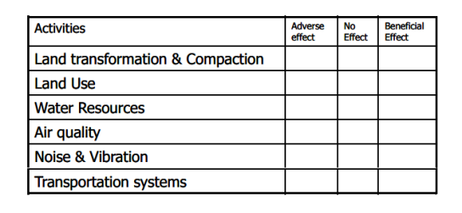
Checklist method

Slide 61
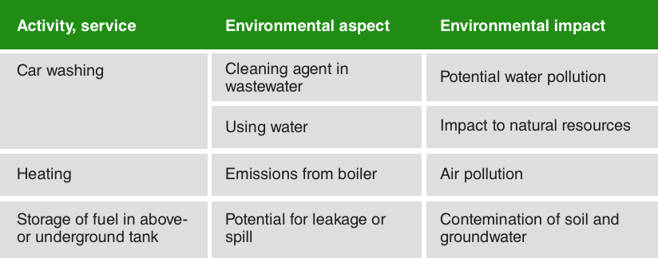
Checklist method

Slide 62
Matrix Method
most familiar and widely used technique.
A matrix developed by combining a checklist of development actions and a checklist of environmental components within a two dimensional matrix . Also referred to as an interaction matrix.

Slide 63
Matrix Method
The activities linked to the project are listed on one axis: eg
  raw material production,
  building construction,
  water supply,
  energy supply,
  raw material preparation,
  gaseous emissions,
  liquid effluents,
  cooling water discharges,
  solid wastes treatment and disposal, etc

Slide 64
Matrix Method
The environmental and social conditions are listed on the other axis, and divided in major groups:
  physical conditions: soil, water, air…,
  biological conditions: fauna, flora, ecosystems…,
  social and cultural conditions: land use, historical and cultural issues, populations, economy… etc
The result is an identification of potential impacts.
The completed matrix clearly shows the impacts and provides Initial guidance for extensive study.

Slide 65
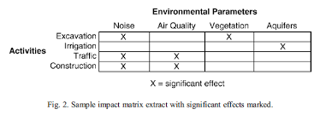
Sample Matrix

Slide 66
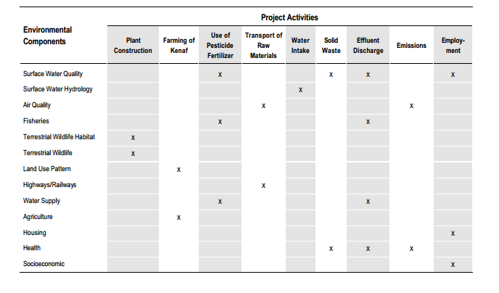
Sample Matrix

Slide 67
Network Method
The network method Is an expanded form of matrix method and it reflects the interrelationship between cause, condition and effect.
Networks are usually in the form of flow charts or radiation diagrams, as illustrated below
Helps to explain linkages between different environmental aspects.
It is solely used to illustrate and understand primary, secondary and tertiary impacts of a developmental activity.

Slide 68
Network Method
This method may also be described as an "Impact Tree”.
Since the environmental impacts are generally complex, the network approach is quite useful for studying such impacts.
Networks help us follow the chain of events of a developmental projects, and its associated impacts.
It can assess multiple impacts at the same time

Slide 69
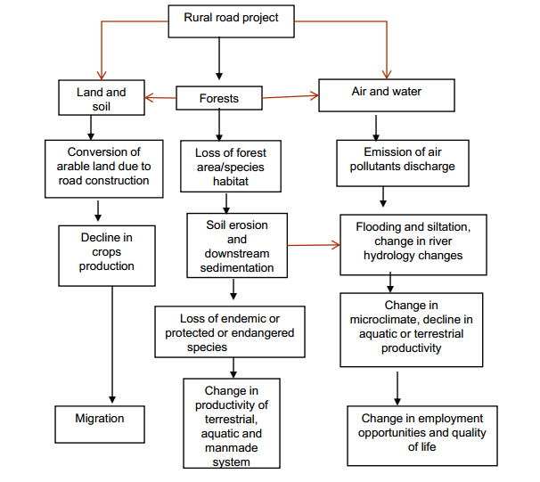
Network Method

Slide 70
Other methods
Expert judgement
Experiences from similar project

Slide 71
Impact prediction
The next step after Impact identification is to predict the magnitude, extent and duration of the Impact on the basis of available baseline data on environmental conditions.
For describing the impacts, following should be undertaken:
  Determine initial or basic environmental condition
  Predict the future environmental condition if the project is not implemented
  Estimate the future environmental condition if the project is implemented

Slide 72
Considerations during Impact prediction
Magnitude of impact- on the basis of severity of each impact (reversible/irreversible, High/moderate/minor)
Extent of impact (Zone of influence- Site specific, Local (within watershed), Regional (beyond watershed) National/Transboundary)
Duration of impact (Short term ( up to 3 years), Medium term (>3 – <20 years), Long term (>20 years))

Slide 73
Impact evaluation
Impacts identified and predicted should be evaluated to know their significance.
For the impact evaluation, the matrix method with numerical ranking is used for the quantitative ranking of the predicted impacts.
Normally a numerical scale should be developed in order to provide a qualitative assessment of various types of predicted impacts.

Slide 74
Impact Mitigation Measures

Slide 75
Impact mitigation
Mitigation is a critical component of the EIA process.
Mitigation refers to minimizing or avoiding the described impacts.
The purpose of mitigation is to identify measures that safeguard the environment and the community affected by the proposal.
It aims to prevent adverse impacts from happening and to keep those that do occur within an acceptable level.
Opportunities for impact mitigation will occur throughout the project cycle.

Slide 76
Impact mitigation measures
Mitigation can be carried out by:
  structural measures, such as design or location changes, engineering modifications and landscape or site treatment; and
  non-structural measures, such as economic incentives, legal, institutional and policy instruments, provision of community services and training and capacity building.

Slide 77
The elements of mitigation are organized into a hierarchy of actions:
  first, avoid adverse impacts as far as possible by use of preventative measures; (avoidance or prevention measures)
  second, minimize or reduce adverse impacts to ‘as low as practicable’ levels; and (Correction measures)
  third, remedy or compensate for adverse residual impacts, which are unavoidable and cannot be reduced further. (compensation measures)

Slide 78
Mitigation Measures

Slide 79
Types of Mitigation Measures
Consideration of alternatives
Preventive measures
Corrective measures
Compensatory measures

Slide 80
Consideration of alternatives
The development of alternatives to a proposed project is part of a comprehensive approach to mitigation.
A broad range of alternatives can be generated at the earliest stages of project planning and design, when the process is still flexible.
The project must consider the alternatives of the following aspects: (1) scale, (2) technology, (3) location, (4) fuel, (5) mitigation measures, (6) raw materials, (7) design, (8) time schedule, (9) economic aspects

Slide 81
Preventive Measures
Most effective when applied at early phase of the project
Such measures help to avoid the occurrence of impacts and harm or even produce positive outcomes.
Preventive measures are as follows:
  Implementation of health education
  public awareness programme.

Slide 82
Corrective Measures
Corrective measures should be adopted to reduce adverse impacts to acceptable levels.
to limit or reduce the degree, extent, magnitude, or duration of adverse impacts
Redesigning certain elements of the project or using supplementary measures
Eg
  Installation of pollution control devices,
  construction of polluted water treatment plants,

Slide 83
Compensatory measures
Compensatory measures are actions which are undertaken to compensate for unavoidable adverse impacts that can not be reduced further.
It may be monetary payment, in kind measures, a resettlement plan etc
Compensatory measures must specifically include the following activities:
  Restoration of damaged natural resources,
  rehabilitation of displaced settlements, and
  compensation to affected persons.

Slide 84
Other compensatory measures
Providing relevant training/skills to local people
Priority to local people for employment in project construction/operation works
Construction/rehabilitation of some public facilities such as taps, schools, health care centers, temples etc.

Slide 85
Implementation of Mitigation Measures
As implementation of mitigation measures requires
  funding,
  a statement of estimated expenditure must be included in the EIA report.
  All proposed mitigation measures must be integrated in the project design so that these measures may automatically form a part of the construction and operational phases of the project.
This is a more cost-effective approach than adding mitigation measures to an existing project.

Slide 86
Environmental Management Plan (EMP)
A plan to ensure systematic integration of all proposed mitigation measures with the project construction/operation activities.
It translates recommended mitigation and monitoring measures into specific actions that will be carried out by the proponent.
the basis for impact management during project construction and operation.

Slide 87
Environmental Management Plan
Helps in Project Management for Environmental Protection Measures (EPM) Implementation
Helps to formulate Monitoring Plan
Helps to formulate Auditing plan

Slide 88
Components of EMP
the EMP should contain the following:
summary of the potential impacts of the proposal;
description of the recommended mitigation measures;
Description of monitoring programme;
Institutional arrangments
Implementation schedule and reporting procedures
Cost estimate and source of fund

Slide 89
Environmental monitoring and auditing

Slide 90
Objectives of Environmental monitoring and auditing
To clarify and identify sources of pollution, impact and nuisance from the works;
To establish a record of change associated with the implementation of a project;
To verify all or selected parameters measured are in compliance with legal and contract specifications, internal policies and standards;
To provide an early warning system for impact prevention;
To provide a database of environmental parameters against which to determine any short term or long term environmental impacts;
to propose timely, cost-effective and viable solutions to actual or potential environmental issues;

Slide 91
Objectives of Environmental monitoring and auditing (contd..)
to setup event and action plans and determine the degree and scope of any necessary remedial measures in case of exceedance of compliance
to monitor performance of the mitigation measures and to assess their effectiveness and, whenever necessary, identify any further need for additional measures;
to verify the EIA predicted impacts and compare the impact predictions with actual impacts for the purpose of assessing accuracy of impact predictions in EIA;
to collate information and evidence for use in public and Government consultation; and
to audit the environmental performance.

Slide 92
Environmental monitoring
Ensuring that impacts do not exceed the legal standards
checking the implementation of mitigation measures in the manner described in the EIA report
providing early warning of potential environmental damages

Slide 93
Environmental monitoring (contd..)
Must be carried out regularly to obtain necessary data and information in order to draw accurate conclusions
Provides information required to ensure that project implementation has the least possible adverse impacts on the people and environment

Slide 94
Types of Monitoring
Baseline Monitoring
Compliance Monitoring
Impact Monitoring

Slide 95
Types of monitoring
Baseline monitoring | Compliance monitoring | Impact monitoring
Carried out prior to the initiation of construction activities Surveys of construction site and basic environmental parameters of the surrounding areas. Help subsequent monitoring to identify changes in those parameters compared to the baseline | Periodic sampling or continuous recording of specific environmental quality indicators or pollution levels to ensure project compliance with recommended protection standards Helps to ensure fulfillment of all conditions set forth and commitments made in the approved EIA report | The ecological, social and economic, and public health parameters measured during the project construction and operation phases to detect environmental changes To ensure that the actual impacts in the field are well within the manageable limit and set standards To detect any unexpected damages To provide early warning to the responsible agencies for undertaking corrective/additional measures to avert/minimize such unanticipated impacts

Slide 96
Environmental Impact Auditing
It must be undertaken after the project has been operational for some time (usually at the end of the project)
Examines critically the methods and approach adopted during the environmental impact assessment study.
The environmental impact auditing assesses
  actual environmental impact,
  accuracy of impact prediction,
  effectiveness of impact mitigation/enhancement measures and
  Functioning of monitoring mechanisms.

Slide 97
Environmental Impact Auditing
In the course of environmental auditing, monitoring and evaluation results should be compared with data generated during the pre-project period.
Comparisons made between predicted impacts and actual impacts help to evaluate the accuracy and adequacy of environmental impact assessment predictions.

Slide 98
Impact Auditing Agency and Timing
Carried out by the government agency approving the project with the assistance of relevant government agencies and non-government organizations, as necessary.
Carried out immediately after completion of the project or whenever necessary.
The result should be made available to the project proponent and concerned agencies.

Slide 99
Environmental Impact Auditing requirements Nepal (EPR 1997)
Once for each project after two years of commencement of project operation
Responsibility of Ministry of Environment

Slide 100
Public consultation and participation

Slide 101
Community participation
Community participation (public involvement) is one of the main foundation stones of planning and implementation of a project.
The effectiveness of an environmental impact assessment is determined largely by how successfully the community has been involved.
Therefore, community participation must be mobilized during the environmental impact assessment process.

Slide 102
Benefits of Community Participation
Encourages individual involvement in development projects from the early planning stage.
Develops a sense of responsibility for making development projects environmentally sound and cost-effective.
Grants due recognition to traditional practices and technology.
Arouses public awareness.
Makes the project a success .

Slide 103
Time for Community Participation
Community participation is necessary during the following phases of project planning:
Project identification, feasibility and scoping.
Initial environmental examination.
Detailed environmental impact assessment study.
Monitoring, evaluation and auditing.

Slide 104
Individuals, Groups and Agencies to be Involved during public participation
Local beneficiaries, target groups, users groups, affected groups, special interest groups (such as women).
Relevant government and private sector agencies.
Local leaders and academic groups.
Relevant non-government organizations.
Recognized experts .

Slide 105
Methods for Public Involvement
The following methods during various stages of project
Community meetings and exchange of information.
Inter-personal contact.
Dialogue with users groups and local leaders.
Questionnaires, interviews, surveys
Review of the draft environmental impact assessment report and monitoring/evaluation results by local community.
Panels comprising representatives of concerned organizations and local people.

Slide 106
Public Hearing
The public hearing is one of the important parts of the EIA process, which takes place before finalizing the EIA report.
It is necessary to get the public reaction on the EIA report.
The proponent has to arrange this meeting at project affected VDCs. The stakeholders including the general public are to be invited through public notice and other means.
The appropriate comments are to be incorporated in the final report.
The proof of public hearing and issues raised should be annexed in the EIA report.

Slide 107
Public Hearing Notice

Slide 108
EIA Report Outline
Name and Address of the individual or intuition preparing the report
Executive Summary
Project Description: the activities of the proposed project, including its technical, geographic, ecological, economic, social and physical aspects. Includes the objectives, strategy, and work schedule
Baseline information: pertaining to the geophysical, biological and socioeconomic situation of the area including any changes anticipated prior to proper implementation.
Identification of Environmental Impact: Possible impacts, adverse as well as beneficial, anticipated as a consequence of the proposed project activities at different stages of the project cycle
Notes:
This diagram illustrates the main pathways.
Barriers can stop the transmission of disease; these can be primary (preventing the initial contact with the faeces) or secondary (preventing it being ingested by a new person). They can be controlled by water, sanitation and hygiene interventions.
The movement of pathogens from the faeces of a sick person to where they are ingested by somebody else can take many pathways, some direct and some indirect. This diagram illustrates the main pathways. ‘f’: fluids (drinking water) food, flies, fields (crops and soil), fingers and floods (and surface water generally).

Slide 109
EIA Report outline
Analysis of the alternatives : Comparison of design, site technology, and operational alternatives in terms of potential environmental impact; capital and recurring costs; suitability to local conditions; institutional training and monitoring requirements. Environmental costs and benefits.
Measures to reduce environmental impact : practical mitigation and compensatory measures for adverse impact on the environment.
Matters concerning environmental management plan
Review of Policy and Legal Framework: To review the related policies, laws, and Rules on the basis of the nature and scale of the proposal
Monitoring: Who, how, the cost and time schedule for monitoring
References
Annexes

Slide 110
Environmental clearance procedure in Nepal

Slide 111
Environmental clearance procedure
Stage 1: Scoping, preparation and approval of TOR
Stage 2: EIA report preparation and approval

Slide 112
Stage 1
15 days notice in National newspaper from the concerned project and submission of scoping report and TOR for approval to EIA section.
Discussion and meeting in EIA suggestion committee according to section 6(4) of EPA, 2053.
Revision of scoping report and TOR according to the advice of committee
Approval or Disapproval (to be informed )

Slide 113
Stage 2
Preparation of EIA report according to approved TOR
Final EIA report including the feedback of public hearing and submission (with recommendation letter from local authority) though concerned ministry to environment ministry.
Discussion in Environment ministry
The final EIA report will be available for all public and stakeholders (should publish 30 days notice in national newspaper requesting for their opinion and suggestions on it)
Further modification according to the suggestions
Discussion in committee
Further process for approval if the proposal is satisfactory
Information about approval or disapproval

Slide 114
Legal provisions regarding IEE/EIA in EPA (1997) and EPR (1997)

Slide 115
EPA 1997
Sections 3, 4, 5 and 6 of the Environmental Protection Act, 1997 have explicitly mentioned the need for undertaking Initial Environmental Examination (IEE) or Environmental Impact Assessment (EIA) for prescribed projects as well as the process of approving IEE and EIA reports.
The proponent is required to carry out the IEE and/or EIA of the prescribed project before its implementation

Slide 116
EPA 1997 (contd..)
Section 3 of the EPA, 1997 requires the proponent to conduct an IEE and EIA in relation to the prescribed proposals.
Section 4 of the Act prohibits implementation of development proposals without prior approval of the concerned agencies or Ministry of Environment (MoEnv) as specified by the Act.
Section 5 of the Act provides that all IEE/EIA reports of the development proposals should be presented to the concerned agencies (concerned ministry) for approval.

Slide 117
EPA 1997 (contd..)
Provisions regarding IEE/EIA report
Under Sections 6 of the Act, the relevant agency is empowered to grant approval for the IEE/EIA report as per the provisions of the Act (concerned Ministry in case of IEE and MOE in case of EIA).
In case of IEE, Section 6 of the Act has authorized the Concerned Body to approve the IEE report after examination of the report and if it is satisfied that the project will not bring any significant adverse environmental impact.

Slide 118
EPA 1997 (contd..)
The concerned body, while examining the IEE report of the project, if it finds it necessary to carry out an EIA, shall order the proponent to undertake EIA study of that project and such report shall have to be approved by MoE.
In case of EIA report, the Concerned Body has to send the EIA reports along with its comment to MoE for approval.

Slide 119
EPA 1997 (contd..)
After receiving EIA report from the proponent through the Concerned Body, MoE will publish a public notice for comments and suggestions.
Section 6 has authorized MoE to constitute a committee comprising of experts of related sectors and representatives of concerned agencies for experts' opinion on the EIA and its associated reports.
Section 6 has authorized MoE to approve the EIA report with and without conditions, if it is satisfied that the proposed project will create no significant adverse environmental impact.

Slide 120
Environmental Protection Rule (EPR) 1997
The government has brought out the EPR in 1997 and has amended first in 1999.
The Rules 3 to 7 and 10 to 14 deal with IEE and EIA report approval aspects.
The EPR, 1997 has made it mandatory that prescribed projects shall undergo screening as per Schedules 1 and 2 of EPR, 1997.

Slide 121
Environmental Protection Rule (EPR) 1997
For IEE, the format for TOR should follow as prescribed in Schedule 3 of EPR 1997, while the project requiring EIA will have to undertake scoping and TOR preparation before the preparation of EIA report.
TOR for EIA should be prepared in the format as mentioned in Schedule 4 of EPR, 1997. It shall also include an Environmental Management Plan (EMP) including environmental auditing in addition as that of IEE report.
In EPR 1997, provisions are made to involve the local people as well as stakeholders in the EIA process.
The noteworthy components of the EIA study process are, among others, public hearing, EMP and environment monitoring.

Slide 122
IEE and EIA procedures in Environmental Protection Rule (EPR) 1997
As per the Rule 4, proposals requiring EIA will have to prepare a scoping document incorporating the public concerns and apply to MoE through concerned agencies.
In this process, a 15 days public notice in the national newspaper requesting suggestions and comments on environmental issues arising due to the proposal implementation has to be published.
The MoE is empowered to review the document and give approval with or without needed amendments.

Slide 123
As per Rule 5, the proponent of both IEE and EIA proposals has to prepare Terms of Reference (ToR) of the proposal for approval. In the case of IEE, ToR is approved by the concerned agency whereas MoE will give ToR approvals for proposals requiring EIA.
Rule 6 stipulates that if the review of the IEE proposals identifies the proposal to require an EIA, it will have to comply with all the provisions of EIA.

Slide 124
Rule 7 of EPR provides that IEE proposal proponents to publish 15 days public notifications in the national daily and present the notification to the public institutions of the affected area for comments and suggestion on IEE proposals during the study phase.
Whereas, proponents of the EIA proposal have to organize a public hearing in the project affected area to collect public concerns and suggestions to be incorporated into the report.

Slide 125
Rule 10 of EPR stipulates that all the proposals submitted for approval will have to take letter of recommendations from the concerned affected VDCs and municipalities on the proposals.
The Ministry can grant its approval to implement the proposal if it does not cause significant adverse effects on the environment under Rule 11.

Slide 126
Rule 12 of EPR stipulates that the proponent is obliged to follow the terms of conditions set by concerned agencies or the Ministry of Environment in the approval letter during project implementation and operation.
Rule 13 provides that the concerned agency to be responsible for the project monitoring.
Rule 14 provides that the MoE to be responsible for environmental audit after two years of project implementation.

Slide 127
Thank You

