Slide 1
Pregnancy and Emergency Child Birth

Slide 2
Pregnancy
The period from conception to birth.
After the egg is fertilize by a sperm and then implanted in the lining of the uterus, it develops into the placenta and embryo, and later into the fetus.
Pregnancy usually lasts 40 weeks, beginning from the first day of the woman’s last menstrual period, and is divided into three trimester, each lasting three months.
An egg goes down the fallopian tube after ovulation; if a sperm makes its way from the vagina through the uterus to the egg within 24 hours, conception is likely to occur.

Slide 3
Pregnancy Facts
A normal pregnancy lasts about 40 weeks and is grouped into three trimester
Symptoms of early pregnancy include the absence of menstrual period, breast changes, tiredness, nausea, mood swings or other symptoms
A pregnancy test measures the hormones human chorionic gonadotropin in the urine or blood.
By the end of 37 weeks, a baby is considered full term and its organs are ready to function on their own.
Babies at birth typically weight between 2500 gm to 4 kg

Slide 4
NINE Signs of Pregnancy
Food Craving- Do not rely on them as a sure symptoms (it maybe all in your head) but if craving are accompanied by some of the other symptoms on this list, start counting the days from your last period.
Darkening of Your Areolas- If your skin around your nipples get darker, you may have successfully conceived, though this may also signal of a hormonal imbalance unrelated to pregnancy or be the left over effect from previous pregnancy.
Implantation Bleeding or Cramping- About 8 days after ovulation, they may experience implantation spotting, a slight staining of a pink or brown color, as well as some cramping. This is cause by the burrowing into the endometrial lining.

Slide 5
NINE Signs of Pregnancy
Frequent Urination- Once the embryo implants and begins producing the hormone human chorionic gonadotropin (hCG), she may find herself going to the bathroom more often.
Fatigue- Feeling tired? No, make that exhausted. High level of hormone progesterone can make women feel as if they’ve run a marathon when all they’ve done is put in a day at the office. Fatigue is a hallmark of early pregnancy.
Tender, Swollen Breasts- If a woman pregnant, her breast will probably become increasingly tender to the touch, similar to the way they feel before her period, only more so. Once her body grows accustomed to the hormone surge, the pain will subside.

Slide 6
NINE Signs of Pregnancy
Altered Sense of Taste- Women may notice that their sense of taste changes. Some women say they have a metallic taste in their mouth, others that may cannot stand the taste of coffee, tea or food they usually like.
Morning Sickness- if a woman lucky, morning sickness won’t hit her until a few weeks after conception. But as early as a couple of days following conception, she may begins feeling nauseated and queasy.
A Missed Period- If women are usually pretty regular and their period are late, it is worth trying pregnancy test. A missed period is the surest sign of pregnancy in a woman of childbearing age who usually has regular periods.

Slide 7
Stages of Pregnancy
First Trimester- Week 1- Week 12
Second Trimester- Week 12 – Week 28
Third Trimester- Week 29- Week 40

Slide 8
First Trimester
Body undergoes many changes. Hormonal changes effect almost every organ system in your body.
Period stopping is a clear sign of pregnancy.
Other changes may include:
Extreme tiredness Tender,
Swollen breast
Upset stomach
Craving for certain foods,
Mood swing headache,
heartburn
Might need to make changes to daily routine. Fortunately, most of this discomfort will go away as pregnancy progresses.

Slide 9
Second Trimester
The symptoms like nausea and fatigue are going away.
Abdomen will expand as the baby continues to grow.
Before this trimester is over, the movement of the baby can be feel.
As body changes to make room for growing baby, may have:
Body aches,
Stretch mark on abdomen, breast, thigh or buttock,
Darkening of skin around nipple,
Numb or tingling hand,
Itching on abdomen, palms and sole of the feet

Slide 10
Third Trimester
Some of the same discomfort in second trimester will continue.
Find breathing difficulty and notice have to go to the bathroom more often. This because the baby is getting bigger and it is putting more pressures on organs
Some new body changes might notice in third trimester include:
Shortness of breath
Heartburn
Swelling of the ankle, finger and face
Belly button may stick out
Trouble sleeping

Slide 11
First aid for emergency childbirth
The safest place for the mother who is about to deliver her baby is in the maternity hospital or birthing center, sometimes this is not possible and pre-hospital delivery of the baby is necessary it is also home delivery.
Remember that women have been performing the function of childbirth for a long time, and the process is natural.
First aiders are there to provide any help that may be required during a process that is controlled by the mother. Your active intervention is necessary only in extreme situations.

Slide 12
First aid for emergency childbirth
The initial step is to decide what has happened & what stage of delivery the mother is at. Attempt to determine if any of the following are present:
Show-This is a loss of mucus, often blood stained, from the plug that keeps the cervix closed. Labour can start any time after this although it could be as long as a few days.
Waters have broken- This means the membranes holding the amniotic sac, which contains the baby & the amniotic fluid, have started to leak. It can happen suddenly, but is more likely to be a gradual trickle.
Intermittent pain- There is usually pain accompanying contractions of the uterus. It’s probably labour if the contractions last more than 40 seconds and are occurring about every three or four minutes.
Bleeding- There is a possibility of vaginal bleeding before, during & after labour. This should not be confused with the show

Slide 13
Labour Stages
Labour is divided into three stages:
First stage – the womb contracts and the baby moves into the birth canal
Second stage – the mother pushes with the contractions of the womb to help the baby through the birth canal and out
Third Stage – the placenta is expelled

Slide 14
Signs of Emergency Child Birth
Very strong contractions, 2 to 3 minutes apart
Water bag or the amniotic fluid has broken
An urge to push down the baby
The woman says the birth will happen very soon
A bit of blood running from the vagina

Slide 15
How to Deliver a Baby in an Emergency
What to Do If You Have to Deliver a Baby-
When you read these instructions you will find that they read more as
A list of what not to do. That's because childbirth is a normal event, &
Rarely an illness.
Don't panic. Remaining calm can help you focus on the birth, even if you are alone
Call for an ambulance or have someone else call.
Place a plastic sheet or towel or paper sheets and help the woman lie down with her back supported by a pillow and her legs apart.
Let the woman decide which position is comfortable for her.
Reassure the mother that help is on the way. There is usually enough of time to get to the hospital or get help.
Keep the mother at rest, and tell her to try to stop pushing with each contraction and slow the baby’s progress down to the birth canal.

Slide 16
How to Deliver a Baby in an Emergency
If medical professionals or a midwife has not yet arrived and the baby’s
Head is already visible in the vagina opening, assist the mother, as the birth is
about to happen very soon. Do not try to deliver the baby, the birth will
Naturally happen without intervention. Your role is to comfort and assist the
mother.
Wash your hands and use disposable gloves if available.
Do not pull the baby’s head. Let the woman push the baby out. Encourage the woman to push.
Assist the baby by supporting the head and shoulders. Do not pull the baby.
Be extra careful as the baby is slippery. Gently wipe off the membrane coverings from the mouth and nose with a clean cloth.
Give the baby to the mother and do not remove the coating from the baby’s body.
Support the mother as she delivers the afterbirth. Keep the placenta and the umbilical cord intact, do not cut the cord.
If there is severe pain or bleeding, treat for shock. Help the mother to lie down and raise her legs and keep her warm.

Slide 17
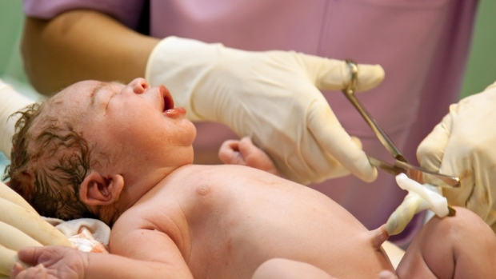

Slide 18
How to Deliver a Baby in an Emergency
After birth, a clamp is put on the cord, and it is cut so that the baby is no longer attached to the placenta.
Routinely cut the baby's umbilical cord almost immediately after birth because it's thought to lower the risk of severe bleeding in the mother. ... If left alone, the cord will continue to pulse for a few minutes as blood flows from the placenta to the baby.
Delayed cord clamping is a birth practice where the umbilical cord is not clamped or cut until after pulsations have ceased, or until after the placenta is delivered. ... When your baby is born, the cord and placenta system will contain about one third of your baby's blood, whilst the remaining two thirds is in the baby.

Slide 19
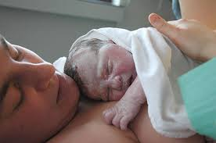

Slide 20
Potential Complications
If there are any potential complications, such as
Severe vaginal bleeding,
Prolapsed cord (cord protruding from the vagina),
Continuous abdominal pain,
Presentation of part of the baby other than the head
Then immediately request for further medical assistance

