Slide 1
UNIT IV
Health Education Methods
Prepared By
Sushila Baral
Assistant Professor
Health Promotion education
5th semester

Slide 2
Contents
Meaning
Types
Importance
Selection criteria
Examples
References

Slide 3
Concept of method and media
Methods of health promotion and education are techniques or ways in which series of activities are carried out to communicate ideas, information, and develop necessary attitudes and skills.
In health education it is not enough to decide what will be done; by whom and when, we also need to decide how it will be done (methods).
Media are the teaching aids through which knowledge, information and ideas are
communicated.
Aids are facilitators of communication both for the sender and for the receiver
Media are teaching learning materials, the another name of media is educational materials.

Slide 4
contd
Media are a channel of communication.
Communication is facilitated and strengthened or reinforced by the use of suitable audio visual aids.
Media are materialistic things or objectives through which a message is passed.
There is the particular means of communication employed in the method.
Media support to the method, examples of media are poster, pamphlets, computer, T.V., Radio etc.

Slide 5
  Definition of method
(i) According to J. E. Event: "Methods are the procedures by which a goal is reached, a purpose accomplished or a result achieved."
(ii)"The teacher's way, which causes behavioral change in pupils. " - Lardisbal and Friends.
(iii)"Method is the way or path followed in imparting knowledge with the aim of securing the best possible educational result." - Bhatia and Bhatia.

Slide 6
Types of methods
There are three types of Health promotion and Education methods
  1. Individual methods
  2. Group methods
  3. Mass methods

Slide 7
Types of health Education Methods
Individual
Group
Mass
Demonstration
Symposium
Lecture
Interview
Role Play
Brain Storming
Exhibition
Counselling
Group Discussion
Campaigns
Buzz Session
Panel Discussion
Workshop/ Seminar
Case Study
Study Trip
Project Assignment
Mini Lecture

Slide 8
Common teaching method in health education
Informal methods
Health talk
Brainstorming
Group discussion
Buzz group discussion
Demonstration
Role play
Drama
Case studies
Formal methods
Conference
Workshop
Seminar
Panel discussion
Symposium
Abraham Tamirat, 2015

Slide 9
Types of media
1. First Ways of Classification
Audio Aids
Video aids
Audio-visual aids
1. Second way of classification
Projected Aids (need of power for projection)
Non-projected(does not head power for projection)

Slide 10
Projected Aids (need for projection)
Overhead projector
Slide projectors
LCD projector
Television
Film/documents

Slide 11
Non-projected
Poster
Flip chart
Flash cards
Flannel graphs
Pamphlets
Wall chart/Flipchart/clip chart
Black/white board
Models/puppets/pictures
Handout/Books/Magazines/journals etc.

Slide 12
Criteria for Choosing Health Education Method

Slide 13
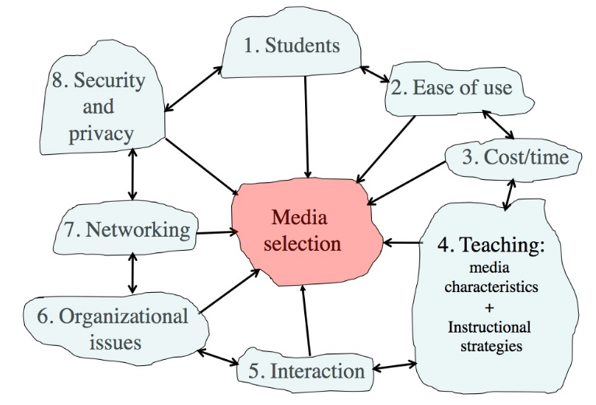
Criteria For Selecting Appropriate Method
Choosing Health Educational Method.docx H.Ed. Methods.xlsx
1.Audience
Anthony Williams (Tony) Bates

Slide 14
Criteria For Selecting Appropriate Method
Feasibility or practicability: A method should be feasible to apply from the point of view of transportation (geographical), economic factor, availability of necessary equipment and other facilities.
Nature of the audience: A method should be chosen to suit the educational status, culture etc. of the target group.
People’s attitude and belief on the method: People have different kinds of interest for different kinds of methods. So, each method should be chosen according to the interest and belief of people on them. E.g.: TV and radio broadcast, government published report/ posters, etc. considered valid
Accessibility: The method that a health educator chooses must be able to reach to the people concerned. In fact a health education program or message should be accessible to each member of the target group in the community.
Subject or purpose of teachings: The purpose of teaching also affects in the selection of particular method. The subject and purpose of the teaching will be based on audience need. If it is for conveying some health message or knowledge a lecture can help but when there is a need of skill and attitude development, demonstration method has to be applied.

Slide 15
Effectiveness of Different Methods
Verbal Symbol (Lecture)
Study Trip
Demonstration
Dramatized Experience (Role Playing)
Visual Symbols (Poster, Pamphlets)
Recording, radio, Still Pictures
Motion Picture (Film)
Educational Television
Exhibition
Direct Purposeful Learning (project, Learning by Doing)
Dale’s Cone of Experience

Slide 16
Retention of Learned Messages
After 3 Hours
After 3 Days
Words and Pictures
Words, Pictures and Actions
Self Discovery
Words
Pictures
30%
10%
60%
20%
80%
70%
90%
80%
99%
90%
Notes:
the act or process of gaining knowledge or understanding of your abilities, character, and feelings. own journey. Realization of self through self realization

Slide 17
Criteria of Selection and Use of Appropriate Media
Consider the audience (status interest & objective)
Easy to use see & understand
It should be simple and direct.
Easy to handle and transport.
Attractive, clean and good working condition.
Briefly of (Attitude of) audience on media.
It should be appropriate according to time and place.
It should be cost effective.

Slide 18
Importance of the media in teaching learning situation
Research has been shown that media help a learner to;
learn more and faster,
remember longer, complete; and permanent,
arose and hold interest,
over come language barriers,
make active learning,
save time and help sharing the experience.

Slide 19
Regarding the importance of media , proverb:
If I hear it, I forget it.
  If I see it, I remember it.
  If I do it, I know it.
  If I research it I use it.

Slide 20
Individual Methods of health education

Slide 21
Individual Methods
Characteristics
Person to person or face to face communication
Provides maximum opportunity for two way flow of ideas, knowledge and information.
Feedback and interaction is maximum
Examples:
Interview
Counselling

Slide 22

Individual Method (Interview)
Interview
Interview is to meet and talk each other and collect information and ideas.
Two way communication
Questioning and answering process occurred between the health educator and the learners
Interviewee’s knowledge, attitude, feeling and health practices are studied and essential suggestions are provided to bring about the positive change.
Examples: Could occur in Doctor’s consultation room,
in home, in school, etc.
Types of Interview
Planned/ Structured / Formal Interview
Spontaneous/ Unstructured/ Informal Interview

Slide 23
Individual Method (Interview)
Types of Interview
Planned/ Structured / Formal Interview
  Set of designed questions are used
  Based on structured, closed-ended questions.
  Along with collection of information and data, some relevant health teaching could also be done
Spontaneous/ Unstructured/ Informal Interview
  No predetermined set of questions.
  Open-ended questions that can be asked in any order.
  Discussion is made on the basis of problems .
  Allows people to express what they think in their own words.
  E.g.: Interview with the mother of a child or with patients by physician in hospital

Slide 24
Types of Interviews
On the basis of Structure
Structured Interview : Pre-defined questions with no deviation.
Semi-structured Interview :Some set questions with flexibility to probe deeper.
Unstructured Interview : Open-ended, free-flowing conversations
On basis of the information and purpose
Indepth Interview: A one-on-one, detailed conversation aimed at exploring the participant's personal experiences, opinions, beliefs, or behaviors.
Key informant Interview (KII):A structured or semi-structured interview with an individual who has specialized knowledge, expertise, or a unique position relevant to the research topic.
Case Interviews : Focused on problem-solving or specific scenarios.

Slide 25
On basis of mode of delivery
Face to Face Interviews
Telephone Interviews
Online/virtual Interviews
Asynchronous Interviews
On the basis of Interaction setting
one-on-one interview
Panel interview
Walkthrough interview

Slide 26
On the basis of Recording or Documentation
1.Recorded Interviews :Audio or video recorded for later transcription and analysis.
2. Non-Recorded Interviews : Notes taken during or after the interview.

Slide 27
Individual Method (Interview)
Stages of Interview
(a) Preparation of interview
Adequate knowledge and information about the subject matter
Decide the participants
Develop the question schedule
Decide the place and time
(b) Conducting the interview
Rapport building Sharing about the purpose and importance of interview Start interview politely and sequentially Do not put embarrassing comment Control the subject | Make clear conclusion and provide necessary suggestions. Close the interview and thanks them Make report of results

Slide 28
Individual Method (Interview)
Advantages
Disadvantages
Help to know knowledge, attitude & practice.
Help to reach a better conclusion for solution of a problem.
Easy to conduct with less cost and limited facilities.
Even illiterate persons can be interviewed and taught.
Easy to make follow-up
The expression & gestures can be observed.
Time consuming
Difficult to cover wide range of target people
Limited manpower
Tedious if has to be repeated for too many peoples.
Notes:
Tedious -boring

Slide 29

Individual Method (Counselling)
Counselling
Encouraging and helping an individual in identifying his or her health problem, the cause of the problem, the ways of its solution and also encourage to take necessary actions to solve it.
Decision of action is made on his/ her choice with advice or direction from counsellor
Best approaches of health education.
E.g.: For mental patient, drug users, AIDS patient. etc.
Characteristics of counselor
Friendly and sincere
Co-operative
Capacity of judging
Patience to listen
Respect to clients
Skill of communication and interpretation

Slide 30
Individual Method (Counselling)
Settings of Counselling
At Hospital
At School
At Home
Techniques of Counselling
Building rapport
Identifying clients needs or problem
Finding the ways to solve the problem
Maintaining patience
Maintain Privacy
Follow up

Slide 31
Individual Method (Counselling)
Advantages
Disadvantages
It is helpful in dealing with individual clients and motivate him to take necessary action to solve his health problem.
Provides maximum opportunity for feedback.
Helps to maintain two way communications.
Illiterate people can be taught by this method.
Easy to make follow up studies on the basis of counseling records.
Counseling takes long period of time.
It is difficult to cover wide range of people through counseling method.
Sometimes, loss of patience might make counselling failure

Slide 32
Steps in family planning counselling: the GATHER approach
G - Greet the client respectfully.
A -Ask them about their family planning needs.
T- Tell them about different contraceptive options and methods.
H- Help them to make decisions about choices of methods.
E - Explain and demonstrate how to use the methods.
R- Return/refer; schedule and carry out a return visit and follow up.

Slide 33
Group Methods of Health education

Slide 34
Group Method
Characteristics
A group of limited person in teaching, learning situation who have some kind of need about certain health problems.
Active participation of learners is required
Provides opportunities for interaction and to share experiences
Based on andragogical model
Principles
Do not impose ideas; respect others ideas as well
Do not lecture them only; try to discuss with them
Do not teach them only; try to learn from them as well
Do not advocate knowledge and practice only; adopt their
best knowledge and practice as well
Examples:
Demonstration Brainstorming Role Playing Group Discussion | Panel Discussion Symposium Workshop Seminar

Slide 35
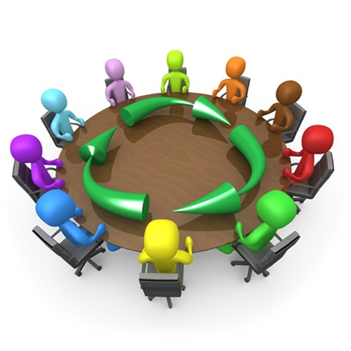
Group Method (Group Discussion)
Characteristics
A group is an aggregation of people interacting in a face to face situation.
It is a two way communication where people learn by exchanging their views and experiences.
This method is useful when the group have common interest and similar problems
Commonly used in teaching a group of people to identify health problem and find out ways to solve it.
Group size :
Consists of 6-12 members depending upon the situation so that each person is able to communicate with all the others face to face to reach to a decision and achieve the common goal.
Constituents of group discussion:
1. Leader or chairperson
2. Recorder
3. General members

Slide 36
What to do in a Group Discussion?
Speaking is important; do not sit silently. Speak freely.
Do not monopolize the conversation or talk too much.
Give everyone a chance to speak.
Maintain eye contact with everyone in the group. Show active listening skills.
Do not interrupt anyone while they are speaking. Keep the topic on track and don’t be irrelevant.
Encourage someone who is silent to talk.

Slide 37
Do not argue with anyone.
Do not debate with anyone, while the group looks on.
Do not repeat what has been said; be attentive; try to develop on ideas expressed or give out new ideas.
Clarify your doubts and then proceed.
Be brief.
Do not commit grammatical errors while talking

Slide 38
Focused Group Discussion
Most commonly used qualitative research techniques that is open ended.
It allows a small group of people to come together and share their views, under the guidance of the researcher.
A group interview guided by a moderator and a way of listening to people and learning from them. The sharing acts as a ‘brainstorming’ session, generating a wide range of views and reactions.
FGD is a discussion around a predetermined set of topics.

Slide 39


Slide 40
Use of FGD:
To assess needs and gaps
To guide program development
To evaluate program/service visibility
To evaluate program/service effectiveness, strengths and weaknesses

Slide 41
How are FGDs conducted?
It comprises 8 -10 people, who have been specifically screened to match set criteria.
They may have similar demographic characteristics - for example, we would not generally mix upper and lower socioeconomic people in the same group.
Discussions generally last around 2 hours
Discussion are audiotaped, and sometimes videotaped for later analysis.

Slide 42
Benefits of FGD:
Very efficient way of collecting rich information from a group of people in a short time.
A good tool for collecting information about people’s attitudes and perceptions.
Group dynamics focus on the most important issues.

Slide 43
Drawbacks of FGD:
Must be limited to a few questions about a small number of related topics
Group dynamics can make participants reluctant to share their views.
Data can be difficult and time consuming to analyze

Slide 44
Components of FGD:
1. Planning
2. Identifying and recruiting participants
3. Selecting a moderator
4. Developing focus group questions
5. Analyzing and reporting results

Slide 45
Steps of FGD Conduction
1. Welcome participants and thank them
2. Introduce yourself
3. Describe the research project on and the other components of the work
4. Provide an overview of the subjects to be covered
5. Explain that participants need not provide personal information unless they are asked to.
6. Explain that participants’ comments will be compiled with information from others in the group
7. Explain in advance that the facilitator will guide the questions to ensure that the group stays on one topic at a time and that some responses may need to be cut short
8. Set ground rules that each participant must respect the views of other participants

Slide 46
Developing FGD Guideline:
1. Isolate 3-4 major themes
2. Develop 3-5 questions for each theme
3. Develop probes for each question
4. Allocate time for each theme
5. Start with an “ice breaker”
6. When possible, order questions to allow participants to begin with the “easy” or general questions

Slide 47
7. Positive questions should come before negative questions
8. Never ask a question that gives you a “yes” or “no” answer
9. Refrain from asking “why” questions
10. Avoid leading or biased questions
11. Avoid examples
12. Keep questions simple
13. Consider using “if you were in charge” questions
14. Adapt the language to the level of the participants
15. Consider cultural and language issues
16. Repeat or rephrase the question when necessary, use probes

Slide 48
Group Method (Group Discussion)
Advantages
Disadvantages
Develops creativity, confidence and ability of judgment in the members or learners.
Helps learners to come to a group decision and solve their common problem. Group decision is better than individual decision.
Helps members to become active learners and learn new knowledge, ideas and experiences about their subject of concern through a cooperative process.
Provides adequate communication among all the members with exchange of ideas and experiences.
The health educator can make a closer study of the members of target group regarding their need, interest, attitude, ability and other potentialities.
Some self-conscious members may not venture to bring forth their valid idea "for fear of disapproval by other members”.
Sometimes discussion may be prolonged without any fruitful result, or it may take longer time to come to the conclusion or decision.
Somebody may not feel personally responsible for the result of discussion. So, they may not participate well.

Slide 49
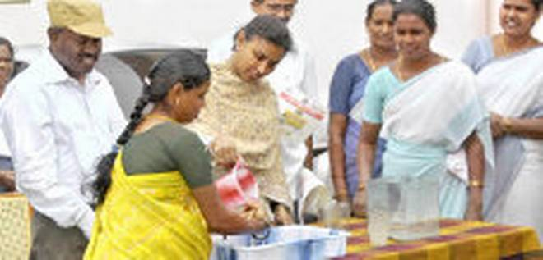
Group Method (Demonstration)
Process of providing knowledge and skills as well as developing attitude of a small group of people through the appropriate teaching devices or materials.
Teaching by demonstration involves verbal and visual explanation.
It is a mixture of theoretical and practical teaching.
It is organized to teach about the specific topics
It takes 45 minutes to complete the demonstration but it slightly vary according to the topic.
The numbers of learners in the group may be about 15 to the maximum.
The learners are given opportunity to see and manipulate the device or materials used in demonstration and also give opportunity to practice the process
and questions and answers to clarify doubts
Examples: ORS Preparation, HW awareness, CPR steps, etc.

Slide 50
Group Method (Demonstration)
Advantages
Disadvantages
Effective teaching method which involves varied learning experiences like seeing, hearing, feeling , testing and smelling depending upon the subject of demonstration.
Interesting & draws attention because of the active learning process.
Helps to develop not only knowledge & attitude but also skills
Achievement could be immediately assessed through verbal expression & skill practice.
Provides concrete & realistic visual picture of what is being taught with lasting impression.
It is cheap, practicable, accessible and useful for different categories of learners. It needs only limited materials and object. It can be used at different teaching-learning situations at different places.
Sometimes it may be difficult to get necessary equipment and materials for certain demonstration.
May not be appropriate to conduct demonstrative teaching on certain topic especially when there will be only cognitive gain.

Slide 51
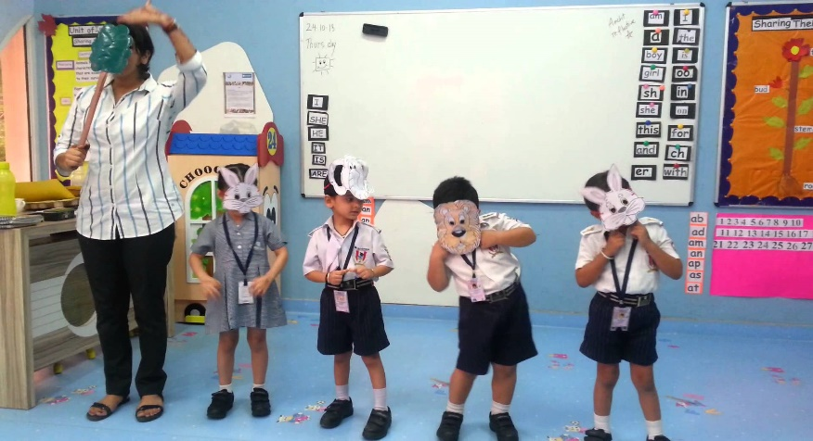
Group Method (Role Play)
Characteristics
Role play is a socio drama which can be carried out by individual or a group of people taking different roles and acting out problem situation similar to that they encounter in their real life situation.
They enact roles as they have observed or experienced and act or pretend to be a sick person, as a mother, child , health worker etc.
In a role playing there will be about 5 to 6 characters and 15-20 audience but the number may be slightly vary according to situation .
It can be of 30 minutes including few minutes of discussion

Slide 52
Group Method (Role Play)
Advantages
Disadvantages
Give learners opportunity to express their ideas based on real life situation and can learn from each other.
Enables the learners to see things through the eyes of others. Start learning how knowledge and attitude affect health behavior.
Develops the power of quick thinking and expression .
Helps the characters to explore their potentialities and come to a better decision . They can apply those skills in their real life situation while dealing with health problems.
Develop careful listening habit.
Makes people think in a more constructive way.
It interesting & provides active learning opportunity in a realistic way.
It simple and inexperience and can easily be conducted at different situation.
The best way to teach people about health in order to make them understand it.
It may lead to only a recreational activity not educational.
Everybody can not successfully act due to shyness , lack of experience , lack of confidence and expression skills.
Every learner may not get opportunity to participate as role player.

Slide 53
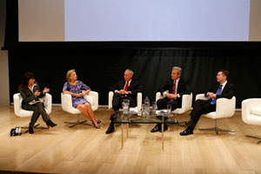
Group Method (Panel Discussion)
Characteristics
Panel discussion is one of the methods of group teaching.
It can be adopted both for school students and community people in order to provide health education.
The panel members will be a group of experts normally 3 or 4 persons who themselves enter into question and answer process regarding a specific topic of discussion.
Health educator can work as coordinator to introduce
topic, experts & also helps to conduct the discussion
At end, audience ask questions and clarify their doubts
Notes:
3-5 panelist

Slide 54
Group Method (Panel Discussion)
Advantages
Disadvantages
Provides varied knowledge, ideas and experiences about the subject of concern to the learners.
Interesting and can draw attention of the audience or learners.
Learners get opportunity to ask questions and pass comments, which help, in teaching-learning process.
Sometimes it is difficult to get the appropriate experts.
Difficult to set definite time to suit the experts.

Slide 55
Things to ensure for panel discussion
1. Define purpose of panel discussion
What is the main topic or theme that we want to cover?
What are the key issues or questions we want to explore?
What is the goal of the panel discussion? Is it to educate the audience, spark conversation or debate, share diverse perspectives, or inspire action?
Who is our target audience? What do they want to learn or gain from the panel discussion?
What are the key takeaways we want the audience to leave with?

Slide 56
Contd..
2. Choose panelists with diverse perspectives and expertise
With the topic in hand, carefully select and prepare panelists to ensure that they deliver valuable insights and engage in a productive discussion.
Selecting and preparing panelists for a productive discussion:
Shortlist the panellists (Based on knowledge on topic)
Do your research (Search the expertise credential
Set clear expectations
Hold a pre panel discussion
Consider rehearsals
Notes:
5. Depending on the complexity and experience level of the panelists, consider holding a rehearsal session to help them feel comfortable with the format and effectively deliver their insights.

Slide 57
3. Structure the discussion for focus and productivity (Aim for Agenda)
Determine the format
Outline Key discussion points
Provide context
4. Moderate the discussion for focus and productivity
5. Encourage audience engagement and interaction
6. Evaluate the success of the panel discussion
Gather feedback from the panel discussion
Track key performance indicators

Slide 58
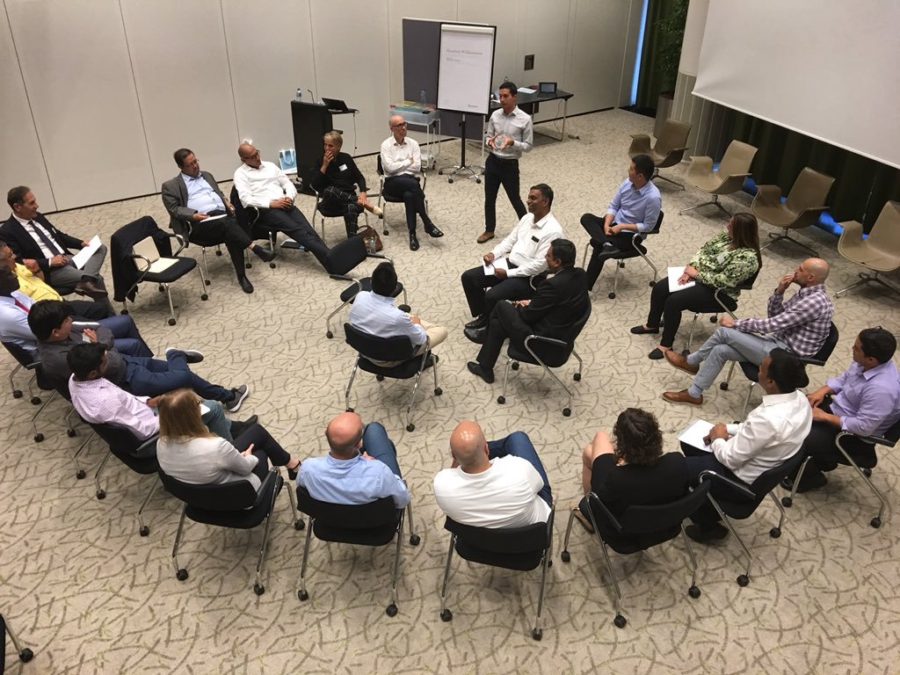
Fish Bowl Session

Slide 59
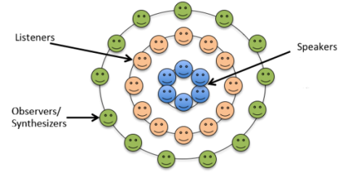
What is Fish Bowl Session ?
It is a tool for facilitating dialogue between Experts in a way that exposes others to their knowledge while expanding the collective understanding of a subject
Knowledgeable people (THE FISH) sit in circle to discuss a series of directional questions, surrounded by a larger group of observers in an outer circle (THE BOWL)

Slide 60

What is Fish Bowl Session ?
The inner circle is the stage for speaking and contributing
Those in the outer circle must listen actively and move into the role of fish when they wish to participate in the conversation

Slide 61
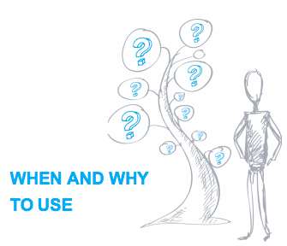
When to Use it ?
As an alternative to traditional debates
As a substitute for panel discussions
To foster dynamic participation
To address controversial topics
To avoid lengthy presentations

Slide 62
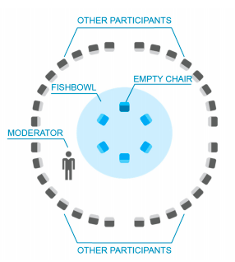
How is it applied?
Identify 2-3 experts and brief them on the Fishbowl Process
Setup a small circle of chairs surrounded by a larger circle with 3-4 additional chairs to facilitate mobility
Explain process, objectives and the issue

Slide 63

Use Either Open or Closed Fishbowl
An Open Fishbowl
  Contains several empty chairs in the center circle from the outset
  Any member of the audience can join the discussion by occupying an empty chair at any time
  A ”FISH” must voluntarily leave the center circle to free a chair
  The discussion continues either by entering/leaving the Fishbowl
  Participants can have more than one opportunity to move into the inner circle

Slide 64
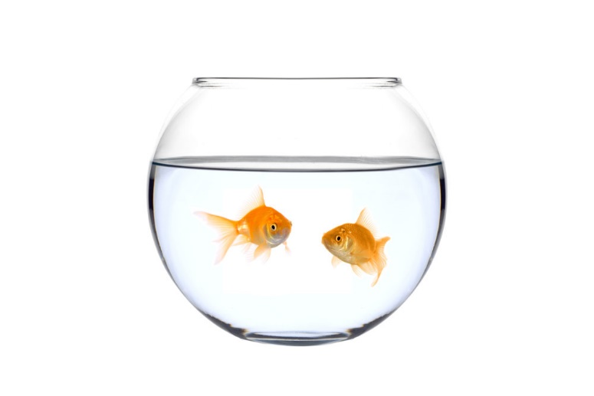
Use Either Open or Closed Fishbowl
Closed Fishbowl
  Facilitator splits the participants into two groups and assigns the role of speakers to one group, and the role of the observers to the other
  The initial participants in the inner circle speak for some time about the chosen subject
  When the time runs out, the first group of participants leaves the fish bowl and a new group from the audience enters
  Useful when all the participants have some knowledge on the topic

Slide 65
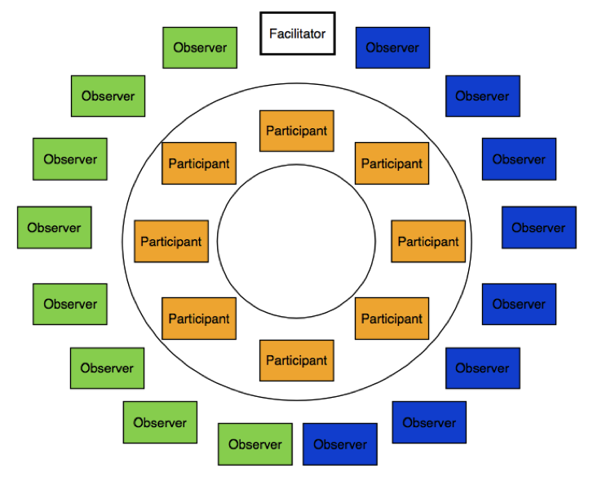
How is it concluded
The outer circle must always observe silently and prepare questions and comments
Once the topics or the time allocated is covered, the facilitator should summarize the discussion and open floor for a debriefing
Finally, the facilitator should provide overview of the discussion, lessons learned and key resources that can be helpful after the discussion

Slide 66

Key Considerations
Brief the experts in the process so that they know the Fishbowl is for conversations and not for presentations
Consider setting a time limit for any speaker in the Fishbowl
To maintain focus and clarity, ensure all conversation in the room takes place in the Fishbowl

Slide 67
BUZZ SESSION

Slide 68
Introduction
A very short discussion on a narrow topic that involves simultaneous small group work (usually in pairs) and stimulates contribution from each member of the participant group.
A brief meeting of the few people to bring quick ideas and help the group to make a decision.

Slide 69
A BUZZ SESSION MAY BE ORGANIZED
The whole group is divided into smaller buzz groups to buzz together about a problem and produce some ideas to solve it.
The collected ideas are brought forth to the original group by the leader of each buzz group where further judgement will be made. No experts will be available to the buzz session.
The health educator can adopt this method of buzz session to encourage the learners to think and express quickly. It is also a good teaching method with learner’s active participation.

Slide 70
HOW TO USE IT
» Carefully consider the outcomes you seek from a buzz session. Here are some examples of how to use a buzz session effectively:
› Follow a presentation with a buzz session.
Ask audience members to talk for five to ten minutes to the person next to them about how key points in the presentation relate to their own experiences.
This dialogue will bring out new perspectives and may also reduce questions and increase active participation.

Slide 71
› Structure a buzz session so that two to three participants take turns interviewing each other.
The facilitator(s) may instruct participants to allow each to talk for three to five minutes without interruption and then have a five minute discussion as a group.

Slide 72
Advantages
» tap into the knowledge and experience of each participant.
» energize the group
» identify needs/solicit quick feedback on a narrow topic.
» support to generate large number of ideas from different members of learning group.
Help to reach to fruitful group decision.
Practicable to conduct. No need of special arrangement and pre planning.

Slide 73
Disadvantages
Buzz groups can easily get off-track or bogged-down.
Buzz groups can produce “pooled ignorance”, invalid assumptions, and cannot be relied upon to reach viable conclusions.
To be most effective, buzz groups should have experienced leaders and “idea recorders” to produce accurate, unbiased reports.
Doesnot provide adequate time to think and discuss.
Notes:
Bogged down–get stuck.

Slide 74
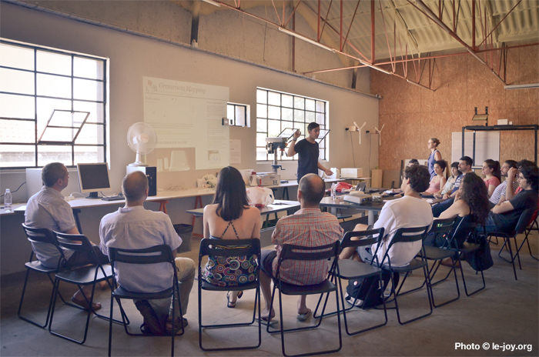
Group Method (Workshop)
Characteristics
Educate a group of people who belong to a specific discipline
Organized for people with previous experience with objective
to enhance or update knowledge and skills
Experienced consultants and participants interacts each other
To work & to learn from practical experience is the theme of workshop.
It consists of a series of meeting with emphasis on individual work within a group with the help of consultants and resource personnel.
The total workshop may be divided into small group and each group will choose a chairman and recorder.
In workshop, the individuals work, solve a part of problem through their personal effort with the help of consultants which will contribute to the group work for solving problems.
Learning in workshop takes place in a friendly, happy and democratic atmosphere under expert guidance.
Workshop group: About 15 members
Workshop Duration: Few days- 1 or 2 weeks

Slide 75
Group Method (Workshop)
Techniques/ Steps to conduct Workshop
Advertisement/ Information on workshop conduction Application and sorting of participants Organizer receives the participants Sharing objectives of workshop Introduction among participants Selection of chairperson from participants Important information and skills delivery by consultant Group division and discussion on specific topic | Group leader will share their discussion points Massive discussion will be carried out Brainstorming for new idea creation Refreshment activities Common understanding/ Conclusion Workshop report preparation Closing of workshop

Slide 76
HOW TO CONDUCT a WorkSHOP
1. Planning
Consider your topic
Consider your audience
Consider the workshop size
Consider the time available
Vary activities
Plan a break
Participants need time to talk and connect with one another
Consider the purposes of the workshop
Consider your presentation

Slide 77
2. Preparation
Find out about the space you will be using, if possible
Bring everything you need
Arrange well beforehand for any equipment you’ll need
Make materials and hand-outs as attractive and interesting as possible so that participants will return to them.
Be prepared
Make up an evaluation form
Notes:
https://ctb.ku.edu/en/table-of-contents/structure/training-and-technical-assistance/workshops/main

Slide 78
3. Implementation
Introduction of the program
Objectives of the conducting workshop
Contents and Hands on training/ developing skill
Conclusion

Slide 79
Group Method (Workshop)
Advantages
Disadvantages
Helps to provide up-to-date knowledge and skills as well as to develop appropriate attitude.
Provide varied learning experiences like listening, speaking, discussion etc.
Enhances participant’s power of thinking and critical learning.
Take long time to organize the workshop. It might take weeks or even months.
Needs more money, materials and physical facilities.
Sometimes it may be difficult to get appropriate consultant.

Slide 80
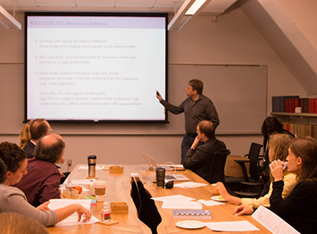
Group Method (Seminar)
Characteristics
Seminars are simply a group of people coming together for the discussion & learning of specific techniques & topics.
Seminar is a teaching technique for higher learning. A specific subject or topic is delivered as an article or report in the seminar.
The article and its concepts submitted in the seminar are analyzed and discussed through group discussion to arrive a final decision or concept.

Slide 81
The word seminar is derived from the latin word “seminarian” meaning seed plot.
It is the group method of health promotion and education.
Seminar is generally ,a form of educational instruction at an academic institution or in commercial or professional organization.
It is the functions of bringing together small groups for recurring meetings ,focusing each time on some particular subject ,in which everyone present is supposed to actively participate.

Slide 82

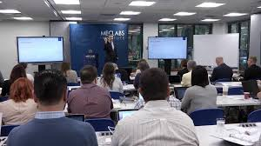

Types of seminar
Seminars are conducted in various stages . Based on the size and organizational aspects the seminar can be classified into four types:
Mini seminar
Major seminar
National seminar
International seminar

Slide 83
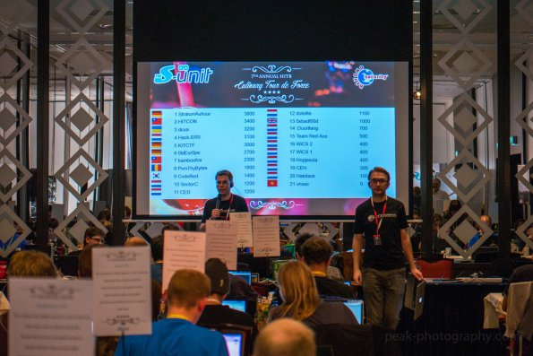
Process
There are a number of activities that are involved in preparing seminar these activities can be categorized in three stages:
Preparation
Implementation
Evaluation

Slide 84
PREPARATION
Preparation for the seminar involves a number of activities listed below:
Determine the budget available to host event.
Determine the theme/topic to be discussed at the seminar or workshop.
Conduct and secure the relevant Presenter.
Identify target group and number of participant required.
Secure venue
Finalize details events

Slide 85
Preparation (contd…)
Contact relevant departments/participants.
Follow up to ensure the information was received.
Finalize list of person attending
Source and prepare all necessary resources needed by organizer and presenter.
Secure caterer to provide meals if not included in venue package.
Contact Accountant and request a local purchase order.

Slide 86
IMPLEMENTATION
This is the phase where actual conducting of seminar takes place .
Arrive early at venue to ensure the following:
Furniture is arranged at desired.
Name tags of participants are laid out.
Participants informational packet are laid out.
Equipment and material required by presenter are ready and working .
Completion of Registration form if necessary.

Slide 87
Implementation (contd…)
Welcome address and introduction of presenter:
The facilitator formally welcome all participants to the seminar.
The facilitator gives a brief synopsis of the seminar.
Explanation of role in the seminar.
Answers any queries the participants may have
Introduce the presenter and gives an insight into his backgrounds.
Hands over the seminar to the presenter.

Slide 88

Implementation (contd…)
Conducting the seminar
The Presenter should consider the following :
Seating arrangement
Presentation style
Workshops method
Visual Aids

Slide 89
EVALUATION
Seminar can be evaluated using formal and informal methods .
The evaluation must be made to get the immediate feedback from the speaker and participants regarding the seminar paper and other seminar details.
The objectivity of the paper presented ,the view of audience also need to be evaluated.
The observation schedule , questionnaire can be used as evaluation tools for seminar.
The information obtained through the evaluation tools must be a feedback for paper presentations.

Slide 90
Group Method (Seminar)
Advantages
Disadvantages
Regulate the creating and organizing of facts and information
Seminar is always subject / theme specific, so that sufficient knowledge about the concerned subject can be developed.
Makes teaching and learning process lively
Ensures the understandability and enhances the capability of the students learning
Costly
Rely on resource person knowledge.
Setting of seminar for every topic in the Text is not feasible.
The subject area to be taught must be relevant to the theme seminar .
The seminar themes must confirm the learning experience to be inculcated to the student .
This method found fit for higher learning only.
Implementation of this method for lower classes is cumbersome.
Time management is somewhat difficult.
Passive observations without interaction also make seminar dull and worthless.

Slide 91
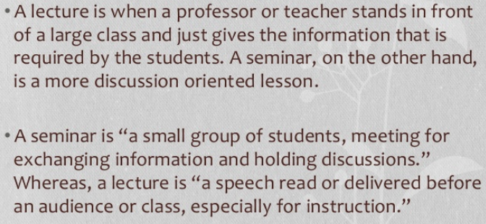
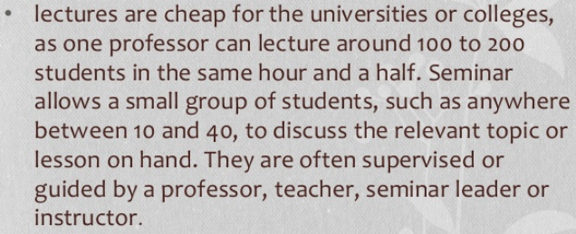
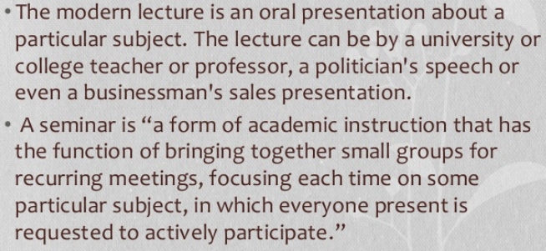
Difference Between Seminar and Lecture Method

Slide 92
Mini lecture
Mini lecture is an overview of a topic for quick and efficient understanding of the subject and improved learning.
Brief lecture can be given to smaller group called as Mini lecture.
The number of audience in a mini lecture may be about thirty persons to the most.
A mini lecture deals with only a specific topic, or a unit of topic and so it can be completed in a short period of time, about fifteen minutes.
Other salient features of the lecture resembles with mini lecture.

Slide 93
Advantages
Disadvantages
There is interaction between the teachers and learners by breaking the culture of silence and traditional learning.
It encourages critical learning through active participation of learners.
It is not expensive and is usually given to a group of community people, students, mothers, etc.
It does not cover a large group of audience and is limited to a specific group only.

Slide 94
Field trip
A planned visit to the place outside the classroom to provide practical knowledge in real situation.
It is also called study trip, educational excursion or an educational tour.
The participants of a study trip are primarily observers. A successful trip also provide an active exploratory experience of taking notes, sketching, taking pictures, collecting specimen.

Slide 95
Advantages
Disadvantages
It allows students to have a real-world experience .
Participants make active co-operation.
Helps to develop knowledge and skills in certain aspects .
It promotes better understanding between participants and teachers.
Enables students to relate what they learnt in classroom with the reality inside.
Creates interest and curiosity for learning.
Develop self confidence.
Learners may get the good opportunity to manipulate and practices things.
More expensive to the institute.
If unplanned , will not be effective.
It is difficult to manage proper facilities like transport ,fooding and lodging .
Sometimes difficult to adjust in new place.
Sometimes conflict may arise due to lack of good leadership and creates frustration.
Accidents , unusual incidents may occur.
Cannot be organized for every kind of learning group , topic and in all situations.

Slide 96
What should be done during study trip?
What should be done after study trip?
Brief on purpose of trip
Clarify the doubts of students.
Check if nobody ( any students) is left behind.
Short rest after the tour so that students properly gather the information, check notes.
Arrange on-the –spot discussion during trip to exchange knowledge , ideas and experiences. Students can clarify their doubts, misunderstanding right on the spot.
organize follow up discussion to evaluate achievements.
Encourage students to put into practice what they have learnt.
Prepare a brief report of trip to improve future trip.

Slide 97
Case studies
Case study is the restatement of event occurred in a community to a person, group or family. It is based on facts and present that really happened. A teacher or a health educator hypothetically can narrate simple, relevant and practical stories of such events to the children in the form of case studies. The case study should fit to the real life situation of the learners
Case study can be read and discussed in the group. Even students can be given opportunity to read it before their fellow learners. If feasible, its copies can be distributed to every learner. Otherwise they can share the limited copies in pairs.
Case study should be short and related to the need of the group. The essence of case study is to provide knowledge and encourage taking necessary actions to solve problems. The conclusion of the discussion should be made clear to every member of the learning group.

Slide 98
Advantages
Disadvantages
1. Helps to provide valuable knowledge based on real life experience.
2. Is interesting and can draw attention.
3. Is impressive. Ideas learnt will be retained for longer period of time.
4. Students can relate the knowledge and ideas learnt to their real life situation. They will learn the ways and means of solving their health problem.
5. Develops students' reasoning power or increase the power of critical judgement.
1. Sometimes a health educator may not find appropriate case study when needed.
2. Good for providing only knowledge.

Slide 99
Mass Methods of Health education

Slide 100
Mass Methods
Characteristics
Especially meant for a large number of heterogeneous people commonly called as mass
Little interaction or exchange of experience between the members of the mass
No two way communication
Best applied in the situation when there is lack of resources and adequate time
This methods helps in reaching broad section of the target population at a time
Examples:
Lecture, Exhibition, Campaign

Slide 101

Mass Method (Lecture)
Characteristics
Oral presentation of information and ideas
by a person to a large group of people (heterogeneous) at a particular place.
Mostly no any other teaching aids are used
Lecture is organized at a particular time usually for the people who come together for common purpose.
Though it is face to face presentation there is no adequate opportunity for interpersonal reaction between the speaker and audience.
Based on traditional model of communication
Also called as Pedagogy model; where student only listen

Slide 102
Mass Method (Lecture)
Techniques of giving Lecture
The subject of the lecture should be related to the needs and interest of the target audience.
Speaker should get thorough & up to date knowledge of the content.
The language should be correct, simple, clear and understandable.
Avoid monotony in voice.
The speaker can raise his voice while expressing important points.
The lecturer should try to know the feedback of the audience by watching their gestures.
The speaker should be sincere, pleasing and properly dressed up.

Slide 103
Mass Method (Lecture)
Advantages
Disadvantages
One person can provide health education to many at a time
No need of teaching aids
Not expensive
Can be adopted at different settings
Message can be made systematic for presentation in case of written speech
One way communication method
Learners are passive and no interaction
Message learnt will be retained for short period of time so not suitable for behavior change
No evaluation system of knowledge and practice
Difficult to draw attention for longer period of time

Slide 104
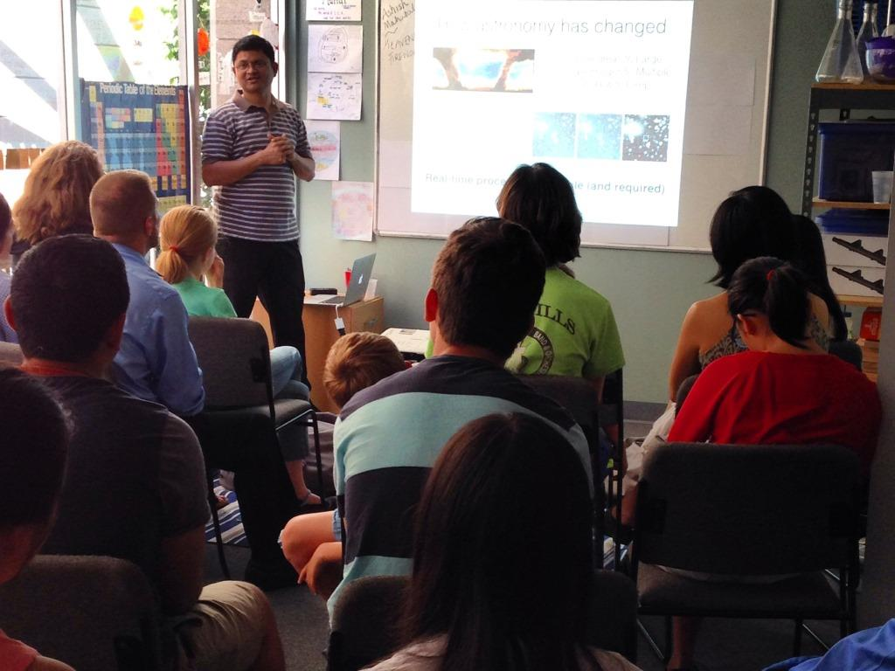
Method (Lecture)
Mini Lecture
Teaching aids can be used
Maintain feedback system
Maintain eye contact
Study the gesture of audience
Interaction between teacher and learner
Breaks the culture of silence and helps learn critically with full understanding (Principle of Conscentization-Paulo Freire)
Participants: 30
Time Duration: 15 minutes

Slide 105
Mass Method (Lecture)
Types of Lecture
Extempore Talk: Lecture without previous preparation
Impromptu Talk: Provides lecture immediately, when any events occurs
Memorized Speech: Lecture based on prepared speech which is memorized
Read Speech: Written message is read out before the audience

Slide 106
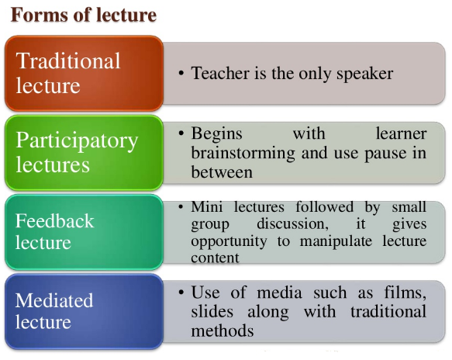

Slide 107
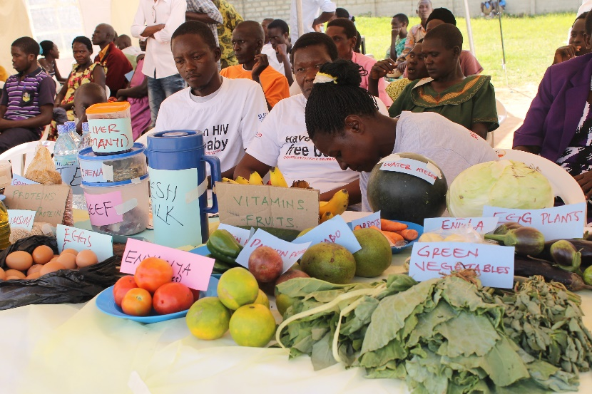
Mass Method (Exhibition)
Characteristics
It is systematic and meaningful display of educational materials with an intention to educate large number of people within a limited period of time and at a particular place.
Exhibition can sometimes be organized to provide health education to the community people.
Use of different teaching materials and methods
Posters, charts, graphs, real objects, cassette/
video playing health messages, demonstration
It should be self explanatory
In some case; Interpreter for better learning

Slide 108
Mass Method (Exhibition)
Advantages
Disadvantages
Provides better learning through varieties of experiences like hearing, seeing, touching, feeling and tasting.
Opportunity may be provided for practical learning through demonstration, manipulation of objects and through practice.
Interesting and attractive because of decorations, good setting, and other lively displays.
Helps students to develop creativity.
Organizing exhibition can also help learn some new knowledge and skills.
Difficult to organize in terms of money, materials and manpower.
Difficult to organize to suit different kinds of people with different needs, background, interest ,etc.
Difficult to get appropriate place and adjust to the available time due to lack of resources, unfavorable weather, etc.

Slide 109
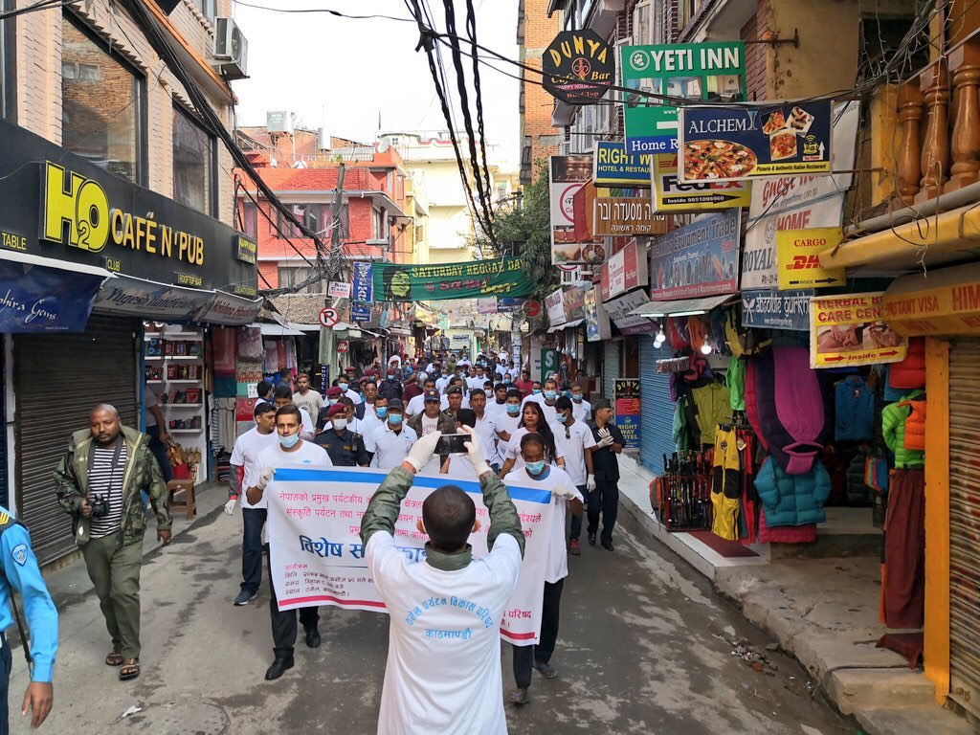
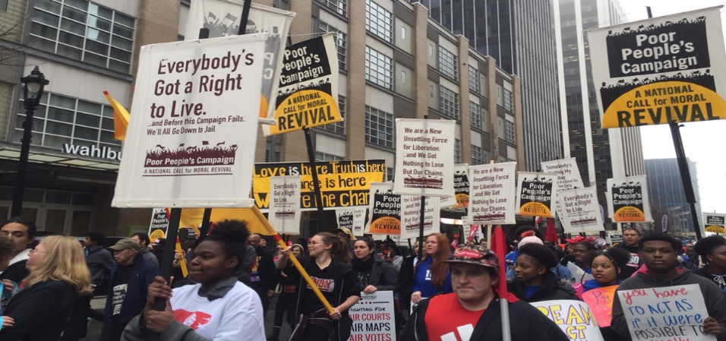
Mass Method (Campaign)
Characteristics
Organized to create public awareness
Conducted on mass scale with an intention of motivating large number of community people to take necessary actions to solve their health problems
It encourages people by which active participation is observed in the program conducted in community
Various methods and media are used to deliver health message like: Lecture, poster, pamphlets, street drama, role play, radio broadcast, television broadcast, newspaper, exhibition, demonstrations, rallies, etc.
Coordinated and cooperative approach among different
stakeholders is required
Examples of campaigns:
No smoking campaign, child nutrition campaign, Toilet construction campaign, Child immunization campaign, Cleaning campaign, etc.

Slide 110
Mass Method (Campaign)
Advantages
Disadvantages
Reaches many people quickly
Stronger voice and wider reach of message
Low cost per person reached (social media)
People works together and can modify their behavior
Fixed message
One way communication
Language might not be friendly (sometime)
Community participation might be a questionable

Slide 111
Example of Use of Health education Methods
H.Ed. Methods.xlsx

Slide 112
References
Abraham Tamirat, Health Education Methods and Materials, Dec 8, 2015, Available at https://www.slideshare.net/abrish777/health-education-methods-and-materials2015
Hari Bhakta Pradhan, Methods and Media of Heath Education, A text book of Health Education, Page 70-117, 2009
Robert Gordon University, Tertiary level teaching, Selecting appropriate teaching/ learning methods, page 24, Available at: http://www2.rgu.ac.uk/celt/pgcerttlt/selecting/select24.htm
Anthony William (tony) Bates, Models for methods and media selection, Teaching in a digital age, Available at: https://opentextbc.ca/teachinginadigitalage/

Slide 113
Thank You!

