Slide 1

Health Policies: National Health Policies 2071(Focused On Public Health Aspects)
&
Social Health Insurance Scheme : Concept, Objectives, Coverage
PRESENTED BY:
DURGA SHRESTHA; 15
LUNA BARAL; 16
BPH,4th Semester
SHAS,PU
PRESENTED TO:
KIRTI SAGAR BARAL
LECTURER
SHAS,PU

Slide 2
Health Policies: National Health Policies 2071(Focused On Public Health Aspects)

Slide 3
Health Policies:
Health policies refers to decisions, plans and actions that are undertaken to achieve specific health care goals within a society.
Health policy is a formal statement or procedure within institutions(notably government) which defines priorities and the parameters for action in response to health needs available resources and other political pressures.

Slide 4
Contd…
One of the key functions of public health professionals is to influence and shape policy decisions at all levels for the benefit of the population.

Slide 5
National Health Policies 2071(Focused On Public Health Aspects)
To protect the achievements made so far and to adequately address prevalent and new challenges faced within health sector by developing people-centred and efficient management by optimal utilization of available means and resources to provide promotive, preventive, curative and rehabilitative health services, National Health Policy -2048 has been updated and National Health Policy-2071 has been formulated.

Slide 6
Policies:
1.Make availability of quality health services to all citizen (universal health coverage) and basic health services at free of cost.
2.To plan produce, acquire, develop, and utilize necessary human resources to make health services affordable and effective.
3. Develop ayurvedic medicine system and make utilization of available herbs in the country as well as developing other complementary medicine system.
4. Aim at becoming self sufficient in quality medicine and medical equipment-emphasis on internal production and effective importation.

Slide 7
Contd…
5. Enhancement of research activities to international level and utilize proven behavior or practices obtained from research to formulate policy, programme planning and medical treatment system.
6.Promote public health through extensive use of education, information and communication program and provision of message about health as a right to information for the citizen.
7. To reduce prevalence of malnutrition through promotion and usage of quality healthy foods.

Slide 8
Contd…
8. To ensure availability of quality health services through competent and accountable mechanism and system for coordination, monitoring and regulation.
9. To ensure professional and quality service standard by making health related professional council capable, professional and accountable.
10. To mainstreaming health in every policy of state by re enforcing collaboration with health related various stakeholders.
11. To ensure the right of citizens to live in healthy environment through effective control of environmental pollution for protection and promotion of health.

Slide 9
Contd…
12.To maintain good governance in the health sector through necessary policy, structure and management for delivery of quality health services.
13.To promote public and private sectors partnership for systematic and quality development of health sector.
14.To increase the investment in the health sector by state to ensure quality and accessible health services and to provide financial security to citizens for medical cost and as well as effectively utilize and manage financial resources obtained from private and non government sector.

Slide 10
Social Health Insurance Scheme : Concept, Objectives, Coverage

Slide 11
What Is Social Health Insurance Scheme?
Social health insurance is defined as “coverage that provides for the payments of benefits as a result of sickness or injury”.
It includes insurance for losses from accident, medical expenses, disability or accidental death.
Social Health Insurance (SHI) is one of the possible organizational mechanisms for raising and pooling funds to finance health services, along with tax-financing, private health insurance, community insurance and others.

Slide 12
Historical Background:
An early initiative to health insurance in Nepal begun from 1976 through united mission to Nepal as Lalitpur insurance scheme in Ashrang, which was later expanded to other facilities.
The government funded community-based health insurance program was initiated in 203 in 2 districts and expanded to additional 4 in 2005/6.
National health insurance policy was passed by government of Nepal in 2014.

Slide 13
CONTD:
In 9th Feb. 2015, the ordinance for formation of social health security development committee was passed by government of Nepal.
In FY 2071/72, the government of Nepal had announced to roll out SHSP to three districts (Kailali, Baglung and Ilam).

Slide 14



Social Health Insurance Scheme In Nepal

Slide 15
Aim :
The main aim of this policy is to improve the overall health situation of people of Nepal.
Main Objective:
The main objective of this policy is to ensure universal health coverage by increasing access to, and utilization of, necessary quality health services.
Specific Objective:
Increase the financial protection of the public by promoting pre-payment and risk pooling in the health sector.
Mobilize financial resources in equitable manner.
Improve the effectiveness, efficiency, accountability and quality of care in the delivery of health care services.

Slide 16
Need for Social Health Security (Health Insurance ) program
This program is needed to improve the health situation of the people of Nepal. Specifically, this program is needed to:
Increase accessibility to and equity in provision of health care services by removing financial barriers to the use of health care services focusing on poor;
Promote pre-payment and risk pooling mechanism to mobilize financial resources for health in equitable manner;
Strengthen health system in an integrated manner;
Improve the health seeking behavior of the public through clear entitlement procedures.
Encourage output –oriented expenditure in health sectors.

Slide 17
Key Program Features
Universal coverage
Family size
Premium payment is annual
registration
Subsidy by government for poor
Referrals
Web based / IT

Slide 18
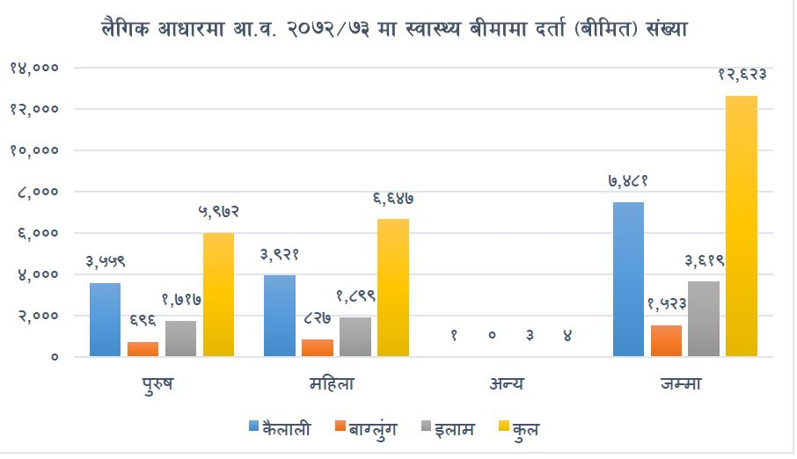
Coverage

Slide 19
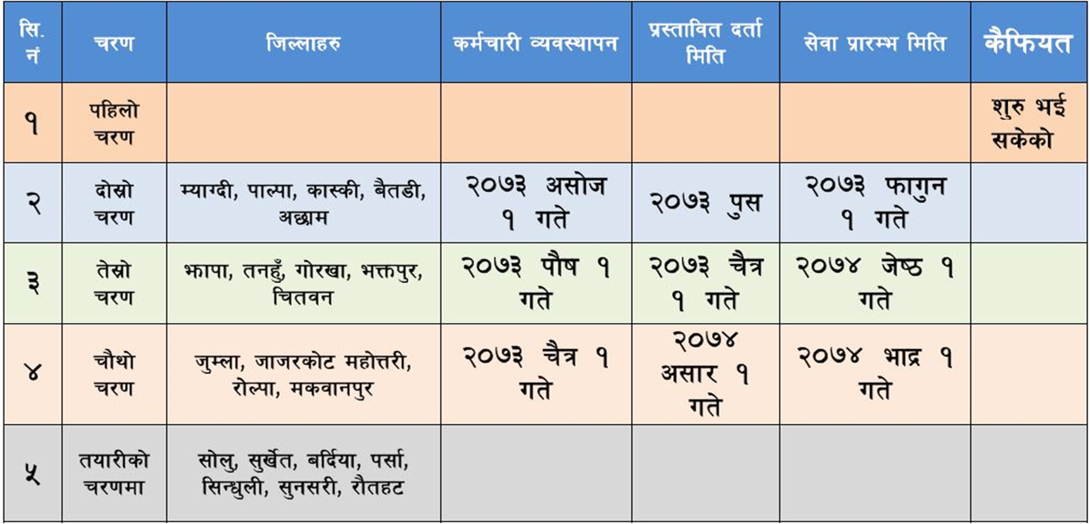
Coverage

Slide 20
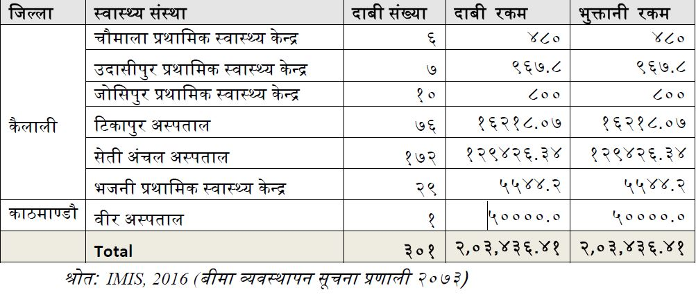
Coverage

Slide 21
Challenges for the Program
Increasing insurance coverage
Enrolling people into insurance plan
Determining poo rand making poverty card and it’s implementation
Achieving 100% health insurance by 2030
Increasing access to health care services

Slide 22
References:
https://drive.google.com/file/d/0BxYPsAJu5Bn_dm5FZHh6ZThzSlU/view
https://www.ncbi.nlm.nih.gov/pubmed/29635799
https://www.publichealthupdate.com/social-health-security-health-insurance-program-in-nepal/

Slide 23


