Slide 1

Human Resource Development Information System (HURDIS)

Slide 2
DEFINITION OF HURDIS
It is a systematic way of storing data & information for each individual employee to aid planning, decision making & submitting of returns and reports to the external agencies.
A method by which an organization collects, analyses & reports the information about people and job.

Slide 3
OBJECTIVES OF HURDIS
To offer sufficient, comprehensive & ongoing information about people & jobs.
To supply up to date information at a realistic cost.
To offer data security & personal privacy.

Slide 4
ATTRIBUTES OF HRIS
A
part of the organization's larger management
information system
An integration of HRM and Information Systems
Helps HR managers to perform the functions in an effective and systematic way
The system used to acquire, store, manipulate, analyze, retrieve, and distribute appropriate information regarding human resources
To make decisions, H.R. and line managers require accurate human resource information

Slide 5
HRIS CONTAINS INFORMATION ABOUT:
=========================
Jobs
Positions
People

Slide 6
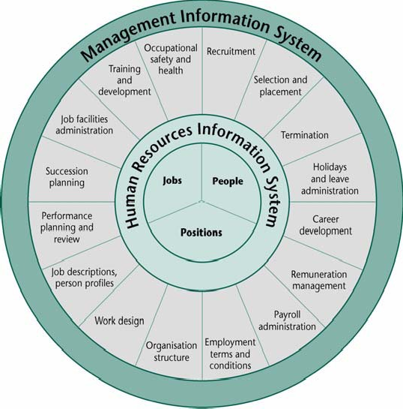
HRIS model

Slide 7
HRIS supports in:
The strategic, tactical & operational use of the human resource of an organization
Collect, store and process employee information
Provide reliable information for decision- making
Allow organisation to assess effectiveness of HR policies, programmes and decisions

Slide 8
Human Resources Information System
SYSTEM | DESCRIPTION
TRAINING & | TRACK TRAINING, SKILLS,
DEVELOPMENT | APPRAISALS
CAREER PATHING | DESIGN EMPLOYEE CAREER PATHS
COMPENSATION | MONITOR WAGES, SALARIES,
ANALYSIS | BENEFITS
HUMAN RESOURCES | PLANLONG-TERM LABOR FORCE
PLANNING | NEEDS

Slide 9
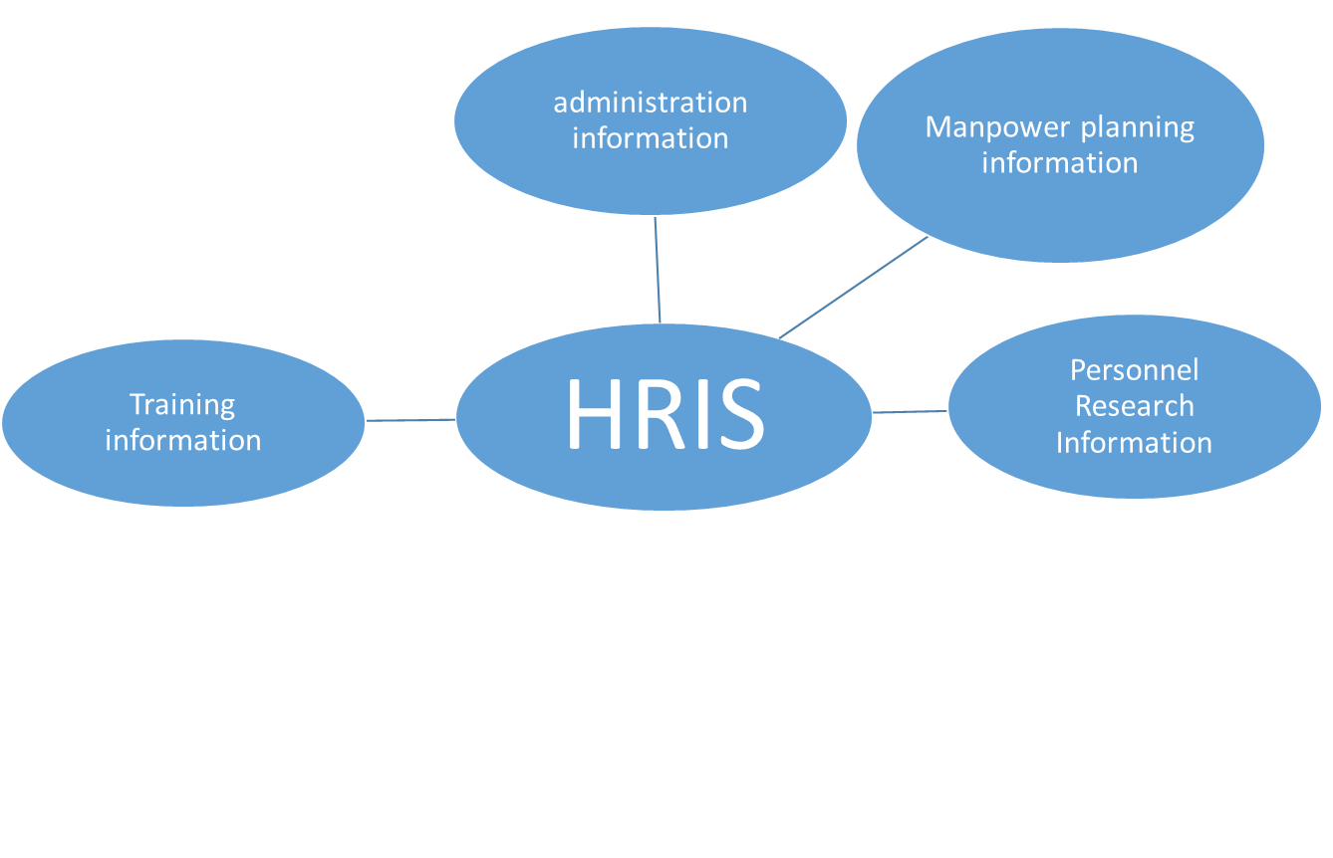
Subsystems of HRIS
Recruitment information
Payroll Information
Appraisal Information

Slide 10
Steps of setting up an HRIS
Planning
Analysis
Design
Implementation
Maintenance
11

Slide 11
Steps in planning
Inception of idea
Feasibility study
Selecting a project team
Steps in analysis
Defining the Requirement
Vendor Analysis
Contract negotiations

Slide 12
Steps in designing
Examines the flow of Information
Identification of gaps and outlines
Steps in Implementing
Tailoring the system
Collecting data
Testing the system
Starting up
Running in parallel

Slide 13
Steps in maintenance
Maintaining of HRIS
Auditing

Slide 14
Applications of HRIS
¬Personnel administration
¬Salary administration
¬Leave/absence recording
¬Skill inventory
¬Medical History
¬Accident monitoring
¬Performance appraisal
¬Training and development
¬Human resource planning
¬Recruitment

Slide 15
importance of HRIS
¬Large amount of data and information to be processed.
¬Project based work environment.
¬Employee empowerment.
¬Increase of knowledge workers & associated information.
¬Learning organization

Slide 16
Benefits of HRIS
Higher speed of retrieval and processing of data
Decrease in duplication of efforts leading to condensed cost
Ease in classifying and reclassifying data
Better analysis leading to more effective decision making
Higher accuracy of information/report generated

Slide 17
contd….
Fast response to answer queries
Improved quality of reports
Better work culture
Establishing of streamlined and systematic procedures
More transparency in the system

Slide 18
Limitations of HRIS
It may be expensive in terms of finance and manpower
It may be inconvenient for computer illiterates or people with mere knowledge of computer
Computers can not substitute human

Slide 19
Barriers to the success of HRIS
Lack of management commitment
Poorly done needs analysis
Failure to include key people
Failure to keep project team intact
Politics / hidden agendas
Failure to involve / consult significant groups
Lack of communication
Bad timing (time of year and duration

Slide 20
RefeRences Books
¬Rao, V.S.P., (2006), Human Resource Management, 2nd edition,
Excel Books, N. Delhi
inteRnet
¬http://www.hrtotal.com/hris.asp
¬http://management.about.com/cs/peoplemanagement/g/HRIS.htm

Slide 21
tHank
You

