Slide 1
Initial Environmental Examination (IEE)
Kirti Sagar Baral, MPH, MA

Slide 2
Initial Environmental Examination (IEE)
It is a preliminary environmental review of reasonably foreseeable impacts of proposed activities to determine the adverse impacts whether an EIA is required or not
Done for the projects as per the schedule 1 of EPR 1997
Required for small scale proposals
Conducted with limited budget and based on existing information
Potentially significant impacts are identified and mitigation measures are prescribed

Slide 3
Difference between IEE and EIA
 | IEE | EIA
scope | Preliminary environmental review | Full environmental assessment
Scale of the project | For small scale project | For large scale projects
Cost | Low cost projects | High cost projects
Based on impacts | Project with no significant adverse impacts | Projects with significant adverse impacts, Analysis of environmental impacts much more detailed
Screening criteria | Schedule 1 of EPR 1997 | Schedule 2 of EPR 1997
Scoping | Not required | Required
Public Hearing | Not required | Required

Slide 4
Difference between IEE and EIA
 | IEE | EIA
Open report for public review | Not required (however publication of 15 days notice for suggestions/concerns of stakeholders on the project mandatory before finalization of report is mandatory) | Required
Approving agency | Concerned agency | MOE
Deadline for approval | Within 21 days of the receipt of the report by the concerned agency | Within 60 to 90 days of the receipt of the report in the ministry
EMP | Not required | required

Slide 5
What does IEE do?
Describes the proposed project or activity and examine alternative
Identifies and addresses community concerns to extent possible
Identifies most likely environmental impacts from proposed actions
Identifies mitigation measures for adverse impacts likely to be non significant
Directs future action

Slide 6
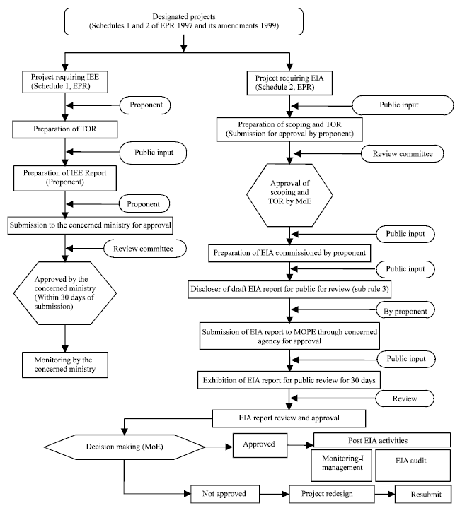
IEE process and EIA for health projects

Slide 7
IEE process
Fig: IEE process highlighted

Slide 8
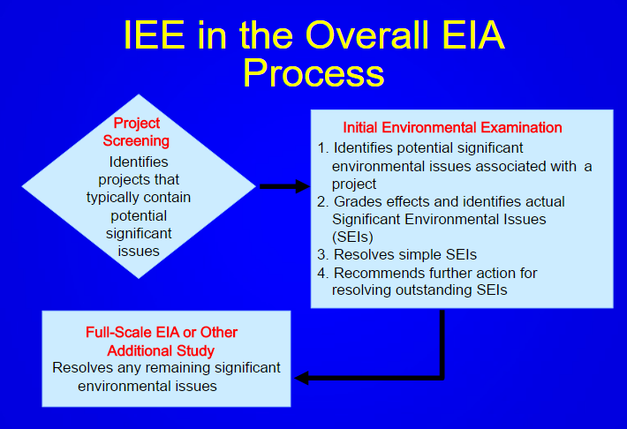

Slide 9
Outcomes of IEE
No requirements for further environmental studies, proposal not anticipated to have significant impact
Limited environmental study needed; environmental impacts are known and can be easily mitigated
Full scale EIA required, impacts unknown or likely to be significant

Slide 10
IEE Process in Nepal
According to Section 3 of Environmental Protection Act (EPA), 1997, a proponent shall have to carry out Initial Environmental Examination (IEE) and/or Environmental Impact Assessment (EIA) of the proposals as prescribed in Schedule 1 and Schedule 2 (pertaining to Rule 3 of Environment Protection Regulation, 1997).
Upon the commencement of EPA, no one shall implement or cause to be implemented a proposal without getting it approved from concerned agency (Ministry related to the proposal).

Slide 11
In case of IEE, the proponent should prepare terms of reference (ToR) in the format of Schedule 3 of the EPR, 1997 and submit for approval to the concerned Ministry.
The IEE report should be prepared as per the approved ToR and Schedule 5 of EPR, 1997.
The final IEE report should be submitted to the concerned Ministry for the approval. After approval of the IEE report the project could be implemented.

Slide 12
Projects that require IEE
The schedule 1 of EPR, 1997 includes a list of projects in the different sectors which require IEE level of assessment.
Eg According to this, operation of hospitals or nursing homes or medical profession (study and teaching also) with 25 to 100 beds require IEE and if exceeds 100 beds, it requires to conduct EIA (EPA/EPR, 1997 with amendment). Besides this, if total investment cost of project is in between NRS. 50 to 250 million, it requires to carry out IEE and if exceeds NRS. 250 million, it requires Environmental Impact Assessment.

Slide 13
IEE process for health projects

Slide 14
TOR format for IEE (Schedule 3 of EPR 1997)
Name and address of the individual or institution preparing the report
Description of proposal (a) General introduction
(b) Relevancy of the proposal
Procedure to be adopted while preparing the report
Policies, laws, Rules and manuals to be taken into account while preparing the report
Preparation of the reports: (a) Time (b) Estimated budget
Specific impact of the implementation of the proposal on the environment: (a) Social and economic, (b) Cultural and physical, (c) Chemical, (d) Biological
Alternatives for the implementation of the proposal: (a) Design (b) Project site (c) Technology, procedure of operation, time schedule, raw material to be used (d) Other matters
Matters concerning the prevention of the impact of the implementation of the proposal on the environment
Matters to be monitored while implementing the proposal.
Other necessary matters.

Slide 15
Public Notice for IEE

Slide 16
Outline of IEE report (contd..)
Name and address of individual or institution preparing the report:
Summary of the proposal
Project description
Impact of the implementation of the proposal on environment
Alternatives for the implementation of the proposal
Mitigation measures
Matters to be monitored while implementing the proposal
Other necessary matters

Slide 17
Thank You

