Slide 1
UNIT III- Nutrition in Lifecycle
Introduction to energy requirements and energy balance
Recommended Dietary Allowance (RDA): Concept and importance, reference men and women
By:
Laxmi Adhikari
Nutritional Science
2nd sem

Slide 2
Introduction
Human energy requirements are estimated from measures of energy expenditure plus the additional energy needs for growth, pregnancy and lactation.
Recommendations for dietary energy intake from food must satisfy these requirements for the attainment and maintenance of optimal health, physiological function and well-being.
The latter (i.e. well-being) depends not only on health, but also on the ability to satisfy the demands imposed by society and the environment, as well as all the other energy-demanding activities that fulfil individual needs.

Slide 3
Energy requirement
Energy requirement is the amount of food energy needed to balance energy expenditure in order to maintain body size, body composition and a level of necessary and desirable physical activity consistent with long-term good health.
This includes the energy needed for the optimal growth and development of children, for the deposition of tissues during pregnancy, and for the secretion of milk during lactation consistent with the good health of mother and child.

Slide 4
Main objective for the assessment of energy requirements is the prescription of dietary energy intakes that are compatible with long-term good health.

Slide 5
The recommended level of dietary energy intake for a population group is the mean energy requirement of the healthy, well-nourished individuals who constitute that group.

Slide 6
COMPONENTS OF ENERGY REQUIREMENTS
Human beings need energy for the following:
Basal metabolism: This comprises a series of functions that are essential for life, such as:
cell function and replacement;
the synthesis, secretion and metabolism of enzymes and hormones to transport proteins and other substances and molecules;
the maintenance of body temperature;
uninterrupted work of cardiac and respiratory muscles;
and brain function.

Slide 7
Metabolic response to food.:
Eating requires energy for the ingestion and digestion of food, and for the absorption, transport, interconversion, oxidation and deposition of nutrients.
These metabolic processes increase heat production and oxygen consumption, and are known by terms such as dietary-induced thermogenesis, specific dynamic action of food.

Slide 8
Physical activity:
This is the most variable and, after BMR, the second largest component of daily energy expenditure.
Humans perform obligatory and discretionary physical activities.
In addition to occupational work, obligatory activities include daily activities such as going to school, tending to the home and family and other demands made on children and adults by their economic, social and cultural environment.
Discretionary activities include
- the regular practice of physical activity for fitness and health;
-the performance of optional household tasks that may contribute to family comfort and well-being;
-and the engagement in individually and socially desirable activities for personal enjoyment, social interaction and community development.

Slide 9
Growth:
The energy cost of growth has two components:
the energy needed to synthesize growing tissues; and
2) the energy deposited in those tissues.
The energy cost of growth is about 35 percent of total energy requirement during the first three months of age,
falls rapidly to about 5 percent at 12 months
and about 3 percent in the second year,
remains at 1 to 2 percent until mid-adolescence,
and is negligible in the late teens.

Slide 10
Pregnancy: During pregnancy, extra energy is needed for the growth of the foetus, placenta and various maternal tissues, such as in the uterus, breasts and fat stores, as well as for changes in maternal metabolism and the increase in maternal effort at rest and during physical activity.
Lactation: The energy cost of lactation has two components:
the energy content of the milk secreted; and
the energy required to produce that milk.
Well-nourished lactating women can derive part of this additional requirement from body fat stores accumulated during pregnancy.

Slide 11
Energy balance
Energy balance is achieved when input (i.e. dietary energy intake) is equal to output (i.e. total energy expenditure), plus the energy cost of growth in childhood and pregnancy, or the energy cost to produce milk during lactation.
When energy balance is maintained over a prolonged period, an individual is considered to be in a steady state.
This can include short periods during which the day-to-day balance between intake and expenditure does not occur.

Slide 12
An optimal steady state is achieved when energy intake compensates for total energy expenditure and allows for adequate growth in children, and pregnancy and lactation in women, without imposing metabolic, physiological or behavioural restrictions that limit the full expression of a person’s biological, social and economic potential.

Slide 13
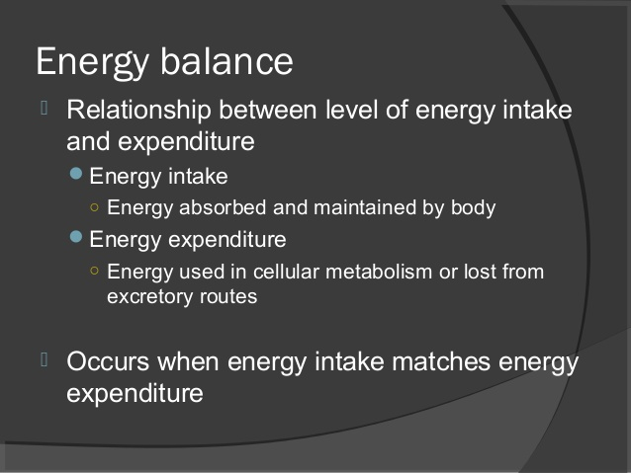

Slide 14
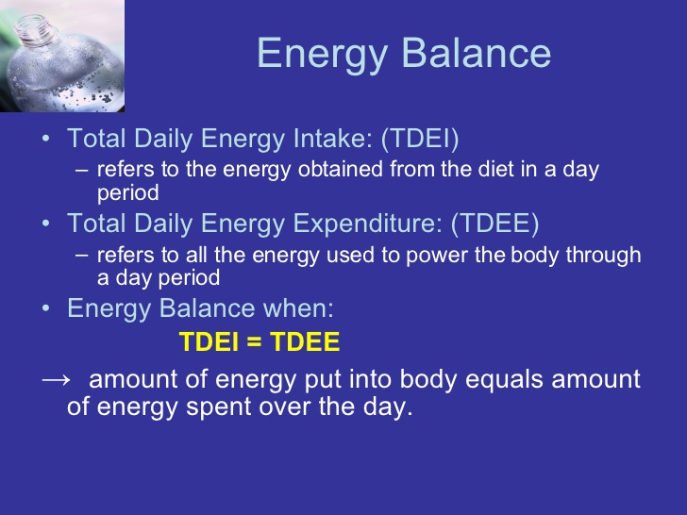

Slide 15
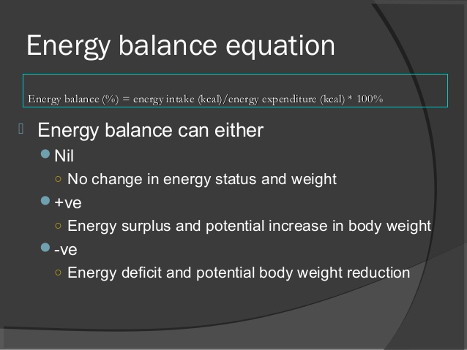

Slide 16
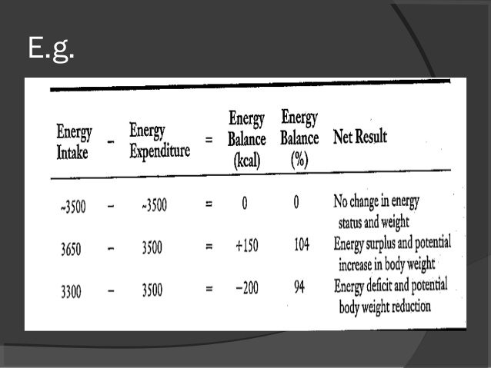

Slide 17
Concept of RDA
As the United States entered World War II, the Food and Nutrition Board (FNB) was established within the National Academy of Sciences initially to advise the Army and later other government agencies on problems relating to food and the nutritional status of the U.S. population.
The FNB recognized the need to develop recommendations on the amounts of nutrients that should be provided to the general public as well as to the armed forces.
Therefore, it took as its first task the formulation of what came to be known as the Recommended Dietary Allowances (RDAs).

Slide 18


Slide 19
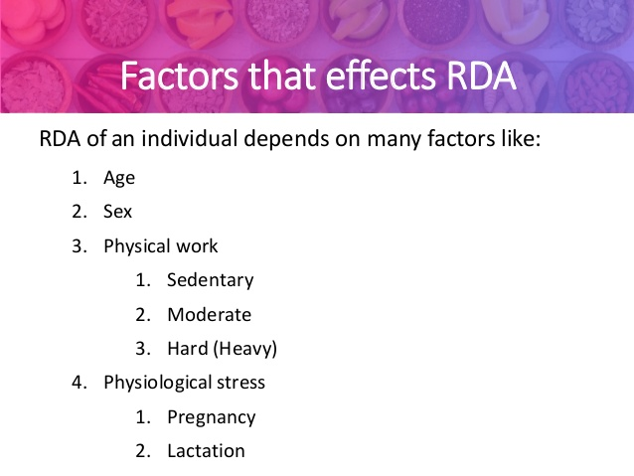

Slide 20
Importance of RDA
It is necessary to inform how much of a specific nutrient the body needs on a daily basis.
It is important to meet the daily recommended dietary allowances so that the body gets everything it needs to function.
Basis for all feeding program (school launch program)
To interpret food consumption record.
To understand nutritional needs.
Guidelines for public food program.
To develop and evaluate the new food product.
To develop nutritional education programs.

Slide 21
Reference men and women
Defined on the basis of body weight of well nourished healthy adults who have satisfactory growth during their childhood and are currently leading a healthy and moderately active life under normal comfortable condition.

Slide 22
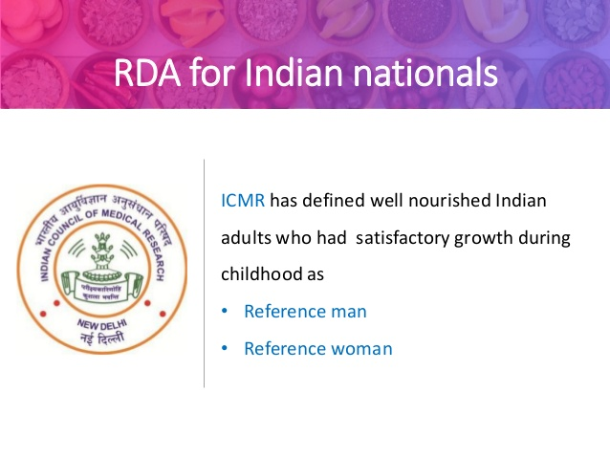

Slide 23
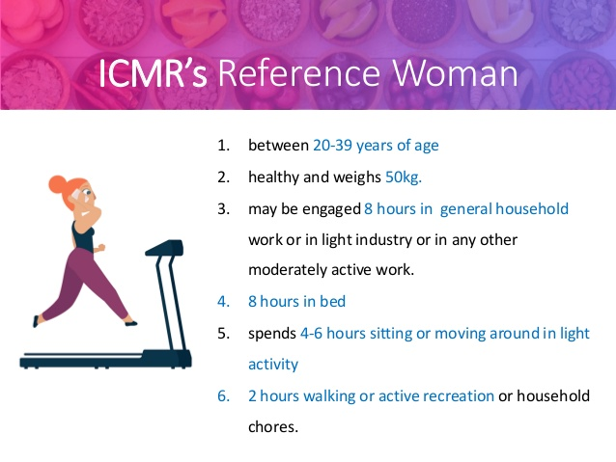

Slide 24
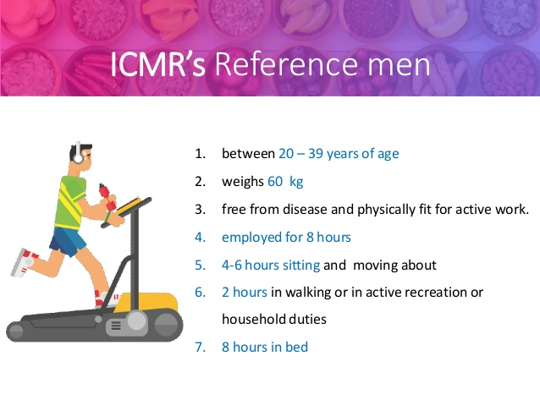

Slide 25
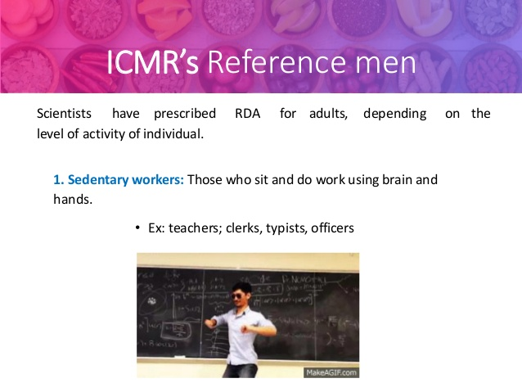

Slide 26


Slide 27


