Slide 1

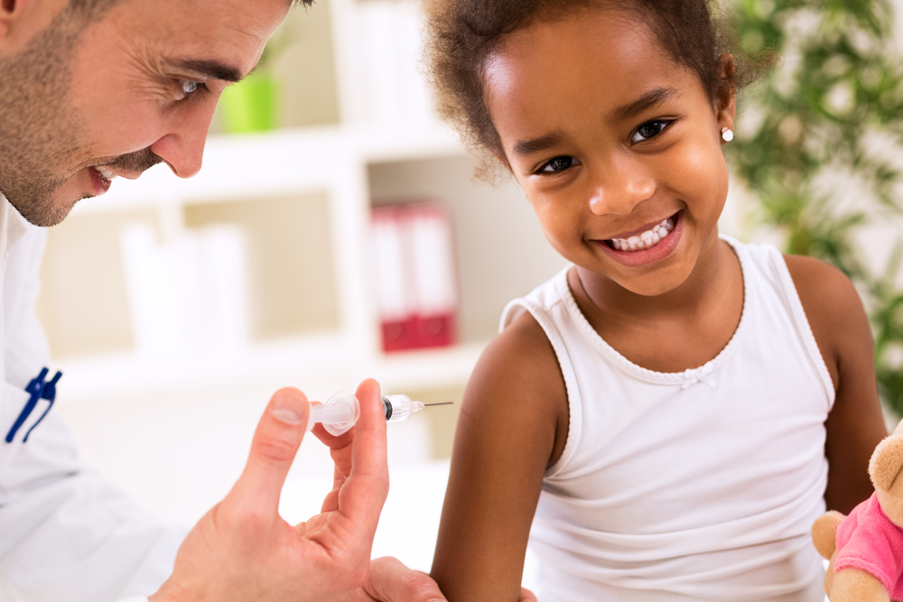
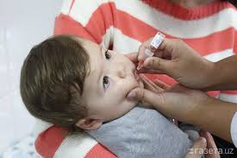
National Immunization Program
Presented By:
Aakriti Mahat
Puran K.C
Presented To:
Dr. Hari Prasad Kaphle
Associate Professor SHAS,PU

Slide 2
Background of NIP
NIP of Nepal was started in 2034 BS as Expanded Program on Immunization. In this time EPI start from 3 Districts Dhanusha,Rupendehi and Sindupalchok (DR.Sindu).(BCG and DPT)
It is a priority one program of Ministry of Health and Population.
It is one of the successful public health programs of Nepal.
It has contributed significantly in reduction of morbidity and mortality associated with vaccine preventable diseases.
As of 15 July 2025, all 77 districts in Nepal have been declared "fully immunized."

Slide 3
NIP works closely with other divisions & national centres as well as with supporting partners, including GAVI, WHO and UNICEF.
Currently, the program provides vaccination against 14 VPDs through almost 16,000 service delivery points in health facilities (fixed sessions), outreach sessions, and mobile clinics.
The NIP has a Comprehensive Multi-year Plan for Immunization (cMYP) aligned with global, regional, and national guidelines, policies, and strategies to guide the program for five years.
Nepal has introduced the HPV vaccine in the FY 2081/82 as an effort to accelerate the elimination of cervical cancer.

Slide 4
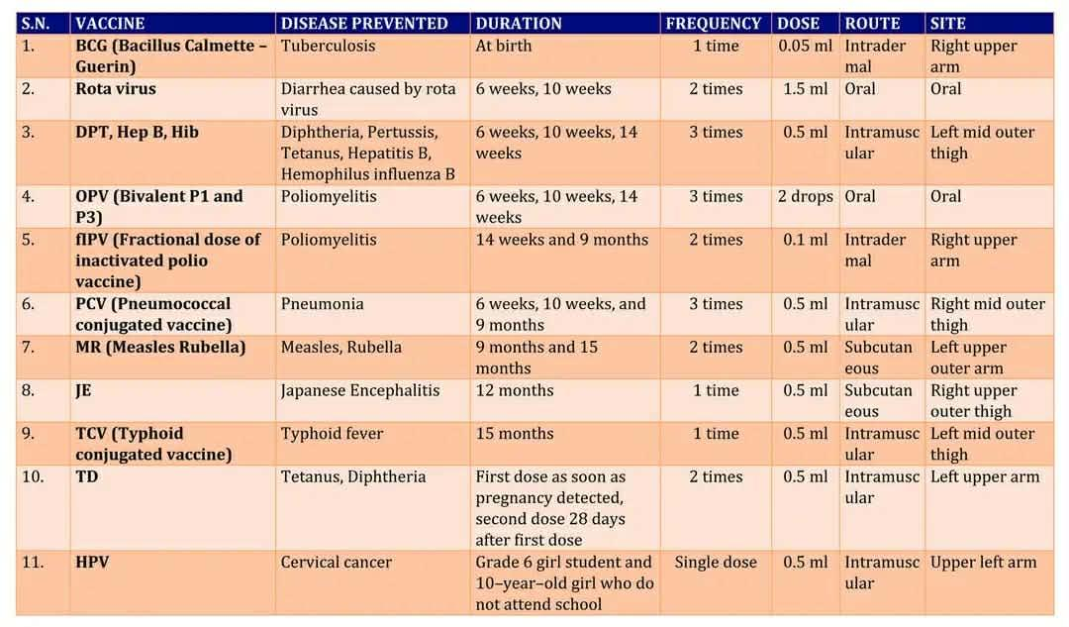
National Immunization Schedule

Slide 5
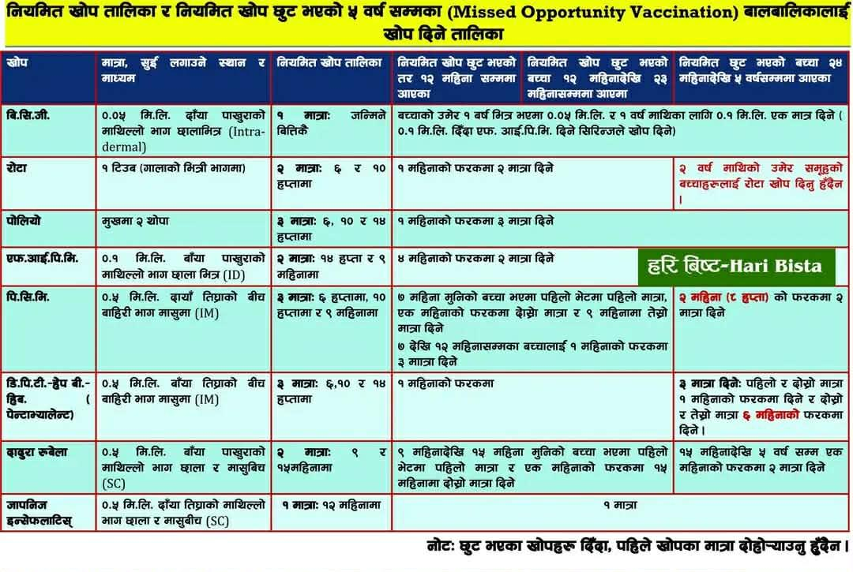

Slide 6
Target population
Under 1 year children for BCG, DPT-HepB-Hib, Rotavirus, OPV, IPV, PCV and Measles/ Rubella1 (MR1) vaccine.
Twelve months children for JE
15 months children for MR2
Pregnant women for Tetanus Toxoid containing (Td) vaccine.
HPV vaccination for 6-10 Class Girls and out-of-school girls aged 10-14 years.

Slide 7
Milestone of Immunization Programme in Nepal
  Smallpox control activities were commenced in Nepal
1962
  Smallpox Eradication project was started
1967
  (April 6) Last case of Smallpox in Nepal
1975
  Eradication of smallpox was declared in Nepal in 13th April 1997
1977
  Expanded Programme on Immunization was started in Nepal (in three district)(DR.Sindu)
1979
  EPI program expanded to all 75 districts of Nepal
1989

Slide 8
  Introduced BCG vaccine in immunization schedule
1979
  Introduced DPT vaccine in immunization schedule
1979
  Introduced OPV vaccine in immunization schedule
1980
  Introduced TT vaccine in immunization schedule
1981
  Introduced measles vaccine in immunization schedule
1982
  Introduced Hepatitis B vaccine in immunization schedule
2005

Slide 9
  Introduced JE vaccine in immunization schedule
2007
  Introduced Hib vaccine in immunization schedule
2009
  Polio eradication activities started in Nepal
1996/97
  AFP Surveillance was started in Nepal
1998
  School immunization (TT) for grade 1,2,3 children
2005
  Nepal achieved maternal and neonatal tetanus elimination status
2005

Slide 10
  Last case of polio was found in Nepal
2010
  comprehensive Multi-year Plan for Immunization (cMYP) 2012 – 2016
2011
  Nepal was certified polio free status by WHO
2014
  Nepal became first country to introduce IPV in SEA region
2014
  Rubella vaccine added in measles as MR in immunization schedule
2014
  Introduced PCV vaccine in immunization schedule
2015
  Nepal has initiated ‘full immunization program’(Achham,Bhageswor VDC)
  Palpa is first district declaration as fully immunized district.
2012/13

Slide 11
  JE vaccine was scaled up in all districts from 31 endemic districts.
2016
  Nepal became first country in SEA to have Immunization Act (2072)
2016
  comprehensive Multi-year Plan for Immunization (cMYP) 2017 – 2021
2017
  80% Palikas, and 56 districts have been declared ‘fully immunized’
2017/18
  Gandaki Province declared as fully immunized province
2017/18
  Nepal certified as having achieved control of rubella & congenital rubella syndrome
2018
  Immunization Regulation 2074
2018

Slide 12
  Certified of having achieved hepatitis B control among children through immunization
2019
  Rota virus vaccine has been added in routine immunization In NIP.
2020
  COVID-19 vaccine introduce in Nepal
2021
  Typhoid Conjugate Vaccine (TCV) was introduced in routine immunization and is given at 15 months of age.
2023
  Environmental surveillance expanded in Madhesh and Koshi Provinces.
2023
  Environmental surveillance expanded in Gandaki Province
  MR sub-national lab expanded in Sudurpashchim Province
  HPV Demonstration conducted through 7 hospitals of 7 provinces
2024

Slide 13
  HPV vaccine has been added in routine immunization in NIP.
2025
  All 77 districts in Nepal have been declared "fully immunized.“(Fully immunized means all the children of 12-23 aged are immunized with all mentioned vaccines within one year during survey.
2025

Slide 14
Vision, Mission, Goal and strategies (cMYP 2017-2021)of Immunization program
Vision
Nepal: a country free of vaccine-preventable diseases.
Mission
To provide every child and mother high-quality, safe and affordable vaccines and immunization services in an equitable manner.
Goal
Reduction of morbidity, mortality and disability associated with vaccine preventable diseases.

Slide 15
Strategic Objectives
Objective 1: Reach every child for full immunization;
Objective 2: Accelerate, achieve and sustain vaccine preventable diseases control, elimination and eradication;
Objective 3: Strengthen immunization supply chain and vaccine management system for quality immunization services;
Objective 4: Ensure financial sustainability for immunization program;
Objective 5: Promote innovation, research and social mobilization activities to enhance best practices

Slide 16
Activities
Regular immunization through outreach and static clinics
Surveillance of Vaccine Preventable Diseases
AEFI surveillance
Training to health workers and volunteers on immunization
Declaration of full immunization
Advocacy with the members of parliament, policy makers, private sectors and civil society
Orientation for municipality leader & employee on micro-planning
Orientation at local level to ensure full immunization & its sustainability

Slide 17
Orientation to FCHVs for identification of hard to reach and drop-out children
Expansion of electronic immunization registration system
Supervision and monitoring through program staff, partners, independent monitors
Outbreak response and investigation
Review of immunization program
Immunization data verification and validation
Financial cost effectiveness analysis of immunization service
Introduction of new vaccines

Slide 18
Information Management
Integrated HMIS Section of Management Division
Recording and Reporting tools:
  HMIS 2.1: Child Health Card
  HMIS 2.2: Immunization Register
  HMIS 9.1: FCHV Reporting Form
  HMIS 9.2: ORC Reporting Form
  HMIS 9.3: Primary Health Care Facility Reporting Form
  HMIS 9.4: Hospital Reporting Form
  HMIS 9.5: Private and NGO Health Care Facility Reporting Form

Slide 19
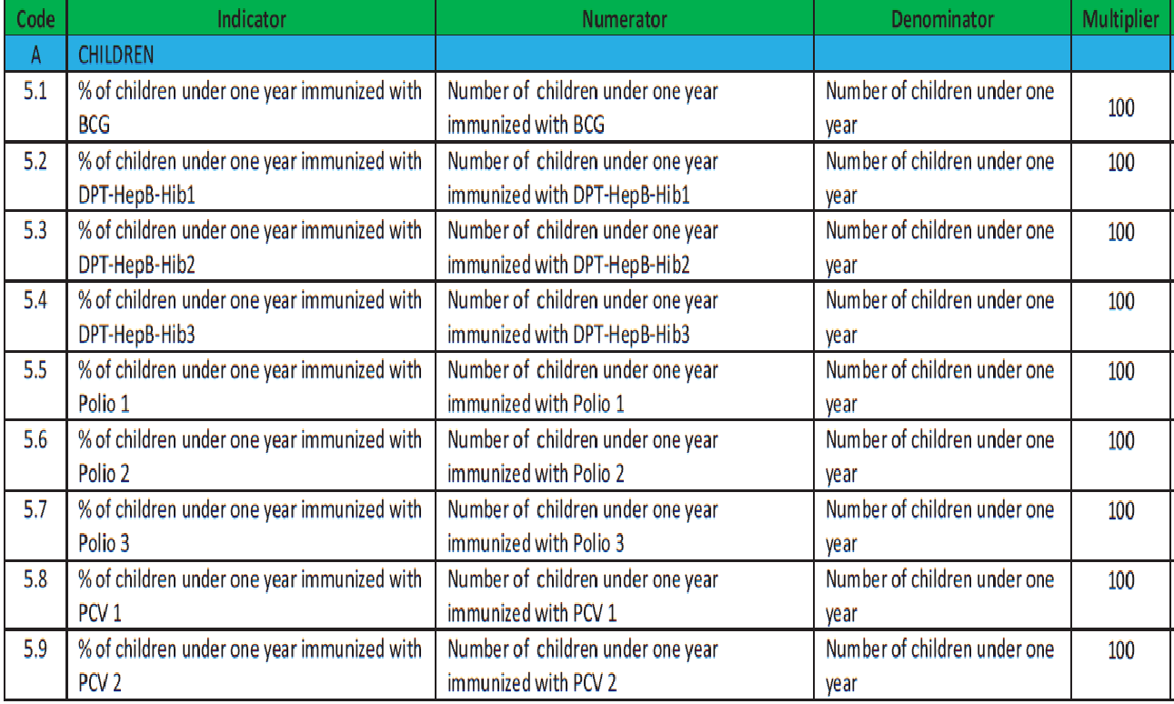

Slide 20
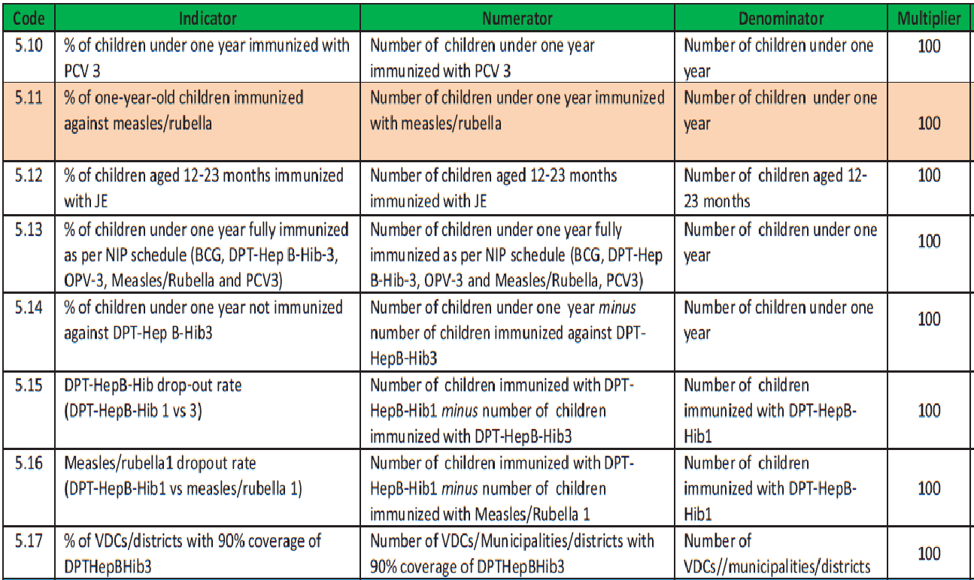

Slide 21
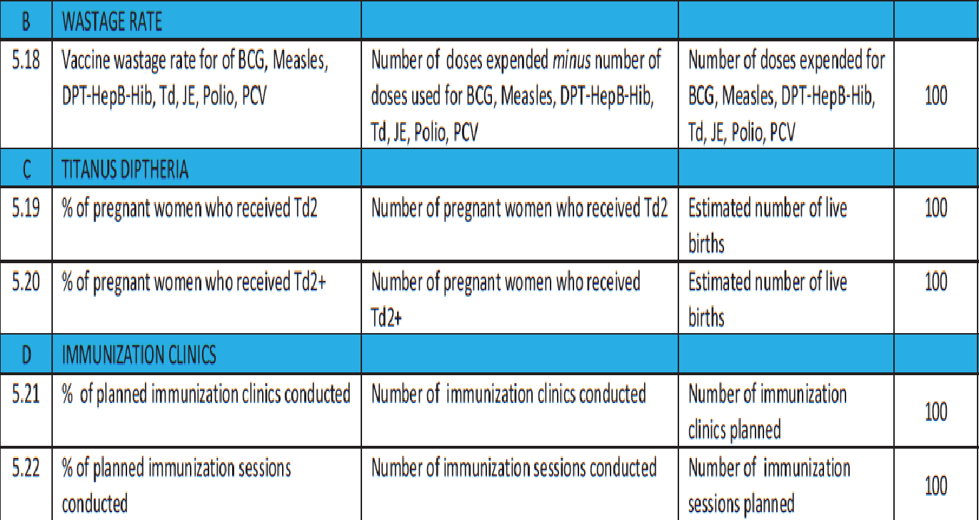

Slide 22
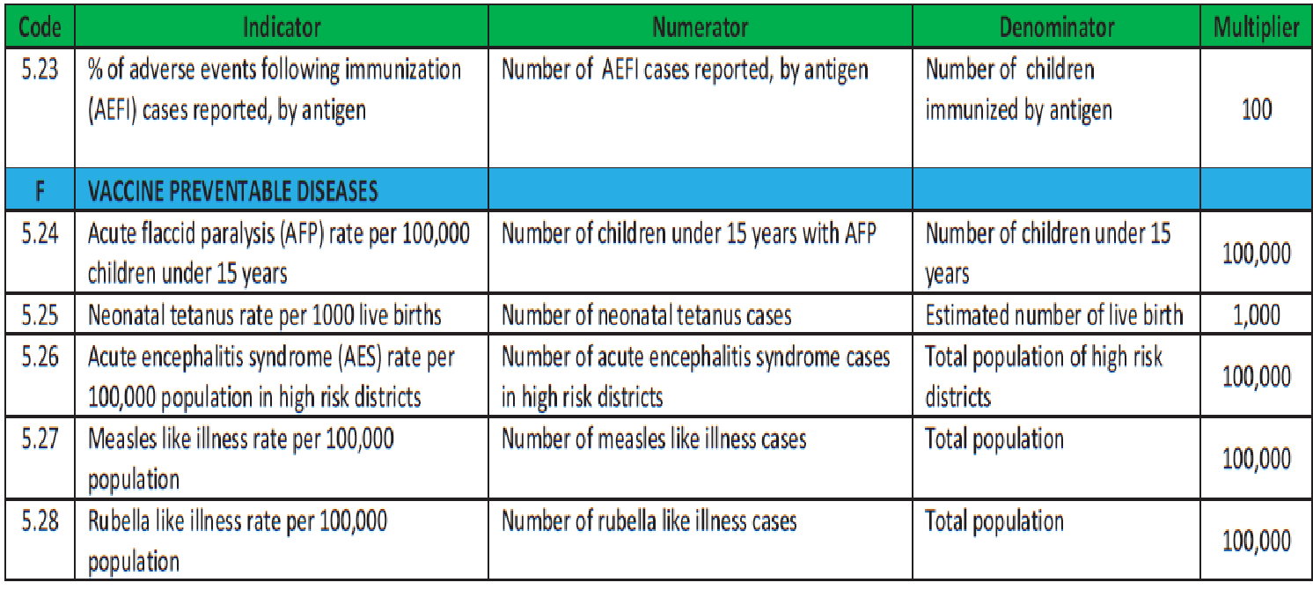

Slide 23
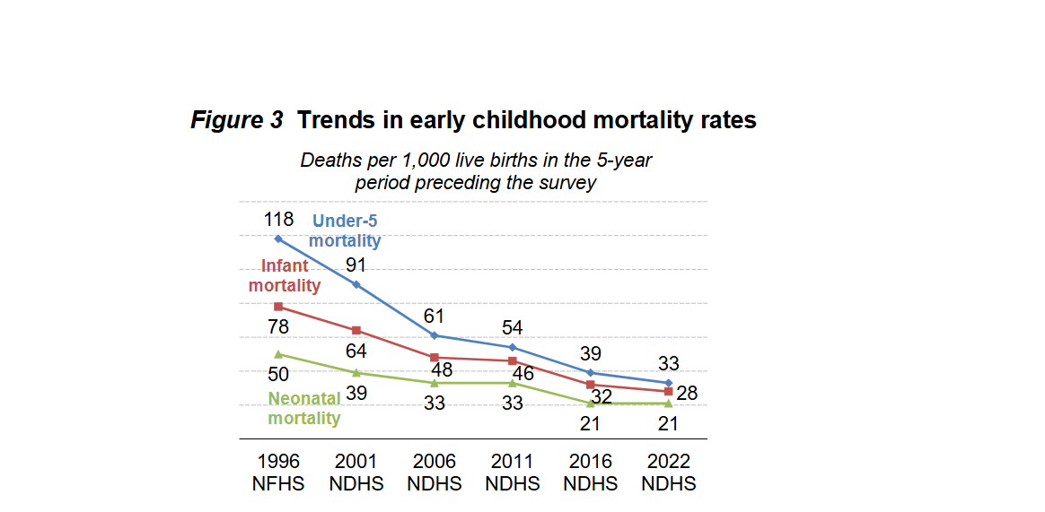
Trends in early childhood mortality (1996-2022)

Slide 24
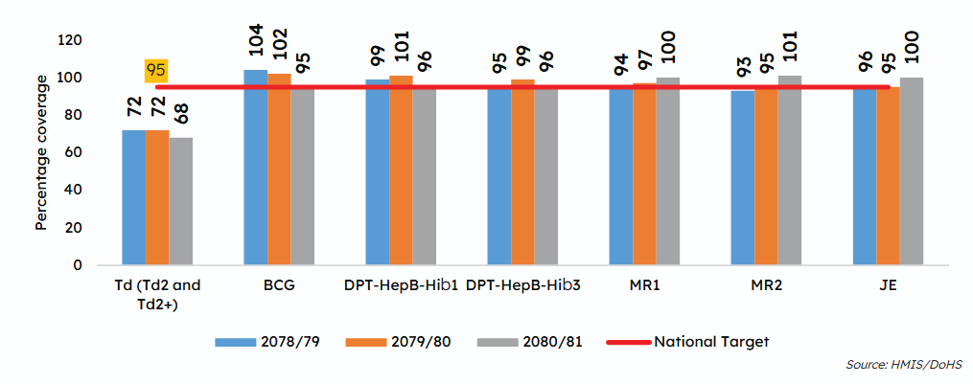
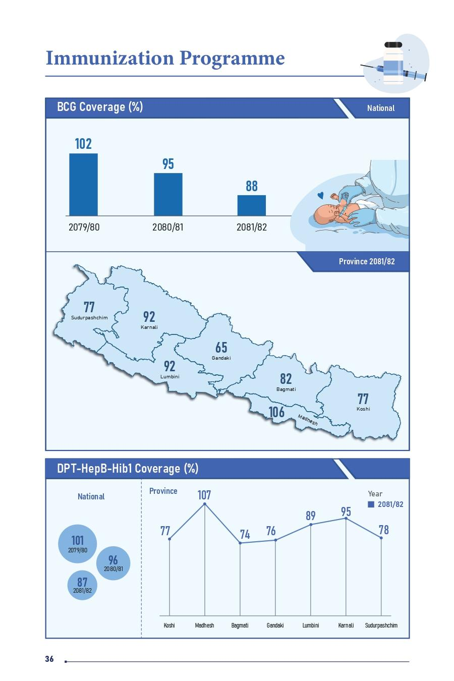
Coverage of Td, BCG, and DPT-HepB-Hib, MR and JE (FY 2078/79 - 2080/81)
Nepal Health Fact Sheet 2025

Slide 25
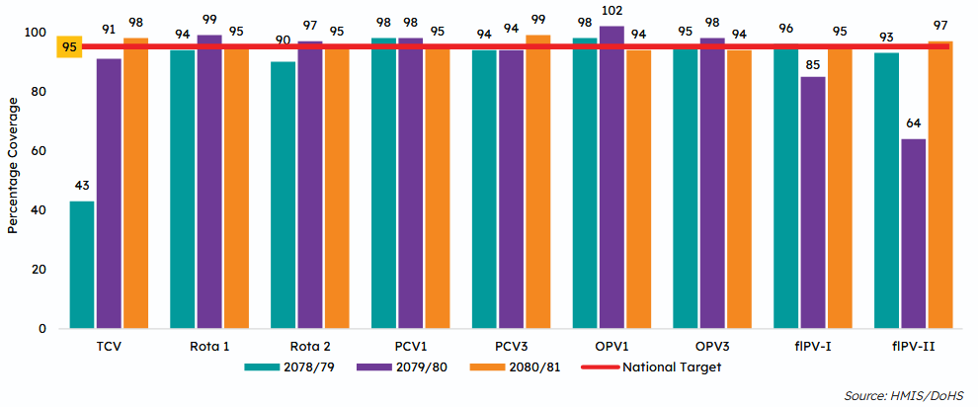
Coverage of different antigens (FY 2078/79 - 2080/81)

Slide 26
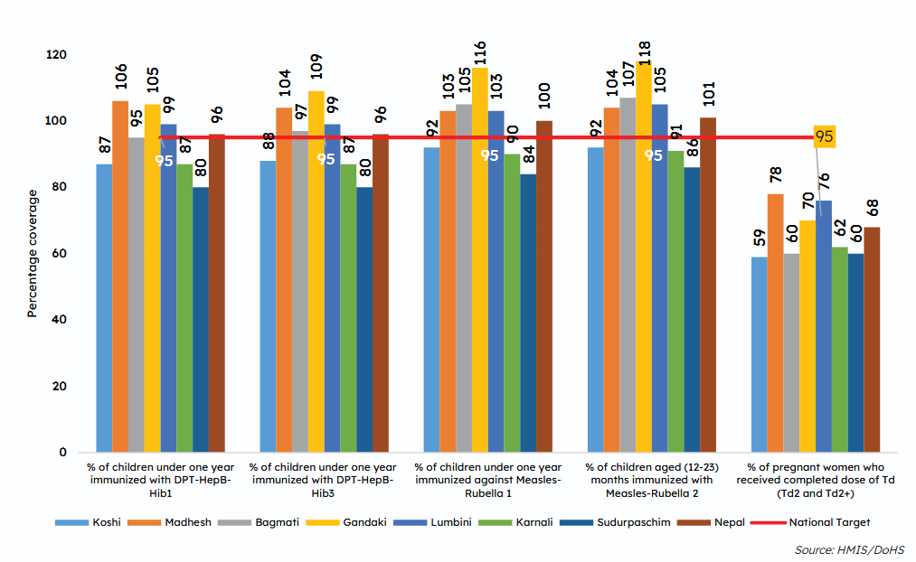
Coverage of Pentavalent, MR and Td (FY 2080/81

Slide 27
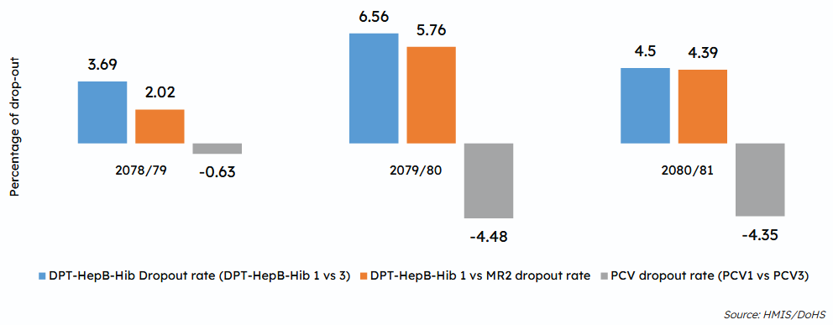
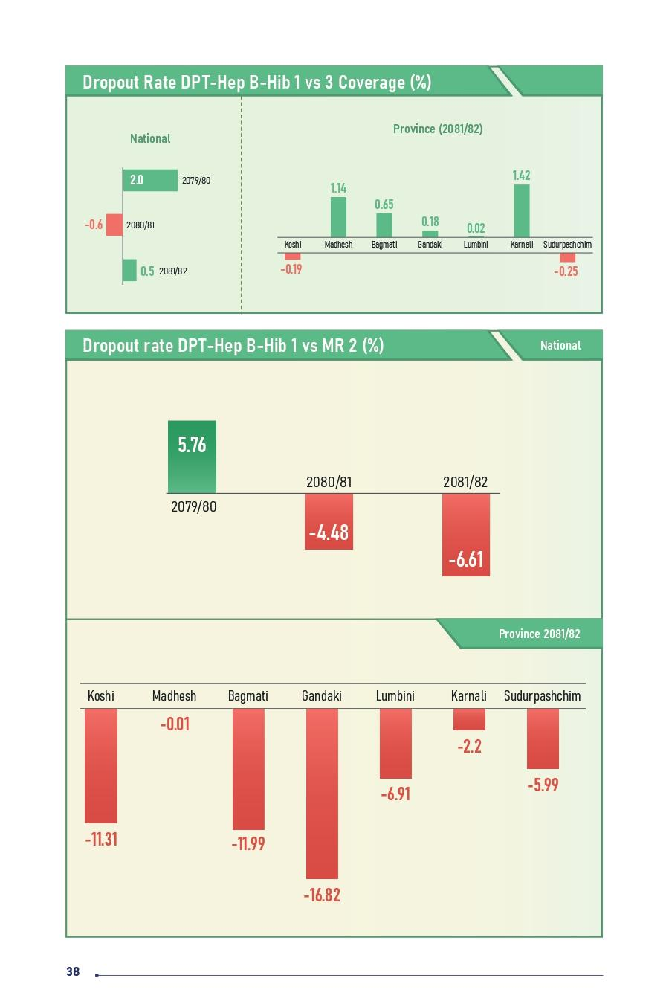
Drop-out rates (%) of vaccination
Nepal HFS 2025

Slide 28
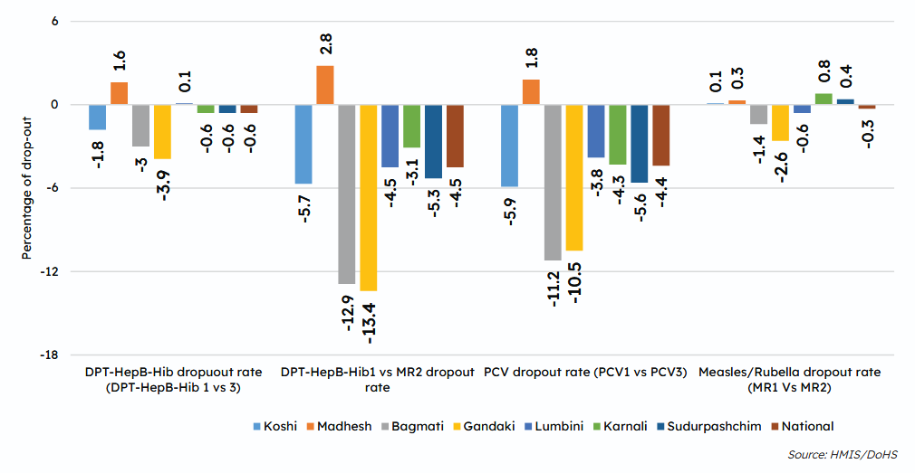
National and Provincial vaccinations drop out (FY 2080/81)

Slide 29
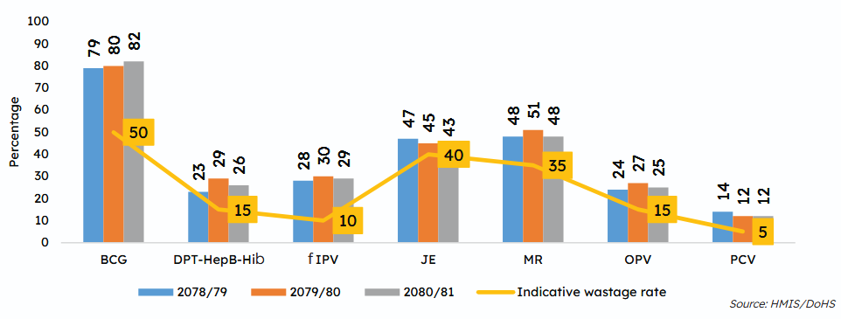
Vaccination wastage rate against indicative wastage rate (FY 2078/79 - 2080/81)

Slide 30
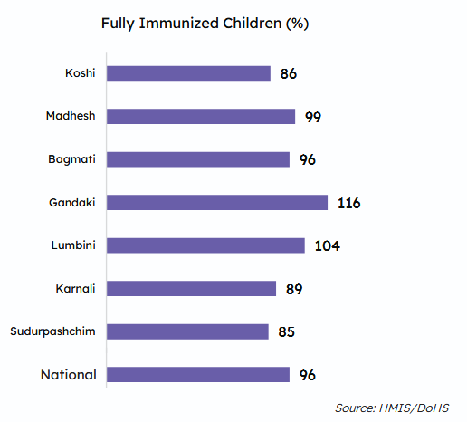
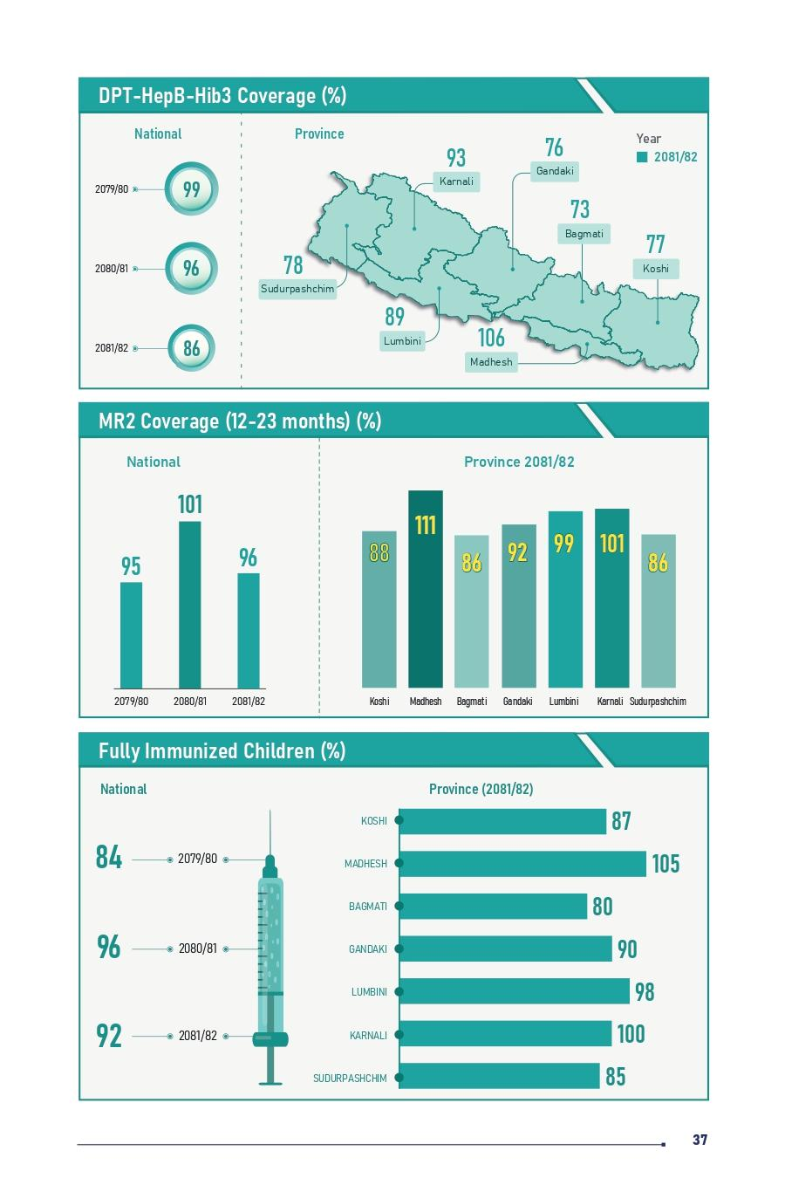
Percentage of Fully Immunized Children as per NIP schedule(FY 2080/81)
Nepal Health fact sheet 2025

Slide 31
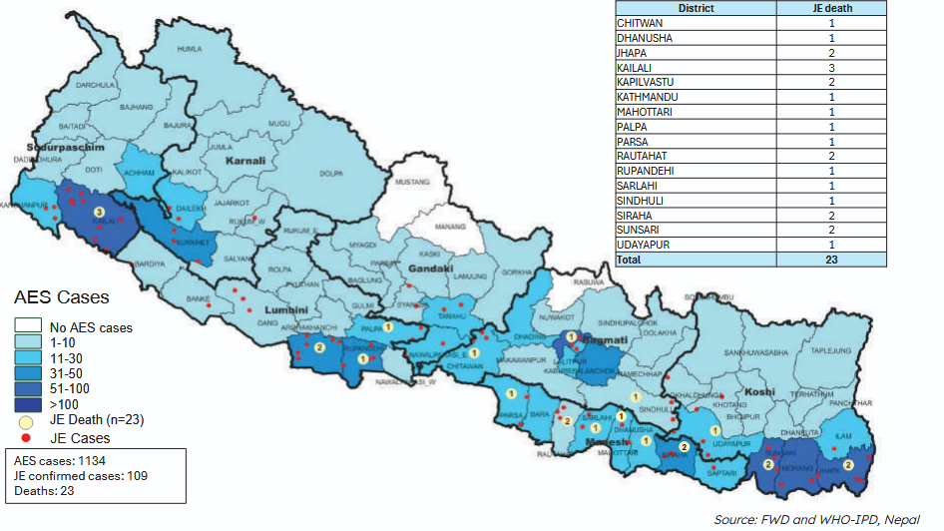
Acute Encephalitis Syndrome (AES)/Japanese Encephalitis(JE) Surveillance status,2024

Slide 32
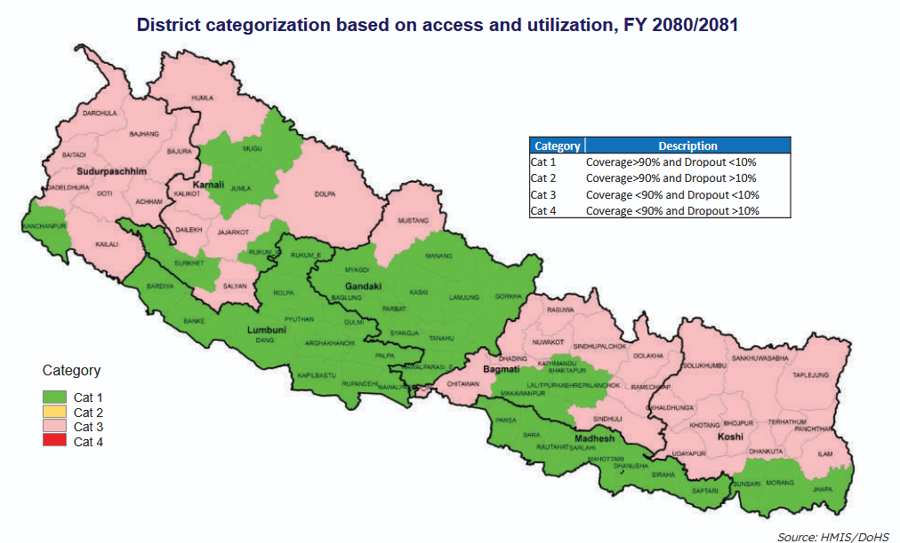
Access and utilization of immunization service

Slide 33
Current Achievements
Nepal vaccinates over 1.46 million girls with the HPV vaccine, achieving 94% coverage.
Nepal NIP now covers 14 vaccine preventable diseases including BCG, polio, diptheria, pertussis,tetanus, measles-rubella, Hib , Hepatitis B, Rota, pneumococcal diseases, Japanese encephalitis, typhoid and HPV.
Sustained Td vaccination of pregnant woman which had led to the elimination of maternal and neonatal tetanus as a public health problem in Nepal since 2005.
Nepal’s NIP is recognized as a regional leader for overcoming challenges and, as a Priority 1 program, plays a vital role in reducing child mortality.

Slide 34
Strengths
Strong Government Commitment: Immunization is a P1 programme of Gov Nepal, which is provided free of cost to all eligible target populations.
Strong Immunization Policy and Law (Immunization is mandated as a fundamental right in the Immunization Act, 2072, and Immunization Regulation 2074)
Expert committees (National Immunization Advisory Committee, Immunization Coordination Committee, Adverse Event Following Immunization Committee, National Certification Committee for Polio Eradication, National Verification Committee for Measles and Rubella Elimination, etc.) to guide and oversee NIP. Immunization coordination committee at all levels (i.e., up to ward level) to guide and support the immunization programme.
Support from donors and partners (Collaboration with Gavi, WHO, UNICEF, WaterAid, and other health organizations).

Slide 35
Cont..
Extensive network and accessibility (services are available in all 77 districts through over 16,000–19,000 immunization sites and outreach clinics, which ensures vaccine access in remote and rural areas).
Full immunization sustainability declaration initiative ensuring full immunization of every child.
Strong AEFI surveillance system.
Well-established VPD surveillance system with laboratory support.
Well-established integrated health management information system and logistic management information system (IHIMS, LMIS)
Well-maintained and robust cold chain infrastructure and supply chain management.
Community engagement and reach through a cadre of FCHVs.

Slide 36
Weakness
Limited internal resource mobilization (high dependency on external funding and no plans for long-term sustainability).
Limited local resource allocation and mobilization.
Human resource constraints (high turnover and inadequate capacity).
Vaccine hesitancy (pockets of high-risk population having vaccine hesitancy due to religious, cultural, and social beliefs)
Geographical Barriers {hard-to-reach areas with difficult terrains (e.g., mountainous regions)}
Paper based routine immunization recording and microplanning.

Slide 37
Cont..
No dedicated immunization focal person at sub-national level after federalization.
Inadequate documentation of monitoring/supervision and feedback mechanisms.
Inadequate monitoring of routine health information system data related to immunization.

Slide 38
Opportunities
Integration with Maternal and Child Health Services.
Expansion of cold chain management and supply chain by Provincial Health Logistics Management Centers (PHLMC).
Decentralized governance for resource mobilization, smooth service delivery, and accountability.
Strong inter-ministerial collaboration, for example, the use of school platform for vaccine delivery and demand generation activities (e.g., TCV).

Slide 39
Cont..
New vaccine introduction campaigns (TCV, Rota, HPV etc.) and supplementary immunization campaigns (SIAs) provide an opportunity to strengthen the routine immunization programme.
Public-private partnership for vaccine service delivery and surveillance.
Improved monitoring and supervision using structured checklists at all levels with a regular feedback mechanism.
Digitalization of immunization records.

Slide 40
Threats
Sustainable international funding commitment and resource allocation during transitions and co-financing (e.g., VPD Surveillance transition, including polio transition)
Outbreaks of VPDs.
Rapid and unorganized migration and urbanization.
Nepal is prone to natural disaster.

Slide 41
Suggestions for improvement
Strengthen cold chain capacity — expand solar-powered refrigerators and temperature monitoring in remote districts.
Improve vaccine coverage equity — target underserved groups (migrants, slum populations, mountain communities) where coverage gaps remain.
Enhance HPV and new vaccine rollouts — ensure sustained financing and awareness for HPV, JE, and rotavirus vaccines.
Digitize immunization records — scale up electronic immunization registry (EIR) for real-time monitoring and accountability.
Boost community engagement — mobilize Female Community Health Volunteers (FCHVs) for household-level awareness and follow-up.

Slide 42
Contd……
Strengthen surveillance of vaccine-preventable diseases — integrate lab-based confirmation and rapid response teams.
Introduce reminder/recall systems — SMS, phone calls, and local ward announcements to reduce dropouts.
Improve supply chain logistics — adopt automated forecasting and distribution to prevent stockouts.
Expand training for health workers — regular refresher courses on safe injection practices, communication, and data use.
Sustain financing and partnerships — reduce donor dependency by increasing government budget allocation and local partnerships.

Slide 43
References
DoHS. Annual Report 2080/81. Department of Health Services, Ministry of Health and Population, Government of Nepal.
Immunization Act 2072.
Immunization Regulation 2074.
comprehensive Multi Year Plan 2017-2021
www.dohs.gov.np
www.mohp.gov.np
www.fhd.gov.np
https://publichealthupdate.com/national-immunization-schedule-nepal/
https://www.who.int/nepal/news/detail/18-06-2025-nepal-vaccinates-over-1.46-million-girls-with-the-hpv-vaccine
https://www.who.int/nepal/news/detail/31-12-2024-nepal-s-public-health-achievements-2024

Slide 44


