Slide 1
Physiology of bacteria and Culture media
Kusum Shrestha
Assistant Professor
School of Health and Allied Sciences
Pokhara University

Slide 2
Nutritional Requirements
1. Essential Elements
Bacterial structure is made up of various components eg. carbohydrates, lipids, proteins, nucleic acids
These compounds are made up of four basic elements viz.C, H, O, and N
Besides these four elements, phosphorous and sulphur are also required for bacterial growth

Slide 3
contd
Hydrogen and oxygen:
Supplied from water added to the culture medium
Carbon:
Supplied by carbohydrates
Bacteria also get energy in the form of ATP from carbohydrate breakdown
Makes up 50% of dry weight of cell

Slide 4
contd
Nitrogen: It is a major component of proteins and nucleic acids. It is obtained from mainly ammonia, usually in the form of ammonium salts. Ammonium salts are obtained from environment or from deamination of amino acids
Sulphur: It is a part of proteins and coenzymes. Sulphur is obtained from sulphates. Many bacteria reduce these sulphates to hydrogen sulphide
Phosphorous: It is required for nucleic acids, ATP, coenzymes etc.
2.Mineral Sources:
Potassium, calcium, magnesium, iron, copper, cobalt, manganese, molybdenum and zinc
These elements are required in trace amounts and are provided from various food sources

Slide 5
contd
3.Growth Factors:
Organic compounds that are essential cell components or precursors of such components but cannot be synthesized by the organism are called growth factors
Three major classes of growth factors: amino acids, purines and pyrimidines, and vitamins
A growth factor may be essential for some, and accessory for other bacteria, and totally unrequired by some others.
Eg. H.influenzae requires accessory growth factors X & V

Slide 6
Bacterial growth
Growth may be defined as an increase in cellular constituents and leads to a rise in cell number when microorganisms reproduce by processes like budding or binary fission.
Growth also results when cells simply become longer or larger.
If the microorganism is coenocytic—that is, a multinucleate organism in which nuclear divisions are not accompanied by cell divisions— growth results in an increase in cell size but not cell number.

Slide 7
Microbial Growth
Pure Culture: Contains a single microbial species.
Most clinical and environmental specimens contain several different microorganisms.
To obtain a pure culture, individual organisms must be isolated.
The most common method of isolation is the streak plate, in which a sterile loop is inserted into a sample and streaked onto a plate in a pattern, to obtain individual colonies
Colony: A group of descendants of an original cell.

Slide 8
Microbial Growth
Growth of Bacterial Cultures
Bacterial Division: Occurs mainly by binary fission.
A few bacterial species reproduce by budding.
Generation Time: Time required for a cell to divide, and its population to double.
Generation time varies considerably:
E. coli divides every 20 minutes.
Most bacteria divide every 1 to 3 hours.
Some bacteria require over 24 hours to divide.

Slide 9
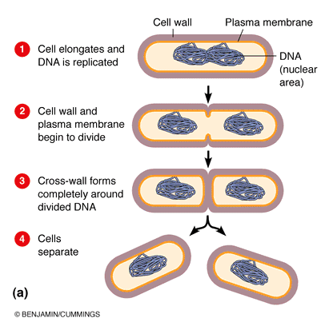
Bacterial Growth: Binary Fission

Slide 10
Factors Affecting Growth
1) Oxygen
Obligate aerobes: can grow only in the presence of oxygen ( e.g. Pseudomonas, Mycobacterium tuberculosis Bacillus, Brucella, Nocardia)
Facultative anaerobes: aerobes that can also grow anaerobically’ e.g. E. coli, S. a.ureus, etc
Facultative aerobes: are anaerobes that can also grow aerobically (e.g. Lactobacillus)
Microaerophllic bacteria: can grow in presence of low oxygen tension, i.e. 5-10% of oxygen ( e.g. Campylobacter, Helicobacter)
Obligate anaerobes: can grow only in absence of oxygen. Clostridium spp
Aerotolerant anaerobe: can tolerate oxygen for some time but do not use it. Eg: Clostridium histolyticum

Slide 11
contd
2) Carbon dioxide: require higher amounts of carbon dioxide (5- 10%) for growth are called capnophilic bacteria. Eg: Brucella abortus, Streptococcus pneumoniae
3) Temperature:
Psychrophiles: grow best at temperatures below 20°C. Eg: most of the saprophytes
Mesophiles: grow within a temperature range 25°C to 40°C. eg: most of the pathogenic bacteria
Thermophiles: grow at high temperature range of 55° C to 80°C e.g. Bacillus stearothermophilus

Slide 12
contd
3) pH:
Most pathogenic bacteria grow between pH 7. 2 -pH 7 .6.
Very few bacteria (e.g. lactobacilli) can grow at acidic pH below pH 4
Bacteria such as Vibrio cholerae are capable of growing at alkaline pH (8.2-8.9)
4)Light: Bacteria (except phototrophs) grow well in darkness. They are sensitive to ultraviolet rays and other radiations in light. Photochromogenic mycobacteria produce pigments only on exposure to light.

Slide 13
contd
5)Osmotic Effect:
Bacteria are able to withstand a wide range of external osmotic variation because of the mechanical strength of the cell wall
Sudden exposure of bacteria to hypertonic solutions may cause plasmolysis. This occurs more readily in gram negative than in gram positive bacteria
Sudden transfer of bacteria from concentrated solution to distilled waler may cause plasmoptysis

Slide 14
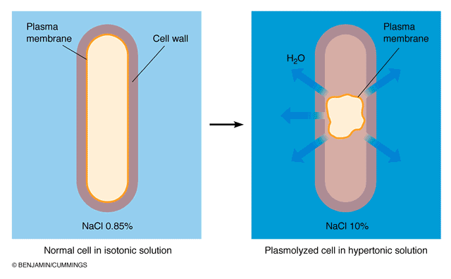
Isotonic Versus Hypertonic Solution
Plasmolysis

Slide 15
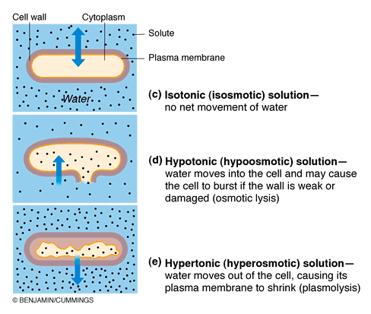
Effects of Osmosis on Bacterial Cells

Slide 16
contd
6) Mechanical and Sonic Stresses:
Though bacteria have tough cell walls, they may be ruptured and disintegrated by vigorous shaking with glass beads and by exposure to ultrasonic vibrations
7) Moisture and Desiccation:
Some organisms Like Treponema pallidum, N. gonorrhoeae die quickly after drying, while M. tuberculosis, Staphylococcus aureus may survive drying for several weeks.
Drying in cold and vacuum (lyophilization) is used for preservation of microorganisms.

Slide 17
Bacterial Growth Curve
In a closed system,
Lag Phase
When microorganisms are introduced into fresh culture medium, usually no immediate increase in cell number occurs
Bacteria increase in size due to accumulation of enzymes and metabolites and reach their maximum size at end of lag phase
Varies considerably in length with the condition of the microorganisms and the nature of the medium
When a young, vigorously growing exponential phase culture is transferred to fresh medium of the same composition, the lag phase will be short or absent.
Notes:
This phase may be quite long if the inoculum is from an old culture or one that has been refrigerated. Inoculation of a culture into a chemically different medium also results in a longer lag phase.

Slide 18
contd
Log phase/exponential phase:
Microorganisms are growing and dividing at the maximal rate possible given their genetic potential, the nature of the medium, and the conditions under which they are growing.
Their rate of growth is constant during the exponential phase; that is, the microorganisms are dividing and doubling in number at regular interval
At this stage, the bacteria is smaller in size, biochemically active
Uniformly stained

Slide 19
contd
Stationary phase:
Bacterial growth ceases almost completely due to exhaustion of nutrients, accumulation of toxic products and autolytic enzymes
Number of progeny cells formed is just enough to replace the number of cells that die.
Total cell count increases
Bacterium becomes Gram variable, more storage granules are formed, sporulation occurs
Bacteria produce exotoxins, antibiotics, bacteriocins

Slide 20
contd
Senescence and death:
Decline in viable count and not in total count
Involution forms are seen
Phase of Prolonged Decline:
Long-term growth experiments reveal that an exponential decline in viability is sometimes replaced by a gradual decline in the number of culturable cells
This decline can last months to years

Slide 21
contd
Instead of a distinct death phase, successive waves of genetically distinct subpopulations of microbes better able to use the released nutrients and accumulated toxins survive.
This dynamic process is marked by successive waves of genetically distinct variants.
Thus natural selection can be witnessed within a single culture vessel

Slide 22
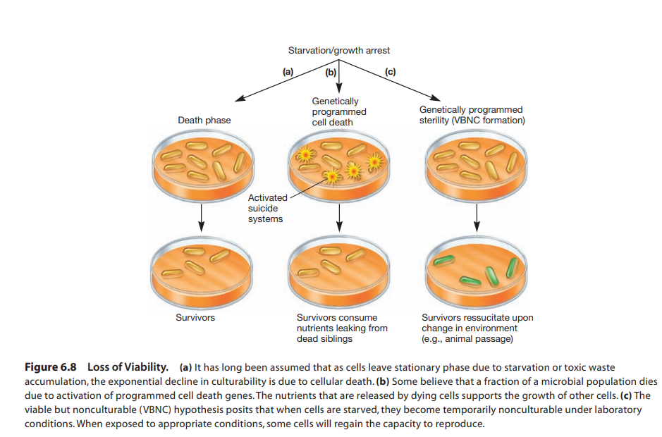

Slide 23
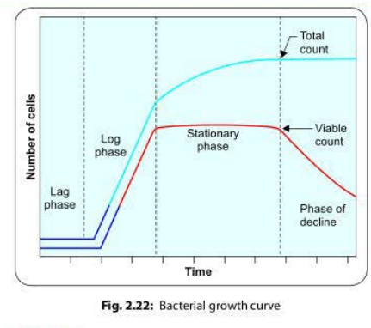

Slide 24
Bacterial growth kinetics
Growth rate studies contribute to basic physiological and ecological research and are applied in industry
During the exponential phase each microorganism is dividing at constant intervals. Thus the population will double in number during a specific length of time called the generation time or doubling time
Suppose that a culture tube is inoculated with one cell that divides every 20 minutes. The population will be 2 cells after 20 minutes, 4 cells after 40 minutes, and so forth. Because the population is doubling every generation, the increase in population is always 2n where n is the number of generations. The resulting population increase is exponential or logarithmic.

Slide 25
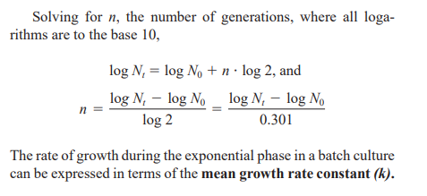
contd
Let ,N₀ be initial population number
N_{t} be the population at time t
n the number of generations in time t
Then,
N_{t}= N₀X2^{n}

Slide 26
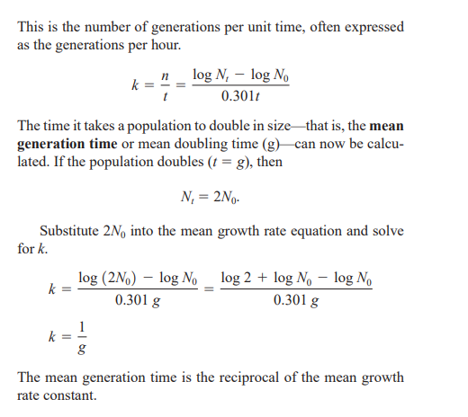
Contd

Slide 27
contd
Generation times vary markedly with the species of microorganism and environmental conditions. They range from less than 10 minutes (0.17 hours) for a few bacteria to several days with some eucaryotic microorganisms
Generation times in nature are usually much longer than in culture

Slide 28
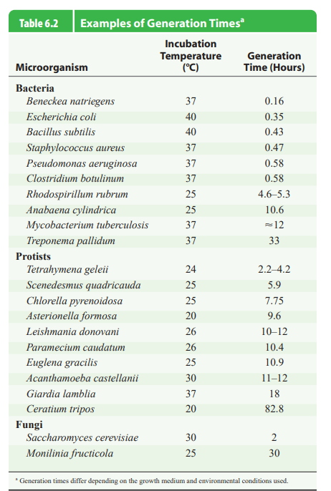

Slide 29
Measurement of growth
Measurement of Cell Numbers:
Determine microbial numbers is through direct counting.
Using a counting chamber is easy, inexpensive, and relatively quick; it also gives information about the size and morphology of microorganisms.
Petroff-Hausser counting chambers can be used for counting prokaryotes; hemocytometers can be used for both prokaryotes and eukaryotes.

Slide 30
contd
Procaryotes are more easily counted in these chambers if they are stained, or when a phase contrast or a fluorescence microscope is employed.
The number of microorganisms in a sample can be calculated by taking into account the chamber’s volume and any sample dilutions required.
One disadvantage to the technique is that the microbial population must be fairly large for accuracy because such a small volume is sampled

Slide 31
contd
Larger microorganisms such as protists and yeasts can be directly counted with electronic counters such as the Coulter Counter, although more recently the flow cytometer is increasingly used
Several plating methods can be used to determine the number of viable microbes in a sample. These are referred to as viable counting methods because they count only those cells that are alive and able to reproduce. Two commonly used procedures are the spread-plate technique and the pour-plate technique

Slide 32
contd
Plating techniques are simple, sensitive, and widely used for viable counts of bacteria and other microorganisms in samples of food, water, and soil
Measurement of Cell Mass:
The most direct approach is the determination of microbial dry weight
Cells growing in liquid medium are collected by centrifugation, washed, dried in an oven, and weighed. This is an especially useful technique for measuring the growth of filamentous fungi. It is time-consuming, however, and not very sensitive

Slide 33
contd
Spectrophotometry:
These methods are more rapid and sensitive.
They depend on the fact that microbial cells scatter light that strikes them.
Because microbial cells in a population are of roughly constant size, the amount of scattering is directly proportional to the biomass of cells present and indirectly related to cell number.

Slide 34
contd
If the amount of a substance in each cell is constant, the total quantity of that cell constituent is directly related to the total microbial cell mass.
Analysis for total protein or nitrogen: An increase in the microbial population will be reflected in higher total protein levels.
Chlorophyll determinations can be used to measure algal and cyanobacterial populations
Quantity of ATP can be used to estimate the amount of living microbial mass.

Slide 35
Culture media

Slide 36
Definition
Culture media is defined as an artificial media to isolate the microorganisms from the clinical specimens; following which the appropriate biochemical tests can be performed to identify the causative agent.

Slide 37
History
The original media used by Louis Pasteur were liquids such as urine or meat broth.
The earliest solid medium was cooked cut potato used by Robert Koch.
The use of agar to solidify culture media was suggested by Frau Hesse, in Koch’s laboratory .
Agar ( or agar-agar) is prepared from some types of seaweed, a long chain polysaccharides composed of D-galactopyranose units.

Slide 38
Properties of Media
Support the growth of the bacteria.
Should be nutritive (contains the required amount of nutrients).
Suitable pH (neutral to slightly alkaline 7.3-7.4).
Suitable temperature, and suitable atmosphere. (Bacteria grow at 37⁰C).

Slide 39
Common ingredients of culture media
Information on the preparation and composition of commercial products used in bacterial culture media is given in a report edited by Sykes ( 1956)
Water
Agar
Casein hydrolysate
Meat extract
Yeast extract
Mineral salt
Blood / serum

Slide 40
Classification of culture media
1.Based on physical state/consistency
Liquid(broth)
Semi-solid
Solid(agar)
Biphasic

Slide 41
contd
2. based on presence of molecular oxygen and reducing substances
Aerobic media
Anaerobic media
3. Based on nutritional factors
Complex media
Synthetic or defined media
Simple media
Special media

Slide 42
Special type of media are further divisible into
Enriched media
Enrichment media
Selective media
Differential media
Indicator media
Transport media and
Sugar media

Slide 43
contd
1. Liquid media :
contain specific amounts of nutrients but don’t have a trace of gelling agents such as gelatin or agar.
2. Semisolid media : clot-like consistency, (0.2-0.5)% agar
3. Solid media : 1.5-2.0% agar
4. Biphasic media: contains both solid and liquid phase. Casteneda biphasic media

Slide 44
Advantages of liquid media
Specimens containing inhibitory substances like antibiotics and other antibacterial substances get diluted by inoculation into the large volume of the fluid medium.
Liquid medium are widely used for biochemical tests.
There are also useful enrichment media like selenite F broth
Presumptive bacterial count in water sample is made in liquid media.

Slide 45
Advantages of solid media
There is separate colony formation.
By studying colonial morphology, presumptive identification of most bacterial species can be made.
Quantative bacterial count and relative propotion of different species can be made.
Isolation of bacteria in pure culture can be made.

Slide 46
contd
Complex media
They have added ingredients for special purposes or for providing special nutrients.
Synthetic or defined media
Media prepared from pure chemical substances and its exact composition is known
Eg: peptone water – 1% peptone + 0.5% NaCl in water

Slide 47
Simple/Basal Media
contain minimum ingredients that support the growth of non-fastidious bacteria.
Peptone water: peptone + NaCl + water
Nutrient broth: peptone water and meat extract .
Nutrient agar: nutrient broth+ 2% agar, pH 6.8 +/- 0.2.

Slide 48
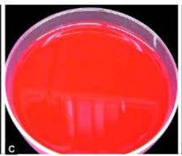
Enriched Media
When a basal medium is added with additional nutrients, such as blood, serum or egg.
Blood agar:
5- 10% of sheep blood to the molten nutrient
agar at 45°C.
test the hemolytic property of the bacteria

Slide 49
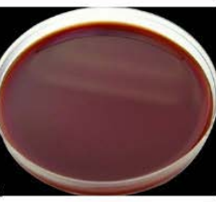
Enriched Media
Chocolate agar
heated blood agar, prepared by adding
5- 10% of sheep blood to the molten nutrient agar at
70°C.
Loeffler's serum slope: contains serum and used
for isolation of Corynebacterium diphtheriae.

Slide 50
Enrichment Broth
liquid media added with some inhibitory agents which selectively allow certain organism to grow and inhibit others.
Tetrathionate broth
Selenite F broth
Alkaline peptone water (APW)

Slide 51
Differential Media
differentiate between two groups of bacteria by using an indicator, which changes the color of the colonies of a particular group of bacteria but not the other group.
MacConkey Agar
Cystine-Lactose-Electrolyte-Deficient (CLED)
Eosin Methylene Blue (EMB) Agar

Slide 52
Transport Media
Used for the transport of the clinical specimens suspected to contain delicate organism
used when the delay is expected while transporting the specimens from the site of collection to the laboratory.
Transport media | Organisms
Stuart’s and Amies Media | N. gonorrhoea
Pike’s medium | Streptococcus
Cary blair medium | V. cholerae

Slide 53
Anaerobic Culture Media
contain reducing substances which take-up oxygen and create lower redox potential and thus permit the growth of obligate anaerobes
Robertson's cooked meat (RCM) broth
Thioglycollate broth
Anaerobic blood agar
Neomycin blood agar
Egg yolk agar

Slide 54
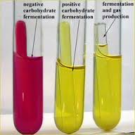
6. Sugar medium
Standard sugar media used for biochemical test contain 1% sugar, peptone water with an indicator (andrade’s indicator- 0.05%acid fuschin in 1N NaOH.

Slide 55
Indicator media
These media contain an indicator which changes its colour when a bacterium grows in them.
Eg:
  CLED
  Mac Conkey’s medium
  Christensen’s urease medium

Slide 56
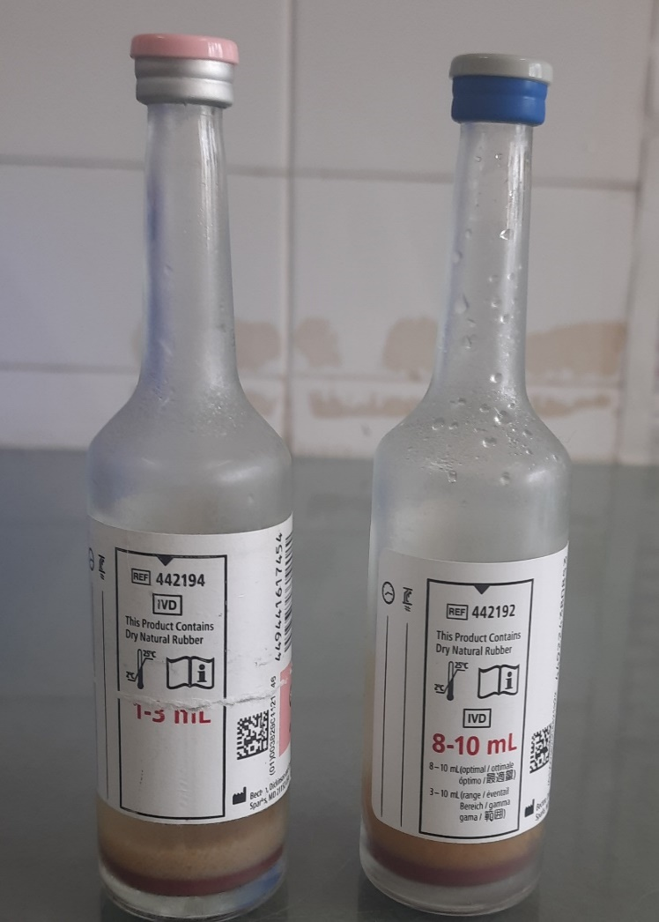
BACTEC Blood Culture Medium
Automated blood culture system
Composition:
resin, soyabean- casein digest broth, yeast
extract, amino acids, sodium polyanetholsulfonate
sugars, vitamins and antioxidants/reductants

Slide 57
Preparation of culture media
Major process during preparation of culture media:
Weighing and dissolving of culture media ingredients
pH testing of culture media
Sterilization
Addition of heat sensitive ingredients
Dispensing of culture media
Quality assurance
Sterility testing of culture media
Storage of culture media

Slide 58
Choice of culture media
Major pathogens to be isolated, their growth requirement and the features by which they recognized
Sites of specimens culture ( selective medium is applicable In where maximum chance to get contamination or normal flora )
Cost availability, and stability of different media
Training and experience of laboratory staff in preparing, using and quality controlling culture media

Slide 59
Purpose of culture
Isolating bacteria in pure culture from clinical specimens
To perform biochemical tests for the identification of bacteria
To perform antimicrobial susceptibility testing of the isolated bacteria
To maintain stock cultures
To obtain sufficient growth for the preparation of antigens
For typing of bacterial isolates
To estimate the viable bacterial count

