Slide 1
Introduction to Microbiology
Kusum Shrestha
Lecturer
School of Health and Allied Sciences
Pokhara University

Slide 2
History and Contributors in Microbiology
The existence of microorganisms was hypothesized for many centuries before their actual discovery
Epidemic, transmissible diseases were documented in the recorded histories of early, yet advanced civilizations
Ancient Hebrew texts refer to “plagues” that beset the Pharaohs in Egypt more than 1,000 years before the birth of Christ

Slide 3
contd
Robert Hooke, a 17th-century English scientist was the first to use a lens to observe the smallest unit of tissues he called cells.
Antonie van Leeuwenhoek (1632-1723) of Netherland was the first person to observe and accurately describe microorganisms (bacteria and protozoa) called ‘animalcules’ (little animals) in 1676
John Needham (1713-1781): He proposed that tiny organisms the animalcules arose spontaneously on his mutton gravy. He covered the flasks with cork and even heated some flasks. Still the microbes appeared on mutton broth

Slide 4
contd
Lazzaro Spallanzani (1729-1799): He boiled beef broth for longer period, removed the air from the flask and then sealed the container. Followed incubation no growth was observed by him in these flasks. He showed that the heated nutrients could still grow animalcules when exposed to air by simply making a small crack in the neck
Ignaz Semmelweis and John Snow were the two persons who showed a growing awareness of the mode of disease transmission
Edward Jenner , developed the first vaccine of the world, the smallpox vaccine. He used the cowpox virus against smallpox from which the term vaccine has been derived
Notes:
When microorganisms were known to exist, most scientists believed that such simple life forms could surely arise through spontaneous generation. That is to say life was thought to spring spontaneously from mud and lakes or anywhere with sufficient nutrients. This concept was so compelling that it persisted until late into the 19th century.

Slide 5
contd
Louis Pasteur(1822-1895):
Known as the “Father of Modern Microbiology / Father of Bacteriology
Proposed principles of fermentation for preservation of food
Introduced the sterilization techniques and developed steam sterilizer, hot air oven and autoclave
Described the method of pasteurization of milk
Contributed for the vaccine development against several diseases, such as anthrax, fowl cholera and rabies

Slide 6
contd
Disproved the theory of spontaneous generation of disease and postulated germ theory of disease which states that disease cannot be caused by bad air vapor but it is produced by microorganisms present in air
Liquid media concept: Used nutrient broth to grow microorganisms
Joseph Lister (1867):considered to be the father of antiseptic surgery. He had observed that postoperative infections were greatly reduced by using disinfectants such as diluted carbolic acid during surgery to sterilize the instruments and to clean the wounds.

Slide 7
contd
Robert Koch (1843- 1910):
Introduced solid media for culture of bacteria
Introduced methods for isolation of bacteria in pure culture
Described hanging drop method for testing motility
Discovered bacteria such as anthrax bacilli, tubercle bacilli and cholera bacilli
Introduced staining techniques by using aniline dye
Koch's phenomenon: Robert Koch observed that guinea pigs already infected with tubercle bacillus developed a hypersensitivity reaction when injected with tubercle bacilli or its protein. Since then, this observation was called as Koch's phenomenon
Notes:
Eilshemius Hesse, wife of, one of Koch's assistants had suggested the use of agar as solidifying agents.

Slide 8
contd
Koch's postulates: postulated that a microorganism can be accepted as the causative agent of an infectious disease only if four criteria are fulfilled.The criteria are as follows:
1)The microorganism should be constantly associated with the lesions of the disease.
2)It should be possible to isolate the organism in pure culture from the lesions of the disease
3)The same disease must result when the isolated microorganism is inoculated into a suitable laboratory animal
4)It should be possible to re-isolate the organism in pure culture from the lesions produced in the experimental animals

Slide 9
contd
Exceptions:
There are some bacteria which do not satisfy all the four criteria of Koch's postulates. Those organisms are:
a)Mycobacterium leprae and Treponema pallidum: They cannot be grown in vitro; however, they can be maintained in experimental animals
b)Neisseria gonorrhoeae: There is no animal model ; however, it can be grown in vitro

Slide 10
contd
Paul Ehrlich(1854- 1915): known as father of chemotherapy
first to report the acid-fast nature of tubercle bacillus
developed techniques to stain tissues and blood cells
proposed a toxin-antitoxin interaction called Ehrlich phenomenon and also introduced methods of standardising toxin and antitoxin
Proposed side chain theory of antibody production
discovered salvarsan, an arsenical compound (also called as 'magic bullet') as the first effective medicinal treatment for syphilis, thereby initialing and also naming the concept of chemotherapy.

Slide 11
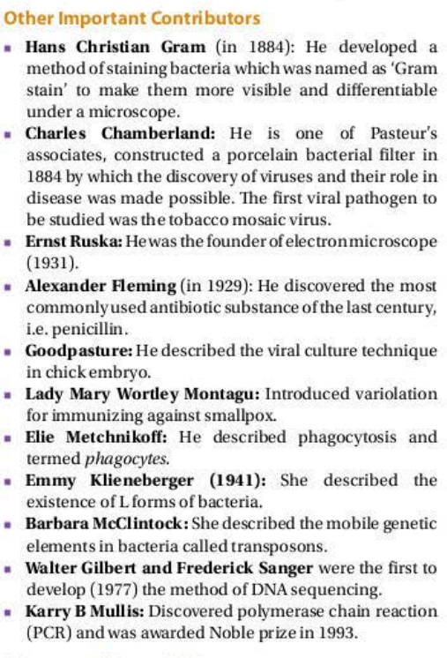

Slide 12
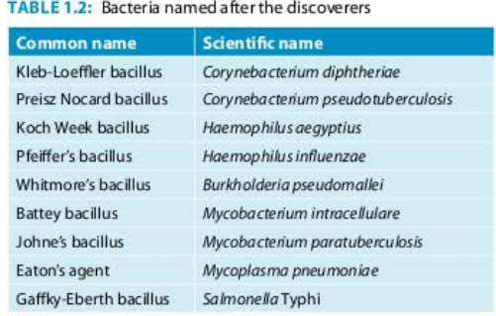
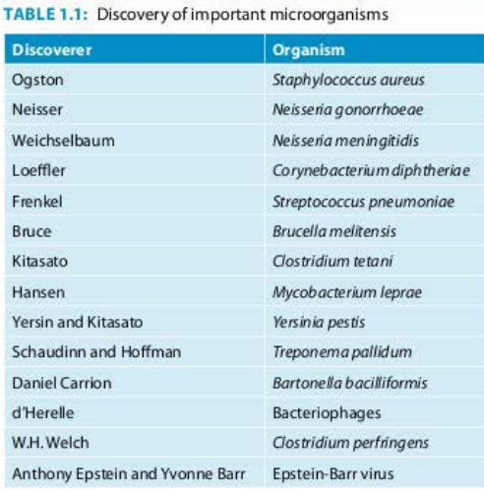

Slide 13
Definition
Derived from Greek mikros: small, bios: life and logia: study
Study of microorganisms, or microbes, a diverse group of generally minute simple life-forms like bacteria, archaea, algae, fungi, protozoa, and viruses
Concerned with the structure, function, and classification of such organisms and with ways of both exploiting and controlling their activities

Slide 14
Branches of microbiology
Medical microbiology:
Bacteriology
Immunology
Mycology
Virology
Parasitology

Slide 15
contd
Public health microbiology
Agriculture microbiology
Food microbiology
Pharmaceutical microbiology
General microbiology
Industrial microbiology

Slide 16
contd
Public Health Microbiology:
A crosscutting area that spans the fields of human, animal, food, water and environmental microbiology, with a focus on human health and disease.
It requires laboratory scientists with the ability to work effectively across disciplines, particularly epidemiology and clinical medicine’
Public health microbiology aims to interpret diagnostics at the population level, rather than at the level of the individual patient.
Notes:
fields like Clinical Microbiology, Food Microbiology, Water Microbiology and Environmental Microbiology exist entirely or partially within the scope of Public Health Microbiology.

Slide 17
contd
Highly interdisciplinary field that includes anyone involved with the microorganisms and infectious diseases that impact human health.
Encompasses every aspect of infectious disease in humans, from diagnosis and treatment to prevention and protection.

Slide 18
Scope of microbiology in public health
Local, state or national public health laboratories
Academic laboratories
Environmental laboratories
Pharmaceuticals
Research
Genetic engineering
Biotechnology
Food scientist

Slide 19
Importance of microbiology in public health
Recommend methods for obtaining and transporting clinical specimens that aid in diagnosing infectious diseases.
Select the most appropriate tests and identify bacterial, viral, fungal and parasitic agents that are likely to be contributing to infectious processes.
Determine the susceptibility of microorganisms to antimicrobial agents that could be used to treat infections caused by the microorganisms.
Report results to healthcare providers caring for patients in a clear, concise and clinically-relevant manner.

Slide 20
contd
Work with healthcare teams, including public health officials, to improve processes to diagnose and control infectious diseases, with a strong emphasis on effective communication at all levels.
Work with pharmaceutical and medical device manufacturers to develop new and improved technologies to confront emerging infectious diseases.
Use digital technology to interpret clinical cultures, perform identification of microorganisms and initiate appropriate antimicrobial susceptibility testing.

Slide 21
contd
Develop and perform diagnostic, outbreak and surveillance testing for infectious diseases in humans.
Provide lab testing for a range of environmental and animal samples for pathogens of public health importance.

Slide 22
THANK YOU!!!

