Slide 1
National Health Centers
Dr. Hari Prasad Kaphle
Assistant Professor (Public Health)
School of Health and Allied Sciences, Pokhara University

Slide 2
National Health Centers
Nepal’s public health system has the following five centres with autonomy in personnel and financial management:
National Health Education, Information and Communication Centre (NHEICC);
National Health Training Centre (NHTC);
National Centre for AIDS and STD Control (NCASC);
National Tuberculosis Centre (NTC);
National Public Health Laboratory (NPHL).

Slide 3
National Health Training Centre

Slide 4
Background
NHTC was established in 1993 AD under DoHS, MoHP to coordinate and manage all health training.
NHTC is an apex body, responsible to organize and manage training for different cadres of health service providers.
In its training network, NHTC has seven Provincial Health Training centers (Dhankuta, Pathaliya, Pokhara, Surkhet and Dhangadi and two in process of running).

Slide 5
Goal and Objective
Goal:
To enhance the technical and managerial capacity of health care service providers at all levels to deliver quality health care services towards attainment of the optimum level of health status of Nepali citizens.

Slide 6
Objectives:
To enhance and standardize the training curricula, references, trainer’s capacity with the training sites.
To organize training activities to address the need of quality health services providers in different level of health facilities.
To address the training requirements reflected in current national health policy and strategies

Slide 7
To ensure quality of training programs using different mechanisms in adherence to national standards.
To adopt and promote innovative training approaches
To strengthen mechanism and capacity for post training follow up and support

Slide 8
Strategies:
Assessing, standardizing and accrediting training and training sites.
Developing and standardizing training packages.
The institutional capacity development of all training units.
Conducting pre-service, in-service, orientation, refresher, long-term and short-term training as per national requirements.

Slide 9
Integrating and institutionalizing training.
Develop links with professional career development organizations.
Strengthening the Training Information Management System (TIMS)and training rosters.

Slide 10
Training Network of NHTC
National health training network co-ordinates seven Provincial Health Training Center.
The hospital-based training sites conduct Family Planning, Skilled Birth Attendance, Mid-Level Practicum, Safe Abortion Services, Rural USG, Anesthesia Assistant, Pediatric Nursing, Medico-Legal and other types of training program.

Slide 11
New Organizational Structure of NHTC

Slide 12
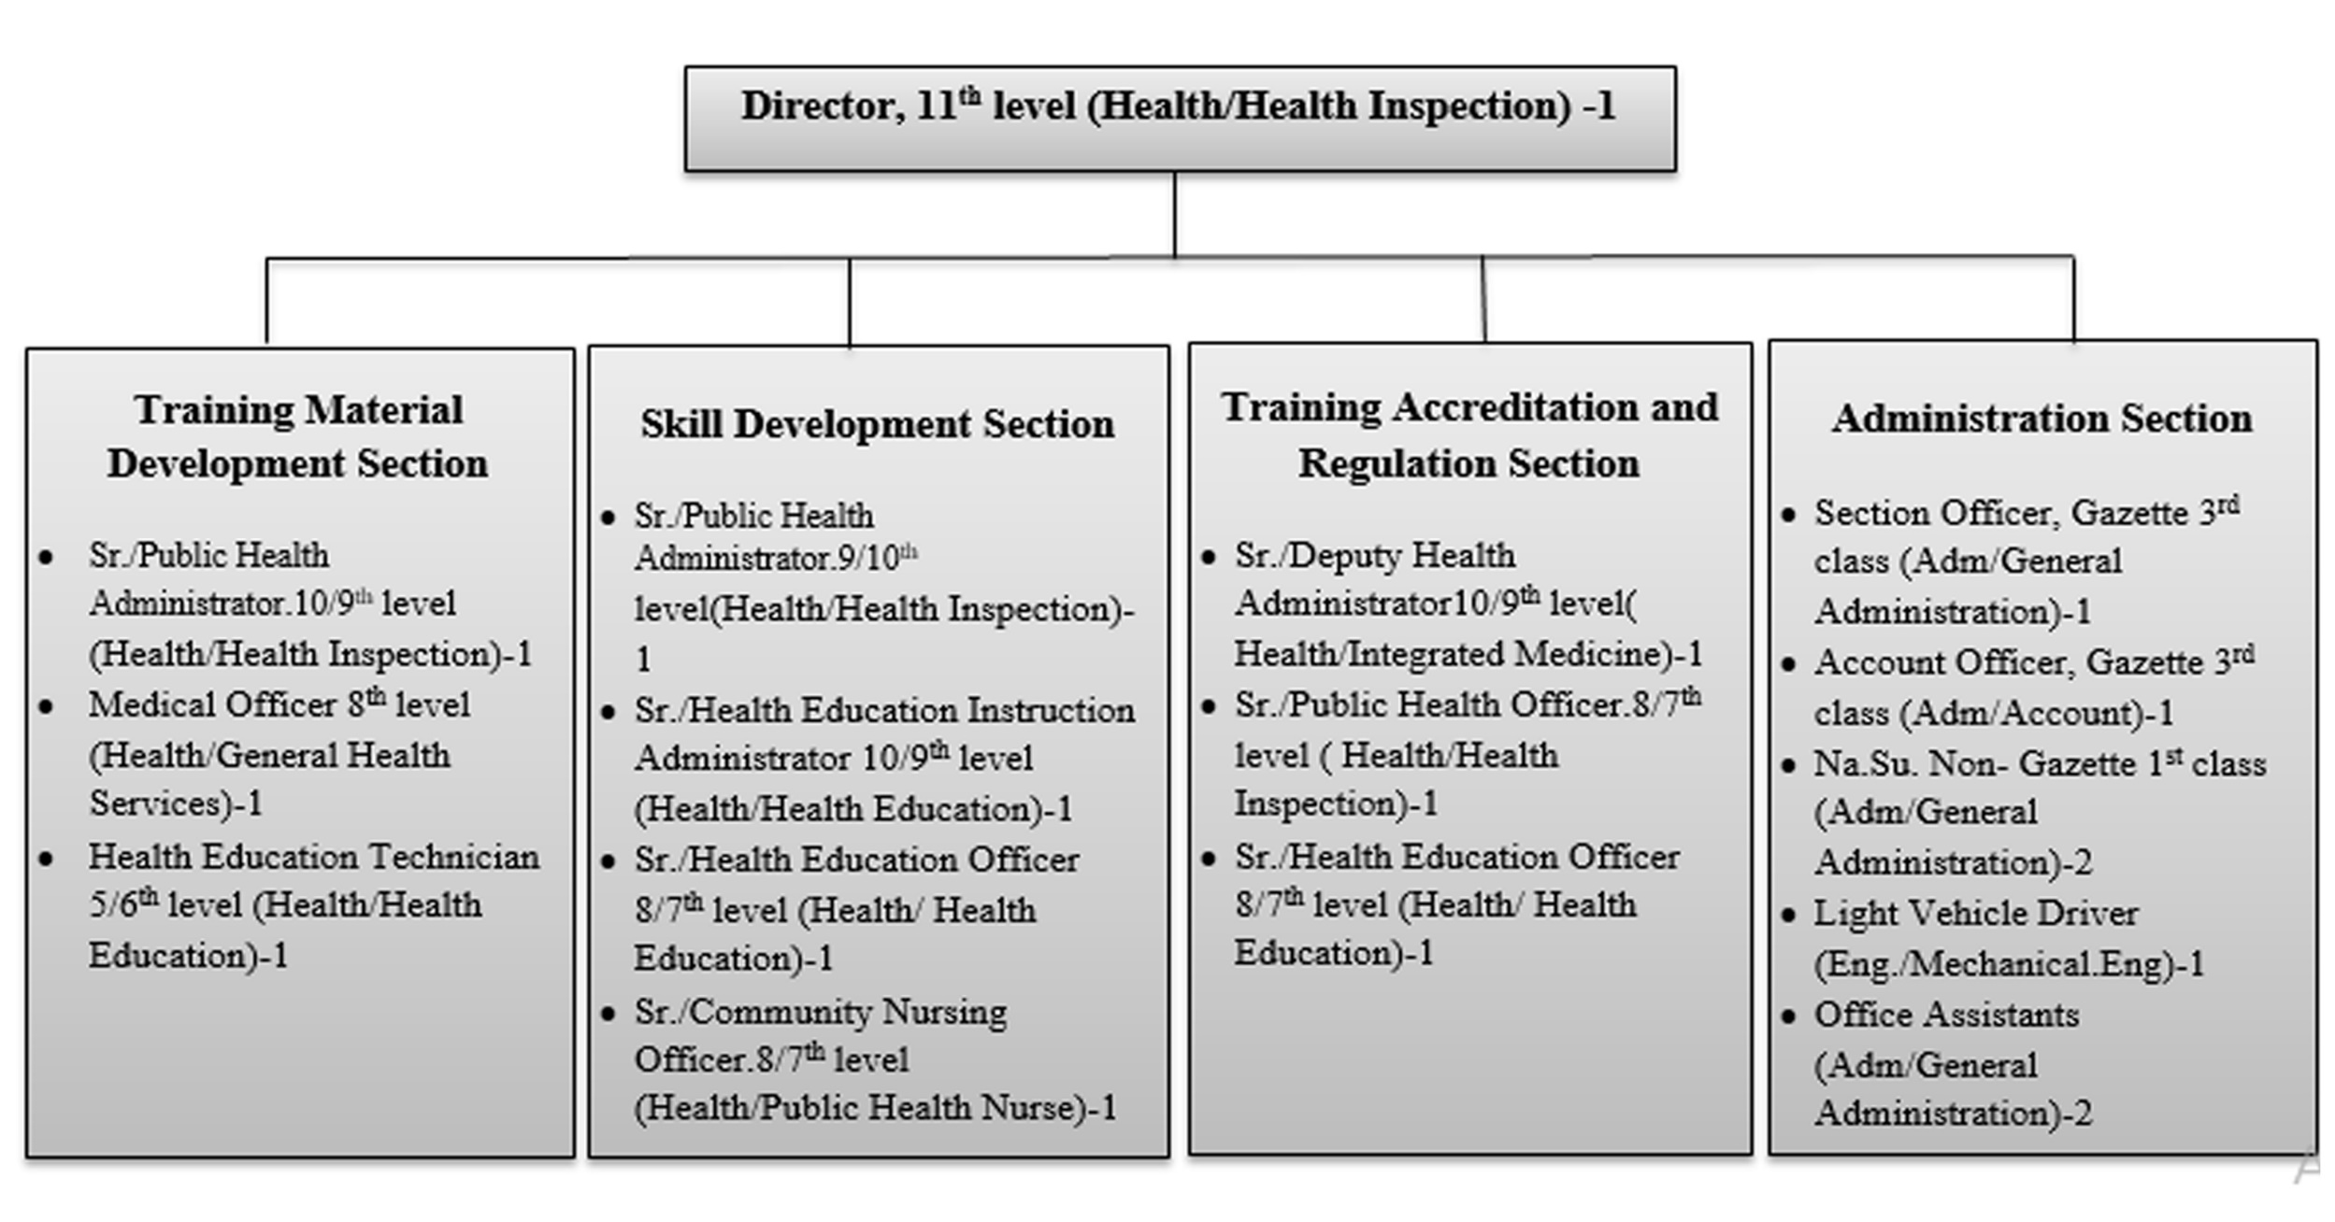
Organogram with HRH in NHTC

Slide 13
Training Material Development Section
To support MoHP in preparation of national policy, strategies and regulations regarding training material development
To prepare guidelines, protocols, standards and quality regulations regarding training material development
To develop learning resource packages or curriculum for health sector’s training or skill development activities
To facilitate in development of training materials at a national level which needs involvement of federal government

Slide 14
To update and revise learning resource packages in coordination with different stakeholder
To revise training materials and curriculum as per need based on monitoring and evaluation
To provide technical support in development of training packages or curriculum at provincial level
To develop training packages for professional development of health workers

Slide 15
Skill Development Section
To support MOHP in preparation of national policy, strategies and regulations regarding skill development
To prepare guidelines, protocols, standards and quality regulations regarding skill development
To identify training needs for capacity enhancement of health workers at national level
To manage & conduct trainings at federal level
To facilitate in conduction of trainings at federal level

Slide 16
To coordinate with different stakeholders for conduction of health related trainings
To provide technical support in conduction of trainings at provincial level
To facilitate in implementation of distance learning packages for health workers
To help in implementation of professional development related activities of health workers at provincial level
To support in management of training related information

Slide 17
Training Accreditation and Regulation Section
To help Ministry of Health and Population (MOHP) in preparation of national policy, strategies and regulations regarding training accreditation and regulation
To prepare guidelines, protocol, standards and quality regulations regarding training accreditation and regulations

Slide 18
To grant permission and regulate the organization which conduct health related trainings
To regulate and assure quality of different training packages or curriculum and training or skill development related activities
To accredit organizations which develop the packages and conduct trainings

Slide 19
Decentralization of many training programs at provincial level has been done and Health and Social Development Ministry is responsible for this task.
Accordingly, the main role of NHTC will be transferred of training programs to Provincial Health Training Centers.

Slide 20
In central level, NHTC will be more focus on development of program guideline, expenditure guideline; training manual development and revision; monitoring programs; and further facilitate the provincial level for conducting training programs.

Slide 21
Training Networks
National health training network co-ordinates and supports seven Provincial Health Training Centre, under MoSD of each Province and 49 clinical training sites.
The hospital-based training sites conduct Family Planning, Skilled Birth Attendance, Mid-Level Practicum, Safe Abortion Services, Rural USG, Anesthesia Assistant, Pediatric Nursing, Medico-Legal and other types of clinical training program.

Slide 23
Training Provided by NHTC

Slide 24
Pre-service training:
NHTC provides two types of pre-service trainings; the Diploma in Biomedical Equipment Engineering (18 months) for plus two science graduates accredited by CTEVT and Anaesthesia Assistant Course (1 year) under NAMS for Health Assistant and Staff Nurse.
Upgrading Training:
In-service upgrading trainings are designed and conducted as per the needs of program divisions and centers. The training packages aim to develop the skills to implement new programs and improve job performance.

Slide 25
Competency and clinical-based training courses:
NHTC organize various clinical training for existing government health workers in coordination with multiple clinical training sites to upgrade the knowledge and skills of the service providers in multiple clinical areas.
These in-service trainings are based on local need and demand and are supported, developed, and updated according to the national and international practice and scientific evidence.

Slide 26
Refresher training:
A range of refresher trainings are conducted as per the needs of divisions and centers to develop the skills for implementing new programmes and to improve job performance.
Orientation programs:
NHTC supports the divisions and centers to develop orientation packages and prepare pools of trainers for conducting orientations for health and non-health workers including for Health Facility Operation and Management Committee (HFOMC) members and on Appreciative Inquiry (AI).

Slide 27
Basic training:
Basic trainings are organized for Female Community Health Volunteers (FCHVs) who are newly recruited by the local mother’s group among the member. The duration of this course is 18 days.
Induction training:
NHTC has begun providing induction training for all gazetted 3rd level Officers of all health service groups from 2072/73. The one month courses (24 days working day) are provided for all health service disciplines.

Slide 28
Other training includes:
Induction Training for newly recruited officers (health personnel)
Training on the Transaction Accounting and Budgetary Control System (TABUCS)
Biomedical equipment assistant training (BMEAT)
Biomedical equipment training for users (cold chain, laboratory, X-ray)

Slide 29
Key Innovation/Initiatives
NSV blended learning approach
IUCD blended learning approach
Follow up Enhancement Program
Mental Health Training
Palliative Care Training
Primary Trauma Management Training
PPIUCD Training
POP Package (Competency Based Standardized)
Trauma Management Trainings
Revision of NHT strategy (amendments in according to the federal situation)
Web based access to training related documents (manuals and references, etc)
Climate change package development
Medico legal e-learning Training Program

Slide 30
In FY 2074/75, 5764 health workers were trained on different training (1633 male and 4131 female).
80% of the trainings were funded by GoN and rest 20% were supported by multi-lateral development partners like USAID and UNFPA.

Slide 31
Training Databank (TIMS):
NHTC is working to update the information in the TIMS.
All the training information taken from different training sites is being updated and made available to participants.
NHTC plans to update the TIMS at the central level and link it with the regional health training centres another clinical training sites.
NHTC is also preparing a trainers’ roster.

Slide 32
Management Issues
Manage a separate pool of trainers from different disciplines
Unplanned selection of participants:
  Training plan for programme and service (district and respective division)
  Training as incentives rather than need based and carrier development
Multi‐door trainings

Slide 33
Lack of strategic and uncoordinated approach to training, e.g. staff may be trained but lack the equipment required or opportunities to practice their skills.
Focus of training on transfer of knowledge (theory) rather than developing practical skills
Inadequate training follow up mechanism
Selection process and criteria of Sr. AHW, Sr. ANM(age and level)
System of ‘irrational and frequent’ transferring of staff

Slide 34
Recommendations
Consolidate the overall training needs of health service providers
Consolidate all training programme run by divisions and centers through NHTC.
Improve the quality of training by regularly updating trainers, by post-training follow up, by preparing a roster of master trainers and by ensuring training quality as per guidelines
Recognize competency based training for career development
Design and develop practical training which encourages ‘learning by doing’ and links directly to an individual’s job/ tasks

Slide 35
Establish a national health resource unit at NHTC
Rapidly assess the needs of NHTC, RHTCs and training sites including infrastructure and human resources.
Make transfer policies and guidelines
Revise the selection criteria for upgrading training
Develop regulating bodies to ensure quality and standard of training

Slide 36
National Health Education Information and Communication Centre

Slide 37
Background
NHEICC is the apex body under the MoHP for planning, implementing, monitoring and evaluating Nepal’s health promotion, education and communication programmes including periodic surveys and research.
The Scope of the centre is guided by the National Health Communication Policy 2012 and the National Health Policy 2014, communication strategies and other health related plans and policies.

Slide 38
The centre aims to achieve national health goals and SDGs through health promotion, education, information and communication approach.
The centre is the lead for all health promotion, education and communication programmes including multi-sectoral health initiatives.
The centre uses advocacy, social mobilization and marketing, behaviour change and community lead social change strategies to implement its programmes.

Slide 39
Organizational Structure
National Health Information Education and Communication Centre
Environmental and Community Health Section
Idea Generation and Coordination Section
Material Development and Coordination Section
Cartography Section
Administration Section

Slide 40
Vision, Goal and Objectives
Vision:
Every Nepali is healthy and lives a long and productive life.
Goal:
The goal of the Health Information, Education and Communication Programme is to promote healthy behaviour, prevention and control of diseases and increase use of health services.

Slide 41
Objectives:
Mobilize and use modern and traditional communication multimedia and methods to raise health awareness, knowledge and promote healthy behaviour among the general public.
Strengthen, expand and implement health communication programmes at all levels.
Generate, collect and mobilize resources to implement health communication programmes.

Slide 42
Prevent the unauthorized dissemination and duplication of health related messages or information and materials on different issues.
Enhance capacity on health communication to develop, produce and disseminate quality, correct, authorized, uniform and appropriate messages and information.
Provide quality health messages and information through appropriate media and methods to the citizens who otherwise have little access to such messages and information.

Slide 43
Strategies:
Advocacy, social mobilization and behaviour change communication are the major strategies for health promotion, education and communication.
The specific strategies are as follows:
Implementing a one-door integrated approach for all health communication programmes under MoHP.

Slide 44
Ensuring adequate budget for health communication programmes.
Coordinating with stakeholders through technical committees and other means.
Ensuring implementation of health communication programs through health infrastructure at all federal, provincial and palika levels in a decentralized manner.

Slide 45
Mobilizing communication media, methods and materials for the prevention of diseases and promotion of health.
Standardizing health messages and information for uniformity and appropriateness.
Using edutainment approach with an education format for disseminating health messages and information.

Slide 46
Ensuring that all stakeholders disseminate health messages and information after taking consent from concerned MoHP authorities.
Encouraging the media to disseminate messages and information on health issues.
Encouraging the dissemination of health messages and information through public-private partnerships.

Slide 47
Discouraging messages and information that is harmful to health.
Prioritizing lifestyle diseases prevention messages and information dissemination.
Building the capacity of health workers to plan and implement health communication programmes.

Slide 48
Ensuring the quality, uniformity and standardisation of health messages and materials through technical committees.
Introducing new communication technologies for health promotion and health communication.

Slide 49
Coordinating with academia for building the capacity of health workers on health promotion and health communication.
Strengthening monitoring and supervision activities to determine the gaps in knowledge, attitudes and practices among target audiences and service providers.

Slide 50
Health Promotion
Standardize, regulate and update health promotion, education and communication related initiatives and contents.
Develop, produce and disseminate messages, materials and tools.
Ensure target audience centric approach.
Conduct periodic formative studies for evidence based planning.
Coordinate initiatives to promote healthy life style.
Provide strategic guidelines to partner organization to plan evidence based promotion of intervention.

Slide 51
Environment Health
Develop, implement and update framework and strategies for multi – sectoral collaboration to improve environmental and occupational health
Develop community/school based health and hygiene programs.

Slide 52
Communicable Disease Prevention
Develop, implement and update framework and strategies for multi – sectoral collaboration to enhance communicable disease prevention.
Develop community/school based health and hygiene programs.

Slide 53
Reproductive and Child Health
Develop, Implement and update evidence based strategies and action plan to promote maternal, newborn, and child health, sexual and reproductive health and multi sector nutrition plan.
Provide health promotion, education and communication technical support to maternal, newborn, and child health, sexual and reproductive health programs.

Slide 54
HRH in NHIECC

Slide 56
Management of National Tuberculosis Centre/Program (NTC/NTP)
Dr. Hari Prasad Kaphle
Associate Professor (Public Health)
School of Health and Allied Sciences, Pokhara University

Slide 57
Background
National Tuberculosis Programme (NTP) is one of the priority health programme of Nepal.
National Tuberculosis Centre (NTC) is the focal point of the NTP and responsible for formulating programme, policies, strategy, and planning.
Technical support, monitoring and evaluation, training, supervision, logistics, health education, communication, and research are key functions of NTC.

Slide 58
Furthermore, quantification and procurement and supply of anti-tuberculosis drugs are key responsibilities of the NTC.
Drugs are distributed through the system of Logistics Management Section of Management Division of DoHS.
Central laboratory at the NTC is the focal point for the NTP laboratory network, which is responsible for policy and guideline development, training, quality control, and supervision.

Slide 59
At the Provincial level, NTP activities are planned and carried out in coordination and cooperation with the Provincial Health Directorate (PHD).
The Regional Tuberculosis Centre (RTC) in Pokhara provides technical support to TB control activities in the previous Western Region in coordination with National Tuberculosis Center.

Slide 60
Provincial levels are responsible for programme implementation within the province.
In addition, the PHD and MoSD is responsible for training, monitoring & evaluation and supervision of Programme activities.
PHD also provides logistical support, the supply of TB drugs and other requirements through Provincial Logistic Management Division.

Slide 61
END TB Strategy-2016-35
Vision:
A world free of TB Zero deaths, disease and suffering due to TB
Goals
End the Global TB Epidemic

Slide 62
Milestones for 2025:
75% reduction in TB deaths (compared with 2015)
50% reduction in TB incidence rate (less than 55 TB cases per 100,000 population)
No affected families facing catastrophic costs due to TB

Slide 63
Targets for 2035:
95% reduction in TB deaths (compared with 2015)
90% reduction in TB incidence rate (less than 10 TB cases per 100,000 population)
No affected families facing catastrophic costs due to TB

Slide 64
Principles
Government stewardship and accountability, with monitoring and evaluation
Strong coalition with civil society organizations and communities
Protection and promotion of human rights, ethics and equity
Adaptation of the strategy and targets at country level, with global collaboration

Slide 65
NTP Strategic Aim and Policies
Vision
TB Free Nepal
Goal
To reduce the TB incidence by 20% by the year 2021 compared to 2015 and increase case notifications by a cumulative total of 20,000 from July 2016 to July 2021, compared to the year 2015.

Slide 66
Objectives
Objective 1
Increase case notification through improved health facility-based diagnosis; increased diagnosis among children, examination of household contacts and expanded diagnosis among vulnerable groups within the health service, such as PLHIV, and those with diabetes mellitus (DM).

Slide 67
Strategies for objective 1
Improved and sustained public health facility-based TB case finding
Strengthen and expand TB diagnostic services
Enhance TB diagnosis and treatment among children
Active TB Case Finding (ACF)
Strengthen TB-HIV collaboration between NCASC and NTP at all levels

Slide 68
Objective 2:
Maintain the treatment success rate at 90% of patients (all forms of TB) through to 2021
Strategic for objective 2
Maintain the treatment success rate at 90% of patients (all forms of TB) by 2020
Ensure and strengthen uninterrupted supply and storage of quality assured first-line TB drugs for all TB patients
Promote psychosocial support system for TB patients

Slide 69
Objective 3
Provide MDR diagnostic services for 50% of persons with suspected MDR TB by 2018 and 100% by 2021; successfully treat at least 75 % of the diagnosed MDR patients
Strategies for objective 3
Establishment and operationalization of formal structures for DR TB
Expansion of DR TB Treatment Services
Capacity Building of Service Providers

Slide 70
Objective 4
Further expand case finding by engaging providers for TB care from the public sector, beyond MoHP, medical colleges, NGO sector, and private hospitals and practitioners through results-based PPM financing schemes, with formal engagements (signed MoUs) to notify TB cases. 100 municipalities by 2021
Strategies for objective 4
Establishment and operationalization of formal structures for PPM
Engagement of Medical Colleges and their hospitals

Slide 71
Objective 5
Strengthen community systems for management, advocacy, support and rights for TB patients in order to create an enabling environment to detect & manage TB cases in 60% of all districts by 2017 and 100% by 2020
Strategies for Objective 5
Mobilize local community for TB case detection, treatment delivery and patient support in districts
Strengthen and expand advocacy and communications activities

Slide 72
Objective 6
Contribute to health system strengthening through HR management and capacity development, financial management, infrastructures, procurements and supply management in TB
Strategies for objective 6
HR Management (including recruitment)
Capacity building of all levels
Infrastructure development

Slide 73
Objective 7:
Develop a comprehensive TB Surveillance, Monitoring, and Evaluation system
Strategies for objective 7
Develop a comprehensive Surveillance, Monitoring, and Evaluation system, research, and innovation

Slide 74
Focused justification for some key elements of the M&E Plan
Estimates of TB burden
Four monthly reviews of data
Measurement of presumed cases
Case-based, web-based electronic recording and reporting system
Surveillance for childhood TB
TB/HIV: New recording and reporting forms with details on HIV
Treatment outcomes : The recording and reporting mechanisms for extra-pulmonary

Slide 75
Objectives 8:
To develop a plan for continuation of NTP services in the event of natural disaster or public health emergency
Strategic for objective 8
Management of public health emergencies. Develop a plan, based on national risk assessment, to provide rapid, prioritized, resumption of any interrupted TB services

Slide 76
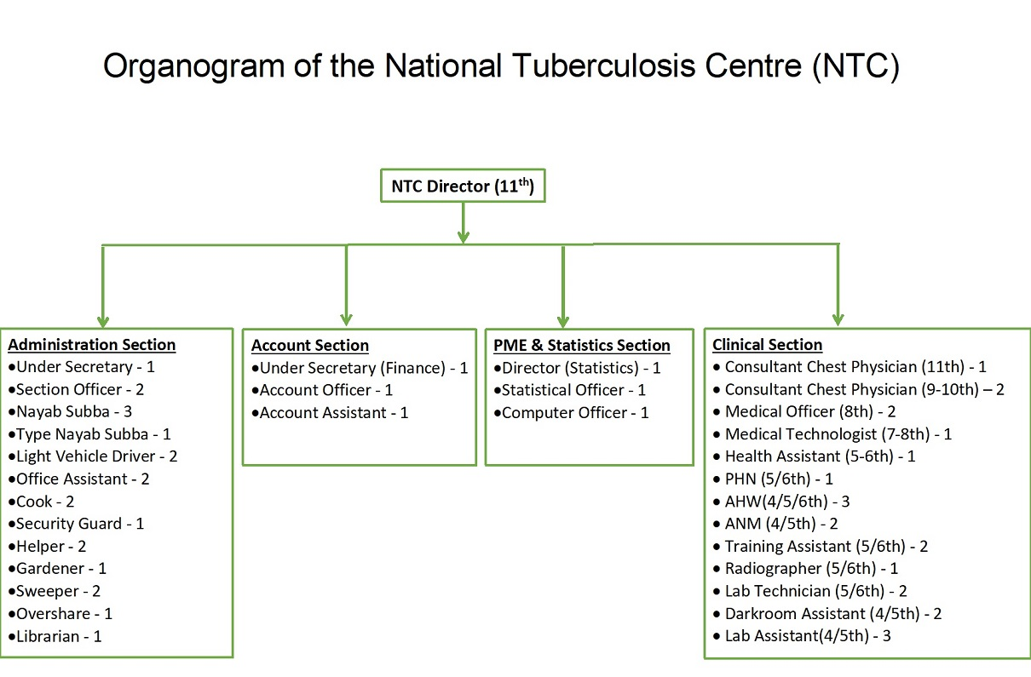

Slide 77
Services of NTC
Tuberculosis diagnosis services
Tuberculosis treatment services
Tuberculosis prevention services

Slide 78
Tuberculosis diagnosis services
Smear Microscopy Network Coverage
Currently, there are 624 microscopy centers in Nepal.
Province 1:104 Province 2: 66 Province 3:164 Gandaki:66 Province 5:97 Karnali:32 Sudurpaschim: 95 Total: 624
Majority are established within the government health facilities; some are established in NGOs as well as in the private sector.

Slide 79
External Quality Assurance (EQA)
NTP implements random blinded rechecking of slides using Lot Quality Assurance Sampling System (LQAS) for EQA.
There are 7 Province TB Quality Control Center (PTQCC) in Province level and National Quality Control Center at NTC.

Slide 80
Microscopy centers send the examined slides to their respective provincial TB quality control centers via district health office according to lot quality assurance sampling (LQAS) method.
Five Province TB Quality Control Centers (Biratnagar, Hetauda, Pokhara, Surkhet and Dhanghadi are functioning smoothly.
Two Province TB Quality Control Center at Province 2 Janakpur and Province 5 Butwal is under process.

Slide 81
Xpert MTB/RIF
The Xpert MTB/RIF is a fully automated and cartridge-based rapid, real-time PCR that integrates sample processing, DNA extraction, and amplification, for TB and RR-TB diagnosis.
It has high sensitivity and specificity and enables simultaneous detection of rifampicin resistance via rpoB gene.
95% of rifampicin resistance is associated with concurrent resistance to isoniazid, however, mono-resistance to rifampicin is found in approximately 5% of rifampicin-resistant strains.

Slide 82
The use of Xpert MTB/RIF started in Nepal from 2011/2012.
Currently, there are 55 Xpert MTB/RIF centers, having 57 Xpert MTB/RIF machines contain 196 modules, and are functioning in different parts of the country as listed below.
18 more machines are being planned to be installed at various sites of the country.

Slide 83
Culture and Drug Susceptibility Test (DST)
The NTP has established three culture laboratories – BPKIHS, Dharan: RTC, Pokhara and Regional Hospital, Surkhet.
Among these BPKIHS have started a primary culture and in RTC Pokhara and Surkhet Regional Hospital, equipment has been installed and culture will start shortly.
All the culture/DST laboratories are equipped with Xpert MTB/RIF.

Slide 84
Line Probe assay:
LPA is a PCR based test used for diagnosis of TB and for determining susceptibility to different anti TB drugs.
1st line LPA includes Isoniazid and Rifampicin susceptibilities and 2nd line LPA includes Fluoroquinolones and injectable anti TB drugs (aminoglycosides and polypeptides) susceptibilities.
LPA needs a higher bacterial load in samples than Xpert for a positive result and hence smear positive samples and cultures are preferred.

Slide 85
TB TREATMENT SERVICES
TB treatment categories and regimens.

Slide 87
Drug Resistance TB Treatment Categories

Slide 88
TB PREVENTION SERVICES
Nepal has three major categories of health interventions that were done for TB prevention in 2017/18:
Treatment of latent TB Infection (LTBI): Through isoniazid daily for 6 months, with particular attention to people living with HIV (PLHIV)and children under 5 who are the contacts of bacteriologically confirmed TB cases;

Slide 89
Prevention of transmission of Mycobacterium tuberculosis through infection control; and
Vaccination of children with the Bacille-Calmette-Guérin (BCG) vaccine.

Slide 90
Social Protection Programme in NTP
1. Skill Development Trainings to Drug-Resistant Tuberculosis Patient (DRTB)
Different vocational trainings e.g. candle making, file and folder making, tailoring, mobile phone repairing, electrical wiring, motorbike or repairing training.

Slide 91
2. Nutritional and transpiration allowances
NTP has been providing nutritional and transportation allowance to DRTB and retreatment cases in the country. (NPR 3,000 per patient/month).
Retreatment TB cases also received the same allowances (NPR 500 per patient/per month).

Slide 92
3. Hostel facilities
6 hostels and 1 Drug Resistant (DR) home located in different part of the country offered accommodation, food, treatment, and care supports to the needy DRTB patients for intensive phase of treatment.

Slide 93
4. Diagnosis and Treatment support
Diagnosis and treatment support to presumptive TB patients, support for malnourished or ARI children- every presumptive TB cases (Rs. 3500).
Similarly they also get NRs 2000 for travel and accommodation to reach to referral hospitals from Global Fund support.

Slide 94
Monitoring & evaluation framework of NTP

Slide 95
Supervision System

Slide 96
Monitoring System

Slide 97
Logistics supply management

Slide 98
Partners of NTC
World Health Organization (WHO)
SAARC Tuberculosis and HIV/AIDS Centre (STAC)
LHL International Tuberculosis Foundation, Norway
Save the children
Birat Nepal Medical Trust (BNMT), Nepal
Health Research and Social Development Forum (HERD)
Nepal Anti tuberculosis Association (NATA)
TB NEPAL
International Organization for Migration (IOM)

Slide 100
The National Case Notification Rate (All forms) is 112/100,000 population.
There are 22 districts with CNR >120, 29 districts with CNR 75-120 and remaining 26 districts with CNR <75.
Among 22 high burden districts, 13 from the Terai & 9 are from Hill.
66% TB cases were reported from Province 2, 3, and 5.
Terai belt held more than half of TB cases (57%) in 2074/75.

Slide 101
Notified TB case and Case Notification Rate (CNR) by provinces, FY 2074/75

Slide 102
Distribution of TB cases by age and sex

Slide 103
TB Cases Notification Rate

Slide 104
TB treatment success trend (2070/71–74/75)

Slide 105
Province-wise TB treatment outcomes (2074/75)

Slide 106
Drug Resistant TB Types
Rifampicin resistant TB (RR-TB) is resistant to rifampicin (detected using rapid diagnostic tests), with or without resistance to other anti-TB drugs and covers any resistance to rifampicin.
Pre-extensively drug resistant TB (Pre-XDR TB) is a multi-drug resistant strain of TB that is also resistant to either one of the fluoroquinolones and all the second line injectable drugs.
Extensively drug resistant TB (XDR TB) is a severe form of MDR-TB that is multidrug-resistant (MDRTB) to all the fluoroquinolones and second line injectable drugs.

Slide 107
Burden of MDR-TB
A total of 420 RR/MDR-TB cases were registered for treatment in FY 2074/75.
50 cases (12%) were on treatment at DR centers of province 1,
81 cases (19%) at province 2,
96 cases (23%) at province 3,
29 cases (7%) at Gandaki province,
105 cases (25%) at province 5 and
59 cases (14%) at Sudurpaschim.
However, there were no patients on treatment at DR centers of Karnali province.

Slide 108
Number of MDR-TB cases notified (71/72–74/75)

Slide 109
MDR-TB cases notified by provinces

Slide 110
Treatment outcomes of MDR TB cases registered between 2068/69–2072/73

Slide 111
NTP laboratory network (no. of institutions) by province

Slide 112
TB/HIV co-infection
In FY 2074/75, 21750 TB patients tested for HIV (a 26% increase from 2073/74), equivalent to 67% of notified TB cases.
This represented a 9-fold increase in the number of people with TB tested for HIV since 2072.

Slide 113
Constraint & Challenges
Lack of focal person for TB program at Palika and Province in the federal context
Staff restructuring and its impact on staff motivation: Staffs may be demotivated
Insufficient income generation program for the patient and their family members.
Inadequate TB management training to medical doctors, doctors working in private hospitals, medical colleges, private practitioners

Slide 114
Minimum interventions for strengthening PPM component
Lack of operational research regarding increasing retreatment cases
Lack of patient-friendly TB treatment service
Lack of sputum transportation services at all districts
Low availability of TB IEC materials at health facilities
Difficult to coordinate with regional and provincial hospitals

Slide 115
TB-HIV co-infection, MDR, XDR, retreatment cases are increasing
Increasing labour migration may lead to increase infection
Increasing in slum populations in major cities
Cross boarder issue: open boarder, patients go to India, consult with quacks, consult with private practitioners who don’t follow DOTS regimen,
Challenges to establish DOTS clinic in private hospital and medical colleges

Slide 116
Action to be taken
Expansion of CB-DOTS programme throughout the country
Endorsement of PPM guideline to strengthen Public-Private Mix approach
Strengthen the community support system programme
Explore operational research areas on TB prevention, treatment, and care
Develop and distribute patients centred on TB IEC materials
Pilot patient-friendly treatment centres in the country

Slide 117
Strengths
Provides effective chemotherapy to patients in accordance with national treatment policies.
Provides continuous drug supply to all treatment centers.
Implement active case findings interventions across high burden districts.
Maintains a standard system for recording and reporting.
Monitors the result of treatment and evaluates progress of the program.
Pursue high quality DOTS expansion and enhancement.
Prioritization of MDR-TB treatment in national spotlight.

Slide 118
Strengths
NTC has planned to shorten MDR-TB regimen.
TB prevalence survey 2018-2019
Number of gene-Xpert sites has increased.
Testing of HIV among TB patient is increased

Slide 119
Weaknesses
Accountability, prioritization, engagement and investment in TB at all levels has been a key challenge for NTP.
There is lack of proper identification of community and private sectors and their meaningful engagement in TB program.
Nationwide scale-up of e-case based or digitized case based surveillance isn’t satisfactory.
Case notification rate continues to decrease in recent years.

Slide 120
Weaknesses
Disruption of the continuation of TB services due to COVID-19.
Defaulter tracing and providing patient friendly services including side effect management for DR-TB is declining gradually.
Gradual reduction in the number of clinically confirmed TB cases.
Difficulty in finding missing TB cases, especially childhood TB cases

Slide 121
Opportunities
Support from bilateral and multilateral organizations.
Emerging research on TB-HIV treatment integration and improved outcomes.
Government support in health care management research.
Coordinate and collaborate NTP activities with National HIV/AIDS program.
Piloting of patient-friendly treatment centers in the country.
National strategic plan to END TB 2021/22-25/26 is initiated.
GoN use domestic funding to cover 100% first line anti TB drugs and increased proportion (40-60%) of 2nd line anti TB drugs.
GoN funded over 50% of the total budget of NTP.
Operate mobile screening TB camp.
Availability of new technologies that reduce the cost of treatment.
Engage all care providers [public-public, Public-Private Mix (PPM)]

Slide 122
Challenges
New structure of NTP has not been cleared.
Withdrawal of donors, bilateral and multilateral partners.
Failure of Public-Private Mix (PPM) approach.
Emergence and re-emergence of TB-HIV co-infection at high rate.
High rate of drug resistance among TB patients.
Treatment outcome of MDR-TB and XDR-TB aren’t satisfactory.
Irrational use of first and second line drugs due to market forces.
Patient’s negligence in medication.
Social stigmatization
Open border is the threat for TB problem.

Slide 123
National Centre for AIDS and STD Control

Slide 124
Introduction
An estimated 39397 people were living with HIV in Nepal at the end of 2015.
In the same year 1331 people were newly infected with HIV and there were 2263 AIDS-related deaths.
Despite steady improvements, the global target to reach 90% treatment coverage is far from being accomplished, as only about 30% of people living with HIV in Nepal were enrolled in treatment.

Slide 125
Regional framework to Fast-Track the HIV response
Countries in the Asia Pacific region committed to ending the AIDS epidemic by 2030 at the United Nations Economic and Social Commission for Asia and the Pacific consultation in January 2015 and endorsed a regional framework to Fast-Track the HIV response.

Slide 126
The global Fast-Track targets include:
75% reduction of new infections between 2010 and 2020 (leading to 90% reduction by 2030);
Achieving the 90.90.90 treatment targets by 2020 and the 95.95.95 targets by 2030;
Achieving zero discrimination by 2020;
Eliminating new infections among children by 2020

Slide 127
The principles of the Fast-Track approach are:
Ambition: ensuring leadership, political commitment and ambitious national targets;
Focus: investing in services in locations and populations most affected;
Change: scaling up effective responses and innovating community-based approaches;

Slide 128
Speed: front-loading investment to accelerate scale-up of effective and efficient services;
Saturation: investing in high-impact services with intensity and quality;
Human rights: ensuring effective, equitable, people-centred HIV responses.

Slide 129
National HIV Strategic Plan 2016-2021
Vision:
Ending the AIDS epidemic as a public health threat in Nepal by 2030.

Slide 130
Goals and Targets
Identify, recommend and test 90% of key populations.
Treat 90% of people diagnosed with HIV.
Retain 90% of people diagnosed with HIV on antiretroviral therapy.
Eliminate vertical transmission of HIV and keep mothers alive and well.
Eliminate congenital syphilis.
Reduce 75% of new HIV infections.

Slide 131
Strategies
Offer HIV “test and treat” services, regardless of CD4 count.
Retain people living with HIV in treatment, resulting in undetectable viral load.
Fast-Track prioritized investments with a scope, scale, intensity, quality, innovation and speed to have the biggest impact.
Enhance critical programme and critical social enablers.
Establish functional public-private partnerships to bridge the prevention-treatment continuum through task-sharing.
Focus on innovative, well-coordinated and integrated services towards primary HIV prevention for and with key populations.

Slide 132
Indicators & targets to be achieved by 2021

Slide 135
Guiding principles
Universal and equitable access to services for HIV prevention, treatment, care and support,
National solidarity and shared responsibility,
Fast-Tracking towards ending the AIDS epidemic as a public health threat,
Integration of HIV within systems for health,
Innovation,
Evidence-informed planning and programming,

Slide 136
Decentralized, multi-sectoral and interdisciplinary engagement,
People-centred inclusive approaches,
Advancing human rights,
Gender justice,
Zero tolerance for prejudice and discrimination related to HIV and key populations,
Prevention and treatment continuum using the “identify, reach, recommend, test, treat and retain” approach,

Slide 137
Meaningful involvement of affected communities,
Public private partnerships and task-sharing, and
Country stewardship (government leadership).

Slide 138
Prevention to treatment continuum

Slide 139
Identify, reach, recommend, test, treat and retain-continuum of prevention, care & treatment

Slide 140
Estimated investment need, 2016-2021

Slide 141
Nepal HIV targeted investments (2016-2021)

Slide 142
Governance, structures and responsibilities
The National AIDS Council was established for policy coordination under the chairmanship of the Prime Minister, with high-level representation of numerous ministries and Government entities, civil society representatives and other partners.
This structure is important for overall leadership at the highest level of government.

Slide 143
The National HIV/AIDS and STI Control Board was established to work as the secretariat of the National AIDS Council and for the formulation of national policies, strategies and plans; coordination, monitoring and evaluation of the national multi-sector response to AIDS; mobilization of internal and external resources; and fulfilment of national and international commitments.

Slide 144
The National Centre for AIDS and STD Control was established for the execution, coordination and monitoring of the National HIV and STI Policy, Strategy and Action Plan, in order to implement the endorsed policy and programmes at the federal, provincial, & local levels.
The NCASC maintains and, where necessary, establishes functional technical and thematic working groups comprising multiple sectors of Government of Nepal and nongovernmental members.

Slide 145
The tasks of the NCASC, under the National HIV Strategic Plan, focus on coordination; leveraging and mobilization of financial and technical resources; quality control; development and implementation of policy, programmes and plans; and monitoring and reporting.

Slide 147
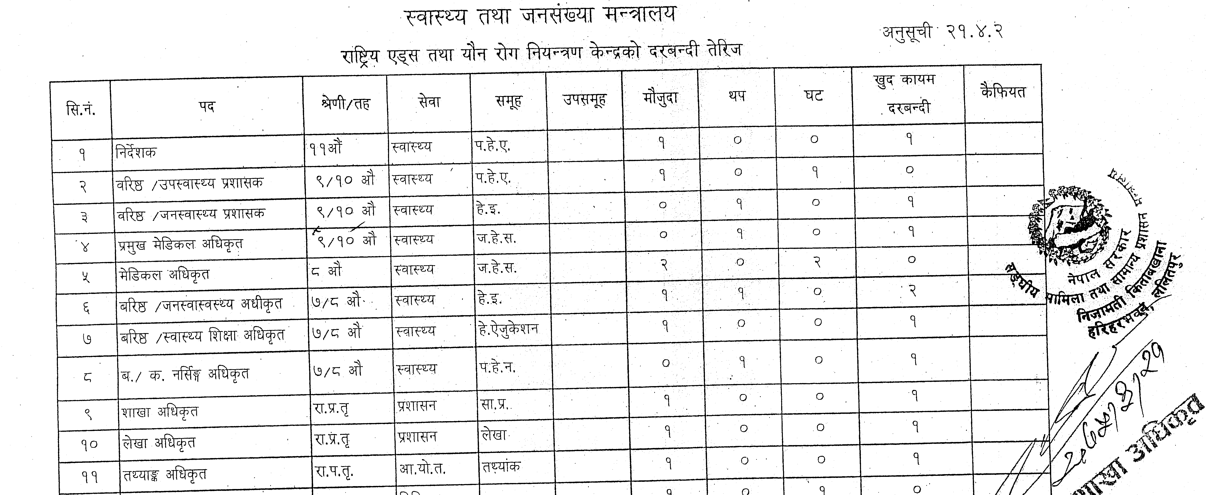
Human Resource for Health in NCASC

Slide 149
Service delivery modalities
Facility-based: in existing clinical settings such as standalone HIV testing services and antiretroviral therapy sites, mobile facility, antenatal care and labour rooms, opioid substitution therapy sites, TB care sites and private clinics, and public private partnerships.
Community-based: in-reach among key populations using mobile units, entertainment sites, and hotspots for sex work and injecting drug use, and also focusing on remote birthing sites and areas with higher numbers of male labour migrants and their partners. This include community led testing using "test for triage".

Slide 150
Service Sites by Province (2074/2075)
Province | HIV Testing sites | ART sites | Opioid substitution therapy (OST) sites
1 | 23 | 9 | 2
2 | 14 | 8 | 1
3 | 43 | 15 | 8
4 | 26 | 9 | 1
5 | 33 | 15 | 3
6 | 16 | 4 | 0
7 | 20 | 13 | 0

Slide 151
External Financing
EDPs equally support the national response to HIV in Nepal by providing a substantial amount of resources required for combating HIV.
The Global Fund to Fight AIDS, TB and Malaria (GFATM),
United States Agency for International Development (USAID),
United Nations Children’s Fund (UNICEF),
World Health Organization (WHO),
AIDS Health Care Foundation (AHF) etc.

Slide 152
Program Monitoring Indicators
Impact level Indicators
a) HIV incidence- Number and percentage of new HIV infections
b) HIV prevalence among key population
c) HCV and HBV prevalence among people who inject drugs
d) HIV prevalence in young people
e) Mother to child transmission of HIV (MTCT): Estimated percentage of children newly infected with HIV from MTCT

Slide 153
Outcome level indicators
a) Percentage of sex workers reporting condom use with most recent client
b) Percentage of people who inject drugs reporting having used a condom the last time they had a sexual-intercourse
c) Percentage of men reporting the use of condom the last time they had anal sex with a male partner
d) Percentage of migrants aged 15-49 reporting the use of condom the last time they had sex with non-regular sexual partner

Slide 154
Output level indicators
a) Needle and syringe distributed per person who injectdrugs
b) Percentage of individuals receiving Opioid Substitution Therapy who received treatment for at least six months
c) Number and percentage of key population who had an HIV test in the past 12 months and know their results
d) Percentage of key population reached by HIV prevention programmes - (BCC intervention, condom and lube distribution)
e) Number of key population screened for HIV by trained layperson

Slide 155
f) Percentage of pregnant women with known HIV status
g) Percentage of pregnant women living with HIV who received antiretroviral therapy to eliminate vertical HIV transmission
h) Percentage of reported congenital syphilis cases (live births and stillbirths)
i) Number and percentage of people living with HIV who are receiving HIV care (Including ART)
j) Percentage and number of adults and children on antiretroviral therapy among all adults and children living with HIV at the end of the reporting period

Slide 156
k) Percentage of people living with HIV who are on retained on ART after 12, 24 and 36 months after initiation of antiretroviral therapy
l) Percentage of health facilities dispensing antiretroviral therapy that experienced a stock-out of at least one required antiretroviral drug in the last 12 months
m) Number (and percentage) of adults and children living with HIV currently receiving care and support services from outside facilities
n) Percentage of HIV-positive patients who were screened for TB in HIV care or treatment settings
o) Percentage of TB patients who had an HIV test result recorded in the TB register

Slide 157
Estimated HIV prevalence among adult population (15-49 Year) 2017 (1985-2020)

Slide 158
Estimated Trend of New HIV Infections and Deaths 2017 (1985-2020)

Slide 159
Estimated HIV infections by age group, 2017

Slide 160
Annual HIV infections among adults (15+) by route of transmission : 1990-2020

Slide 161
Distribution of People Living with HIV
(15 years and above), 2017

Slide 162
HIV Testing Services
Service Statistics HIV Testing and Counselling

Slide 163
Province wise Service Statistics HIV Testing and Counselling in 2074/75

Slide 164
Prevention of Mother to Child Transmission for Elimination of Vertical Transmission (EVT)
HIV testing and counseling during ANC, labour and delivery and postpartum
ARV drugs to mothers infected with HIV infection
Safer delivery practices
Infant feeding information, counseling and support,
Early Infant Diagnosis (EID) of all HIV exposed children at 6 weeks
Referrals to comprehensive treatment, care and social support for mothers and families with HIV infection.

Slide 165
Service Statistics on PMTCT in Nepal for the period of BS 2072/73 -2074/75

Slide 166
Province wise Service Statistics on PMTCT in Nepal 2074/75

Slide 167
Early Infant Diagnosis (EID)
Initiatives for Early Infant Diagnosis (EID) of HIV in infants and children below 18 months of age have been taken with the goals
of identifying infants early in order to provide them life-saving ART; and
of facilitating early access to care and treatment in order to reduce morbidity.
A Deoxyribonucleic Acid (DNA) Polymerase Chain Reaction (PCR) testing facility has been set up at National Public Health Laboratory in Kathmandu.

Slide 168
EID Service Statistics in Nepal

Slide 169
HIV Treatment, Care and Support Services
Treatment Cascade in Nepal, 2017

Slide 170
ART Profile of FY 2072/73-74/75

Slide 171
Province wise people on ART FY 2074/75

Slide 172
Service Statistics on Community and Home Based palliative care (CHBC) Services in Nepal (2074/75)

Slide 173
Service statistics on Clinician Consultation Centre (CCC) FY 2074/75

Slide 174
Strengths
It is the priority one program by government of Nepal.
The Community Based Testing (CBT) approach has been initiated in key population.
Human resources have been trained for HIV testing and counselling for public health facilities as well as NGO’s run HTS sites.
Nation wide increasing in services delivery sites.

Slide 175
Strengths
Establishment of prevention of mother to child transmission (PMTCT), Antiretroviral therapy (ART) sites along with training of human resources from maternal and child health care in alignment with PMTCT services.
Strategies are focused on building one consolidated, unified, right-based and decentralized HIV program with services that are integrated into the general health services.

Slide 176
Weaknesses
Inadequate IEC/BCC materials (on STI/HIV/AIDS).
Lack of HIV testing facility.
Inadequate counselling on HIV/AIDS.
Shortage of trained manpower in specialized area of HIV/AIDS.
No special section to deal with HIV/AIDS programs in the Association.
Shortage of resources for specialized HIV/AIDS service ( to establish lab for testing services).

Slide 177
Opportunities
Substantial amount of resources is provided by EDP’s to support the national response to HIV/AIDS.
External sources like GFATM “The Global Fund to Fight AIDS, TB and Malaria”, USAID, UNICEF, WHO are contributing to the program.
Civil societies through the Empowerment of key persons have been playing important roles in prevention, treatment, care and support services of HIV.
Increasing public awareness on HIV/AIDS.
National HIV strategic plan 2016-2021 is launched to achieve ambitious global goals of 90-90-90 global strategy.
Supportive stakeholders for HIV program.

Slide 178
Challenges
The financing of the HIV response in Nepal relies heavily on external funding that is rapidly declining.
Stigma and discrimination towards HIV patients.
Discontinuation of follow-up to services by HIV patients.
Low rate of literacy on HIV/AIDS and STI, specifically among rural women.
The existing socio-cultural frameworks of Nepal do not provide an environment for any safe disclosure for person who is HIV infected.
Geographical challenges

Slide 179
Challenges
Huge data gap is found in the HIV program especially the report from many sites (Hospitals and NGOs) are yet to be covered in the electronic IHIMS system.
Low HIV testing coverage among key populations (KPs) has been a long-standing challenge in response to HIV. The problem of low coverage is most prominent for the returning labor migrants.

Slide 180
Need to establishment of testing sites in government institutions.
Tracking of HIV-positive mothers and exposed baby for Early Infant Diagnosis (EID).
Supportive monitoring visit at service delivery points from the district and centre.
Client duplication in the service
Lost or incomplete medical records (Recording and Reporting)

Slide 181
National Public Health Laboratory

Slide 182
Background
National Public Health Laboratory (NPHL) is a central specialised national referral public health laboratory under DoHS and MoHP for the country and the regulatory body to licence public and private labs.
It was established in 1968 as Central Health Laboratory.
The name was changed to National Public Health Laboratory in 1991.

Slide 183
Networking, Licensing, monitoring, supervision, capacity, strengthening and conducting research activities and NEQAS of the laboratories are the major functions of NPHL.
NPHL is also a focal point for blood safety through its National Bureau of Blood Transfusion Services (NBBTS).
Since 2075, NPHL is given, the responsibility of National Coordination Centre for Antimicrobial Resistance (AMR).

Slide 184
There are currently diagnostic health laboratories in 104 public hospitals, 198 PHCCs, 150 health posts and more than 1,700 private health institutions.
NPHL support these laboratories to improve their quality assurance practices, human resources, competency, service range and physical infrastructure.
NPHL monitors these laboratories through its external quality assurance of lab services and the quality control testing of samples and periodic supervision of both government and private laboratories.

Slide 185
It conducts the National External Quality Assurance Scheme (NEQAS) programme to monitor testing quality.
NPHL also provides feedback based on the results.
This also helps to enhance the testing capability of lab personnel.

Slide 186
Number and types of laboratories province

Slide 187
Organogram of NPHL
National Public Health Laboratory
Non-communicable disease laboratory
Infectious disease laboratory
Laboratory and blood transfusion regulation section
Quality control and training section
Administration and logistic management section

Slide 188
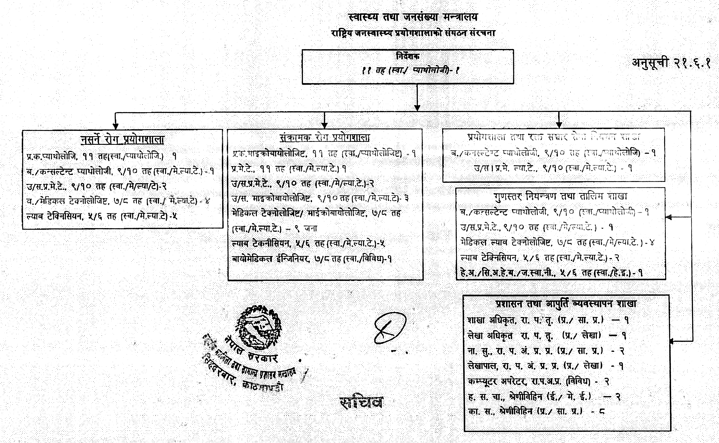

Slide 189
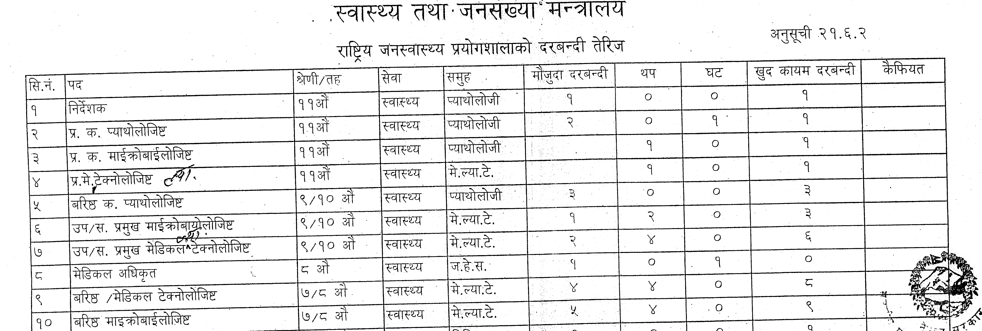
HRH in NPHL

Slide 192
Vision and Mission
Vision
To develop National Public Health Laboratory as centre of excellence in diagnosis.
Mission
To provide quality laboratory services (diagnostic and public health related) to the people of Nepal through Federal, Provincial, Primary Hospitals based and PHC based laboratories.

Slide 193
Goal
Extend laboratory services in all hospital and health case institution up to PHC level.
To develop NPHL as national reference laboratory for diagnostic and public health services.
To address the diagnostic needs due to emerging and re-emerging diseases.

Slide 194
Objectives
To upgrade and introduce new facilities at NPHL.
To introduce new technology for specified test not available at other laboratories
To strengthen overall capacity of health laboratory services through NEQAS and supervision and monitoring.
To procure quality equipment and reagents according to the need.
To practice Good Laboratory Practice (GLP) by all the laboratories in the country.
To assist the laboratory in introducing specialized tests by NPHL.

Slide 195
Non-Communicable Disease Department
Four sections: Haematology, Biochemistry, Endocrinology and Histocytopathology are being run under non-communicable disease department.
Both routine and specialized services are being provided from these departments.
Various research activities are also being carried out in these sections.

Slide 196
Specialized services being provided by NCD department
Acute leukaemia panel (flow cytometric technique),
Haemoglobin electrophoresis for haemoglobinopathies
Coagulation factor assays and inhibitor assays,
Fertility panel
Thyroid hormone panel
Molecular tests related to haematology
Monitoring sentinel sites for Hemoglobinopathies of Nepalgunj, Bharatpur, Dhangadi and Butwal.

Slide 197
Quality Control and Training Section
Carries out quality related activities and conducts training for lab personnel.
Supervision and monitoring of both government and nongovernment laboratories.
Based on supervision and monitoring, license is provided for laboratory operation (as one of the five categories, A to E)

Slide 198
National Bureau for Blood Transfusion Services (NBBTS)
The NBBTS is the national authority for implementing the National Blood Programme (NBP).
NBBTS works to ensure the safe, adequate and timely supply of blood and blood products to meet transfusion needs by developing policies, guidelines, protocols, standard operating procedures and related softwares.

Slide 199
NPHL is the national reference laboratory for screening transfusion transmissible infections (TTIs)
It is also responsible for training BTSC staff and supervising monitoring, licensing BTSCs and motivational program.
Also, provide equipments to the BTSCs to initiate or enhance the related services.

Slide 200
HIV Reference Laboratory
HIV and Hepatitis Reference Laboratory mainly focused on the testing and monitoring the HIV and Hepatitis related programs and tests.
It mainly comprised of Molecular Unit and Immuno-serology Unit
Molecular tests like HIV Viral load, HBV Viral load, HCV Viral load and Early infant diagnosis of HIV is conducted on routinely basis.

Slide 201
In Immunoserology, CD4 testing by flowcytometry, HIV 1&2 Ab ELISA, HIV Ag/AbCombi ECLIA, HBsAg ELISA, HCV Ab ELISA, HAV and HEV test by rapid diagnostic kits and HBeAg, HBeAb, HBcAb, HBsAb by ECLIA is also performed routinely in our laboratory.
NPHL have COBAS Ampliprep/COBAS Taqman and Rotorgene 6000 for molecular analysis, BD FACSCalibur and BD FACS Count for CD4 Testing and e411, Roche for ECLIA machine.

Slide 202
National Influenza Centre
National Influenza Centre is one of the newly established and highly equipped departments of NPHL designated by MoHP and recognized by WHO for the purpose of participating in WHO Global Influenza Programme.
Upon such recognition by WHO, NIC has become member of the WHO Global Influenza Surveillance Network.

Slide 203
Japanese Encephalitis, Measles and Rubella Laboratory
The infectious and communicable diseases are of growing concern and continue to be a major public health problem worldwide.
Among them, vaccine preventable diseases still have top most mortality rate worldwide among the children below 15 years.
In order to reduce and control the mortality and morbidity of such vaccine preventable disease (Japanese Encephalitis, Measles, Rubella, etc.), a partnership between WHO and GoN is working in close collaboration with NPHL under the DoHS of MoHP.

Slide 204
Major Routine Activities
Routine and specialized diagnostic services including services of referral laboratory.
Public health related activities (laboratory based surveillance [AES/Japanese encephalitis, measles/rubella, polio, antimicrobial resistance (AMR), influenza)], HIV reference unit, National Influenza Centre, BSL-3 laboratory and outbreak investigation)

Slide 205
Training and workshops
Logistics procurement and supply and laboratory refurbishment
Supervision and monitoring, licensing lab & BTSCS.
National External Quality Assurance Scheme (haematology, biochemistry, gram stain, microbiology, AMR on selected bacterial pathogens and TTIs)

Slide 206
Polio containment and its accreditation.
Assisting MoHP for preparing medical laboratory related, policy, legislation and guidelines.
Procurement of especial types of kits and reagents and equipment for provincial and local level government laboratories.
General administration functions.

Slide 207
AMR (Antimicrobial Resistance) Surveillance Activities
NPHL conducts laboratory surveillance on various disease pathogens including on measles-rubella, Japanese encephalitis, influenza and antimicrobial resistance surveillance to monitor the burden of these diseases and to inform disease control strategies.

Slide 208
Revenue Generation
NPHL generate revenue from different laboratory testing service.
There is increasing trend on revenue generation.

Slide 209
Challenges
The major challenge is lack of appropriate laws and bylaws most needed for laboratory standardization and accreditation.
Lack of separate budget for the quality assurance activities of medical laboratories, in each hospital/labs, so that something is invested every year in a planned manner to improve and sustain quality in the service.

Slide 210
Lack of scholarships for higher education and advance level trainings, lack of pro-research environment and inadequate number of functional human resource.
Professionalism and code of conduct of each profession given should also be emphasized adequately from everybody concerned to improve our overall performances.

Slide 211
Thank You!

