Slide 1
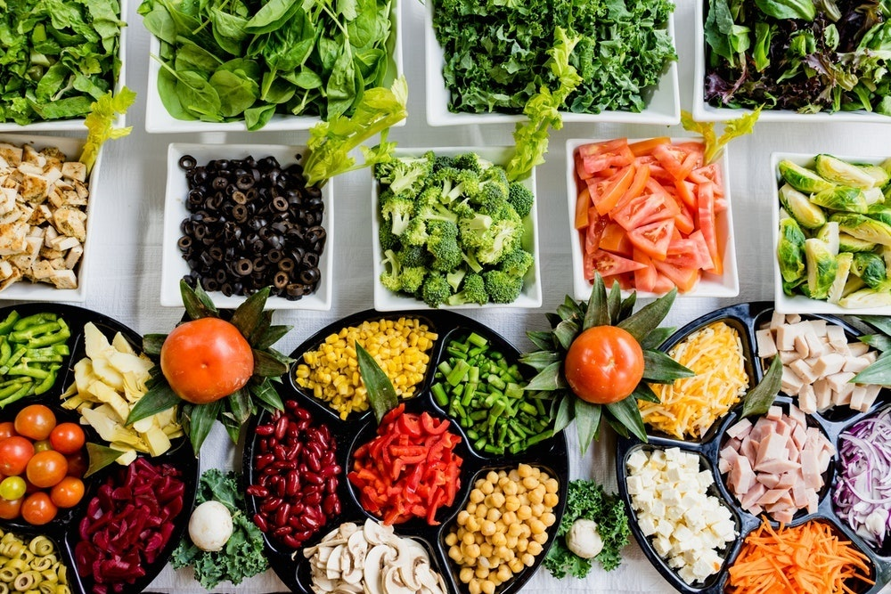
UNIT I- INTRODUCTION OF FOOD SCIENCE AND NUTRITION
Nutrients (Classification, function, excess, and deficiency, daily requirements)
Presented by :
Laxmi Adhikari

Slide 2
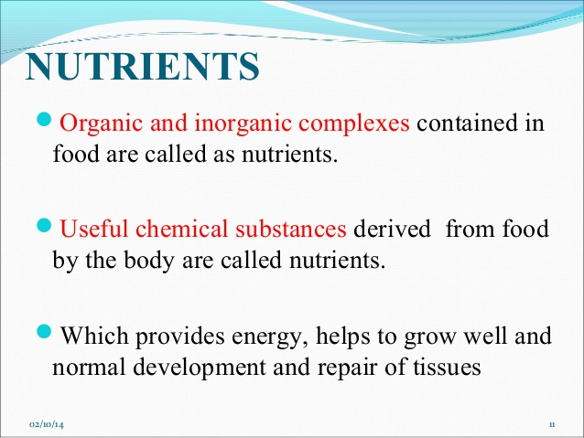

Slide 3
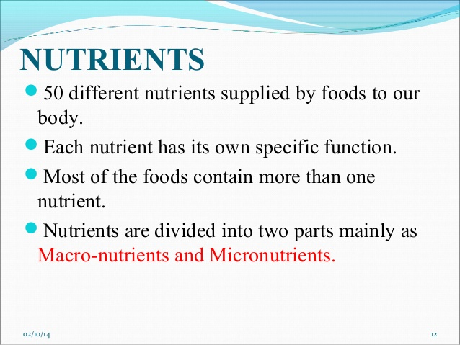

Slide 4
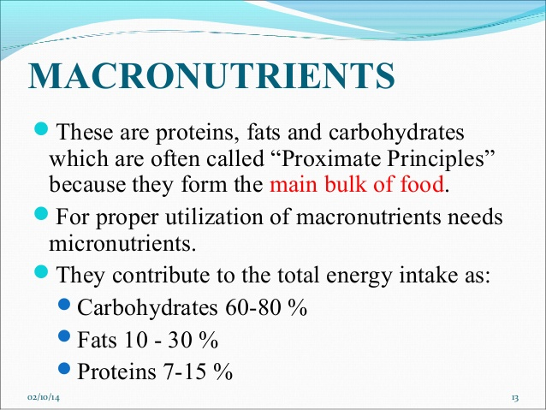

Slide 5
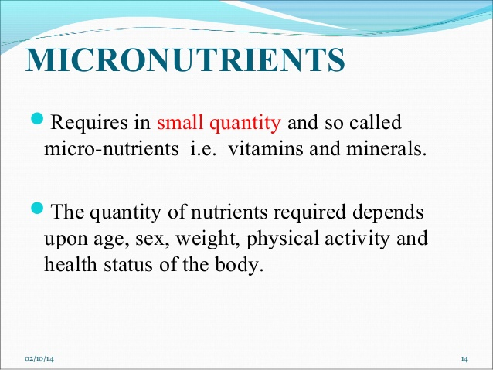

Slide 6
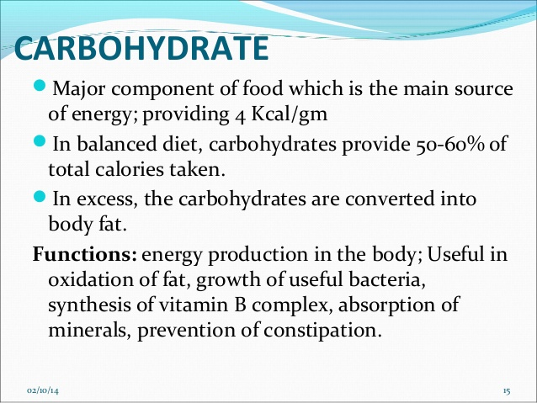

Slide 7
Sources
Starches : It is basic to human diet (Cereals, roots, and tubers)
Sugars : comprise monosaccharides (glucose, fructose and galactose) and disaccharides (sucrose, lactose and maltose).These free sugars are highly water soluble and easily assimilated. (white sugar, honey, glucose etc)
Free sugars along with starches constitute a key source of energy.
3. Cellulose : It is indigestible component of carbohydrate with scarcely any nutritive value , contributes to dietary fibre.

Slide 8
Recommended minimum carbohydrate intake grams/day
0-6mnths: 60g
7-12mnths:95g
1-8 yrs: 130g
9-18yrs:130g
19 + yrs: 130g
Pregnancy : 175g
Lactation :210g

Slide 9
Dietary Fiber
Dietary fiber which is mainly non starch polysaccharide is a physiologically important component of diet.
Found in vegetables, fruits and grains
These are degraded to a greater or lesser extent by the microflora in the human colon.

Slide 10
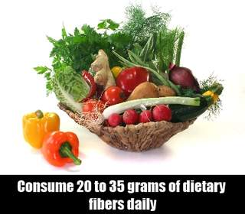
Benificial effects of Dietary fiber
The fiber absorbs water , and this increases the bulk of the stool and helps reduce the tendency to constipation by encouraging bowel movements.
Lowers cholesterol level
Weight reduction
Lowers blood pressure
Helps control blood sugar level
Prevents colon cancer

Slide 11
Harm of excess carbohydrates
Excess consumption of carbohydrates causes pancreas to continue secreting insulin and body is constantly in fat storage mode.
Obesity- excess fat storage
Diabetes
High blood pressure- excess insulin forces kidney to retain Na ions, hence increases fluid retention. Blood retain more fluids hence blood pressure rise
High cholesterol- Excess insulin causes LDL level to rise.
Heart disease- when LDL particles migrate into the walls of coronary artery.

Slide 12
Carbohydrate Deficiency
Acidosis: Acidity in blood and tissue rises and causes irreversible cell damage.
Ketosis: Prolonged fasting or starvation. Acetyl CoA in liver is used to produce ketone bodies which leads to ketosis
Hypoglycemia: Non availability of glucose, occurs when blood glucose levels drop under 70mg/ml .
Constipation: Dietary fiber is essential component of carbohydrate food.
Mood swing: Dietary carbohydrate exclusion causes the brain to stop regulating serotonin hormone. Low serotonin supply causes mood swing and depression.

Slide 13
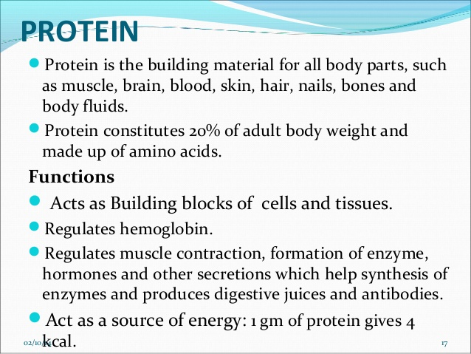

Slide 14
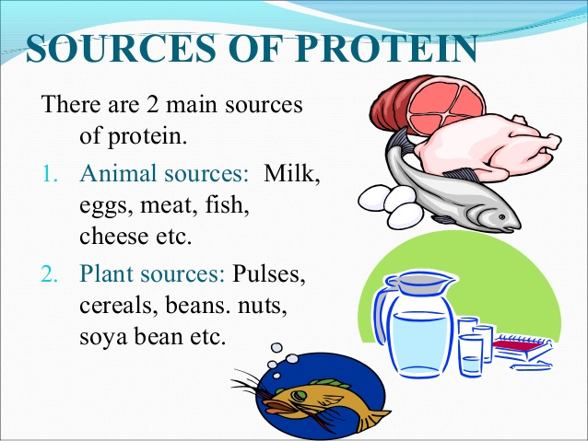

Slide 15
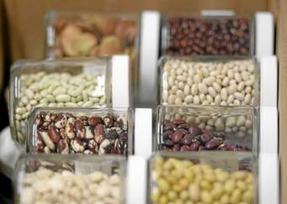
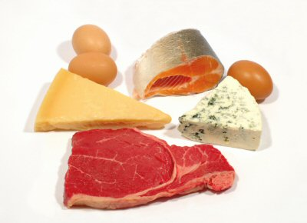
Proteins
Proteins are made up of smaller units, called amino acids.
incomplete proteins
lack some essential amino acids
e.g. plant protein
complete proteins
Contains all the essential amino acids
e.g. animal protein

Slide 16
Essential Amino Acids
Not synthesized by the body
Tryptophan
Methionine
Valine
Threonine
Histidine
Phenylalanine
Leucine
Isoleucine
Lysine

Slide 17
Nonessential Amino Acids synthesized by the body
Alanine
Arginine
Aspartate
Cysteine
Glutamate
Glutamine
Glycine
Proline
Serine
Tyrosine
Asparagine
Selenocysteine

Slide 18
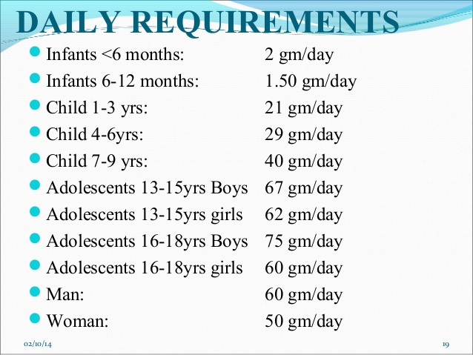

Slide 19
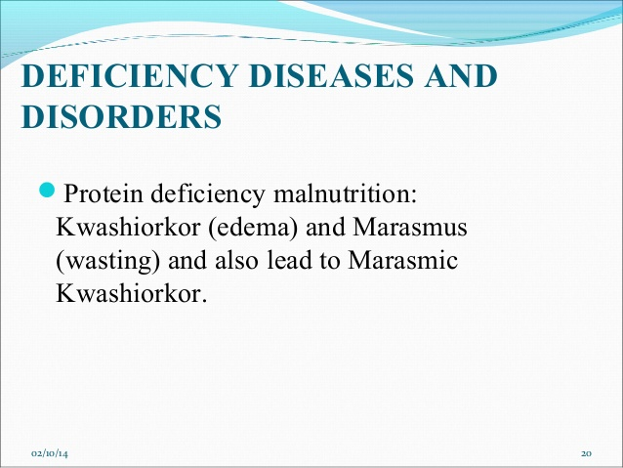

Slide 20
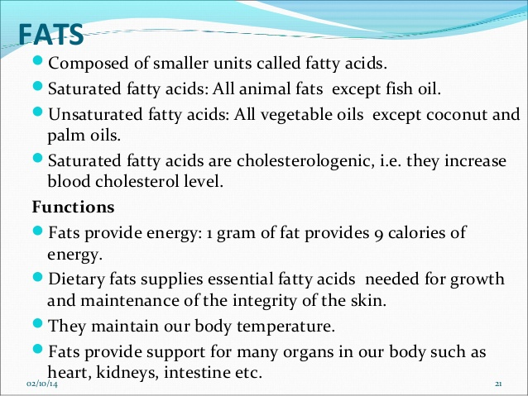
m

Slide 21
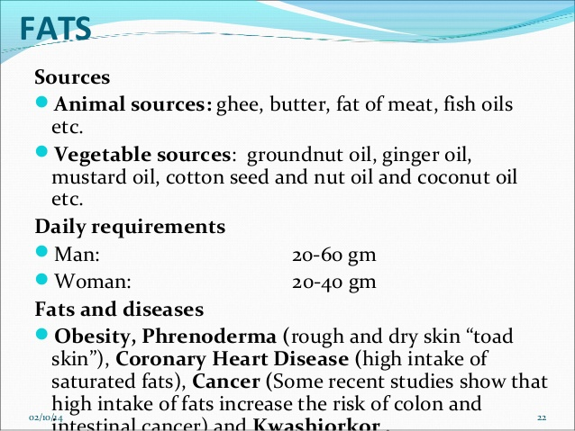

Slide 22
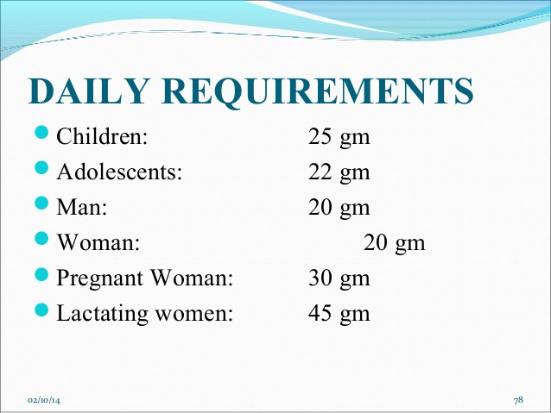

Slide 23
Vitamins
Organic compounds needed by the body in small, but essential amounts
Cannot be synthesized by the body in sufficient amounts so must be provided by food.
Vitamins do not yield energy but enable the body to use other nutrients.

Slide 24
Class work
Fat soluble vitamins:
Water soluble vitamins:

Slide 25


Types of vitamins
Fat soluble vitamins : Vitamins A,D ,E, K
Water soluble vitamins : Vitamins of B-group and vitamin C

Slide 26
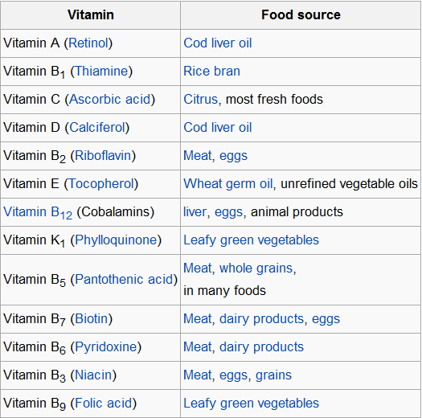

Slide 27
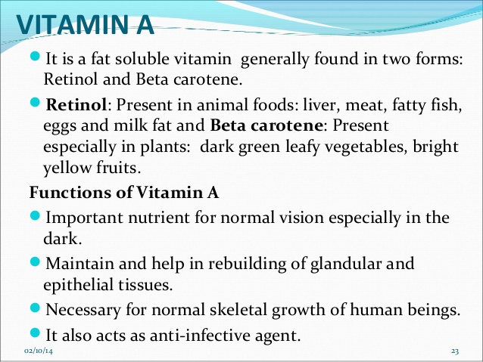

Slide 28
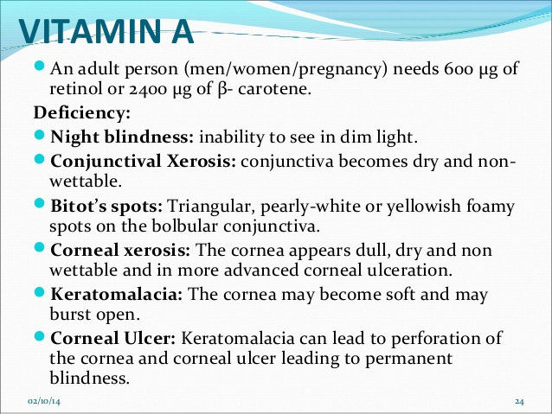

Slide 29
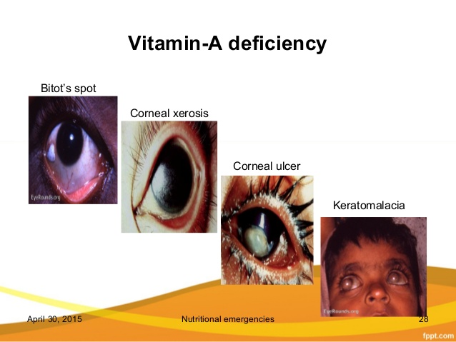

Slide 30
Toxicity
Nausea
Vomiting
Anorexia
Sleep disorders
Skin desquamation
Enlarged liver

Slide 31
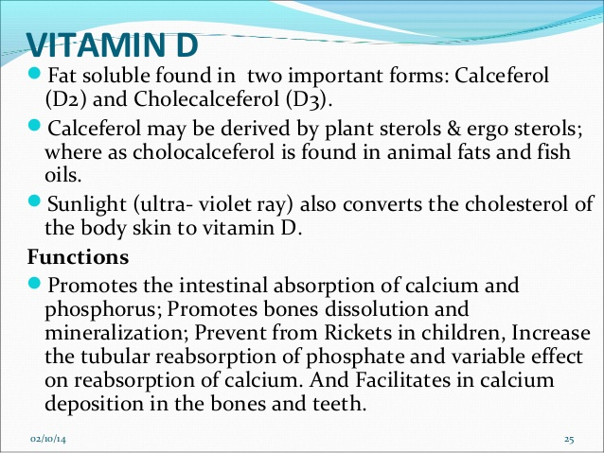

Slide 32
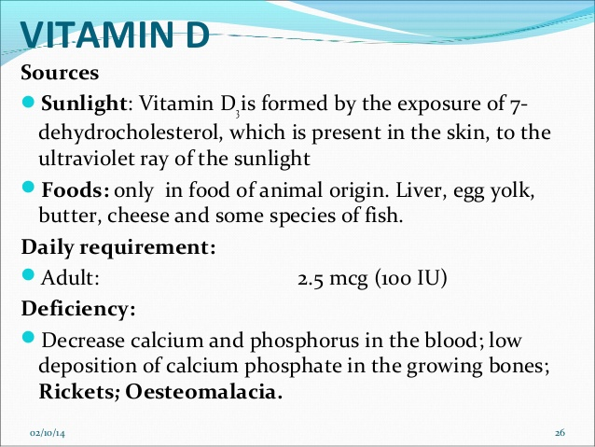

Slide 33
Daily requirements
Adults: 2.5 mcg (100 IU)
Infants and children : 5.0 mcg (200 IU)
Pregnancy and lactation :10.0 mcg (400IU)

Slide 34
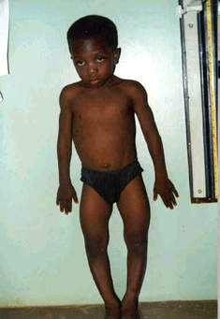
Rickets:
Observed in young children between the age of six months and two years.
There is reduced calcification of growing bones, characterized by growth failure, bone deformity, muscular hypotonia, tetany and convulsions due to hypo-calcemia.
Boney deformities include curved leg, deformed pelvis, pigeon chest, kyphoscoliosis,etc.

Slide 35
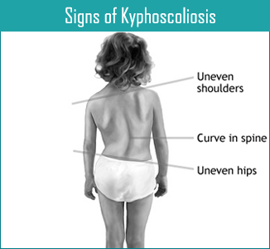

Slide 36
Osteomalacia
Softening of the bones , typically through a deficiency of vitamin D or calcium.
In adults, occurs mainly in women, esp during pregnancy and lactation when requirements of vit D are increased.

Slide 37
Excess
Anorexia
Nausea
Vomiting
Thirst
Drowsiness
Cardiac arrhythmias
The effects are due to hypercalcemia induced by increased intestinal absorption and mobilization of calcium from bone.

Slide 38
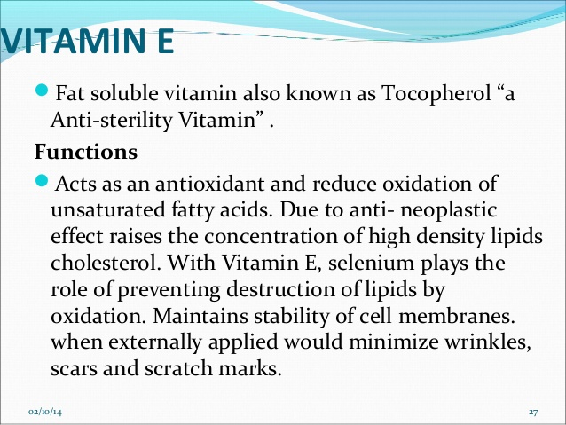

Slide 39
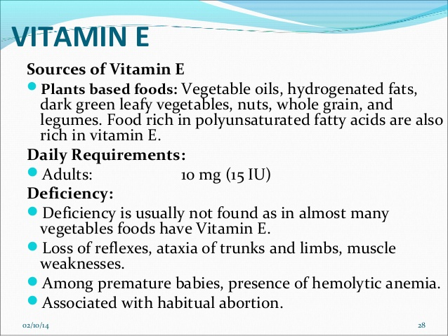

Slide 40
Excess
Some research suggests increased chance of prostrate cancer in men.
Nausea
Diarrhea
Stomach cramps
Fatigue
Weakness
Headache
Blurred vision
Rash
Bruising
Bleeding

Slide 41
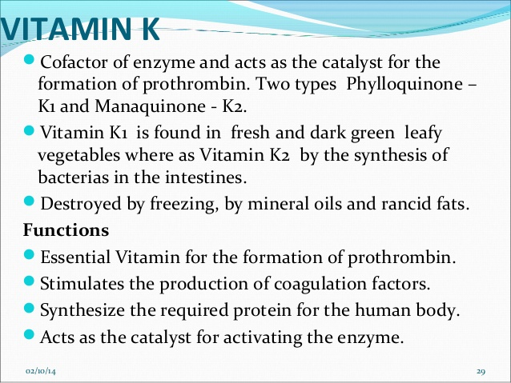

Slide 42
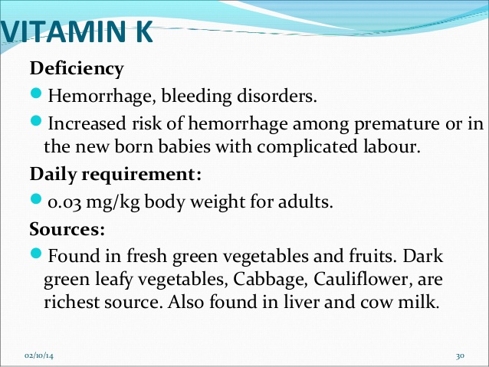

Slide 43
Vitamin C
Known as ascorbic acid and is water soluble
It is most unstable of all vitamins and rapidly destroyed by high temperature, oxidation, drying and storage.
Functions
Helps in absorption of iron
Anti- infective, helps in wound healing and formation of scar tissue
Is potent antioxidant
Absorption, mobilization and distribution of metal ions.
Growth, development and repair of all body cells
Formation of collagen and maintenance of cartilage, bones and teeth

Slide 44
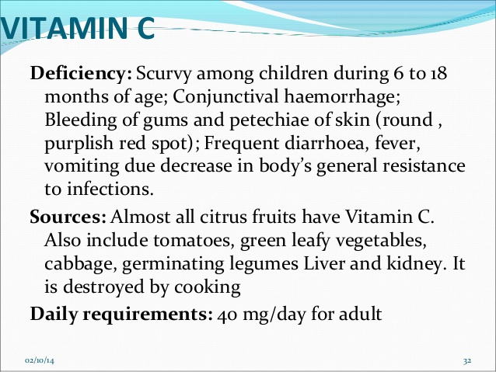

Slide 45
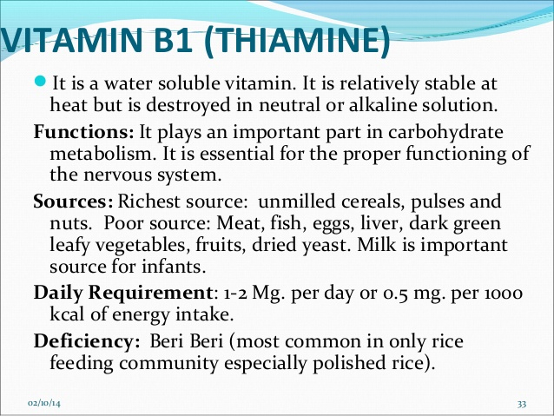

Slide 46
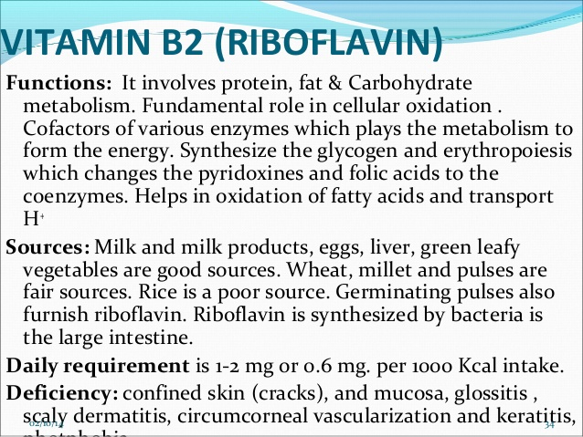

Slide 47
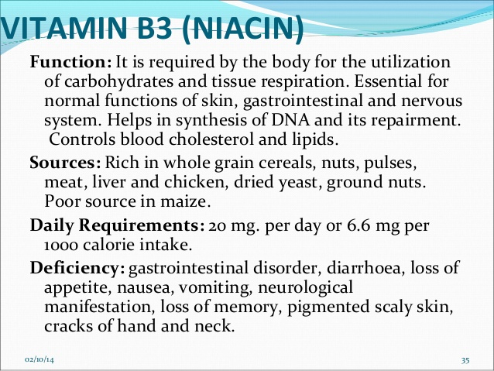

Slide 48
4Ds
Diarrhoea
Dementia
Dermatitis
Death

Slide 49
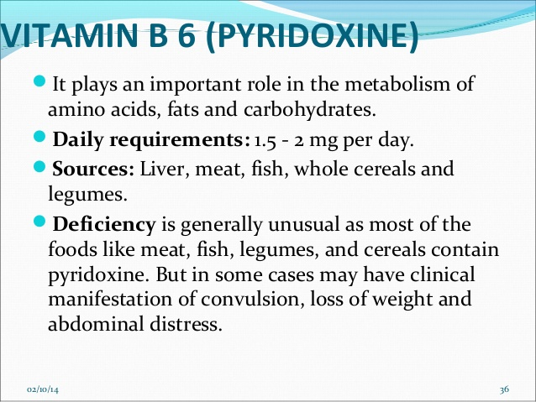

Slide 50
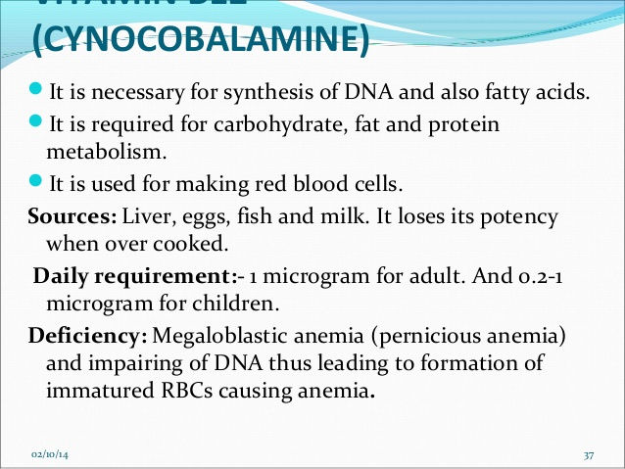
Vitamin B12

Slide 51
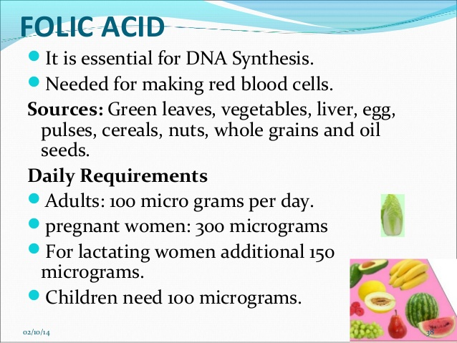

Slide 52
Minerals
Food Sources:
  Meats, beans, nuts, fruits, vegetables, dairy products, and grains.
Functions in the Body:
  The body depends on minerals for practically every process necessary for life.
  Minerals actually become part of the body.
  The body requires 16 minerals daily.

Slide 53
Minerals
Calcium
Phosphorus
Magnesium
Sodium
Potassium
Iron
Others include:
  Iodine, Zinc, Copper, Sulfur, Chloride, etc.

Slide 54
Calcium and phosphorus
Food Sources:
  Dairy Products: milk, cheese, ice cream, green leafy vegetables, and other processed fish eaten with bones.
Function in the Body:
  Helps build and maintain healthy bones and teeth.
  Helps heart, nerves, and muscles work properly.
Deficiency (lack) of calcium & phosphorus leads to osteoporosis.
Requirements: A daily intake of 400 to 500 mg (both calcium and phosphorus)

Slide 55
Iron
Food sources
  Liver, kidney, heart, meat, egg yolk, dried beans and peas, spinach, dried fruit, whole-grain & enriched breads & cereals, nuts.
Function in the Body:
  Helps make hemoglobin in red blood cells.
  Helps cells used oxygen.
Deficiency (lack) of iron leads to anemia, reduced resistance to infection, diminished work performance, Increased morbidity and mortality, etc

Slide 56
Requirements of iron for different age group
Age group | Iron in mg that should be absorbed (daily needs)
Infants (5-12mnths) | 0.7
Children (1-12 yrs) | 1.0
Adolescents (13-16yrs) | 1.8 (males) 2.4 (female)
Adults , male | 0.9
Adult , females Menstruation Pregnancy (first half) (second half) Lactation Post menopause | 2.8 0.8 3.5 2.4 0.7

Slide 57
Sodium
Food sources
  Processed & prepared foods. Canned vegetables, soups, pickles, lunch meats, sausage, and frozen foods. Salt/sodium is used to preserve food and improve the taste and texture of food.
  Condiments. Table salt, soy sauce, ketchup, mustard, BBQ sauce, steak sauce…
  Natural sources. Some meats, poultry, dairy products (esp. cheeses) and vegetables.

Slide 58
Sodium
Function in the Body:
  Helps maintain the right balance of fluids in your body.
  Helps transmit nerve impulses.
  Influences the contraction and relaxation of muscles.
Excess sodium can lead to hypertension (high blood pressure), a condition that can lead to cardiovascular and kidney diseases.
Depletion of sodium cause Muscular Cramps
Adult requirements: 10-15 gm

Slide 59
Magnesium
Magnesium is a constituent of bones, and is present in all body cells.
Essential for normal metabolism of calcium and potassium.
Deficiency may occur in chronic alcoholics, cirrhosis of liver, PEM, etc
Requirements: 200-300mg/day for adults.

Slide 60
Iodine
It is a essential micronutrients.
Required for the synthesis of the thyroid hormones, thyroxine (T4) and triiodothyronine (T3) containing respectively 4 and 3 atoms of iodine.
Essential in minute amounts for the normal growth and development and well being of all human beings.
Sources: Best sources are sea foods (sea fish, sea salt) and cod liver oil. Smaller amounts occur in milk, meat, vegetables, cereals,etc.
Requirements: 150mg/day

Slide 61
Goitrogens
Goitrogens are chemical substances leading to development of goitre.
Interfere with iodine utilization by the thyroid gland.
May occur in food and water like cabbage, cauliflower ,etc

Slide 62
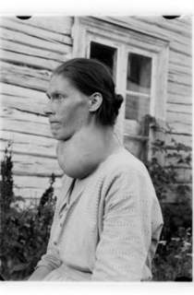
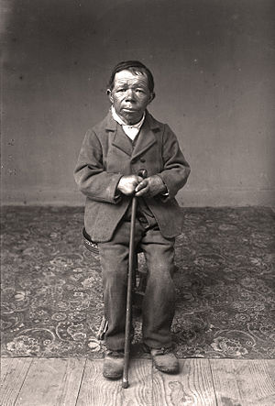
Deficiency
Iodine deficiency disorders
Goitre
Hypothyroidism
Retarded physical development and impaired mental function
Increased rate of spontaneous abortion and still birth
cretinism including dwarfism and severe mental retardation
(severe hypothyroidism in an infant and child and occurs as a result of maternal iodine deficiency)

Slide 63
Fluorine
Most abundant element in nature
About 96% of the fluoride in the body is found in bones and teeth.
Essential for the normal mineralization of bones and formation of dental enamel.
Sources
Drinking water (major source)
Foods (sea fish, cheese, tea, etc)

Slide 64
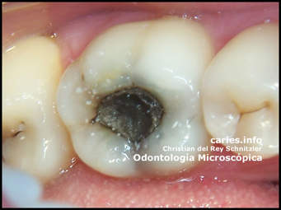
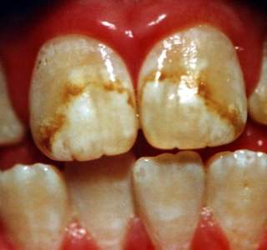
Deficiency
Dental caries
Excess
Dental and skeletal fluorosis
Requirements
The recommended level of fluorides in drinking water is accepted as 0.5 to 0.8 mg per litre.

Slide 65
Water
Almost every part of the body contains large amount of water.
A 50 kg adult contain about 31 liters of water.
A 10 kg child contains about 8 liters of water.
Human beings can live without food for a few weeks, but they cannot live without water for more than a few days. That is why giving drink is so important when people lose a lot of water, such as during diarrhea.

Slide 66
Needs of water
To make body cells and fluids, such as blood, digestive juices and tears;
For body processes, such as digestion, which take place in water;
To keep the lining of the mouth, intestine, lungs and other parts of the body moist and healthy;
For urine which carries away body waste;
For sweat to cool the body.

Slide 67
Water requirement
An adult needs about 2-3 liters of water a day. People need extra water when-
They sweat a lot during hot weather, or when they take a lot of exercise;
They have a fever;
They lose water because of diarrhea or vomiting.
A breastfeeding mother may feel more thirsty than usual.

Slide 68
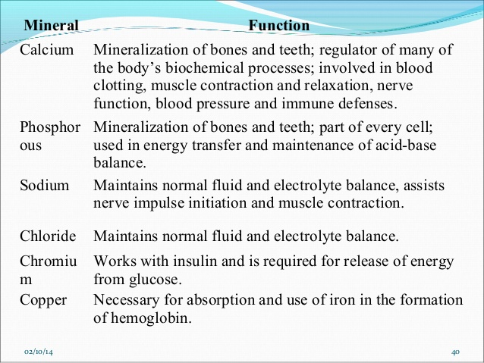

Slide 69
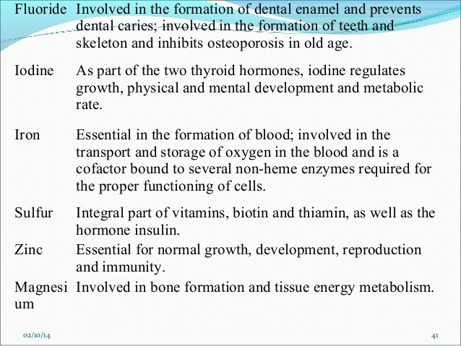

Slide 70


