Slide 1
Nutrition In Adolescence

Slide 2
Introduction
Adolescence :
It is considered as a period of transition from childhood to adulthood.
It is characterized by rapid physical growth, significant physical, emotional, psychological and spiritual changes.
During the period of adolescence that nutrient needs are the greatest.

Slide 3
Period of adolescence :
Acc. to WHO,
Adolescence : 10 – 19 years
Early Adolescence : 10 – 13 years
Middle adolescence : 14 – 16 years
Late adolescence : 17 – 19 years

Slide 4
Nutrition requirement in adolescence:
Total nutrient needs are higher during adolescence than any other time in the lifecycle.
Failure to consume an adequate diet at this time can result in
  delayed sexual maturation
  can arrest or slow linear growth.

Slide 5
Nutrition is also important during this time to help to prevent adult diet-related chronic diseases
  such as cardiovascular disease, cancer, and osteoporosis.
At the peak of the adolescent growth, the nutritional requirements may be twice as high as those of the remaining period of adolescence.

Slide 6
Energy and nutrient need
Energy requirement :
  a mean energy intake
    for females ages 12-19 years : 1793 calories/day
    for males ages 12-19 years : 2843 calories/day
Chronically low energy intakes can lead to delayed puberty or growth retardation.

Slide 7
Protein:
  Protein requirements per unit of height are highest for females in the 11 to 14 year age range and for males in the 15 to 18 year age range
  When protein intakes are consistently inadequate,
  reductions in linear growth, delays in sexual maturation, and reduced accumulation of lean body mass may be seen.

Slide 8
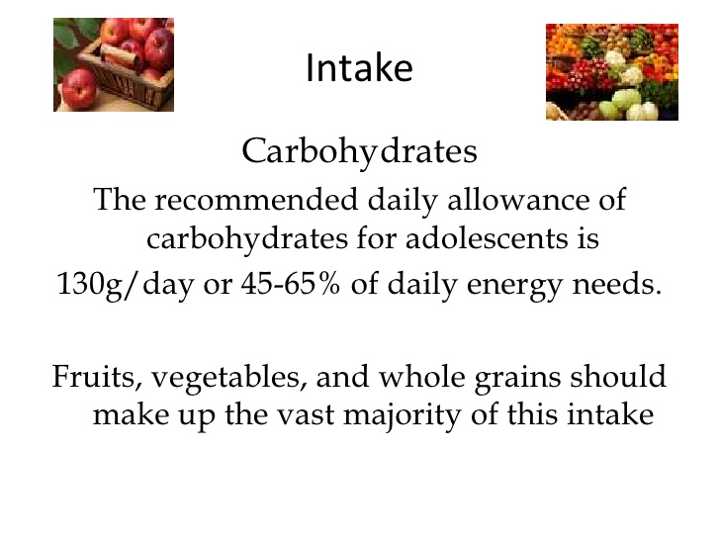
Carbohydrates:
Adolescents consume approximately 53% of their calories as carbohydrate.

Slide 9
Calcium
Calcium needs during adolescence are greater than they are in either childhood or adulthood because of the dramatic increase in skeletal growth.
About 45% of peak bone mass is attained during adolescence
Adequate calcium intake is important
  for the development of dense bone mass
  the reduction of the lifetime risk of fractures and osteoporosis

Slide 10
Calcium intake of adolescent girls;
  796 mg/day for ages 12-15
  822 mg/day for ages 16-19
Milk provides the greatest amount of calcium in the diets of adolescents.

Slide 11
Iron
Iron is vital for transporting oxygen in the bloodstream and for preventing anemia.
For both male and female adolescents, the need for iron increases with rapid growth and the expansion of blood volume and muscle mass.
The onset of menstruation imposes additional iron needs for girls.

Slide 12
Iron needs are highest during the adolescent growth spurt in males and after menarche in females.
The most common dietary sources of iron in diets of adolescents included ready-to-eat cereal, bread, and beef.

Slide 13
Zinc
Zinc is associated with more than 100 specific enzymes
Vital for protein formation and gene expression.
Zinc is important in adolescence because of its role in growth and sexual maturation.
Males who are zinc deficient experience growth failure and delayed sexual development.

Slide 14
Mild zinc deficiency have been found in 18% to 33% of female adolescents.
Vegetarians, are at highest risk for low intakes of zinc.
Zinc requirement for
  males and females ages 9-13 is 8 mg/day
  males and females ages 14-18 is 11 mg/day and 9 mg/day respectively.

Slide 15
Vitamins
1) Vitamin A
  Besides being important for normal vision, vitamin A plays a vital role in reproduction, growth, and immune function.
  Boys and girls ages 9-13 should consume 600 µg/day,
  Females ages 14-18, 700 µg/day and males ages 14-18, 900 µg/day.
  30% of adolescents had inadequate intakes of vitamin A.

Slide 16
  Most obvious symptom of inadequate vitamin A consumption is vision impairment, especially night blindness.
  Up to 500,000 children in developing countries go blind each year because of vitamin A deficiency.
  Top five dietary sources of vitamin A in the diets of adolescents are ready-to-eat cereal, milk, carrots, margarine, and cheese.

Slide 17
2) Vitamin E
Vitamin E is well known for its antioxidant properties, which become increasingly important as body mass expands during adolescence.
9-13 year olds is 11 mg/day and 15 mg/day for 14-18 year olds.

Slide 18
3)Vitamin C
Vitamin C is involved in the synthesis of collagen and other connective tissues.
For this reason, vitamin C is an important nutrient during adolescent growth and development.
45 mg/day for 9-13 year olds, 75 mg/day for males ages 14-18 and 65 mg/day for females ages 14-18.

Slide 19
Adolescents who use tobacco and other substances have poorer quality diets and consume fewer fruits and vegetables, which are primary sources of vitamin C.

Slide 20
Folate
Folate plays an integral role in DNA, RNA and protein synthesis. Thus, adolescents have increased requirements for folate during puberty.
300 µg/day for 9-13 year olds and 400 µg/day for 14-18 year olds.
Severe folate deficiency results in the development of megaloblastic anemia, which is rare among adolescents.

Slide 21
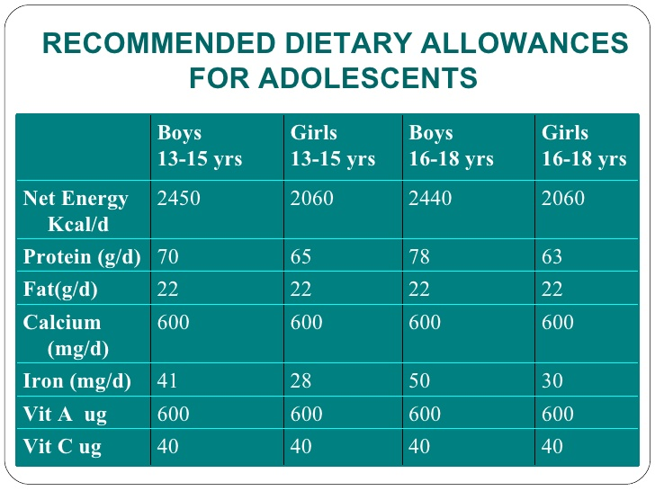

Slide 22
Nutritional problem that affects adolescence
Unhealthy eating habits
Undernutrition and pregnancy
Obesity and chronic disease
Micronutrient deficiency
Eating disorders

Slide 23
Prevention and Managment of Nutritional Disorder
Nutritional assessment
Control of iron deficiency anaemia,iron,vit. A and other micronutrient deficiency
Nutrition integration in antenatal and postnatal care for adolescents
Prevention and managment of obesity and eating disturbance
Managment of severe malnutrition

Slide 24
Conclusion
Encourage the good eating practices to the adolescence group.
Nutrition screening can be done to set the goal and develop a action plan.
Factors that contribute the poor eating habits should be avoided.

Slide 25
References
K. park. A text book of Preventive and Social medicine, 21th edition.
www.slideshare.net( assessed on 2016/9/17)
www.eufic.org
whqlibdoc.who.int/publications/2005

