Slide 1
PHS 211: Communicable Diseases
Sushila Baral
Assistant Professor
School of Health and Allied Sciences
Pokhara university

Slide 2
Course Description
Upon the successful completion of the course, students will be able to:
Describe common communicable diseases prevalent in Nepal,
Explain emerging communicable diseases in context of Nepal and world,
Identify cause and factors, mode of transmission of communicable diseases, and
Apply prevention and controlling measures of the communicable disease.

Slide 3
Unit I: Bacterial Diseases

Slide 4
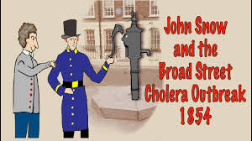
Cholera

Slide 5
Introduction
Cholera is an acute diarrhoeal infection caused by eating or drinking food or water that is contaminated with the bacterium Vibrio cholerae.
Cholera remains a global threat to public health and is an indicator of inequity and lack of social development. Researchers have estimated that every year, there are 1.3 to 4.0 million cases of cholera, and 21 000 to 143 000 deaths worldwide due to the infection. (WHO)
Notes:
https://www.who.int/health-topics/cholera#tab=tab_1 ( indicator of inequality- increasing function of level of income)

Slide 6
Introduction
Cholera is an extremely serious disease that can cause severe acute watery diarrhoea with severe dehydration. It takes between 12 hours and 5 days for a person to show symptoms after consuming contaminated food or water.
Cholera affects both children and adults and can kill within hours if untreated.

Slide 7
Introduction
The Vibrio cholera has two biotypes and two serotypes but both these are not so important from control point of view.
The first biotype E1 Tor is the main responsible for pandemic previously but both biotypes are responsible for cholera endemic in Africa and Asia.
V.Cholera is responsible for 5-10% of diarrhoea among hospitalized cases in all age group
Mostly affects among 2-9 years age group and mostly severe cases
In newly affected area, young adults is the sufferers
Notes:
Biotype- a group of organism having same genotype. Serotype- group of microorganism having same antigens composition on their surface.

Slide 8
Situation of Cholera in Nepal
As of 15th of August 2022 , a total of 52 cases of Cholera has been reported in Nepal from Kathmandu, Lalitpur, Bhaktapur, Nuwakot district and Dhading district. Two new cases of Cholera was detected in last 24 hours in 35 years old females from Kathmandu-21 and Dhading-2.
(https://reliefweb.int/report/nepal/epidemiology-and-disease-control-division-cholera-outbreak-kathmandu-valley-15th-august-2022#:~:text=As%20of%2015th%20of%20August,%2D21%20and%20Dhading%2D2.)
Notes:
https://reliefweb.int/report/nepal/epidemiology-and-disease-control-division-cholera-outbreak-kathmandu-valley-15th-august-2022#:~:text=As%20of%2015th%20of%20August,%2D21%20and%20Dhading%2D2.

Slide 9
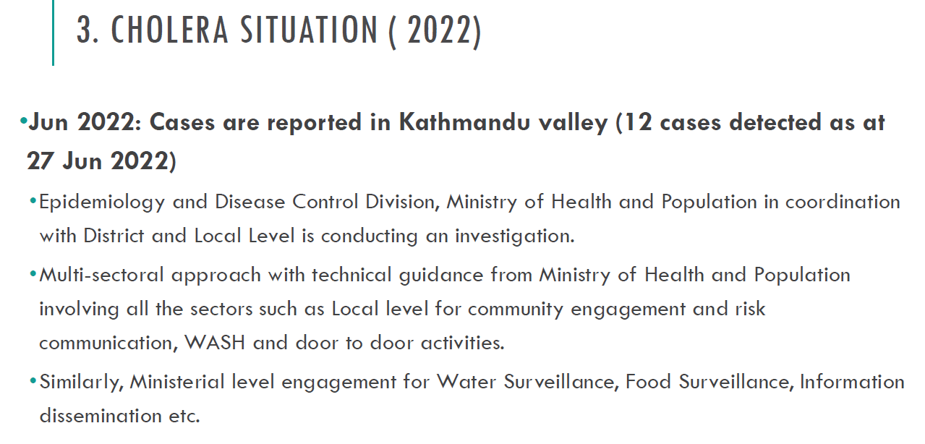

Slide 10
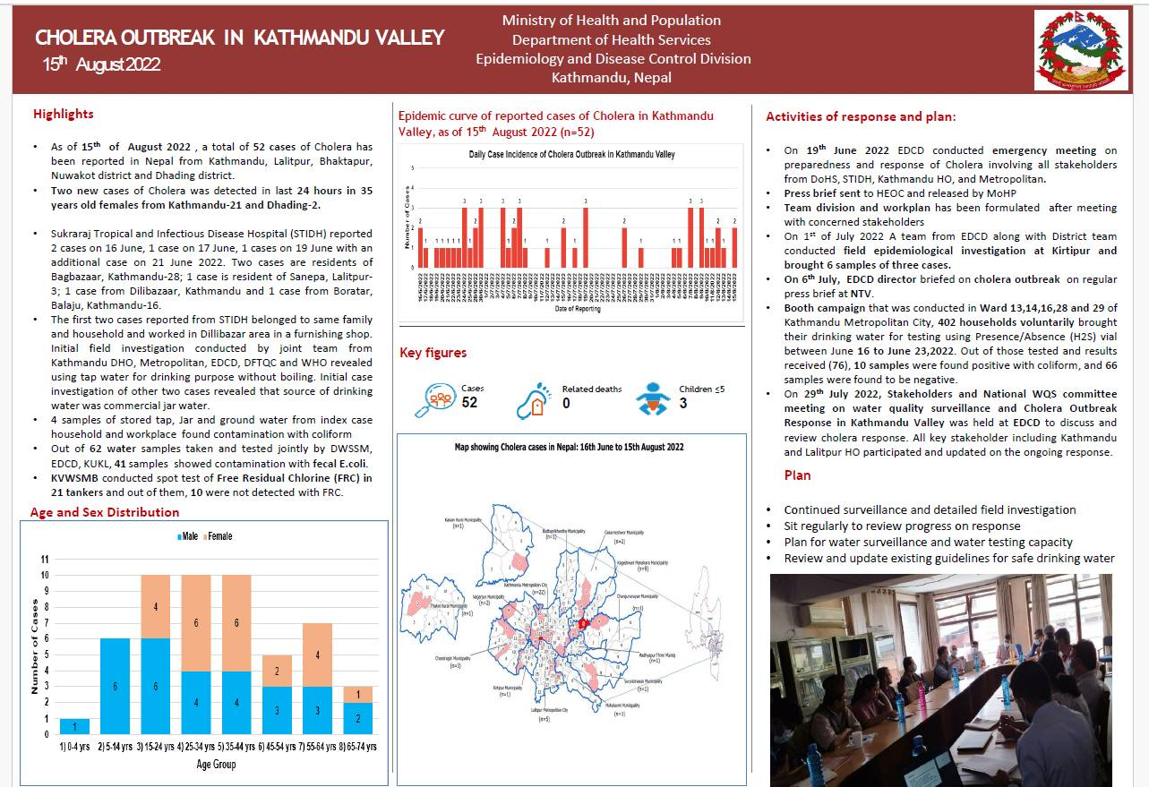

Slide 11
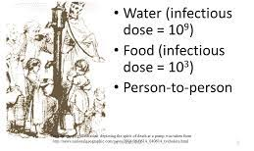
Mode of transmission:
It is a water and food borne disease
The disease transmitted from one person to another person in over crowded and unhygienic conditions
V. cholera adhere to mucosa of small intestine, multiply and produce enterotoxin causing diarrhea.
Notes:
Enterotoxin- substance that is harmful to your digestive system. Enterotoxin enters ur stomach and intestine if u eat contaminated food or water and cause cramp, nausea, vomit, diarrhea

Slide 12
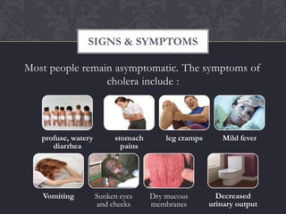
Signs and symptoms
Large and frequently discharge of watery diarrhoea associated with vomiting
Notes:
Profuse- प्रशस्त

Slide 13
Prevention
Drinking and use safe water
Wash hands often soap and safe water
Use latrines or bury feces; do not defecate in any body of water
Cook food well (especially seafood), keep it covered, eat it hot and peel fruits and vegetables
Clean up safety- in the kitchen and in places where the family bathes and washes clothes

Slide 14
Prevention
Basic health education and hygiene
Mass chemoprophylaxis
Provision of safe water and sanitation
Comprehensive multidisciplinary approach: water, sanitation, education and communication.
Oral cholera vaccines is used in conjunction with improvements in water and sanitation to control cholera outbreaks and for prevention in areas known to be high risk for cholera.

Slide 15
Treatment
Tetracycline, I.V saline and ORS very frequently

Slide 16


Slide 17
Enteric Fever

Slide 18
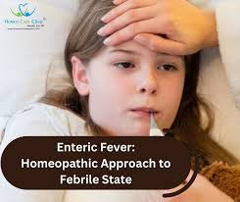
Introduction
It is a systemic infection with typical continuous fever for 3 to 4 weeks.
Enteric fever includes both typhoid and paratyphoid fever.
It may be sporadic, endemic or epidemic in nature.

Slide 19
Problem Statement
Enteric fever, also known as typhoid fever, is a common infectious disease in low and middle income countries.
About 14 million people are affected annually with 136 000 deaths, mainly in low and middle income countries, according to estimates from the Global Burden of Disease Study in 2017.
GBD 2017 Typhoid and Paratyphoid Collaborators The global burden of typhoid and paratyphoid fevers: a systematic analysis for the Global Burden of Disease Study 2017. Lancet Infect Dis2019;19:369-81. doi:10.1016/S1473-3099(18)30685-6 pmid:30792131

Slide 20
Contd..
According to the recent estimates published in 2014, approximately 21 million cases and 222000 typhoid-related deaths occur annually worldwide.
(According to the World Health Organization (WHO) report published in 2014)

Slide 21
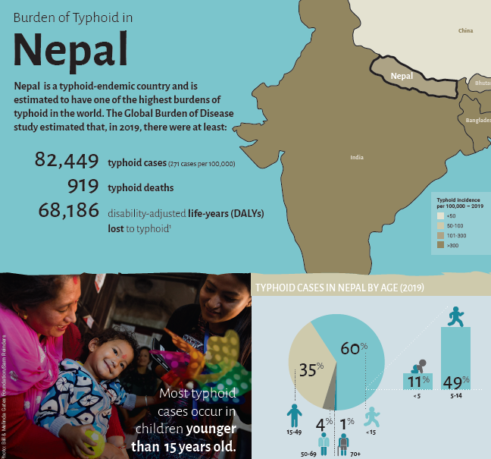
Problem Statement in Nepal

Slide 22
Problem Statement in Nepal
In 2001 outbreak of typhoid occurred only in Dhanusa district in Shrawan. 100 cases were diagnosed by widal test.
In 2002 outbreak in Chitwan district occurred with total 5835 cases out of which 4 deaths occurred.

Slide 23
Epidemiological Determinants
Agent:
Salmonella typhi and Salmonella paratyphi A & Salmonella paratyphi B
Can be killed by drying, pasteurization & common disinfectants.

Slide 24
Contd..
Reservoir of Infection:
Cases: mild, moderate or severe.
Case is infectious as long as bacilli appear in the stool or urine.
Carrier: Can be temporary or chronic.
In most of the cases, organism persist in gall bladder & in biliary tract.
A chronic carrier case can be expected to develop in 2 to 5% of the cases.
Chronic carrier can excrete bacilli for many years even upto 50 yrs.

Slide 25
Contd..
Source of Infection:
Feces & urine of cases or carrier
Secondary sources-contaminated water, food fingers & flies.
Not excreted in sputum.

Slide 26
Host Factor:
a) Age: Any age
Highest in 5 to 19 years of age.
b) Sex: More males than females due to exposure.
Carrier state higher in female.
c) Immunity: Antibody may be stimulated by infection or immunization.
Natural typhoid fever does not always confer solid immunity; second attack may occur when challenged with large oral dose.
Gastric acidity & local intestinal immunity provide resistance.

Slide 27
Environmental & Social Factor:
Peak from July to September (rainy season)
Outside human body, bacilli are found in water, ice, food, milk & soil for varying period of time.
Typhoid bacilli do not multiply in water, it might die within 48 hours, but some may survive for about 7 days.
They may survive for over a month in ice/cream.

Slide 28
Contd..
Food being bad conductor of heat provide shelter to bacilli which may multiply & survive for sometimes in food.
Grows rapidly in milk without altering its taste & appearance
Vegetables grown in sewage farm or washed in contaminated water are a positive health hazard.

Slide 29
Incubation period
Usually 10 to 14 days.
May be short as 3 days or long as 3 weeks depending on the dose of bacilli ingested.

Slide 30
Mode of Transmission:
Fecal-oral route/urine-oral route
Contaminated finger, food, soil, water, milk, flies etc.

Slide 31
Clinical features
In children with abrupt chills & high fever.
At prodromal stage- Malaise, headache, cough & sore throat often with abdominal pain & constipation.
After 7 to 10 days, fever reaches a plateau & patient look toxic appearing exhausted.
May be constipation on early stage or pea soup diarrhoea.
If no complication, patient condition improves over 7 to 10 days.
Relapse may occur for up to 2 weeks after termination of therapy.
Notes:
Malaise-discomfort

Slide 32
Contd..
Rash (rose spot) commonly appear during 2nd week of disease. Especially found in trunk region which disappears in 3-4 days.
Intestinal hemorrhage may cause with drop in temperature & sign of shock, followed by dark or fresh blood in the stool.
Intestinal perforation may cause after 3rd week.

Slide 33
Diagnosis
Diagnosis of typhoid fever is made by
Blood, bone marrow, or stool cultures test (microbiological)
Widal test (serological)
Slide agglutination
Antimicrobial susceptibility testing (quick and reliable)

Slide 34
Control of Typhoid
Control of Reservoir
Immunization

Slide 35
Control of reservoir
Cases:
Cases should be isolated till three bacteriologically negative stools & urine report are obtained on 3 separate days.
Treatment: Fluoroquinolone (More effective than former first line drug: Chloramphenicol, Ampicillin, Amoxicillin & TMP-SMX)
Disinfection: Stool & urine. Disinfection with 5% cresol for at least 2 hours.
All soiled clothes should be soaked in solution of 2% chlorine & steam sterilized.
Nurses & doctors should not forget too disinfect their hands.
Notes:
Trimethoprim/sulfamethoxazole, also known as co-trimoxazole (TMT_SMX)

Slide 36
Contd..
b) Carrier:
Treatment: Carrier should be given an intensive course of Ampicillin or Amoxicillin together with probenecid for 6 weeks.
Surgery: Cholectectomy, Nephrectomy
Heath Education
Sanitation
Notes:
Probenecid-prevent gout attack(Uric acid). Cholectectomy-remove gallbladder, Nephrectomy- remove part of kidney

Slide 37
Contd..
Immunization- Typhoid Vaccine
Not 100% but lowers incidence & seriousness of infection.
Can be given in any age more than 2 years.
Recommended to high-risk groups: those living in endemic areas, household contacts, hospital staff, school children, travellers etc.

Slide 38
Contd..
Vaccination
First type: Vi Polysaccharide Vaccine
Contains killed Salmonella typhi bacteria.
Administered by a shot.
Second type: The Ty21a Vaccine
Contains a live but weakened strain of the Salmonella bacteria that causes typhoid fever.
Taken orally.

Slide 39
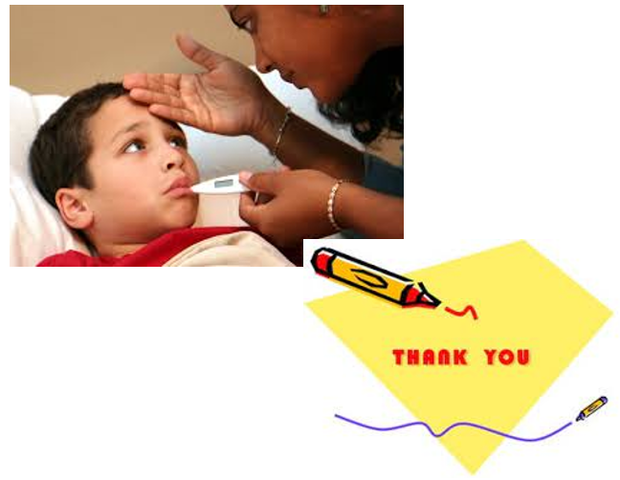

Slide 40
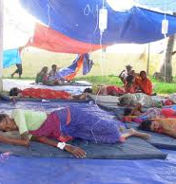
Diarrhea

Slide 41
Introduction
According to WHO, Diarrhea is defined as “Passage of 3 or more loose stools per day or passing more stools than normal for the age”.
For adults stool weight >200 g/d can generally be considered diarrhea.
Frequent passage of normal stool is no diarrhea.

Slide 42
CLINICAL TYPES OF DIARRHOEAL DISEASE
Acute watery diarrhoea - which lasts several hours to days; the main danger is dehydration, weight loss also occurs if feeding is not continued. The pathogens that usually cause acute diarrhoea include V. cholerae or E. coli bacteria, as well as rotavirus.
Acute bloody diarrhoea - which is also called dysentery the main dangers are damage of the intestinal mucosa, sepsis and malnutrition; other complications including dehydration, may also occur. It is marked by visible blood in the stools. The most common cause of bloody diarrhoea is shigella,

Slide 43
Contd..
Persistent diarrhoea - which lasts 14 days or longer. The main risk is malnutrition and serious non-intestinal infection, dehydration may also occur. Persons with other illness, such as AIDS, are more likely to develop persistent diarrhoea.
Diarrhoea with severe malnutrition (Marasmus and Kwashiorkor) - The main dangers are severe systemic infection, dehydration, heart failure, and vitamin and mineral deficiency.

Slide 44
As per IMNCI national protocol, diarrhoea has been classified into three categories:
No Dehydration
Some Dehydration
Severe Dehydration
(Source: Annual Report DoHS, FY 2078/79)

Slide 45
Problem Statement-Global
Diarrhoeal disease is the second leading cause of death in children under five years old. It is both preventable and treatable.
Each year diarrhoea kills around 525 000 children under five.
A significant proportion of diarrhoeal disease can be prevented through safe drinking-water and adequate sanitation and hygiene.
Globally, there are nearly 1.7 billion cases of childhood diarrhoeal disease every year.
Diarrhoea is a leading cause of malnutrition in children under five years old.
Total deaths due to Diarrhoeal diseases of 370,000 children in 2019.
(Source: https://www.who.int/news-room/fact-sheets/detail/diarrhoeal-disease)

Slide 46
Problem Statement in Nepal
A total of 9,23,861 diarrhoeal cases were reported in FY 2078/79.
While there was a decreasing trend in diarrhoeal cases in all provinces in FY 2078/79.
More than three fourth (87.67%) were classified as having no dehydration, about one fifth (12%) some dehydration. Severe dehydration remained below 1% across all provinces and at national level as well.

Slide 47
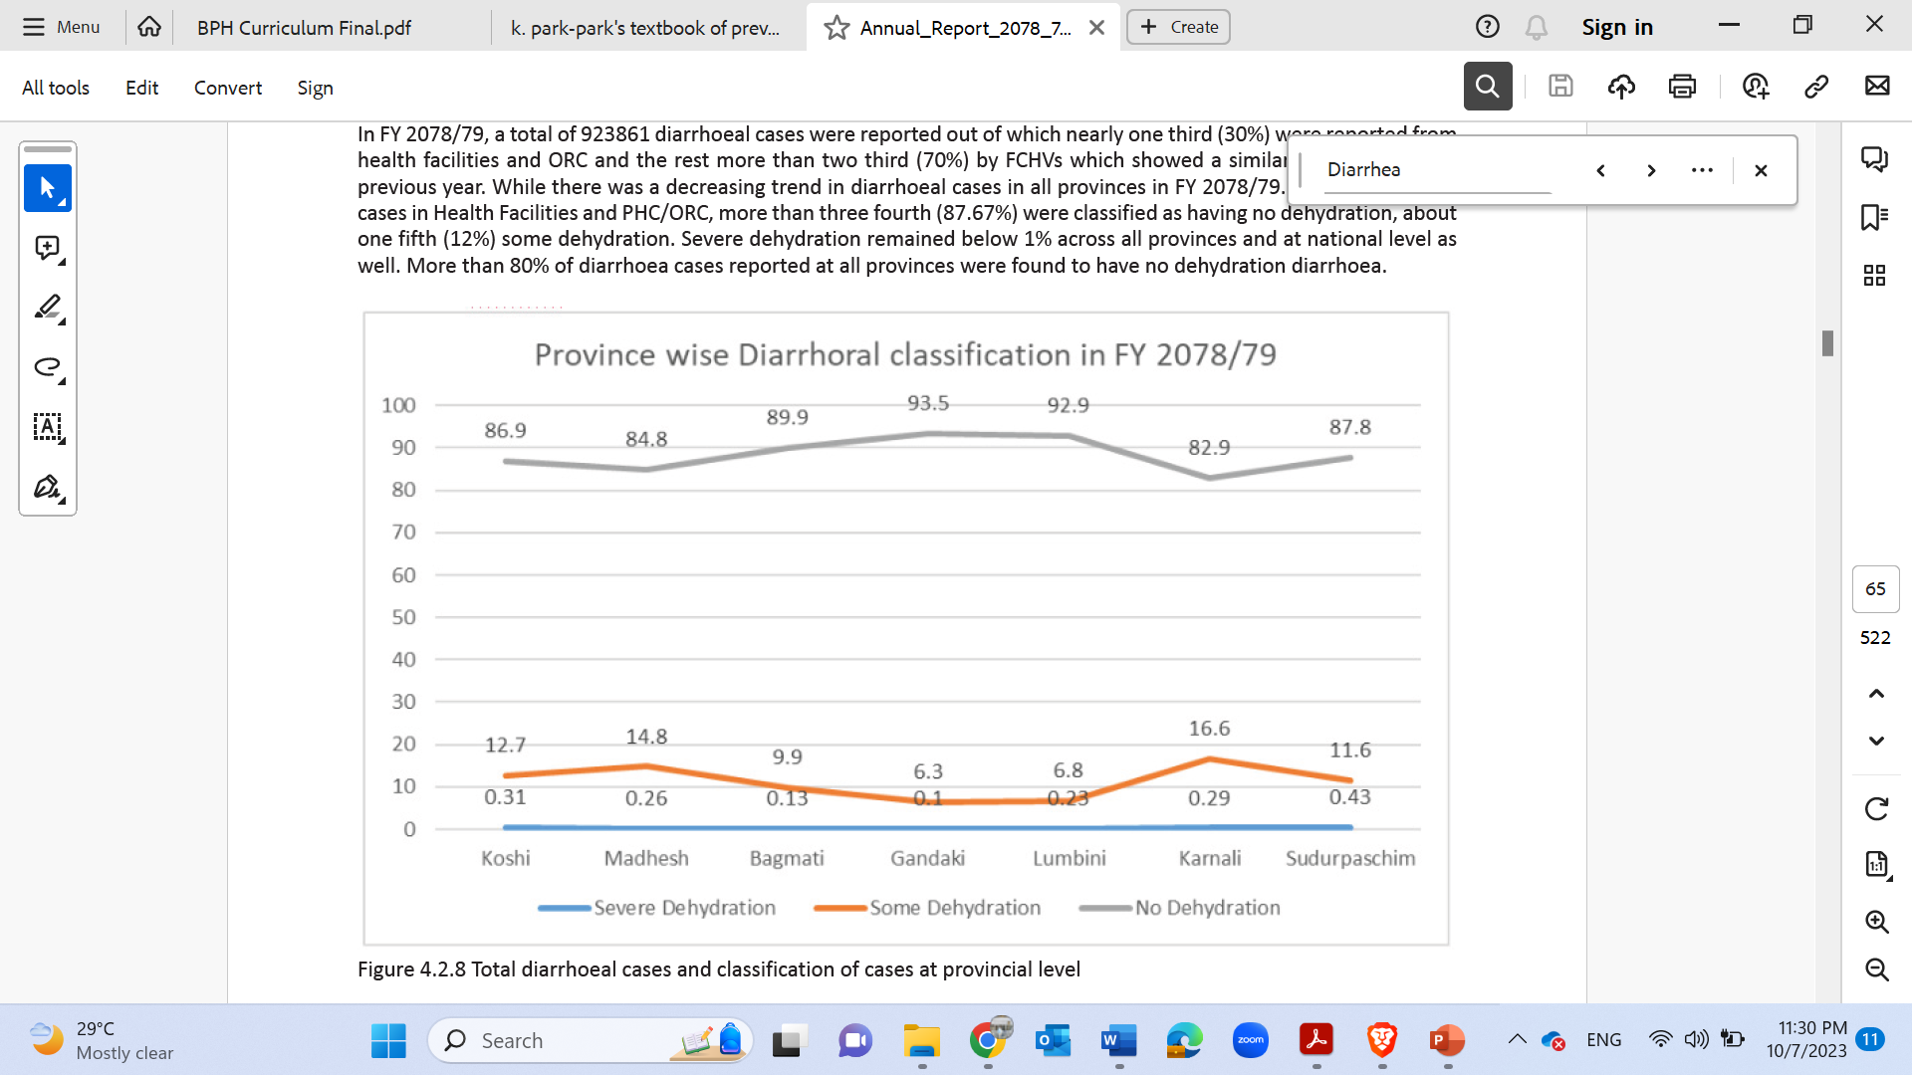

Slide 48
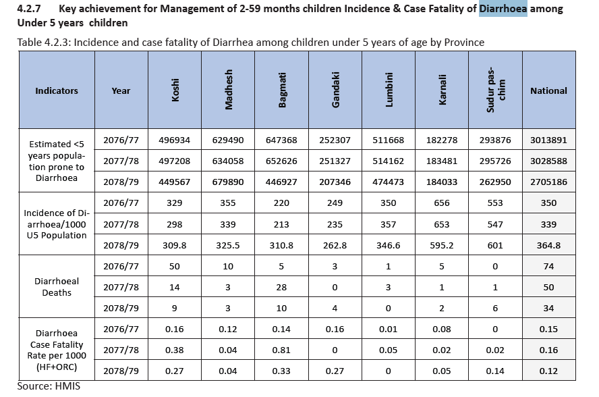
Notes:
Annual Report 78/79

Slide 49
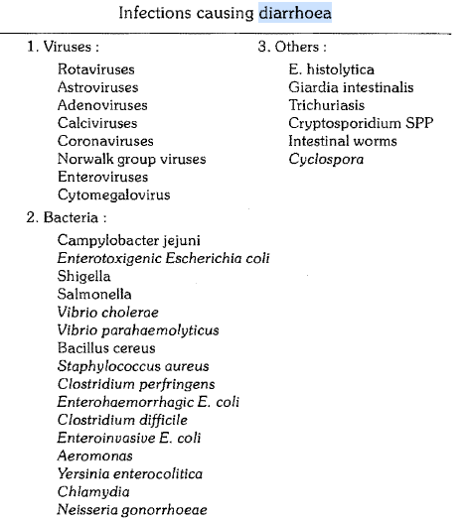
Epidemiological determinants
Agent factors:
Diarrhoea is almost universally infectious in origin. A wide assortment of organisms cause acute diarrhoea, and many of them have been discovered only in recent years such as rotaviruses and campylobacters.

Slide 50
Contd..
Host factors:
Diarrhoea is most common in children especially those between 6 months and 2 years.
Incidence is highest in the age group 6-11 months, when weaning occurs. It reflects the combined effects of declining levels of maternally acquired antibodies, the lack of active immunity in the infant, the introduction of contaminated food, and direct contact with human or animal feces when the infant starts to crawl.
Diarrhoea is more common in persons with malnutrition. Malnutrition leads to infection and infection to diarrhoea which is a well known vicious cycle.

Slide 51
Contd..
Environmental factors:
Frequently during the warm season, whereas viral diarrhoea, particularly diarrhoea caused by rotavirus peak during the winter.
In tropical areas, rotavirus diarrhoea occurs throughout the year, increasing in frequency during the winter season, whereas bacterial diarrhea peak during the warmer, rainy season.
Notes:
Escherichia coli (most common worldwide), Shigella, Salmonella, Campylobacter (most common in children), Yersinia, and Clostridium spp

Slide 52
Mode of transmission
Fecal – oral route
Ingestion of contaminated food, water or by contact with hands fecal contaminated
Reasons of causing diarrhea:
Inadequate water supply, poor personal and domestic hygiene
Improper food preparation and storage of food
Poor weaning practices – early cessation breast feeding, bottle feeding)
Malnutrition, immunodeficiency, immunological suppression
Genetic factors

Slide 53
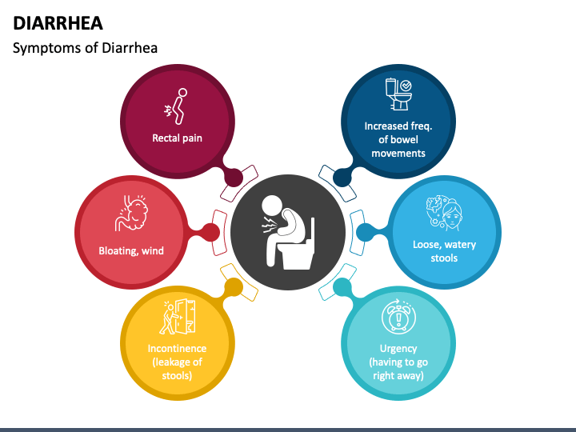
Common Signs and Symptoms
Loose watery stool with
Nausea and Vomiting
Loss of Appetite
Bloating and gas
Abdominal cramps and pain
Fever

Slide 54
Diagnostic Evaluation of Diarrhea
History taking
Physical examination
Stool examination
Stool culture
Blood tests

Slide 55
Prevention and Control of Diarrhea
Access to safe drinking water
Hand washing with soap
Use of improved sanitation
Exclusive breastfeeding for the first six months of life
Good personal and food hygiene

Slide 56
Prevention and Control of Diarrhea
Flies control
Health Education about how infections spread
Rotavirus Vaccination

Slide 57
Treatment of Diarrhea
Diarrhoeal cases treated with Zinc+ORS.
Use of oral rehydration therapy.
Vitamin A supplementation coverage rate (percent full coverage) 6 to 59 months.

Slide 58
Dysentery
Dysentery is a gastrointestinal disease. It is cause by bacterial or parasitic infections. Symptoms include diarrhea, fever, nausea, vomiting, weight loss and stomach cramps. Healthcare provider can diagnose dysentery with a stool culture. Treatment includes antibiotics.
It causes severe diarrhea that contains blood or mucus. There are two main types of dysentery:

Slide 59
Types
Bacillary dysentery: A bacterial infection causes bacillary dysentery. Some of the most common bacteria that cause bacillary dysentery include Shigella, Salmonella, Campylobacter and Escherichia coli (E. coli). Bacillary dysentery is the most common type of dysentery.
Amoebic dysentery (amoebiasis): The parasite Entamoeba histolytica (E. histolytica) is one of the main causes of amoebic dysentery. Other parasites that cause amoebic dysentery include Balantidium coli (B. coli) and strongyloidiasis.

Slide 60
Who does dysentery affect?
Anyone can get dysentery. It’s a more common condition in tropical areas of the world with poor water sanitation.Water sanitation is a process that cleans and purifies water, so it’s safe to drink.

Slide 61
Symptoms of dysentery
Most people who have amoebic dysentery don’t have any symptoms.
Mild symptoms of amoebic dysentery may include:
Diarrhea.
High fever
Nausea and Vomiting
Weight loss.
Upset stomach.
In rare cases, the parasite may move to other areas of your body and cause an abscess

Slide 62
Bacillary dysentery
Symptoms of bacillary dysentery may include:
Diarrhea containing blood or mucus.
High fever.
Nausea and vomiting.
Painful stomach cramps (abdominal pain).
If you have severe dysentery, complications may include extreme inflammation, widening (dilation) of your large intestine and acute kidney disease.

Slide 63
Classification of ARI
ARI is often classified by clinical syndromes depending on the site of infection and referred to as:
1. ARI of upper (AURI)- Acute upper respiratory tract infection
2. ARI of lower (ALRI) – Acute lower respiratory tract infection
Upper respiratory tract infection includes: Common cold, pharyngitis and otitis media
Lower respiratory tract infection include: epiglottis, laryngitis, laryngotracheitis, bronchitis, bronchiolitis and pneumonia.

Slide 64
Prevalence/ Magnitude of disease
Acute respiratory infections (ARI) are responsible for almost 20% of all deaths of children aged less than 5 years worldwide. The proportion of under-fives with ARI that are taken to an appropriate health-care provider is a key indicator for coverage of intervention and care-seeking, and provides critical inputs to the monitoring of progress towards child survival-related Sustainable Development Goals and Strategies. (WHO)

Slide 65
Acute respiratory infection (ARI) is responsible for about 30–50 percent of visits to health facilities and for about 20–30 percent of admissions to hospitals in Nepal for children under 5 years old. Incidence of ARI in children among under-five years of age is 344 per 1000 in Nepal.
Out of 286 children, more than half of children (60.8%) had Acute Respiratory Infection (ARI). Nearly one-fifth of the children had severe or very severe pneumonia.
Findings of study done in Kathmandu Valley
Acute Respiratory Infection (ARI) is a major problem among under-five children. The prevalence of ARI among the male child is more than that of female child. The prevalence was higher among the children of age less than 24 months. Children when get exposed to smoking while cooking have greater chance of acquiring ARI. Similarly, when the family members have respiratory tract infections, it could double the risk of ARI among the children.
Notes:
doi: 10.1371/journal.pone.0265933

Slide 66
Children aged 0 to 23 months had1.5 times higher odds of pneumonia compared to the age group 24 to 59 months (AOR = 1.5, CI 1.0–2.3) and children from rural area had 1.9 times the odds of having pneumonia than urban children (AOR = 1.9, CI 1.2–3.2). Underweight children had 2.3 times greater odds of having pneumonia than normal weight children (AOR = 2.3, CI 1.4–3.9). The odds of having pneumonia were 2.5 higher among children of current smoking mothers compared those with non-smoking mothers (AOR = 2.5, CI 1.1–5.7). (Dharel S)

Slide 67
Findings NDHS 2022
Symptoms of acute respiratory infection: 1% of children under age 5 had symptoms of acute respiratory infection (ARI) in the 2 weeks before the survey, and advice or treatment was sought for 75% of these children.
Acute respiratory infections are a major public health problem among children under age 5 in Nepal, and pneumonia has emerged as the leading cause of death among children in that age group. The Community-Based Integrated Management of Neonatal and Childhood Illness (CB-IMNCI) program focuses on five major diseases among children under age 5: pneumonia, diarrhea, malaria, measles, and malnutrition.

Slide 68
Children living in households where solid fuel is used for cooking (2%) were more likely to have symptoms of ARI in the 2 weeks preceding the survey than children in households using clean fuel and technology (1%).
The percentage of children with symptoms of ARI is higher in Karnali Province (4%) than in the other provinces (2% or less).

Slide 69
Source of Advice or Treatment for Symptoms of ARI
Among children under age 5 with symptoms of ARI, advice or treatment was more often sought from private medical sector facilities (60%) than from public sector facilities (19%) .
Among private sector facilities, the prominent sources are private clinics (40%) and pharmacies (25%). Health posts are the most common public sector source (14%).

Slide 70
Morbidity and Mortality due to ARI is very high because excessive cold in Mountain, Mother and kitchen smoke in hill, overcrowding in Urban and Terai.
Low birth weight, malnourished and non-breastfed children and those living in overcrowded conditions are at higher risk of getting pneumonia. These children are also at a higher risk of death from pneumonia.

Slide 71
Causes and Factors
Agents
Most common cause are:
1. Bacteria:
Bordetella Pertusis
Corynebacterium diphtheriae
Haemophilus Influenzae
Klebsiella pneumoniae
Streptococcus pyogenes /pneumoniae
Staphylococcus pyogenes
2.Virus:
Adenovirus- endemic types(1,2,5). Epidemic (3,4,7)
Entero virus (ECHO and Coxsackie)
Influenza A, B,C
Measles
Para influenza 1,2,3
Respiratory syncytial virus
Rhinovirus
Corona virus
3. Others:
Chalamydia type B
Coxiella Burnetti (Q fever)
Mycoplasma pneumoniae.

Slide 72
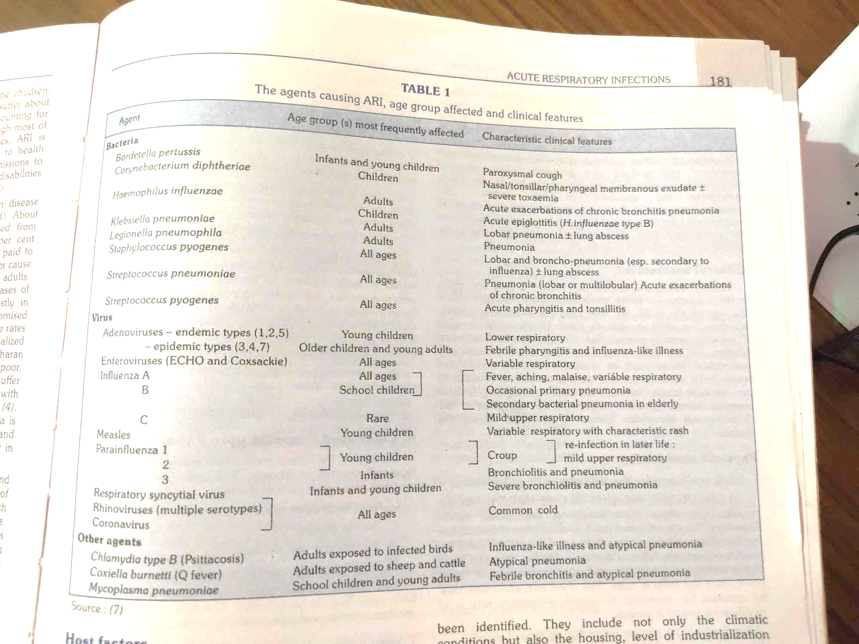

Slide 73
Host Factors:
Nutritional Status.
Individual Immunity.
Other repeated cross- infections otitis media measles, chicken- pox etc.
Male and female are equally affected but case incidence high in male.

Slide 74
Risk Factors/ Environmental factors.
Over crowding.
Poor nutrition.
Lower birth weight.
Intensive indoor smoke.
Maternal smoking.
Day care centers and pre school children.
Infection more common on urban/ slums area.

Slide 75
Sign and symptoms
According to classification of diseases, there are different signs and symptoms
1. Very severe disease – Not able to drink, convulsion, stridor in calm child , severe malnutrition
2. Severe pneumonia – chest indrawing
3. Pneumonia – No chest indrawing and Fast breathing (50 per minute or more if child 2-12 months; 40/ min or more if child 12 month -5 years
4. No pneumonia – No chest indrawing and no fast breathing (less than 50 per minutes if child 2 month-12 months; less than 40/min if child 12 month-5 years

Slide 76
Classification of ARI
WHO broadly classified the ARI cases into four:-
Classification | Under 2 months with cough or difficult breathing | 2 months to 5 years with cough or difficult breathing
No Pneumonia | Cough or cold without any of the signs of severe pneumonia and very severe disease. | Cough, or cold without any of the signs of pneumonia
Pneumonia | Any degree of pneumonia very high risk of death so need to be hospitalized. | Fast breathing without any signs of severe pneumonia or very severe disease.
Severe Pneumonia | Fast breathing, or severe chest indrawing, | Chest indrawing without any signs of very severe disease.
Very severe disease | Central cyanosis, stopped feeding completely, or convulsions, or extreme drowsiness, or stridor, or wheezing, or fever, or low body temperature | Central cyanosis, or not able to drink ay all, or convulsions,or extreme drowsiness, or stridor in a calm child , or wheezing, or severe undernutrition

Slide 77
As of WHO guidelines, for diagnosing the ARI (Pneumonia) cases, two principal signs are used
Fast breathing ( 60RR/ m or more – under 2 months baby, 50RR/m or more in 2-12 months children and 40RR/m or more in 1-5 years children)
Chest indrawing

Slide 78
Mode of transmission
- Droplet infection ( very acute and sensitive transmission.)
Common Clinical Features:
Cough (dry or productive)
Shortness of breath.
Fast breathing according to their age.
Abnormal sounds on the chest: Wheezing Stridors
Chest indrawing
Hyper pyrexia/hypothermia.
Convulsion/Not able to drink or feed.
Nasal flaring, Grunting.
Immediate death with in 4 hours.
Incubation Period: Few hours to 7days (Depends upon organism)

Slide 79
Complication:
Chronic Respiratory Tract Infection; COPD, Bronchial Asthma, TB etc.
Severe Malnutrition.
Meningitis, Encephalitis.
CSOM. (Chronic Superaitve Otitis Media.)
Septicemia.
Pleural Effusion.
Lung Abscess.
Empyma.
Respiratory obstruction and Death.

Slide 80
Prevention and Control.
Primordial Prevention: To make less risk pregnancy, Safe labour, and proper post natal care, Exclusive breast feeding to the child, Proper child care, timely Check up, survive on proper environmental condition etc.
Primary Prevention: To minimize relative risks, dust, smoke, over-crowding, cold, timely immunization; within 1 year etc.
Secondary Prevention: Early Diagnosis, Adequate treatment as well as continue primary and primordial prevention.

Slide 81
Cont…………………….
Treatment : Main aim of ARI treatment to treat by one drug to several Childhood disease (pneumonia, otitis Media, Bacillary Dysentery, Malaria and other skin disease)- Amoxicillin
Tertiary Prevention : Risk prevention and Disability limitation.( Multiple Drugs can be used for single disease.)

Slide 82
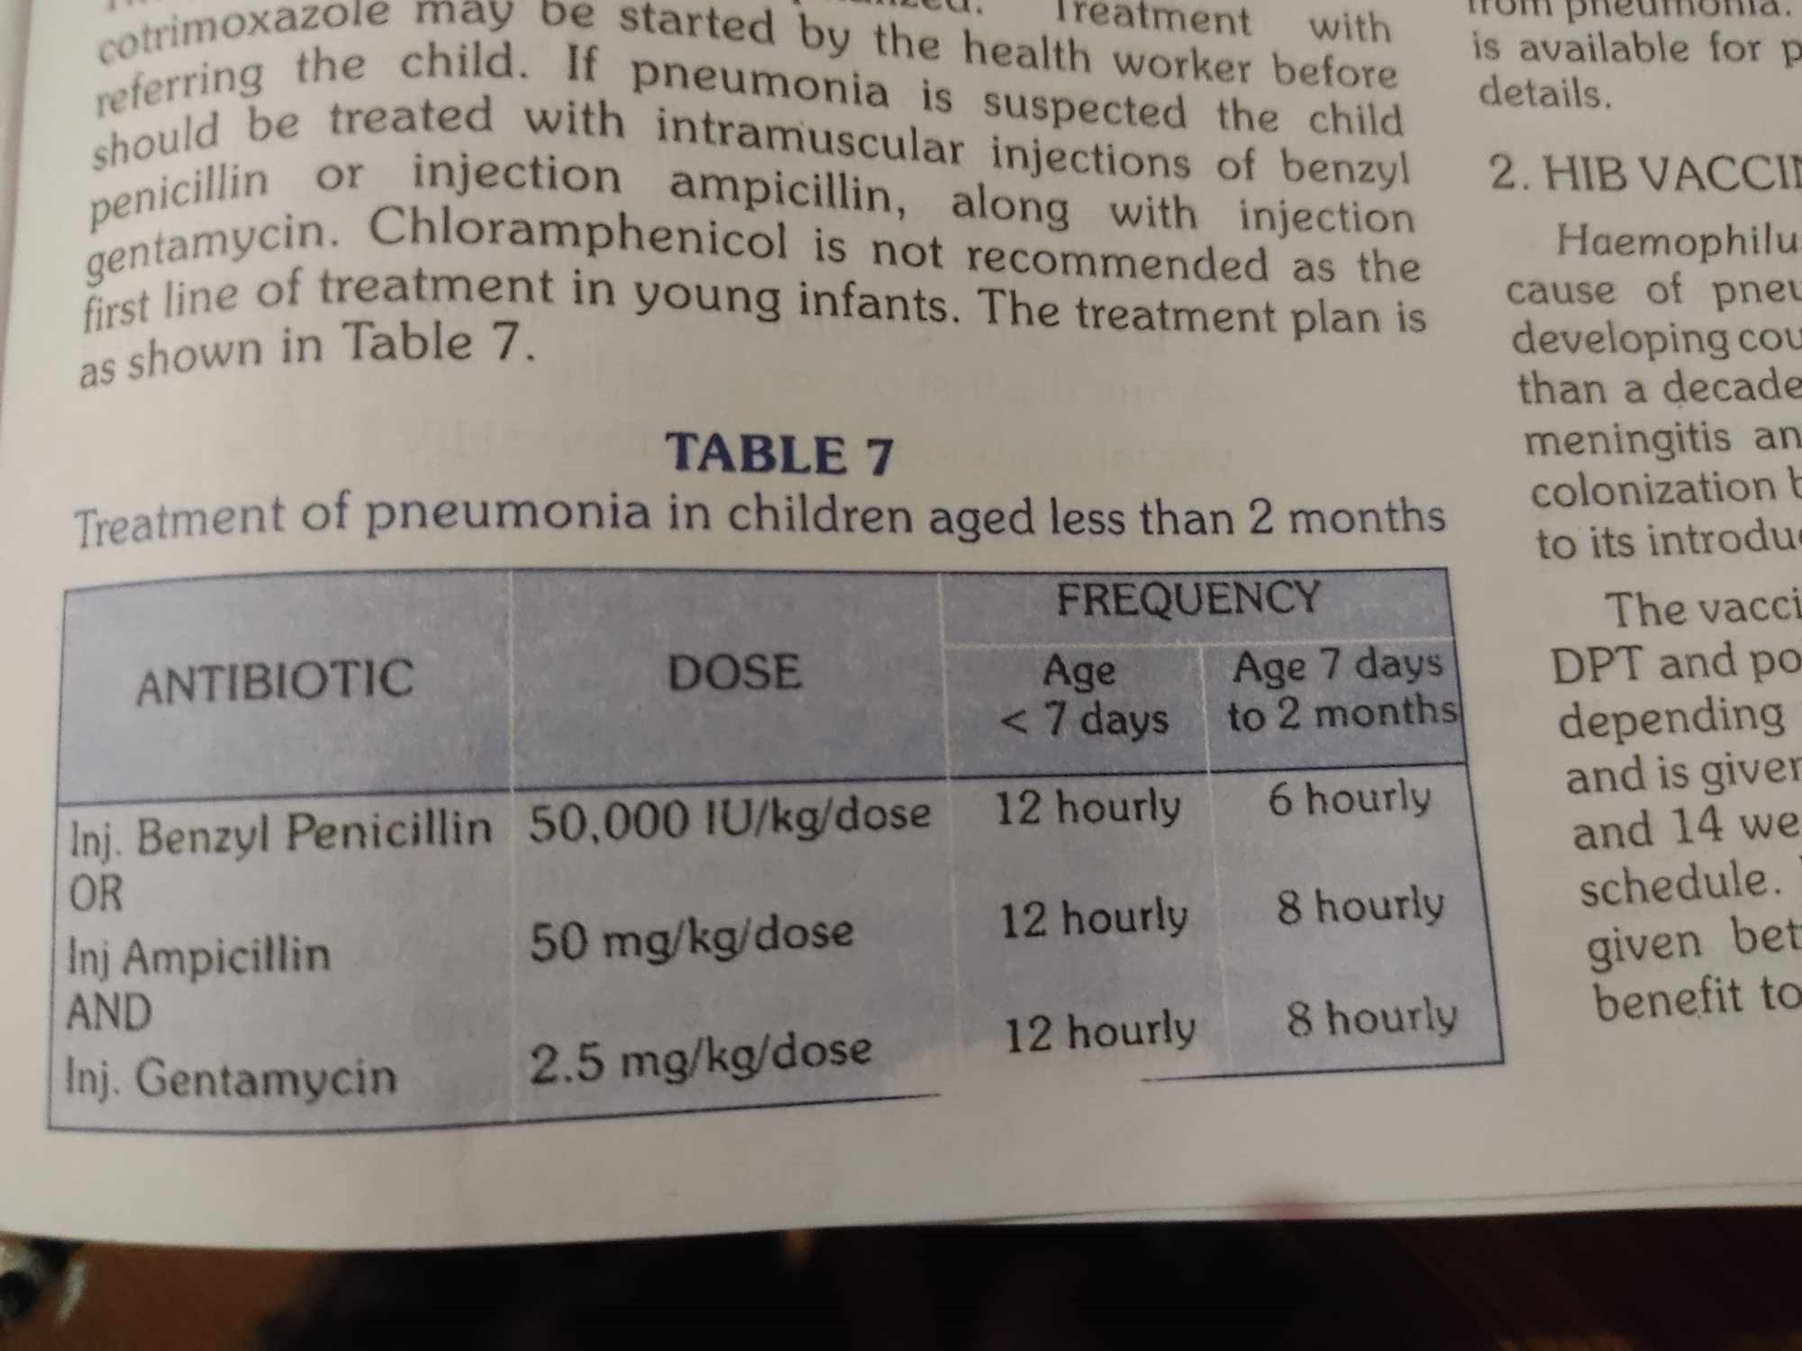

Slide 83
Medicine for treatment
https://www.slideshare.net/mgmcricommunitymed/who-guidelines-ari-59980214

Slide 84
References
1. Acute Respiratory Infection ; Definition https://vikaspedia.in/health/diseases/lungs-related/acute-respiratory-infection-ari
2. K park. Textbook of preventive and social medicine. Page no;180.
3. WHO. https://www.who.int/data/gho/indicator-metadata-registry/imr-details/3147.
4. Ghimire P, Gachhadar R, Piya N, Shrestha K, Shrestha K (2022) Prevalence and factors associated with acute respiratory infection among under-five children in selected tertiary hospitals of Kathmandu Valley. PLoS ONE 17(4): e0265933.
5. Dharel S, et.al. Factors associated with childhood pneumonia and care seeking practices in Nepal: further analysis of 2019 Nepal Multiple Indicator Cluster Survey. BMC Public Health. https://bmcpublichealth.biomedcentral.com/articles/10.1186/s12889-022-14839-6

Slide 85


