Slide 1
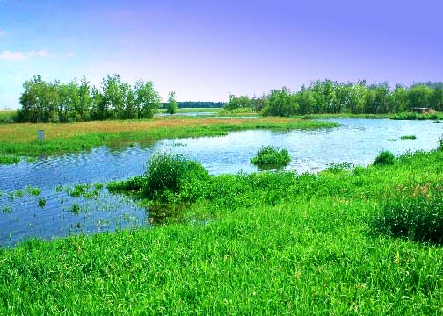
CRITERIA FOR INCLUSION OF WET LAND INTO RAMSAR SITE
Presented by
Naveen Rajaure
Roll no: 22 ,BPH 2nd Semester
School of Health and Allied Sciences
Pokhara University, 2018

Slide 2
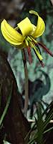
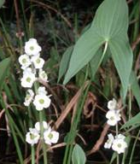
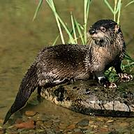
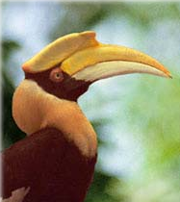
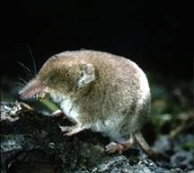
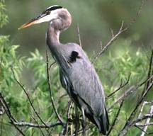
Contents
Introduction/Background
Criteria for inclusion of wet land into ramsar site
Ramsar sites of Nepal
References

Slide 3
What is a Wetland?
Wetlands are areas where water covers the soil, or is present either at or near the surface of the soil all year or for varying periods of time during the year, including during the growing season.
It is the transition zone between truly aquatic habitat and terrestrial habitat
The prolonged presence of water creates conditions that favor the growth of specially adapted plants (hydrophytes) and promote the development of characteristic wetland (hydric) soils.
Wetlands occur where water meets land

Slide 4
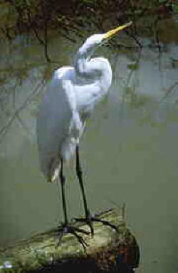
Wetland Characteristics
Shallow water or saturated soils at least at some time during the year
Accumulate slowly decomposing organic matter
Have plants and animals typically adapted to saturated conditions

Slide 5
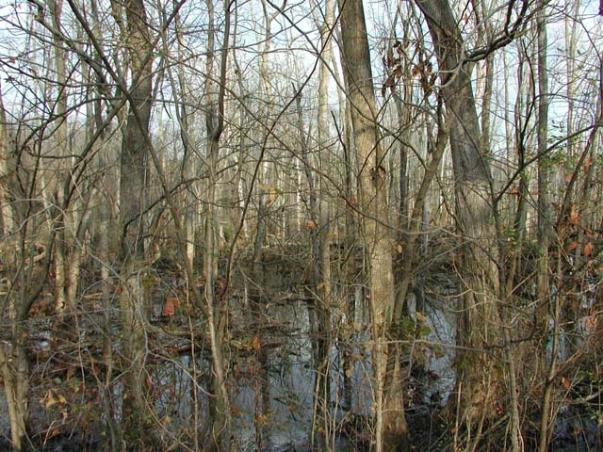
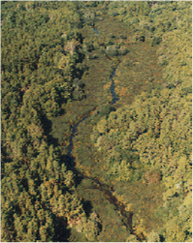

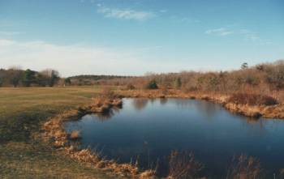
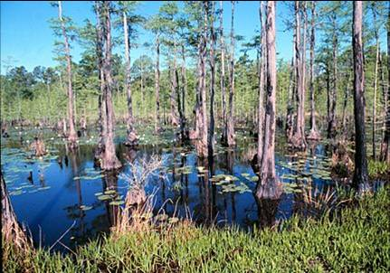
Wetlands

Slide 6
Why are Wetlands Valuable to Environment?
They are purifiers – “kidneys of the landscape”
Prevent floods
Protect shorelines
Recharge aquifers with “purified” water
Important as wildlife habitat
Global climate stabilizers and CO₂ absorbers

Slide 7

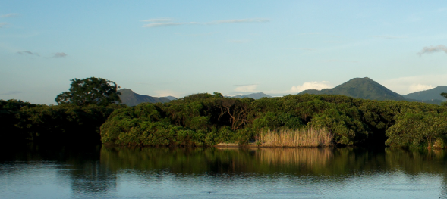
Ramsar sites
Wetlands of International Importance.
Wetlands protected by national governments to fulfil their obligations under the Convention on Wetlands of International Importance (commonly called the Ramsar Convention).

Slide 8
Ramsar sites
The international convention which forms the basis for their identification is commonly referred to as the "Ramsar Convention" after the city in Iran where the convention was signed in 1971. The Convention is an international treaty for the conservation and wise use of wetlands. All joining Parties of the Ramsar Convention commit themselves to work towards the “three pillars” of the Convention:
Ensuring the conservation and wise use of wetlands it has designated as Wetlands of International Importance,
Including as far as possible the wise use of all wetlands in national environmental planning, and
Consulting with other Parties about implementation of the Convention, especially in regard to transboundary wetlands, shared water systems, and shared species.

Slide 9
Ramsar sites
Upon joining, each Contracting Party is obliged to designate at least one wetland site for inclusion in the List of Wetlands of International Importance.
The main objective of this key obligation is “to develop and maintain an international network of wetlands which are important for the conservation of global biological diversity and for sustaining human life through the maintenance of their ecosystem components, processes and benefits/services”.

Slide 10
Ramsar sites
There are currently 168 Contracting Parties to the Ramsar Convention.
The Convention uses a broad definition of wetlands as “areas of marsh, fen, peatland or water, whether natural or artificial, permanent or temporary, with water that is static or flowing, fresh, brackish or salt, including areas of marine water the depth of which at low tide does not exceed six metres”.
Wetlands to be included on the List may incorporate riparian and coastal zones adjacent to the wetlands, and islands or bodies of marine water deeper than six metres at low tide lying within the wetlands.

Slide 11
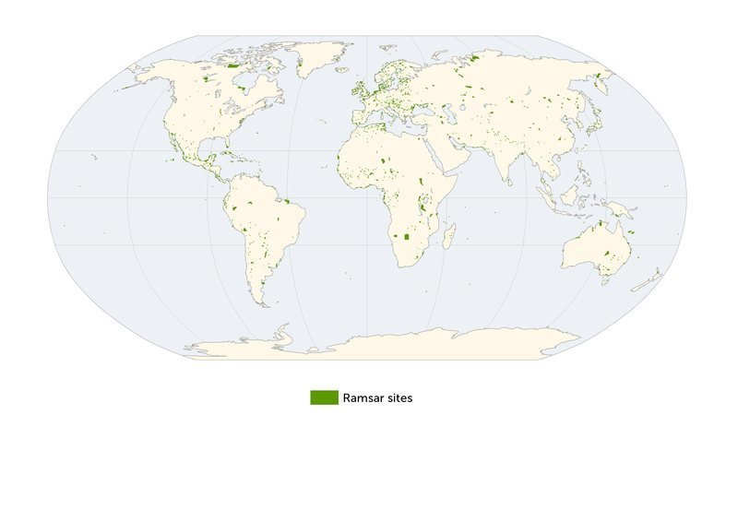
IUCN and UNEP-WCMC (2014). The World Database on Protected Areas (WDPA). October 2014. Cambridge, UK: UNEP-WCMC

Slide 12
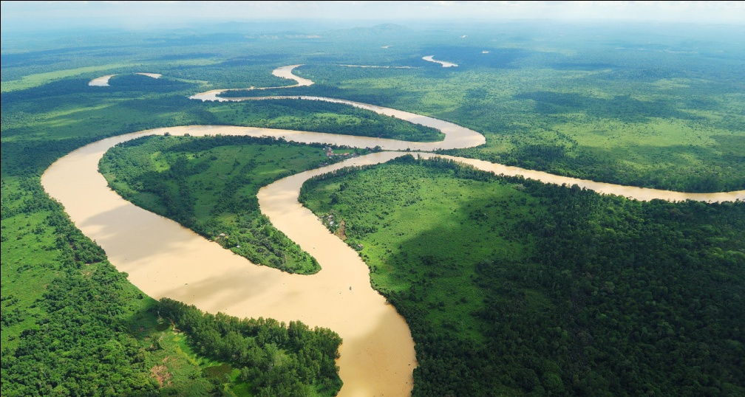
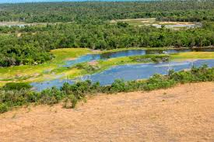
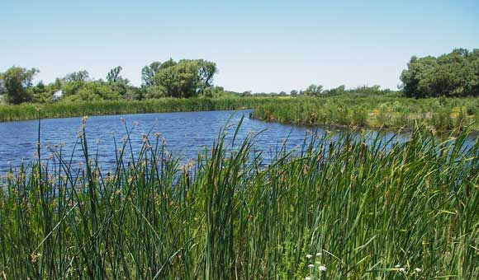
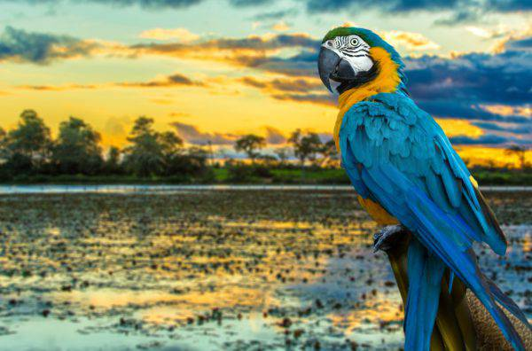
CRITERIA FOR INCLUSION OF WET LAND INTO RAMSAR SITE

Slide 13
Group A:Sites containing representative, rare or unique wetland types
Criterion 1:
A wetland should be considered internationally important if it contains a representative, rare, or unique example of a natural or near-natural wetland type found within the appropriate biogeographic region.

Slide 14
Group B: Sites of international importance for conserving biological diversity
Criteria based on species and ecological communities

Slide 15
Group B: Sites of international importance for conserving biological diversity
Criteria based on species and ecological communities
Criterion 2: A wetland should be considered internationally important if it supports vulnerable, endangered, or critically endangered species or threatened ecological communities.
Criterion 3: A wetland should be considered internationally important if it supports populations of plant and/or animal species important for maintaining the biological diversity of a particular biogeographic region.
Criterion 4: A wetland should be considered internationally important if it supports plant and/or animal species at a critical stage in their life cycles, or provides refuge during adverse conditions.

Slide 16
Group B: Sites of international importance for conserving biological diversity
Specific criteria based on waterbirds
Criterion 5: A wetland should be considered internationally important if it regularly supports 20,000 or more waterbirds.
Criterion 6: A wetland should be considered internationally important if it regularly supports 1% of the individuals in a population of one species or subspecies of waterbird.

Slide 17
Group B: Sites of international importance for conserving biological diversity
Specific criteria based on fish
Criterion 7: A wetland should be considered internationally important if it supports a significant proportion of indigenous fish subspecies, species or families, life-history stages, species interactions and/or populations that are representative of wetland benefits and/or values and thereby contributes to global biological diversity.
Criterion 8: A wetland should be considered internationally important if it is an important source of food for fishes, spawning ground, nursery and/or migration path on which fish stocks, either within the wetland or elsewhere, depend.

Slide 18
Group B: Sites of international importance for conserving biological diversity
Specific criteria based on other taxa
Criterion 9: A wetland should be considered internationally important if it regularly supports 1% of the individuals in a population of one species or subspecies of wetland-dependent non-avian animal species.

Slide 19
Ramsar sites in Nepal
The convention entered into force in Nepal on 17 April 1988.
Nepal currently has 10 sites designated as Wetlands of International Importance (Ramsar Sites), with a surface area of 60,561 hectares.
Source: https://www.ramsar.org/wetland/nepal

Slide 20
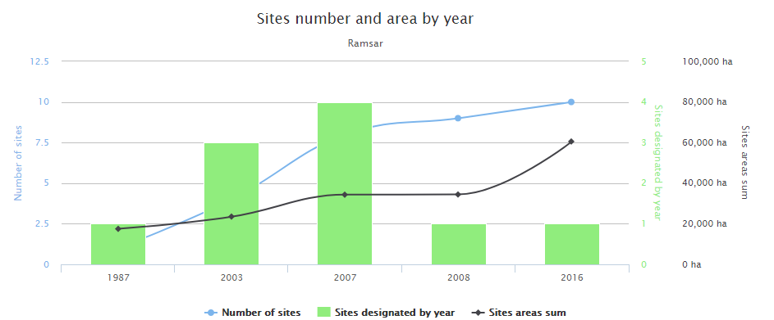
Ramsar sites in Nepal
Source: https://www.ramsar.org/wetland/nepal

Slide 21
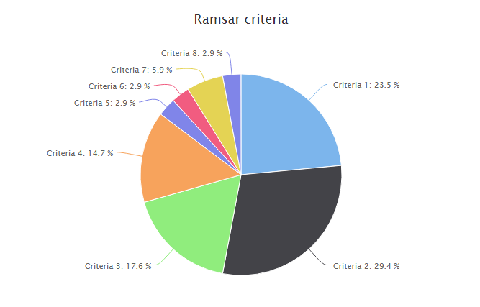
Ramsar sites in Nepal
Source: https://www.ramsar.org/wetland/nepal

Slide 22
Reference
Ramsar Regional Center – East Asia. (2017). The Designation and Management of Ramsar Sites – A practitioner’s guide. Available at www.ramsar.org and www.rrcea.org
Ramsar Convention Secretariat, 2010. Designating Ramsar Sites: Strategic Framework and guidelines for the future development of the List of Wetlands of International Importance, Ramsar handbooks for the wise use of wetlands, 4th edition, vol. 17. Ramsar Convention Secretariat, Gland, Switzerland.
https://www.ramsar.org/wetland/nepal

Slide 23
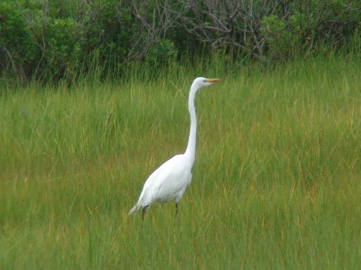
Saving Wetlands
Is saving Lives

Slide 24


