Slide 1

Nutritional profile of locally available foods:
Submitted to:
Dipendra Kumar Yadav
Lecturer,SHAS
Pokhara University.

Slide 2
Presented by:
Aakriti Regmi
Durga Shrestha
Melina Kafle
Apar Paudel
Pooja Gautam

Slide 3
Contents:
Introduction
Food pyramid
Local foods available in mountain, hilly and terai region.
Nutritional components of major foods
Problems
Conclusion

Slide 4
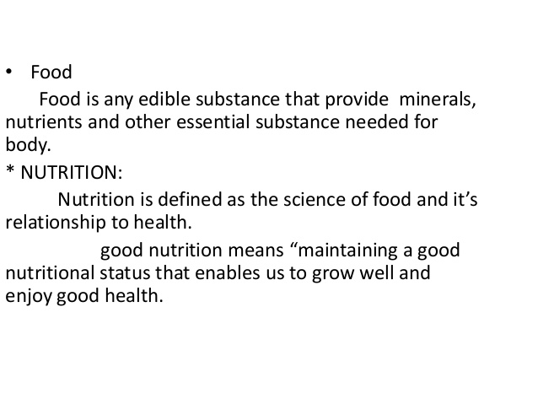

Slide 5
Food pyramid
It is a triangular shaped diagram representing the optimal number of servings to be eaten each day from basic food groups.

Slide 6
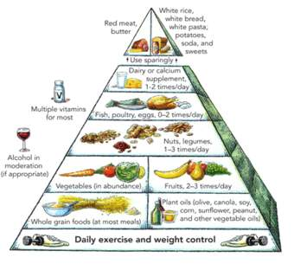
Food pyramid
www.theweightlosssite.com

Slide 7
Nepal is a country of geographical variations. The mountains in the north, hills below mountains and the plain terai . With the geographical variations the availability of foods are also different. The nutritional amount of the same food product may also varies due to the environment they grow upon.
The mountain region is cold so there is not much availability of plants stuff for foods. People are mainly involved in animal rearing and medicinal plants. Medicinal plants include yarshagumba , chirayito , panchaule , padamchal etc are found.

Slide 8
The hilly region is neither hot nor cold. The area contains semi fertile soils so abundance of foods are grown here along with animal rearing.
The terai region is hotter . The soil is fertile here. So many crops are grown in these area. Most of the domestic food products are produced here.

Slide 9
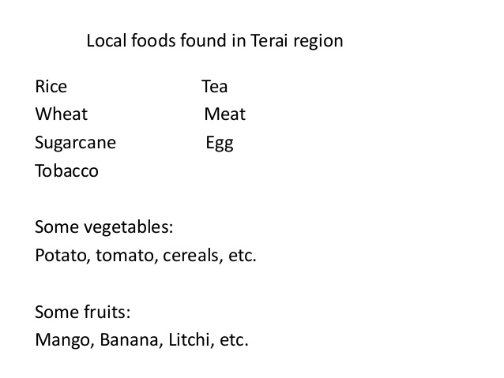

Slide 10
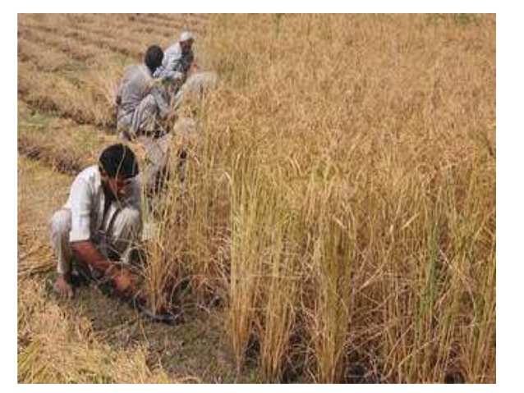

Slide 11
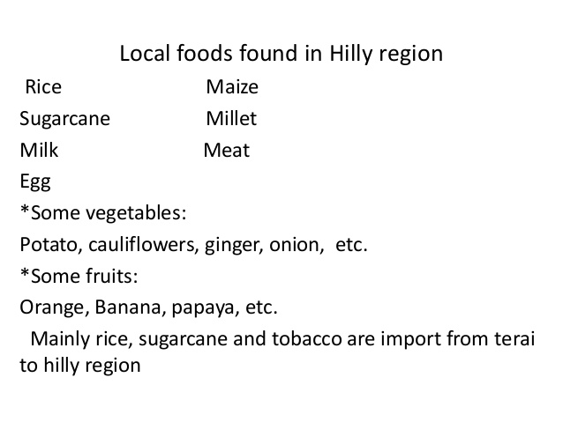

Slide 12
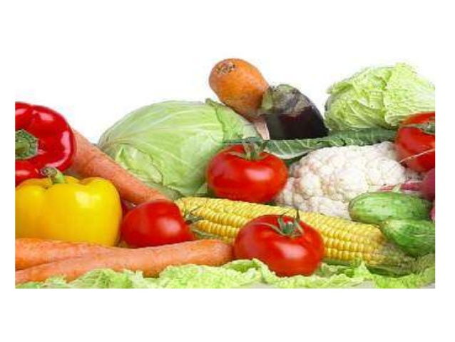

Slide 13
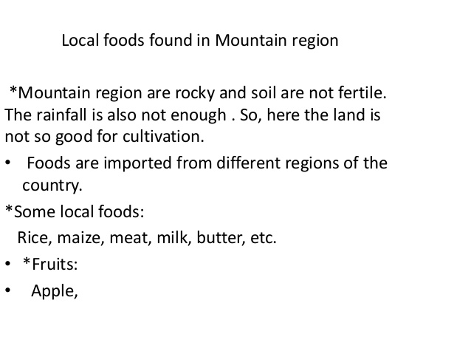

Slide 14
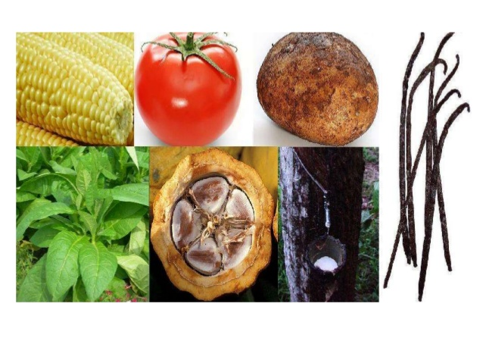

Slide 15
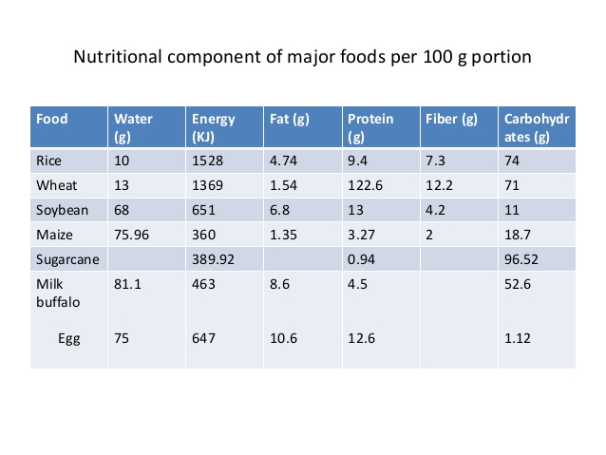

Slide 16
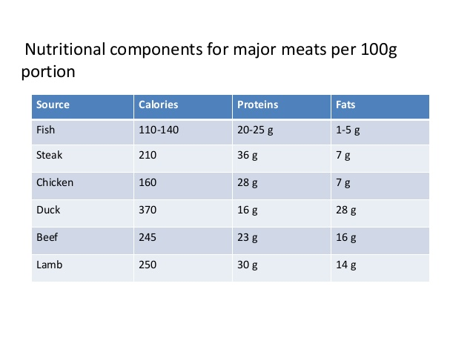

Slide 17
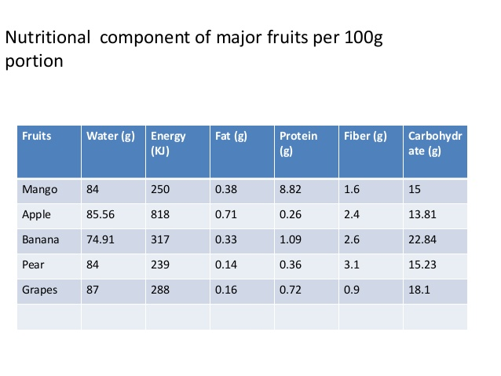

Slide 18
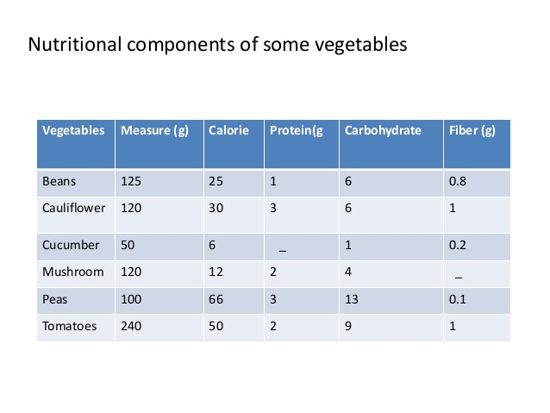

Slide 19
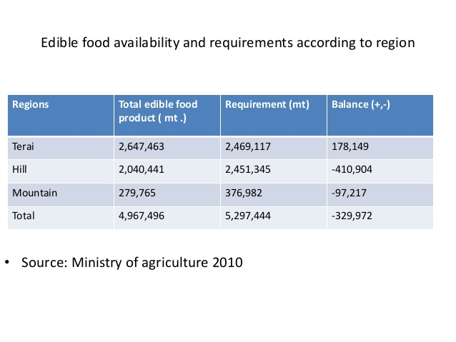

Slide 20
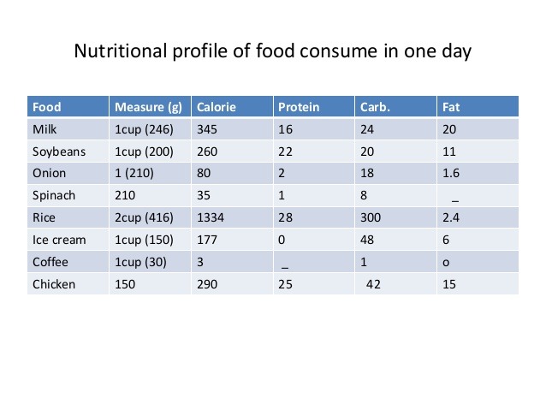

Slide 21
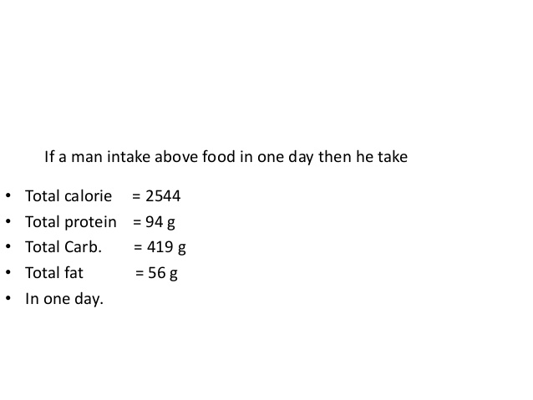

Slide 22
Due to the improper use of those foods 49% of the children under 5 years are suffering from stunting , 13% from wasting , 39% are underweight , 49% from PEM and 48% from anemia.
41% of women are suffering from anemia.

Slide 23
The proportion of women consuming meat products and eggs is higher in hills (39% meat and 19% eggs) and lower in mountain(19% and 10% eggs) . Egg consumption is lowest in terai with only 10% women consuming eggs.
Consumption of leafy vegetables is higher in mountain (60%) in compared to hills(58%) and terai(45%) . Further, consumption of fruits and vegetables rich in vitamin A is also lower(28%) than other regions.

Slide 24
Consumption of food from more diverse groups among women is higher in hills (58%) and mountain(53%) than in terai (44%).
The proportion of women consuming more diverse foods are educated (73%) than uneducated ones.
Nepal demographic and health survey 2016

Slide 25
Conclusion
The nutritional value of the foods have been degrading during the process of cooking and processing. Over cooking , wrong way of cooking , over use of insecticides have tremendously decreased the nutritional value of the foods.
With the development of knowledge and the globalization , the locally available foods are processed and are used in such a way to uptake maximum nutrition i,e the right way of harvesting and the proper and rational use of less insecticides .

Slide 26
Contd..
The new techique of harvesting the foods and the proper knowledge of food nutrition and the establishment of different nutritional centers also have played a great role in nutritional assesment of locally available foods.
Proper balance of foods with rational use is a must .

Slide 27
Contd…
The science of human nutrition is mainly concerned with defining the nutritional requirements for the promotion, protection and maintenance of health in all groups of population.

Slide 28
Contd..
Such knowledge is necessary in order to assess the nutritional adequacy of diets for growth of infants, children, adolescents and for maintenance of health in adults of both sexes and during pregnancy and lactation in women.

Slide 29
In conclusion, the nutrition intake of proper foods by people of all parts of Nepal ie; Terai, Hilly and Himalayan regions should be significantly increased so as to obtain fit and healty citizens in upcoming future.

Slide 30
For this, people should be made aware about proper diet intake through different awareness programmes.

Slide 31
References
Demographic and health survey 2016
WHO:The Health aspects of food and nutrition
FAO:Nutritional Studies
Park’s textbook of preventive and social medicine
www.nutritionalstatusofNepal.com
www.authorstream.com

Slide 32


