Slide 1

Report Writing
Presented by
Tribhuwan Pokharel

Slide 2
Report
… is a written statement or document prepared after a detailed investigation of cause, effect, and possible solutions of a given problem.
to give people information about something that you have heard, seen or done.
the main purpose of report presentation is to communicate its information or findings with recommendations to the concerned authority or targeted group of audience.

Slide 3
Types of report
Financial / budget report
News/ Information Report
Medical Report
Study/ Academic/Progress Report

Slide 4
Cont’d
Investigation/ Research Report
Field trip Report
Feasibility/ achievability Report
Technical Report

Slide 5
Qualities of Good Report
short and specific.
keep the sentence short and try to avoid complexity.
keep facts, findings, and logical interpretation to justify the objectives of report
not to impress your audience in a round about way without any supporting details.

Slide 6
Cont’d
make it reader centered not writer centered.
consider your readers.
avoid jargons as well as metaphoric words, use familiar words.

Slide 7

Parts of a research report
Preliminary
Title page
Letter of authorization
Acknowledgement
Abstract
List of contents
List of tables
List of figures
List of abbreviations
Table of contents

Slide 8
Body part
Introduction
Objectives
Significance
Limitations
Methodology
Source of data
Data collection tools
Data analysis
Findings
Conclusions
Recommendations

Slide 9
End part
References/Bibliography
Appendix

Slide 10
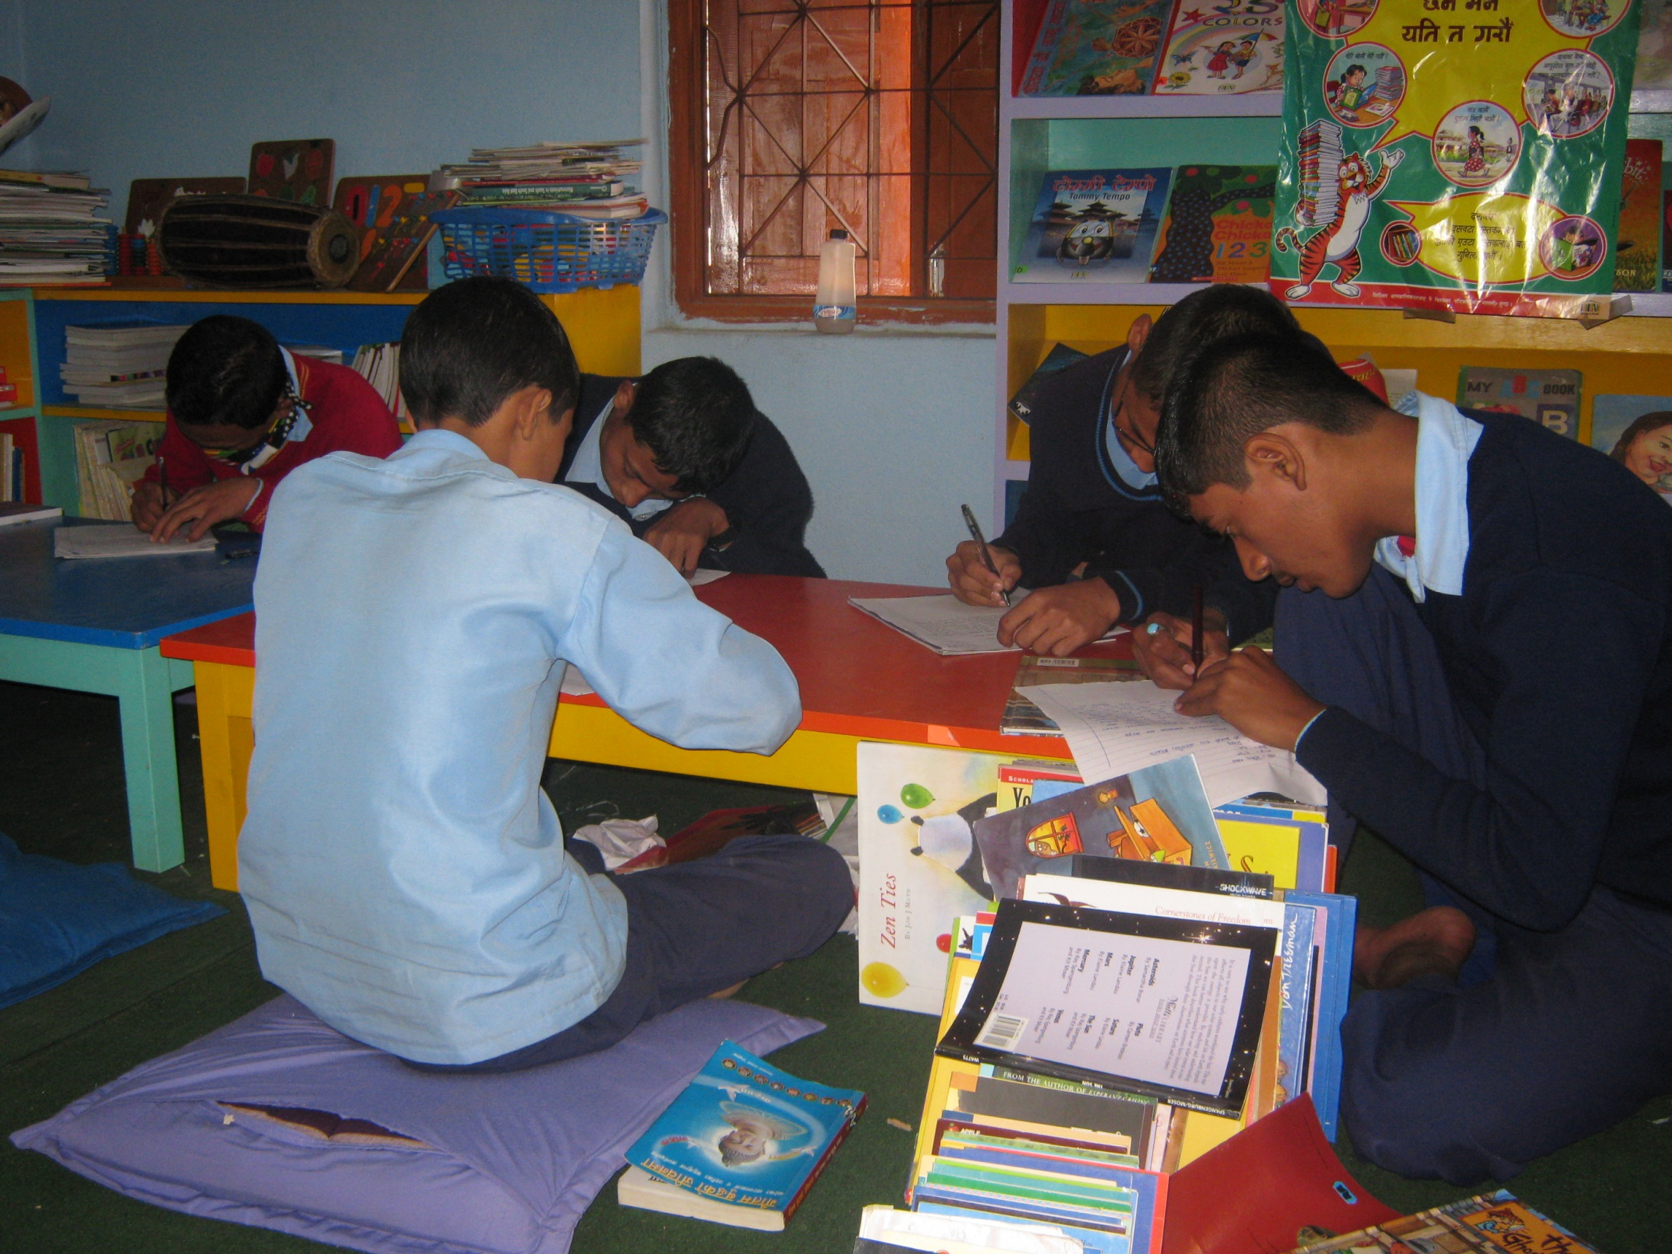
Let’s discuss them one by one

Slide 11
Preliminary
Title page
Letter of authorization
Acknowledgement
Abstract
List of contents
List of tables
List of figures
List of abbreviations
Table of contents

Slide 12
Title page
Street Children And Education
An Ethnographic study with Street Children
Tribhuwan Pokharel
An Ethnographic Paper
Submitted to Mr. Mahesh Nath Parajuli

Slide 13
In partial fulfillment of the requirements of Advanced Qualitative Research Methods M.Phil in
Education Leadership
School of Education
Kathmandu University
Bal Kumari, Lalitpur
December 2014

Slide 14
Maintaining an Intricate Balance between Work and Play
An Ethnographic study with Montessori teacher
Gaurav Ojha
An Ethnographic Paper
Submitted to Mr. Mahesh Nath Parajuli
In partial fulfillment of the requirements of Advanced Qualitative Research Methods M.Phil in Education Leadership
School of Education
Kathmandu University
Bal Kumari, Lalitpur
December 2014

Slide 15
Acknowledgement/Abstract
When I entered into a Montessori school in my neighborhood the very first thing that caught my eyes were the fact that children were moving inside out, outside in without any permission or direction from their teachers and caretakers. They were free to leave their seats and wonder around without any fear of punishment and reinforcements. They were free to move around the class room, select work from shelves scattered through out the room, and converse and chatter freely with each other and their teachers and caretakers.

Slide 16
Another thing that amazed me was that all the children were engaged with different activities. Further when I inquired about the phenomenon with some Montessori teachers, they rather lucidly replied that their children are engaged in ‘the work’. Initially I was shocked and enthralled by their rather straight and blunt answer. However, further observing in Montessori classrooms, talking with Montessori teachers, and reading Montessori’s own words about her method have led me to look closely at how the concept of work is constructed within the frame of Montessori education. After this initial encounter with Montessori pedagogical practices and discussions with Montessori teachers I realized that the concept of work is an especially useful lens for examining the theory and practice of Montessori education.

Slide 17
In Montessori education system teachers have an important responsibility assign to them so that they can maintain a balance between work and play. Children inside Montessori class-room are engaged in various forms of play, however it is the responsibility of Montessori teacher to make those work purposive, formative and more importantly a learning process

Slide 18
ACRONYMS
DEC : District Education Committee
ETC : Education Training Center
FGD : Focus Group Discussion
I/NGOs : International Non – government Organization
MOES : Ministry of Education and Sports
NCED : National Center for Educational Development
NEFIN : Nepal Federation of Indigenous Nationalities
NESAC : Nepal South Asia Center

Slide 19
Tables of Contains
Setting the Stage 1
Need for Inquiry 3
Participant Observer: Being an Ethnographer, Coming out of the shadow 4
Paradox: Children Play and it’s a Work 6
Role of a Montessori Teacher 7
Interactions with the Montessori world 12
Montessori Education and Constructivism 15
Interactions with Montessori Teachers 16
Into the Shadows 18
Call to Serve 20

Slide 20
Table of Contents
Introduction 1
Purpose 3
Teacher-Teacher relationships and school environment 5
Formation of Identity in cross-cultural settings 7
Research questions 9
International School 13
Expatriate Teachers 15
Nepalese assistant teachers 17
Methods 19
Designing a study to interview teachers 22
Ethnographic Study 25
Analysis of ethnographic data 27
Participants 30
An Analysis of four teachers Narratives’ of Expatriate teachers32
Superiority 35
Misconstrued images 37
Communication Gaps 40
A circle strictly ours 42
Professionalism and Dedication 44
Conclusion 46
References: 47

Slide 21
Lists of figures
Fig. 1: Status of questionnaire distributed and returned (Department wise) 36
Fig. 2: Frequency of library visit for research 36
Fig. 3: Member of special library 38
Fig. 4: Necessity felt for the member of special library 38
Fig. 5: Easy system for information retrieval 40
Fig. 6: Literacy skills (library orientation) got 40
Fig. 7: Difficulties on existing tools 41
Fig. 8: Main obstacle to fulfill the needs 44
Fig. 9: Need of changing environment on library you used 45

Slide 22
Body part

Slide 23
Introduction
Objectives
Significance
Limitations
Methodology
Source of data
Data collection tools
Data analysis
Findings
Conclusions
Recommendations

Slide 24
Introduction
Objectives
Significance
Limitations

Slide 25
Introduction
…. Also called background of the study.
detailed introduction about the problem that have chosen.
it gives clear details about the topic chosen.
… it should be clear and detailed.

Slide 26
Objectives
it gives why one is doing this research.
who is benefited after the work is completed.
what recommendations are to be given to the concerned authority etc.
what is intended to find out.

Slide 27
Cont’d
must be measurable and short and simple language.

Slide 28
Significance
… the importance of the study is described in this sessions.
who would be benefitted with your research is mentioned in this part.

Slide 29
Limitations
The researcher mentioned the boundaries of the study.
It mentioned the time, economic condition, geographic condition etc.
limitations is data collection, sampling procedures etc.

Slide 30
Methodology
Source of data
Data collection tools

Slide 31
Methodology
…. Called design section.
… detailed description of the manner in which decisions have been made about the types of data needed for the study, tools and devices for collecting the data and methods to collect data.

Slide 32
Cont’d
the researcher may present the definition of the population, source of data, the size of the sample, rationale of sample, procedure of sampling, number of participants participated and not participated in the data process.

Slide 33
Cont’d
why/ where / when/ what types of data are collected, the tools and devices used for collecting the data along with reliability and validity.

Slide 34
Source of data
Primary source
( first hand data collected from the participants)
Secondary source
( second hand data, includes books, journals, newspaper, bulletin, magazines, collected through either from print media or electronic media.

Slide 35

Data collection tools
Questionnaire
Interview
Observations

Slide 36
Questionnaire
Open ended
Close ended

Slide 37
Interview
Structured
Unstructured

Slide 38
Observations
Participants
Non- participants

Slide 39
  Data analysis
  Findings
  Conclusions

Slide 40
  Data analysis
researcher describes how to organize, analysis and interpret the data.
the data are processed through editing, coding and tabulating.
Data tools are used like percentages, mean. ratio., standard deviations to analysis the data.

Slide 41
  Findings
findings are mentioned in this sections.

Slide 42
Conclusion
Give conclusions in this part.
Concluding remarks are given.

Slide 43
Implications
In this secessions how the findings are implemented is mentioned.

Slide 44
End Part
References/Bibliography
Appendix

Slide 45
Referencesand Bibliography
Cohen, L., Maninon,L. & Morrison,K. (2008). Research methods in education. Taylor and Francis e-library.
Creswell, J.W. (2011). Research design (3rd ed.). New Delhi. Sage Publications.
Bryman, A. (2008). Social research methods. New York, Oxford University Press.
Gelink.J. (2011). Fear of conflict-Why conflict is necessary. Retrieved from
http://druckerphilosophy.com/2011/06/05/fear-of-conflict-%E2%80%93-why-conflict-is-necessary/ on 21st December 2012.
Hatoss, A. (2003). Identity formation, cross-cultural attitudes and language maintenance in the
Hungarian Diaspora of Queensland. Retrieved from eprints.usq.edu.au/1158/1/Hatoss_Deakin_paper.pdf, on 29th December 2012.

Slide 46
Palmer, Peter. (1998) The Courage to Teach. San Francisco: Jossey-Bass.
Dent, Nathan.(1997) Rousseau an Introduction to His Psychological, Social and political
Theory. Oxford: Blackwell.
Becker, G. (1998) Tricks of the trade: How to think about our research while you’re doing it. Chicago: The University of Chicago Press.

Slide 47


Slide 48

Appendix
Appendix I
Montessori World (Photographs)

Slide 49


Slide 50
Please Continue Reading
and
Thank You

