Slide 1
SNAKE BITE

Slide 2
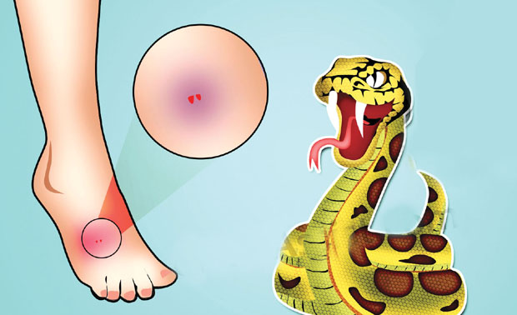

Slide 3
INTRODUCTION
A snakebite is an injury caused by the bite of a snake, especially a venomous snake. A common sign of a bite from a venomous snake is the presence of two puncture wounds from the animal's fangs.
Venom = a poisonous substance secreted by animals such as snakes, spiders etc.

Slide 4
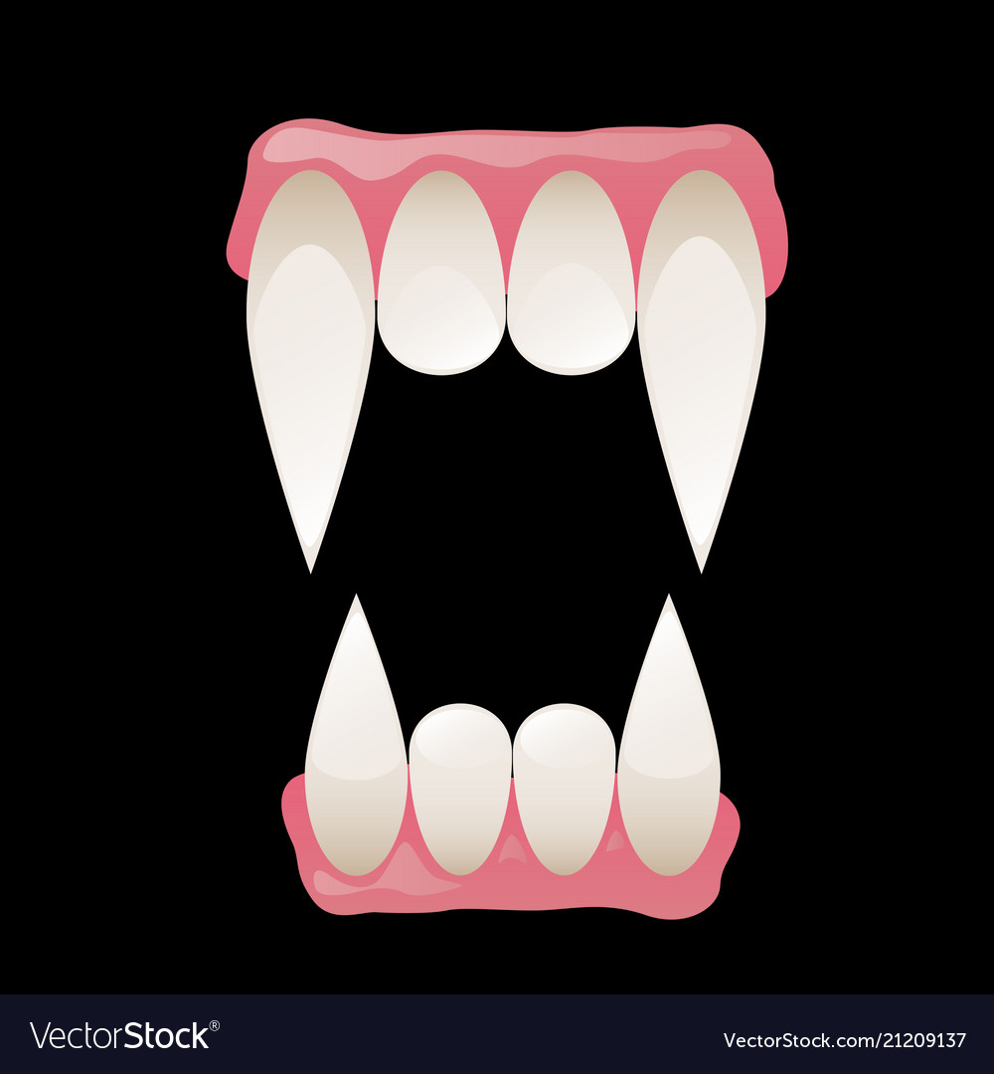
FANGS

Slide 5
Poisonous species of snakes in nepal :
King Cobra
Vipers
Craits

Slide 6
SYMPTOMS
Localized Pain
Allergic reaction
Nausea
Convulsion ( violent uncontrollable contraction of muscles)
Even paralysis
Change in skin colour
Drooping eyelids (the uppereyelid falls to a lower position than normal)

Slide 7
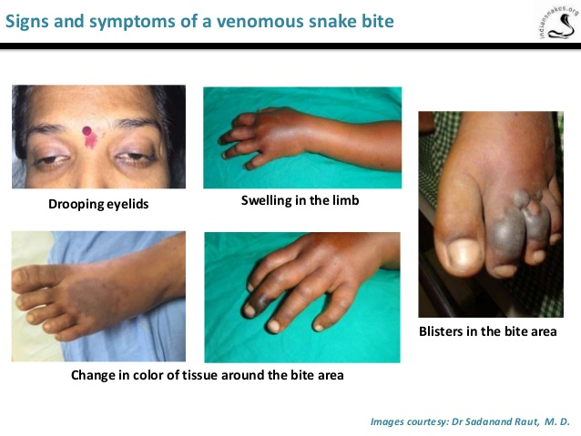

Slide 8
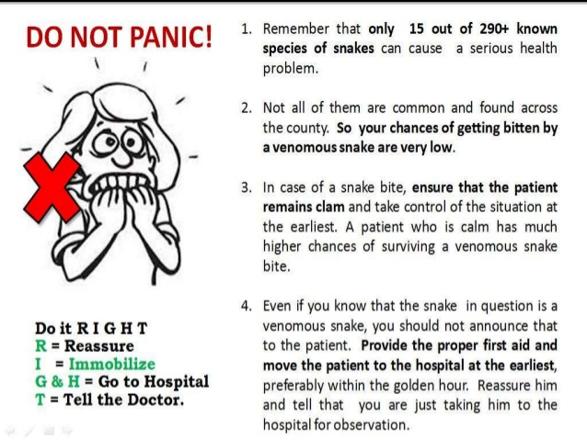

Slide 9
WHAT EXACTLY TO DO?
First aid
● Prevent a second bite or a second victim. Do not try to catch the snake as this can lead to additional victims or bites. Snakes can continue to bite and inject venom with successive bites until they run out of venom.
Remove constricting items on the victim, such as rings or other jewelry, which could cut off blood flow if the bite area swells.
Secondly, the affected limb should be used as little as possible to delay absorption and circulation of the venom.

Slide 10
Contd…
● Wash the wound with large amounts of soap and water. Inspect the wound for broken teeth or dirt.
Identify or be able to describe the snake, but only if it can be done without significant risk for a second bite or a second victim.
Safely and rapidly transport the victim to an emergency medical facility.

Slide 11
contd
Antivenom should be given( incase of poisonous snake bite, marked by muscle spasm, patient’s unconciousness.)
The early administration of an adequate dose of effective antivenom to patients with signs of envenoming(having poison) is crucial.

Slide 12
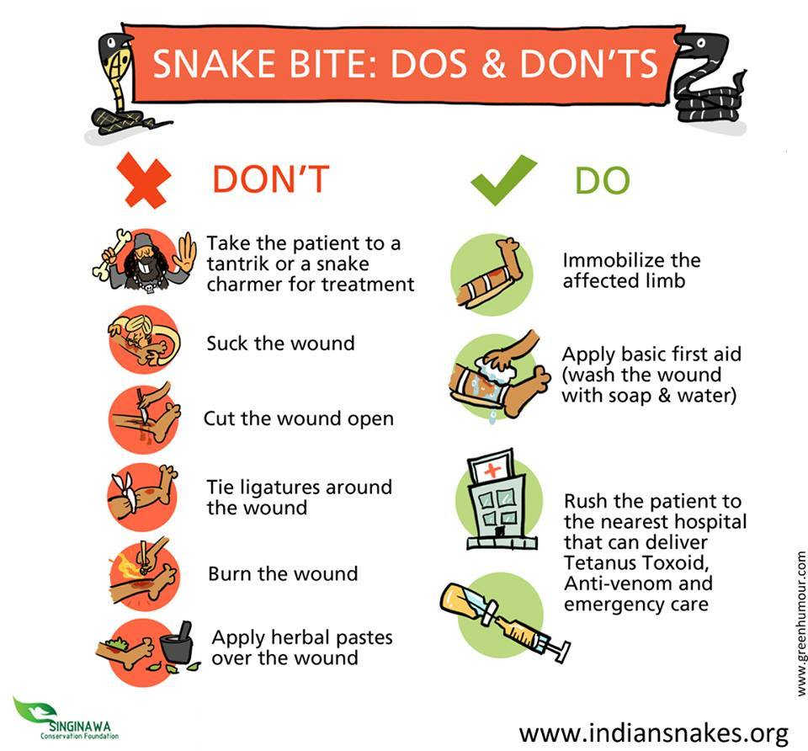

Slide 13
DO NOT..
Do not cut and suck
Do not use ice
Do not use electric shocks
Do not use alcohol
Do not use tourniquets or constriction bands

Slide 14
What not to do?
Do not cut and suck. Cutting into the bite site can damage underlying organs, increase the risk of infection, and sucking on the bite site does not result in venom removal.
Do not use ice. Ice does not deactivate the venom and can cause frostbite.
Do not use electric shocks. The shocks are not effective and could cause burns or electrical problems to the heart.

Slide 15
Contd…
Do not use alcohol. Alcohol may deaden the pain, but it also makes the local blood vessels bigger, which can increase venom absorption.
Do not use tourniquets or constriction bands. These have not been proven effective, may cause increased tissue damage, and could cost the victim a limb.

Slide 16
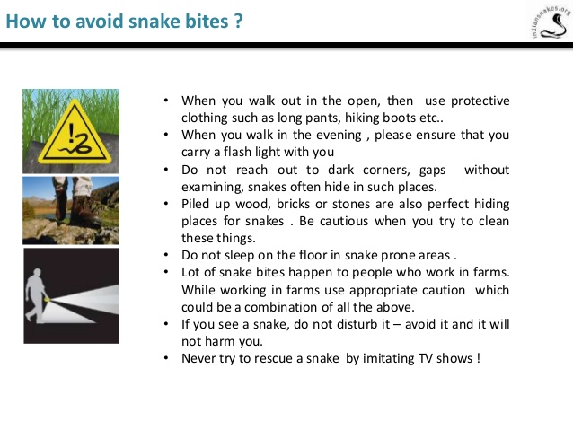

Slide 17
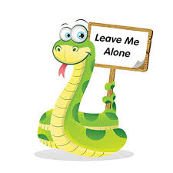
THANK YOU!

