Slide 1

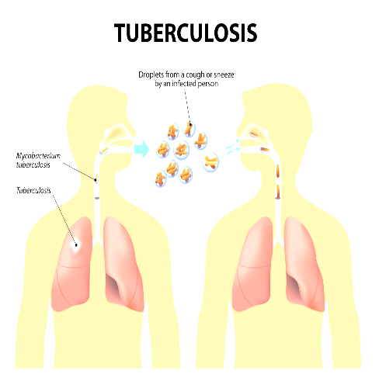
National Tuberculosis Control Program
Presented By:
Arika K.C. (7)
Ritika Baskota (26)
Presented To:
Dr. Hari Prasad Kaphle
Associate Professor
SHAS,PU

Slide 2
Background
Tuberculosis (TB) is a significant public health issue in Nepal and one of the leading causes of global mortality.
National Tuberculosis Programme (NTP) is one of the priority health programme of Nepal.
Within the organizational structure of the Ministry of Health and Population, NTCC is the leading entity for National TB Control Program (NTP) and is responsible for formulating policies, strategy, planning, monitoring, and quality assurance of the program.
In 2079 (2023), Nepal faced a TB burden of an estimated 68,000 cases, with an incidence rate of 229 per 100,000 population.

Slide 3
NTP Strategic Aim and Policies
Vision
TB Free Nepal .
Goal
To reduce the TB incidence by 20% by the year 2021 compared to 2015 and
increase case notifications by a cumulative total of 20,000 from July 2021,
compared to the year 2015.

Slide 4
Objectives
Objective 1
Increase case notification through improved health facility-based diagnosis; increase diagnosis among children ; examination of household contacts and expanded diagnosis among vulnerable groups within the health service, such as PLHIV and those with diabetes mellitus (DM) .
Objective 2:
Maintain the treatment success rate at 90% of patients (all forms of TB)

Slide 5
Objective 3
Provide DR diagnostic services for 50% of persons with presumptive DR
TB by 2018 and 100% ; successfully treat at least 75 % of the diagnosed DR
patients.
Objective 4
Further expand case finding by engaging providers for TB care from the public sector (beyond MoHP), medical colleges, NGO sector, and private sector through results-based financing (PPM) schemes, with formal engagements (signed MoUs) to notify TB cases.

Slide 6
Objective 5
Strengthen community systems for management, advocacy, support and rights for TB patients in order to create an enabling environment to detect & manage TB cases in 100% of all districts.
Objective 6
Contribute to health system strengthening through HR management and capacity development, financial management, infrastructures, procurements and supply management in TB

Slide 7
Objective 7
Develop a comprehensive TB Surveillance, Monitoring, and Evaluation system.
Objectives 8
To develop a plan for continuation of NTP services in the event of natural disaster or public health emergency.

Slide 8
Strategic interventions for objectives
a. Strategic intervention for objective 1
Improved and sustained public health facility based TB case finding
Strengthen and expand TB diagnostic services
Enhance TB diagnosis and treatment among children
Active TB Case Finding (ACF)
Strengthen TB-HIV collaboration between NCASC and NTP at all levels

Slide 9
b. Strategic interventions for objective 2
Maintain the treatment success rate at 90% patients (all forms of TB) by 2020
Ensure and strengthen uninterrupted supply and storage of quality assured first-line TB drugs for all TB patients
Promote psycho-social support system for TB patients
c. Strategic interventions objective 3
Establishment and operationalization of formal structures for DR TB
Expansion of DR TB Treatment Services
Capacity Building of Service Providers

Slide 10
d. Strategic interventions for objective 4
Establishment and operationalization of formal structures for PPM
Engagement of Medical Colleges and their hospitals
e. Strategic interventions objective 5
Mobilize local community for TB case detection, treatment delivery and patient support in districts
Strengthen and expand advocacy and communications activities

Slide 11
f. Strategic interventions objective 6
HR Management (including recruitment)
Capacity building of all levels
Infrastructure
g. Strategic interventions objective 7
Develop a comprehensive Surveillance, Monitoring and Evaluation system, research and innovation

Slide 12
THE END TB STRATEGY
VISION: A world free of TB
Zero deaths, disease and suffering due to TB
GOAL: End the Global TB Epidemic
MILESTONES FOR 2025:
1. 75% reduction in TB deaths (compared with 2015)
2. 50% reduction in TB incidence rate (< 55 TB cases/100,000)
3. No affected families facing catastrophic costs due to TB.

Slide 13
TARGETS FOR 2035:
95% reduction in TB deaths (compared with 2015)
90% reduction in TB incidence rate (less than 10 TB cases per 100,000 population
No affected families facing catastrophic costs due to TB
The main principles for implementing the strategy are:
Government stewardship and accountability, with monitoring and evaluation.
Strong coalitions with civil society organizations and communities.
The protection and promotion of human rights, ethics and equity.
The adaptation of the strategy and targets at country levels, with global collaboration.

Slide 14
Strategy’s components (three pillars)
Integrated, patient- entered care and prevention
Early diagnosis of TB including universal drug-susceptibility testing, and systematic screening of contacts and high-risk groups.
Treatment of all people with TB including drug-resistant TB.
Collaborative TB/HIV activities and the management of co-morbidities.
The preventive treatment of persons at high risk, and vaccination against TB.
Bold policies and supportive systems
Political commitment with adequate resources for TB care and prevention.
The engagement of communities, civil society organizations, and public and private care providers.
Universal health coverage policy and regulatory frameworks for case notification, vital registration, quality and rational use of medicines, and infection control.
Social protection, poverty alleviation and actions on other determinants of TB.

Slide 15
Intensified research and innovation
The discovery, development and rapid uptake of new tools, interventions and strategies.
Research to optimize implementation and impact and promote innovations.

Slide 16
Major Activities
Provided effective chemotherapy to all patients in accordance with national treatment policies.
Promote early diagnosis of people with infectious pulmonary TB by sputum smear examination and GeneXpert.
Implemented active case finding interventions across high burden districts to identify missing tuberculosis cases among high risk groups through sub recipients of Global Fund grant.
Provided continuous drugs supply to all treatment centers.
Maintained a standard system for recording and reporting

Slide 17
Contd..
Monitored the result of treatment and evaluate progress of the programme
Strengthened cooperation between NGOs, bilateral aid agencies and donors involved in the NTP.
Coordinate and collaborate NTP activities with and HIV /AIDS programmes.
E-TB Orientation to private practitioner to notify the TB patients diagnosed at private health facilities.
Roll out of DR TB Tracking and Laboratory System at all the DR and GX sites.
Linkage of DOTS centres to Microscopic centre through courier.
Provided training to health personnel.
Training to medical doctors for childhood TB diagnosis.

Slide 18
TB burden estimates
In 2079 (2023), Nepal faced a TB burden of an estimated 68,000 cases, with an incidence rate of 229 per 100,000 population.
HIV-related TB cases totaled 430, with an incidence rate of 1.4 per 100,000 population.

Slide 19
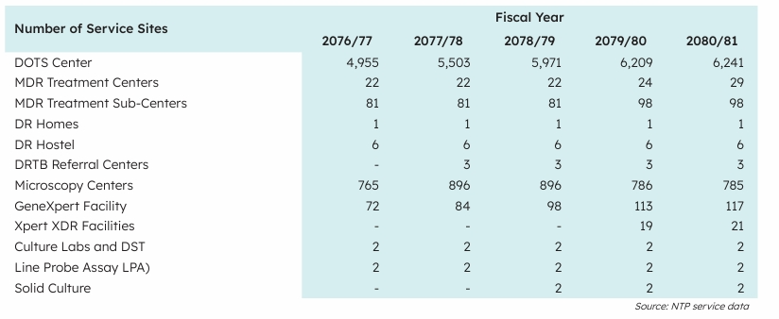
Current Achievement
Institutional coverage

Slide 20
Case notification rates
In FY 2080/81,the case notification rate (CNR) of all forms of TB is 139 /100,000 population.
Incident TB cases (PBC new and relapse) is 78.2 per 100,000 population.
Total 98.4% incident TB cases registered (New and Relapse) among all TB cases.
Among the 30 districts with high TB case notifications, 18 are in the Terai region, and the remaining 12 are in the Hilly region.

Slide 21
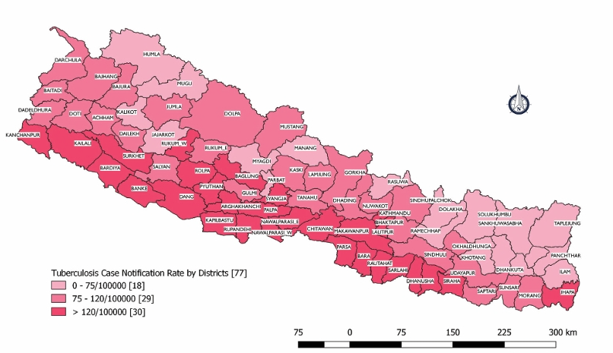
District wise tuberculosis case notification rate, 2080/81
Source: NTCC/DoHS

Slide 22
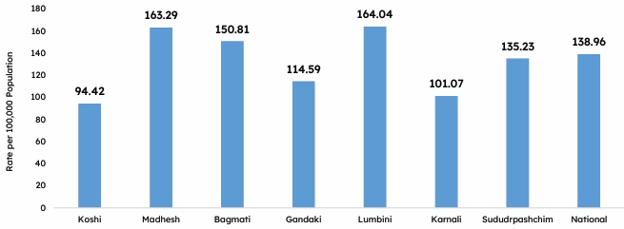
Notified TB cases (all forms) in rates by provinces for FY 2080/81
Source.NTCC/DoHS

Slide 23
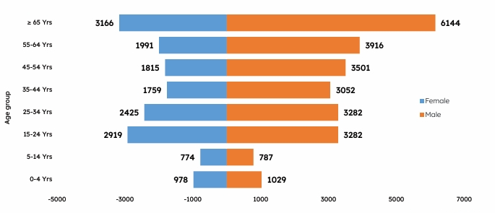
Notified TB cases by age-group compared to the estimated incidence
Source.NTCC/DoHS

Slide 24
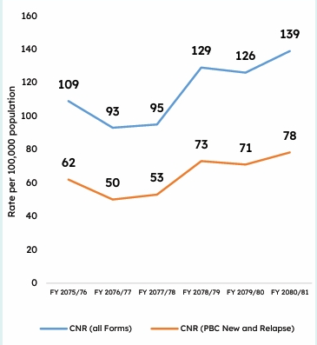
TB case notification rate (2075/76–2080/81)
Source: NTCC/DoHS

Slide 25
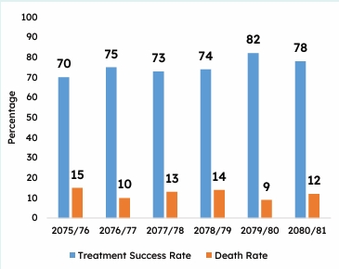
Treatment success rates (%) in FY 2075/76 - 2080/81
Source: NTPMIS/NTCC

Slide 26
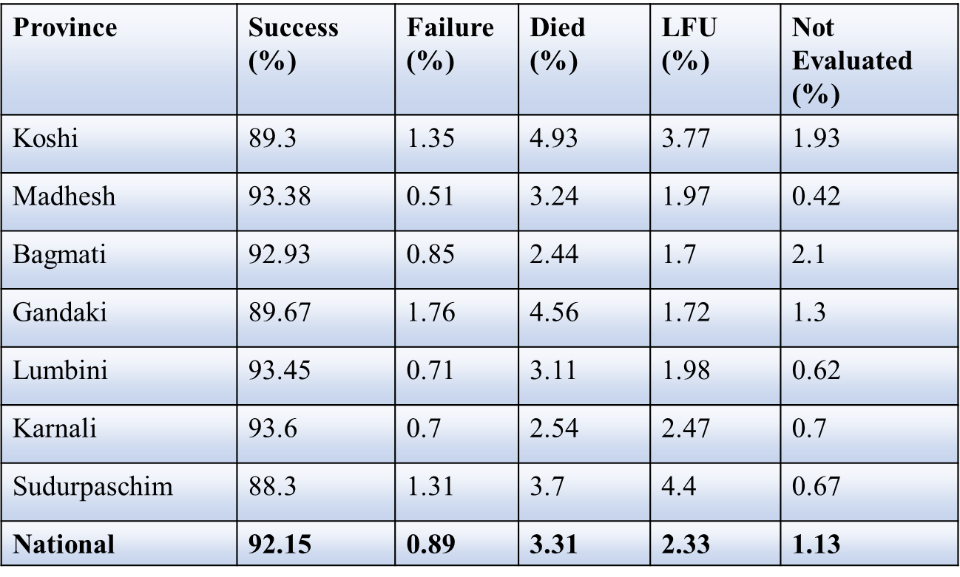
Province wise TB treatment outcomes (2080/81)

Slide 27
Drug Resistant TB Types
Rifampicin resistant TB (RR-TB) is resistant to rifampicin (detected using rapid diagnostic tests), with or without resistance to other anti-TB drugs and covers any resistance to rifampicin.
• Pre-extensively drug-resistant TB (Pre-XDR TB) is a multi-drug resistant strain of TB that is also resistant to either one of the fluoroquinolones and all the second line injectable drugs.
• Extensively drug resistant TB (XDR TB) is a severe form of MDR-TB that is multidrug-resistant (MDRTB) to all the fluoroquinolones and second line injectable drugs.

Slide 28
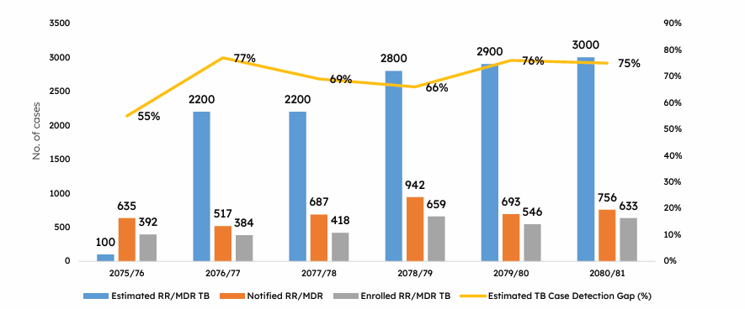
MDR TB annual case finding and gap in fiscal year 2080/81
Source: NTPMIS

Slide 29
NTP’s laboratory network
A strong TB laboratory network is essential to ensure timely and universal access to quality-assured diagnostics
Trained human resources, adequate infrastructure, equipment, a quality assurance system, a sample transportation network, a supply of commodities, and a monitoring system are key components of such a laboratory network.
The National Tuberculosis Reference Laboratory (NTRL) is an apex laboratory in TB laboratory network which works along with the PPHL and Provincial TB Laboratory present in each province to provide quality assured TB laboratory diagnostic services to the patients.

Slide 30
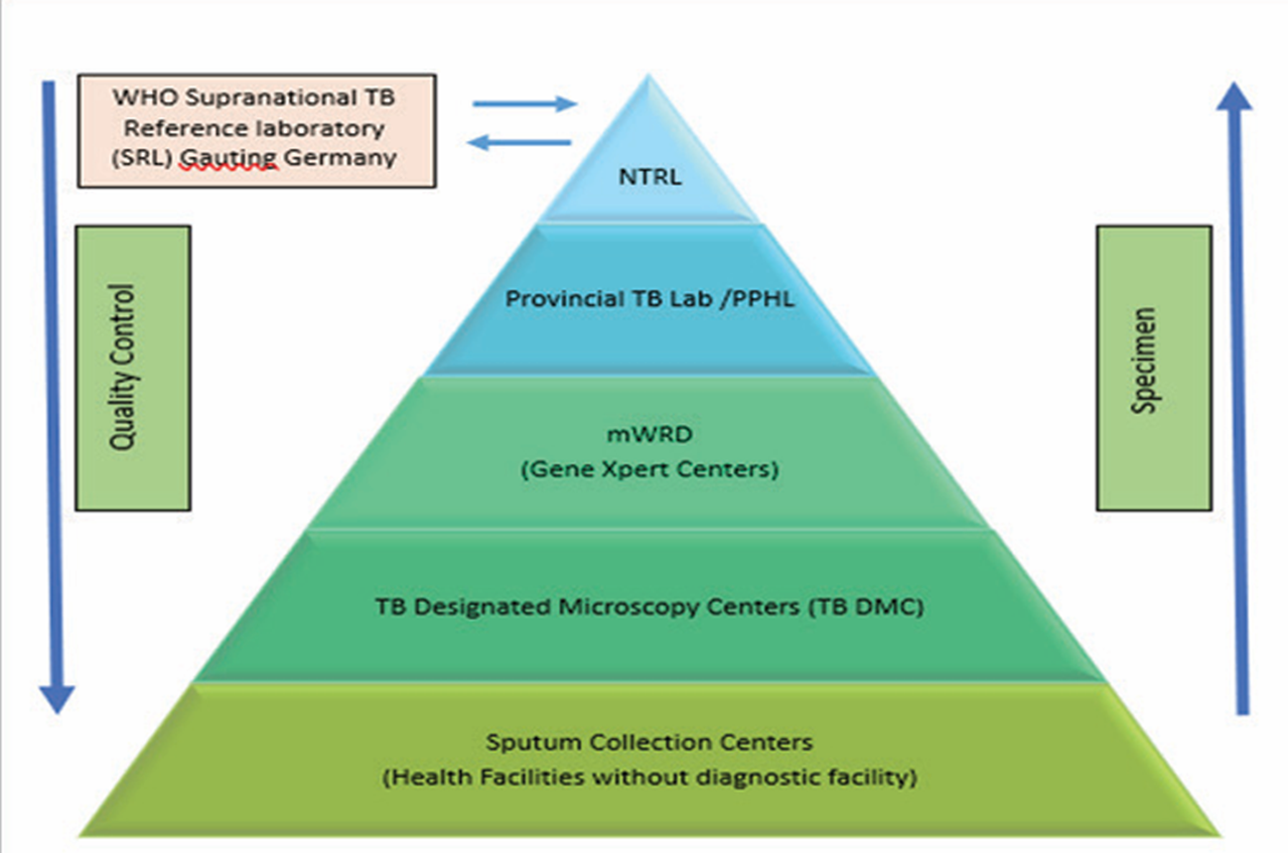
National TB Laboratory Network

Slide 31
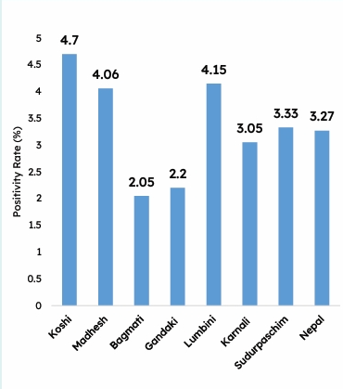
Sputum Microscopy Positivity Rate performed in FY 2080/81
Source: HMIS, NTPMIS

Slide 32
Strengths
Dedicated and well-qualified team at NTCC
Standard protocol for TB treatment and management
Wider reach of treatment service facilities (>6200) and diagnostic services ( mWRD services available in 87% of districts - 67 districts out 77 in total)
Digitalization of case-based database systems (NTPMIS) and integration with national reporting system (HMIS) for TB
Well established Procurement and Supply Management (PSM) System for the TB Program

Slide 33
Engagement of partners in national TB program
Participation of Provincial Public Health Laboratories (PPHL) in the EQA( External quality assurance) of TB Sputum Microscopy

Slide 34
Weakness
Insufficient human resources dedicated to TB program management at all levels
Significant gap in treatment coverage (TB case notification vs. estimated incident TB cases).
Limited engagement of the private sectors and communities in TB diagnosis and management
Gap in quality reporting of NTP data from HMIS in terms of accuracy
Inadequate onsite coaching, mentoring and supportive supervision

Slide 35
Opportunities
Possibility for recruiting additional human resources based on program needs (Mobilization of HR – Scholarship Contract)
Priority one public health program; high political commitment (TB Free Initiative expanded to additional 99 local levels/Palikas, Global Fund/SR extensive interventions in 42 districts)
Participation of PPHL in the EQA of laboratory diagnosis of TB Interoperability between HMIS and NTPMIS, including biometric systems for GX and DR sites with the support of Province and Local Levels.
eLMIS system is rollout by Management division and eTB system capturing data on TB logistics supply management.

Slide 36
Threats
Smooth implementation of NTP in emergency situation created due to natural disasters such as floods, landslides and earthquake Inadequate coordination between provincial and local levels.
High stigma and catastrophic costs.
Challenges in extending warranties for GeneXpert.
Frequent transfer of dedicated staffs at all levels.
Dependence on external funding and issues on its sustainability.
Open border with high internal and external migration.
Rising TB co-morbity rates with other infectious diseases.

Slide 37
Suggestion
Expansion of CB-DOTS programme throughout the country
• Endorsement of PPM guideline to strengthen Public-Private Mix approach
• Strengthen the community support system programme
• Explore operational research areas on TB prevention, treatment, and care
• Develop and distribute patients centred on TB IEC materials
• Pilot patient-friendly treatment centres in the country

Slide 38
References
http://nepalntp.gov.np/
https://hmis.gov.np/posts/single/annual-health-report-208081
Nepal health sector strategic plan

Slide 39
Thank you !

