Slide 1
Toxoplasma gondii

Slide 2
Introduction
Recognized as the most common protozoan parasite globally and is world wide in distribution.
Obligate intracellular coccidian parasite which is found inside the reticuloendothelial cells and many other nucleated cells.

Slide 3
Morphology
T. gondii 3 occurs in forms:
Trophozoite (Tachyzoite)
Tissue cyst
Oocyst.
The trophozoite and the tissue cyst represent the asexual multiplication (schizogony) while the oocyst represent the sexual reproduction (gametogony or sporogony).
All three forms are present in cats and only asexual forms are present in mammals and birds.

Slide 4
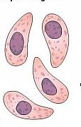
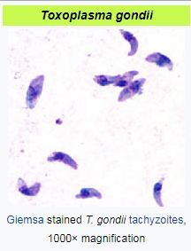
Trophozoites (Tachyzoites)
Crescent shaped with one end pointed and the other end rounded.
Measures 3-7µm in length.
Nucleus is ovoid and is situated at the bunt end of the parasite.
Tophozoites stains well with Giemsa stain.
The rapidly proliferating trophozoites in acute infection are called tachyzoites.

Slide 5
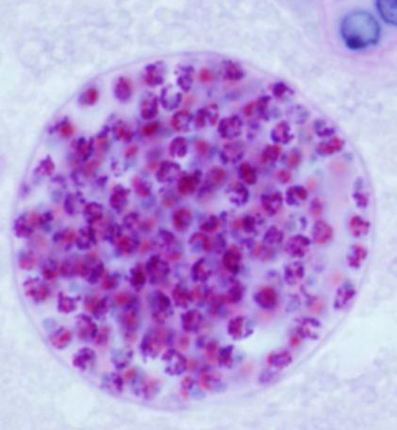
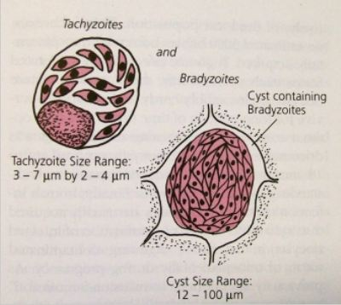
Tissue cyst (Bradyzoites)
Resting form of the parasite.
Found in the brain, skeletal muscles and other various organs.
Round or oval in shape, 10-20µm in size and contains several bradyzoites.
When the raw or uncooked meat containing cysts is eaten infection occurs.

Slide 6
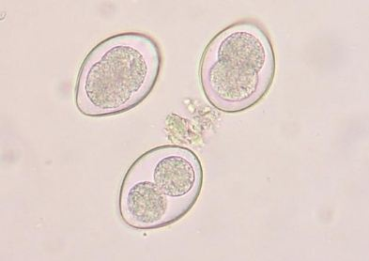
Oocyst
Developed in the definitive host (cats and felines)
Oval and measures 10-12µm in diameter.
Cats shed millions of oocysts per day in feces.
Oocysts are resistance to environmental conditions and can remain infective in soil for about an year.
Contains 2 sporocyst and 4 sporozoites.

Slide 7
Life cycle
Host: 2 hosts
Definitive host: Cats and other felines.
Intermediate host: Man and other mammals.
Mode of transmission:
- Eating uncooked or undercooked infected meat.
- Ingestion of mature oocysts.
- mother to fetus. ( Congenital toxoplasmosis)
- Blood transfusion.
Life cycle:
- Enteric cycle (Definitive host).
- Exoenteric cycle (Intermediate host).

Slide 8
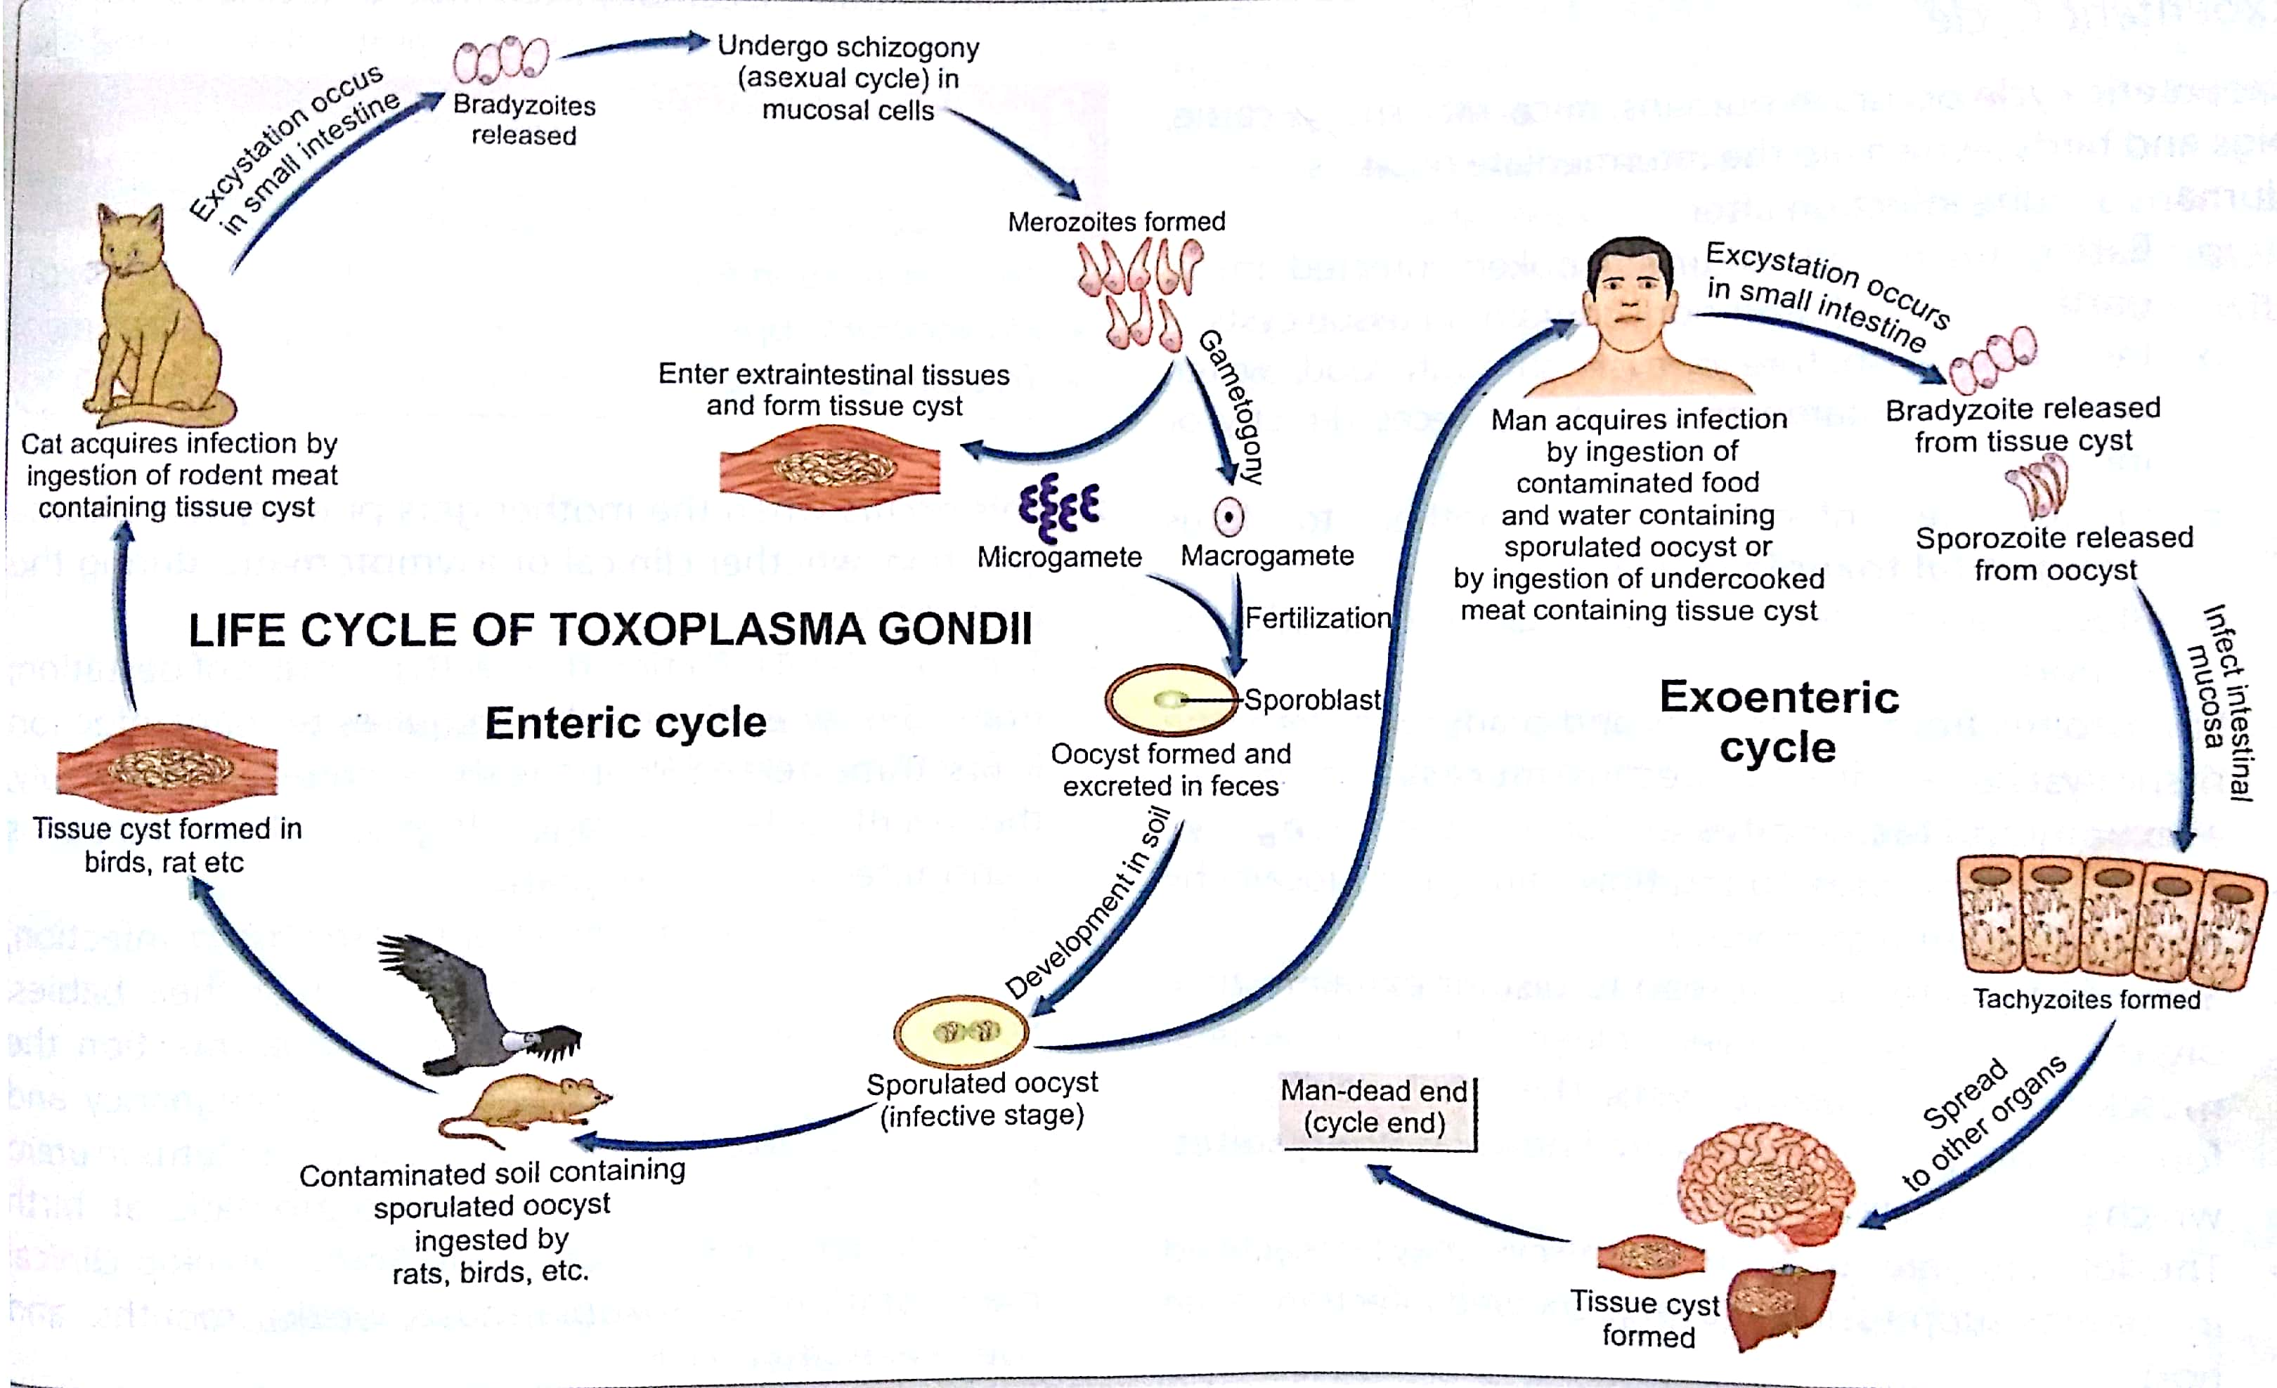
Life cycle

Slide 9
Enteric cycle:
Cats acquires infection by ingestion of tissue cysts in the meat of rats and other animals or by ingestion of oocysts passed in its feces.
Bradyzoites are released in the small intestine and they undergo asexual multiplication (schizogony) leading to the formation of merozoites.
Some merozoites enters extra intestinal tissue resulting in the formation of tissue cysts in the other organs of the body.
Other merozoites transform into male and female gametocyte and sexual (gametogony) begins with the formation of microgamete and macrogamete.
Macrogamete is fertilized by motile microgamete resulting in the formation of oocysts which mature in the soil.

Slide 10
Exoenteric cycle:
Human acquire infection by:
- Eating uncooked or undercooked infected meat.
- Ingestion of mature oocysts.
- mother to fetus. ( Congenital toxoplasmosis)
- Blood transfusion.
- Sporozoites from the oocysts and bradyzoites from the tissue cysts enter into the intestinal mucosa and multiply asexually and trachyzoites are formed.
Trachyzoites continue to multiply and spread locally by lymphatic system and blood to different organs and forms tissue cysts.
Bradyzoites are present inside the tissue cysts and remain viable for years which may renewed infection in immune suppression host
Human infection is the dead end of the parasite.

Slide 11
Pathogenesis
Clinical toxoplasmosis can be congenital or acquired.
Congenital toxoplasmosis:
The severity of fetal damage is highest when infection is transmitted in early pregnancy.
The manifestation of congenital toxoplasmosis include chorioretinitis, cerebral calcifications, convulsions, deafness, blindness, mental retardness, microcephaly and hydrocephalus.
2. Acquired toxoplasmosis:
Infection acquired postnatally is mostly asymptomatic.
Lymphadenopathy is the common manifestation.
Fever, headache, myalgia and splenomegaly are often present. Mild flue may be present which is self limiting.

Slide 12
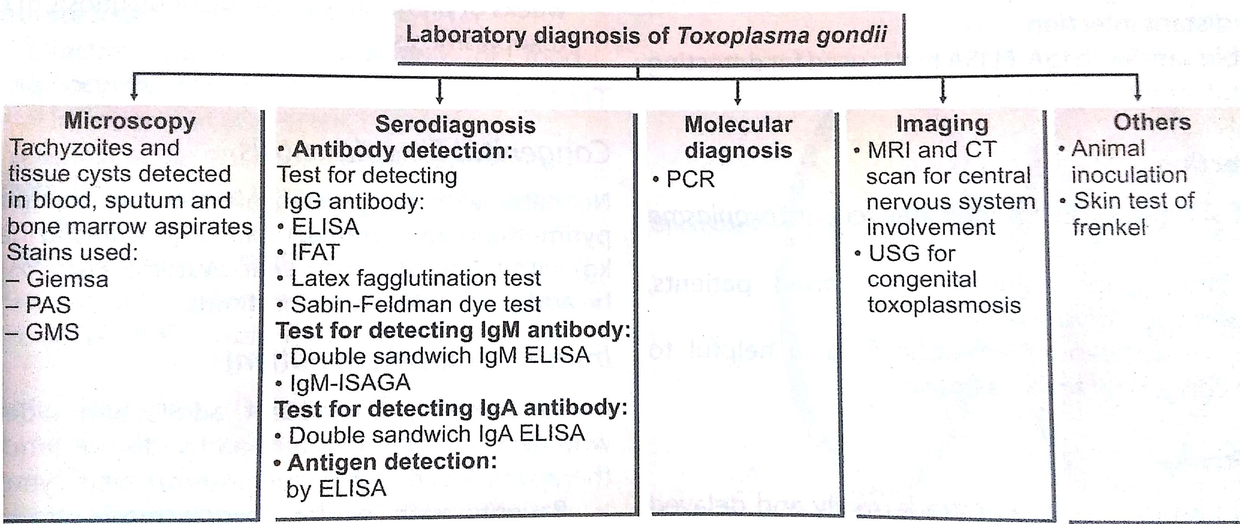
Laboratory diagnosis

Slide 13
Treatment and Prophylaxis
Congenital toxoplasmosis:
Oral pyrimethamine (1mg/kg) daily and sulfadiazine (100mg/kg) with folinic acid for 1 year.
Immunocompetent patients:
Pyrimethamine plus either sulfadiazine or clindamycin for 1 month.
Prophylaxis:
- Avoid contact with cats and its feces.
Proper cooking of meal.
Washing of hands and vegetables and fruits.
Screening for seropositive blood samples before the transfusion.

