Slide 1
PLANNING AND PROCESS OF MONITORING
Presented By
Presented to
Anuska Rai
Roll No:06,BPH 7th Sem Pou, SHAS,PU
Associate Prof. Dr. Dipendra Kumar Yadav
Pou, SHAS,PU
Bishmark Sapkota
Roll No:11, BPH 7th Sem Pou, SHAS,PU
Resham Karki
Roll No:25, BPH 7th Sem Pou, SHAS,PU
3/23/2026
Planning and Process of Monitoring
1
1

Slide 2
List of Content
1
Planning Of Monitoring
2
Process of Developing Monitoring Indicator
3
Implementation of Monitoring
4
Reporting Of Monitoring

Slide 3

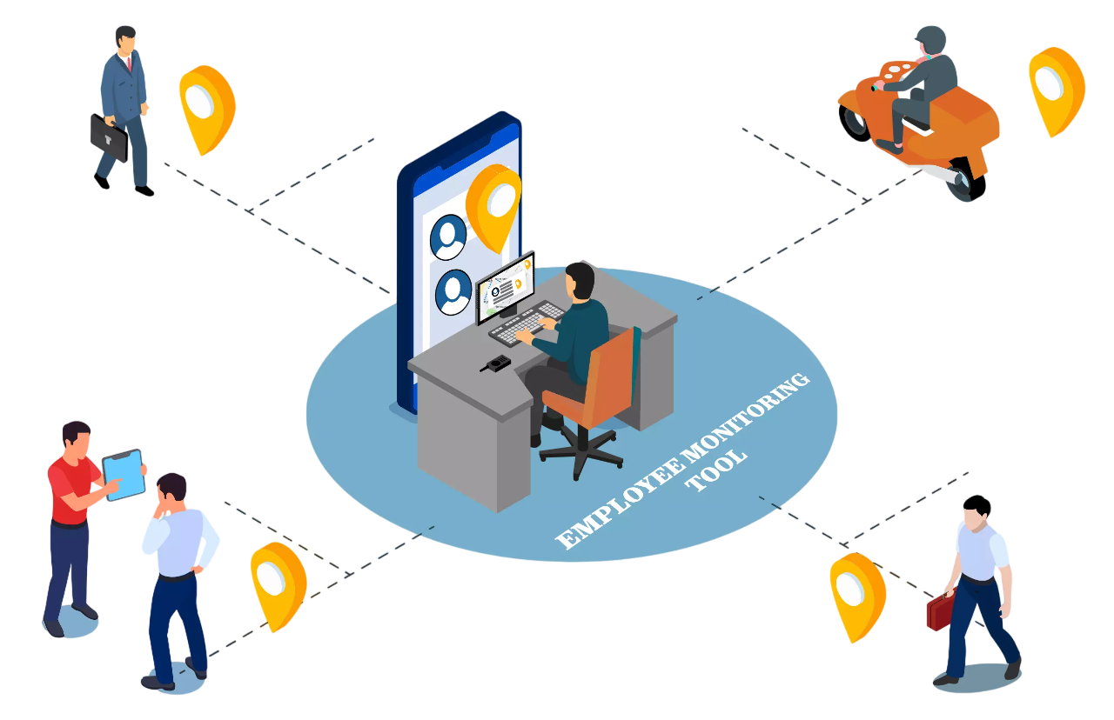

Slide 4
Plan
A plan is a structured outline or roadmap that describes what needs to be done, how it will be done, who will do it, and when it will happen to achieve a specific goal.
A plan = Goal + Actions + Resources + Timeline + Responsibilities + Monitoring
3/23/2026
Planning and Process of Monitoring
4
4

Slide 5
Planning of monitoring
Refers to the process of designing how monitoring will be carried out for a program or project. It ensures that data collection, analysis, and reporting are systematic and aligned with program goals.
3/23/2026
Planning and Process of Monitoring
5
5

Slide 6
Key Elements of Planning for Monitoring
Purpose
  why are we monitoring? (e.g., track progress, improve service delivery, ensure accountability)
Indicators
  What will we measure? (e.g., number of immunizations, maternal mortality rate)
Methods & Tools
  How will data be collected? (e.g., surveys, HMIS reports, checklists)
Roles & Responsibilities
  Who will collect, analyze, and report data? (e.g., health workers, local governments, MoHP)
Frequency & Timing
  When will monitoring happen? (e.g., monthly, quarterly, annually)
Resources
  What is needed? (budget, staff, technology)
Data Use
  How will findings be used for decision-making and improvement?
3/23/2026
Planning and Process of Monitoring
6
6

Slide 7
Process of planning for monitoring
1. Define Purpose and Objectives
Why do we need monitoring?
(e.g., track progress of maternal health program, ensure accountability)
2. Identify Indicators
Select SMART indicators for inputs, outputs, outcomes, and impact.
(e.g., % of pregnant women receiving 4 ANC visits)
3/23/2026
Planning and Process of Monitoring
7
7

Slide 8
cont..
3. Determine Data Sources and Methods
Decide where data will come from: HMIS, surveys, facility records.
Choose collection methods: routine reporting, field visits, interviews.
4. Assign Roles and Responsibilities
Who will collect, analyze, and report data?
(Local health workers, municipality, provincial health office, MoHP)

Slide 9
Cont.......
5. Set Frequency and Timeline
When will monitoring occur?
(Monthly reporting, quarterly reviews, annual evaluations)
6. Allocate Resources
Budget, staff, technology, training needed for monitoring.
7. Develop Reporting and Feedback Mechanism
How will data be shared and used for decision-making?
(Reports, dashboards, review meetings)
3/23/2026
9
9
Planning and Process of Monitoring

Slide 10
Planning for Monitoring
In short, planning of monitoring is about creating a clear roadmap for what, who, how, when, and why monitoring will occur so that health programs remain effective and accountable.
3/23/2026
Planning and Process of Monitoring
10
10

Slide 11
Planning for Monitoring in Nepal
Planning for health monitoring in Nepal involves using a national strategy like the Nepal Health Sector Strategy (NHSSP) 2023-2030, defining indicators to track progress towards universal health coverage and Sustainable Development Goals, and utilizing systems like the Health Management Information System (HMIS) for data collection, analysis, and reporting. Key activities include setting up M&E frameworks, conducting regular surveys such as the National Demographic Health Survey (NDHS), and building capacity for data management and reporting across all levels of government.
3/23/2026
Planning and Process of Monitoring
11
11

Slide 12
Where: Geographical and Institutional Scope
Monitoring must be conducted across all levels of Nepal's federal health system to ensure comprehensive coverage and address disparities.
Local Level (Program Implementation Site): This is the frontline of monitoring.
  Health Facilities: Health Posts, Primary Health Care Centres (PHCCs), Birthing Centres, and hospitals where services are delivered.
  Community: Wards, settlements, and households, often reached by Female Community Health Volunteers (FCHVs) and Outreach Clinics.
3/23/2026
Planning and Process of Monitoring
12
12

Slide 13
Province Level:
  Provincial Health Directorates/Ministries: For oversight, aggregation of data from local units, and monitoring of province-specific programs.
Federal Level:
  Ministry of Health and Population (MoHP): The apex body for policy compliance, national indicator tracking, and sectoral performance review.
  Integrated Health Information Management Section (IHIMS)/Department of Health Services (DoHS): For national data compilation, analysis, and reporting through the Health Management Information System (HMIS).

Slide 14
How: Tools and Methods for Monitoring
Monitoring Method | Example/Tools
Routine Data Collection | HMIS/DHIS2: Electronic platform for aggregating service statistics (e.g., number of ANC visits, immunization coverage). EWARS (Early Warning and Response System) for disease surveillance.
Supervisory/Supportive Visits | Checklists for facility readiness, on-site coaching of health workers, Data Quality Assurance (DQA) tools.

Slide 15
Monitoring Method | Example/Tools
Periodic Surveys | Nepal Demographic and Health Survey (NDHS), Nepal Multiple Indicator Cluster Survey (NMICS), or specific project baseline/endline surveys.
Community Feedback | Mothers' Group Meetings, focus group discussions (FGDs), suggestion boxes, and citizen report cards.
Program Review Meetings | Data Review meetings at the facility, local, and provincial levels.
3/23/2026
Planning and Process of Monitoring
15
15

Slide 16
Who: Roles and Responsibilities
Effective monitoring relies on clear accountability across all tiers of the health system.
Local Level:
  Health Facility In-Charge: Responsible for daily monitoring of service delivery, ensuring accurate recording, and timely reporting into HMIS.
  FCHVs: Monitor community-level activities, track eligible beneficiaries (e.g., pregnant women, children), and report to the local health facility.
  Local Government (Ward/Palika): Oversight, resource allocation, and conducting local review meetings.

Slide 17
Province Level:
  Provincial Health Ministry/Directorate: Responsible for supportive supervision, aggregating district data, and annual/semi-annual provincial performance reviews.
Federal Level:
  MoHP/DoHS: Responsible for designing the M&E framework, establishing national indicators, conducting central-level reviews, and commissioning large-scale surveys (like NDHS).
  External Partners (NGOs/INGOs): Often conduct their own project monitoring and capacity building for local government staff, aligning with national guidelines.
3/23/2026
Planning and Process of Monitoring
17
17

Slide 18
What: Key Areas and Indicators to Monitor
Monitoring focuses on tracking program inputs, processes, and outputs using a logical framework approach. The indicators should align with the national priorities and the Sustainable Development Goals (SDGs).

Slide 19
Focus Area | Examples of Program Indicators (What to Monitor)
Inputs/Resources | Availability of tracer drugs and commodities (e.g., contraceptives, vaccines). Percentage of health facilities with functional equipment (e.g., thermometer, weighing scale).
Process/Activity | Percentage of planned Primary Health Care Outreach (PHC/ORC) sessions held. Percentage of reported data that is complete and timely (data quality). Number of supportive supervision visits conducted.
Outputs/Services | Immunization Coverage (e.g., DPT3/Measles). Contraceptive Prevalence Rate (CPR) (modern methods). Percentage of institutional deliveries. Out-Patient Department (OPD) utilization rate.
Outcomes (Longer-term) | Infant Mortality Rate (IMR), Maternal Mortality Ratio (MMR) (measured through surveys/census), or changes in knowledge/behavior
3/23/2026
Planning and Process of Monitoring
19
19

Slide 20
When: Frequency of Monitoring Activities
The frequency is determined by the need for timely corrective action and the reporting requirements of the health system.
Daily/Weekly:
  Daily: Service registration at the facility level, tracking stockouts.
  Weekly: Reporting for the EWARS surveillance system (for outbreak-prone diseases).
Monthly:
  Submission of routine service data from health facilities to the Palika (Local Unit) via HMIS.
  Monthly review of service statistics by the Health Facility In-Charge.
3/23/2026
Planning and Process of Monitoring
20
20

Slide 21
Quarterly:
  Local Level Review: Review meetings at the Palika/Local Government level to analyze monthly data trends and plan resource mobilization.
  Supportive Supervision by Provincial/District teams.
Semi-Annual/Annual:
  Joint Annual Review (JAR): Sector-wide national review led by MoHP with development partners.
  Annual Planning and Budgeting: Use of annual HMIS data for evidence-based planning for the next fiscal year.

Slide 22
Why Monitoring Matter ?
3/23/2026
Planning and Process of Monitoring
22
22

Slide 23
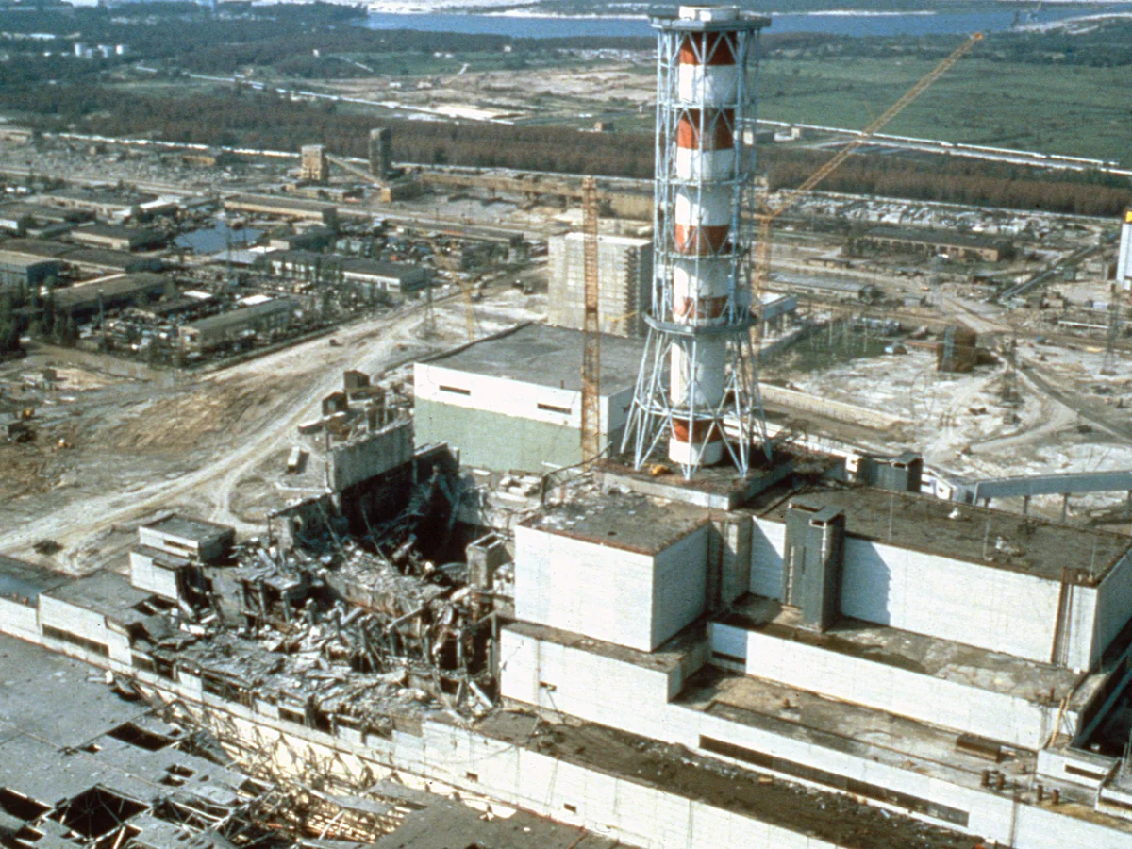


Slide 24
Why Indicators Matter ?
Definition: Health indicators are variables that reflect the health status of a community and the performance of health services.
  Measure progress towards health goals.
  Guide evidence-based decision-making and policy.
  Identify inequalities and areas for improvement.
3/23/2026
Planning and Process of Monitoring
24
24

Slide 25
Process Of Developing Monitoring Indicator
01
02
03
Define Program Goals and Objectives
Identify Program Activities, Outputs, and Outcomes
Select Key Performance Indicators (KPIs
04
05
06
Define Each Indicator Clearly
.
Establish Baselines and Set Targets
Plan Data Collection and Analysis
07
Use Data for Improvement and Reporting
3/23/2026
Planning and Process of Monitoring
25
25

Slide 26
Step 1 - Define Program Goals and Objectives
Clarify objective: What exactly should change, for whom, by when?
Clearly establish what the program aims to achieve. Goals describe the overall purpose, while objectives define specific, measurable results that the program intends to accomplish.
Example (Malaria Prevention Program):
  Goal: To reduce the burden of malaria in a specific district.
  Objective: To reduce confirmed malaria cases by 40% among children under 5 within two years.
  Target Population: Children under 5 and the general population in the target district.
3/23/2026
Planning and Process of Monitoring
26
26

Slide 27
Step 2 - Identify Program Activities, Outputs, and Outcomes
Action: Map the program's logic to understand what needs to be measured.
Break down the program into:
Activities – What actions will be carried out?
Outputs – What immediate products or services will be delivered?
Outcomes – What short-term and long-term changes are expected?
Example (Malaria Prevention Program):
  Activities: Distribute insecticide-treated nets (ITNs) and provide health education workshops.
  Outputs: Number of ITNs distributed; Number of people attending workshops.
  Outcomes: Increased use of ITNs among children; Improved knowledge of malaria prevention.
  Impact: Reduced malaria incidence and mortality rates.
3/23/2026
Planning and Process of Monitoring
27
27

Slide 28
Step 2 - Identify Program Activities, Outputs, and Outcomes
1
Action
Map the program's logic to understand what needs to be measured.
Example (Malaria Prevention Program):
  Activities: Distribute insecticide-treated nets (ITNs) and provide health education workshops.
  Outputs: Number of ITNs distributed; Number of people attending workshops.
  Outcomes: Increased use of ITNs among children; Improved knowledge of malaria prevention.
  Impact: Reduced malaria incidence and mortality rates.
2
Activities
What actions will be carried out?
3
Output
What immediate products or services will be delivered?.
4
Outcome
What short-term and long-term changes are expected?
3/23/2026
Planning and Process of Monitoring
28
28

Slide 29
Step 3 - Select Key Performance Indicators (KPIs
Choose the most important indicators that effectively measure progress at different levels:
Process indicators (activities)
Output indicators (deliverables)
Outcome indicators (changes and results)
Indicators must be SMART (Malaria Prevention Program):
Level | Indicator Description | SMART Check
Output | Number of ITNs distributed in the target district by the end of Year 1. | Specific, Measurable, Time-bound
Outcome | Proportion of children under 5 who slept under an ITN the previous night (measured annually by survey). | Relevant, Measurable
Impact | Confirmed malaria case incidence rate per 1000 persons per year. | Specific, Time-bound, Relevant
3/23/2026
Planning and Process of Monitoring
29
29

Slide 30
Criterion | Description | Check-point Question
Specific | Measures a single, well-defined item, target group, and location. | Does it clearly define the target population and intervention?
Measurable | Can be quantified (e.g., count, rate, percentage) consistently. | Is there a reliable source of data for the numerator and denominator?
Achievable | The data collection is realistic, affordable, and possible within the program's resources and context. | Can we realistically collect this data with existing HMIS/survey tools?
Relevant | Directly related to the program objective and decision-making needs. | Does the indicator matter to the program's success?
Time-bound | Specifies the frequency of measurement and reporting period. | Is the measurement period (e.g., monthly, annual) clearly defined?

Slide 31
Step 4- Define Each Indicator Clearly
Write a precise definition for consistency in data collection and interpretation.
Example (Malaria Prevention Program - Outcome Indicator):
  Indicator Name: ITN Use Among Children Under 5.
  Definition: "The percentage of children aged 6-59 months in the target district who slept under an insecticide-treated net the night prior to the survey".
  Numerator: Number of children aged 6-59 months who slept under an ITN.
  Denominator: Total number of children aged 6-59 months surveyed.
3/23/2026
Planning and Process of Monitoring
31
31

Slide 32


Step 5 - Establish Baselines and Set Targets
Baseline
The starting value of the indicator before program implementation.
Target
The expected level of achievement within a specific timeframe.
Measure the starting point and set realistic goals.
Setting baselines and targets helps compare progress over time.
3/23/2026
Planning and Process of Monitoring
32
32

Slide 33
Step 6 - Plan Data Collection and Analysis
Determine data sources, methods, and frequency.
  Specify the operational plan for monitoring:
  What data will be collected
  How often
  Who is responsible
  Tools and methods (surveys, registers, checklists, MIS, etc.)
  Processes for data verification, analysis
Example (Malaria Prevention Program):
  Sources: Health Management Information System (HMIS), routine facility surveillance, population-based surveys (e.g., DHS/MIS).
  Methods: Facility records review, household questionnaires.
3/23/2026
Planning and Process of Monitoring
33
33

Slide 34
Step 7 - Use Data for Improvement and Reporting
Regularly review data to inform decisions and adapt the program (adaptive management).
Use monitoring findings to:
Identify gaps and make program adjustments
Strengthen implementation strategies
Inform stakeholders through reports
Example (Malaria Prevention Program):
  Review: Quarterly meetings to review ITN distribution figures and test positivity rates.
  Action: If coverage targets are missed, adjust distribution strategies (e.g., add more distribution points, run awareness campaigns).
  Reporting: Submit annual reports to the Ministry of Health and funding partners (e.g., The Global Fund).
3/23/2026
Planning and Process of Monitoring
34
34

Slide 35
Promotive Monitoring Indicator
"Health promotion is the process of enabling people to increase control over, and improve, their health"
-WHO
A promotive monitoring indicator is a measurable variable used to track the progress, quality, and effectiveness of health promotion activities aimed at improving healthy behaviors, empowering communities, and creating supportive environments for better health.
1. Health Education & Awareness
Number of health education sessions conducted (schools, communities, workplaces)
Proportion of population reached with IEC/BCC materials (Information, Education, Communication / Behavior Change Communication)
2. Nutrition Promotion
Proportion of households consuming diversified diets
% of adolescents and women aware of balanced diet practices
School meal program coverage
3/23/2026
Planning and Process of Monitoring
35
35

Slide 36
cont....
3. Physical Activity & Lifestyle
% of adolescents/adults engaging in ≥30 minutes of physical activity daily
Number of schools/communities with regular sports or exercise programs
Workplace wellness program coverage
4. Tobacco, Alcohol & Substance Use Prevention
Prevalence of tobacco use among adolescents/adults
Prevalence of harmful alcohol consumption
Number of awareness campaigns against tobacco/alcohol
3/23/2026
Planning and Process of Monitoring
36
36

Slide 37
Preventive health Monitoring Indicator
Preventive health refers to actions taken to avoid disease occurrence or progression before it happens. It includes
  immunization,
  screening,
  maternal and child health services, communicable disease control, and environmental health measures.
“Preventive health = stopping disease before it starts."
3/23/2026
Planning and Process of Monitoring
37
37

Slide 38
cont.....
1. Immunization & Child Health
  Full immunization coverage (12–23 months)
  Dropout rate (DPT1–DPT3, BCG–Measles)
  Zero‑dose children proportion
  Vitamin A supplementation coverage
  De‑worming tablet distribution coverage
2. Maternal & Reproductive Health
  Antenatal care (ANC) 1st visit and 4th visit coverage
  Postnatal care (PNC) coverage within 48 hours and 7 days
  Institutional delivery rate
  Skilled birth attendance rate
  Contraceptive prevalence rate (CPR)
3/23/2026
Planning and Process of Monitoring
38
38

Slide 39
Protective health Indicator
Protective health refers to measures that safeguard individuals and communities from health risks and hazards. It emphasizes safety, regulation, and enforcement to protect people from environmental, occupational, and social threats.
“Protective health = shielding people from harm.”
3/23/2026
Planning and Process of Monitoring
39
39

Slide 40
cont....
1. Environmental & Occupational Safety
  % of industries complying with occupational health and safety standards
  Number of workplaces with protective equipment available (helmets, masks, gloves)
  Incidence of workplace injuries and accidents
2.Road & Transport Safety
  Road traffic accident incidence rate per 100,000 population
  % of drivers using seatbelts/helmets
  Number of road safety awareness campaigns conducted
3. Disaster & Emergency Preparedness
  % of health facilities with disaster preparedness plans
  Number of simulation drills conducted annually
  Availability of emergency stockpiles (medicines, blood, equipment)
3/23/2026
Planning and Process of Monitoring
40
40

Slide 41
Example:
Road Safety Indicator
Indicator Name: Road Traffic Accident Incidence Rate
Definition: “Number of reported road traffic accidents per 100,000 population in a given year.”
Numerator: Total number of reported road traffic accidents in the district.
Denominator: Total population of the district × 100,000.
Baseline (Year 0): 25 accidents per 100,000 population.
Target (Year 2): Reduce to 15 accidents per 100,000 population.
Data Source: Police records, hospital emergency registers, HMIS.
Frequency: Quarterly reporting, annual review.
Impact Goal: Reduced mortality and disability due to road traffic accidents
3/23/2026
Planning and Process of Monitoring
41

Slide 42
Epidemic Control Service Indicator
An epidemic is the sudden increase in the number of cases of a disease above what is normally expected in a specific population or area.
"Control outbreaks quickly“
1. Surveillance & Early Detection
Timeliness of reporting (proportion of health facilities submitting weekly surveillance reports on time)
Completeness of reporting (proportion of expected reports actually received)
Number of suspected cases detected through community/event-based surveillance
Laboratory confirmation rate (proportion of suspected cases tested and confirmed)
3/23/2026
Planning and Process of Monitoring
42

Slide 43
2. Outbreak Response
Average time from case detection to response initiation
Proportion of outbreaks investigated within 48 hours of notification
Number of rapid response teams deployed per outbreak
Availability of emergency stockpiles (PPE, medicines, test kits)
3. Case Management & Containment
Case fatality rate (CFR) for epidemic-prone diseases
Isolation/quarantine compliance rate
Proportion of contacts traced and monitored during outbreaks
3/23/2026
Planning and Process of Monitoring
43

Slide 44
Example:
Measles Outbreak Control Indicator
Indicator Name: Outbreak Investigation Timeliness
Definition: “Percentage of measles outbreaks investigated within 48 hours of notification.”
Numerator: Number of measles outbreaks investigated within 48 hours.
Denominator: Total number of measles outbreaks notified.
Baseline (Year 0): 60% of outbreaks investigated within 48 hours.
Target (Year 2): Achieve ≥90% timely investigation.
Data Source: HMIS, District Health Office outbreak reports, rapid response team logs.
Frequency: Quarterly reporting, annual review.
Impact Goal: Faster containment of measles outbreaks, reduced spread, and lower case fatality.
3/23/2026
Planning and Process of Monitoring
44

Slide 45
Implementation of Monitoring
Implementation monitoring answers the question, ``Did we do what we said we would do?‘’
It is the operational phase where the monitoring plan is executed to continuously track the program's progress, efficiency, and fidelity.
It is a real-time process designed to provide immediate feedback for mid-course corrections, ensuring the program is "doing things right."

Slide 46
Steps involved in implementing monitoring
Step 1: Setup and Capacity Building
Successful monitoring implementation starts with a well-resourced and trained team.
Finalize and Disseminate Tools: Ensure all data collection tools (registers, reporting forms, digital questionnaires like DHIS2/HMIS modules, supervisory checklists) are finalized, printed, and distributed to the point of service delivery (e.g., the health post, clinic, or community health worker).
3/23/2026
Planning and Process of Monitoring
46

Slide 47
Establish Data Flow and Reporting Schedule: Clearly define the data flow path
  Eg: FCHV > health post > Palika/local unit
  > District > Province > Federal MoHP.
The reporting frequency for each indicator must be strictly enforced.
Capacity Building: Train the personnel responsible for each step:
Data Collectors (e.g., Health Workers, FCHVs): Training on indicator definitions, filling out registers correctly, and digital data entry (e.g., in Nepal's HMIS).
Supervisors (e.g., District Health Officers): Training on data quality assurance (DQA), conducting supportive supervision, and leading performance review meetings.

Slide 48
Step 2: Data Collection and Quality Assurance (DQA)
This phase focuses on the rigorous and consistent capture of reliable data. The principle here is: "Garbage In, Garbage Out."
Routine Data Collection: Data is collected continuously, usually as a byproduct of service delivery (e.g., recording the number of institutional deliveries in the birthing register). This generates real-time service statistics for output and process indicators.
Periodic Data Collection: Conduct occasional data collection activities like surveys (e.g., patient satisfaction, facility readiness) or observation (e.g., adherence to clinical protocols).
3/23/2026
Planning and Process of Monitoring
48

Slide 49
Data Quality Assurance (DQA): Implement checks to verify accuracy:
Internal Checks: Cross-check data consistency (e.g., the number of children vaccinated in the register must match the number reported in the monthly summary).
Verification Visits: Supervisors conduct site visits to triangulate data—verifying reported figures against source documents (registers) and even physical counts (e.g., drug stock levels)
3/23/2026
Planning and Process of Monitoring
49

Slide 50
Step 3: Analysis, Review, and Learning
Data Analysis: Aggregate the data based on the reporting schedule and analyze it against the set targets and baselines. Analysis should include disaggregation (by age, sex, geography) to identify equity gaps.
  Key Question: Is the actual performance (e.g., DPT3 coverage rate) higher or lower than the planned target?
3/23/2026
Planning and Process of Monitoring
50

Slide 51
Performance Review Meetings: Hold regular meetings at all administrative levels (e.g., monthly at the Local Unit/Palika level, quarterly at the Provincial level). These are forums to:
  Interpret Findings: Discuss why performance is lagging or exceeding expectations (e.g., "Why did immunization coverage drop in Ward 5 last month?").
  Identify Bottlenecks: Pinpoint specific challenges (e.g., staff turnover, drug stock-outs, poor road access).
Feedback and Utilization: This is the most important step. Monitoring data must be used to inform decision-making. Insights should lead to corrective actions, resource reallocation, or program adjustments. Good performance should be rewarded, and underperformance should trigger supportive supervision and technical assistance, not just punishment.

Slide 52
Step 4: Reporting and Accountability
Standardized Reporting: Prepare periodic reports (monthly dashboards, quarterly performance reports) using standardized templates that clearly show performance against indicators and targets.
Stakeholder Dissemination: Share reports with all key stakeholders, including the Ministry of Health, local government officials, community representatives (e.g., Mothers' Group leaders), and development partners.
Accountability Mechanisms: Integrate monitoring results into the overall accountability structure. For example, using the data during the Joint Annual Review (JAR) process for the national health sector to inform future policy and budget allocations.

Slide 53
Reporting of monitoring
Process of documenting and communicating the results of ongoing surveillance, observation, or data collection activities.
Purpose :
The primary purpose of reporting in monitoring is to provide stakeholders with information about the status, performance, or changes in a particular system, process, or situation . This information can be used for decision making , problem-solving ,and accountability.

Slide 54
Reporting of monitoring includes:
Data Compilation
collect from registers, tally sheets, digital tools
01
Verification
check accuracy and completeness
02
03
Analysis
compare with targets, identify trends.
04
Documentation
prepare reports (monthly, quarterly, annual).
05
Dissemination
Share with health facilities, district offices, MoHP
3/23/2026
Planning and Process of Monitoring
54

Slide 55
System used in Nepal
DHIS2 (District Health Information System 2): Digital platform for routine health data entry and reporting.
EWARS (Early Warning and Reporting System): Hospital-based sentinel surveillance for communicable diseases, covering 134 hospitals nationwide.
Manual Registers & Tally Sheets: Still used in rural health posts for daily reporting
3/23/2026
Planning and Process of Monitoring
55

Slide 56

THANK YOU

