Slide 1
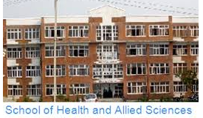
UNIT III: Musculoskeletal System
BIJAY SUBEDI, APL
SHAS, BPH 1st semester

Slide 2
Introduction: BONE
Bone is a special form of connective tissue with a collagen framework impregnated with Ca²⁺ and PO₄^{3–} salts, particularly hydroxyapatites.
Bone is also involved in overall Ca²⁺ and PO₄^{3–} homeostasis.
It protects vital organs, and the rigidity it provides permits locomotion and the support of loads against gravity.
Old bone is constantly being resorbed and new bone formed, permitting remodeling that allows it to respond to the stresses and strains that are put upon it.
It is a living tissue that is well vascularized and has a total blood flow of 200 to 400 mL/min in adult humans.

Slide 3
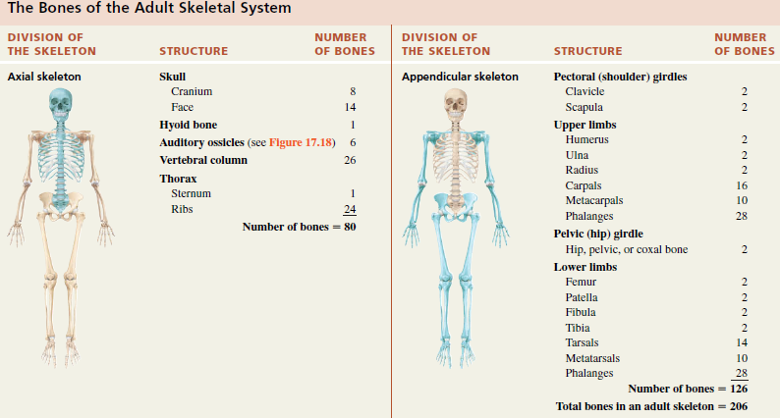
The skeletons of infants and children have more than 206 bones because some of their bones fuse later in life.

Slide 4
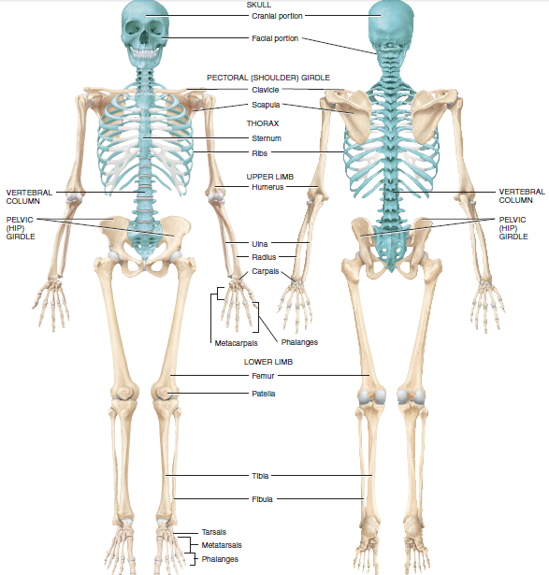

Slide 5
Functions of bone
Besides contributing to body shape and form, our bones perform several important functions:
1. Support. Bones provide a framework that supports the body and supports its soft organs. For example, bones of lower limbs act as pillars to support the body trunk when we stand, and the rib cage supports the thoracic wall.
2. Protection. The fused bones of the skull protect the brain. The vertebrae surround the spinal cord, and the rib cage helps protect the vital organs of the thorax.
3. Movement. Skeletal muscles, which attach to bones by tendons, use bones as levers to move the body and its parts. As a result, we can walk, grasp objects, and breathe. The design of joints determine the types of movement possible

Slide 6
4. Mineral and growth factor storage. Bone is a reservoir for minerals, most importantly calcium and phosphate. The stored minerals are released into the bloodstream as needed for distribution to all parts of the body. Indeed, “deposits” and “withdrawals” of minerals to and from the bones go on almost continuously. Additionally, mineralized bone matrix stores important growth factors such as insulin-like growth factors, transforming growth factor, bone morphogenic proteins, and others
5. Blood cell formation. Most blood cell formation, or hematopoiesis, occurs in the marrow cavities of certain bones.

Slide 7
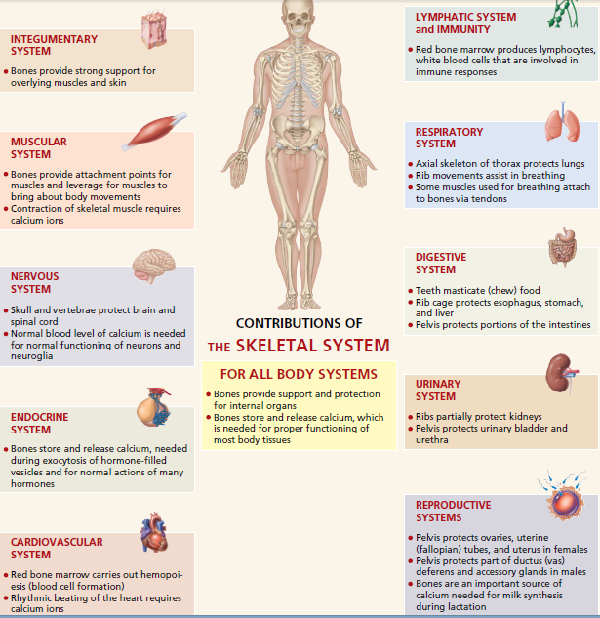
Functions of bone

Slide 8
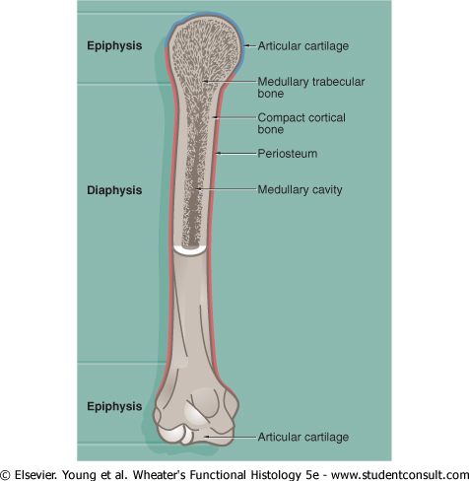
Structure of bones

Slide 9
Bone is composed of cells and a predominantly collagenous extracellular matrix (type I collagen) called osteoid which becomes mineralized by the deposition of calcium hydroxyapatite, thus giving the bone considerable rigidity and strength.
The cells of bone are:
  Osteoblasts - which synthesize osteoid and mediate its mineralization; they are found lined up along bone surfaces.
  Osteocytes - which represent largely inactive osteoblasts trapped within formed bone; they may assist in nutrition of bone.
  Osteoclasts - phagocytic cells which are capable of eroding bone and which are important, along with osteoblasts, in the constant turnover and refashioning of bone.
Osteoblasts and osteocytes are derived from a primitive mesenchymal (stem) cell called the osteoprogenitor cell. Osteoclasts are multinucleate phagocytic cells derived from the macrophage-monocyte cell line

Slide 10
Types of bone being based on microscopic study
Bone in children and adults is of two types:
  compact or cortical bone,
    Makes up the outer layer of most bones and accounts for 80% of the bone in the body. It is dense rigid outer shell.
    In compact bone, bone cells lie in lacunae.
    They receive nutrients by way of canaliculi that branch throughout the compact bone.
    In compact bone, nutrients are provided via haversian canals, which contain blood vessels.
    Around each Haversian canal, collagen is arranged in concentric layers, forming cylinders called osteons or haversian systems.

Slide 11
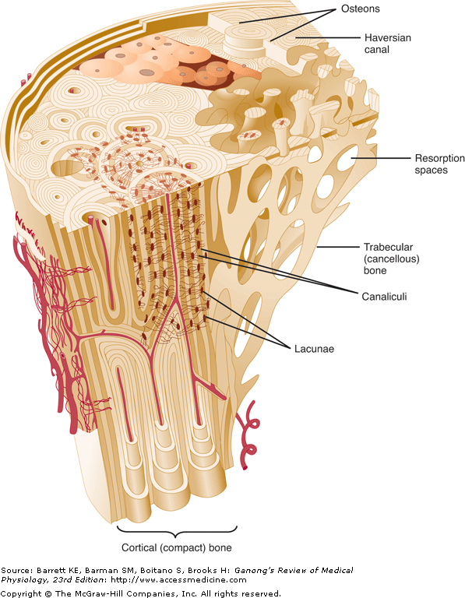
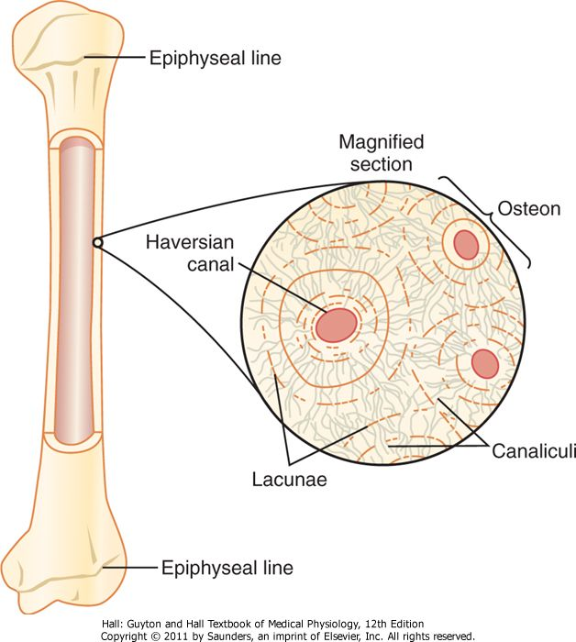

Slide 12
  Trabecular or spongy bones or cancellous
    Lie inside the cortical bone, which makes up the remaining 20% of bone in the body.
    Trabecular bone is made up of spicules or plates, and many cells sit on the surface of the plates.
    central medullary or cancellous zone of thin interconnecting narrow bone trabeculae. The number, thickness and orientation of these bone trabeculae are dependent upon the stresses to which the particular bone is exposed.
    The spaces in the medullary bone between trabeculae is occupied by haemopoietic bone marrow
    Nutrients diffuse from bone extracellular fluid (ECF) into the trabeculae.
Note: The protein in bone matrix is over 90% type I collagen, which is also the major structural protein in tendons and skin. This collagen, which weight for weight is as strong as steel, is made up of a triple helix of three polypeptides bound tightly together.

Slide 13
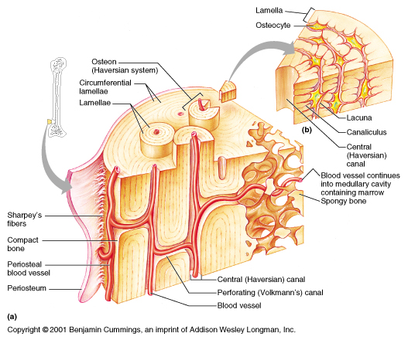

Slide 14
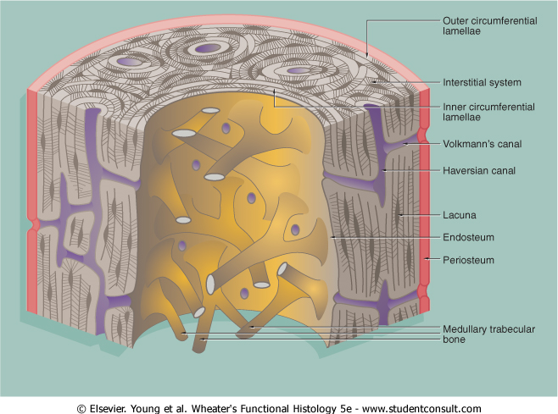

Slide 15
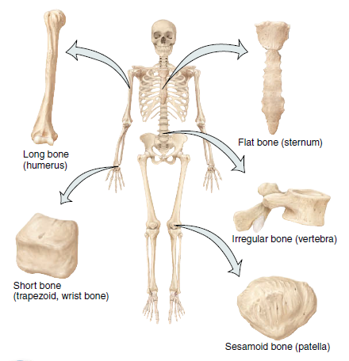
Types of bone based on the shape:

Slide 16
Types of bone based on the shape:
Bones are classified as long, short, irregular, flat and sesamoid.
1. Long bones.
The length is much greater than the width.
These consist of a shaft and two extremities with slight curved for Strength.
Supportive functions
If bones were straight, the weight of the body would be unevenly distributed, and the bone would fracture more easily.
Long bones consist mostly of compact bone tissue in their diaphyses but have considerable amounts of spongy bone tissue in their epiphyses
Examples : femur (thigh bone), tibia and fibula (leg bones), humerus (arm bone), ulna and radius (forearm bones), and phalanges (finger and toe bones).

Slide 17
2. Short bones
somewhat cube-shaped and are nearly equal in length and width.
They consist of spongy bone tissue except at the surface, which has a thin layer of compact bone tissue.
Examples: most carpal (wrist) bones and most tarsal (ankle) bones.
3. Flat bones
generally thin and composed of two nearly parallel plates of compact bone tissue enclosing a layer of spongy bone tissue.
Flat bones afford considerable protection and provide extensive areas for muscle attachment.
Flat bones include the cranial bones, which protect the brain; the sternum (breastbone) and ribs, which protect organs in the thorax; and the scapulae(shoulder blades).

Slide 18
4. Irregular bones
have complex shapes and cannot be grouped into any of the previous categories.
They vary in the amount of spongy and compact bone present.
Such bones include the vertebrae (backbones), hip bones, certain facial bones.
5. Sesamoid bones
shaped like a sesame seed, few millimeters in diameter.
develop in certain tendons where there is considerable friction, tension, and physical stress, such as the palms and soles.
two patellae (kneecaps), large sesamoid bones located in the quadriceps femoris tendon.
Functionally, sesamoid bones protect tendons from excessive wear and tear, which improves the mechanical advantage at a joint.
NOTE : Sutural bones are small bones located in sutures (joints) between certain cranial bones

Slide 19
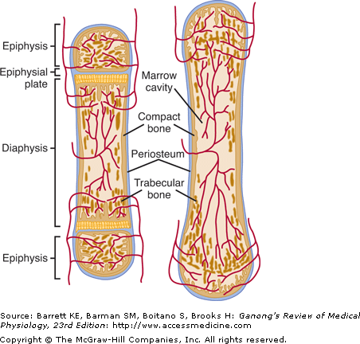
Bone formation & growth
During fetal development, most bones are modeled in cartilage and then transformed into bone by ossification.
During growth, specialized areas at the ends of each long bone (epiphyses) are separated from
the shaft of the bone by a plate
of actively proliferating cartilage,
the epiphyseal plate.
The bone increases in length
as this plate lays down new
bone on the end of the shaft.
growth ceases after the
epiphyses unite with
the shaft (epiphysial closure).
The cartilage cells stop proliferating
become hypertrophic, and secrete
vascular endothelial growth factor
(VEGF), leading to vascularization and ossification.

Slide 20
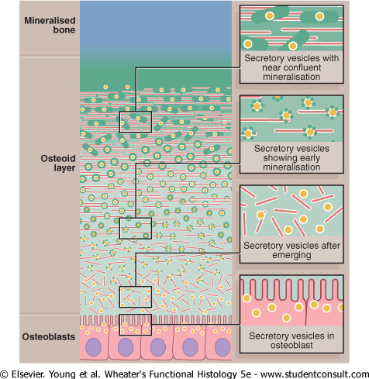
Bone formation

Slide 21
Joints
A joint, also called an articulation or arthrosis, is a point of contact between two bones, between bone and cartilage, or between bone and teeth.
Joints are regions in which bones are capped and surrounded by connective tissues that hold the bones together and determine the type and degree of movement between them.
When we say one bone articulates with another bone, we mean that the bones form a joint.
Joints are classified structurally, based on their anatomical characteristics, and functionally, based on the type of movement they permit.
The structural classification of joints is based on two criteria:
  the presence or absence of a space between the articulating bones, called a synovial cavity, and
  (2) the type of connective tissue that binds the bones together.

Slide 22
Structural classification of joint
Fibrous joints: There is no synovial cavity, and the bones are held together by dense irregular connective tissue that is rich in collagen fibers.
Cartilaginous joints: There is no synovial cavity, and the bones are held together by cartilage.
Synovial joints: The bones forming the joint have a synovial cavity and are united by the dense irregular connective tissue of an articular capsule, and often by accessory ligaments.
Functional classifications of joints
Synarthrosis (syn- together): An immovable joint.
Amphiarthrosis (amphi- on both sides): A slightly movable joint.
Diarthrosis : A freely movable joint. All diarthroses are synovial joints. They have a variety of shapes and permit several different types of movements

Slide 23
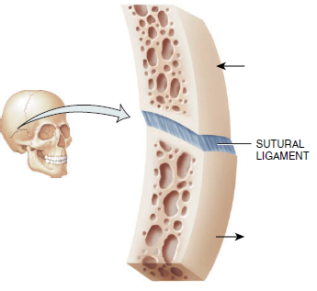
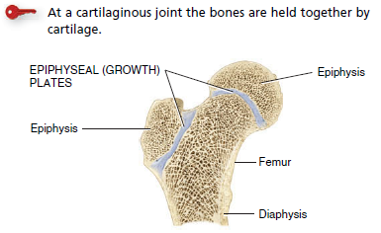
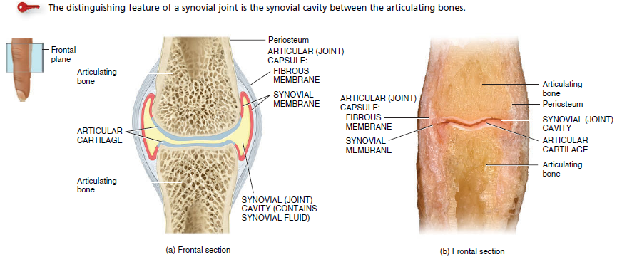
Fibrous joints
Cartilaginous joints
SYNOVIAL JOINT

Slide 24
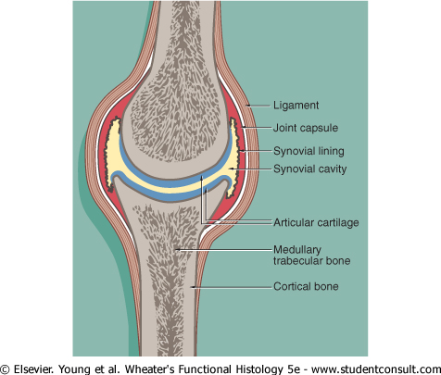
Fig: Synovial joint

Slide 25
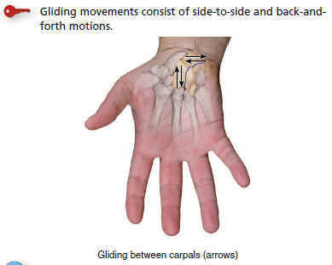
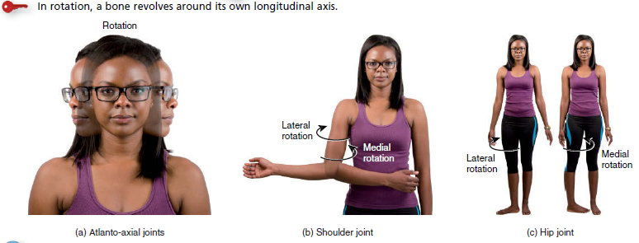
Types of Movements at Synovial Joints
gliding,
(2) angular movements
(3) rotation
(4) special movements, which occur only at certain joints.
gliding
rotation

Slide 26
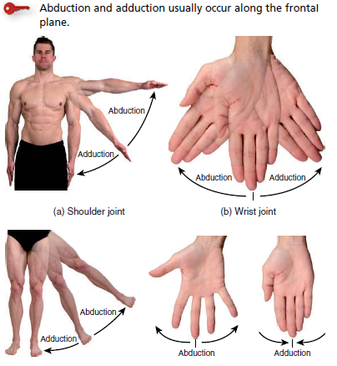
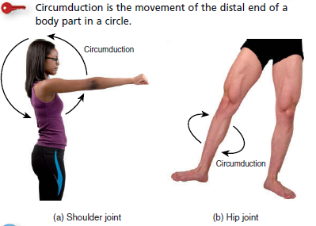
Angular movements at synovial joints—
abduction and adduction.
Angular movements at synovial joints— circumduction.

Slide 27
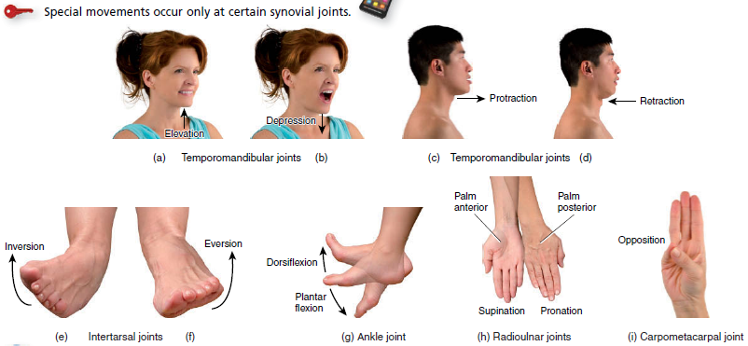
special movements

Slide 28
Muscular Tissue Generates Force for Movement
MUSCLES
Muscular tissue is composed of elongated muscle cells called muscle fibers.
The job of muscular tissue is to generate force, which produces motion, maintains posture, change the caliber of different ducts, secretion of various enzymes, hormones and generates heat.
There are three types of muscular tissue:
    Skeletal,
    Smooth &
    Cardiac.

Slide 29
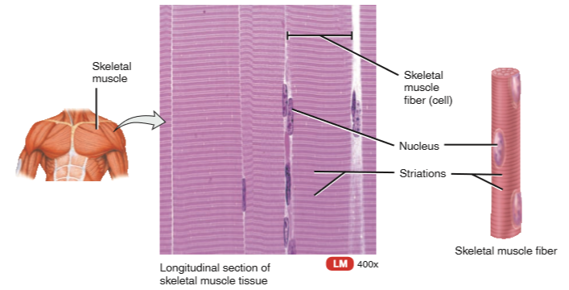
Skeletal muscle.
These groups of long (up to 35 cm),
multi- nucleated cells with
regular bands or striations.
generate force upon voluntary
commands, under our control.
This muscle is usually attached to
the skeleton and contracts voluntarily.
Note: Skeletal muscle contraction is
stimulated by motor nerve impulses
from brain.
Note Striations are apparent in
skeletal muscle and are due to
the highly organized arrangement of thick and thin filaments in the myofibrils of the skeletal muscle fibers.

Slide 30
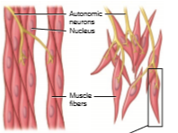
2. Smooth muscle.
Small cells with one nucleus.
capable of stretching
part of blood vessels,
the stomach, intestines
uterus, and bladder.
Individual smooth muscle
cells are spindle shaped
no striations and
contracts involuntarily, not under our conscious control
Smooth muscle activity is controlled by nerves (principally autonomic), circulating hormones, locally generated signaling substances, junctions with other smooth muscle cells, and even junctions with other non-smooth muscle cells.

Slide 31
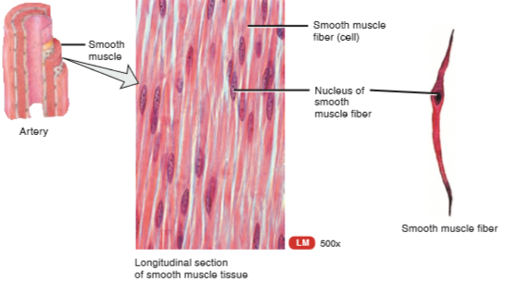

Slide 32
3. Cardiac muscle
found only in the wall
of the heart. Its contractions
help propel blood through
the blood vessels to all parts
of the body
The intermediate-sized cells that make up this tissue are connected to one another by cell junctions called intercalated discs.
Cardiac muscle has striations like that of skeletal muscle however they differ structurally in that cardiac cells
(1) are uninucleate
(2) are branching cells that fit together tightly at unique junctions called intercalated disc and
(3) contracts involuntarily

Slide 33
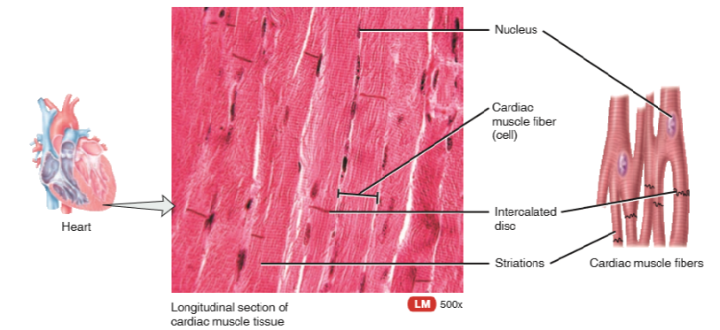

Slide 34
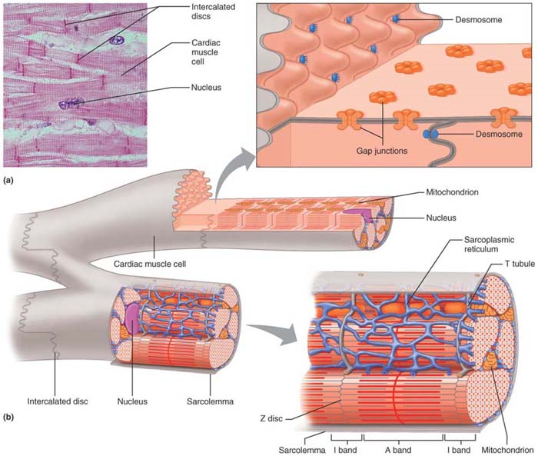

Slide 35
Summary
Type
functions
location
Skeletal muscle tissue (striated)
Smooth muscle
Tissue (lack striated)
Cardiac muscle tissue (striated)
Voluntary movements of skeletal parts
Involuntary movements of internal organs
Heart movements
Muscles usually attached to bones
Walls of hollow organs
Heart muscles

Slide 36
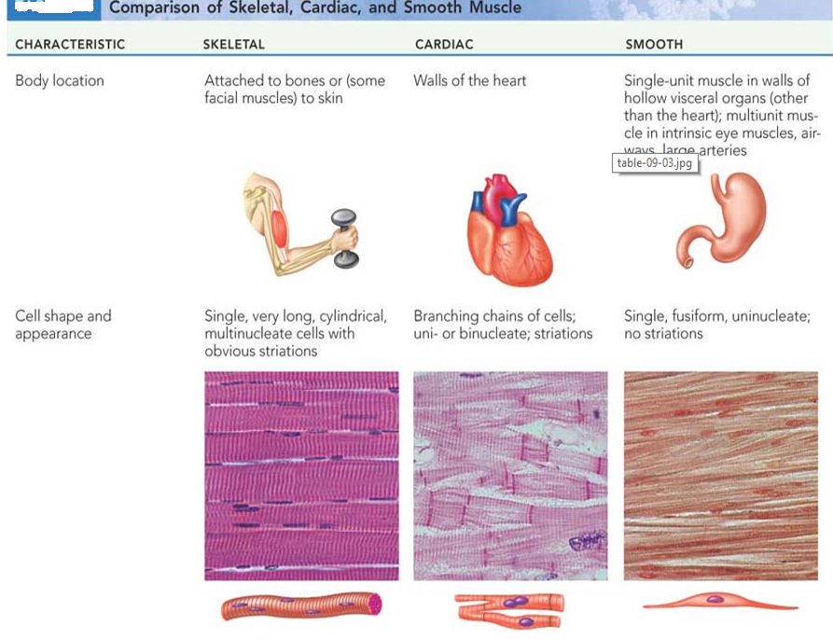

Slide 37
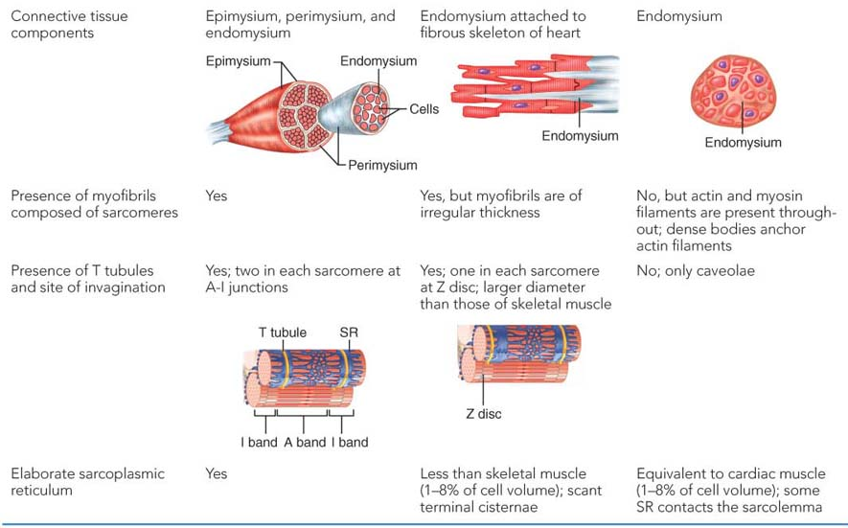
skeletal
cardiac
smooth

Slide 38
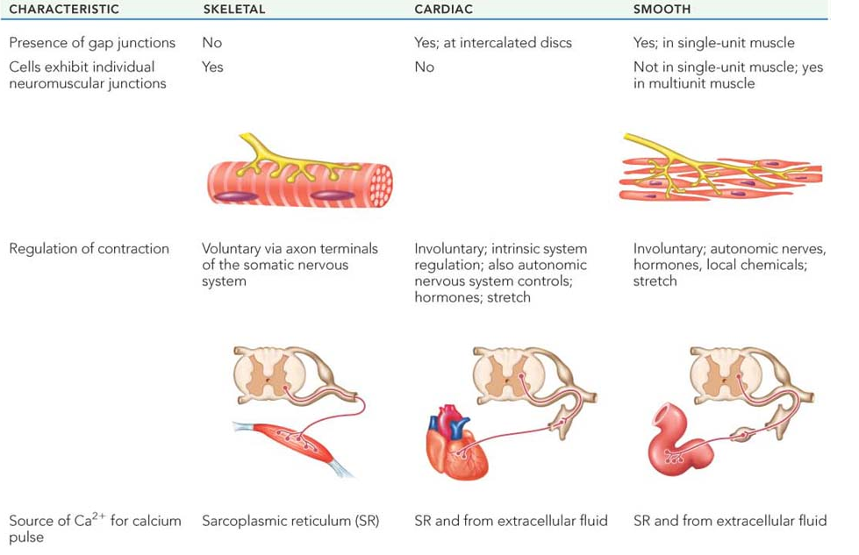

Slide 39
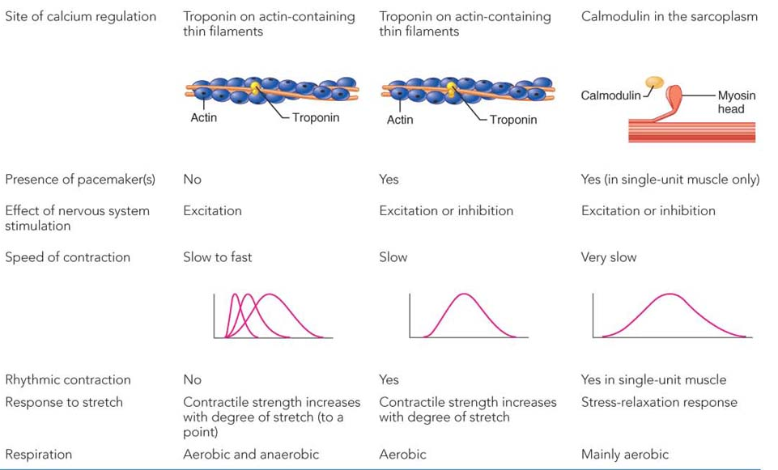
skeletal
cardiac
smooth

Slide 40
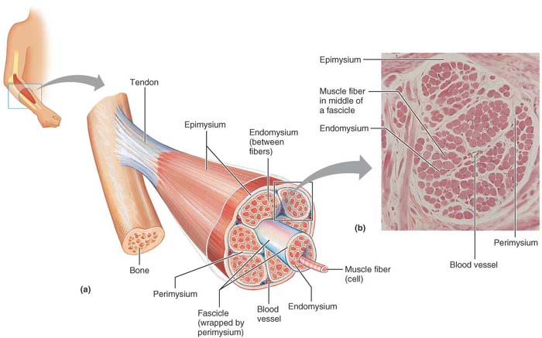
ORGANIZATION OF SKELETAL MUSCLE
It is composed primarily of skeletal muscle tissue, nervous tissue, blood and other connective tissues.
In an intact muscle, the individual muscle fibers are wrapped and held together by several different connective tissue sheaths.

Slide 41
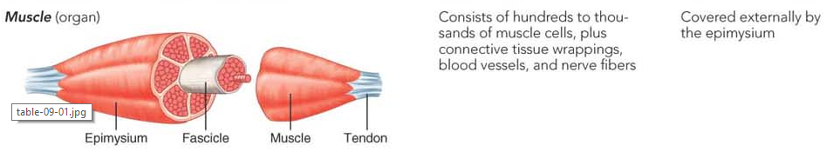
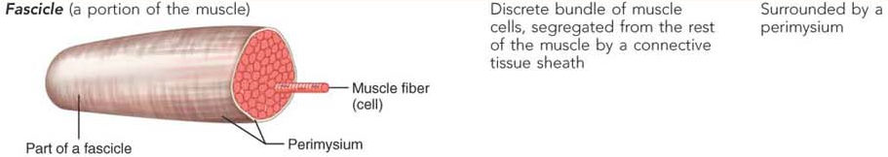
ORGANIZATION OF SKELETAL MUSCLE

Slide 42
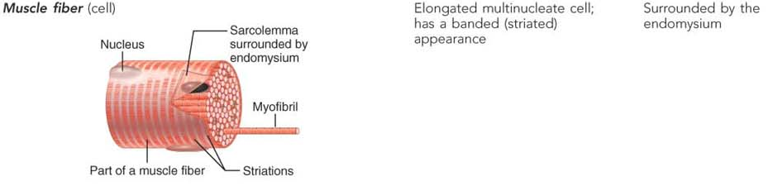
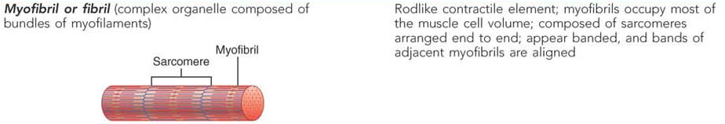

Slide 43
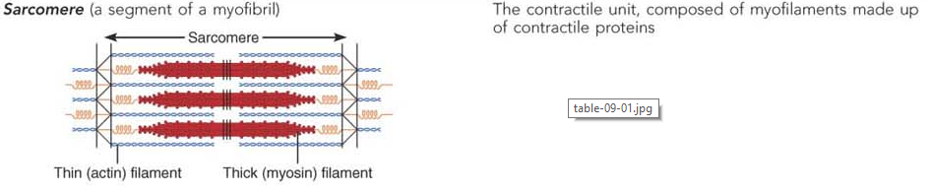
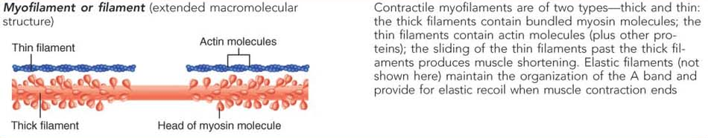

Slide 44
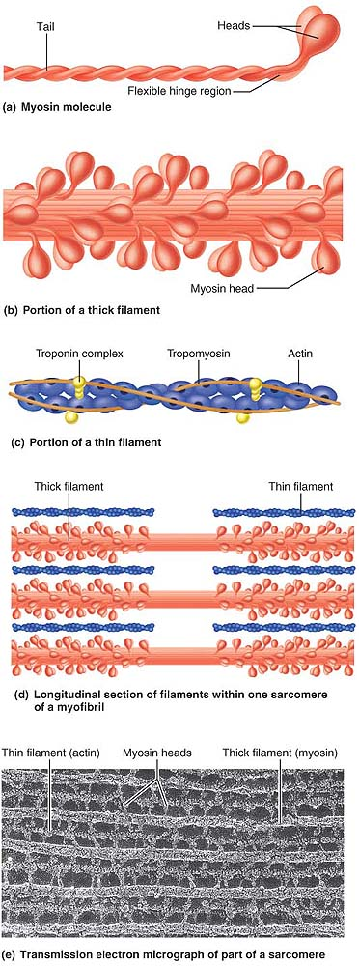
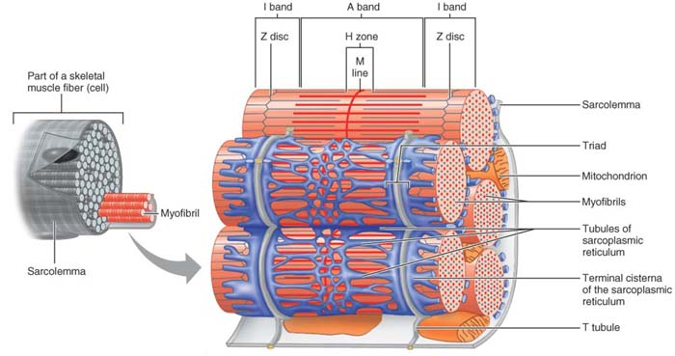

Slide 45
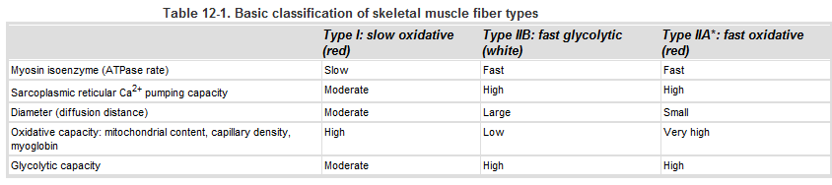
Skeletal muscle fiber types (types of skeletal muscle)
Skeletal muscle can be classified as either fast twitch or slow twitch muscle.
Fast fibers (types IIA and IIB): few mitochondria, extensive Sarcoplasmic Reticulum, fatigue rapidly. Consequently, they are used only occasionally and for brief periods of time.
Slow fibers (type I): large number of mitochondria, few SR, fatigue more slowly and therefore are used for more sustained activities (e.g., maintenance of posture).

Slide 46
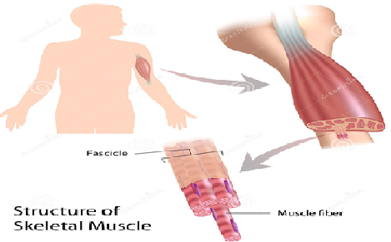
Contraction of skeletal muscle

Slide 47
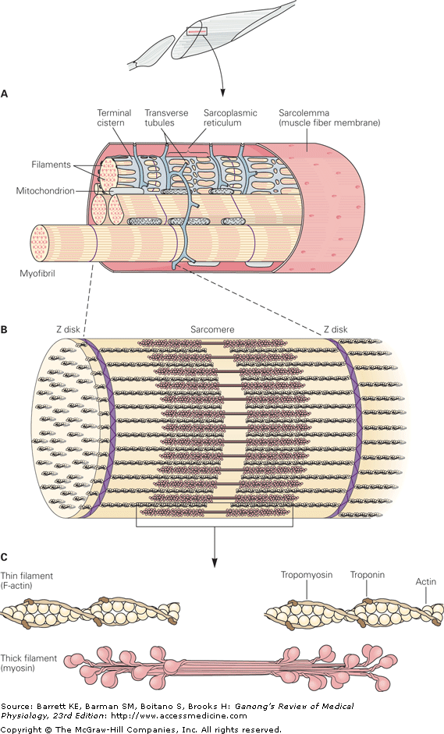

Slide 48
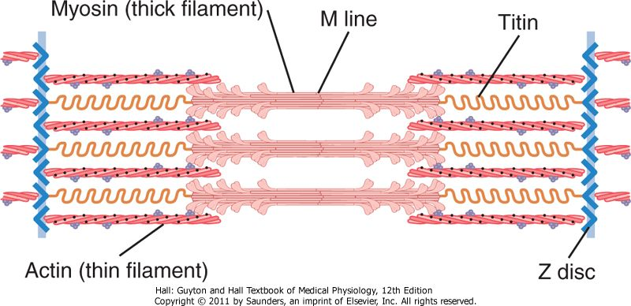
……..Cont. functional anatomy of skeletal muscles
A band is darkly stained & I band lightly stained, both bands of all myofibrils are in same level – stripped or striated appearance – striated muscle.
Actin filaments slide
between myosin filaments
Towards the center of
sarcomere during contraction.
Sarcoplasm is the intracellular fluid between myofibrils which contains ions, mitochondria, sarcoplasmic reticulum (specialized ER with high calcium concentration)- important in muscle contraction.
Myosin head function as ATPase enzyme.

Slide 49
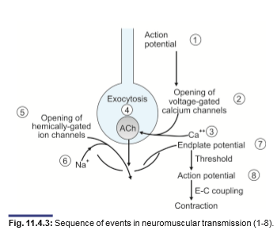
Transmission of impulses in skeletal muscles: Neuromuscular transmission
Each branch of motor nerve fiber innervates one muscle fiber.

Slide 50
Mechanism of transmission of impulses at Neuromuscular junction:
An action potential travels along a motor nerve to its endings on muscle fibers.
At each ending, the nerve secretes a small amount of the neurotransmitter substance acetylcholine.
The acetylcholine acts on a local area of the muscle fiber membrane to open multiple "acetylcholine-gated" cation channels through protein molecules floating in the membrane.
Opening of the acetylcholine-gated channels allows large quantities of sodium ions to diffuse to the interior of the muscle fiber membrane. This causes a local depolarization that in turn leads to opening of voltage-gated sodium channels. This initiates an action potential at the membrane.
The action potential travels along the muscle fiber membrane in the same way that action potentials travel along nerve fiber membranes.

Slide 51
6. The action potential depolarizes the muscle membrane, and much of the action potential electricity flows through the center of the muscle fiber. Here it causes the sarcoplasmic reticulum to release large quantities of calcium ions that have been stored within this reticulum.
7. The calcium ions initiate attractive forces between the actin and myosin filaments, causing them to slide alongside each other, which is the contractile process.
8. After a fraction of a second, the calcium ions are pumped back into the sarcoplasmic reticulum by a Ca⁺⁺ membrane pump and remain stored in the reticulum until a new muscle action potential comes along; this removal of calcium ions from the myofibrils causes the muscle contraction to cease.

Slide 52
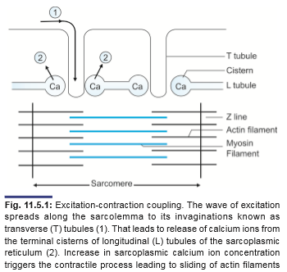
Excitation- contraction coupling

Slide 53
Excitation-contraction coupling
The process by which the muscle fiber initiates contraction is called excitation–contraction coupling.
The action potential is transmitted to all the fibrils in the fiber via the T tubule system
It triggers the release of Ca²⁺ from the terminal cisterns of sarcoplasmic reticulum.
Depolarization (positive potential developed due to action potential)of the T tubule membrane activates the sarcoplasmic reticulum via special receptor called Rynodine receptor (RYR) and thus there is outflow of stored calcium from Sarcoplasmic Reticulum to cytosol of muscle cell/fiber called sarcoplasm.
Increased sarcoplasmic calcium now induce the interaction of actin and myosin filaments of myofrils in muscle fibres.
One pump system in Sarcoplasmic Reticulum uses energy (ATP) to remove Ca²⁺ from the cytosol back into the terminal cisterns, where it is stored until released by the next action potential.
Once the Ca²⁺ concentration outside the reticulum has been lowered sufficiently, chemical interaction between myosin and actin ceases and the muscle relaxes.

Slide 54
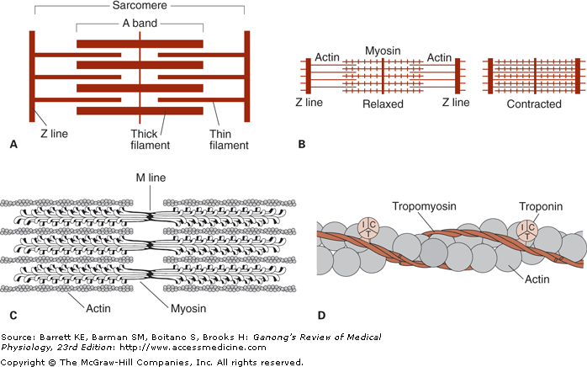
Sliding filaments theory/ role of calcium
The process by which the sliding of the thin filaments (actins) over the thick filaments (myosins) will bring the contraction of muscle.
Note that this shortening is not due to changes in the actual lengths of the thick and thin filaments, rather, by their increased overlap within the muscle cell.
The width of the A bands is constant, whereas the Z lines move closer together when the muscle contracts and farther apart when it relaxes .

Slide 55
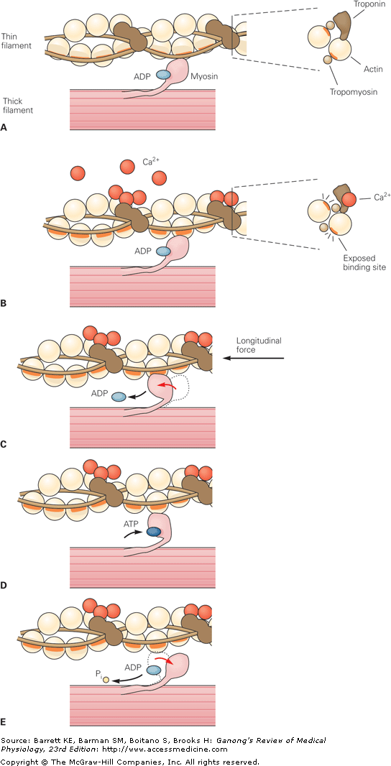

Slide 56
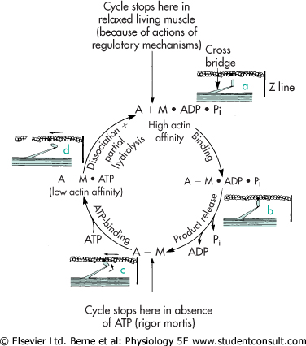
Fig: Cross-bridge cycle.
State a: In the relaxed state, ATP is partially hydrolyzed (M ADP P_{i}).
State b: In the presence of elevated myoplasmic Ca²⁺, myosin binds to actin. State c: Hydrolysis of ATP is completed causing a conformational change in the myosin molecule, which pulls the actin filament toward the center of the sarcomere.
State d: A new ATP binds to myosin causing release of the cross-bridge.
Partial hydrolysis of the newly bound ATP recocks the myosin head, which is now ready to bind again and again. If myoplasmic Ca²⁺ levels are still elevated the cycle repeats. If myoplasmic Ca²⁺ levels are low, relaxation results.

Slide 57
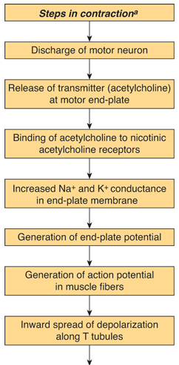
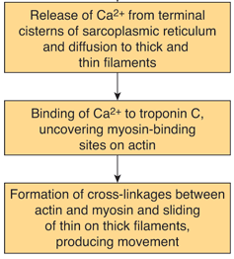
Summary of skeletal muscle contraction

Slide 58



Slide 59

Myasthenia gravis (mys, muscle; astheneia, weakness)
Myasthenia gravis (mys, muscle; astheneia, weakness) is a disease characterized by profound muscular weakness.
It is an autoimmune disorder
Characterized
by progressive
muscular
weakness caused
by a reduction in the
number of functionally
active
Nicotinic acetylcholine receptors
in the sarcolemma
of the
myoneural junction.

Slide 60

Rheumatoid arthritis
A destructive disease of synovial joints in which the synovium lining the joint capsule becomes thickened and heavily infiltrated with lymphocytes and plasma cells, and the articular cartilage (hyaline cartilage) is destroyed and replaced by fibrovascular tissue (pannus).
There are many other causes
of arthritis, including
bacterial infection and
deposition of urate crystals
(gout).

