Slide 1
Reproductive system
BPH, 1st semester, SHAS,PU

Slide 2
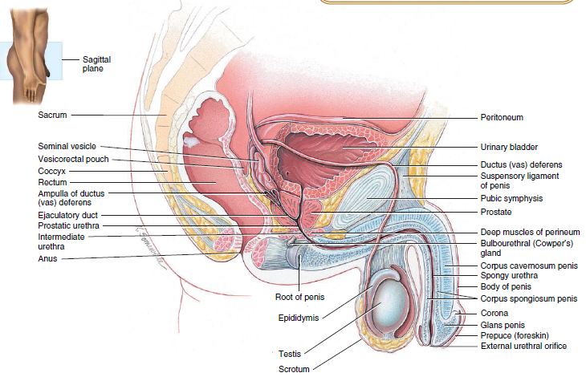
PARTS OF MALE REPRODUCTIVE SYSTEM
Male gonads: Testes; produce sperm & male sex hormones, testosterone.
Each testes mass of 10–15 grams, 5*2.5 cm in dimension

Slide 3
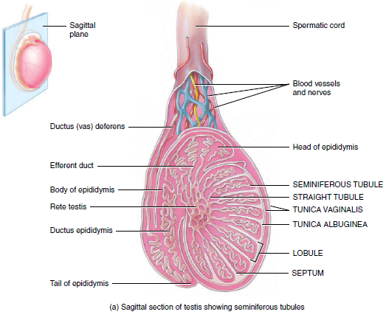
FUNCTIONS OF THE MALE REPRODUCTIVE SYSTEM
1. The testes produce sperm and the male sex hormone testosterone.
2. The ducts transport, store, and assist in maturation of sperm.
3. The accessory sex glands secrete most of the liquid portion of semen.
4. The penis contains the urethra, a passageway for ejaculation of semen and excretion of urine.
Fig: Testes showing seminiferous tubules, sperm factory
Normal sperm production requires a temperature about 2–3C below core body temperature.
This lowered temperature is maintained within the scrotum because it is outside the pelvic cavity.

Slide 4
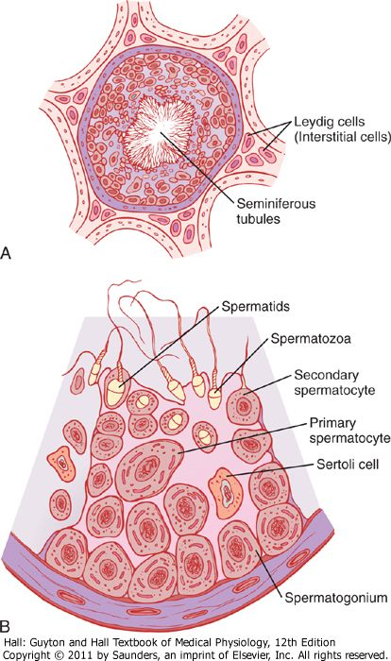
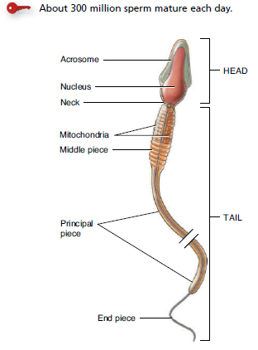
Spermatogenesis
Immature germ cells (spermatogonia) lie in two or three layers of the inner surfaces of the seminiferous tubules.
The process by which the spermatogonia begin to undergo mitotic division, beginning at puberty, and continually proliferate and differentiate through definite stages of development to form sperm is called as spermatogenesis.

Slide 5
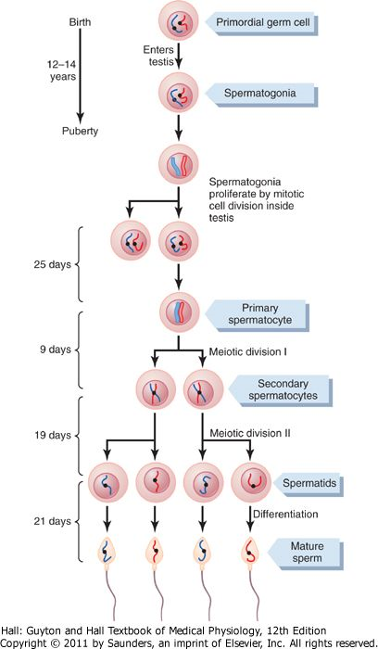
Fig. Cell divisions during spermatogenesis. (74 days)
During embryonic development the primordial germ cells migrate to the testis, where they become spermatogonia.
At puberty (usually 12 to 14 years after birth), the spermatogonia proliferate rapidly by mitosis.
Some begin meiosis to become primary spermatocytes and continue through meiotic division I to become secondary spermatocytes.
After completion of meiotic division II, the secondary spermatocytes produce spermatids, which differentiate to form spermatozoa.
spermiogenesis

Slide 6
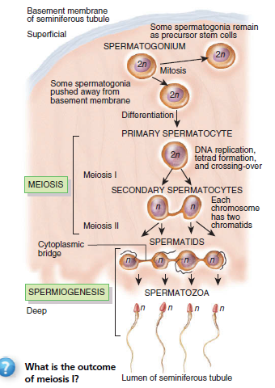
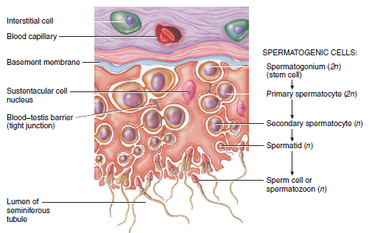
Events in spermatogenesis.
Diploid cells (2n) have 46 chromosomes; haploid cells (n) have 23 chromosomes.
Spermiogenesis involves the maturation of spermatids into sperm.

Slide 7
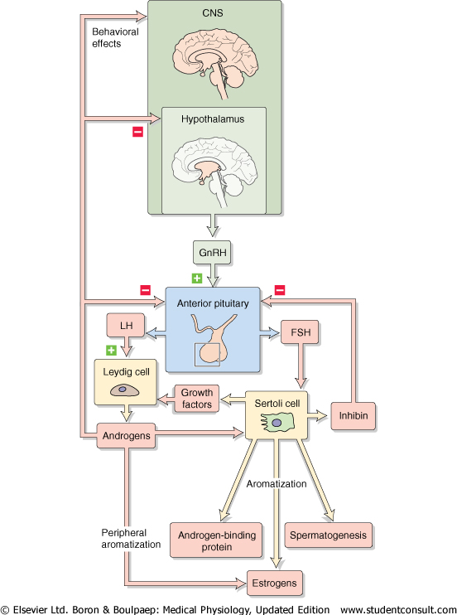
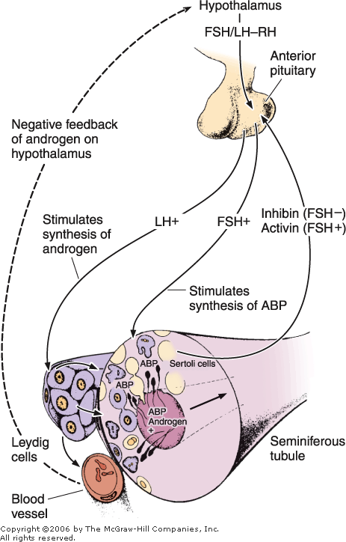
Fig. control of male reproduction

Slide 8
Functions of sertoli cells/sustantacular cells
Surround sperm cells and provide structural support within the epithelium.
They form adhering and gap junctions with all stages of sperm cells: blood-testis barrier.
Sertoli cells express the androgen receptor (testosterone)
Sertoli cell expresses the FSH receptor, not the developing sperm.
Sertoli cells also produce androgen-binding protein (ABP), which maintains a high androgen level within the adluminal compartment; the lumens of the seminiferous tubules.
Sertoli cells also produce a large amount of fluid; provides an appropriate bathing medium for the sperm and assists in moving the immotile spermatozoa from the seminiferous tubule into the epididymis.
The Sertoli cells also produce the hormone inhibin; negatively feeds back on gonadotropes to inhibit FSH production

Slide 9
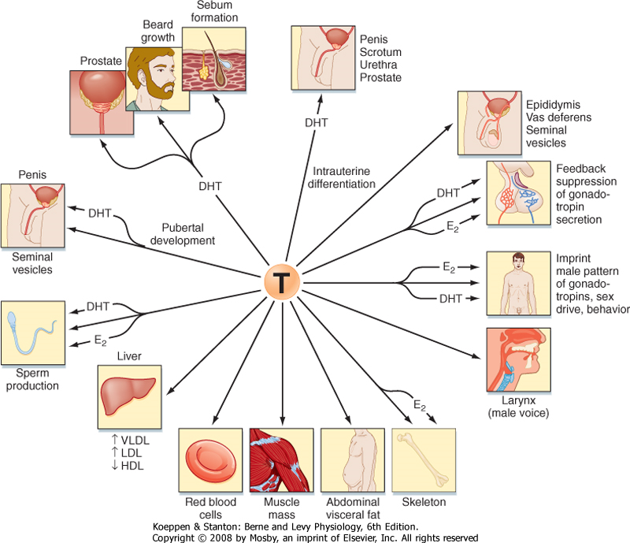
Dihydrotestosterone (DHT) and estradiol (E₂)
Fig. Spectrum of effects of testosterone

Slide 10
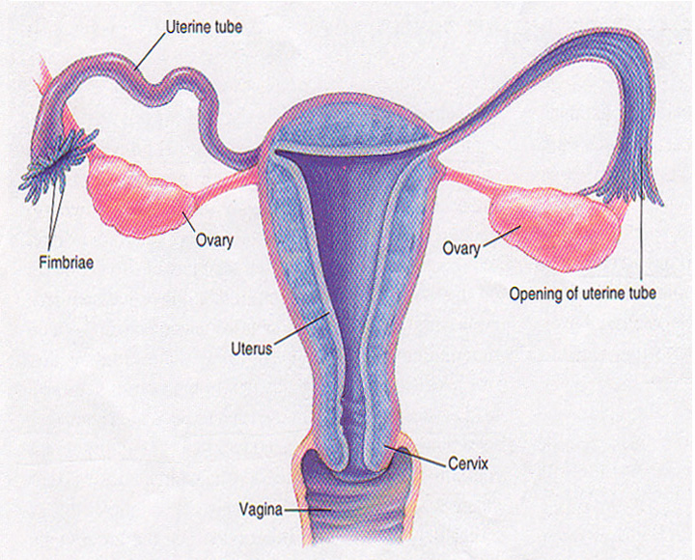
The female reproductive system
Two ovaries, for the development of female germ cell, ovum (egg) and production of female sex hormones
Fallopian tubes or oviducts, receive ovum shed from ovary at ovulation, where egg fertilization by sperm takes place
A uterus, where embryo implantation and development take place
A vagina, receives sperm

Slide 11
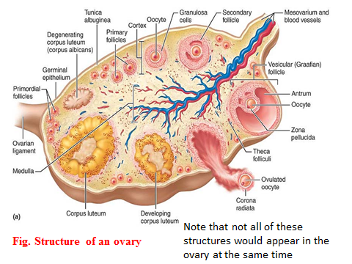
Structure of ovary
Cortex: contains germ cells (in follicles), ovarian stroma contains connective tissue, blood vessels and interstitial cells
Medulla: consists primarily of connective tissue and the blood vessels serving the cortex
Hilum: the entry point for blood vessels and nerves.

Slide 12
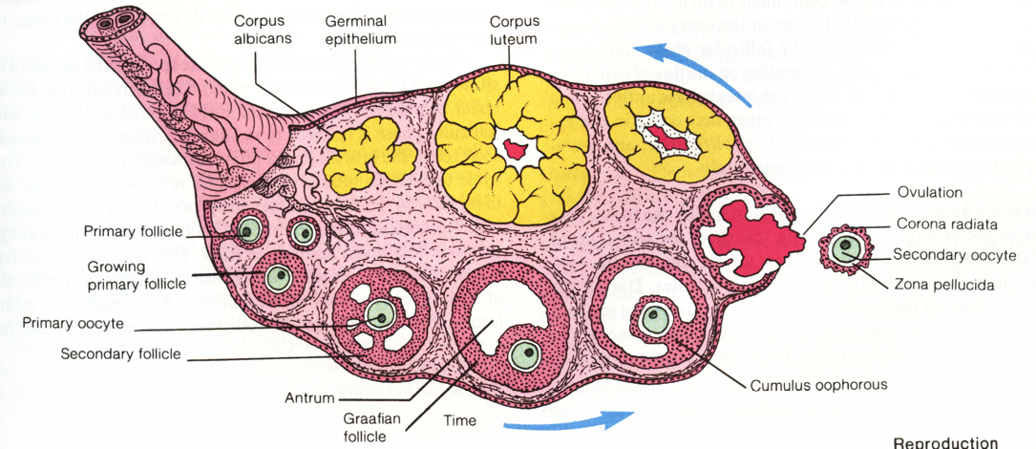
Diagrammatic section of the ovary, showing various stages in the life of a Graafian follicle: a primary oocyte developing into a fully mature follicle about to ovulate, then turning into a corpus luteum and finally ending up as a corpus albicans.

Slide 13
Ovarian functions
Oogenesis,
production of female gametes, the ova (eggs)
Steroidogenesis,
production of the female sex hormones, estrogen and progesterone

Slide 14
Endocrine Functions of Ovaries
Estrogens
Estradiol
Estriol
Estrone
Progestins
Progesterone
17α- hydroxyprogesterone
Androgen
Dehydroepiandrosterone (DHEA)
Androstenedione

Slide 15
Functions of Estrogen
On sexual organs
The principle function of estrogen is to cause cellular proliferation and growth of the tissues of the sex organs and other tissues related to production.
Estrogen stimulates the development of sexual organs including ovaries, fallopian tubes, uterus, vagina and the external genitalia.

Slide 16
On secondary female sexual characteristics
Estrogen stimulates development of the secondary sexual characteristics of female, such as feminine figure, soft and smooth skin.
It causes the breast to grow and to show mature appearance.

Slide 17
On metabolism.
Estrogen causes a slight increase in total body protein, which result in growth-promoting effect on the sexual organs, the bones, the breasts and a few other tissues.
Estrogen has a slight effect on retention of water and sodium by the kidney tubules.

Slide 18
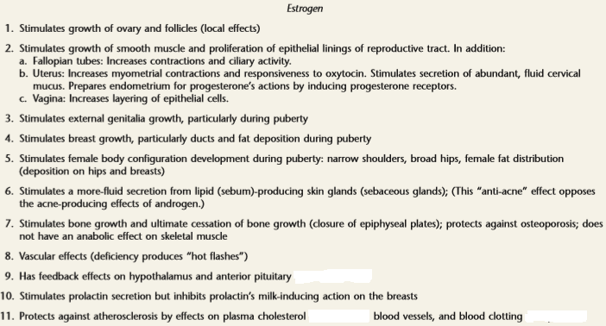
Summary of functions of estrogen
Notes:
Bone: bone formation, calcitropic effect on renal tubule, GI.
Liver: increase LDL receptors so clearance of LDL cholesterol, Increase HDL, promote binding protein.
CVS: vasodilation through NO, inhibits platelates activation, promote angiogenesis.
Skin: healthy, smooth, collagen synthesis.
CNS: Neuroprotective,

Slide 19
Functions of estrogen
Bone: bone formation, calcitropic effect on renal tubule, GI.
Liver: increase LDL receptors so clearance of LDL cholesterol, Increase HDL, promote binding protein.
CVS: vasodilation through NO, inhibits platelates activation, promote angiogenesis.
Skin: healthy, smooth, collagen synthesis.
CNS: Neuroprotective

Slide 20
progesterone
The most distinctive hormone between males and females
It is the ovarian hormone of pregnancy: both preparing and maintenance pregnancy
Source:
  Corpus luteum
  Placenta
  Follicles (small amount)
  Adrenal cortex

Slide 21
Functions of progesterone
Effect on uterus.
By far the most important function of progesterone is to promote secretary changes in the uterine endometrium, thus preparing the uterus for implantation of the fertilized ovum and providing nutrition for the early dividing ovum.
Progesterone decreases excitability and sensitivity to oxytocin of myometrium.
It decreases the frequency and intensity of uterine contractions, thereby helping to prevent expulsion of the implanted ovum.

Slide 22
(2) Effect on breasts.
Progesterone promotes development of the tubules and alveoli of the breasts, causing the alveolar cells to proliferate, enlarge and become secretary nature but not to secrete milk.
(3) Progesterone relaxes the smooth muscle of the blood vessels and digestive tracts.
(4) Thermogenic effect.
Progesterone causes thermogenic effect and is responsible for the rise in basal body temperature at the time of ovulation.

Slide 23
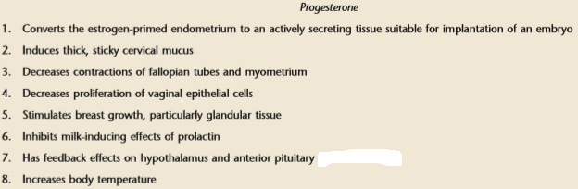
Summary of functions of Progesterone
Progesterone act on hypothalamus to increase the set point for thermoregulation: elevate by 0.5 F.
P act as depressant on CNS so loss of it just before the menstruation: PMS or premenstrual dysphoria disorder (PMDD)

Slide 24
Menstruation cycle/ Female monthly sexual cycle.
Definition: Monthly rhythmical changes in the rates of secretion of the female hormones (LH & FSH) and corresponding physical changes in the ovaries and other sexual organs (Uterus, vagina, breast) in the normal reproductive aged female (14-45 years) is called the female monthly sexual cycle (or, less accurately, the menstrual cycle).
The duration of the cycle averages 28 days. It may be as short as 20 days or as long as 45 days in some women, although abnormal cycle length is frequently associated with decreased fertility.
There are two significant results of the female sexual cycle. First, only a single ovum is normally released from the ovaries each month. Second, the uterine endometrium is prepared in advance for implantation of the fertilized ovum at the required time of the month

Slide 25
Menstrual cycle thus has major changes in:
  Ovaries for development/ maturation ova; OVARIAN CYCLE.
  Uterine endometrial layer; UTERINE CYCLE.

Slide 26
1. Ovarian cycle
Follicular Phase
Luteal Phase
Bleeding
starts
Day
1
7
14
25
28
Antral follicle
Multiple
follicles
develop
Dominant
follicle
matures
Corpus luteum
is functioning
Corpus luteum
degenerates
Ovarian
events
Dominant
follicle
selected
Ovulation
occurs

Slide 27
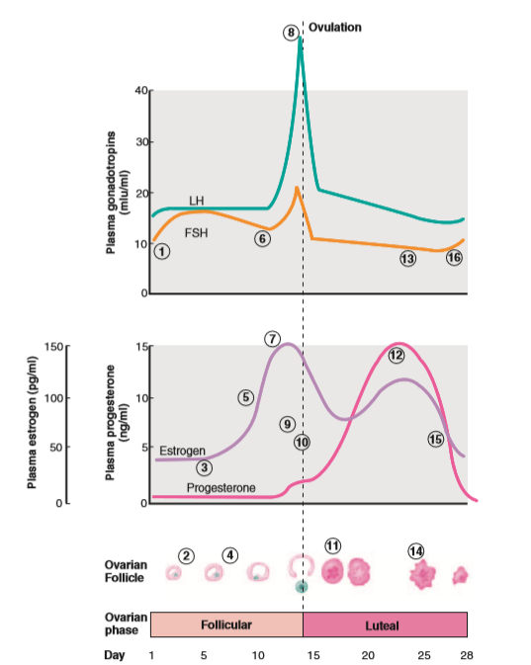
Summary of systemic plasma hormone concentrations and ovarian events during the menstrual cycle

Slide 28
2. Uterine cycle
Proliferative phase (estrogen phase)
Secretory phase (progesterone phase)
Menstruation

Slide 29
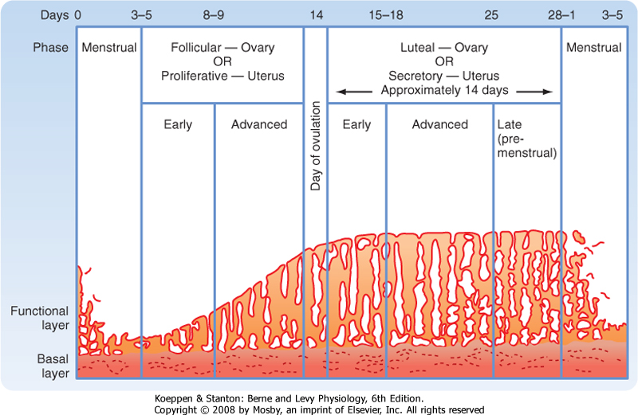
Fig. Phases of endometrial growth and menstruation during each monthly menstrual cycle.
The length of the secretory phase is remarkably constant at about 14 d

Slide 30
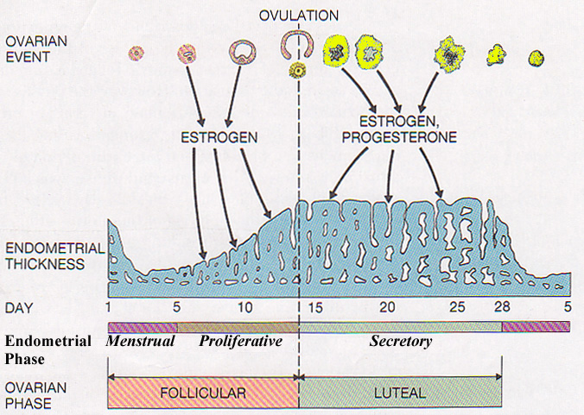
Endometrial cycle – effect of hormones on the endometrium
Menstrual phase (day 1-5)
Proliferation phase (day 5-14)
Secretory phase (day 14-28)
Repeats monthly from puberty to menopause unless interrupted by pregnancy

Slide 31
1. Days 1–5: Menstrual phase
  The thick, hormone-dependent functional layer of the endometrium detaches from the uterine wall (because of declining level of FSH & LH from anterior pituitary), a process that is accompanied by bleeding for 3–5 days.
  The detached tissue and blood pass out through the vagina as the menstrual flow.
2. Days 6–14: Proliferative (preovulatory) phase
  In this phase, the endometrium rebuilds itself.
  Under the influence of rising blood levels of estrogens, the basal layer of the endometrium generates a new functional layer.
  As this new layer thickens, its glands enlarge and its spiral arteries increase in number.
  Consequently, the endometrium once again becomes smooth, thick, and well vascularized

Slide 32
3. Days 15–28: Secretory (postovulatory) phase
This 14-day phase is the most constant time wise.
Endometrium prepares for implantation of an embryo.
Rising levels of progesterone from the corpus luteum cause the spiral arteries to elaborate and convert the functional layer to a secretory mucosa.
The uterine glands enlarge, coil, and begin secreting nutritious glycogen into the uterine cavity for embryo until implanted in the blood-rich endometrial lining.
Increasing progesterone levels also cause the cervical mucus to become viscous again, forming the cervical plug, which blocks sperm entry and plays an important role in keeping the uterus “private” in the event an embryo has begun to implant.

Slide 33
If fertilization has not occurred, the corpus luteum begins to degenerate toward the end of the secretory phase as LH blood levels decline.
Progesterone levels fall, depriving the endometrium of hormonal support, and the spiral arteries kink and go into spasms.
Deprived of oxygen and nutrients, the ischemic endometrial cells die, setting the stage for menstruation to begin on day 28.
The spiral arteries constrict and then suddenly relax and open wide.
As blood flows into the weakened capillary beds, they fragment, causing the functional layer to degenerate; menstrual flow.

Slide 34
Events of the Menstrual Cycle
Hypothalamus secretes GnRH
Anterior pituitary secretes LH and FSH
Graafian follicle stimulated
Proliferative phase
Follicular stage
Ovaries release estrogen
High estrogen levels inhibit FSH secretion, stimulate LH production
LH makes mature follicle burst: ovulation
LH makes corpus luteum secrete progesterone
Secretory phase
Luteal stage
Progesterone inhibits LH secretion
Decreased LH and FSH levels
Corpus luteum atrophies, stops making progesterone
Menstrual
phase
Decreased estrogen and progesterone levels stimulate GnRH secretion

Slide 35
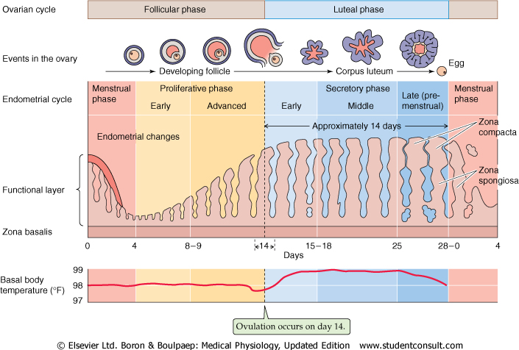
Ovum lives for approximately 72 h after it is extruded from the follicle, but it is fertilizable for a much shorter time than this
Most fertile period is clearly the 48 h before ovulation

Slide 36
Puberty is defined as the period when the endocrine and gametogenic functions of the gonads have first developed to the point where reproduction is possible.
Puberty generally occurs between the ages of 8 and 13 in girls and 9 and 14 in boys.
Stages of puberty in girls
Adrenarche: preadolescent .
Thelarche: breast development
Pubarche: pubic hair development
Menarche: irregular at begainning
Full regular cycle of menstruation
Stages of puberty in boys
Stage 1: Adrenarche: preadolescent
Stage 2: enlargement of testes >2.5 cm
Stage 3: Enlargement of penis, spermarch
Stage 4: ejaculation of sperm
Stage 5: Full adult pattern

Slide 37
Pregnancy is the process whereby the life of a baby begins in the mother’s womb and progresses up to the stage when it is safe to expose the baby to the outside world
Sources of nourishment of the embryo from conception onwards
a. The nutrients stored in the ovum
b. Secretions of the Fallopian tube
c. Secretions of the uterine endometrium
d. Digested decidual cell
The endometrial cells of pregnancy are called decidual cells

Slide 38
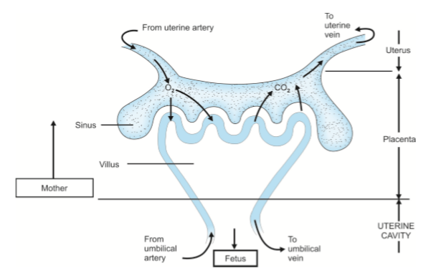
Functions of the Placenta
1. Supply of oxygen to the fetus
2. Removal of carbon dioxide from the fetus
3. Supply of nutrients to the fetus
4. Removal of waste products from the fetus
5. Secretion of hormones : hCG, estrogens, progesterone, human chorionic somatomammo tropin (hCS) and relaxin.

Slide 39
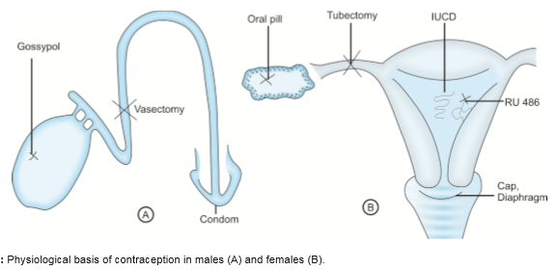
Contraception
Prevent conception.
The surest and safest method of contraception is abstinence.
A better accepted method is the rhythm method. This method involves abstinence only around the time of ovulation

Slide 40
For men
For women
Prevent spermatogenesis
-Gossypol
Prevent sperm transport
-vasectomy
Prevent fertilization
-condom
Prevent ovulation – Hormonal preparation
Prevent ovum transport – Tubectomy
Prevent fertilization – Diaphragm/ Cervical cap/ Spermicidal jelly/ IUCD
Prevent implantation – Antiprogestin (mifepristone)
Periodic abstinence/ Rhythm method: 4 days before ovulation and 3 days after ovulation

Slide 41
Methods
Hormonal Methods
Nonhormonal Methods
Oral Contraceptives (pill)
Vaginal ring (NuvaRing)
Patch (Ortho Evra )
Injectable(Depo-Provera)
Intrauterine Device [IUD] (Mirena, Progestin-releasing IUD)
Implant
Male Condom
Female Condom
Vaginal Spermicides
Diaphragm
Contraceptive Sponge
Cervical Cap
Intrauterine Device IUD (ParaGard)
Periodic abstinence
Withdrawal

Slide 42
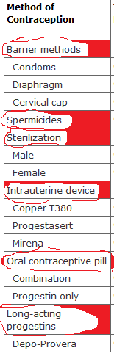
Barrier: A major advantage of barrier contraceptives is the protection provided against sexually transmitted diseases (STIs)
Sterilization: surgical interruption of the fallopian tubes in women or the vas deferens in men.
Tubal ligation in female reduces the risk of ovarian cancer, possibly by limiting the upward migration of potential carcinogens.
Intrauterine Devices
Inhibit pregnancy primarily through a spermicidal effect caused by a sterile inflammatory reaction produced by the presence of a foreign body in the uterine cavity (copper IUDs) or by the release of progestins (Progestasert, Mirena).
An IUD should not be used in women at high risk for development of STI or in women at high risk for bacterial endocarditis

Slide 43
Abortion: (abort = born prematurely) Premature removal of the embryo or fetus from the uterus; may be spontaneous or induced.
Disorder of early pregnancy.
loss of presumably fertilized and implanted ova
10 to 15% of recognized pregnancies terminate in spontaneous abortion.
The mechanisms leading to early loss of pregnancy are still mysterious.
The causes of recognized spontaneous abortion are both fetal and maternal.
Defective implantation inadequate to support fetal development and death of the ovum or fetus in utero because of some genetic or acquired abnormality constitute the major origins of spontaneous abortion.
Numerous studies have indicated chromosome abnormalities in more than half of spontaneous abortuses

Slide 44
Maternal influences are less well understood and include inflammatory diseases, both localized to the placenta and systemic; uterine abnormalities; and possibly trauma.
Toxoplasma, Mycoplasma, Listeria, and viral infections have also been implicated as causes of abortion.
Morphological chnages in uterus in abortion
  There are focal areas of decidual necrosis with intense neutrophilic infiltration.
  Thrombi within decidual blood vessels, and considerable amounts of hemorrhage.
  Placental villi may be markedly edematous and devoid of blood vessels.
Chromosomal studies are recommended
  (1) in habitual or recurrent abortion and
  (2) when there is a malformed fetus.

Slide 45
ECTOPIC PREGNANCY
Ectopic pregnancy is the term applied to implantation of the fetus in any site other than a normal uterine location.
Ectopic pregnancies occur about once in every 150 pregnancies.
The most common site is
  within the tubes (approximately 90%).
  The ovary
  The abdominal cavity, and the
  Intrauterine portion of the fallopian tube (cornual pregnancy)
The most important predisposing condition in 35% to 50% of patients is PID (Pelvic Inflammatory Diseases) with chronic salpingitis (inflammation of fallopian tube).
Other factors are peritubal adhesions due to appendicitis or endometriosis, leiomyomas, and previous surgery.
Intrauterine devices may also increase risk.

Slide 46
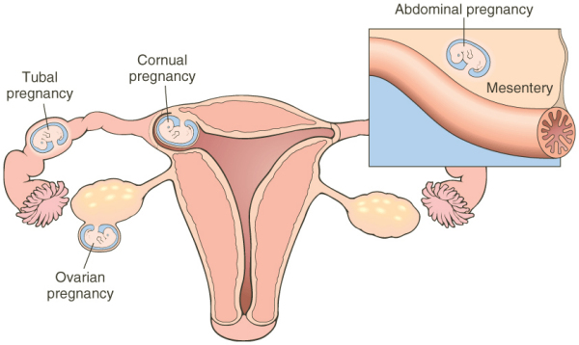
Potential sites for ectopic pregnancy, including the fallopian tube, ovary, cornu, and (rarely) abdominal viscera

Slide 47
Ovarian pregnancy is presumed to result from the rare fertilization and trapping of the ovum within the follicle just at the time of its rupture (during ovulation)
Abdominal pregnancies may develop when the fertilized ovum drops out of the fimbriated end of the tube.
In all these abnormal locations, the fertilized ovum undergoes its usual development with the formation of placental tissue, amniotic sac, and fetus, and the host implantation site develops decidual changes.

Slide 48
The clinical course of ectopic pregnancy is
  the onset of severe abdominal pain about 6 weeks after a previous normal menstrual period, when rupture of the tube leads to pelvic hemorrhage.
  The patient may rapidly develop a shocklike state.
Diagnosis
  human Chorionic gonadotropin(hCG) assays,
  Ultrasound studies
  Laparoscopy may be helpful.
  Endometrial biopsy specimens

Slide 49
Carcinoma of cervix
Carcinoma of the cervix was once the most common cause of cancer death in women, but over the past 40 years, the mortality rate has decreased by 50% due to widespread screening with the Pap smear.
It is more common in lower socioeconomic groups, in women with early initial sexual activity and/or multiple sexual partners, and in smokers.
Venereal transmission of human papilloma virus (HPV- associated with genital warts) has an important etiologic role.
The protein product of HPV, the E7 protein, binds and inactivates the tumor-suppressor gene p53 which explains the carcinogenic effect of HPV

Slide 50
Clinical Presentation
  Generally are asymptomatic.
  Present with abnormal bleeding
  Yellowish vaginal discharge,
  Lumbosacral back pain,
  Lower-extremity edema, and
  Urinary symptoms
Disease is detected on routine pelvic examination under anesthesia with cystoscopy.
Chest x-rays, intravenous pyelograms, and CT are generally required, and MRI may be used to assess extracervical extension

