Slide 1
UNIT V: Blood & cardiovascular system
SHAS, BPH 1st semester

Slide 2
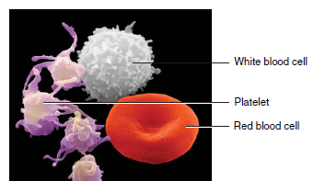
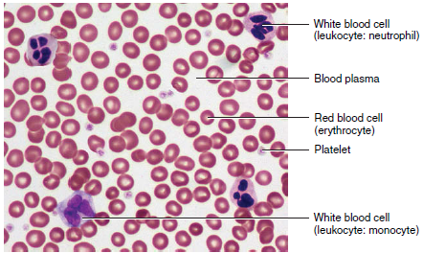
Blood is a liquid connective tissue that consists of cells surrounded by a liquid extracellular matrix.
The extracellular matrix is called blood plasma, and it suspends various cells and cell fragments.

Slide 3
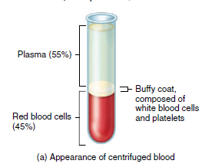

Components of Blood
Blood is denser and more viscous (thicker) than water.
The temperature of blood is 38C , about1C higher than oral or rectal body temperature.
Slightly alkaline pH ranging from 7.35 to 7.45.
When saturated with oxygen, it is bright red. When unsaturated with oxygen, it is dark red.

Slide 4
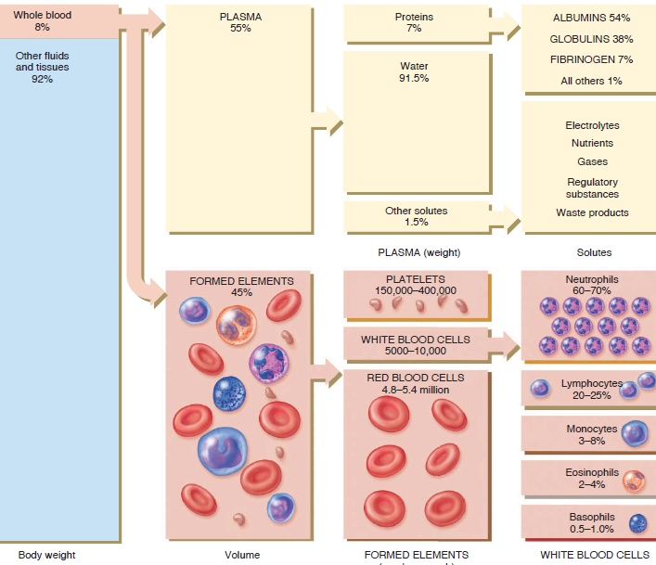

Slide 5
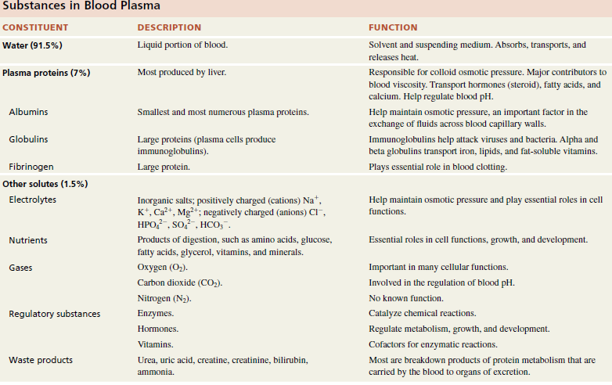

Slide 6
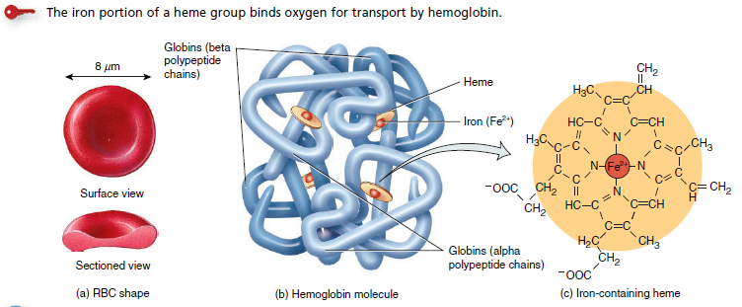
FUNCTIONS OF BLOOD
Transports oxygen, carbondioxide, nutrients, hormones, heat, and wastes.
2. Regulates pH, body temperature, and water content of cells.
3. Protects against blood loss through clotting, and against disease through phagocytic white blood cells and proteins such as antibodies, interferons, and complement.

Slide 7
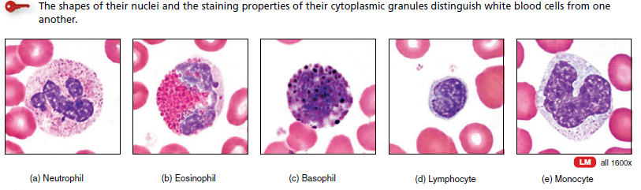
TYPES OF WBCs
Protection
Neutrophil: Phagocytosis. Destruction of bacteria with
Lysozyme.
Eosinophil
Combat effects of histamine in allergic reactions.
destroy certain parasitic worms.
Basophil
Liberate heparin, histamine, and serotonin in
allergic reactions that intensify overall inflammatory response.
Lymphocyte: B & T
T cell: Cell mediated immunity.
B Cell: Humoral immunity
Monocyte
Phagocytosis (after transforming into fixed macrophages).

Slide 8
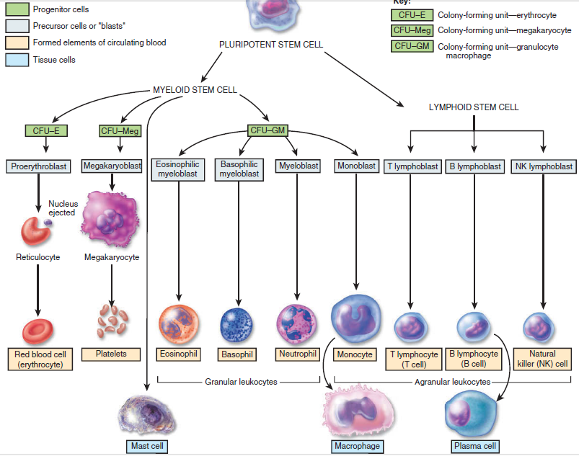
Formations of blood cells

Slide 9
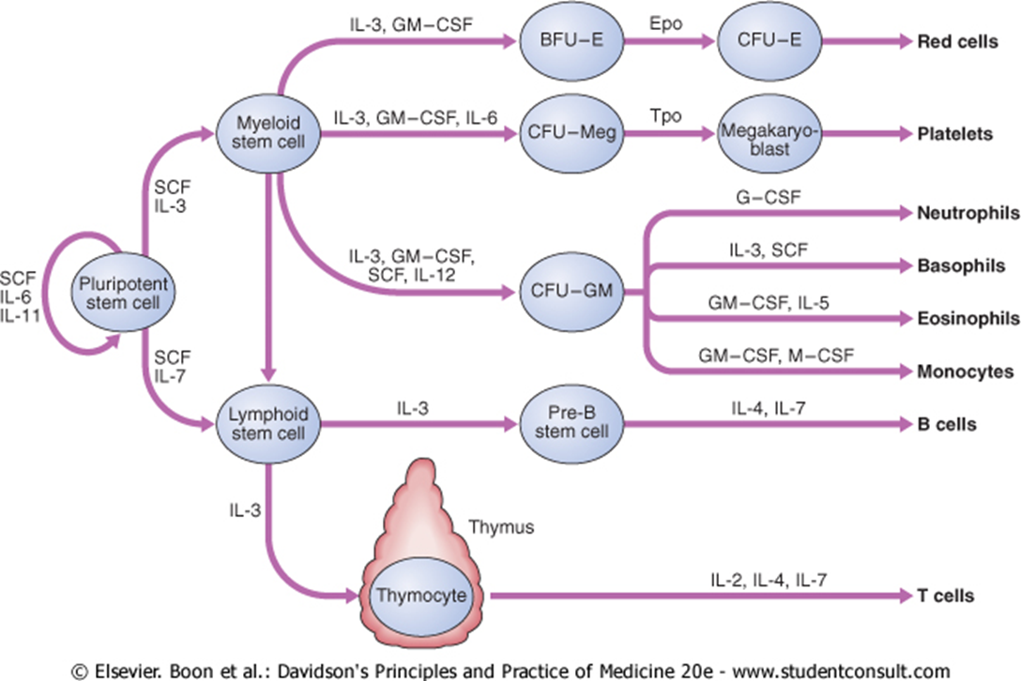
Formations of blood cells
Stem cells and growth factors in haematopoietic cell development

Slide 10
Erythropoesis: RBC synthesis
Early weeks of embryonic life, nucleated red blood cells →produced in the yolk sac
During the middle of gestation→ liver & spleen
Last month & after birth synthesis of RBC takes place in red bone marrow
Interleukin-3 (growth factor)→ promotes growth of all committed stem cells

Slide 11
Factors affecting Erythropoiesis
Erythropoietin
Protein diet
Vitamins e.g. Vit B12,Folic Acid, Vit C, Vit E, Riboflavin etc.
Metals e.g. Fe, Cu, Co, Mn etc
Hormones e.g. Testosterone, Growth hormone, Cortisol, Adrenaline and nor-adrenaline, estrogen

Slide 12
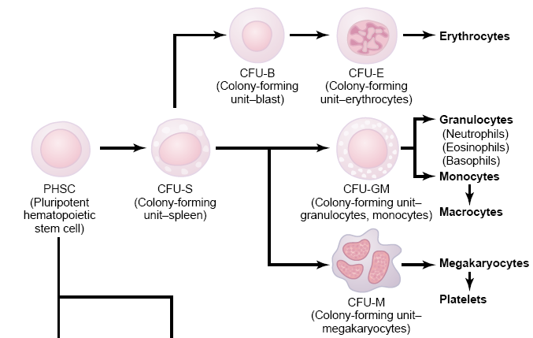
ERYTHROPOESIS

Slide 13
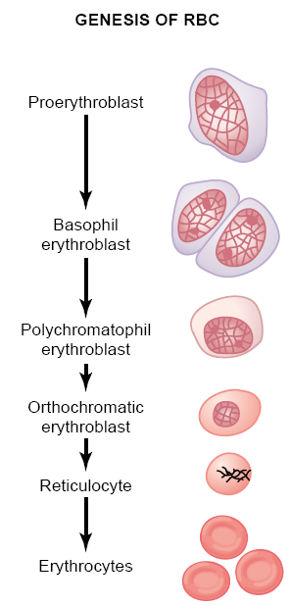
Genesis of RBC
Proerythroblast
Basophil erythroblast/ early normoblast
Polychromatophil erythroblast/ intermediate normoblast
Orthochromatic erythroblast/ late normoblast
Reticulocyte
Erythrocytes

Slide 14
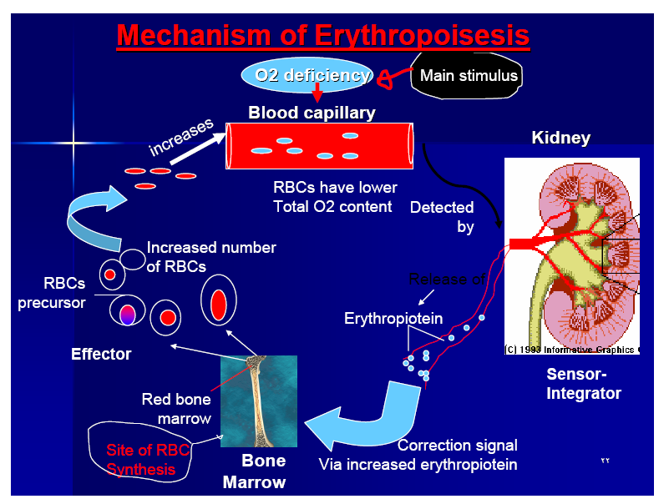
Regulation of erythropoiesis

Slide 15
Blood Groups and Blood Types
Based on the presence or absence of various antigens, blood is categorized into different blood groups.
Within a given blood group, there may be two or more different blood types.
There are at least 24 blood groups and more than 100 antigens that can be detected on the surface of red blood cells.
Two major blood groups—ABO and Rh.
Other blood groups include the Lewis, Kell, Kidd, and Duffy systems.

Slide 16
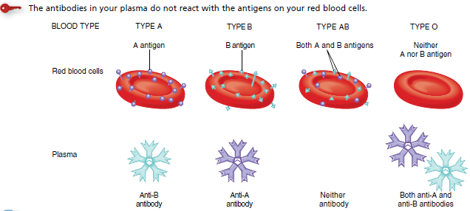
1. ABO BLOOD GROUP SYSTEM
Universal receipient: People with type AB positive blood do not have anti-A or anti-B or anti-D antibodies in their blood plasma to attack antigens on donated RBCs so they can receive blood from donors of all four blood types.
Universal donor: O negative blood have neither A nor B nor D antigens on their RBCs and they can donate blood to all four ABO blood types

Slide 17
2. Rh Blood Group (Rh factor in Rhesus monkey)
People whose RBCs have Rh antigens are designated Rh (Rh positive), those who lack Rh antigens are designated Rh (Rh negative).
Normally, blood plasma does not contain anti-Rh antibodies.
If an Rh negative person receives an Rh positive blood, the immune system starts to make anti-Rh antibodies that will remain in the blood.
If a second transfusion of Rh positive blood is given later, the previously formed anti-Rh antibodies will cause agglutination and hemolysis of the RBCs in the donated blood, and a severe reaction may occur.

Slide 18
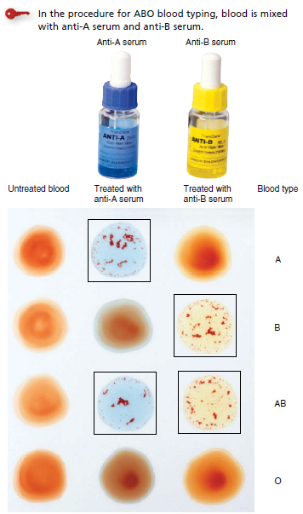
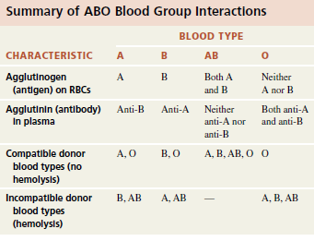

Slide 19
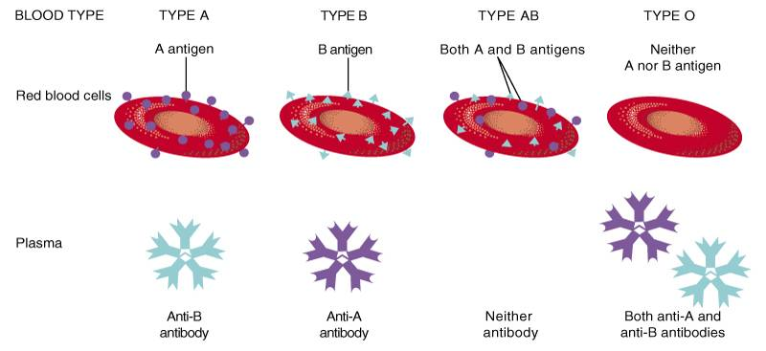
Mismatch blood transfusion: Agglutination in Transfusion Reactions
When bloods are mismatched so plasma antibodies are mixed with antigens present on the erythrocytes, this causes the cells to clump – “agglutination”.
Because antibodies have 2 or 10 binding sites, a single antibody can attach to two or more erythrocytes at the same time.
During the ensuing few hours to few days, either physical distortion of the cells or attack by phagocytic white blood cells destroys the agglutinated cells, releasing hemoglobin into the plasma, which is called “hemolysis” of the red blood cells.
Notes:
When bloods are mismatched so anti-A or anti-B plasma agglutinins are mixed with red blood cells that contain A or B agglutinogens, respectively, agglutinins will make the red cells to clump– “agglutination”. (antibody - antigen reaction) Because agglutinins have 2 or 10 binding sites, a single agglutinin can attach to two or more erythrocytes at the same time, thereby causing the cells to be bound together by the agglutinin.
During the ensuing few hours to few days, either physical distortion of the cells or attack by phagocytic white blood cells destroys the agglutinated cells, releasing hemoglobin into the plasma, which is called “hemolysis” of the red blood cells.

Slide 20
Erythroblastosis Fetalis
— Hemolytic Disease of the Newborn
It is a disease of the fetus and newborn child characterized by agglutination and phagocytosis of the fetus’s red blood cells.
Rh-negative mom, Rh-positive foetus.
The 1st child is fine, the incidence of the disease rises progressively with subsequent pregnancies.
Jaundice, anemia, enlarged liver and spleen, kernicterus, death
Notes:
A type of hemolytic anemia
Suppose we have an Rh- mom whose 1st child is Rh+. At birth, the placenta ruptures and the baby’s blood mixes with the mother’s blood. This sensitizes the mom to the Rh antigen and she begins to produce antibodies against the Rh antigen.
The 1st child is fine – he/she has already been born.
However if the mom has a 2nd Rh+ child, her anti-Rh antibodies will cross the placenta and begin to attack the fetal RBCs.. This condition is erythroblastosis fetalis (a.k.a. hemolytic disease of the newborn)
The baby becomes anemic and hypoxic; brain damage and death may result if blood transfusions are not performed.
Jaundice-yellow skin
P415

Slide 21
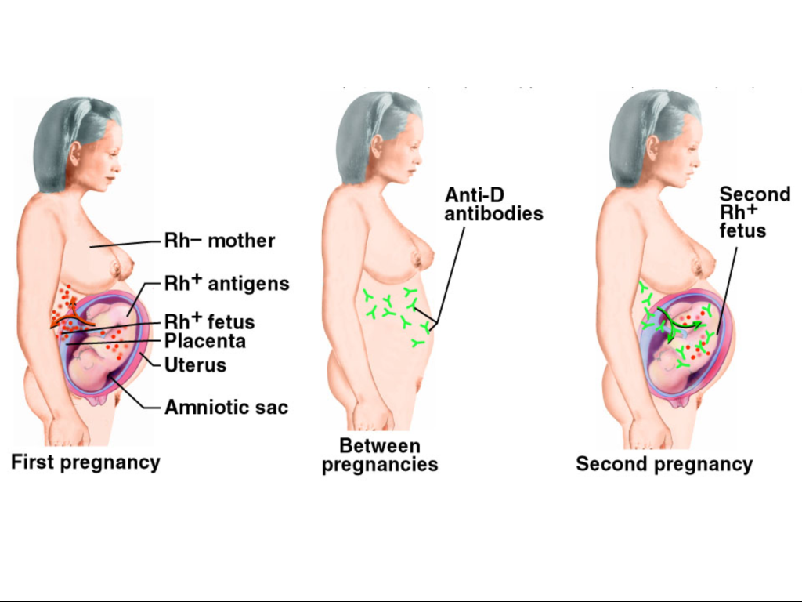

Slide 22
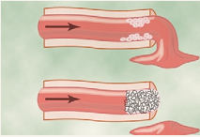
Hemostasis
The term hemostasis means prevention of blood loss.
In normal condition when a small blood vessel is severed or ruptured, the injury can initiate a series of events that stop the bleeding automatically within a few minutes.
This process to arrest the bleeding is called hemostasis.

Slide 23
Events in Hemostasis
Vascular spasm/constriction
Formation of platelet plug
Formation of a blood clot as a result of blood coagulation
Growth of fibrous tissue into the blood clot to close the hole in the vessel permanently
Hemostasis is achieved by interacting and overlapping mechanisms.
Notes:
Hemostasis is achieved by several mechanisms, including
Vascular Constriction

Slide 24
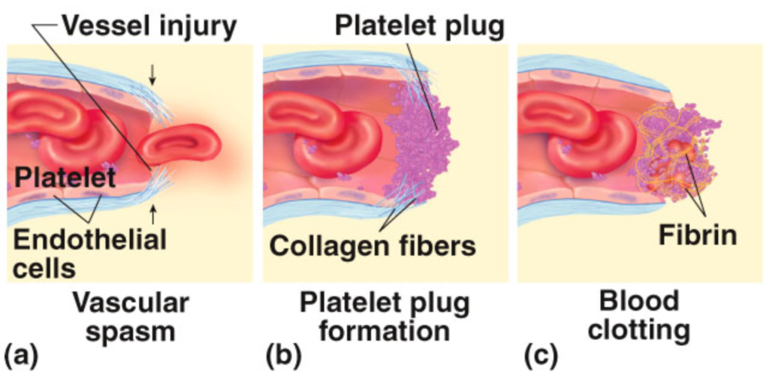
Three Main Phases of Hemostasis

Slide 25
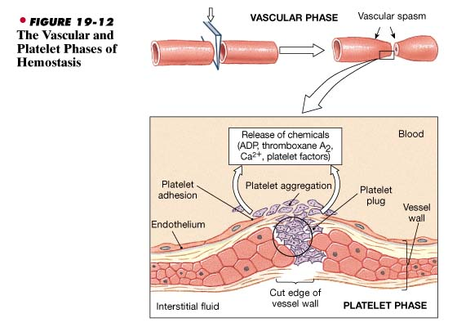
1. Vascular Constriction
Nervous reflexes
Local myogenic spasm
Local humoral factors from the traumatized tissue and blood platelets, such as thromboxane A₂
Notes:
Vascular constriction results from Nervous reflex, Local myogenic spasm, Local humoral factors from the traumatized tissue and blood platelets. Such as 5-HT, endothelin and thromboxane A₂.
Immediately after a blood vessel has been cut or ruptured, the trauma to the
vessel wall itself causes the smooth muscle in the wall to contract; this instan-
taneously reduces the ﬂow of blood from the ruptured vessel. The contraction
results from (1) local myogenic spasm, (2) local autacoid factors from the trau-
matized tissues and blood platelets, and (3) nervous reﬂexes. The nervous
reﬂexes are initiated by pain nerve impulses or other sensory impulses that orig-
inate from the traumatized vessel or nearby tissues. However, even more vaso-
constriction probably results from local myogenic contraction of the blood
vessels initiated by direct damage to the vascular wall. And, for the smaller
vessels, the platelets are responsible for much of the vasoconstriction by releas-
ing a vasoconstrictor substance, thromboxane A2.
The more severely a vessel is traumatized, the greater the degree of vascular
spasm. The spasm can last for many minutes or even hours, during which time
the processes of platelet plugging and blood coagulation can take place.

Slide 26
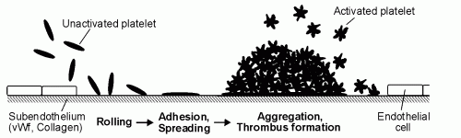
2. Formation of Platelet Plug
Occurs within 15sec of the injury, Platelets begin to adhere to exposed collagen fibers.
As platelets “stick”, they become “activated”. Activated platelets release many substances.
The aggregation of platelets eventually results in a platelet plug, a temporary mass of platelets that stops blood loss and forms a framework for the clot.

Slide 28
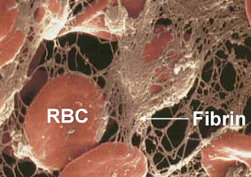
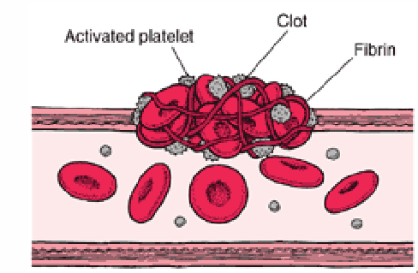
3. Blood Coagulation
Begins 30sec or more after vessel damage occurs (unlike the first 2 phases which begin almost immediately)
Involves a sequence of steps leading to the conversion of fibrinogen (a circulating plasma protein) to the insoluble protein fibrin.
A network of fibrin grows and covers the surface of the platelet plug. RBCs and additional platelets are trapped in this tangle, forming a blood clot that effectively seals the damaged vessel wall.
Notes:
Blood coagulation is the transformation of blood into a solid gel termed a clot or thrombus.
The fundamental reaction in the clotting of blood is conversion of the soluble plasma protein fibrinogen to insoluble fibrin.

Slide 29
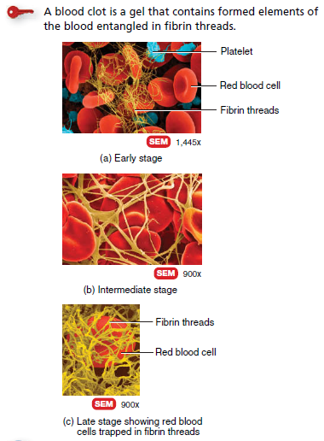

Slide 30
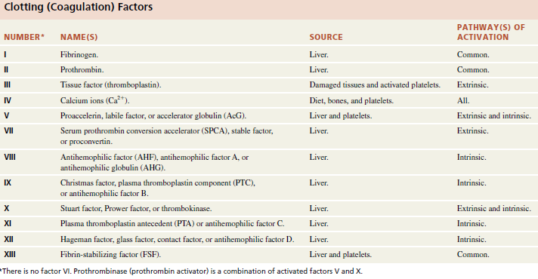
CLOTTING FACTORS USED FOR COAGULATION

Slide 31
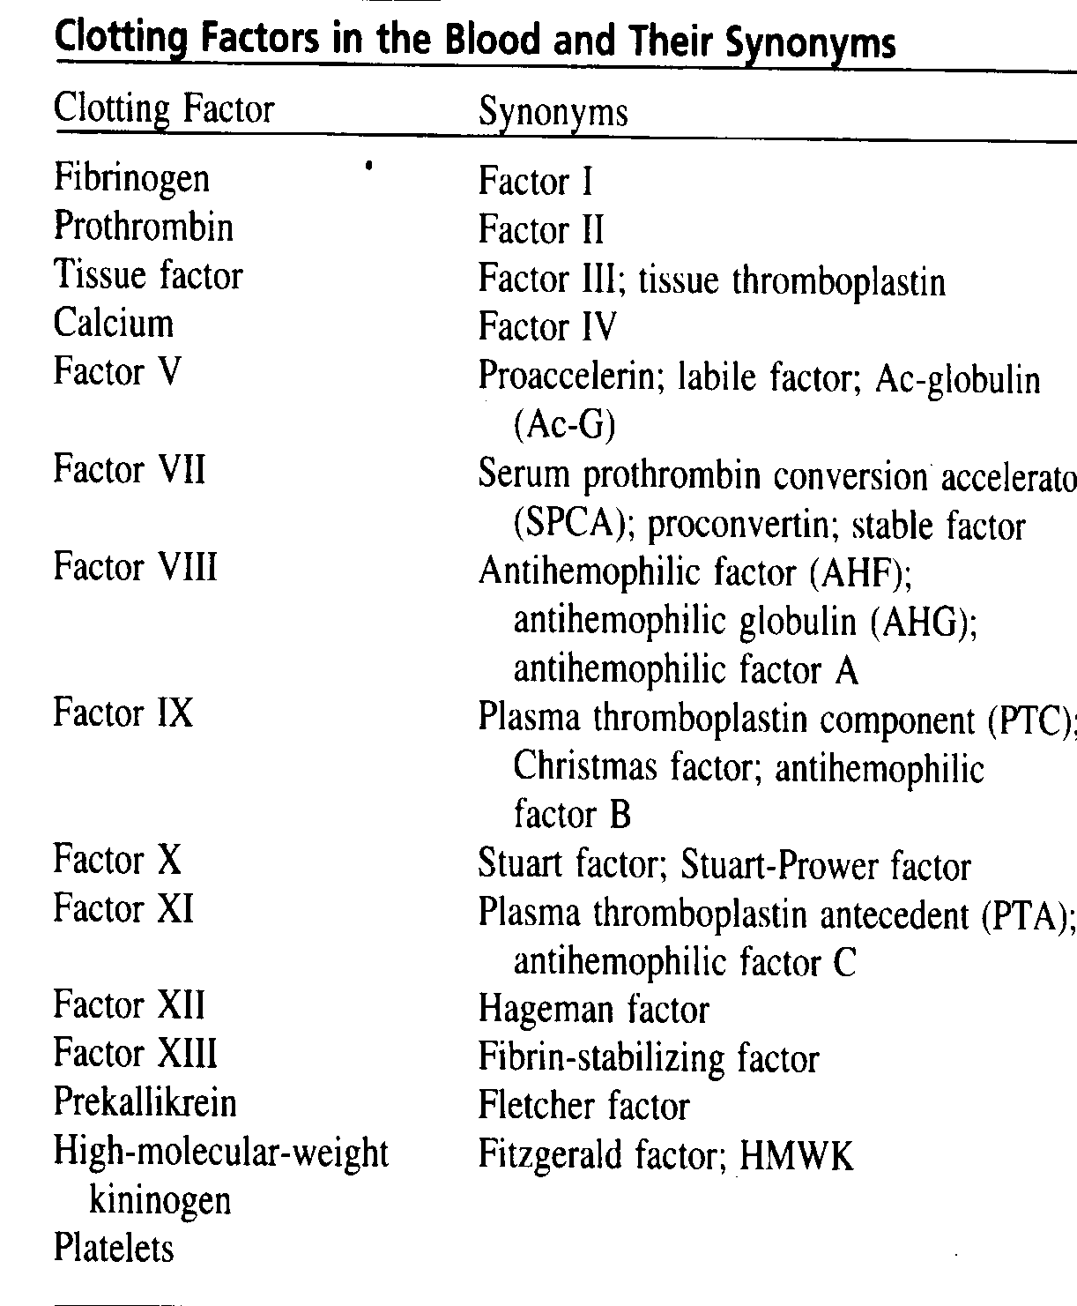
Clotting Factors
Most of these are designated by Roman numerals.
Most of these are inactive forms of proteolytic enzymes. To indicate the activated form, a small letter “a” is added after the Roman numeral (e.g., Factor Xa).
Notes:
Table 36–1 lists the most important of the clotting factors.
To indicate the activated form, a small letter a is added after the Roman numeral.
II, VII, IX, X are formed by the liver
Prekalli’krein, ‘kininogen
In both the extrinsic and the intrinsic pathways, a
series of different plasma proteins called blood-
clotting factors play major roles. Most of these are inac-
tive forms of proteolytic enzymes. When converted to
the active forms, their enzymatic actions cause the suc-
cessive, cascading reactions of the clotting process.
Most of the clotting factors, which are listed in Table
36–1, are designated by Roman numerals. To indicate
the activated form of the factor, a small letter “a” is
added after the Roman numeral, such as Factor VIIIa
to indicate the activated state of Factor VIII.

Slide 32
Clotting Factors
Except Factor IV (Ca²⁺) and platelets, all clotting factors are proteins.
Most of these proteins are formed in the liver. Furthermore, the synthesis of Factor II, VII, IX and X requires vitamin K.
Except Factor III (tissue factor), all factors exist in the fresh plasma.
Notes:
Requires clotting factors such as:
Calcium ions. Where are they stored?
11 different proteins, most synthesized by the liver
Many are proenzymes (inactive enzymes) that, when converted to active enzymes direct essential reactions in the clotting process.
The synthesis of some of them requires Vit. K
Prothrombin is formed continually by the liver, and
it is continually being used throughout the body for
blood clotting. If the liver fails to produce prothrom-
bin, in a day or so prothrombin concentration in
the plasma falls too low to provide normal blood
coagulation.
Vitamin K is required by the liver for normal for-
mation of prothrombin as well as for formation of a
few other clotting factors. Therefore, either lack of
vitamin K or the presence of liver disease that pre-
vents normal prothrombin formation can decrease the
prothrombin level so low that a bleeding tendency
result

Slide 33
Events in Blood Coagulation
Formation of prothrombin activator
Conversion of prothrombin to thrombin
Conversion of fibrinogen to fibrin
Prothrombin activator
Prothrombin
Thrombin
Fibrinogen
Fibrin
Notes:
All research workers in the ﬁeld of
blood coagulation agree that clotting takes place in
hree essential steps: (1) In response to rupture of the
vessel or damage to the blood itself, a complex cascade
of chemical reactions occurs in the blood involving
more than a dozen blood coagulation factors. The net
result is formation of a complex of activated sub-
stances collectively called prothrombin activator. (2)
The prothrombin activator catalyzes conversion of
prothrombin into thrombin. (3) The thrombin acts as
an enzyme to convert ﬁbrinogen into ﬁbrin ﬁbers that
enmesh platelets, blood cells, and plasma to form the
clot.

Slide 34
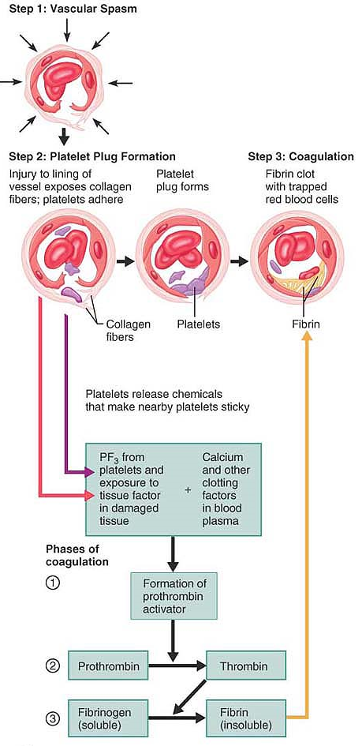

Slide 35
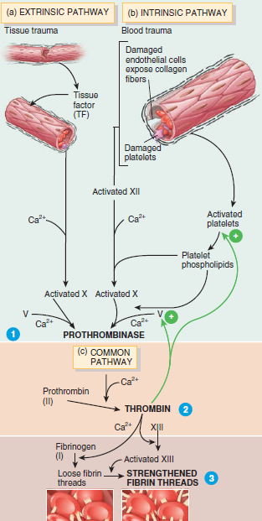
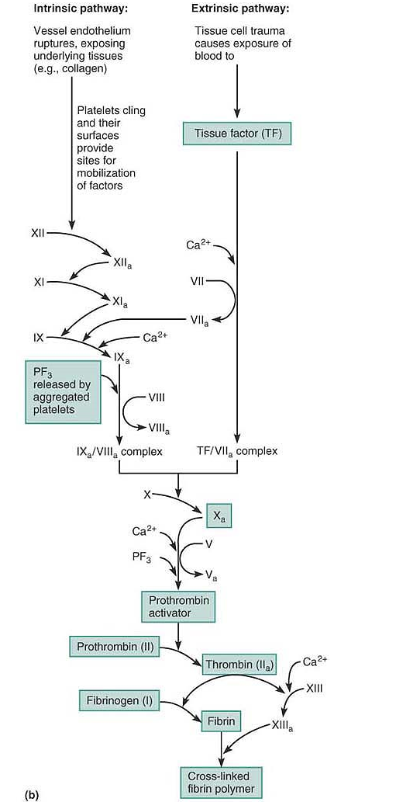
Two pathways of coagulation

Slide 36
Anemias
Reduction below normal limits of the total circulating red cell mass or a reduction in the hemoglobin concentration of the blood is called anemia.
It leads to reduced oxygen-carrying capacity of blood
Thrombocytopenia:
Decreased platelets count < 1.5 lakh/mm3.
Sever symptoms <20,ooo/mm3. Cutaneous bleeding is seen in the form of pinpoint hemorrhages (petechiae).
sudden onset of purpura and sometimes oral and nasal bleeding.

Slide 37
Hemophilia
Disorder of secondary plug formation (permanent plug) due to deficiency of clotting factors Factor VIII & IX Deficiency.
Hemophilia A is the most common hereditary disease associated with serious bleeding. It is caused by a reduction in the amount or activity of factor VIII.
Hemophilia B (Christmas Disease): Severe factor IX deficiency produces a disorder clinically indistinguishable from factor VIII deficiency.
factor VIII and IX function together to activate factor X which ultimately convert prothrombin to thrombin

Slide 38
Hemophilia A
Inherited as an X-linked recessive trait, and thus occurs in males and in homozygous females often associated with point mutations in factor VIII that impair the function of the protein.
Bruising and massive hemorrhage after trauma or operative procedures. Subject to trauma, particularly the joints, where they are known as hemarthroses, leads to progressive deformities that can be crippling.
Treatment of hemophilia A involves infusion of recombinant factor VIII.
Hemophilia B (named after the first patient with this condition)
Like hemophilia A, it is inherited as an X-linked recessive.
Recombinant factor IX is used for treatment.

Slide 39
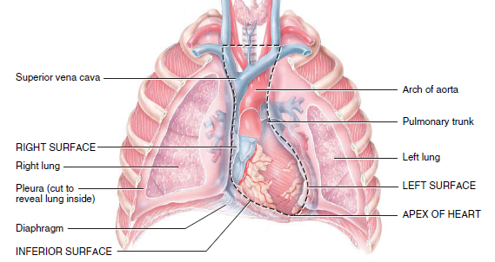
HEART
12 cm long, 9 cm wide at its broadest point, and 6 cm thick, with an average mass of 250 g in adult females and 300 g in adult males.
The heart rests on the diaphragm, near the midline of the thoracic cavity.
The heart lies in the mediastinum.
The pointed apex is formed by the tip of the left ventricle (a lower chamber of the heart) and rests on the diaphragm.
It is directed anteriorly, inferiorly, and to the left.
The base of the heart is opposite the apex and is its posterior aspect. It is formed by the atria (upper chambers) of the heart, mostly the left atrium

Slide 40
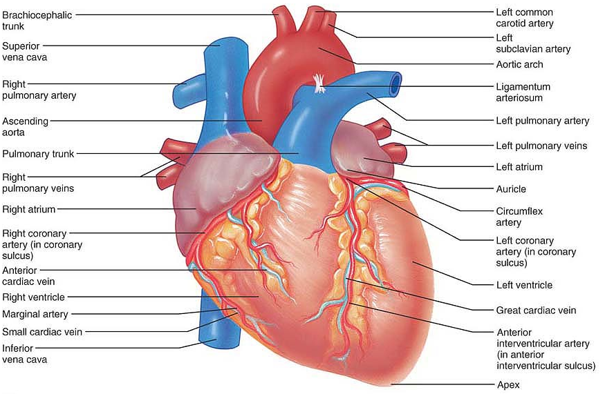
Anterior view.

Slide 41
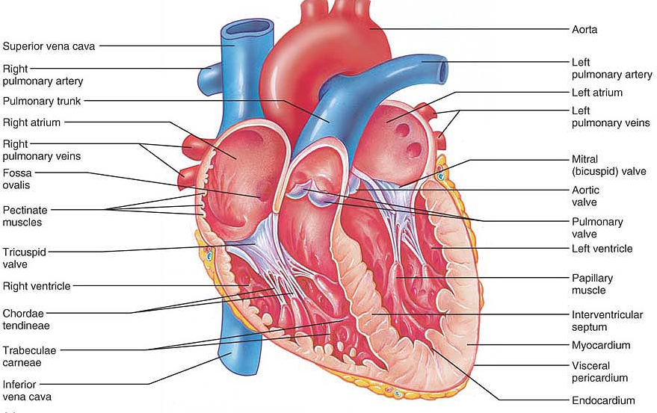
Frontal section showing interior chambers and valves

Slide 42
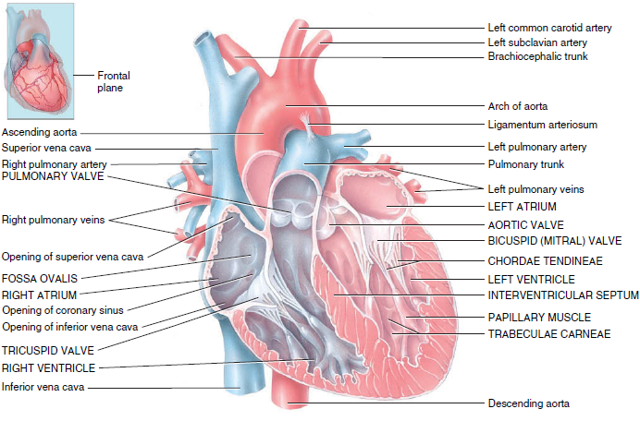
Structure of the heart: internal anatomy

Slide 43
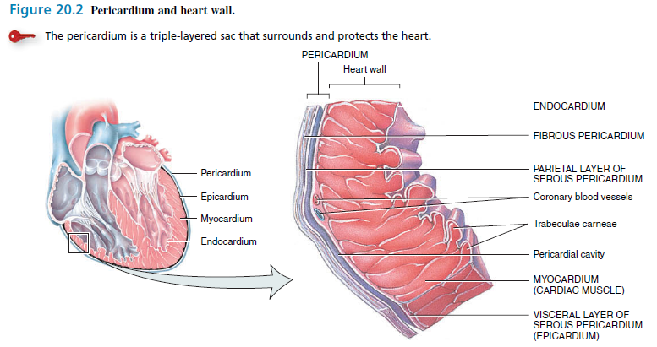
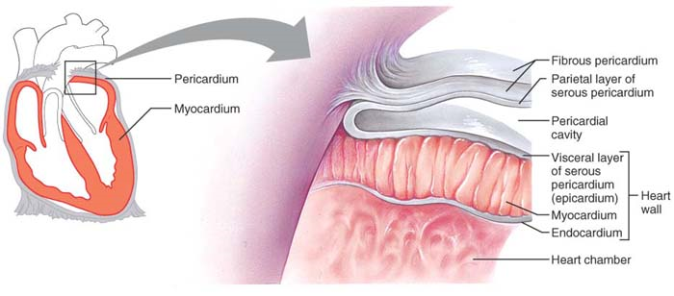
Coverings of heart

Slide 44
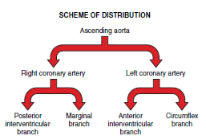
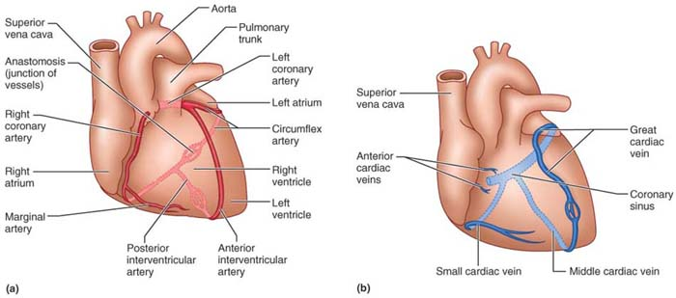
Coronary Circulation
Circulation to heart

Slide 45
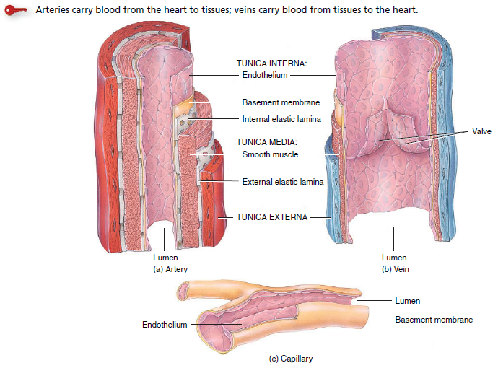
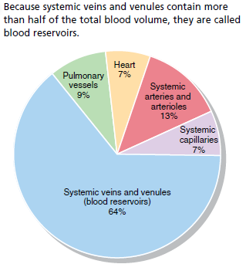
Resistant vessel
Capacitance vessels
Areteries Vs Veins Vs Capillaries
Comparative structure of blood vessels

Slide 46
Setting the Basic Rhythm: The Intrinsic Conduction System of the heart.
The ability of cardiac muscle to depolarize and contract is intrinsic; that is, it is a property of heart muscle and does not depend on the nervous system. Even if all nerve connections to the heart are cut off, the heart continues to beat rhythmically
The independent, but coordinated, activity of the heart is brought about by:
  (1) Presence of gap junctions, and
  (2) Activity of the heart’s “in-house” conduction system/the intrinsic cardiac conduction system:
  Consists of noncontractile cardiac cells specialized to initiate and distribute impulses throughout the heart.
  It depolarizes and contracts in an orderly, sequential manner.
  Thus, the heart beats as a coordinated unit.

Slide 47
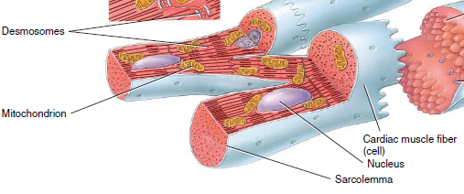
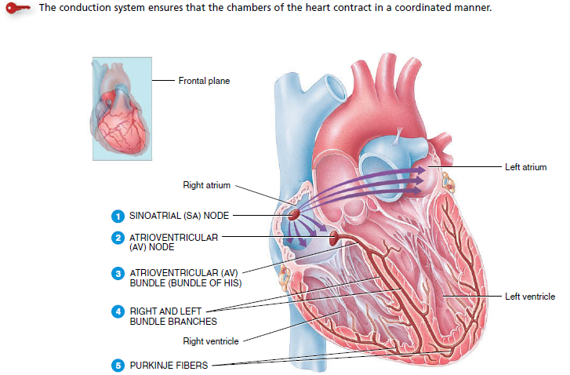
Cardiac muscle fibers connect to neighboring fibers by intercalated discs, which contain desmosomes and gap junctions, so conduction is rapid in heart.

Slide 48
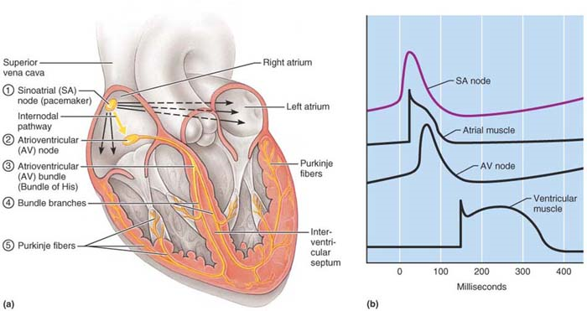
The depolarization wave initiated by the SA node passes successively through the atrial myocardium to the AV node, the AV bundle, the right and left bundle branches, and the Purkinje fibers in the ventricular myocardium.
(b) Comparison of the tracings of membrane potentials generated at various locations in the heart is shown from top to bottom beginning with the pacemaker potential generated by the SA node and ending with an action potential (with a broad plateau) typical of the contractile cardiac cells of the ventricles.

Slide 49
1. Sinoatrial node: (Autorhythmicity generator; PACEMAKER CELL)
  The crescent-shaped node located in the right atrial wall, just inferior to the entrance of the superior vena cava.
  A minute cell mass with a enormous job, typically generates impulses about 75 times every minute. (However, its inherent rate in the absence of extrinsic neural and hormonal factors is closer to 100 times per minute.)
  It is the heart’s pacemaker, and its characteristic rhythm, called sinus rhythm, determines heart rate.
2. Atrioventricular node:
  From the SA node, the depolarization wave spreads via gap junctions throughout the atria and via the internodal pathway to the atrioventricular (AV) node, located in the inferior portion of the interatrial septum immediately above the tricuspid valve.
  At the AV node, the impulse is delayed for about 0.1 s, allowing the atria to respond and complete their contraction before the ventricles contract.
  The pace set by the AV node (junctional rhythm) is 40 to 60 beats per minute, slower than sinus rhythm but still adequate to maintain circulation
Notes:
Defects in the intrinsic conduction system can cause irregular heart rhythms, or arrhythmias (ah-rith′me-ahz), uncoordinated atrial and ventricular contractions, and even fibrillation, a condition of rapid and irregular or out-of-phase contractions in which control of heart rhythm is taken away from the SA node by rapid activity in other heart regions.
Any damage to the AV node, referred to as a heart block,

Slide 50
3. Atrioventricular bundle.
  From the AV node, the impulse sweeps to the atrioventricular (AV) bundle (also called the bundle of His) in the superior part of the interventricular septum.
  Although the atria and ventricles bound each other, they are not connected by gap junctions.
  The AV bundle is the only electrical connection between them.
4. Right and left bundle branches:
course along the interventricular septum toward the heart apex.
5. Purkinje fibers:
  Purkinje fibers complete the pathway through the interventricular septum, penetrate into the heart apex, and then turn superiorly into the ventricular walls.
  The bundle branches excite the septal cells, but the bulk of ventricular depolarization depends on the large Purkinje fibers

Slide 51
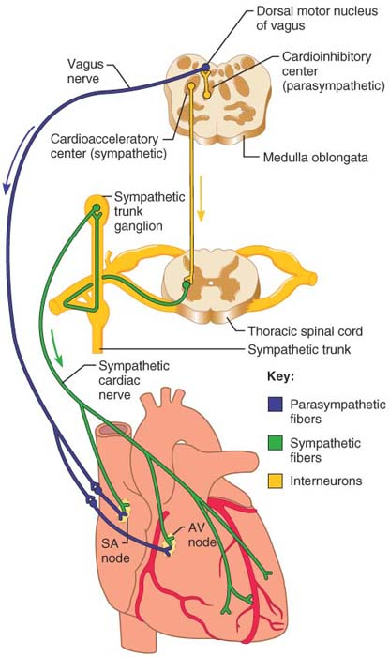
Modifying the Basic Rhythm: Extrinsic Innervation of the Heart (AUTONOMIC NERVE TO HEART)
Autonomic innervation of the heart

Slide 52
The sympathetic nervous system (the “accelerator”) increases both the rate and the force of heartbeat; parasympathetic activation (the “brakes”) slows the heart.
The cardiac centers are located in the medulla oblongata.
The cardioacceleratory center
  projects to sympathetic neurons in the T₁–T₅ level of the spinal cord.
  Innervate the SA and AV nodes, heart muscle, and the coronary arteries.
The cardioinhibitory center
  sends impulses to the parasympathetic dorsal vagus nucleus in the medulla, which in turn sends inhibitory impulses to the heart via branches of the vagus nerves.
  Most parasympathetic ganglionic motor neurons lie in ganglia in the heart wall and their fibers project most heavily to the SA and AV nodes.

Slide 53
Electrocardiography (ECG)
The electrical currents generated in and transmitted through the heart spread throughout the body and can be detected with an electrocardiograph.
A graphic record of heart electrical activity is called an electrocardiogram (ECG or EKG; kardio is Greek for “heart”).
An ECG is a combined action potentials generated by nodal and contractile cells at a given time.
Recording electrodes (leads) are positioned at various sites on the body surface; typically in a clinical setting, 12 leads are used.
Three are bipolar leads that measure the voltage difference either between the arms or between an arm and a leg, and nine are unipolar leads (Chest leads) kept in the chest.
Together the 12 leads provide a fairly comprehensive picture of the heart’s electrical activity.

Slide 54
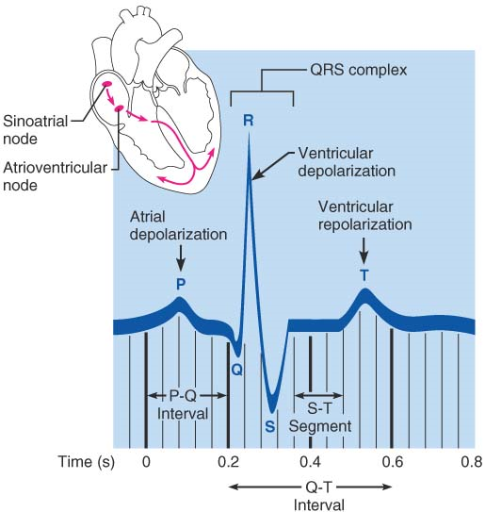
An electrocardiogram tracing (lead I).
The three normally recognizable deflections (waves) and the important intervals are labeled.

Slide 55
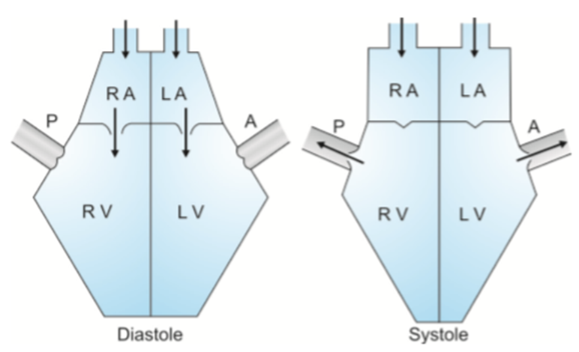
Mechanical events (cardiac cycle) in heart which always follow the electrical event ( ECG)
Systole: Contraction/ ejection phase
Diastole: Relaxation or receiving phase

Slide 56
Mechanical Events of heart: The Cardiac Cycle
The cardiac cycle includes all events associated with the blood flow through the heart during one complete heartbeat, that is, atrial systole and diastole followed by ventricular systole and diastole. Normal time of 1 cardiac cycle is 800milliseconds (0.8 seconds)
A single cardiac cycle includes all of the events associated with one heartbeat. Thus, a cardiac cycle consists of systole and diastole of the atria plus systole and diastole of the ventricles.
These mechanical events always follow the electrical events seen in the ECG.
The cardiac cycle is noticeable by a succession of pressure and blood volume changes in the heart.
Because blood circulates endlessly, we must choose an random starting point for one turn of the cardiac cycle.
We begin our explanation with the heart in total relaxation: Atria and ventricles are quiet, and it is mid-to-late diastole.

Slide 57
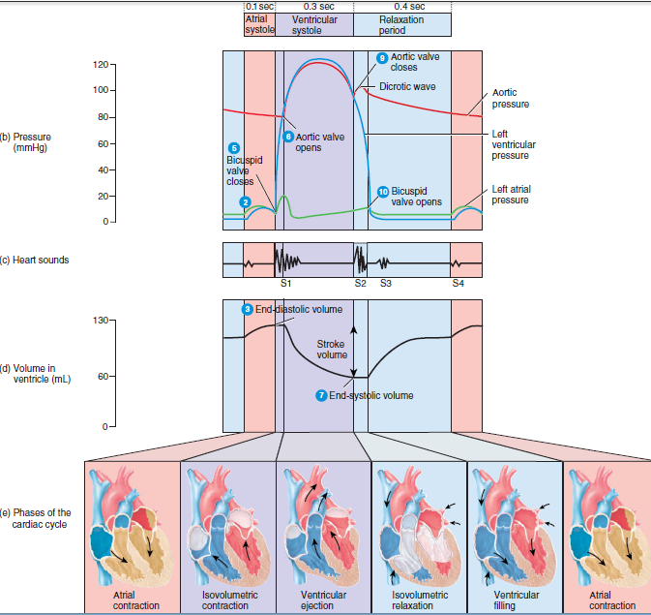
Pressures are lower in the right side of the heart as compared with left heart but all events are going parallel in both ventricles
Summary of events during the cardiac cycle

Slide 58
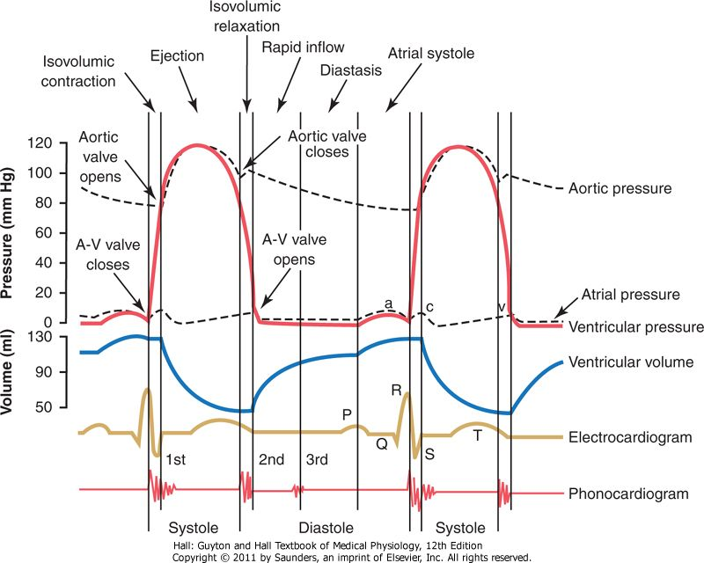
Summary of events during the cardiac cycle
Notes:
Occasionally a weak, rumbling third heart sound is heard at the beginning of the middle third of diastole because of oscillation of blood back and forth between the walls of the ventricles initiated by inrushing blood from the atria.
Atrial Heart Sound (Fourth Heart Sound): never be heard with a stethoscope because of its weakness and very low frequency-usually 20 cycles/sec or less

Slide 59
Often described as lub-dup, are associated with closing of heart valves. (lub-dup, pause, lub-dup, pause, and so on.)
The first sound, which occurs as the AV valves close, signifies the point when ventricular pressure rises above atrial pressure (beginning of ventricular systole)
The first sound tends to be louder, longer, and more resonant than the second, which is a short, sharp sound heard as the semilunar valves snap shut at the beginning of ventricular relaxation (diastole).
Occasionally a weak, rumbling third heart sound is heard at the beginning of the middle third of diastole because of oscillation of blood back and forth between the walls of the ventricles initiated by inrushing blood from the atria.
Atrial Heart Sound (Fourth Heart Sound): never be heard with a stethoscope because of its weakness and very low frequency-usually 20 cycles/sec or less.
Heart Sounds

Slide 60
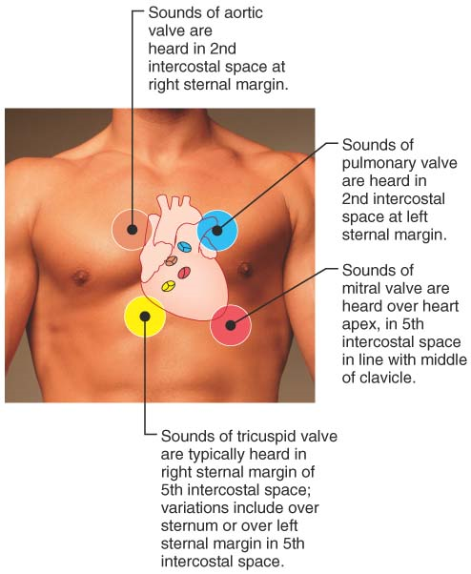
Fig. Areas of the thoracic surface where the heart sounds can be best detected.
Note: sounds take oblique paths to reach the chest wall
Abnormal heart sounds are called heart murmurs.
Most often, murmurs indicate valve problems.
Notes:
Abnormal heart sounds are called heart murmurs. Blood flows silently as long as the flow is smooth and uninterrupted. If it strikes obstructions, however, its flow becomes turbulent and generates heart murmurs that can be heard with a stethoscope. Heart murmurs are fairly common in young children (and some elderly people) with perfectly healthy hearts, probably because their heart walls are relatively thin and vibrate with rushing blood. Most often, however, murmurs indicate valve problems.
If a valve is incompetent, a whistling sound is heard as the blood backflows or regurgitates through the partially open valve, after the valve has (supposedly) closed. A stenotic valve, in which the valvular opening is narrowed, restricts blood flow through the valve

Slide 61

Cardiac Output
Cardiac output (CO) is the amount of blood pumped out by each ventricle in 1 minute. It is the product of heart rate (HR) and stroke volume (SV).
Stroke volume is defined as the volume of blood pumped out by one ventricle with each beat.
Notes:
The difference between resting and maximal CO is referred to as cardiac reserve. In nonathletic people, cardiac reserve is typically four to five times resting CO (20–25 L/min), but CO in trained athletes during competition may reach 35 L/min (seven times resting)

Slide 62

Regulation of Stroke Volume (SV)
SV represents the difference between end diastolic volume (EDV), the amount of blood that collects in a ventricle during diastole, and end systolic volume (ESV), the volume of blood remaining in a ventricle after it has contracted.
Hence, with each beat, each ventricle pumps out about 70 ml of blood, which is about 60% of the blood in its chambers.
Preload affects EDV, whereas contractility and afterload affect the ESV

Slide 63
Preload: Degree of Stretch of Heart Muscle
According to the Frank-Starling law of the heart, the critical factor controlling SV is the preload, which is the degree to which cardiac muscle cells are stretched just before they contract .
Venous return : stretching cardiac cells can produce dramatic increases in contractile force. The most important factor stretching cardiac muscle is the amount of blood returning to the heart and distending its ventricles, called venous return.
Afterload: Back Pressure Exerted by Arterial Blood

Slide 64
Blood Pressure (120/80 mm Hg)
Lateral pressure exerted by the column of blood on the walls of the arteries.
It usually means arterial pressure which fluctuate during & diastole of the heart.
Systolic BP: Maximum pressure produced during systolic phase. This depends mainly on cardiac output, 120 mm Hg
Diastolic BP: Minimum pressure recorded during the diastolic phase. DBP depends mainly on the peripheral resistance (which again depends on the diameter of blood vessels & viscosity of the blood), 80 mm Hg
Pulse Pressure: SBP-DBP.
This maintains the normal pulsatile nature of the flow of blood in vascular compartment.
Required for the perfusion of the tissues.

Slide 65
Mean arterial pressure (MAP)
MAP= DBP+1/3 PP
This pressure help in the forward movement of blood in the lumen.
Normal range
SBP: 100-140 mm Hg
DBP: 60-84 mm Hg
PP: 20-50 mm Hg
MAP: 75-105 mm Hg

Slide 66
Factors affecting BP: (CO*PR)
Cardiac output (stroke volume * Heart rate)
Stroke volume: affected by
      Preload
      Afterload
      Myocardial contractility
Heart rate: affected by parasympathetic & sympathetic activities.
  Preload (End Diastolic Volume): Depends on the venous return to the heart. When EDV increases cardiac output increases which is explained by Frank-Starling law.
  Afterload: It is peripheral resistance. When PR increase (as in Hypertention) cardiac output decrease and vice versa (anemia)

Slide 67
Factors that increase Preload:
  Increased total blood volume
  Increased venous tone
  Increased pumping action of skeletal muscle
  Increased negative intrathoracic pressure.
  Increased atrial contraction.
Myocardial contractility
Strength of contraction increase: Positively inotropic; Sympathetic stimulation, digitalis, glucagon, caffeine.
Strength of contraction decrease: Negatively inotropic; parasympathetic stimulation, hypoxia, acidosis, propranolol, barbiturate.

Slide 68
2. Factors affecting peripheral resistance
Diameter of blood vessels: Sympathetic tone constrict the blood vessel (mainly the arteriole)
Viscosity: depends on the composition of plasma & the number of blood cells , temperature.
  Factors increasing viscosity : Polycythemia, hyperproteinemia, decreased temp.
  Factors decreasing viscosity: anemia, hypoproteinemia

Slide 69
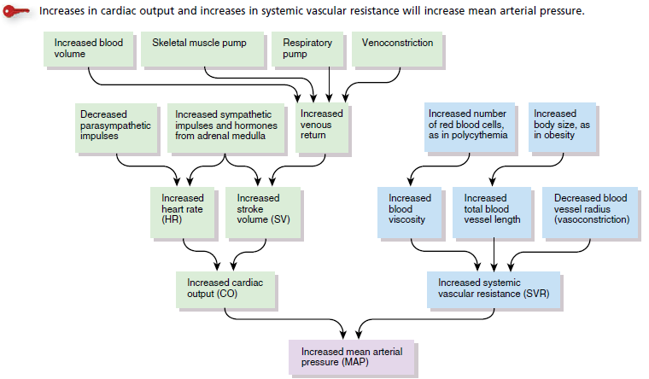
BP = (CO*PR)

Slide 70
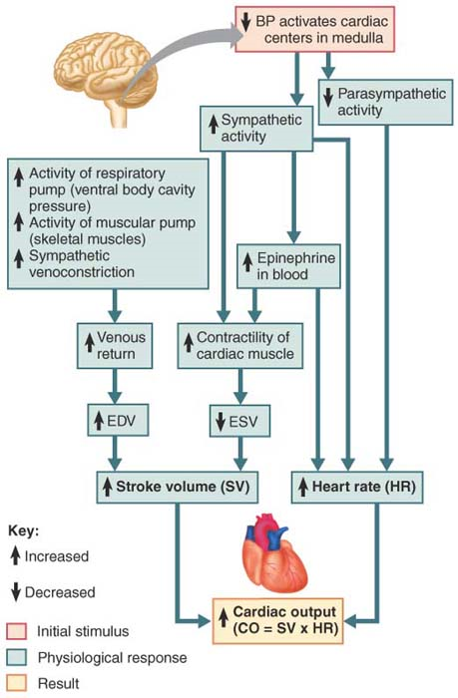

Slide 71

Short term regulation: NEURAL CONTROL
Baroreceptor reflexes that help maintain blood pressure homeostasis

Slide 72

Long-Term Mechanisms: Hormonal Controls

Slide 73

Long-Term Mechanisms: Renal Regulation

Slide 74


The Two Main Circulations of the Body
Pulmonary circulation
Systemic circulation

Slide 75



Slide 76


Slide 77


Slide 78

Four principal divisions of the Aorta
1. Ascending aorta 2. Arch of aorta 3. Thoracic aorta 4. Abdominal aorta

Slide 79

principal branches of the aorta

Slide 80


Slide 81

principal branches of the aorta

Slide 82

HYPERTENSION
The British Hypertension Society has defined ranges of blood pressure which fall within the normal range and those that indicate hypertension

Slide 83
Hypertension
Elevated arterial blood pressure is called as hypertension.
Measurements above 140/90 mmHg are considered higher than normal.
Blood pressure tends to rise naturally with age.
Arteriosclerosis may contribute to this.
Hypertension is described as essential (primary, idipathic), 95% and secondary;5% to other diseases.

Slide 84

Aetiology
In more than 95% of cases, a specific underlying cause of hypertension cannot be found. Such patients are said to have essential hypertension

Slide 85
Essential hypertension
Hypertension of unknown cause and accounts for 95% of all cases.
Subdivided according to the rate at which disease progresses as
  Benign ( Chronic) hypertension : the rise of blood pressure is usually slight to moderate and continues to rise slowly over many years.
  Malignant (accelerated) hypertension: This is a rapid and aggressive acceleration of hypertension. DBP in excess of 120 mmHg is common.

Slide 86
Secondary hypertension
Hypertension resulting from other diseases accounts for 5% of all cases.
It may be in diseases like
  Kidney disease
  Endocrinal disorders of adrenal cortex and adrenal medulla
  Stricture of the aorta
  Drug treatment.

Slide 87
Etiology
Genetic
Environment
  - Dietary: Salt intake
  Alcohol intake
  Obesity
  Racial variation
Risk Factors
  Age: Younger the age lower the life expectancy
  Sex: Females do well
  Atherosclerosis

Slide 88
The pathogenesis of secondary hypertension are explained as below.
Renal Hypertension
  Activation of renin-angiotensin system
  Sodium and water retention
  Release of vaso depressor materials like PG.
Endocrine Hypertension
  Aldosteronism
  Hyperparathyroidism
  Oral contraceptives
Coarctation of Aorta
Neurogenic

Slide 89
Effects and complications
Hypertension predisposes to atherosclerosis and has specific effects on particular organs.
Heart- The rate and force of cardiac contraction are increased to maintain the cardiac output against a sustained rise in arterial pressure.
  Left Ventricular hypertrophy and failure.
  Back Pressure and pulmonary congestion
Coronary artery atherosclerosis and ischaemic heart disease.

Slide 90
Brain- stroke caused by cerebral haemorrhage is common. Transient ischaemic attack.
Kidneys- Essential hypertension cause kidney damage
Blood Vessels- the walls of small arteries is hardened and in larger arteries, atheroma is accelerated.

Slide 91


