Slide 1
Unit VII: Lymphatic system
Bijay Subedi
BPH, 1st Semester, SHAS

Slide 2
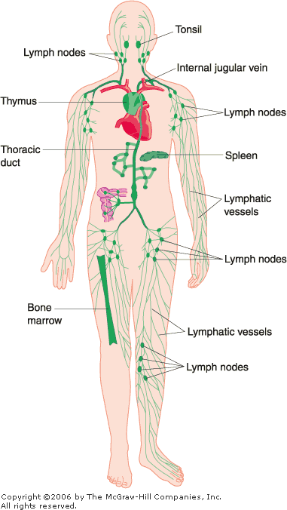
Components of lymphatic system:
The lymphatic system consists of lymph, lymphatic vessels,
lymphatic tissues, and red bone marrow.
Lymphatic tissues:
  Spleen,
  Lymph nodes,
  Thymus,
  Tonsil
Lymph nodes are encapsulated bean-shaped organs consisting of masses of B cells & T lymphocytes

Slide 3
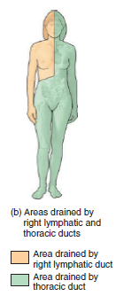
Two major lymphatic ducts draining the tissue fluid into sub-clavien vein are:
  Thoracic duct from the major parts of body, left half of cranial & thoracic region
  Right lymphatic duct from the right half of cranium, abdominothoracic region & right upper limb
Lymphatic vessels resemble small veins
in structure but have thinner walls and more valves.
Lymphatic capillaries are also slightly larger in diameter than blood capillaries and have a unique one-way structure that permits interstitial fluid to flow into them but not out

Slide 4
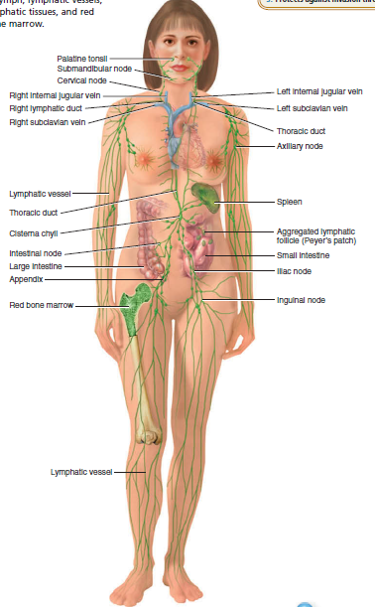
The lymphatic system consists of a fluid called lymph, vessels called lymphatic vessels that transport the lymph, a number of structures and organs containing lymphatic tissue
(lymphocytes within a filtering tissue), and red bone marrow
Lymph is a clear, pale-yellow fluid but in the small intestine, specialized lymphatic capillaries called lacteals (lact- milky) carry dietary lipids into lymphatic vessels and ultimately into the blood so the lymph appear creamy white; such lymph is referred to as chyle

Slide 5
Functions of the Lymphatic System
Drains excess interstitial fluid from tissue spaces and return it to the blood; maintenance of circulating blood volume.
2. Transports dietary lipids: Lymphatic vessels transport lipids and lipid-soluble vitamins (A, D, E, and K) absorbed by the gastrointestinal tract.
3. Carries out immune responses. Lymphatic tissue initiates
highly specific responses directed against particular microbes or abnormal cells.
Lymphatic capillaries have greater permeability than blood capillaries
and thus can absorb large molecules such as proteins and
lipids.

Slide 6
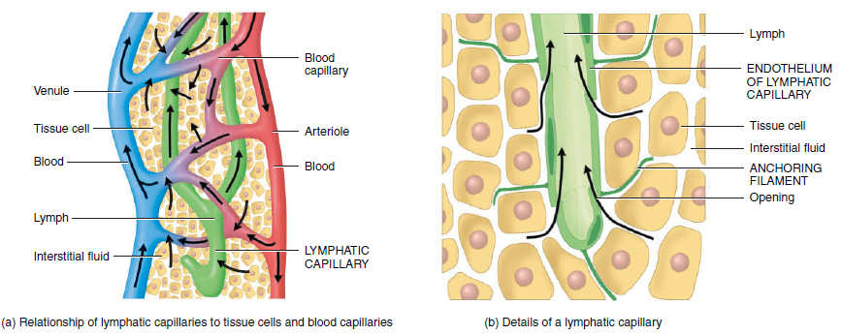
Lymphatic capillaries are found throughout the body except in avascular tissues, the central nervous system, portions of the
spleen, and bone marrow
One way flow of lymph from interstitial space towards the major vein

Slide 7
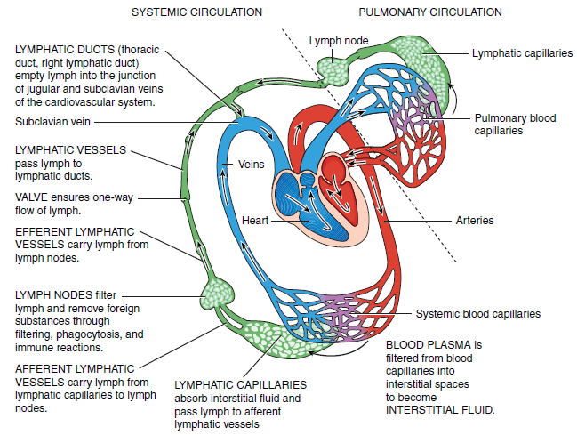
The sequence of fluid flow is: blood capillaries (blood) interstitial spaces (interstitial fluid) lymphatic capillaries (lymph) lymphatic vessels (lymph) lymphatic ducts (lymph) junction of the internal jugular and subclavian veins (blood).

Slide 8
Lymph Composition
Lymph contains a variety of substances, including proteins, salts, glucose, fats, water, and white blood cells. Unlike blood, lymph does not normally contain any red blood cells.
In the lymphatic vessels of arms and legs, lymph is clear and transparent, and its chemical composition is similar to blood plasma. However, lymph contains less protein than plasma.
The lymph returning from intestines is milky (CHYLE), owing to the presence of fatty acids absorbed from your diet.

Slide 9
Types of Lymphatic Organs and Tissues
Based on functions lymphatic organs & tissues are classified into two groups:
Primary lymphatic organs: sites where stem cells divide and become immunocompetent; red bone marrow (in flat bones and the epiphyses of long bones of adults; B lymphocytes mature) and the thymus (T lymphocytes mature)
Secondary lymphatic organs and tissues are the sites where most immune responses occur. They include lymph nodes, the spleen, and lymphatic nodules (follicles)
The thymus, lymph nodes, and spleen are considered organs because each is surrounded by a connective tissue capsule; lymphatic nodules, in contrast, are not considered organs because they lack a capsule.

Slide 10
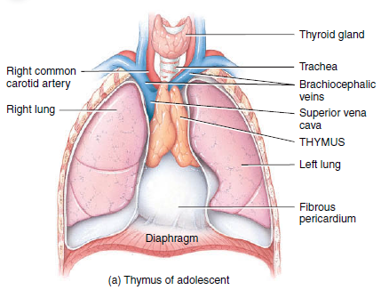
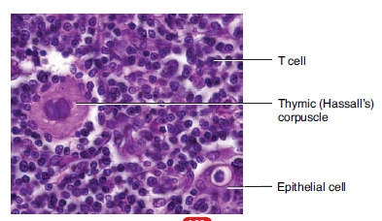
1. Thymus
Bilobed organ located in the mediastinum between the sternum and the aorta.
Outer cortex and central medulla.
The cortex is composed of large numbers of T cells and scattered dendritic cells, epithelial cells, and macrophages.
The medulla consists of widely scattered, more mature T cells, epithelial cells, dendritic cells, and macrophages
In infants, the thymus has a mass of about 70 g, in old age the functional portion may weigh only 3 g.
Functional portion of thymus atrophies with age

Slide 11
2. Lymph Nodes
About 600 bean-shaped structure located along lymphatic vessels.
Large groups of lymph nodes are present near the mammary glands and in the axillae and groin.
1–25 mm long and, like the thymus, are covered by a capsule of dense connective tissue that extends into the node called trabeculae, which divide the node into compartments

Slide 12
Structure of a Lymph Node
Lymph nodes vary in shape and size, but most are bean shaped and less than 2.5 cm in length.
Each node is surrounded by a dense fibrous capsule from which connective tissue strands called trabeculae extend inward to divide the node into a number of compartments.
The node’s internal framework or stroma of reticular fibers physically supports the ever-changing population of lymphocytes.
A lymph node has two histologically distinct regions, the cortex and the medulla.
The superficial part of the cortex contains densely packed follicles, many with germinal centers heavy with dividing B cells.
Dendritic cells nearly encapsulate the follicles and border the deeper part of the cortex.
Deeper part of the cortex primarily houses T cells in transit.
The T cells circulate continuously between the blood, lymph nodes, and lymph, performing their surveillance role.
Lymphoid tissues are basically made up of free cells; as a result, they typically have a rich network of reticular fibrils (made principally of type III collagen) that supports the cells

Slide 13
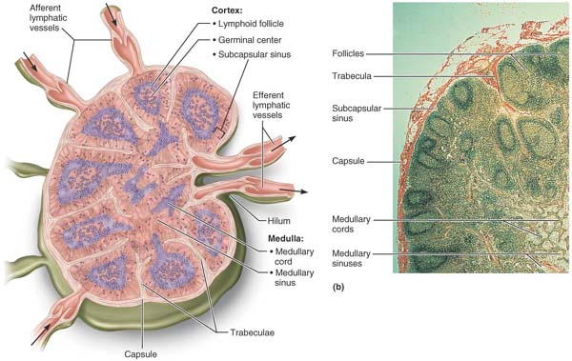
Fig. Longitudinal view of the internal structure of a lymph node and associated lymphatics. Several afferent lymphatics converge on its convex side, whereas fewer efferent lymphatics exit at its hilum. Arrows indicate the direction of lymph flow into and out of the node.

Slide 14
Inner medullary cords, which are thin inward extensions from the cortical lymphoid tissue, contain both types of lymphocytes plus plasma cells.
Throughout the node are lymph sinuses, large lymph capillaries spanned by crisscrossing reticular fibers.
Numerous macrophages reside on these reticular fibers and phagocytize foreign matter in the lymph as it flows by in the sinuses.
Lymph enters the convex side of a lymph node through a number of afferent lymphatic vessels. It then moves through a large, baglike sinus, the subcapsular sinus, into a number of smaller sinuses that cut through the cortex and enter the medulla. The lymph roams through these sinuses and finally exits the node at its hilum

Slide 15
Because there are fewer efferent vessels draining the node than afferent vessels feeding it, the flow of lymph through the node stagnates somewhat, allowing time for the lymphocytes and macrophages to carry out their protective functions.
The parenchyma of the lymph node consists of an open meshwork of reticulin fibres which provides support for an ever-changing population of lymphocytes.
The cortex consists of densely-packed lymphocytes.
In the outer cortex, lymphocytes form a variable number of densely packed lymphoid follicles, many of which show less dense germinal centres. The deep cortex (paracortical zone) is devoid of lymphoid follicles.
Lymphocytes enter lymph nodes mainly via the arterial system

Slide 16
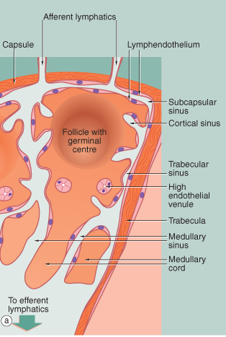
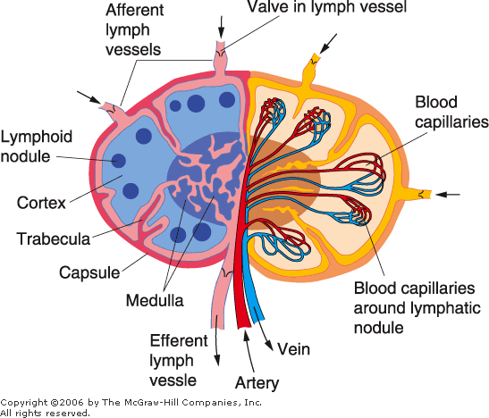
Fig. Histology of Lymph node structure

Slide 17
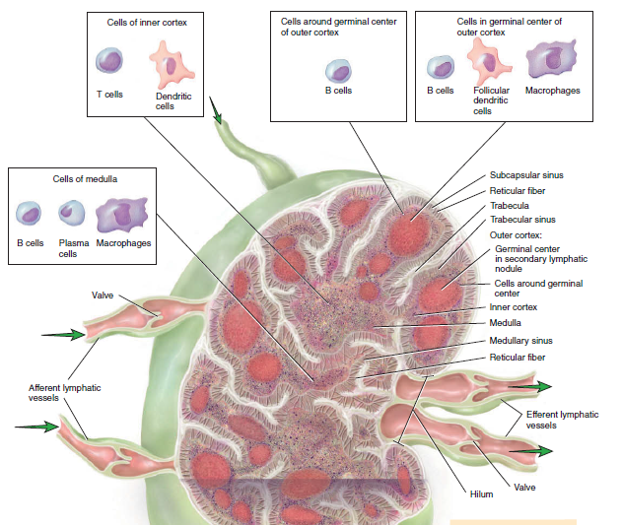
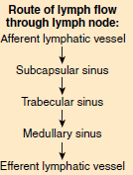
Structure of lymph node

Slide 18
3. Spleen
The oval spleen is the largest single mass of lymphatic tissue in the body, measuring about 12 cm in length.
It is located in the left hypochondriac region between the stomach and diaphragm. The superior surface of the spleen is smooth and convex and conforms to the concave surface of the diaphragm.
A capsule of dense connective tissue surrounds the spleen. The capsule plus trabeculae, reticular fibers, and fibroblasts constitute the stroma of the spleen.
The parenchyma of the spleen consists of two different Kinds of tissue called white pulp and red pulp .
White pulp is lymphatic tissue, consisting mostly of lymphocytes
and macrophages arranged around branches of the splenic artery called central arteries.
Red pulp consists of blood-filled venous sinuses and cords of splenic tissue called splenic cords or Billroth’s cords. Splenic cords consist of red blood cells, macrophages, lymphocytes, plasma cells, and granulocytes.

Slide 19
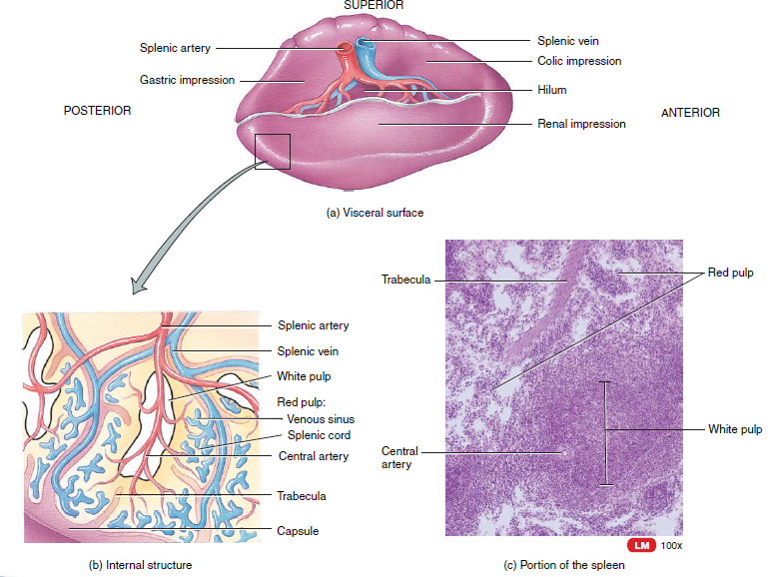
SPLEEN

