Slide 1
ENDOCRINOLOGY
BPH, 1st semester

Slide 2
An Introduction to Endocrinology
Endocrine system: Nervous system being the first it is the second great control system of the body, which interacts with the nervous system to coordinate and integrate the activity of body cells.
The nervous system regulates the activity of muscles and glands via electrochemical impulses delivered by neurons, and those organs respond within milliseconds.
The endocrine system influences metabolic activity by means of hormones (hormon=to excite), which are chemical messengers released into the blood to be transported throughout the body. Binding of a hormone to cellular receptors initiates responses that typically occur after a lag period of seconds or even days.
But, once initiated, those responses tend to be much more prolonged than those induced by the nervous system.

Slide 3
The Endocrine System: An Overview
Two kinds of glands: Endocrine & Exocrine
Exocrine glands:
  Produce nonhormonal substances, such as sweat and saliva.
  Have ducts through which these substances are moved to a membrane surface.
Endocrine glands,
  Also called ductless glands
  produce hormones and lack ducts.
  They release their hormones into the surrounding tissue fluid (endo = within; crine = to secrete),
  Typically have a rich vascular and lymphatic drainage that receives their hormones.
Most of the hormone-producing cells in endocrine glands are arranged in cords and branching network, a situation that maximizes contact between them and the capillaries surrounding them.

Slide 4
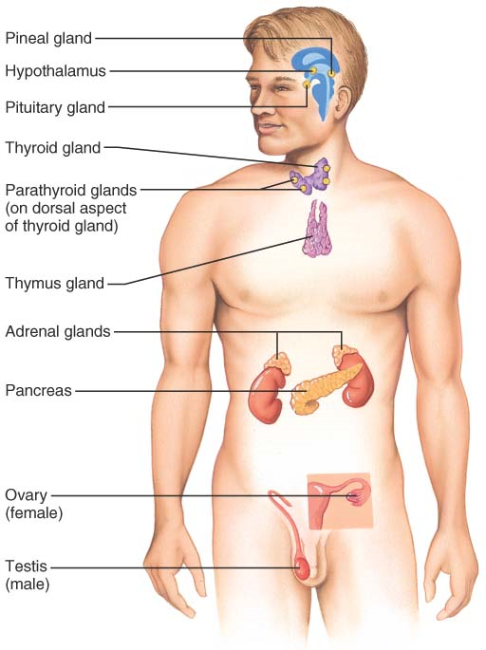
Fig. Location of the major endocrine organs of the body.
The hypothalamus, along with its neural functions, produces and releases hormones, so we can consider the hypothalamus a neuroendocrine organ
Besides the major endocrine organs, various other tissues and organs produce hormones, adipose cells release leptin, and pockets of hormone-producing cells are found in the walls of the small intestine, stomach, kidneys, and heart

Slide 5
Functional division of endocrine glands
Endocrine Glands:
  Endocrine hormones are long-distance chemical signals that travel in blood or lymph throughout the body.
2. Autocrine Glands:
  Autocrine hormones are chemicals that exert their effects on the same cells that secrete them.
  For example, certain prostaglandins released by smooth muscle cells cause those smooth muscle cells to contract.
3. Paracrine Glands:
  Act locally on the adjacent cells but affect cell types other than those releasing the paracrine chemicals.
  For example, somatostatin released by one population of pancreatic cells inhibits the release of insulin by a different population of pancreatic cells.
Note: Certain tumor cells, such as those of some cancers of the lung or pancreas, synthesize hormones identical to those made in normal endocrine glands

Slide 6
Objectives of endocrinology
Identify the gland or tissue that is producing the hormone.
Identify the hormone that is produced.
Identify the target for that hormone (where is that hormone going in the body?).
Identify the function of that hormone (what is that hormone going to cause the body to do?).

Slide 7
For maintaining homeostasis, two major system come into play.
The autonomic nervous system is concerned with rapid changes, while hormones of the endocrine system are mainly involved in slower and more precise adjustments.
The endocrine system consists of glands widely separated from each other with no direct anatomical links.
Endocrine glands consist of groups of secretory cells surrounded by an extensive network of capillaries which facilitates diffusion of hormones (chemical messengers) directly from the secretory cells into the bloodstream; ductless gland.
Two major types of hormone based on chemical nature:
  Amino acids based (amines, polypeptides and proteins).
  Cholesterol-based lipids (steroids).

Slide 8
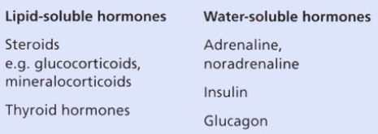
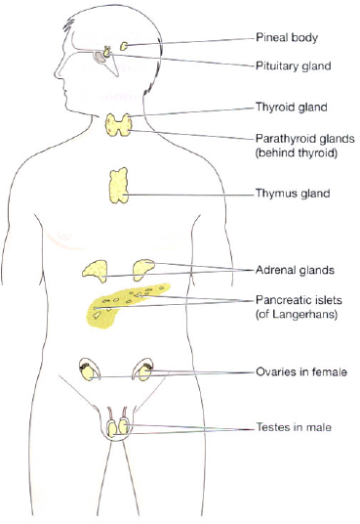
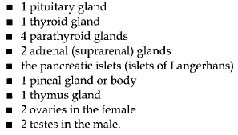
Position of major endocrine glands
Cholesterol derived
Aminoacid derived
The receptors for water-soluble hormones are situated on the cell membrane and those for lipid-soluble hormones
are inside the cell.

Slide 9
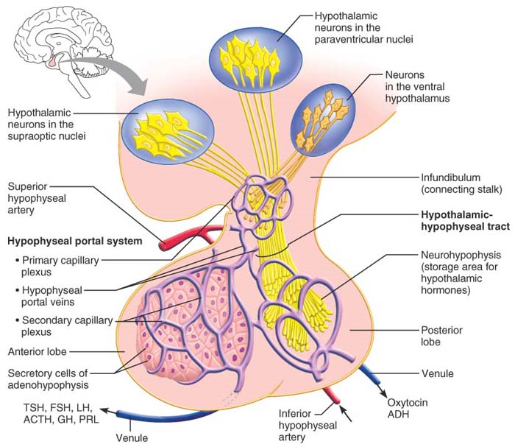
1.The Pituitary Gland (Hypophysis)
Notes:
The glandular anterior lobe originates from a superior outpocketing of the oral mucosa. There is no direct neural connection between the anterior lobe and hypothalamus, but there is a vascular connection.
Oxytocin is made primarily by the paraventricular neurons, and antidiuretic hormone (ADH) primarily by the supraoptic neurons. When these hypothalamic neurons fire, they release the stored hormones into a capillary bed in the posterior pituitary for distribution throughout the body.
The posterior lobe is actually part of the brain. It derives from a downgrowth of hypothalamic tissue and maintains its neural connection with the hypothalamus via a nerve bundle called the hypothalamic-hypophyseal tract

Slide 10
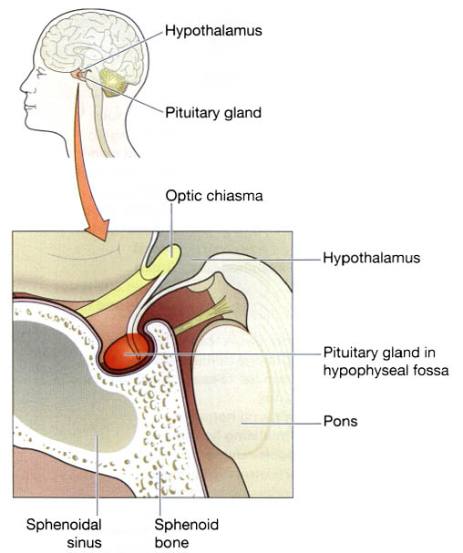
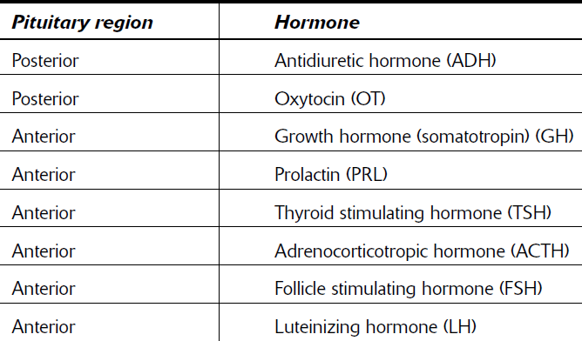

Slide 11
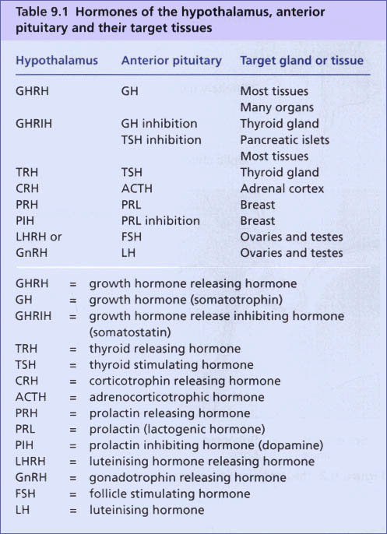
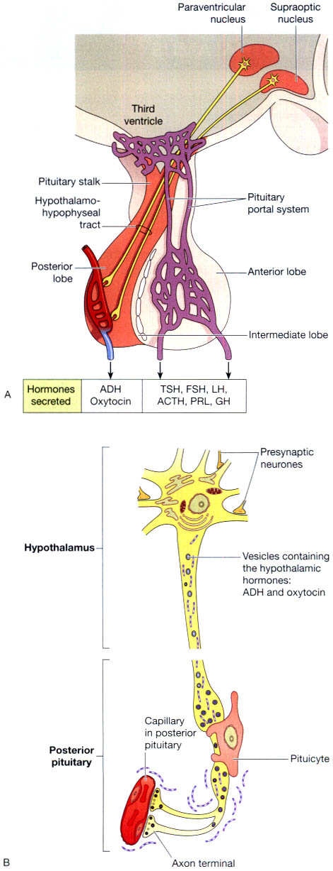

Slide 12
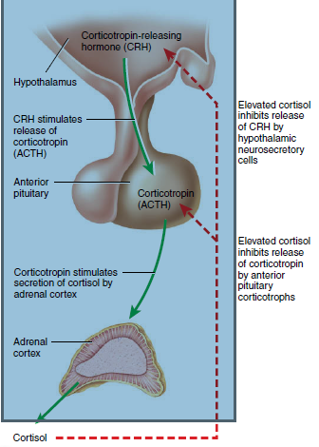
Regulations of hormone secretions:
Negative feedback mechanism is the primary regulatory mechanism for secretion of almost all hormones in the body.
The axis termed as Hypothalamo-pituitary-adrenal axis is one of the example for this regulatory mechanism.

Slide 13
REGULATION/CONTROL of Hormone Release
The synthesis and release of most hormones are regulated by some type of negative feedback system.
As hormone levels rise, they cause target organ effects and inhibit further hormone release. As a result, blood levels of many hormones vary only within a narrow range.
Endocrine glands are stimulated to manufacture and release their hormones by three major types of stimuli:
  Humoral
  Neural, and
  Hormonal.

Slide 14
Humoral Stimuli (bloodborne chemicals):
Some endocrine glands secrete their hormones in direct response to changing blood levels of certain critical ions and nutrients.
Example; Cells of the parathyroid glands monitor blood Ca²⁺ levels, and when they detect a decline from normal values, they secrete parathyroid hormone (PTH).
2. Neural Stimuli:
In a few cases, nerve fibers stimulate hormone release.
The classic example of neural stimuli is sympathetic nervous system stimulation of the adrenal medulla to release catecholamines (norepinephrine and epinephrine) during periods of stress

Slide 15
3. Hormonal Stimuli
Many endocrine glands release their hormones in response to hormones produced by other endocrine organs, and the stimuli in these cases are called hormonal stimuli.
For example, release of most anterior pituitary hormones is regulated by releasing and inhibiting hormones produced by the hypothalamus, and many anterior pituitary hormones in turn stimulate other endocrine organs to release their hormones.
NOTE: Both “turn-on” factors (hormonal, humoral, and neural stimuli) and “turn-off” factors (feedback inhibition and others) may be modified by the nervous system (cerebral cortex, hypothalamus)

Slide 16

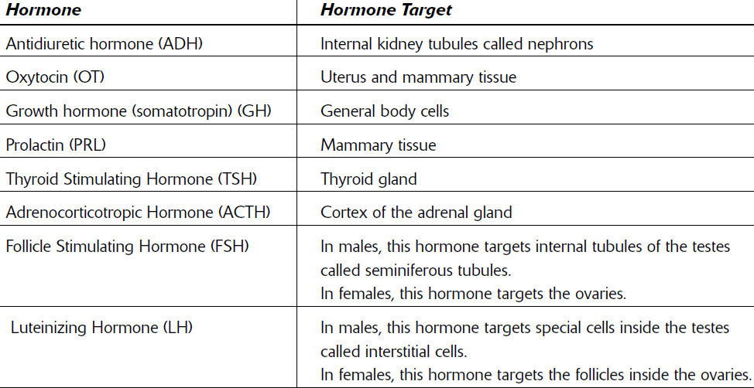

Slide 17
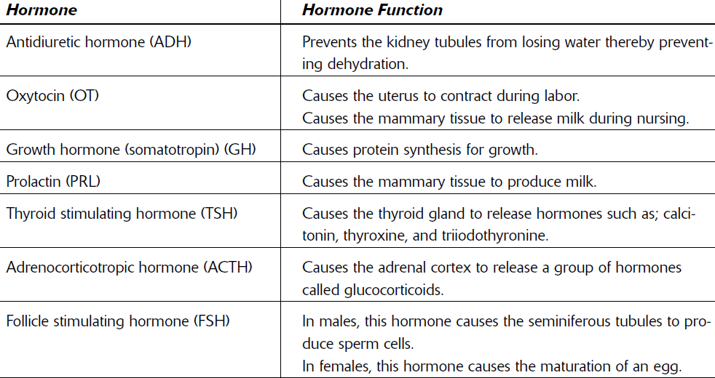

Abnormalities of GH secretion
Excess growth hormone causes diabetes: Diabetogenic effect of excess GH

Slide 18
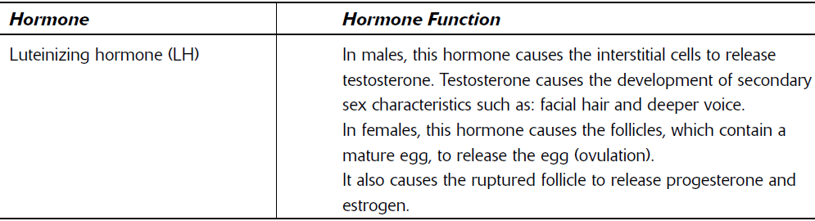

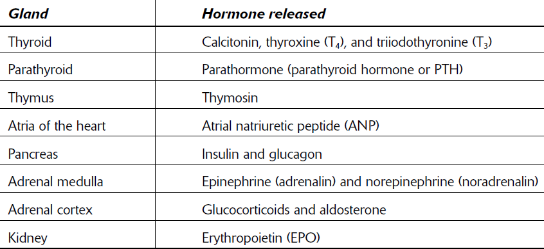

Slide 19
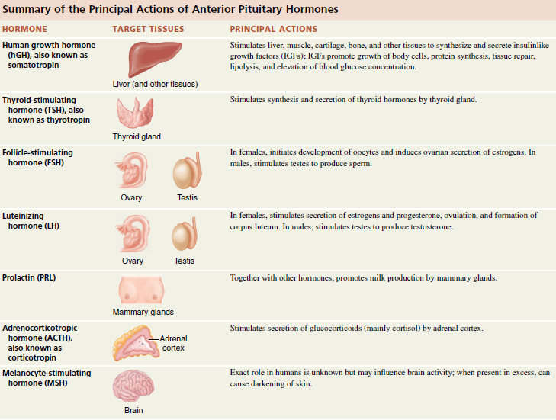

Slide 20
Homeostatic Imbalance of Growth hormone
Both hypersecretion and hyposecretion of GH may result in structural abnormalities
Hypersecretion in children results in gigantism because the still-active epiphyseal (growth) plates are targeted by GH. The person becomes abnormally tall, often reaching a height of 2.4 m (8 feet), but has relatively normal body proportions.
If excessive amounts of GH are secreted after the epiphyseal plates have closed (ADULT), acromegaly results. Literally translated as “enlarged extremities,” this condition is characterized by overgrowth bones of the hands, feet, and face.
Hypersecretion usually results from an adenohypophyseal tumor

Slide 21
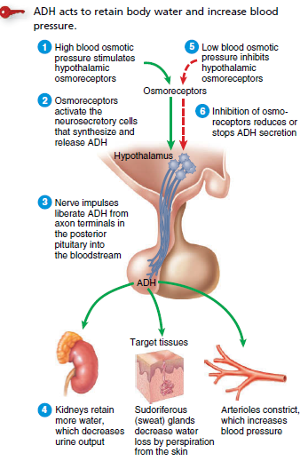
Regulation of secretion of ADH from posterior pituitary & functions of ADH
If you drank a liter of water, what effect would this have on the osmotic pressure of your blood, and how would the level of ADH change in your blood?

Slide 22
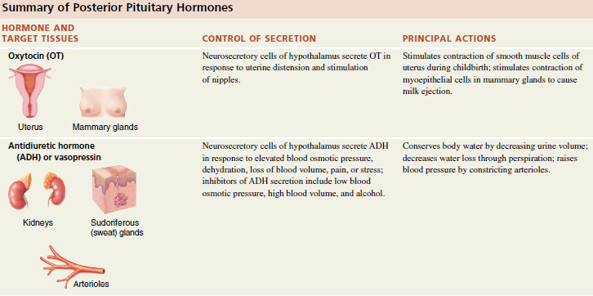

Can you think about the importance of oxytocin for the mother?

Slide 23

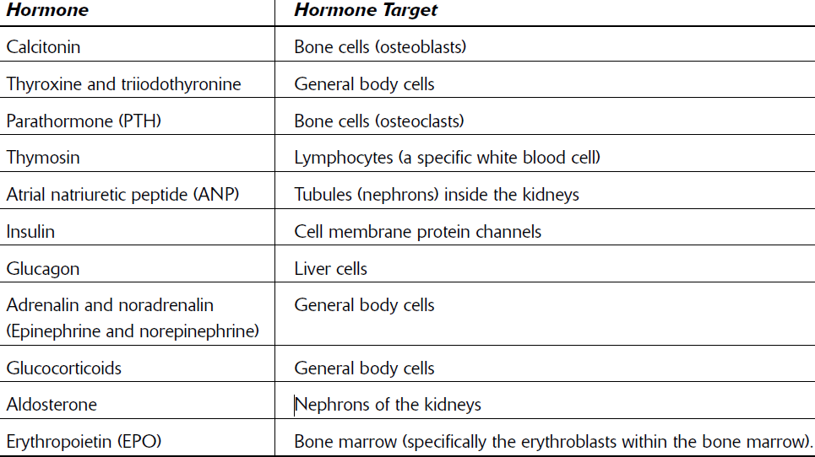

Slide 24
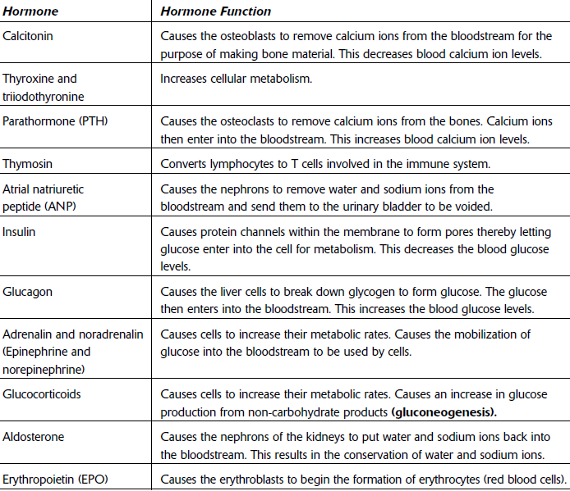

Slide 25
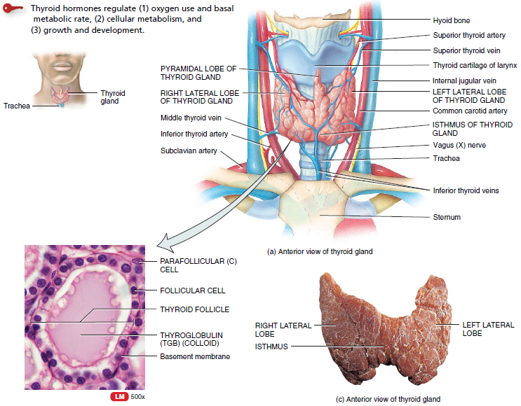
30 gram
Location, blood supply, and histology of the thyroid gland.

Slide 26
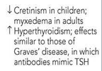
Functions of thyroid hormone (T₃, T₄ )
Increase basal metabolic rate
Regulate development and growth of nervous tissue and bones
Enhance some actions of catecholamines (adrenal medullary hormones)
Stimulate lipolysis
Stimulate protein synthesis
Increase body temperature (calorigenic effect)
Stimulate synthesis of Na+/K+ ATPase
Increase the use of glucose and fatty acids for ATP production
Abnormal thyroid hormone secretion

Slide 27
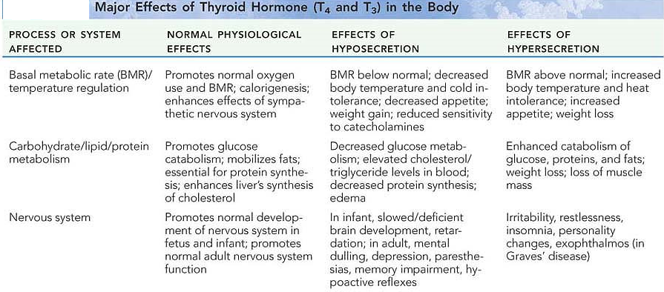
Hyperthyroidism
Hypothyroidism
THYROID DISORDERS

Slide 28
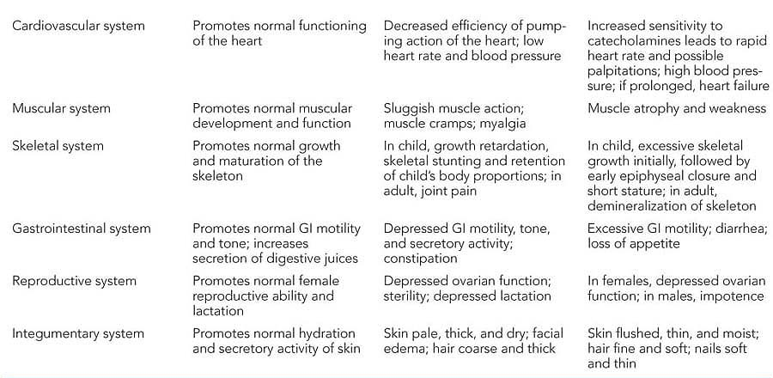
Hypothyroidism
Hyperthyroidism
THYROID DISORDERS

Slide 29
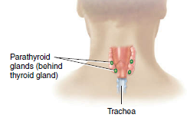
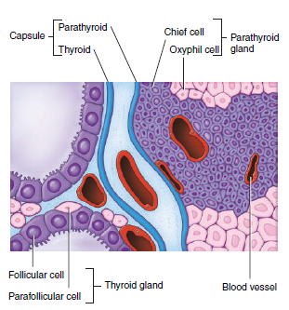
40 mg
Parathyroid glands
Functions of parathyroid hormones
PTH promotes resorption of bone extracellular matrix, which
releases Ca² into the blood and slows loss of Ca² in the urine, raising the blood level of Ca²
PTH also stimulates the kidneys to synthesize calcitriol, the
active form of vitamin D.
Calcitriol stimulates increased absorption of Ca² from foods in the gastrointestinal tract, which helps increase the blood level of Ca²

Slide 30
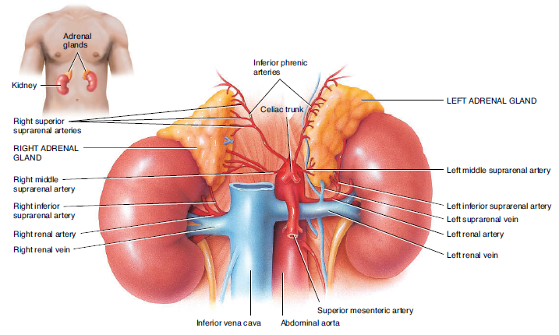
Adrenal; Ad: near or Supra-renal glands
Kidney: Retro-peritoneal organ

Slide 31
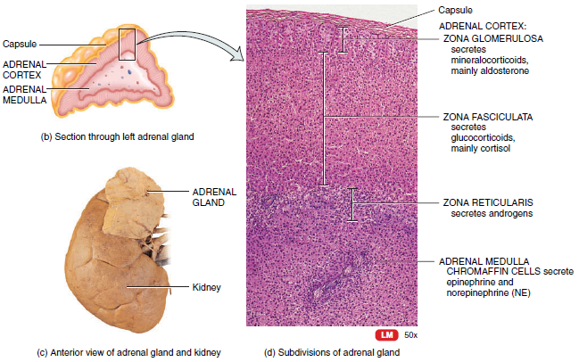
Adrenal gland: Internal structure

Slide 32
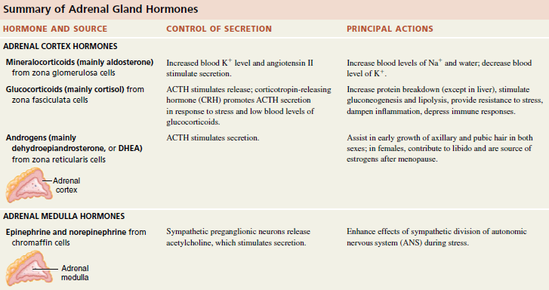

Functions of Adrenal gland

Slide 33
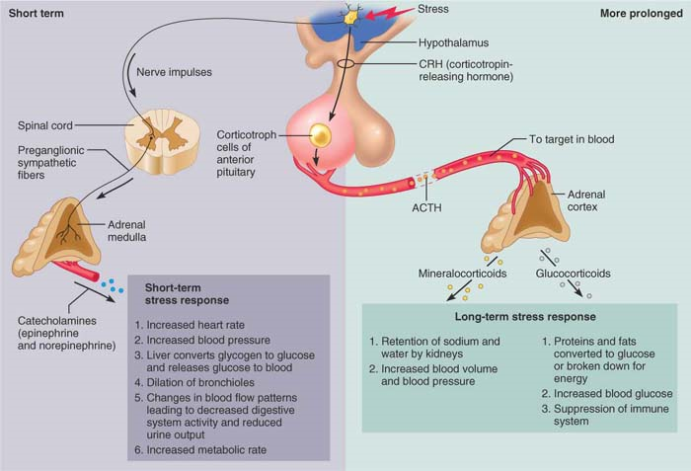
Stress and the adrenal gland.

Slide 34
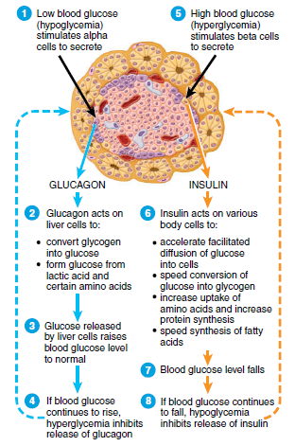
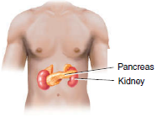
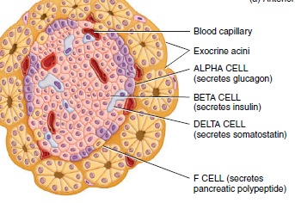
Endocrine pancrease

Slide 35
Diabetes mellitus (DM)
Diabetes mellitus (DM) is not a single disease entity, but rather a group of metabolic disorders sharing the common underlying feature of hyperglycemia.
Hyperglycemia in diabetes results from defects in insulin secretion, insulin action, or, most commonly, both.
Depending on the etiology of the DM, factors contributing to hyperglycemia include reduced insulin secretion, decreased glucose utilization, and increased glucose production
The chronic hyperglycemia and attendant metabolic dysregulation may be associated with secondary damage in multiple organ systems, especially the kidneys, eyes, nerves, and blood vessels.
Two types:
  Type I DM: Insulin dependent
  Type II DM: Noninsulin dependent

Slide 36
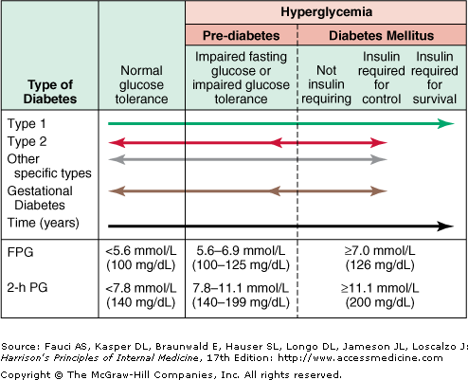

Slide 37
TYPE 2 DIABETES
More complex condition than type 1 diabetes because there is a combination of resistance to the actions of insulin in liver and muscle together with impaired pancreatic β-cell function leading to 'relative' insulin deficiency.
Insulin resistance appears to come first, and leads to elevated insulin secretion in order to maintain normal blood glucose levels. However, in susceptible individuals the pancreatic β cells are unable to sustain the increased demand for insulin and a slowly progressive insulin deficiency develops.
In patients with type 2 diabetes excessive production of glucose in the liver (glycogenolysis & gluconeogenesis) and under-utilisation of glucose in skeletal muscle result from resistance to the action of insulin

Slide 38
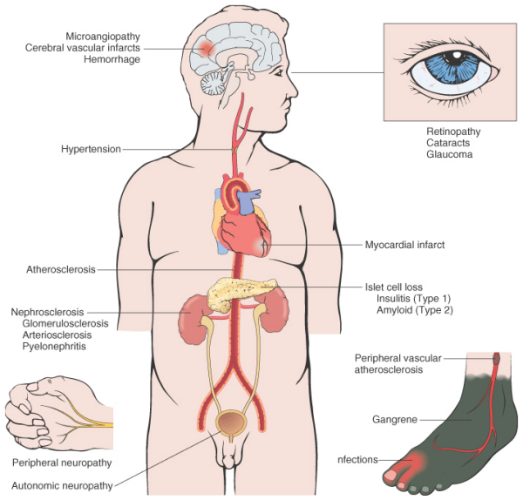
Long-term complications of diabetes

Slide 39
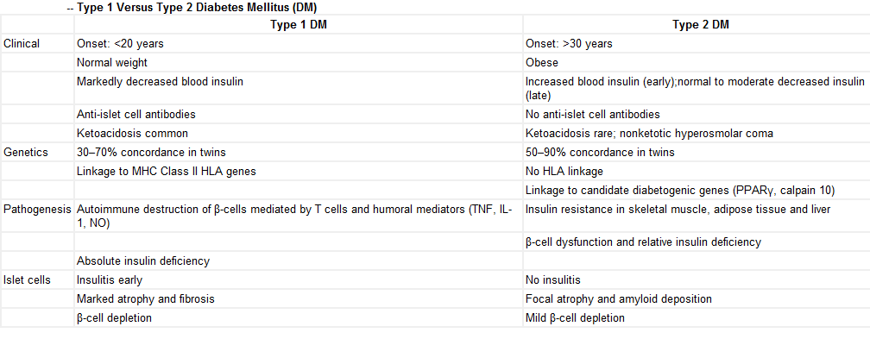

Slide 40
The three cardinal signs of diabetes mellitus
Polyuria, polydipsia, and polyphagia.
The excessive glucose in the kidney filtrate acts as an osmotic diuretic (that is, it inhibits water reabsorption by the kidney tubules), resulting in polyuria, a huge urine output that leads to decreased blood volume and dehydration.
Ketone bodies are negatively charged and carry positive ions out with them; as a result, sodium and potassium ions are also lost from the body. Because of the electrolyte imbalance, the person gets abdominal pains and may vomit.
Dehydration stimulates hypothalamic thirst centers, causing polydipsia, or excessive thirst.
Polyphagia, refers to excessive hunger and food consumption, a sign that the person is “starving in the land of plenty.” Although plenty of glucose is available, it cannot be used, and the body starts to utilize its fat and protein stores for energy metabolism.

Slide 41
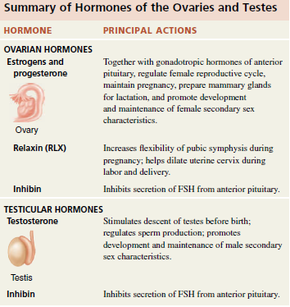

Slide 42
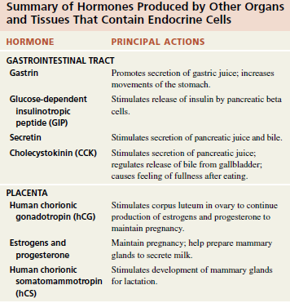
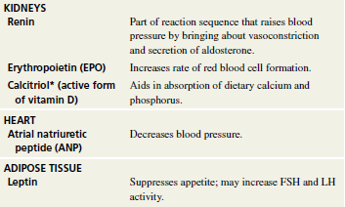
Hormones produced by scattered cells in particular organ system

