Slide 1
UNIT IX: URINARY SYSTEM
Bijay Subedi
SHAS, BPH 1st semester, APL

Slide 2
The Urinary System: Introduction
The urinary system consists of the paired kidneys and ureters and the unpaired bladder and urethra.
Every day the kidneys filter nearly 200 (180 lts) liters of fluid from the bloodstream, allowing toxins, metabolic wastes, and excess ions to leave the body in urine while returning needed substances to the blood
The two kidneys produce about 125 mL of filtrate per minute; of this amount, 124 mL is absorbed in the organ, and only 1 mL is released into the ureters as urine.
About 1500 mL of urine is formed every 24 h.
As the kidneys perform these excretory functions, they also act as essential regulators of the volume and chemical makeup (osmolarity) of the blood, maintaining the proper balance between water and salts and between acids and bases

Slide 3
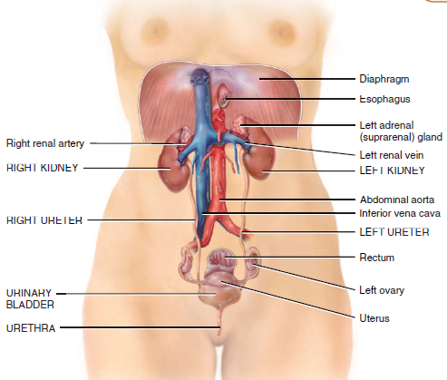


Slide 4
FUNCTIONS OF URINARY SYSTEM
1. Kidneys
  Regulate blood volume and composition.
  Regulate blood pressure.
  Reulate blood pH
  Regulate glucose levels
  Produce two hormones (calcitriol and erythropoietin)
  Excrete wastes in urine.
2. Ureters: transport urine from kidneys to urinary bladder.
3. Urinary bladder stores urine and expels it into urethra.
4. Urethra discharges urine from body.

Slide 5
The functional and structural unit of the kidney called nephron, consists of a renal corpuscle (including the glomerulus) plus a long folded renal tubule.
The human kidney contains approximately one million nephrons that perform the functions of osmoregulation and excretion by the following processes:
  Filtration in the glomerulus of most small molecules from blood plasma to form an ultrafiltrate of plasma.
  Selective reabsorption in the tubule of most of the water and some other molecules from the ultrafiltrate, leaving behind excess and waste materials to be excreted.
  Secretion in the tubule of some excretory products directly from blood into the urine.
  Maintenance of the acid-base balance by selective secretion of H⁺ ions by the tubule into the urine.

Slide 6
Other functions of kidney include
Gluconeogenesis (glucose formation from non-glucogenic substance like aminoacid) during prolonged fasting.
Producing the hormones renin and erythropoietin. Renin acts as an enzyme to help regulate blood pressure and kidney function. Erythropoietin stimulates red blood cell production.
Metabolizing vitamin D to its active form (calcitriol)
Kidneys
Each kidney has a concave medial border, the hilum where nerves enter, blood and lymph vessels enter and exit, and the ureter exits.
Lateral surface is convex.
Renal pelvis expanded upper end of the ureter, is divided into two or three major calyces.
Several small branches, the minor calyces, arise from each major calyx.

Slide 7
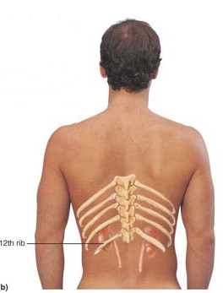
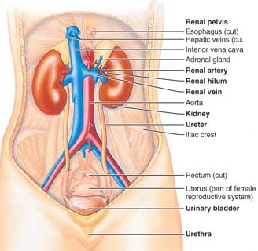
The bean-shaped kidneys lie in a retroperitoneal position (between the dorsal body wall and the parietal peritoneum) in the superior lumbar region extending approximately from T₁₂ to L₃, the kidneys receive some protection from the lower part of the rib cage .
The right kidney is crowded by the liver and lies slightly lower than the left.
An adult’s kidney has a mass of about 150 g and its average dimensions are 12 cm long, 6 cm wide, and 3 cm thick about the size of a large bar of soap.

Slide 8
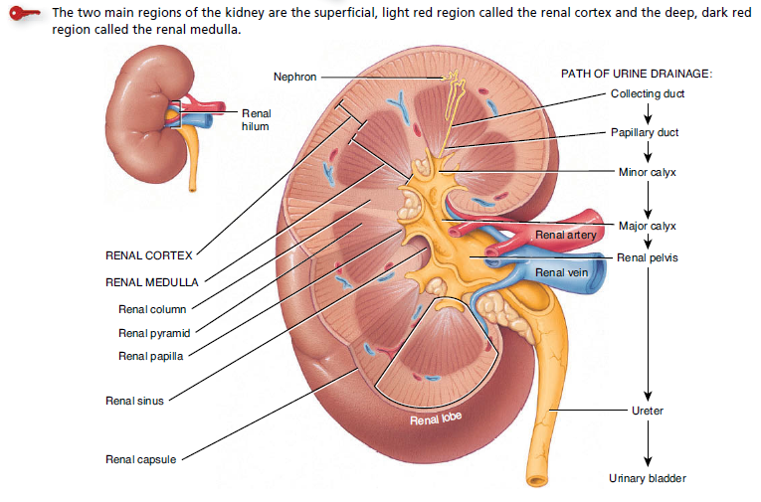
Anterior view of dissection of kidney

Slide 9
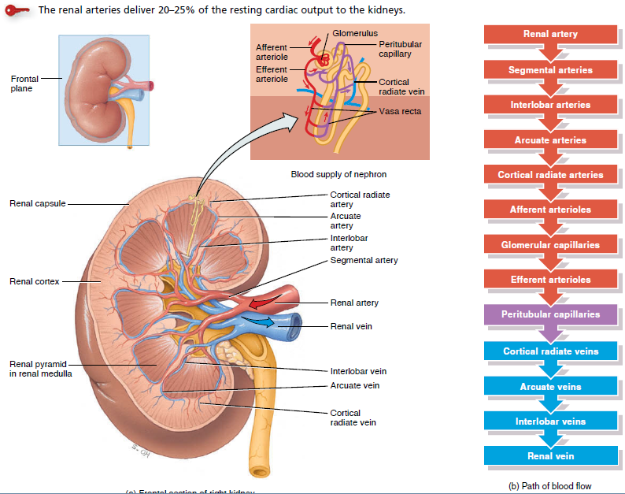
BLOOD SUPPLY TO KIDNEY

Slide 10
Nephrons: (functional unit of kidney)
The structural and functional units of the kidneys. Each kidney contains over 1 million of these tiny blood-processing units, which carry out the processes that form urine. In addition, there are thousands of collecting ducts, each of which collects fluid from several nephrons and conveys it to the renal pelvis.
Each nephron consists of a glomerulus which is a tuft of capillaries, and a renal tubule.
The cup-shaped end of the renal tubule, the glomerular capsule (or Bowman’s capsule) is blind and completely surrounds the glomerulus.
Collectively, the glomerular capsule and the enclosed glomerulus are called the renal corpuscle.
The endothelium of the glomerular capillaries is fenestrated (penetrated by many pores), which makes them exceptionally porous.

Slide 11
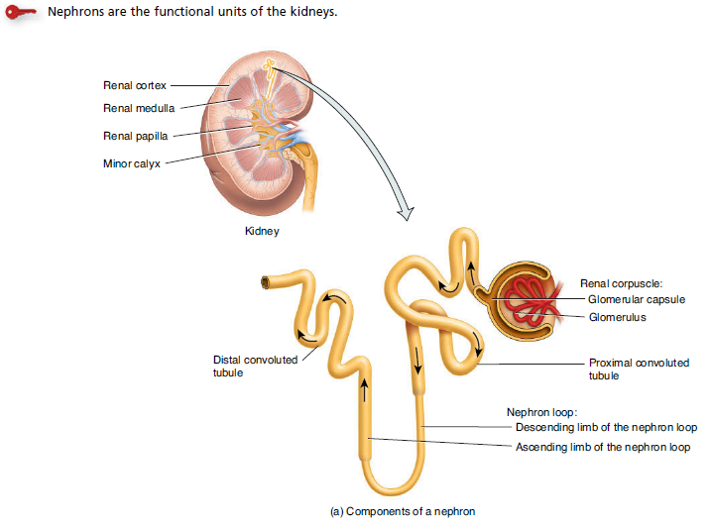
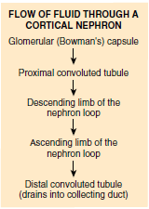

Slide 12
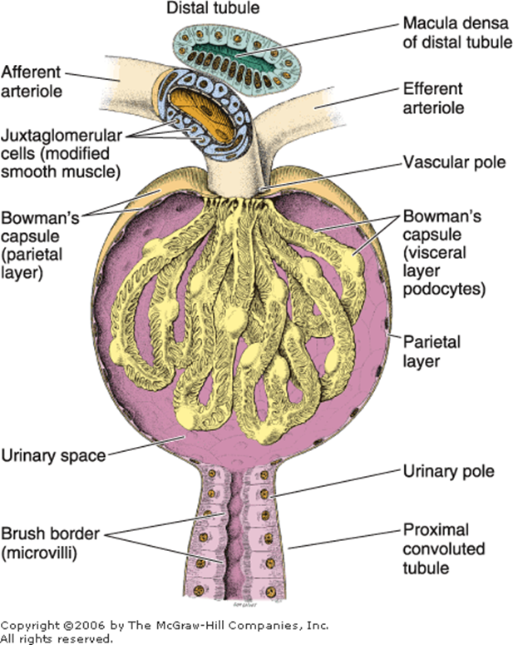
The external parietal layer of the glomerular capsule is simple squamous epithelium. This layer simply contributes to the capsule structure and plays no part in forming filtrate.
The visceral layer, which adheres to the glomerular capillaries, consists of highly modified, branching epithelial cells called podocytes (“foot cells”).
The octopus-like podocytes
terminate in foot processes,
which intertwine as they grip
to the basement membrane
of the glomerulus. The clefts or
openings between the foot
processes are called filtration slits.
Through these slits, filtrate enters
the capsular space inside the
glomerular capsule.
1. Glomerulus

Slide 13
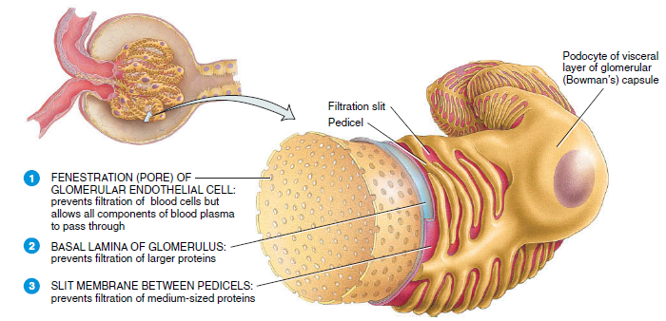
Fig. Filtration slit in the renal corpuscle for blood filtration

Slide 14
2. The renal tubule is about 3 cm long and has three major parts.
It leaves the glomerular capsule as the elaborately coiled proximal convoluted tubule (PCT), makes a hairpin loop called the loop of Henle (also called Henle’s loop), and then winds and twists again as the distal convoluted tubule (DCT) before emptying into a collecting duct.
The walls of the PCT are formed by cuboidal epithelial cells with large mitochondria; their luminal (exposed) surfaces bear dense microvilli. Just as in the intestine, this brush border dramatically increases the surface area and capacity for reabsorbing water and solutes from the filtrate and secreting substances into it.
The U-shaped loop of Henle has descending and ascending limbs.
Thin segment (descending limb’s almost part), is a simple squamous epithelium freely permeable to water. The epithelium becomes cuboidal or even low columnar in the ascending part of the loop of Henle, which therefore becomes the thick segment.

Slide 15
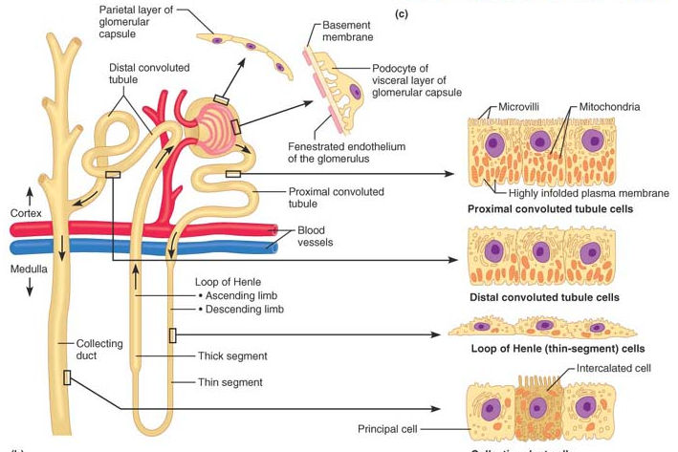

Slide 16
3. Collecting ducts have two types of cells:
  Intercalated cells, cuboidal cells with abundant microvilli. The two varieties (type A and B) of intercalated cells play a major role in maintaining the acid-base balance of the blood
  The more numerous principal cells, which have sparse, short microvilli. The principal cells help maintain the body’s water and Na⁺ balance.
There are two types of nephrons: Cortical & juxtamedullary.
Cortical nephrons represent 85% of the nephrons in the kidneys. Except for small parts of their loops of Henle that dip into the outer medulla, they are located entirely in the cortex.
The remaining juxtamedullary nephrons originate close to (juxta = near to) the cortex-medulla junction, and they play an important role in the kidneys’ ability to produce concentrated urine. Their loops of Henle deeply invade the medulla, and their thin segments are much more extensive than those of cortical nephrons

Slide 17
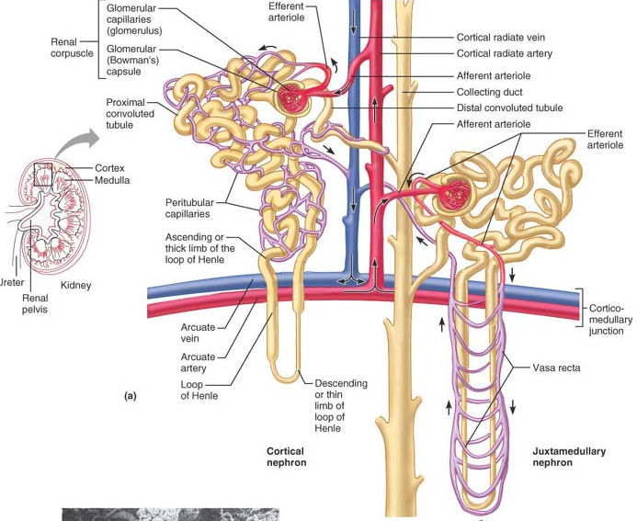
Fig. Types of nephrons: cortical & juxtamedullary

Slide 18
Juxtaglomerular Apparatus (JGA)
Each nephron has a region called a juxtaglomerular apparatus where the most distal portion of the ascending limb of the loop of Henle lies against the afferent arteriole feeding the glomerulus (and sometimes the efferent arteriole). Both the ascending limb and the afferent arteriole are modified at the point of contact.
In the affarent arteriole walls are the granular cells [also called juxtaglomerular (JG) cells]—enlarged, smooth muscle cells with prominent secretory granules containing renin. Granular cells act as mechanoreceptors that sense the blood pressure in the afferent arteriole.
The macula densa is a group of tall, closely packed cells of the ascending limb of the loop of Henle that lies adjacent to the granular cells. The macula densa cells are chemoreceptors that respond to changes in the NaCl content of the filtrate.
Extraglomerular mesangial cells are also part of the JGA, but their function remains unclear.

Slide 19
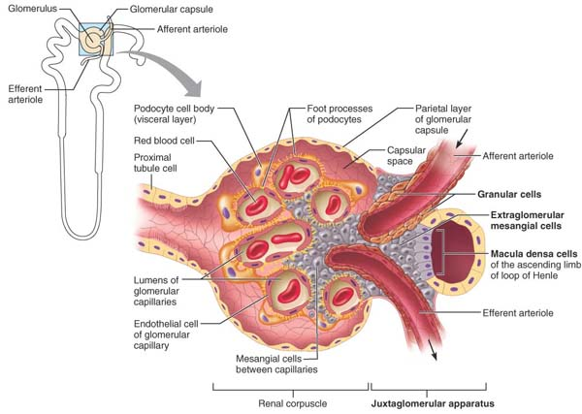

Slide 20
FUNCTIONS OF KIDNEY
Regulation of blood ionic composition. The kidneys help to regulate the blood levels of several ions, most importantly (Na), (K), (Ca2), (Cl), and (HPO4).
Regulation of blood pH. The kidneys excrete a variable amount of hydrogen ions (H) into the urine and conserve bicarbonate ions (HCO3), which are an important buffer.
Regulation of blood volume. The kidneys adjust blood volume by conserving or eliminating water in the urine.
Regulation of blood pressure. The kidneys also help regulate blood pressure by secreting the enzyme renin, which activates the renin–angiotensin–aldosterone pathway. Increased renin causes an increase in blood pressure.
Maintenance of blood osmolarity. By separately regulating loss of water and loss of solutes in the urine, the kidneys maintain a relatively constant blood osmolarity close to 300 milliosmoles per liter

Slide 21
5. Production of hormones. The kidneys produce two hormones Calcitriol, the active form of vitamin D, helps regulate calcium Homeostasis, and erythropoietin stimulates the production of red blood cells.
6. Regulation of blood glucose level. Like the liver, the kidneys can use the amino acid glutamine in gluconeogenesis, the synthesis of new glucose molecules.
7. Excretion of wastes and foreign substances. By forming urine, the kidneys help excrete wastes—substances like ammonia, uric acid, creatinine and urea.

Slide 22
Ureters (25 cm)
The ureters are slender tubes that convey urine from the kidneys to the bladder.
Each ureter begins at the level of L₂ as a continuation of the renal pelvis. From there, it descends behind the peritoneum and runs obliquely through the posterior bladder wall. This arrangement prevents backflow of urine during bladder filling because any increase in bladder pressure compresses and closes the distal ends of the ureters.
The calyces, renal pelvis, ureter, and bladder have the same basic histological structure, with the walls of the ureters becoming gradually thicker as proximity to the bladder increases

Slide 23
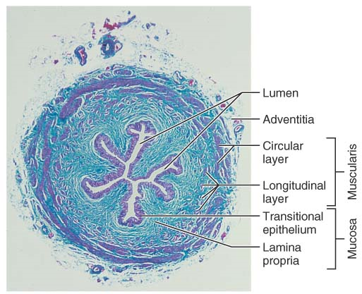
Histologically, the ureter wall is trilayered. The transitional epithelium of its lining mucosa is continuous with that of the kidney pelvis superiorly and the bladder medially. Its middle muscularis is composed chiefly of two smooth muscle sheets: the internal longitudinal layer and the external circular layer. An additional smooth muscle layer, the external longitudinal layer, appears in the lower third of the ureter. The adventitia covering the ureter’s external surface is typical fibrous connective tissue

Slide 24
Urinary Bladder
The urinary bladder is a smooth, collapsible, muscular sac that stores urine temporarily. It is located retroperitoneally on the pelvic floor just posterior to the pubic symphysis. The prostate (part of the male reproductive system) surrounds the bladder neck inferiorly where it empties into the urethra. In females, the bladder is anterior to the vagina and uterus.
The interior of the bladder has openings for both ureters and the urethra. The smooth, triangular region of the bladder base outlined by these three openings is the trigone (trigon = triangle), important clinically because infections tend to persist in this region.
The bladder wall has three layers: a mucosa containing transitional epithelium, a thick muscular layer, and a fibrous adventitia (except on its superior surface, where it is covered by the peritoneum). The muscular layer, called the detrusor muscle, consists of intermingled smooth muscle fibers arranged in inner and outer longitudinal layers and a middle circular layer.

Slide 25
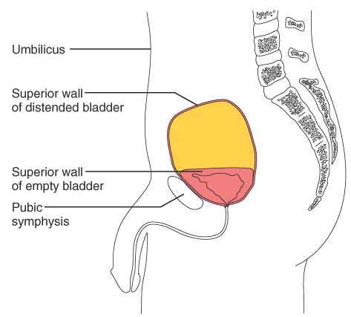
The bladder is very distensible and uniquely suited for its function of urine storage. When empty, the bladder collapses into its basic pyramidal shape and its walls are thick and thrown into folds (rugae).
As urine accumulates, the bladder expands, becomes pear shaped, and rises superiorly in the abdominal cavity.
A moderately full bladder is about 12 cm long and holds approximately 500 ml of urine, but it can hold nearly double that if necessary. When tense with urine, it can be palpated well above the pubic symphysis.
The maximum capacity
of the bladder is 800–1000 ml

Slide 26
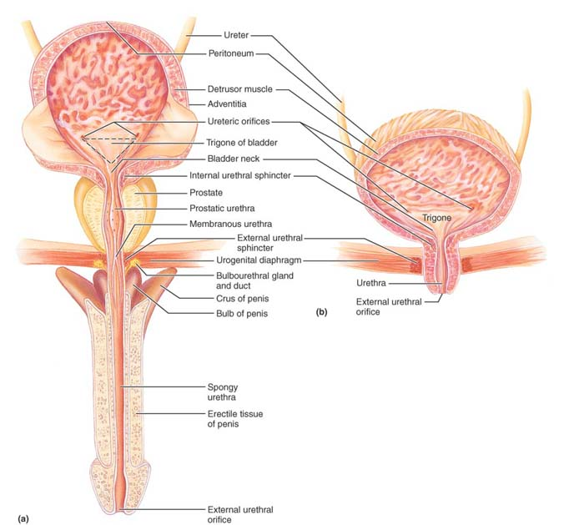

Slide 27
Urethra
The urethra is a thin-walled muscular tube that drains urine from the bladder and conveys it out of the body.
The epithelium of its mucosal lining is mostly pseudostratified columnar epithelium. However, near the bladder it becomes transitional epithelium, and near the external opening it changes to a protective stratified squamous epithelium.
At the bladder-urethra junction a thickening of the detrusor smooth muscle forms the internal urethral sphincter. This involuntary sphincter keeps the urethra closed when urine is not being passed and prevents leaking between voiding.
This sphincter is unusual in that contraction opens it and relaxation closes it.
The external urethral sphincter surrounds the urethra as it passes through the urogenital diaphragm. This sphincter is formed of skeletal muscle and is voluntarily controlled.

Slide 28
The length and functions of the urethra differ in the two sexes. In females the urethra is only 3–4 cm long with stratified squamous epithelium and areas of pseudostratified columnar epithelium and tightly bound to the anterior vaginal wall by fibrous connective tissue.
In males the urethra is approximately 20 cm long and has three regions.
  The prostatic urethra, about 2.5 cm long, runs within the prostate.
  The membranous urethra, which runs through the urogenital diaphragm, extends about 2 cm from the prostate to the beginning of the penis.
  The spongy urethra, about 15 cm long, passes through the penis and opens at its tip via the external urethral orifice. The male urethra has a double function: It carries semen as well as urine out of the body

Slide 29
Kidney Physiology: Mechanisms of Urine Formation
20 % of total blood (5 lit) passes through the glomeruli each minute, some 650 ml is plasma, and about (20%) one-fifth of this (120–125 ml) is forced into the renal tubules which is called filtrate.
kidneys (account for only 1% of body weight) consume 20–25% of all oxygen used by the body at rest.
Filtrate and urine are quite different
Filtrate contains everything found in blood plasma except proteins, but by the time filtrate flows into the collecting ducts, it has lost most of its water, nutrients, and ions. What remains, now called urine, contains mostly metabolic wastes and unneeded substances.
Urine formation and the adjustment of blood composition involve three major processes:
  glomerular filtration by the glomeruli, and
  tubular reabsorption and
  tubular secretion in the renal tubules .
In addition, the collecting ducts work in concert with the nephrons to concentrate or dilute the urine.

Slide 30
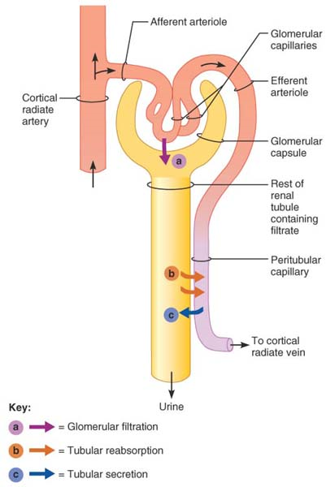
A kidney actually has millions of nephrons acting in parallel. The three major mechanisms by which the kidneys produce urine and adjust plasma composition are
glomerular filtration,
(b) tubular reabsorption, and
(c) tubular secretion.

Slide 31
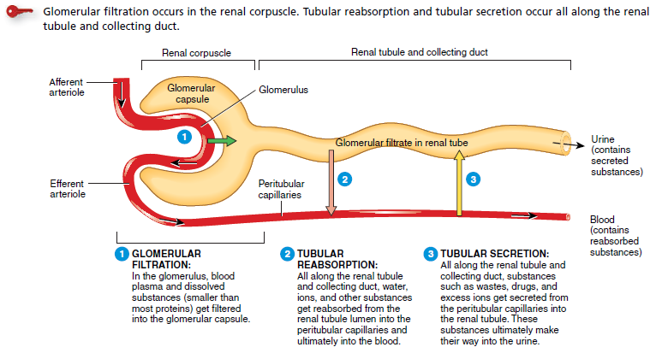
Mechanisms of Urine Formation

Slide 32
Step 1: Glomerular Filtration
Glomerular filtration is a passive process ( no need of ATP) in which hydrostatic pressure forces fluids and solutes through a membrane.
The glomerulus is a much more efficient filter than are other capillary beds because
  Its filtration membrane has a large surface area and is thousands of times more permeable to water and solutes
  (2) Glomerular blood pressure is much higher than that in other capillary beds (approximately 55 mm Hg as opposed to 18 mm Hg or less), resulting in a much higher net filtration pressure.
As a result of these differences, the kidneys produce about 180 L of filtrate daily, in contrast to the 3 to 4 L formed daily by all other capillary beds of the body combined.

Slide 33
Molecules smaller than 3 nm in diameter—such as water, glucose, amino acids, and nitrogenous wastes—pass freely from the blood into the glomerular capsule.
Those larger than 5 nm are generally barred from entering the tubule.
The presence of proteins or blood cells in the urine usually indicates a problem with the filtration membrane.

Slide 34
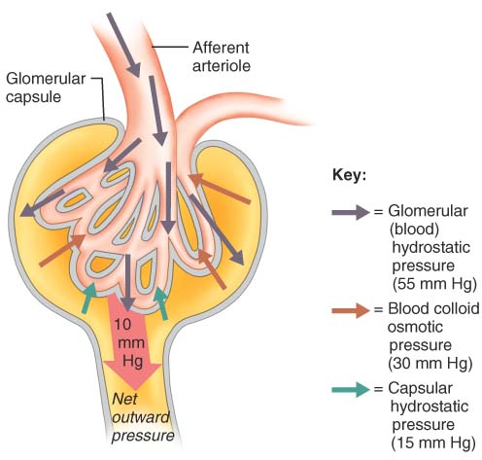
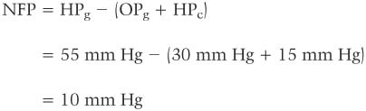
The net filtration pressure (NFP), responsible for filtrate formation, involves forces acting at the glomerular bed

Slide 35
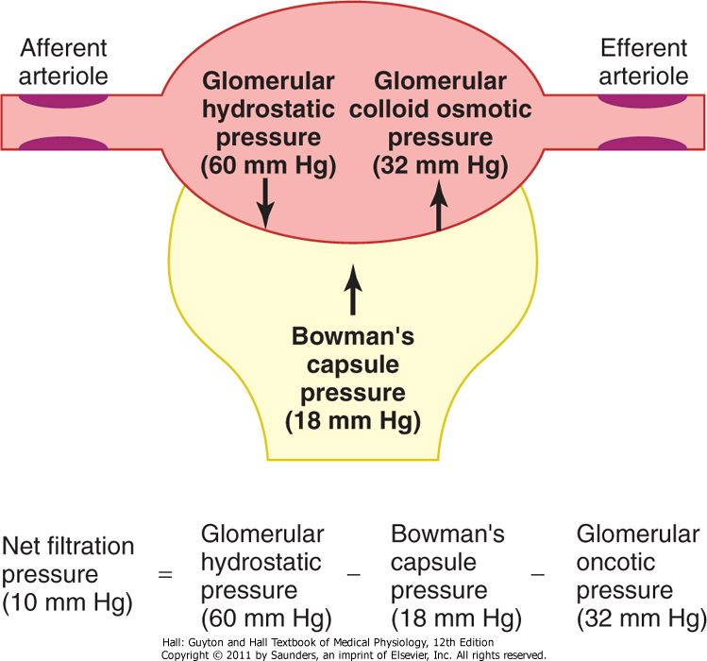

Slide 36
Glomerular Filtration Rate (GFR)
The glomerular filtration rate or GFR is the volume of filtrate formed each minute by the combined activity of all 2 million glomeruli of the kidneys.
In adults the normal GFR in both kidneys is 120–125 ml/min.
Factors affecting GFR at the capillary beds
  Total surface area available for filtration,
  Filtration membrane permeability, and
  Net Filtration Pressure (NFP)
K_{f} = glomerular capillary filtration coefficient,

Slide 37
Because glomerular capillaries are exceptionally permeable and have a huge surface area (collectively equal to the surface area of the skin), huge amounts of filtrate can be produced even with the usual modest NFP of 10 mm Hg.
Because the GFR is directly proportional to the NFP, any change in any of the pressures acting at the filtration membrane changes both the NFP and the GFR.
Forces Favoring Filtration (mm Hg)
Glomerular hydrostatic pressure | 60
Bowman's capsule colloid osmotic pressure | 0
Forces Opposing Filtration (mm Hg)
Bowman's capsule hydrostatic pressure |  | 18
Glomerular capillary colloid osmotic pressure |  | 32

Slide 38
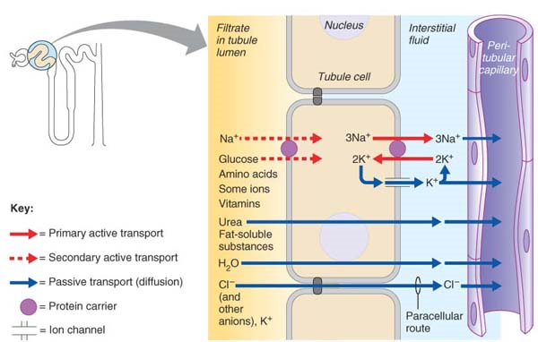
Step 2: Tubular Reabsorption
Fig. Reabsorption at PCT

Slide 39
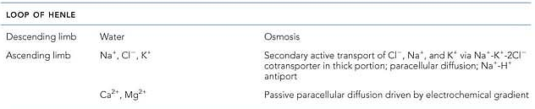
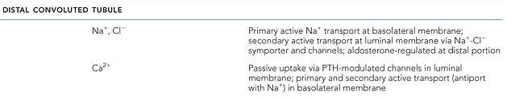
Reabsorption @ loop of henle
The rule for water is that it leaves the descending (but not the ascending) limb of Henle’s loop; the opposite is true for solutes. Virtually no solute reabsorption occurs in the descending limb, but both active and passive reabsorption of solute occurs in the ascending limb.
Reabsorption @ DCT

Slide 40
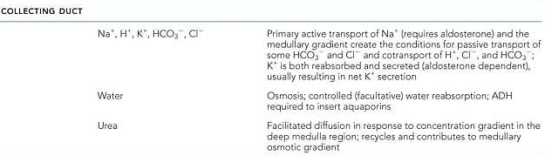
Reabsorption @ Collecting duct
Distal Convoluted Tubule and Collecting Duct:
By the time the DCT is reached, only about 10% of the originally filtered NaCl and 25% of the water remain in the tubule.
Some unregulated NaCl reabsorption occurs in the DCT via Na⁺-Cl– symporters.
However, most reabsorption from this point on regulated by hormones
  Aldosterone for Na⁺,
  ADH for water, and
  PTH for Ca²⁺

Slide 41
Step 3: Tubular Secretion
Substances such as H⁺, K⁺, NH₄⁺, creatinine, and certain organic acids move into the filtrate from the peritubular capillaries through the tubule cells called tubular secretion.
Tubular secretion is important for :
1. Disposing of substances, such as certain drugs and metabolites, which are tightly bound to plasma proteins.
2. Eliminating undesirable substances or end products that have been reabsorbed by passive processes (urea and uric acid).
3. Ridding the body of excess K⁺. Because virtually all K⁺ present in the filtrate is reabsorbed in the PCT and ascending loop of Henle, nearly all K⁺ in urine is from aldosterone-driven active tubular secretion into the late DCT and collecting ducts.
4. Controlling blood pH. When blood pH drops toward the acidic end of its homeostatic range, the renal tubule cells actively secrete more H⁺ into the filtrate and retain more HCO₃– (a base). As a result, the blood pH rises and the urine drains off the excess H⁺.

Slide 42
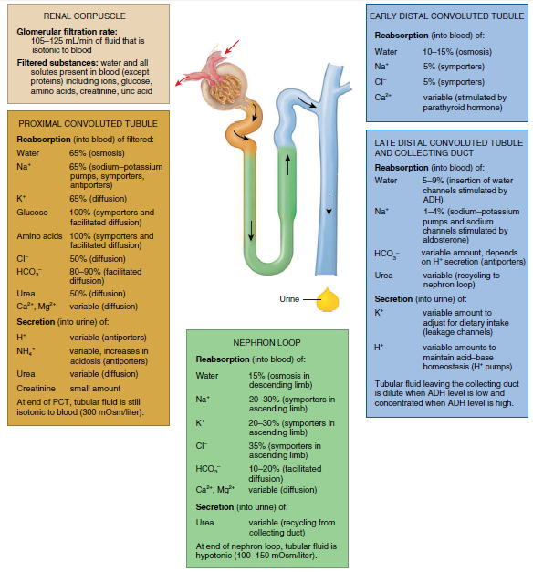
Summary of filtration, reabsorption, and secretion in the nephron and collecting duct

Slide 43
Countercurrent Mechanisms:(regulation of urine concentration and volume).
One crucial function of kidney is to keep the solute load of body fluids constant at about 300 mOsm (1 mol=1000 mOsm) the osmotic concentration of blood plasma, by regulating urine concentration and volume.
The kidneys accomplish this feature using countercurrent mechanisms.
In the kidneys, the term countercurrent means that fluid flows through adjacent tubes in opposite directions.
These countercurrent mechanisms are
  The interaction between the flow of filtrate through the ascending and descending limbs of the long loops of Henle of juxtamedullary nephrons (the countercurrent multiplier), and
  (2) The flow of blood through the ascending and descending portions of the vasa recta blood vessels (the countercurrent exchanger).

Slide 44
A countercurrent system is a system in which the inflow runs parallel to, counter to, and in close proximity to the outflow for some distance. This occurs for
  Both the loops of Henle (countercurrent multiplier- create the osmotic gradient in renal interstitium) and
  The vasa recta (countercurrent exchanger- Maintain the osmotic gradient created by countercurrent multiplier ) in the renal medulla

Slide 45
Micturition
Micturition is the process by which the urinary bladder empties when it becomes filled. This involves two main steps: First, the bladder fills progressively until the tension in its walls rises above a threshold level; this elicits the second step, which is a nervous reflex called the micturition reflex that empties the bladder or, if this fails, at least causes a conscious desire to urinate.
The smooth muscle of the bladder is arranged in spiral, longitudinal, and circular bundles. Contraction of the circular muscle, which is called the detrusor muscle, is mainly responsible for emptying the bladder during urination (micturition)
The micturition reflex is an autonomic spinal cord reflex.
Simply Micturition (mictur = urinate), also called urination or voiding, is the act of emptying the bladder

Slide 46
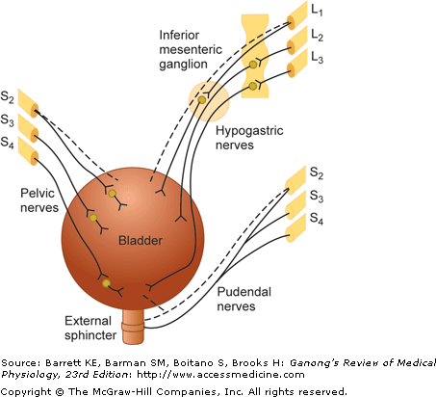
Innervation of the bladder. Dashed lines indicate sensory nerves. Parasympathetic innervation is shown at the left, sympathetic at the upper right, and somatic at the lower right.

Slide 47
Steps of micturation
When about 200 ml of urine has accumulated, afferent impulses are transmitted to the brain through Visceral stretch receptor, creating the urge to void.
Contractions of the bladder become more frequent and more urgent and if it is convenient to empty the bladder (a decision made by the cerebral cortex), voiding reflexes are initiated.
The urge to void eventually becomes irresistible and micturition occurs when urine volume exceeds 500–600 ml
Visceral afferent impulses activate the micturition center of the pons (an on/off switch for micturition).
This center signals the parasympathetic neurons that stimulate contraction of the detrusor muscle, opening the internal sphincter.
It also inhibits somatic efferents, relaxing the external sphincter, and allowing urine to flow

Slide 48
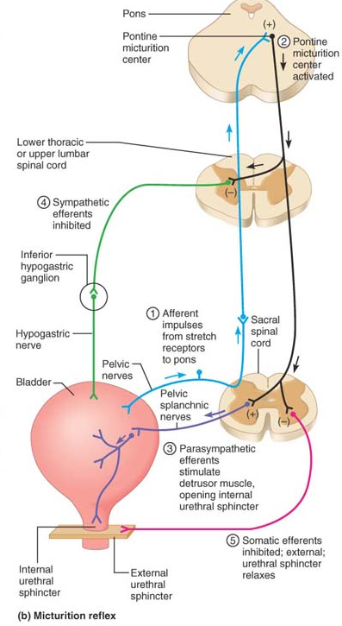
Steps in micturation

Slide 49
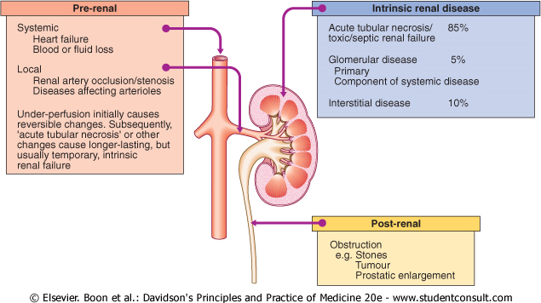
Acute renal failure (ARF)
A sudden and usually reversible loss of renal function, which develops over a period of days or weeks and is usually accompanied by a reduction in urine volume. There are many possible causes and it is frequently multifactorial.
Fig.Causes of acute renal failure

Slide 50
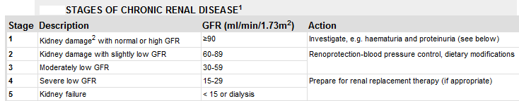
Chronic renal failure (CRF)
An irreversible deterioration in renal function which classically develops over a period of years.
Initially, it is manifested only as a biochemical abnormality, eventually, loss of the excretory, metabolic and endocrine functions of the kidney leads to the development of the clinical symptoms and signs of renal failure, which are referred to as uraemia.
When death is likely without renal replacement therapy, it is called end-stage renal failure (ESRF).

Slide 51
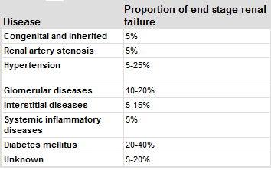
COMMON CAUSES OF CHRONIC RENAL FAILURE
Pathogenesis of CRF
Disturbances in water, electrolyte and acid-base balance contribute to the clinical picture in patients with CRF, but the exact pathogenesis of the clinical syndrome of uraemia is unknown.
Abnormal concentration of 'uraemic toxins', accumulation of various intermediary products of metabolism in the plasma .

Slide 52
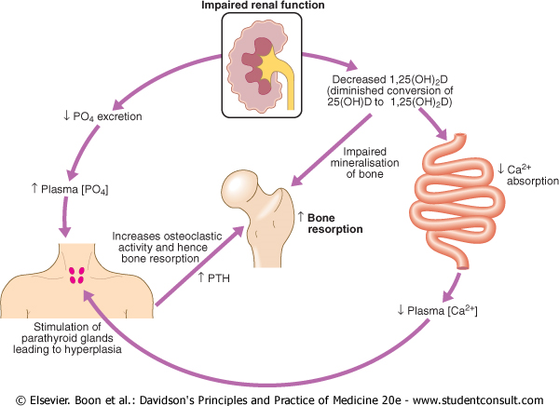
Endocrinal effects due to chronic renal failure

Slide 53
HAEMATURIA
Presence of blood in the urine.
This can be present with or without pain and may be continuous or intermittent.
If visible to the naked eye it is termed macroscopic or gross haematuria; if detected only by stick tests or microscopy it is called microscopic haematuria.
Haematuria as a result of parenchymal renal disease is usually: continuous, painless, microscopic (occasionally macroscopic).
Haematuria arising from renal tumours is likely to be: intermittent, associated with renal pain, macroscopic.
It is important to remember that the commonest cause of dipstick haematuria in women is contamination from menstrual blood.

Slide 54
Causes of hematuria

Slide 55
Polyuria, oliguria, anuria, nucturia, glycosuria.
In renal disease, the urine becomes less concentrated and urine volume is often increased, producing the symptoms of polyuria and nocturia (waking up at night to void) indicating that the diluting and concentrating functions of the kidney have both been lost.
The loss is due in part to disruption of the countercurrent mechanism, but a more important cause is a loss of functioning nephrons.
However, the eventual result of this is loss of so many nephrons that complete renal failure with oliguria (<500mL urine per day. or even anuria (complete absence of urine flow) results.
The excessive glucose in the kidney filtrate (Glycosuria: appearance of glucose in urine when concn of glucose in blood is > 180mg/dl) acts as an osmotic diuretic (that is, it inhibits water reabsorption by the kidney tubules), resulting in polyuria, a huge urine output that leads to decreased blood volume and dehydration

