Slide 1
UNIT III: APPROACH IN HEALTH PROMOTION AND EDUCATION
Sushila Baral
Assistant Professor
School of Health and Allied Sciences
Pokhara university

Slide 2
Formal and Non-formal adult education (NFE) approach
Propagandist approach
Education approach
Social marketing approach
Child to Child approach
Distance learning approach
Risk Approach

Slide 3
What are the approach?
Meaning:
  A way of dealing with a situation or problem
  Approach encompass the way of health education/promotion to reach to the target group with the objective of positive change
  Approach may different by the nature of program/study
  Before going to community or target group, need to find out the socio-cultural situation, level of education, previous program in the community etc.
  Even project objective is good, bad approach destroy the goal of program

Slide 4
Health Education approach
Formal and Non-formal adult education (NFE) approach
Propaganda approach versus health education
Social marketing approach
Child to Child approach
Distance learning approach
Risk Approach: Tobacco use, Indoor smoke, Macro/Micro nutrition, sexual behavior etc
Social mobilization approach
Community Development and community organization approach

Slide 5
Health Promotion approach
Medical Approach
Behavior change approach
Educational approach teacher based approach
Empowerment or client centered approach
Social change or radical approach

Slide 6
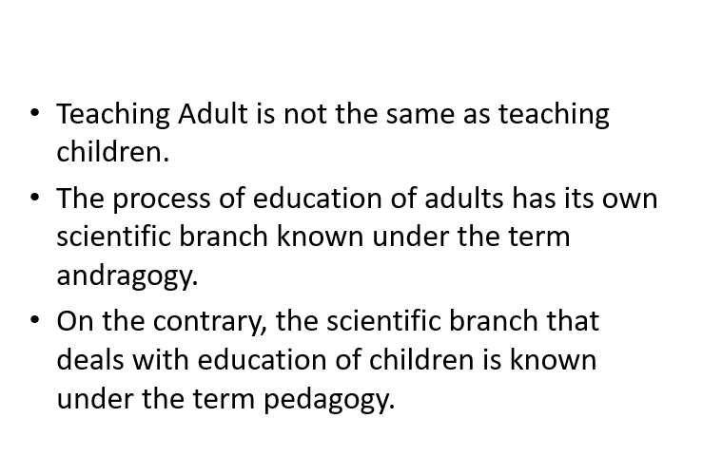
Pedagogy Vs Andragogy

Slide 7
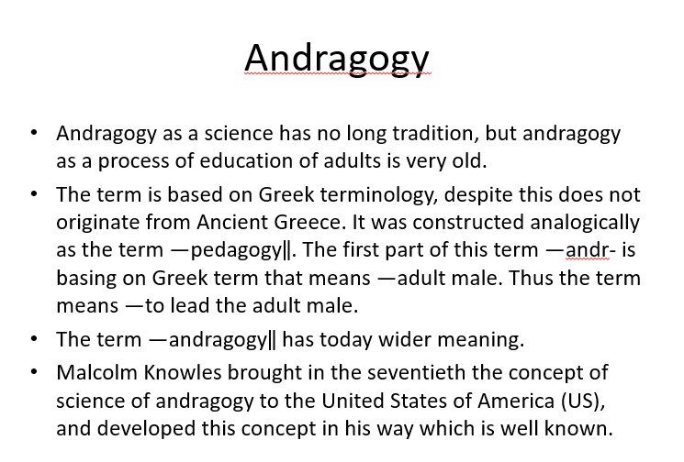

Slide 8
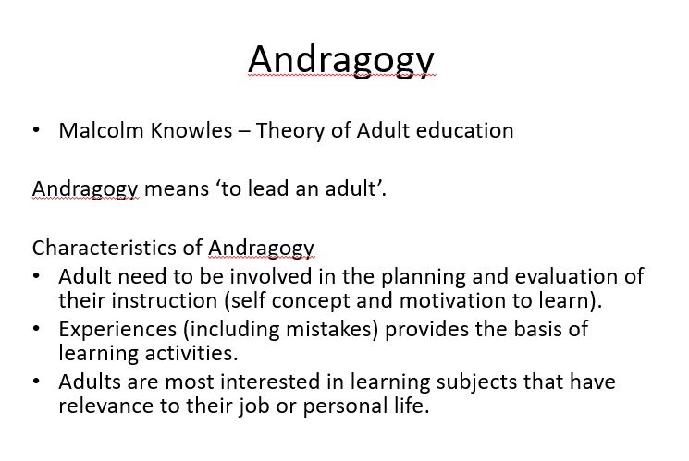

Slide 9
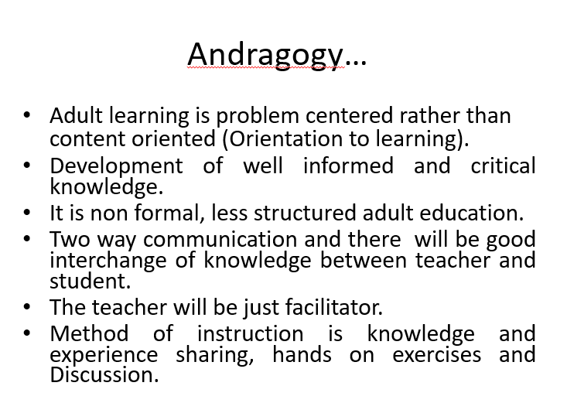

Slide 10
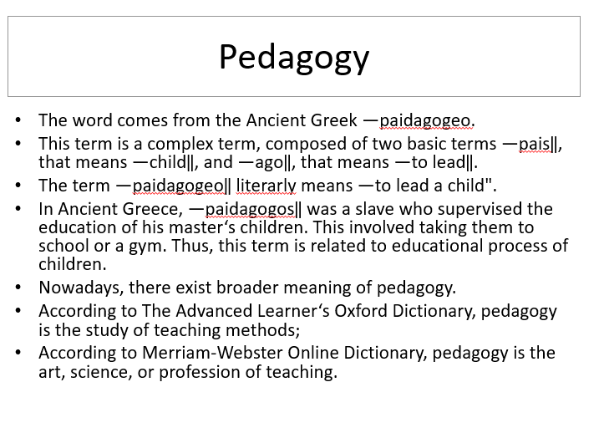

Slide 11
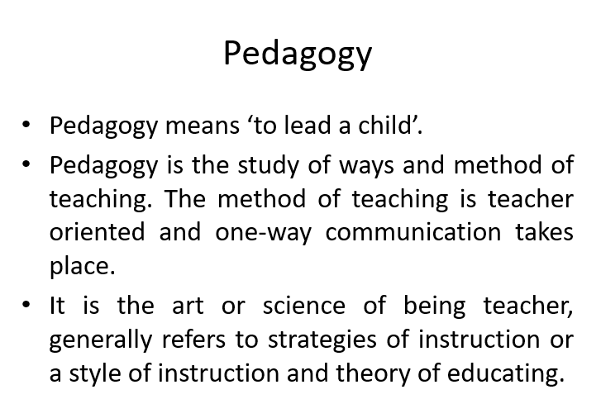

Slide 12
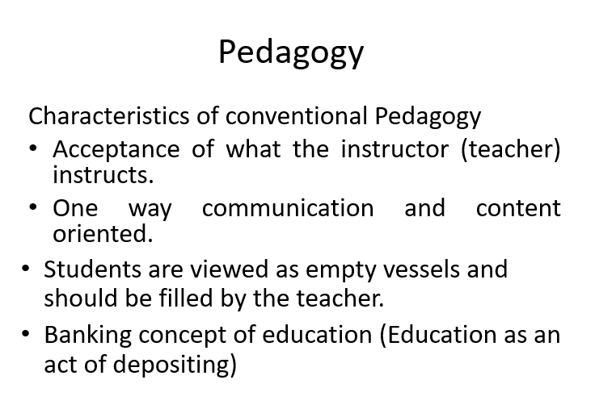

Slide 13
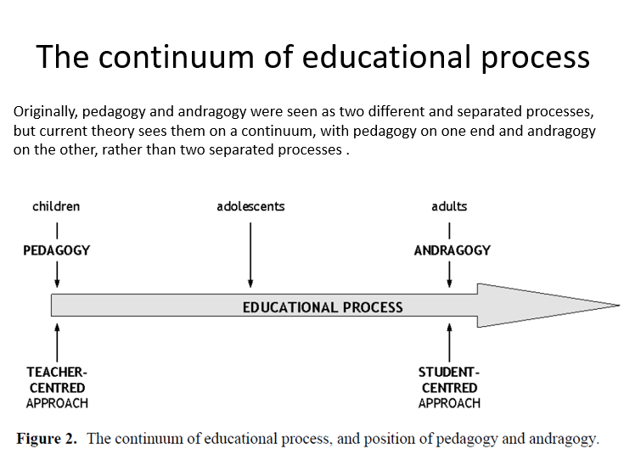

Slide 14
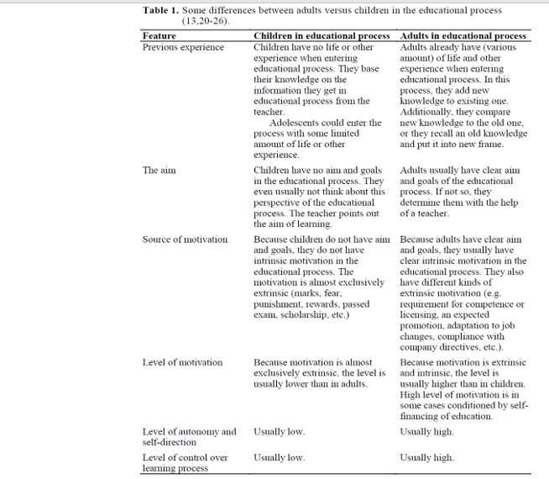

Slide 15
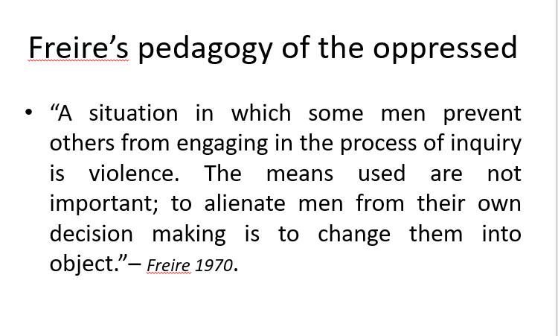

Slide 16
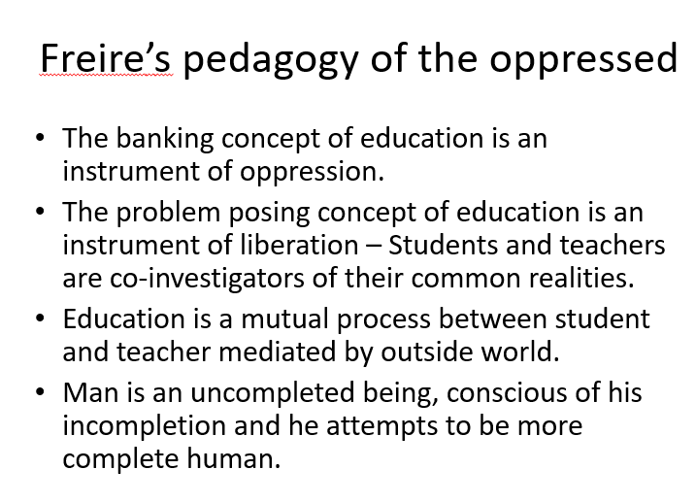

Slide 17
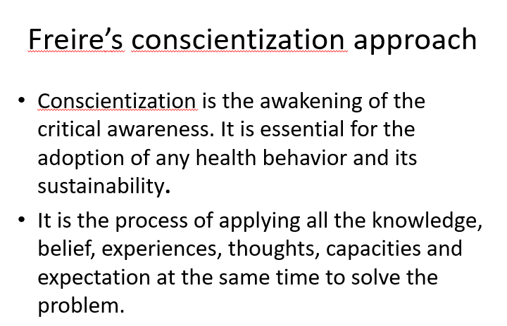

Slide 18
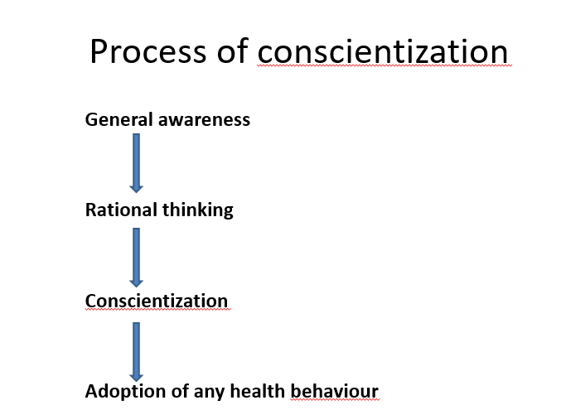

Slide 19
Conscientization
Pedagogy of oppressed described conscientization as “critical awakening of the awareness”
Conscientization is one of the main principles of non-formal education.

Slide 20
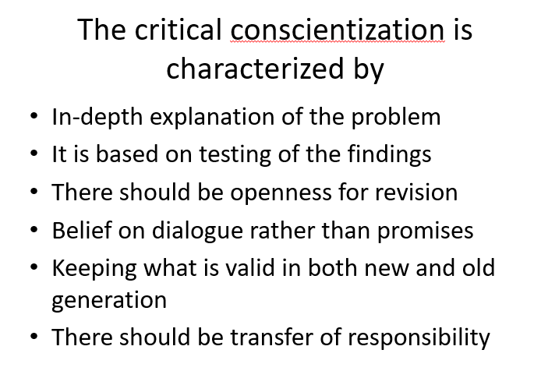

Slide 21
FORMAL AND NON-FORMAL ADULT EDUCATION (NFE) APPROACH

Slide 22
Formal and informal education
  Formal education: the hierarchically structured, chronologically graded ‘education system’, running from primary school through the university and including, in addition to general academic studies, a variety of specialized programmes and institutions for full-time technical and professional training.
  Informal education: the truly lifelong process whereby every individual acquires attitudes, values, skills and knowledge from daily experience and the educative influences and resources in his or her environment – from family and neighbours, from work and play, from the market place, the library and the mass media.

Slide 23
non formal education
What is non formal education ?
  Non-formal education: Any organized educational activity outside the established formal system – whether operating separately or as an important feature of some broader activity – that is intended to serve identifiable learning clienteles and learning objectives.
  An alternative way , to provide educational opportunity to those who couldn’t get education from formal schools and institutes.

Slide 24
Non –formal education is about ‘acknowledging the importance of education, learning and training which takes place ourtside recognized educational institutions.

Slide 25
Four Characteristics
• Fordham (1993) suggests four characteristics associated with non-formal education
1. Relevance to the needs of disadvantaged groups.
2. A focus on clearly defined purposes.
3. Flexibility in organization and methods
4. Concern with specific categories of person

Slide 26
Features of NFE
Uses adult learning principles
Create an atmosphere where participants feels safe and are at ease to express their ideas and opinions freely
Give due importance to their expectations/demands
Accept every opinion
Encourage to overcome fear or shakiness
Be friendly
Use different methods and learning aids
Use simple language
Present lively
Explain the need and importance of participation

Slide 27
Important facilitation skill for nfe
Non verbal communication skill
Active listening skill
Skill of asking questions
Modulation of voice
Skill to give feedback

Slide 28
History of non formal education
In 1967 at an international conference in Williamsburg USA, ideas were set out for what was to become a widely read analysis of the growing ‘world educational crisis’ .
There was concern about unsuitable curricula; a realization that educational growth and economic growth were not necessarily in step, and that jobs did not emerge directly as a result of educational inputs.
In the 1970s, four characteristics came be associated with non-formal education:
  Relevance to the needs of disadvantaged groups.
  Concern with specific categories of person.
  A focus on clearly defined purposes.
  Flexibility in organization and methods.

Slide 29
The area and scope of non formal education
As a training: Health related training
As awareness:
  Mass education and communication for health awareness
  Peer education (friend to friend)
  Physician client education
As informed choice
  Treatment choice
  Family planning choice
  Health care choice
  Health care provider choice
Warning message in consuming materials
  Smoking
  Alcohol drink
  Disaster warning
  Drug use etc.

Slide 30
Impact of non formal Health education Health in Nepal
The main literacy approach has been the Freirean-based Naya Goreto (or New Trail – a popular primer developed with inspiration from Freire in the 1970s), using key words and pictures but depoliticized to focus on development messages.
The informal health education approach impact particularly on
  Promoting sanitation
  Increasing health care utilization
  Minimize the health related rumors
  Explore different kinds of rights including health
  Self care for better health

Slide 32
Video links
Sand mine and child working
https://www.youtube.com/watch?time_continue=12&v=h-QINnhoLVU
Promote sanitation
https://www.youtube.com/watch?time_continue=103&v=eO2rrD4Ewd8

Slide 33
Propagandist approach
Propaganda – Control of public opinion
through
- Information/ideas spread widely to help person/group
Is an attempt to influence other to some pre-determined and by appealing too their thoughts and feeling.
Attempt to influence others to some predetermined end by appealing to their thought and feeling.

Slide 34
Techniques of propaganda
1. Card Stacking- Presents only positive information or selectively omits negative facts to sway opinions.
Example: Highlighting the benefits of a product without mentioning its drawbacks.
2. Glittering Generalities: Uses vague, emotionally appealing words or phrases that are universally valued (eg freedom, hope) without providing evidence
Example: This policy ensures justice , liberty for all.
3. Testimonial : Relies on endorsements from celebrities, experts, or respected individuals to build credibility. Example: A famous athlete promoting a sports drink.

Slide 35
4. Fear Appeals :
Exploits people’s fear to influence their behaviour or support a cause. Example: If we don’t act now, disaster will strike.
5. Repetition :
Repeats a message or slogans frequently to make it memorable and reinforce beliefs. Example: Just Do it.
6. Loaded Language :Uses emotionally charged words to create strong reactions and bias. Example: "Our revolutionary product will transform your life!"

Slide 36
Scapegoating : Blames a person or group for problems, redirecting attention from the real issues. Example: "The economy is struggling because of immigrants taking jobs."

Slide 37
Utilities of propaganda
To bring change in the government policy.
• To win public cooperation.
• To bring about social change.
• To break the bonds of the traditional social order.
• Utility during war time.

Slide 38
Propaganda approach versus health education
Propaganda
  Propaganda is information that is not objective and is used primarily to influence an audience and
  Further an agenda, often by presenting facts selectively to encourage a particular synthesis or perception, or
  Using loaded language to produce an emotional rather than a rational response to the information that is presented.
Propaganda is often associated with material prepared by governments, but activist groups, companies and the media can also produce propaganda.

Slide 39
PROPAGANDA APPROACH VERSUS HEALTH EDUCATION
There are many misconceptions, omissions, distortions and lies surrounding the issue of health and medicine.
Education is looked upon as a basic minimum need, as honest, ethical enlightened and disinterested instruction. Contrary to education propaganda is looked upon as misleading and dishonest.
Propaganda has selfish motive where as Education make the person aware of basic values of life, Reasonable and critical education helps in the exposition of inherent tendencies of a person
Propaganda tries to hypnotize the person through its various strategies and persuades people to accept the propaganda and change their action in favour of the propagandist but Education increases the independent thinking and decision making power

Slide 40
Propaganda approach versus health education
Propaganda offers readymade ideas and hence discourages enquiry, or free thinking. Rather its sole purpose is to see that the person accepts him. But
Education communicate knowledge through education aims at knowing the truth, making independent judgment.
Propagandist often tries to hide the truth for his own selfish interest, while education places all the positive and negative aspects, pros and cons of any subject matter before the students and this helps in enlightening rather than confusing them
Propaganda operates by sharpening a biased selection, suppression, emphasis or distortion of relevant data and denies a hearing of the rival approach. But education try to control the bias
Propaganda offers information not to bring the truth to light, rather its all efforts are pointed to conceal the truth and confuse people. But education encourage to explore the truth

Slide 41
Propaganda approach versus health education
Propaganda operates by sharpening a biased selection, suppression, emphasis or distortion of relevant data and denies a hearing of the rival approach but education control the bias
A propagandist generally intensifies social conflict and likes to fish in the troubled water. Education on the other hand, seeks to resolve the group tension through study and discussion.
Education tries to impress upon others to gain things. Even older ideas are transferred to get additional knowledge. But propaganda is convinced with old values.

Slide 42
Characteristics of propaganda
It transfer the message so fast in geometric way
Some group of people, community, region, caste blindly support the initiated propaganda with true perception
Sometimes there is difficult to access the health propaganda and malpractice but it is done without any intention.
The propaganda in Nepal is establish in politics, social conflict, professional organizations (Public Health/Medicine/Nursing etc.) discipline which is bad practice.
Propaganda with positive outcome often acceptable

Slide 43
Assignment
Write some propagandas related to health in your experiences explore those outcome

Slide 44
EDUCATION APPROACH
The purpose of this approach is to provide knowledge and information, and to develop the necessary skills so that people can make an informed choice about their health behaviour.
Education is intended to have an outcome. This will be the client’s voluntary choice and it may not be the one the health promoter would prefer.
Educational approach is based on a set of assumptions about the relationship between knowledge and behaviour: that by increasing knowledge, there will be a change in attitudes which may lead to changed behaviour.

Slide 45
Methods
An educational approach to health promotion will provide information to help clients to make an informed choice about their health behaviour.
•This may be through the provision of leaflets and booklets, visual displays or one-to-one advice.
•It may also provide opportunities for clients to share and explore their attitudes to their own health. This may be through group discussion or one-to-one counselling. Educational programmes may also develop clients’ decision-making skills through role plays or activities designed to explore options.
•Clients may take on roles or practice responses in‘real-life’situations.

Slide 46
Methods
Psychological theories state that learning involves three aspects:
1.Cognitive (information and understanding)
2.Affective (attitudes and feelings)
3.Behavioural(skills).

Slide 47
Education approach
If the necessary behavior changes are to take place, people must be educated through planned learning experiences what to do, and be informed, educated and encouraged to make their own choice for a healthy life.
This approach is consistent with democratic philosophy which does not "order" the individual. The results are slow, but enduring.
The mass media and social organizations must be mobilized to help introduce new attitudes and new habits without conflicting with the masses and the collective reaction to particular change.

Slide 48
Some examples are:
There are many problems (e.g., cessation of smoking, use of safe water supply, fertility control) which can be solved only through health education.

Slide 49
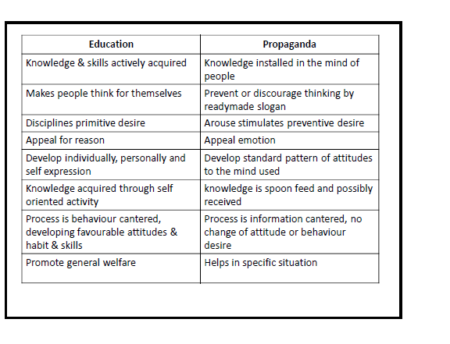

Slide 50
Education | Propaganda
Knowledge is acquired through self-reliant activity | Knowledge is installed or forced into mind through passive spoon feeding
It is behaviour centered (makes people to think for themselves) | Its information centered (discourages thinking)
Disciplines primitive desires | Stimulates primitive desires
Develops reflective behaviour (judgement before acting) | Develops reflexive behaviour
Thought process is promoted which appeals reasoning | Though process is suppressed which appeals emotions
Develops personality | Develops attitudes

Slide 51
 | Health education | Health propaganda
Knowledge and skills | Actively acquired | Instilled in minds
Promotion of thought process | + | _
Behaviour developed | Reflective behaviour | Reflexive behaviour
Appeals to | Reason | Emotion
Develops | Individuality, personality | Set attitudes, behaviour
Knowledge acquired by | Self-reliant activity | Passive spoon-feeding
Process | Behaviour centred | Information centred

Slide 52
SOCIAL MARKETING APPROACH
Social marketing is a powerful strategy for bringing about desired changes in the society with artful application of modern principles, techniques and approaches of marketing.
• It has already proved its worth - successful in promoting FP devices and lodized salt.
SM requires all the knowledge and skills of commercial marketing. It focus on providing services within reach of people in affordable cost.

Slide 53
The application of commercial marketing technologies to the analysis, planning, execution, and evaluation of programs designed to influence the voluntary behavior of target audiences in order to improve their personal welfare and that of society" (Andreasen, 1995)

Slide 54
A key benefit to individuals and society; not focused on profit and organizational benefits as commercial marketing practices.
A focus on behaviour, not awareness or attitude change
An approach centered on the target audiences having a primary role in the process.
Components
Social marketing practices make the consumer the central focus for planning and conducting a program.
The program’s components address:

Slide 55
The Four P’s
of Social Marketing
            Product Price
            Place Promotion

Slide 56
Social Marketing
Product
What we’re offering people:
Service
Behavior
Commodity (tangible goods)

Slide 57
Social Marketing
Product Must Be
Solution to a problem:
Benefits
Unique
Competitive
Real:
Defined in terms of the user’s beliefs, practices, and values

Slide 58
Social Marketing
Price
The cost of adopting the product:
Money
Time
Pleasure
Self-esteem
Embarrassment

Slide 59
Social Marketing
Place
Channels for information:
Where service is provided
Where information is received
Where tangible product is purchased
Available
Easy to find and use
Appropriate
Timely

Slide 60
Social Marketing
Promotion
Message design elements:
Type of appeal
Tone
Spokesperson

Slide 61
Price-what the consumer must give up in order to receive the program's benefits (these costs may be intangible [e.g., changes in beliefs or habits] or tangible [e.g., money, time, or travel])
• Product-what the program is trying to change within the intended audience and what the audience stands to gain
. Promotion-how the exchange is communicated (e.g., appeals used)
Place-what channels the program uses to reach the intended audience (e.g., mass media or interpersonal

Slide 62
Process in SM
The formulation of price, product promotion, and place evolves from research with the consumers to determine what benefits and costs they would consider acceptable and how they might be reached.
. Lessons learned from social marketing stress the importance of understanding the intended audiences and designing strategies based on their wants and needs rather than what good health practice directs that they should do.

Slide 63
Differences between
Commercial Marketing | Social Marketing
Objective is profit General people are the target group/population Cooperation with government is rare Less contributory to development of society | Objective is welfare People in need are the target group/population Cooperation with government is often. High contributory to development of society

Slide 64
Social marketing services are provided in substantial cost to middle section and in zero cost (free of cost) to lower section
Limitation: Caution should be taken to provide subsidy as excessive subsidy can kill the program.

Slide 65
What is Social Marketing?
It is a marketing strategy modeled after corporate marketing, used by health professionals to develop successful health messages.

Slide 66
Social Marketing
Key concepts
Uses commercial marketing technologies and theory
Brings about voluntary behavior change
Targets specific audiences
Focus is on personal welfare and that of society

Slide 67
Social Marketing
Potential Applications
Promote healthy behavior
Promote services
Increase utilization rates
Improve customer satisfaction
Enhance compliance

Slide 68
Social Marketing
Social Marketing’s Popularity
It works by bringing about behavior change
More cost effective
Reaches larger numbers

Slide 69
Social Marketing
Distinguishing Features of Social Marketing
Exchange theory
Consumer orientation
Data based decision making
Competition
Willingness to change offer

Slide 70
Social Marketing
# 1 Consumer Orientation
Understand consumer perceptions
Which benefits they find attractive
Costs or barriers that deter them

Slide 71
Social Marketing
Put Simply, Consumer Orientation Means
Understand what they want and need
Respond to their wants and needs

Slide 72
Social Marketing
#2 Exchange Theory
Exchange time and effort for benefits
Make an attractive offer
Create an awareness that the problem exists
Demonstrate the product’s benefits
Help lower the price

Slide 73
Social Marketing
#3 Data Based Decision Making
Logical model for planning
How you plan to help
What you will help them to do
Which factors you must address

Slide 74
Social Marketing
#4 Competition
Marketers keep a steady/fixed eye on the competition
Marketers position products relative to the competition

Slide 75
Social Marketing
#5 Willingness to Change Offer
Committed to designing products consumers want
Committed to modifying programs
Committed to addressing facts that influence their behavior

Slide 76
Social Marketing
Traditional Approach to Health Education Messages
Top Down Planning
Expert driven
Best practices
Literature review

Slide 77
Social Marketing
In Other Words…
We will tell you what you need and want (expert driven)
Offer everyone same product, price, place and promotion

Slide 78
Social Marketing
Commercial Marketing
Satisfying customer needs and wants
Process for individuals and groups to obtain what they need and want by creating/ exchanging products and value with others

Slide 79
Social Marketing
Social Marketing Works!
It brings about behavior change
More cost effective by reaching larger numbers

Slide 80
Social marketing approach in Nepal
Selling of Iodine salt
Selling of family planning contraceptives
Marketing/promotion of abortion
Marketing of Fluoride tooth pastes
Marketing of smokeless stoves
Marketing of water purification methods
Marketing of sanitary pads for adolescent girls

Slide 81
WHEN CHILD WORKS TOGETHER,
THEY CAN CHANGE THE WORLD

Slide 82
Child to Child Approach
Child-to-child approach is an educational approach that allows children to be empowered as a group by participating in their self-development and the development of their peers.
Child-to-child approach exists but like a silhouette, it needs the required attention and promotion in the right direction, thereby empowering children and using their unique talents and energy in promoting better health practices and improving quality of life.
Notes:
Silhouette- outline/shape/shadow

Slide 83
Child to child approach is important in fostering a love of learning in children. Although the learning process is controlled, children have the freedom to exercise their thoughts towards the direction they are given.
The aspect of freedom is vital in the development of interest in learning. Children love to be appreciated, and when they do well, they get congratulated. Also, the other children copy these actions for them to be rewarded. In the end, children can adapt the skills that please their teachers.

Slide 84
Approach
It is a approach to educate child through peer group
From the teacher/parents some of the child hesitate to share their problems
Some of the area are sensitive and very difficult to share with parents and teacher
  First menstruation of girls/problems related to menstruation
  Health problems/specific diseases etc.

Slide 85
AIMS
CTC projects aim to achieve positive change on three levels:
1. Communal impact on families, children, local professionals and others which involves increased knowledge and positive changes in health attitudes and behaviours, well as improved relations between adults and children or institutions and children.
2. Personal impact on children involved in the project, which involves increased knowledge and skills, improved self confidence, and the development and strengthening of friendships and other relationships.
3. Professional impact on facilitators, including increased respect for children’s ideas and abilities and increased use of child centred learning and teaching methods.

Slide 86
CTC approach help children (HOW)
Knowledge and skills
• It develops knowledge and understanding of important health issues in communities.
• It develops active skills to help children prevent disease and help those who are sick.
• It develops thinking skills of:
- identifying problems and solving them
- communicating ideas to others
- examining actions and results
• This knowledge and these skills increase children's capacity to improve their own lives.

Slide 87
Attitudes
• To develop desirable attitudes in children
• Develops self-confidence, their sense of responsibility and their sense of cooperation.
Behavior
• Changes In behaviour and practice In children in both younger and older children
• More care and attention to the health of others (e.g. children care for safety of younger children).

Slide 88
Effects on families, schools and communities
• helping to make closer links between education and health workers, at community level (and at higher levels too).
• to bring changes in health knowledge and practice, through the knowledge that children can spread and the example they can provide (with the help of their teachers, youth leaders and health workers).

Slide 89
Benefit of child to child to approach
Socialization
  Socialization with people other than the child’s family in a safe environment is an essential foundational element and C to C approach made better.
Concept of cooperation
  Learning how to share, cooperate, take turns and persevere (proceed) within a safe learning environment, guided by professionals who have the children’s best interests at heart.
Encouraging Holistic Development
  The approach taken to build a strong foundation for a child’s emotional, social, physical and mental development, which will prepare them for a lifetime.

Slide 90
Benefit of child to child to approach
Enthusiasm/passion for Lifelong Learning
  Lessons should be given in a fun and exciting way that will encourage children to be effective learners. We need to inspire a thirst for learning with eagerness and enthusiasm.
Convey the value of education through experience
  The value of learning and education by setting an example as role models and by providing actual experiences.
Respect
  Teaching the value of respect for others. This is not limited to people and belongings, but can also mean respect for their environment, both immediate and global

Slide 91
Benefit of child to child to approach
Teamwork
  Demonstrating and instilling the importance of teamwork that can teach respect for the opinions of others, listening, cooperation and equality.
Resilience/flexibility
  It’s important that early childhood educators and parents work together to develop resilience in children as early as possible. By creating a consistent, secure and fair social environment, with clear expectations and predictable consequences, children can develop skills in managing themselves and their emotions.
Concentration
  During preschool years, children explore at every opportunity to discover new experiences, new friends and new environments. Their minds are so lively and imaginative.
Notes:
Instilling (introducing/teaching)

Slide 92
Benefit of child to child to approach
Patience:
  Every day as adults, we encounter situations where our patience is tested. Children need opportunities to be involved in an abundance/complete of social experiences, where they can explore and practice the social skill of patience.
Confidence and Self-Esteem:
  This is critical. A strong sense of wellbeing provides children with confidence, optimism and self-esteem which will encourage children to explore their talents, skills and interests.
Exposure to Diversity
  Valuing difference and diversity are crucial to a child’s early development. Early childhood education serves to guide children to appreciate and accept differences and become well-rounded contributors to society.

Slide 93
Possible area for child to child approach in Nepal
Orientation and training for first aid
Deworming program in school and community
Advocacy for latrine use
Personal hygiene in school
Junk food discourage program
Sex education program

Slide 94
Child-to-child approach in disseminating the importance of health among children –A modified systematic review. Available from: 10.4103/jehp.jehp_8_23 or https://www.ncbi.nlm.nih.gov/pmc/articles/PMC10312397/

Slide 95
Assignment
Please design at least one program based on C to C approach

Slide 96
Six step of child to child program
Step | Activities | Responsibilities
First step | Choose the right idea | Teacher helps to provide facts & student decided
Second step | Find out more | Student find out through the survey , data collection , observation
Third step | Discuss what has been found | Students discussed what they have found.
Fourth step | Plan of action | Teacher facilitates the students and student develop plan of action
Fifth step Six step | Take action Discuss result | Students implement the plan Teacher facilitates students to evaluate program.

Slide 97
Cont…
Step one | Step two | Step three | Step four | Step five | Step six
Availability of safe drinking water | Listing the cause of unsafe water | Discuss on listed cause & identified of main cause | Development of action plan to correct the main cause | Implementation of the developed plan | Evaluating (effect of the implementation
At the end of the session the facilitator emphasized
that after evaluation again the steps should be
repeated if the result is not satisfactory.

Slide 98
Child education approach
Related videos in Nepal
https://www.youtube.com/watch?v=ZrvSG0i-u2E
https://www.youtube.com/watch?time_continue=63&v=OMYGPk6FeoQ
https://www.youtube.com/watch?v=8QFLUf7wem0

Slide 99
DISTANCE LEARNING APPROACH

Slide 100
Distance education Approach
Distance education or long-distance learning is the education of students/learner who may not always be physically present at a formal academic institution
The first distance education course in the modern sense was provided by Sir Isaac Pitman in the 1840s, who taught a system of shorthand (fast writing)by mailing texts transcribed into shorthand on postcards and receiving transcriptions from his students in return for correction.
Definition by “The California Distance Learning Project (CDLP)”
  Distance Learning (DL) is an instructional delivery system that connects learners with educational resources
  DL provides educational access to learners not enrolled in educational institutions and can enhance the learning opportunities of current students.
  The implementation of DL is a process that uses available resources and will evolve to incorporate emerging technologies

Slide 101
DISTANCE LEARNING APPROACH
Distance Learning occurs when there is a separation between the instructor and the student, usually due to geographical or time concerns that prevent the student from attending an on-campus course.
Often, electronic means are used to bridge this gap and distribute educational material though distance learning programs using printed and mailed materials.
These programs have usually been specially designed to help best meet the needs and requirements that arise when learning is taking place outside of a traditional classroom setting.

Slide 102
Today, the predominant mode of distance education leverages the widespread accessibility of the Internet. Students, whether at home or utilizing resources like local libraries, can readily access learning materials through electronic platforms. These digital tools serve to disseminate educational content, facilitate communication between students, and maintain a connection between students and their instructors.
Distance learning support in balancing work and family commitments. Distance learning is also a great tool to help reach students who are in geographically remote areas and may not have readily available access to educational facilities or who want to explore opportunities not offered by their local schools.

Slide 103
Key features of distance learning
The separation of teacher and learner during at least a majority of each instructional process
Separation of teacher and learner in space and/or time.
The use of educational media to unite teacher and learner and carry course content.
The provision of two-way communication between teacher, tutor, or educational agency and learner, and
Control of the learning pace/speed by the student rather than the distance instructor

Slide 104
Types of distance learning
Synchronous instruction: It requires the simultaneous participation of all students and instructors. The advantage of synchronous instruction is that interaction is done in "real time" and has an immediacy.
  Examples include interactive telecourses, teleconferencing and Web conferencing, and Internet chats.
Asynchronous instruction: It does not require the simultaneous participation of all students and instructors.
  Students do not need to be gathered together in the same location at the same time.
  Rather, students may choose their own instructional time frame and interact with the learning materials and instructor according to their schedules.
  For examples self study training, tutorial videos and self assessment of course

Slide 105
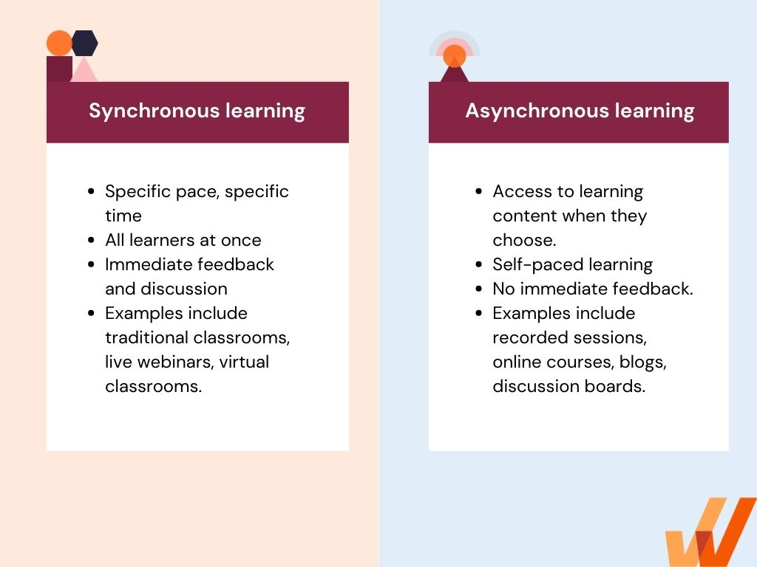

Slide 106
Principles of Distance Learning
Practical focused
Goal oriented
Focused on learner’s interest
Use of appropriate variety of media
Experimental learning
Problem based learning
Context based learning
Interaction and collaboration support learning
Self directed learning
reinforcement

Slide 107
Elements/components/steps in Distance Learning Design
Identify the targeted learner.
Establish the program goals and objectives.
Define the outreach and recruitment strategies.
Determine the intake, testing and enrollment procedures. this should include screening for self directedness.
Provide learner orientation and assignment

Slide 108
Elements/components in Distance Learning Design
Define instructor selection, orientation, training, and support.
Identify the instruction strategies and materials. They should fit your course outlines.
Develop structured and create (ad hoc) learner support activities.
Pilot test the materials and modify as required.

Slide 109
Elements/components in Distance Learning Design
Determine the learner data collection requirements including learning gains and learning achievements and affective measures of motivation and self esteem. (Field study)
Design a self correcting program evaluation system. Include systematic learner and instructor feedback in the system.
Implement and modify the distance learning program as experience indicates.
Report findings and conclusions to key stakeholders.

Slide 110
Distance learning in Health
Radio program for adolescent health“साथी संग मनका कुरा”
Radio Programs for Health Workers and FCHVs “सेवा गरे मेवा पाइन्छ”
Tele Medicine Program for patient diagnosis and treatment
Online course in different Public health Degree in foreign countries
Video teaching in clinical and skill based course

Slide 111
Various Media Used In Distance Learning
Printed materials
Interactive audio or video conferencing
Electronic mail
Pre-recorded video tapes
Faxes

Slide 112
Advantages
Saves time and energy
Program is flexible to your schedule
Allows you to work at your own pace
Saves money
Convenient
Access to study material
Study any topic you want
Equity

Slide 113
Disadvantages
Lacks personal interaction with professors and students
Overdependence on technology
It can get lonely
Because of flexibility, students may not be as motivated as in-class students
Inadequate feedback from professors
Not all courses are available
Absence of academic environment

Slide 114
Discuss the importance of distance learning on health in context of Nepal

Slide 115
RISK APPROACH
Risk approach in health education involves
Appraisal of health risk among individual and communities
Managing those issues from risk perspective
Notes:
Appraisal –assess the value or quality

Slide 116
It is a process of gathering, analysing and comparing an individual’s prognostic characteristics of health with a standard age group, thereby predicting the likelihood that a person may develop prematurely a health problem associated with a high morbidity and mortality rate.
Notes:
Prognostic-prediction

Slide 117
An assessment tool is used by health promoters to evaluate a person's health.
The appraisal usually takes the form of an extended questionnaire that enquires into personal lifestyle, and personal and family medical history.
The appraisal may also include a physical examination, laboratory tests of blood chemistry (e.g. of cholesterol level), blood pressure, and physical fitness levels. The outcome is a profile identifying specific risks (e.g. heavy smoking and sedentary lifestyle) with strategies and targets for reducing the risks.

Slide 118
Health RISk among Nepalese population
Tobacco use
Indoor smoke
Deficiency of Micro/Macro nutrients
Unsafe sexual behaviour
Alcoholism
Drug abuse

Slide 119
Health RISK management
Risk management is the preventative process for managing risks.
Risk management involves identifying risks, strategizing ways to avoid or mitigate those risks and developing a contingency plan in case risks cannot be prevented or avoided.

Slide 120
Steps in Risk appraisal and management
1. Risk identification
2. Risk assessment
3. Exposure assessment
4. Risk characterization
5. Risk management

Slide 121
Risk identification
This is very first step where the possible hazards are identified and taken into interest for further study.
This involves exploratory studies, laboratory investigation in identifying the hazard.

Slide 122
Risk assessment
The dose response of the exposure (hazard) and the adverse effect of the exposure is analysed.
Different effects may be seen at different exposure level.

Slide 123
Exposure assessment
How long people/group are exposed with certain risk?
What was the level/concentration of certain risk?

Slide 124
Risk characterization
After identifying the risk factors, it is essential to prevent its occurrence in future.
Thus, risk characterization help to prevent future risk hazard.
From the previous steps, now we are able to assess the actual risk of that specific exposure to the people.

Slide 125
Risk management
Risk Retention
Risk Transfer
Risk avoidance
Risk minimization
Notes:
Retention-maintenance –Risk Retention may refer to a risk management strategy that involves a party assuming the responsibility for a certain level of risk or losses. This term may also refer to the amount of risk that a party is willing to accept before transferring it to another party through insurance or other forms of risk transfer.

Slide 126
Risk management
Risk retention is for absorbing the certain level of risk within the community people (developing coping or adaptation skills)
Risk transfer can be done by providing the insurance.
Risk avoidance in completely rule out the exposure of risk to the population.
Risk minimization is mitigation of risk by public health measures

Slide 127
Risk Approach!!!
The way of life that is risk for disease, disability and death is risk behavior and may be defined as risk approach
Generally every activities/behavior/action is risk but degree of risk is different
The leading global risks for mortality in the world are:
  High blood pressure (responsible for 13% of deaths globally),
  Tobacco use (9%),
  High blood glucose (6%),
  Physical inactivity (6%), and
  Overweight and obesity (5%).
In 2004, unsafe sex was estimated as being responsible for more than 99% of human immunodeficiency virus (HIV) infection in Africa –

Slide 128
Tobacco use
Worldwide, the age-standardised prevalence of daily smoking was 25·0% for men and 5·4% for women, representing 28·4% and 34·4% reductions, respectively, since 1990

Slide 129
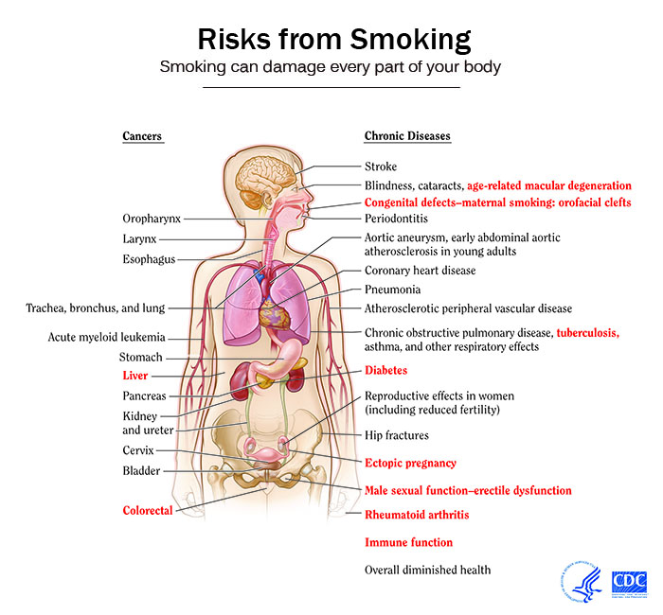
Risk of tobacco use

Slide 130
Macro and Micro nutrients
In developing countries, childhood and maternal undernutrition responsible for 3.5 million death, 144 million DALYs, 73% diarrhea and 50 % responsible for pneumonia, measles and neonatal infection.
Under nutrition reduce immunity and attract any health problems
According to WHO risk behavior report, 1 billion people overweight (BMI>25) and 300 million are obese (BMI>30) and this is related to poor physical inactivity.
Obesity obstruct blood circulation and it is pathway responsible for disease death and disability

Slide 131
Sexual behavior
According to WHO, healthy sexual behavior is defined as
  Enjoyment of sexual relation without exploitation, oppression or abuse.
  Safe pregnancy and childbirth, and avoidance of unintended pregnancies.
  Absence and avoidance of sexually transmitted infections, including HIV
There have been large increases in many STIs in the last 10 years including Chlamydia (up 300%), gonorrhoeas (up 200%) and HIV (up 300%).
All cervical cancer is attributed to sexual transmission of HPV and 11% death due to cervical cancer due to unsafe sex.
Due to unsafe sex, 99% of HIV has been transmitted by unsafe sex
Since 1990, people are having sex for the first time at a younger age, a greater proportion of people have multiple partners, and a greater proportion of men report having had a same sex partner.

Slide 132
Other risk behavior
Sedentary behavior
Junk and creamy food consumption
Poor walking
Use of electronic devices
Use of cosmetic things etc.

Slide 133
Health education for risk behavior
Public health practitioner avoid the risk behavior first
The risk approach should be discourage for public relation
Promoting healthy behavior is easy and cost effective approach but the outcome of risky behavior is multi effect.
The PH program should be priotized based on type and density of risk behavior in community/area of field.

Slide 134
Related more reference
WHO Global health risk report: http://www.who.int/healthinfo/global_burden_disease/GlobalHealthRisks_report_full.pdf
Study of risk taking behaviors and practices long route drivers in Dharan Municipality of Eastern Nepal https://www.nepjol.info/index.php/HREN/article/view/17922/14549
Psychosocial Health Problems Associated with Increased HIV Risk Behavior among Men Who Have Sex with Men in Nepal: A Cross-Sectional Survey http://journals.plos.org/plosone/article/file?id=10.1371/journal.pone.0058099&type=printable

Slide 135
Discuss the importance of distance learning on health in context of Nepal

Slide 136
SOCIAL MOBILIZATION APPROACH

Slide 137
Social mobilization approach
सामाजिक परिचालन
https://www.youtube.com/watch?v=Mm-NhAb2XRA

Slide 138
What is social mobilization?
Social mobilization is a process that engages and motivates a wide range of partners and allies at national and local levels to raise awareness of and demand for a particular development objective through dialogue
In other words, social mobilization seeks to facilitate change through a range of players engaged in interrelated and complementary efforts.
An integrative process where stakeholders are stimulated to become active participants in social change, using diverse strategies to meet shared goals
A comprehensive planning approach that emphasizes – Political coalition building – Community action (UNICEF)

Slide 139
Community Mobilization (सामुदायिक परिचालन )
It aims at informing and gaining the commitment of community leaders as well as local government agencies, Nongovernmental organizations(NGOs), women's groups and cooperatives
Basic process on community mobilization
  Know your community well, and understand their problems and their needs.
  Be aware of existing health beliefs and practices that exist in the community.
  Always listen to community members carefully
  Do not rapidly introduce new interventions that are different from existing practices and beliefs. Take gradual steps to introduce such practices.
In this line, social mobilization approach is a model of development through social movement and social spirit and community mobilization is a part of social mobilization

Slide 140
Social Mobilization | Community Mobilization
activities aimed at engaging and motivating larger segments of society or the general public. It may involve efforts to raise awareness, change attitudes, and promote collective action on a broader scale, often at the societal or national level. | concept is more localized and focuses on engaging and empowering specific communities or groups within a society. It involves working with smaller, more defined groups to address local issues, build community capacity, and foster a sense of collective responsibility.
Targets a broad audience, often involving mass media campaigns, public events, and other strategies to reach a large and diverse population. | Targets specific communities or groups, involving direct interaction and participation with local residents or stakeholders..

Slide 141
Social Mobilization | Community Mobilization
Often aims at addressing issues on a larger scale, such as public health campaigns, environmental awareness, or social change at a national or regional level. | Focuses on specific community development goals, addressing local challenges, and enhancing the capacity of a community to work together for positive change.
May utilize a variety of communication channels, including mass media, social media, and large-scale events to disseminate information and influence public opinion. | Involves a more personalized, grassroots approach, with a focus on building relationships, trust, and collaboration within a specific community.

Slide 143
Key Elements of Social Mobilization
Partnership building and networking
  Identification of key stakeholders
  Stakeholder - group, organization, member or system who affects or can be affected by government policies and actions
Community participation
  Participation is about meeting the interests of the whole community.
  Takes into consideration the different experiences, needs and capabilities of various groups
Media and special events to raise public awareness
  Mass Media: A communication medium—whether written, broadcast, or spoken—that reaches a large audience.
  Mass Media - Influence Public understanding, how much attention people will pay, which actions individuals or communities are likely to take.

Slide 144
Key Elements of Social Mobilization
Advocacy to mobilize resources and effect policy change
  The act or process of supporting a cause or proposal
  Community health advocacy entails advocacy by a community around issues related to health, however that community is defined or formed.

Slide 145
Steps of social mobilization
Social mobilization will be initiated by Community Mobilizers or Social mobilizer
Firstly they should visit the community in the camps and their settlements and establish a rapport
Determine physical boundaries of the settlement with the people
Should assist the community in holding a mass meeting and encourage them to understand the need to organize for collective action
Assist in the formation of Primary Groups in the settlement of clusters of 10 to 15 houses
Assist the Groups in camp management and relief distribution

Slide 146
Social mobilization in health
The social mobilization is necessary in health by two aspects
To improve the social health (one component of health by WHO)
  Social norms and values to promote health
  Social unity to understand health
  Social standard for health (Sanitation, environmental health, social security, safety, peace, free from substance use etc.)
Social movement against the social deviation (Superstition, taboos, innocents, ignorance etc.) that affects individual health
  Bad menstruation practice
  Bad food taboos
  Risky practice for health like female genital mutilation, tongue penetration for newari culture

Slide 147
Social mobilization approach in health
Health education programs in community (Role play, advocacy, demonstration, Film, TV shows etc.
Social campaigns: Poster, pamphlets wall chart, miking
Creative programs: debates, workshop, Paper presentations, essay writing etc
Media campaigns: Facebook, Twitter talk programs

Slide 148
Steps for social mobilization
Choose a health issues that needs social mobilization
Design the programs (multiple programs to address all groups of society)
Manage appropriate resources (Manpower, money, materials, mindset, method, media etc.)
Conduct the program
Evaluate the program (immediate, mid term, long-term)

Slide 149
Challenges for social mobilization
Uniformity for health agenda
Appropriate program
Appropriate time selection
Resources generation for the program
Implement the program/change the behavior

Slide 150
Programs success by social mobilization
Immunization specially polio eradication campaign
Vitamin A promotion program
Open defecation free program
School sanitation program

Slide 151
Assignment
Design a social mobilization program to eliminate leprosy in Nepal

Slide 152


Community development and Community organization approach

Slide 153
“Community is a number of families residing in a relatively small area within which they have developed a more or less complete socio-cultural definitions imbued with collective identifications and by means of which they resolve problems arising from the sharing of an area” (Sutton and Kolaja)
A community is a group of people living together in a particular area where the people get organized themselves to meet common interest and problems.
"Community refers to a group of people inhabiting a limited area who have a sense of belonging together and through their organized relationship share and carry on activities in pursuit of their common interests."
—Lowry Nelson.
Notes:
Imbued-instilled

Slide 154
Community development
Community development is a process where community members take collective action on issues that are important to them. Community development is intended to empower community members and create stronger and more connected communities.
Community development is a process designed to create condition of economic and social progress for the whole community with its active participation and fullest possible reliance upon the common initiative. — Dr A.K. Rahaman
Community development is a process by which the community recognizes the real need and implements it in behaviour or activities. — Murray G. Ross
The aim of community development is to improve all aspects of rural life i.e. agriculture, animal husbandry, irrigation, education,public health, rural industries, cottage industries, communication etc
Notes:
https://aifs.gov.au/resources/resource-sheets/what-community-development#:~:text=Community%20development%20is%20a%20holistic,Kenny%20%26%20Connors%2C%202017).

Slide 155
"The primary goal of community development is the improvement of the basic living conditions or co-operative determination and effort in local communities.“Murray G. Ross
The Objective of community development is creation of such a community in which community people care themselves and think for the best possible development, take every decision themselves, estimate real needs, develop plans and programmes and implement them.

Slide 156
Community development approaches in health promotion involve empowering communities to take control of their own health and well-being. Instead of simply providing healthcare services, this approach seeks to address the broader social determinants of health and involve the community in the process of identifying and solving health-related issues.

Slide 157
Community development approach
Principles: social and environmental justice
Vision: just and sustainable world
Values: ideology of equality
Process: popular education for participatory democracy, practical projects and collective action for change
Theory: analyses of power and discrimination

Slide 158
Community development
The United Nations defines community development as "a process where community members come together to take collective action and generate solutions to common problems
A practice-based profession and an academic discipline that promotes i) participative democracy, ii) sustainable development, iii) rights, iv) economic opportunity, v) equality and vi) social justice, through the organisation, education and empowerment of people within their communities, whether these be of locality, identity or interest, in urban and rural settings

Slide 159
Approach for community development
Women Self-help Group
Community capacity building
Large Group Capacitation
Social capital formation
Nonviolent direct action
Economic development (Developing countries seeks funs from Developed countries)
Community economic development : Internal resource mobilization
Notes:
https://en.wikipedia.org/wiki/Community_development
Women Self-help Group; focusing on the contribution of women in settlement groups.
Community capacity building; focusing on helping communities obtain, strengthen, and maintain the ability to set and achieve their own development objectives.^{[9]}
Large Group Capacitation; an adult education and social psychology approach grounded in the activity of the individual and the social psychology of the large group focusing on large groups of unemployed or semi-employed participants, many of whom with Lower Levels of Literacy (LLLs).
Social capital formation; focusing on benefits derived from the cooperation between individuals and groups.
Nonviolent direct action; when a group of people take action to reveal an existing problem, highlight an alternative, or demonstrate a possible solution to a social issue which is not being addressed through traditional societal institutions (governments, religious organizations or established trade unions) to the satisfaction of the direct action participants.
Economic development, focusing on the "development" of developing countries as measured by their economies, although it includes the processes and policies by which a nation improves the economic, political, and social well-being of its people.
Community economic development (CED); an alternative to conventional economic development which encourages using local resources in a way that enhances economic outcomes while improving social conditions. For example, CED involves strategies which aim to improve access to affordable housing, medical, and child care.^{[10]}

Slide 160
Approach for community development
Sustainable development: Environment friendly development
Community driven development
Asset based community development
Faith based community development
Community based participatory research
Community organizing
Participatory planning
Language based development/ revitalization of languages

Slide 161
Techniques of ComMUNITY Development
External agent approach
Multiple agent approach
Internal resource mobilization approach

Slide 162
1.External agent approach
If the external partners/ agents plan without involving local community members and enter the community to develop to implement that is called external approach/ techniques.
The external agent may appear at the request of national government and basic objective of this approach is to introduce and implement a particular project or plan in the community. In this techniques expert and the managers are manage from their side, they can or cannot involve local community as a development partner.

Slide 163
External………
The external agent themselves decides the areas of development. They themselves allotted all financial budget to implement the project.
The working process of this approaches will be decided at their central project management. They can diagnose the community needs and identified their main needs and develop the objectives of the project and try to implement the project with the help of community people.

Slide 164
2.Multiple agent approach
In this approach various development agents/ partners involve to development process. A team of various experts or agents seeks to provide variety of services such as education , health , agriculture , forestry and other together in the community.
In this technique , the various agent work together for the development of the community. They will actively involves the local community so we can say, community participation in this approach is more than that of in the external approach. It is one of the effective methods of community development.

Slide 165
3. Internal Resource Mobilization Approach
If the community people themselves are united and get involved in the development activities of the community using locally available resources maximum. The community people find out their health needs , plan , implement , monitor and evaluate the program by themselves.
The community people can take support and coordinate from the outsiders if they feel necessary. In this techniques the community people involves local experts and manage themselves to implement their program. This approach is more effective because they will not depend out side partner and it will be sustainable.

Slide 166
How CD approach promotes health?
CD approach centrally focused on economic growth and empowerment
Economic empowerment open the way of information, education, confidence, multiple choice in health care and many more
CD realize the health as a means
CD promotes the social health
CD provide the responsibility for individual members to care health
CD plan implement and evaluate the health service available in community

Slide 167
Community organization
A process through which communities are helped to identify common problems or goals, mobilize resources, and
In other ways develop and implement strategies for reaching their goals they have collectively set forming a GROUP.
Community Organization : it is the process of organizing community for the development of its members. Community organization can be also said as an institution or as the organization of people joined together for a common cause, directed by the feeling of together for development and is governed by an elected body of governance by themselves.

Slide 168
Assumptions/expectation of Community Organization
Communities of people can develop the capacity to deal with their own problems.
People want to change and can change.
People should participate in making, adjusting, or controlling the major changes taking place in their communities.
Changes in community living, which are self-imposed or self-developed is the symbol of sustainable development

Slide 169
Assumptions of Community Organization
5. A ‘holistic approach’ can deal successfully with problems with which a ‘fragmented approach’ cannot cope.
6. Democracy requires cooperative participation & action in the affairs/dealing of the community, & people must learn the skills which make this possible
7. Frequently, communities of people need help in organizing to deal with their needs, just as many individuals require help with individual problems.

Slide 170
Community Organizing Methods
Locality development: is a broad self-help method in which local citizens develop new skills and become more self-sufficient
Social planning: utilizes skilled volunteers in the community in a technical process of problem solving
Social action: is a technique that involves the redistribution of power and resources to disadvantaged segments of the population.

Slide 171
Process for Organizing a Community
Recognizing the problem
Making entry into the community
Organizing the people
Assessing the community
Determining priorities & setting goals
Selecting a solution to the problem

Slide 172
Role of community organization in health promotion
Understanding: Setting a common health agendas and setting a priorities
Contribution: Group/social responsibility for health promotion i.e. contribution for health (Fund, time, idea, skill)
Translation: Convert the individual need/voice to health program
Protection: Protect individual members in crisis like disaster, catastrophe etc.
Utilization: Equal sharing of benefits
Promotion: Promote social health and unity as well as social works

Slide 173
S.No | Community Development | Community Organization
1 | Government sponsored programme | Government sponsorship is not necessary
2. | Aims to provide services to the people mainly economic improvement | Community services are organized and planned by the people themselves under the guidance of a community organizer
3. | Practised mainly underdeveloped or developing communities for the economic development | Is to develop cooperative and collaborative attitude among people in the community.

Slide 174
Community organization emphasizes the process, but community development emphasizes the end or goals.
In community organizations, people's participation is essential. But in community development, people's development is more important.
In community organizations, the assistance provided by the government and external agencies is not a critical factor. But in community development, external help from the government or other agencies is considered necessary.
Community organization is a method of social work, and this method is used in many fields. But unlike community organization, community development is considered a process, a method, a programme, and a movement for planned change.

Slide 175
Community organization is used in all the fields. Still, community development is most relied upon in the context of economic growth and for enhancing people's living standards.
In community organization, planning is undertaken by the people, but community development is mainly carried out by an external agency mostly belonging to the government.
In community organizations, people are organized to solve their problems, but in community development, goals have to be achieved, and it is for this purpose that people are organized.
Community organization is universal to all communities. Still, community development programmes differ from person to person depending upon whether the area is rural, urban or tribal, as also other characteristics of the area.
Notes:
https://www.sweducarebd.com/2019/11/community-organization-vs-community-development.html#:~:text=a)%20Community%20organization%20is%20a,emphasizes%20the%20end%20or%20goals.

Slide 176
More details
https://www.ncbi.nlm.nih.gov/pmc/articles/PMC383386/
http://www.combatpoverty.ie/publications/CommunityDevelopmentAndHealth_2007.pdf

Slide 177
Philosophy, principles, strategies and practice of health promotion and education in schools, workplaces and communities
Health education helps people to make right decision on the matter of health.
• The health problems are created by people themselves. So, the people are responsible to solve these problems by themselves.
• The health educator must help to find out the problems and causes.
• HE should help people identify the ways and means to solve them.

Slide 178
Introduction
According to WHO Health Promotion Glossary 1998,
“A setting is the place or social context in which people engage in daily activities in which environmental, organizational and personal factors interact to affect health and wellbeing.”

Slide 179
Introduction
Health educators conduct programs in a variety of settings.
Examples of settings include families, schools, kindergartens, work sites, hospitals, universities, prisons, villages and cities.

Slide 180
Introduction
Conducting health education program in different settings has a long history. Eg. school health program, patient health education, family education etc.
Understanding the nature of these settings helps us to understand how to reach populations appropriately and how the setting itself can influence health messages and approaches.

Slide 181
Introduction contd…
The use of multiple settings is important as it allows health educators to reach the greatest number of people in the most convenient, efficient, and effective ways possible.
The goals of health education and the skills needed to carry out the responsibilities are nearly the same in all settings.
(Need assessment, planning, implementing, evaluation/research, Administration and management, resource person, communication and advocacy).
The actual duties of a job may differ greatly from setting to setting.

Slide 182
Health Promotion and Education Settings
When considering the range of health education interventions, they are usually described in relation to different settings.
Settings are used because interventions need to be planned in the light of the resources and organizational structures peculiar to each settings.
The unique characteristics and strengths of environments where people live, learn, work, relax, recover, and worship can be used in teaching, modeling, and supporting positive health behaviors.

Slide 183
Health Promotion and Education Settings
Effective health promotion programs in all settings needs
  Competent and enthusiastic leadership,
  A feeling of being welcome and safe,
  Camaraderie among participants and with staff,
  Involvement and adherence to proven programs and services, and
  Measures of success leading to a sense of achievement.
Notes:
Friendship- Comaraderie

Slide 184
Health Promotion and Education Settings
Settings where we live, learn, work, relax, recover, and worship each present unique and powerful opportunities to positively affect the health and wellness of individuals and groups.
Although varied in location, structure, and offerings, environments supporting and contributing to healthy lifestyles are most effective when they become part of our daily life.

Slide 185
Health Promotion and Education Settings
Those individuals who enjoy a healthy home, school, workplace, and other positive settings are likely to experience the compounding effect of continued wellness education, inspiration, and support throughout the day.
The health promotion setting also offers exciting opportunities for employment and volunteerism through which committed leaders can positively affect the health and wellness of others by providing ongoing encouragement, education, coaching, and evaluation.

Slide 186
Evolution of settings approach of health promotion
The following statement from the Ottawa Charter recognizes the interplay between health, context and setting:
“Health is created and lived by people within the settings of their everyday life: where they learn, work, play and love.”
Ottawa Charter 1986
Settings must form partnerships and build alliances with all sectors including non governmental organizations. – added by Bangkok Charter.

Slide 187
Settings approach
Health promotion as a process, a strategy and an approach enable individuals and communities to take charge of conditions and circumstances that contribute to ill health.
Over the past decade, while Healthy Settings have been the predominant approach for implementing health promotion activities, two more tracks have evolved:
  healthy populations/people, addressing risks related to stages in life; and
  healthy lifestyles, addressing risks related to individual behaviour and choices.

Slide 188
Settings approach
health is determined by the interplay of environmental, organizational and personal factors.
The WHO use the term “settings” to describe environments that can enable health and well-being. We all live in such settings whether it is the place we work, the place we live or the place we play.
These settings are not merely opportunities for the delivery of health education. A health promoting setting is one that embraces a “systems” approach towards health.

Slide 189
Settings approach
A systems approach towards health is one that addresses:
  the creation of a healthy working and living environment;
  the integration of health promotion and health development into the daily activities of the setting;
  the development of links with other settings and with the wider community.

Slide 190
Settings approach
Settings approach is more than merely identifying people by the venue of their congregation for purposes finding captive audiences.
Settings approach is a long term approach to protect, improve and develop people’s health.
Example: It is an attempt to go beyond the idea of sport as promoting health through physical activity, towards an idea of the sports club as a health-promoting setting.

Slide 191
Application
Specifically, a settings approach helps us figure out how to provide supportive environments, a key part of health promotion.
Some of the most commonly discussed settings in health promotion include the home and family, school, workplace, health care settings and the community as a whole.

Slide 192
School
School is an important setting influence on health. There are many reasons for this.
  Children and youth spend a large amount of time in school.
  Also, the most formative and impressionable years are spent in school settings, where peer relationships that have profound influences on attitudes and behaviours are formed.
  These relationships have the potential to build confidence and self-esteem.
  However, the school setting can also have the opposite effect, when youth are subjected to bullying, ostracism or peer pressure to conform.
Notes:
Ostracism-isolation

Slide 193
Health Promotion in Schools
Health promoting schools, for example, are effective mechanisms for addressing issues during childhood and adolescence, such as malnutrition, helminthiasis, tobacco use, substance abuse and sexual and reproductive health problems.

Slide 194
School contd…
Both formal and informal learning takes place in the school setting, regarding nutrition, physical activity, sexual health and behavior, and substance use.
For this reason, the school is an extremely important forum for health promotion.
Programs in this setting have the potential for enormous impact.
Notes:
Enormous-huge

Slide 195
Workplace
The workplace is also an important setting for health promotion.
In the developed world, technological innovations, globalization, mechanization of manual labour and increased controls on environmental workplace hazards, have changed the nature of workplace health promotion.
While physical factors such as air quality, hazardous exposures and injuries are still a concern, the focus is increasingly moving to social aspects of health and mental health.

Slide 196
Workplace
Efforts to improve health in the workplace start by identifying the root causes affecting physical and mental health.
They also include the development of equitable, safe and supportive working environments.
As these things are largely influenced by organizational management, policy development tends to be a strong focus of workplace health initiatives.

Slide 197
Health Care Institutions or Hospitals
Health care settings are also important in health promotion.
In addition to the traditional role of providing medical care, health care settings now play a multi-dimensional role in health promotion.
Technological advances, increasing chronic disease rates and budget pressures have spawned an interest in helping patients to better manage their own health, and ultimately become less reliant on health care institutions.

Slide 198
Health Care Institutions or Hospitals contd…
Health care settings may also become involved with health promoting initiatives such as greening of hospital procedures, community engagement, patient counseling, clinical rehabilitation, and corporate and community wellness programs.

Slide 199
Community
The community is also an important setting in health promotion.
The community can offer resources, social support and tools that enhance an individual’s ability to live a healthy life.
On the other hand, the community may also reinforce structural inequalities within society, leaving marginalized individuals and groups in disadvantaged positions.

Slide 200
Cities
Healthy Cities have shown evidences of effectiveness through
  “Smoke-free" policies
  Open spaces for physical activity.
  Intersectoral planning,
  More responsive local government services and local laws, ordinances and regulations.
  Education on food safety, nutrition and hygiene.

Slide 201
School
– An important place for great opportunity for learning
– Normally based on curriculum
– Student life can be best utilized for Behavior change communication (BCC)
– Cover 4 major areas:
• School health instruction
• Healthful school environment
• School health service
• School community joint effort

Slide 202
Community
– Different families and ethnic groups
– HE can be provided about Water supply, drainage system, sewage and garbage disposal
Hospital
– Educating the waste handlers, ward boys, other
support staffs, about health related issues

Slide 203
Industries
– In the factories and industries, it is aimed to Safeguard of health of factory workers
– HE can be given on
• sanitation,
• safety measures,
• accident prevention,
• need of periodic health or medical check ups,
• air and noise pollution,
• ill effects of exposure to hazard,
• HIV/AIDS etc

Slide 204
Further Reading
WHO webpage on healthy settings
http://www.who.int/healthy_settings/en/

Slide 205
Thank You

Slide 206

Thanks

