Slide 1
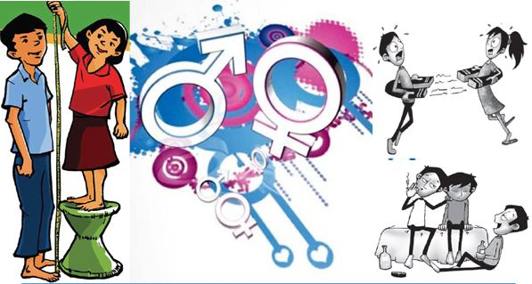
Adolescent Reproductive Health In Nepal
School of Health and Allied Sciences
Pokhara University
2023

Slide 2
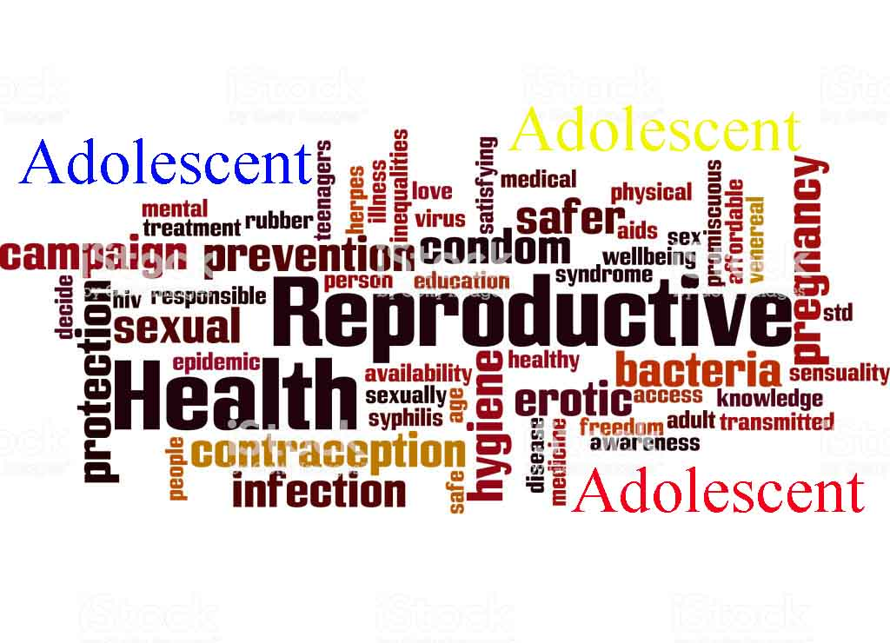
Contents
Introduction
Importance of focusing on adolescent reproductive health
Status of ASRH in Nepal
National adolescent health and development strategy
Adolescent friendly services

Slide 3
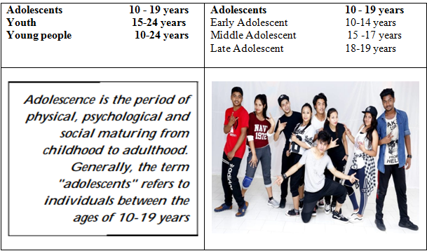
Introduction
The second decade - No longer children, not yet adults and it's a transitional period from childhood to adulthood

Slide 4
Introduction
Adolescence is one of life's most complex stages, when young people take on new responsibilities and experiment with independence. When engaged and supported, adolescents thrive and contribute to communities and families.
Adolescence was described as the period of sexual development from the initial appearance of secondary sex characteristics to sexual maturity, psychological development from child to adult identification, and socio-economic development from dependence to relative independence.
We can define adolescence as a period of sexual maturity that transforms a child into a biologically mature adult capable of sexual reproduction. It is also a period of psychological and socio-economic development. In short, it is a period of transition, growth, exploration and opportunity.

Slide 5
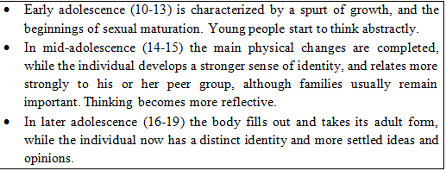
Introduction
What is special about adolescence? Or what makes it different from childhood and adulthood?
A time of rapid physical and psychological (cognitive and emotional) growth and development.
A time in which new capacities are developed.
A time of changing social relationships, expectations, roles and responsibilities.
Adolescents are a diverse population group who have different needs and changing needs than others.

Slide 6
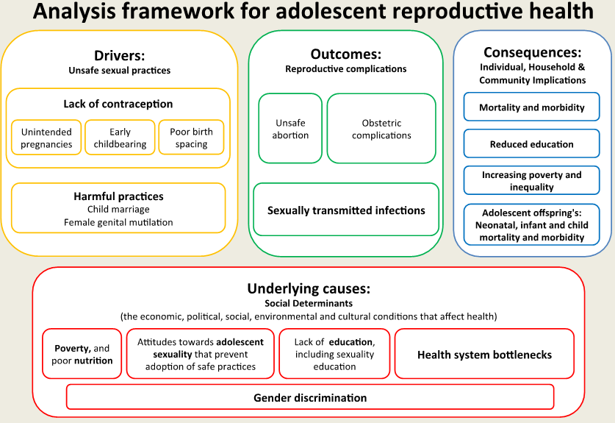
Introduction
Adolescent Reproductive Health
Adolescent reproductive health is a state of complete physical, mental and social
well being and not merely the absence of disease or infirmity, in all matters relating
to the reproductive system of people between the ages of 10 and 19.

Slide 7
Changes during adolescent period
lszf]/x¿df x'g] d'Vo zf/Ll/s kl/jt{gx?
/fu/;x?df(Hormone) tLa| j[l4 x'g' .
z/L/ xnSs a9\g' .
z/L/df kl;gf cfpg yfNg' .
lnË jl/kl/, sfvLdf, 5ftLdf /f}+x? pd|g', bfx|L h'Ëfsf] /]vL a:g' .
lnË / c08sf]ifsf] cfsf/df j[l4 x'g' .
cfjfhdf kl/jt{g cfpg' / :j/ wf]b|f] x'g' .
:jKgbf]if ( Night wet) x'g' / jLo{ :vng x'g yfNg' .
5ftL rf}8f x'g' .
808Lkmf]/ cfpg' .

Slide 8
Changes during adolescent period
lszf]/Lx¿df x'g] d'Vo zf/Ll/s kl/jt{gx?
z/L/ xnSs a9\g' .
sDd/d'lgsf] efu rf}8f cfsf/sf] x'g' .
/fu/; (Hormone) x?df tLa| j[l4 x'g' .
z/L/df kl;gf cfpg yfNg' .
of]gL jl/kl/, sfvLdf /f}+x? pld|g' .
:tgsf] ljsf; x'Fb} hfg' .
of]gLsf] cfsf/df j[l4 x'g' .
cfjfhdf kl/jt{g eO{ ;'l/nf] x'Fb} hfg' .
dlxgfjf/L (Menstruation) ;'? x'g' .
808Lkmf]/ (pimple) cfpg' .

Slide 9
Changes during adolescent period
Dffgl;s kl/jt{gx¿
zf/Ll/s kl/jt{gx¿n] ubf{ nfh dfGg] .
cfkm\gf] JolQmut klxrfgsf] vf]lh ug]{ .
;dfhdf k|rlnt rfnrng / 3/sf ;fdfGo Joxf/k|lt k|Zg / ljb|f]x ug]{ k|j[lQ klg b]vfkg]{ .
Zff/Ll/s ?kdf cfkm' cfsif{s, alnof] tyf ;Ifd x'g rfxg] .
cfkm\gf] pd]/sf ;fyLefOx¿k|lt nufj a9g] .
cfbz{ gfos jf JolQmk|lt ;dk{0f jf nufj a9\g] .
cd't{ efjgfx¿, ts{ ug]{ k|j[lQsf] ljsf; x'g] .
cfbz{sf s'/fx¿af6 al9 k|efljt x'g] / b}lgs Jojxf/sf s'/fx¿k|lt ljb|f]x k|bz{g ug]{ .

Slide 10
Changes during adolescent period
Dffgl;s kl/jt{gx¿
cfFkm} lg0f{o ug]{ cfTdljZjf;sf] sdL x'g] / c?n] u/]sf] lg0f{o klg :jLsf/ ug{ uf¥xf] x'g] .
clN5 nfUg], ;'lt/xg dg nfUg], PsfGtdf a:g dg nfUg] h:tf k|j[lQ b]vf kg]{ .
sf}t'x'ntf / lh1f;f a9g] .
of}g efjgfn] s'l07t jf c;'/lIft dxz'; ug]{ .
x:td}y'g (Masturbation) ug{] OR5f x'g] .

Slide 11
Changes during adolescent period
;fdflhs kl/jt{gx?
cfkm'eGbf 7"nf a8fn] eg]sf] gdfGg] .
PsfGtdf a:g dg k/fpg] .
sfNklgs tyf /f]df~rs k':tsx¿ k9\g dg k/fpg] .
ljleGg lsl;dn] ljk/Lt lnª\uLnfO{ cfslif{t ug]{ .
nfhsf] efjgf ljsl;t x'g] .
PSsf;L tgfjdf cfP/ clk|o lg0f{ox¿ ug]{ .
al9 l/;fpg] tyf ems{g] .

Slide 12
Changes during adolescent period
efjgfTds kl/jt{gx?
nfh nfUg ;'? x'g' .
Psf]xf]/f] 6f]nfP/ a:g' / sNkgfzLn x'g' .
cfkm\gf efjgfx? c?n] a'em"g\ eGg] nfUg' .
ljk/Lt lnËL JolQmx?k|lt cfsif{0f a9\g' .
of}g rfxgf ljsf; x'g' .
cfk"mnfO{ c?n] pl5g]sf] s'/fn] lk/f]Ng' .
;dfh / JolQmaf/] pT;'stfsf] j[l4 x'g' .
k':t}gL leGgtf (Generation gap)b]vf kg'{ . h:t} M cfkm\gf cl3sf k':tfsf dflg;sf] ;f]rfO / ljrf/ k'/fgf] ePsf] af/]df k|ltlqmofx? lbg' .
;dfhn] s]6f / s]6L -lszf]/ / lszf]/L_sf nflu b'O{ 5'§} e"ldsf lgwf{/0f ug{ yfNg' . h:t} lszf]/nfO{ kfl/jfl/s lhDd]jf/L / lszf]/LnfO{ ljjfx u/L c?sf] 3/ hfg] JolQmsf ?kdf x]l/g' .
lszf]/ / lszf]/Lx?sf] cf–cfkm\gf] 5'§f5'§} ;d"x lgdf{0f ug{ / 5nkmn ug{ ;'? x'g', cflb .

Slide 13
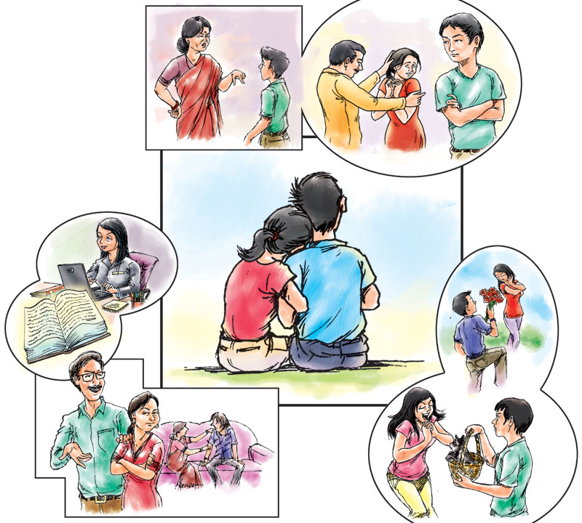
Changes during adolescent period

Slide 14

Changes during adolescent period

Slide 15
Importance of focusing on adolescent reproductive health
Key facts for focusing on adolescent reproductive health:
An estimated 1.3 million adolescents died in 2015, mostly from preventable or treatable causes.
Road traffic injuries were the leading cause of death in 2012, with some 330 adolescents dying every day.
Other main causes of adolescent deaths include HIV, suicide, lower respiratory infections and interpersonal violence.
Globally, there are 49 births per 1000 girls aged 15 to 19 per year.
Half of all mental health disorders in adulthood start by age 14, but most cases are undetected and untreated
Adolescent females are more prone to nutritional difficulties than adolescent males

Slide 16
Importance of focusing on adolescent reproductive health
In most countries, sexual activity precedes marriage, as individuals become sexually active between the ages of 10 and 20. However, adolescents are less able than adults to meet their sexual and reproductive health needs, because of their age, social status, and legal and policy barriers to providing services to unmarried adolescents.

Slide 17
Importance of focusing on adolescent reproductive health
2. Many cultures do not acknowledge adolescent sexuality especially that of unmarried girls, resulting in neglect of their reproductive health needs. In addition, girls who are married while they are still adolescents also face sexual and reproductive health risks.

Slide 18
Importance of focusing on adolescent reproductive health
3. When encouraged, they have the potential to change negative social norms and pave a brighter future for themselves and their future families. Yet as adolescents around the world enter puberty, taboos, discomfort and fear prevent parents and other trusted adults from teaching relevant information to help adolescents navigate the complexities of their emerging sexuality.

Slide 19
Importance of focusing on adolescent reproductive health
4. Global and national health indicators highlight the need to have a greater focus on adolescents. Complications from pregnancy, childbirth and unsafe abortion are a leading cause of death for young women aged 15 to 19. When girls give birth, there is also increased risk of death and disability to her newborn. Adolescents have one of the highest rates of unmet need for family planning. Young people are at high risk for contracting HIV with 40% of all new HIV infections occurring in 15 to 24 year olds. Sexual violence among adolescents, especially in humanitarian emergencies, also continues to pose significant risks to adolescents. Yet adolescents typically do not have access to high quality sexual and reproductive health information and services.

Slide 20
Importance of focusing on adolescent reproductive health
5. Education plays a vital role in empowering adolescents for acquiring knowledge and information, accessing services and practicing positive behaviors. Evidence suggests that it also has a critical role in improving sexual and reproductive health outcomes. The Government of Nepal has envisioned ensuring access to complete, free and compulsory primary education to all children with special focus on girls, children in difficult circumstances, and those belonging to ethnic minorities (Ministry of Education- MoE 2003).

Slide 21
Importance of focusing on adolescent reproductive health
Human Rights Implicated
Right to health
Right to access reproductive health services and facilities
Right to non-discrimination
Right to education and information, example
Right to be protected from all forms of physical and mental abuse and from all forms of sexual exploitation

Slide 22
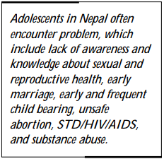
Status of ASRH in Nepal

Slide 23
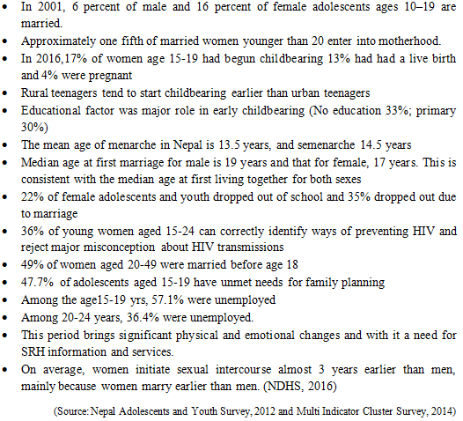
Status of ASRH in Nepal

Slide 24
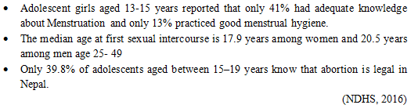
Status of ASRH in Nepal
While generally considered a healthy time of life, adolescents in Nepal face a number of Challenges including:
harmful gender norms and practices
including early marriage and dowry
Chaupadi, (see video of story teller in you tube)
trafficking,
negative peer pressure,
limited economic opportunities,
limited Youth participation within family, community and at national level
Consequently, adolescents suffer from preventable poor health, especially related to mental health, substance use, poor Nutrition and injury and, in particular, poor sexual and reproductive health (SRH).

Slide 25
Status of ASRH in Nepal
Nepal has shown its commitment to adolescent health through being a signatory to the ICPD Program of Action.
Nepal was also involved when the WHO South-East Asia Regional Office (SEARO) developed the Regional Strategy for Adolescent Health and Development in 1996.
Following these commitments, in 1998 ASRH was included in the National Reproductive Health Strategy.
In 2000 the National Adolescent Health and Development Strategy was developed by the Family Health Division (FHD) of the Ministry of Health and Population (MoHP).

Slide 26
Status of ASRH in Nepal
In 2014 a qualitative study assessing supply-side constraints affecting quality of AFHS and the barriers for service utilization was conducted by FHD, UNICEF, UNFPA and Crepha (a private, not-for-profit consultancy and research organization), using data from 12 districts. Key findings of this study were that barriers for service utilization included:
Lack of clarity on informed consent and confidentiality on the part of the provider and clients;
Weak monitoring and evaluation; 
Geographical accessibility; 
Cost of services and transportation; 
Waiting times; 
Lack of same sex health-care providers (barrier for both provider and client); 
Inconvenient opening hours for clients; 
Lack of sufficient knowledge on adolescent health needs among providers, including SRH; 
Family/community attitudes; 
Lack of knowledge about services; 
Shyness and lack of health-care knowledge.

Slide 27
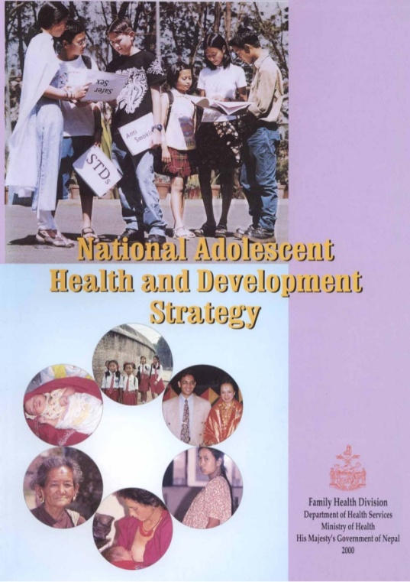
National adolescent health and development strategy

Slide 28
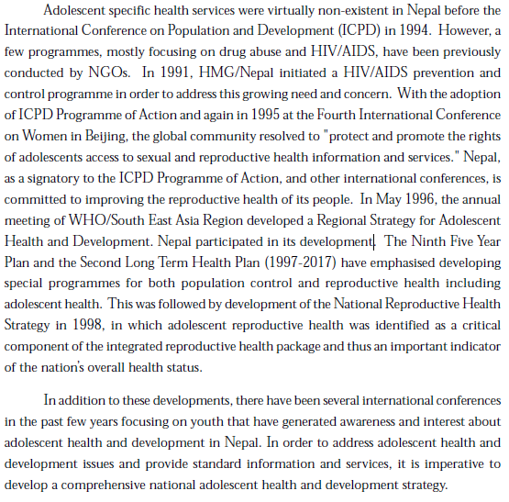
National adolescent health and development strategy

Slide 29
National adolescent health and development strategy
Goal
To improve the health and socioeconomic status of adolescents.
Objectives
Increase the availability of and access to information on adolescent health and development;
Provide opportunities to build skills among adolescents, service providers, and educators;
Increase accessibility and utilization of health and counseling services among adolescents;
Promote a safe and supportive environment for adolescents to improve their legal, social, and economic status

Slide 30
National adolescent health and development strategy
Targets:
To make all health facilities as adolescent friendly as per the envision of National Health policy (2014) and NHSS (2016-2021)
To ensure universal access to ASRH services, the Nepal Health Sector Strategy Implementation Plan (2016-2021) aims to:
scale up Adolescent Friendly Service (AFS) to all health facilities;
behavioral skill focused ASRH training to 5,000 Health Service Providers and
more than 100 health facilities to be certified with quality AFS by 2021

Slide 31
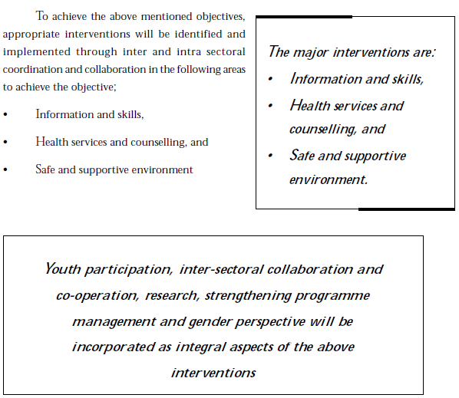
National adolescent health and development strategy
3. Intervention and Strategies:

Slide 32
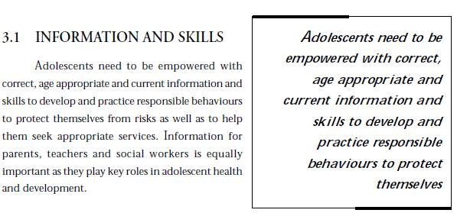
National adolescent health and development strategy
3. Intervention and Strategies:

Slide 33
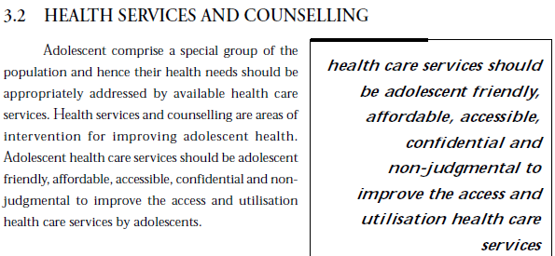
National adolescent health and development strategy
3. Intervention and Strategies:
(4A1Q)

Slide 34
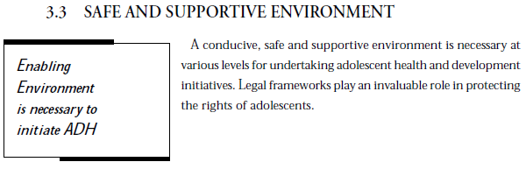
National adolescent health and development strategy
3. Intervention and Strategies:

Slide 35
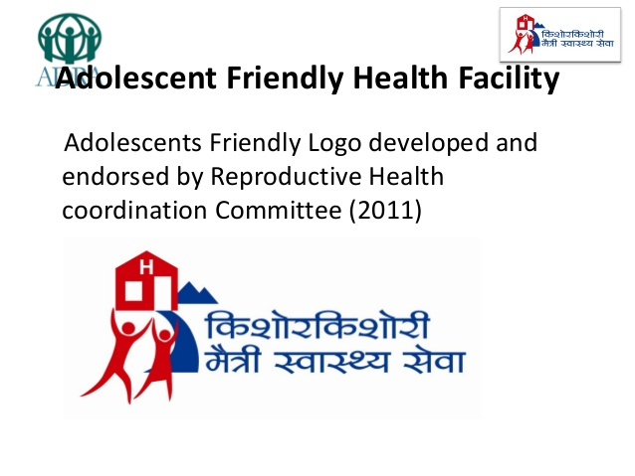
Adolescent friendly services

Slide 36
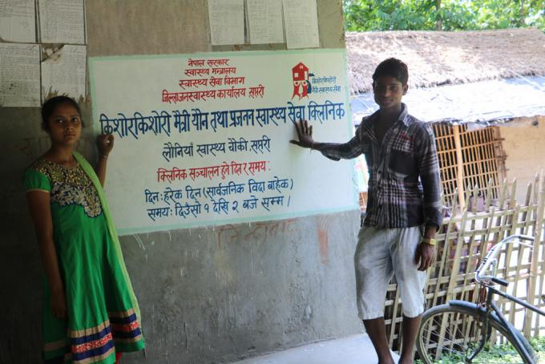
Adolescent friendly services

Slide 37
Adolescent friendly services
The National ASRH program has been gradually scaled up to 70 of the 75 districts covering 1134 health facilities till the end of current fiscal year 2073/74.
Different development partners such as UNFPA, UNICEF, WHO, Save the Children, Ipas, ADRA Nepal and MSI Nepal at national and subnational level supported to Family Health Division (FHD) for scaling up and strengthening ASRH services in the health facilities in order to make those health facilities as adolescent friendly service sites.
The remaining five districts (Manang, Mustang, Dolpa, Rasuwa and Sindhupalchowk) will be covered in the running FY 2074/75.

Slide 38
Adolescent friendly services
Why do adolescent don’t get friendly services?
Adolescents lack knowledge about what services are available and how to access them.
There may be legal restrictions on the use of services or cultural reasons why young people do not wish to be seen there.
Adolescents give high priority to confidentiality.
This may be more important than seeking treatment.
They are put off if the services are a long way away or are expensive.
They will not use unfriendly services or those with poorly trained staff.

Slide 39
Adolescent friendly services can be made by focusing on
Technical competencies:
Doctors and nurses need a good knowledge of normal adolescent development and the skills to diagnose and treat common conditions, such as anemia or menstrual disorders in adolescent girls, and to recognize signs of sexual or physical abuse.
They need access to the correct drugs and supplies to treat common conditions and prevent health problems.
They should know where to refer adolescents for specialist physical or psychological treatment.
Such referrals may be to people or services outside the health system for counseling or social support.

Slide 40
Adolescent friendly services can be made by focusing on
See the person not the problem:
Technical competence must be accompanied by respect and sensitivity to draw the young person out and to discover underlying problems that may not be the immediate cause of a visit.
Adolescents often lack confidence and may present with a ‘safe’ symptom, to test the service before revealing their real concerns.
By focusing on the person, rather than the symptom, providers can discover underlying concerns.
Technical skills and a sympathetic professional approach should be combined with a non-judgmental approach.
Health care providers do not need to abandon their own belief systems or values, but they do need to understand a situation from an adolescent’s point of view and not to allow their own views to dominate the interaction.

Slide 41
Adolescent friendly services can be made by focusing on
Training and staff support:
Technically competent and empathetic staff needs a system of ongoing support.
An adolescent friendly approach should include repeated training sessions to refresh the skills of current staff as well as developing new skills for new staff.
Training and peer-review sessions should cover everyone from doctors (who may believe they need no further training) to the receptionist and cleaner, who may be surprised that they are part of the team. These staff may be the first person an adolescent meets at a health facility. If they are unfriendly, or indiscrete an adolescent may never return.
Management and supervision should be aimed at creating a supportive environment and at developing systems to maintain and improve quality.
Health care providers should be involved in drawing up protocols and guidelines covering key quality issues.
They should also develop self-assessment and peer review mechanisms which create a culture of openness.
Monitoring systems should encourage adolescents to provide feedback on services.

Slide 42
Adolescent friendly services can be made by focusing on
Making services physically accessible:
Services need to be provided in places that adolescents can reach, at times that they can get there. This may involve holding special clinics in youth centers, or other places where adolescents go. Clinical staff can take turns to do late duty rotas so that a clinic can run in the evening or at weekends, when young people are not at school, college or working. Physical surroundings are important. Many places have no special adolescent centre, but still provide a welcoming health facility. Attention can be paid to the paintwork, posters on the walls, cleanliness and whether there are enough chairs where people wait. A general adolescent health clinic can advertise its name at the entrance, while an STI clinic may want a discrete entrance. Adolescents themselves may help to decide on a creative name that will be welcoming but not stigmatising. A busy city hospital with little money for capital development can create an ‘adolescent health corner’, by putting up a partition, so that young people can be seen in privacy, or by using a rear door where they can enter without stigma. Some clinics give young people numbers when they arrive so that they can be called to see the doctor or nurse without having to sit in a queue ‘on display’ and without having their name called out. While waiting they should be able to look at health promotion literature, or even view a video.

Slide 43
Adolescent friendly services can be made by focusing on
Confidentiality and privacy:
Adolescents need to be assured of privacy during a consultation and confidentiality afterwards. Young people should not be expected to undress or be examined where people can see them. Those waiting outside should not be able to hear a doctor giving a diagnosis. Patients must be confident that medical records will not be left on view and that receptionists will not gossip. There is in most countries a legal obligation for doctors to report sexual assault, a road traffic accident or gunshot wounds. There are also legal restrictions on treatment to young people below a certain age without parental consent. These and other legal constraints need to be explained as the only exceptions to a strict policy of confidentiality. This policy itself can be jointly developed with adolescents and health care providers so that everyone understands and feels comfortable with the ground rules. The confidentiality policy, including exceptions, needs to be explained to all adolescent users and to parents or guardians, and needs to be clearly understood by referral agencies.

Slide 44
Adolescent friendly services can be made by focusing on
Services that are acceptable to the community:
Simply making services ‘adolescent friendly’ will not increase usage, unless young people feel that it is acceptable to be seen to use them. Community support for the service must also be sought. The community should have an opportunity to understand why services are important for adolescents, and why these should include sexual and reproductive health services and confidential counseling. Local meetings may be held for parents, and community and religious leaders should be approached for support. Services may even be located in community settings. There are many examples of services being delivered in schools, community centers or on the street. Where public support is difficult to achieve (as is often the case for health services for sex workers or for injecting drug users) the services can be run in a low key way, or through community outreach workers.

Slide 45
Adolescent friendly services can be made by focusing on
Involving adolescent:
Services that reach a high quality are those that closely involve adolescents in their planning and monitoring.
Through the involvement of young people service providers can be confident that they are providing services in the right place, at the right time and in the right style.
The involvement of adolescents in planning and monitoring delivers on their right to have their views heard.
It also increases the confidence that other young people place in those services.

Slide 46
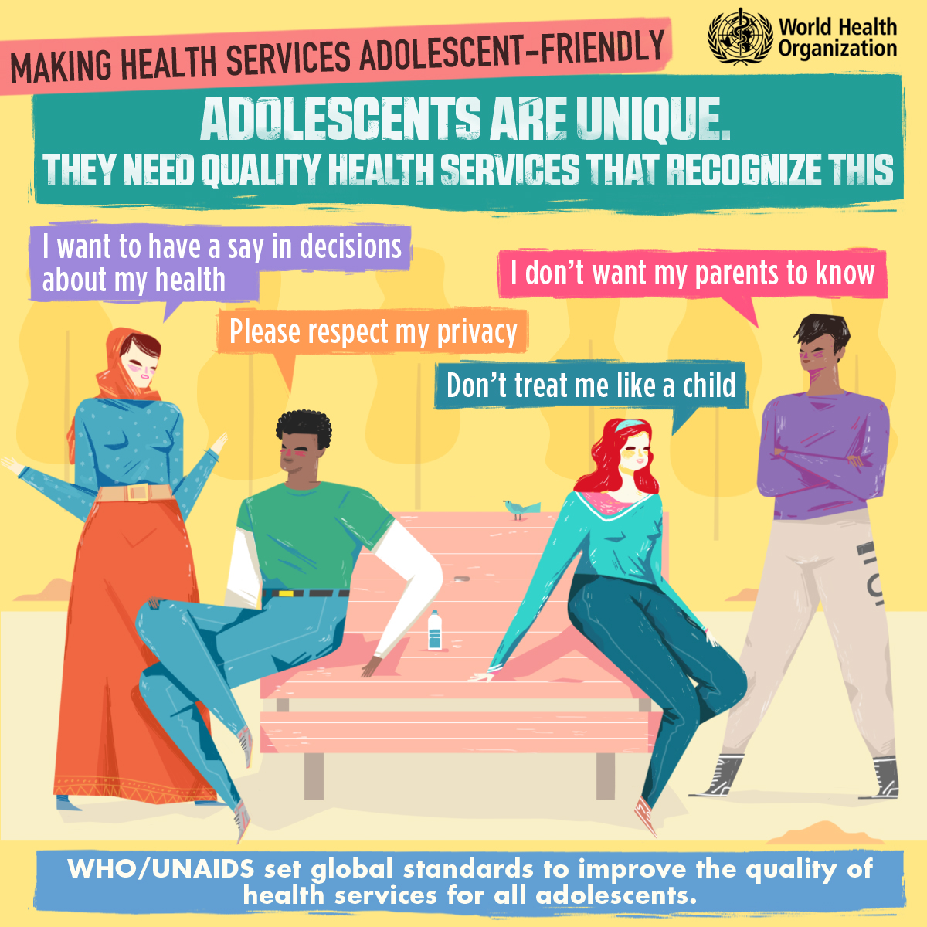
Adolescent friendly services can be made by focusing on

Slide 47
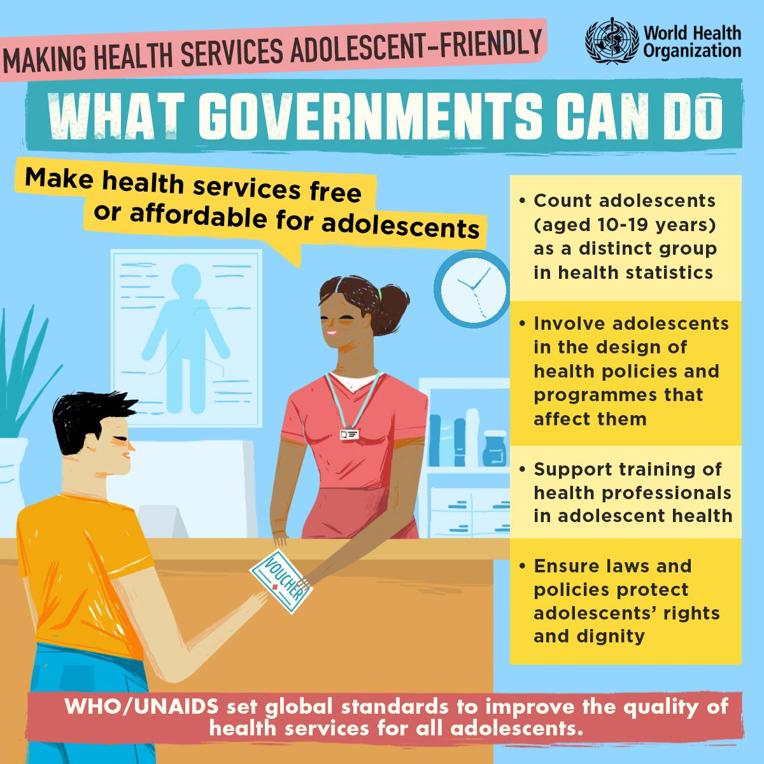
Adolescent friendly services can be made by focusing on

Slide 48
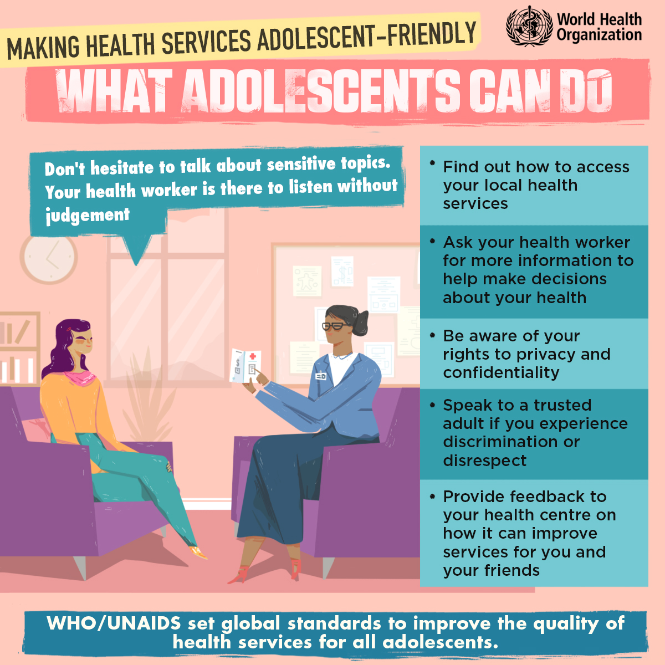
Adolescent friendly services can be made by focusing on

Slide 49
THANK YOU!!!
PRABIN SHARMA
Masters of Public Health
(Public Health Service Management)
Pokhara University, 2017
Contact: +977-9843229635
Email: Prabinsharma9635@gmail.com

