Slide 1
Unit 4: Solid Wastes and Human Health
-Rajendra Lamichhane, MA (TU), MPH (BPKIHS),
Email: rajendralamichhane14@gmail.com

Slide 2
Waste and wastes are unwanted or unusable materials. Waste is any substance which is discarded after primary use, or it is worthless, defective and of no use.

Slide 3
Type of waste
General Waste
Hazardous waste
Health care waste

Slide 4
General Waste:
General waste includes paper, cardboard, metal containers, floor sweeping, and kitchen waste. It doesn't need special treatment and storage facilities it still needs to be collected separately from infectious waste.
General waste should be placed in a suitable container lined with a black plastic bag. Adequate numbers of general waste containers shall be placed in all areas of health care institutions and notices affixed to encourage visitors to use them.

Slide 5
Hazardous Waste:
Hazardous wastes are waste with potential to cause hazard to health and life of human beings. These includes, cotton, gauze, soiled bandages, cotton used for dressing, blood bags, human and animal tissue, body parts, chemicals, drugs, wastes generated by cleaning spills of hazardous waste, and any other soiled materials that has been used for treatment.
The containers shall be colored yellow and marked“ DANGER! HAZARDOUS WASTES" and in Nepali “;fjwfg Û xflgsf/s wfl/nf kmf]x/”

Slide 6
Health Care Waste Definition
Health care waste includes all the generated by health care institutions, research facilities and laboratories. It means any waste, which is generated during diagnosis, treatment, or immunization of human beings or animals or in research activities there to or in the production or testing of biological, and including categories mentioned below:

Slide 7
WHO recommends that health care waste be separated at the source into the following categories:
1. Infectious waste 2. Pathological waste 3. Sharps 4. Pharmaceutical waste 5. Genotoxic waste 6. Chemical waste 7. Waste with high content of heavy metals 8. Pressurized containers 9. Radioactive waste 10. General waste

Slide 8
Types of waste…..
1. On the basis of property
Solid
Liquid
2. On the basis of biological property
Decomposable (Biodegradable)
e.g. Garbage (food waste), paper, wood, dead animals, leaves, straw e.t.c
Non-decomposable (Non biodegradable )
e.g. plastics, glass, metals e.t.c.

Slide 9
Types of waste…
3. On the basis of effect on eco system/environment
a. Hazardous
Waste materials that have toxic, explosive, corrosive or dangerous reactive property. In other words, the materials can cause injury, disease, economic loss, or environmental damage- in short, a danger.
e.g acids, bases, dyes, cyanides, pesticides, insecticides, solvents, compounds of Hg, Pb, Arsenic and Cadmium, mineral oil, radioactive materials e.t.c.
b. Non-hazardous
e.g leaves, straw, wood, garbage, dead animals e.t.c.

Slide 10
Solid Wastes
The term “solid wastes” includes garbage (food wastes) rubbish (paper, plastics, wood, metal, throw- away containers, glass), demolition products (bricks, masonary, pipes), sewage treatment residue (sludge and solids from the coarse screening of domestic sewage), dead animals, manure and other discarded material.
The per capita daily solid waste produced ranges between 0.25 to 2.5 kg in different countries:

Slide 11
Waste generating behavior of rural and urban people of different socio-economic strata ?

Slide 12
Solid waste, if allowed to accumulate, is a health hazard because:
It decomposes and favors fly breeding
b. It attracts rodents and vermin
c. The pathogens which may be present in the solid waste may be conveyed back to mans food through flies and dust.
d. There is a possibility of water and soil pollution, and
e. Heaps of refuse present an unsightly appearance and nuisance from bad odours.

Slide 13
List of type of Hazards exist in Solid Waste
1. Physical Hazards
2. Chemical Hazards
3. Biological Hazards

Slide 14
Health Risk /Problems Form Solid Waste
Infections Skin and blood infections resulting from direct contact with waste, and from infected wounds. Eye and respiratory infections resulting from exposure to infected dust, especially during landfill operations. Different diseases that results from the bites of animals feeding on the waste. Intestinal infections that are transmitted by flies feeding on the waste. Chronic diseases Incineration operators are at risk of chronic respiratory diseases, including cancers resulting from exposure to dust and hazardous compounds.

Slide 15
Health Risk /Problems Form Solid Waste
Accidents Bone and muscle disorders resulting from the handling of heavy containers.
Infecting wounds resulting from contact with sharp objects.
Poisoning and chemical burns resulting from contact with small amounts of hazardous chemical waste mixed with general waste.
Burns and other injuries resulting from occupational accidents at waste disposal sites or from methane gas explosion at landfill sites.
Source - Adapted from UNEP report, 199

Slide 16
Sources of refuse
Refuse that is collected by the street cleansing service or scavenging is called street refuse, It consists of leaves, straw, paper, animal droppings and litter of all kinds.
Refuse that is collected from markets is called market refuse. It contains a large proportion of putrid vegetable and animal matter.
(3) Refuse that is collected from stables is called stable litter it contains mainly animal droppings and left-over animal feeds.
(4) lndustrial refuse comprises a wide variety of wastes ranges from completely inert materials such as calcium carbonate to highly toxic and explosive compounds.
(5) The domestic refuse consists of ash, rubbish and garbage..

Slide 17
Rubbish comprises paper, clothing, bits of wood, metal, glass, dust and dirt.
Garbage is waste matter arising from the preparation. Cooking and consumption of food. It consists of waste food. Vegetable peelings and other organic matter. Garbage needs quick removal and disposal because it ferments on storage.

Slide 18
Principal methods of refuse disposal are:
(a) Dumping (b) Sanitary land-fill (c) Incineration (d) Composting (e) Manure pits (f) Burial

Slide 19
Composition of Waste
Waste composition is influenced by factors such as culture, economic development, climate, and energy sources; composition impacts how often waste is collected and how it is disposed. `
Low-income countries have the highest proportion of organic waste.
Paper, plastics, and other inorganic materials make up the highest proportion of Municipal Solid Waste in high income countries

Slide 20
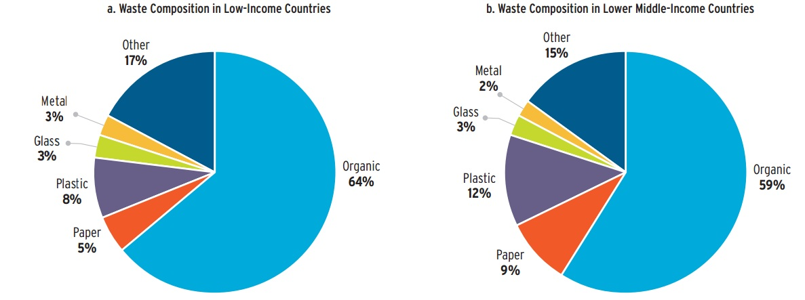

Slide 21
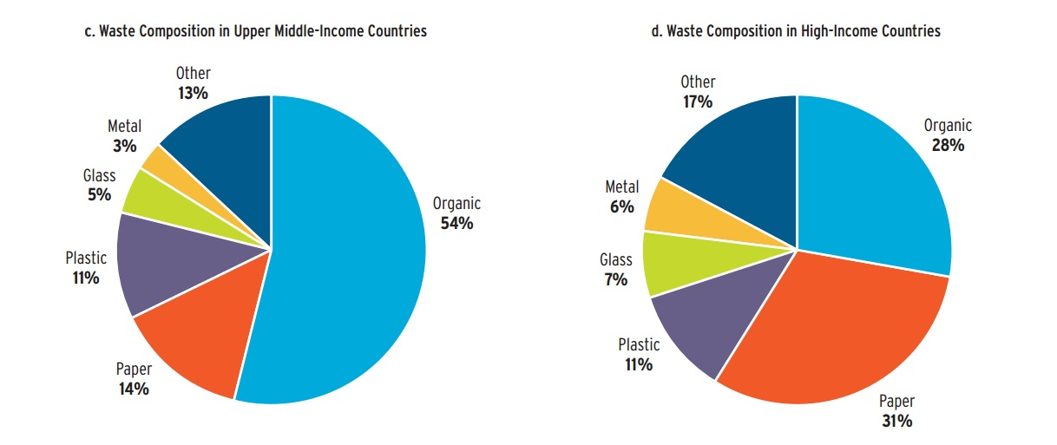

Slide 22
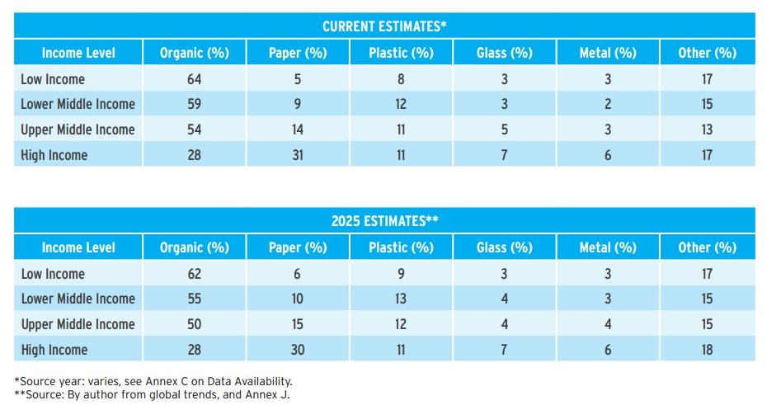

Slide 23
The East Asia and the Pacific Region has the highest fraction of organic waste (62%) compared to OECD countries, which have the least (27%). The amount of paper, glass, and metals found in the MSW stream are the highest in Organization for Economic Co-operation and Development (OECD) countries (32%, 7%, and 6%, respectively) and lowest in the South Asia Region (4% for paper and 1% for both glass and metals).
This report includes waste composition data that was available for 105 countries from various sources.
WHAT A WASTE: A GLOBAL REVIEW OF SOLID WASTE MANAGEMENT

Slide 24
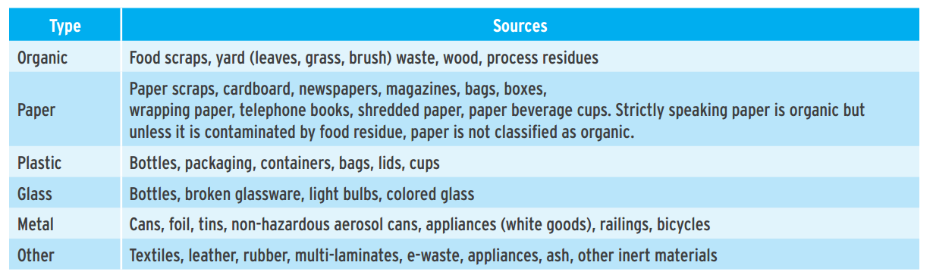

Slide 25
Health Care Waste Generation
Several surveys have provided an indication of typical health-care waste generation, and it shows that this differs not only from country to country but also within the country.
Waste generation depends on numerous factors such as establishment waste management methods, type of health care establishment, hospital specializations, proportion of patients treated etc.

Slide 26
Average distribution of health care waste
80 percent general health care waste, which may be dealt with by the normal domestic, and urban waste management system
15 percent pathological and infectious
1 percent sharps waste;
3 percent chemical and pharmacological waste
Less than 1 percent special waste, such as radio active or cytotoxic waste, pressurized containers, or broken thermometers and used batteries.

Slide 27
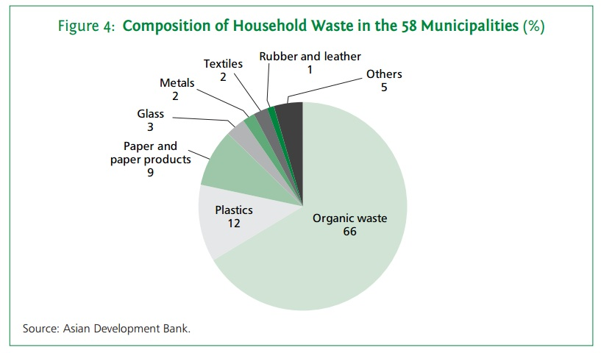
Composition of Household waste in municipalities of Nepal

Slide 28
Composition of Household waste in the 58 municipalities (%)In Nepal..
The waste composition analysis indicates that the highest waste fraction is organic matter (66%), followed by plastics (12%), paper and paper products (9%), others (5%), and glass (3%). Metal, textiles, and rubber and leather each accounted for 2% or less.
The high organic content indicates a need for frequent collection and removal, as well as good prospects for organic waste resource recovery. The content of major reusable and recyclable materials (i.e., plastic, paper and paper products, metal, glass, rubber and leather, and textiles) comprised 29% on average.

Slide 29
Waste Management
The collection, transportation, and disposal of garbage, sewage, and other waste products. Waste management encompasses management of all processes and resources for proper handling of waste materials, from maintenance of waste transport trucks and dumping facilities to compliance with health codes and environmental regulations

Slide 30
Waste Management…
“Waste management or Waste disposal is all the activities and actions required to manage waste from its inception to its final disposal. This includes amongst other things, collection, transport, treatment and disposal of waste together with monitoring and regulation. It also encompasses the legal and regulatory framework that relates to waste management encompassing guidance on recycling etc.”

Slide 31
Principle of 3R for Waste Handling
Reduction
Reuse and
Recycling

Slide 32
Waste reduction strategies at various settings
Home,
School
Business
Houses
Shops
Industry
Restaurant
Farms

Slide 33
Waste reuse strategies at various settings
Home
School
Business
Houses
Shops
Industry
Restaurant
Farms

Slide 34
Resource recovery from solid waste:
Composting,
Vermin-composting,
Pelletization,
Pyrolysis,
Energy
(Biogas) recovery,
Notes:
Pelletization of municipal solid waste involves the processes of segregating, crushing, mixing high-and low-heat value organic waste material and solidifying it to produce fuel pellets or briquettes, also referred to as refuse derived fuel (RDF). The process condenses the waste or changes its physical form and enriches its organic content through removal of inorganic materials and moisture.

Slide 35
Pelletization
Pelletization of municipal solid waste involves the processes of segregating, crushing, mixing high-and low-heat value organic waste material and solidifying it to produce fuel pellets or briquettes, also referred to as refuse derived fuel (RDF). The process condenses the waste or changes its physical form and enriches its organic content through removal of inorganic materials and moisture.

Slide 36
Pyrolysis
Pyrolysis is the thermal decomposition of materials at elevated temperatures in an inert atmosphere.

Slide 37
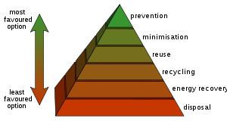
Waste Hierarchy

Slide 38
Solid waste disposal strategies and management at various settings
Home,
school,
business
houses,
shops,
industry,
restaurant
farms:
( Segregation, storage, collection, transportation, and final sanitary disposal including land filling)

Slide 39
Existing Solid Waste Management System

Slide 40
A. Collection and Segregation
The study found that about 30% of surveyed households in the municipalities practice segregation of waste at source; which means that waste generated from about 70% of households in municipalities goes to the stream for collection and disposal by the municipalities in the form of mixed waste.

Slide 41
B. Transport and Final Disposal
The vehicles and equipment available for waste collection and transport in each municipality varies widely. Vehicles commonly used include rickshaws and carts for primary collection, tractors for secondary collection or transport, and dump trucks for transport to the disposal sites.
Not all municipalities have all three types of vehicles. Facilities and equipment available in municipalities affect the efficiency of waste transfer from primary collection to processing centers or final disposal sites.

Slide 42
C. Resource Recovery Methods Tight
Municipal budgets and scarce resources have made municipal SWM an environmental, financial, and social burden to the municipalities.
Although resource recovery from managing msw has the potential to reduce such burdens and even generate revenue, this study found that minimal resource recovery activities are being conducted in the municipalities of Nepal.

Slide 43
Recycling
The household waste composition survey revealed that more than 25% of household waste and a much higher proportion of institutional and commercial waste could be either reused or recycled, excluding organic waste. However, no formal system was observed for reuse and recycling in most municipalities.
While it is encouraging to note that people recover recyclable materials at source and sell them to the formal or informal sectors, a large amount of recyclable material continues to be disposed of on the streets and ends up at the dumping grounds.

Slide 44
2. Composting
Organic materials that could be used for producing compost account for 66% of household waste on average. It was noted that about 30% of surveyed households in the municipalities are practicing composting.
Most of them are in the rural areas of the municipalities and manage their household waste using traditional composting methods. However, urban households are not generally practicing composting.

Slide 45
D. Public Awareness and Community
Lack of public awareness is one of the major problems of SWM. Based on the survey data, only 37 municipalities have awareness programs for SWM staff, only 10% of them conduct them on a regular basis, and more than 65% seldom conduct them. Several municipalities collaborate with other stakeholders such as the NGOs and CBOs to undertake public campaigns.
Moreover, 33% of the municipalities have conducted SWM awareness and promotion of 3R activities in collaboration with educational institutions. In contrast, the survey revealed that more than 65% households are not aware of the SWM program implemented by their municipalities during the last 3 years, and less than 18% of households have participated in these programs.

Slide 46
E. Special Waste Management
Special waste includes categories of waste such as dead animals, construction and industrial waste, and hazardous or infectious waste from health institutions. This category of waste needs to be managed differently from general MSW.
It is observed that for medical waste, incineration is practiced by hospitals in most municipalities, although this essentially involves merely burning the waste in a chamber or open burning in the hospital compound. In some municipalities, medical waste is mixed with municipal waste, and in some cases it is burned or crudely dumped.
https://www.adb.org/sites/default/files/publication/30366/solid-waste-management-nepal.pdf

Slide 47
Solid waste management issues and programs in Nepal
a. Controversies in dumping site b. Scavenger’s health c. Waste in water and on the road d. The culture of lavish packing e. Buy-use-throw away culture particularly in the urban areas f. Waste and trekking business g. The cleanest city campaign

Slide 48
Role of public health practitioner in prevention and control of waste generation and management
Advocacy role,
Educational role,
Empowerment role,
policy/regulatory role,
Infrastructural building role,
community organization,
mobilization and participation role,
managerial role

Slide 49
Thank You!

