Slide 1
UNIT 5
SUSTAINABLE DEVELOPMENT

Slide 2
Unit 5: Sustainable Development
  Goal, principles, pillars and indicators of sustainable development
  Evolution of sustainable development
  Environmental issue and sustainable development
  National resources and sustainable livelihoods
  Eco-village and eco-city development
  Environmental ethics and global view on sustainable-earth

Slide 3
Sustainable Development
The use of renewable and nonrenewable resources in a manner that satisfies our current needs but does not compromise the future availability of resources
According to the UN, sustainable development “meets the needs of the present without sacrificing/compromising the ability of future generations to meet their own needs.”

Slide 4
Contd….
According to Brundtland (1987), sustainable development is development that meets the needs of the present without compromising the future generations to meet their own needs.

Slide 5
Goal of sustainable development
The overall goal of sustainable development is the long-term stability of the economy and environment; this is only achievable through the integration and acknowledgement of economic, environmental, and social concerns throughout the decision making process.

Slide 6
Principles of sustainable development
Key principle of sustainable development is the integration of environmental, social, and economic concerns into all aspects of decision making.
It is deeply fixed concept of integration that distinguishes sustainability from other forms of policy.

Slide 7
Principles……
The Sustainable Development Act defines 16 principles that must be incorporated into the interventions of all departments and agencies.
these principles are a guide for action within a perspective of sustainable development.
They are an original reflection of the principles of the Rio Declaration on Environment and Development, a fundamental text that affirms international commitment to sustainable development.

Slide 8
Contd….
Health and quality of life”: People, human health and improved quality of life are at the centre of sustainable development concerns. People are entitled to a healthy and productive life in harmony with nature;
“Social equity and solidarity”: Development must be undertaken in a spirit of intra- and inter-generational equity and social ethics and solidarity;
“Environmental protection”: To achieve sustainable development, environmental protection must constitute an integral part of the development process;

Slide 9
Contd…
4. “Economic efficiency”: The economy must be effective, geared toward innovation and economic prosperity that is conducive to social progress and respectful of the environment;
5. “Participation and commitment”: The participation and commitment of citizens and citizens' groups are needed to define a concerted vision of development and to ensure its environmental, social and economic sustainability;
6. “Access to knowledge”: Measures favorable to education, access to information and research must be encouraged in order to stimulate innovation, raise awareness and ensure effective participation of the public in the implementation of sustainable development;

Slide 10
Contd….
7. “Subsidiary”: Powers and responsibilities must be delegated to the appropriate level of authority. Decision-making centres should be adequately distributed and as close as possible to the citizens and communities concerned;
8.“ Inter-governmental partnership and cooperation”: Governments must collaborate to ensure that development is sustainable from an environmental, social and economic standpoint. The external impact of actions in a given territory must be taken into consideration;
9. “Prevention”: In the presence of a known risk, preventive, mitigating and corrective actions must be taken, with priority given to actions at the source;

Slide 11
Contd….
10. “Precaution”: When there are threats of serious or irreversible damage, lack of full scientific certainty must not be used as a reason for postponing the adoption of effective measures to prevent environmental degradation;
11. “Protection of cultural heritage”: The cultural heritage, made up of property, sites, landscapes, traditions and knowledge, reflects the identity of a society. It passes on the values of a society from generation to generation, and the preservation of this heritage fosters the sustainability of development. Cultural heritage components must be identified, protected and enhanced, taking their intrinsic rarity and fragility into account;

Slide 12
Contd….
12. “Biodiversity preservation”: Biological diversity offers advantages and must be preserved for the benefit of present and future generations. The protection of species, ecosystems and the natural processes that maintain life is essential if quality of human life is to be maintained;

Slide 13
Contd….
13.“Respect for ecosystem support capacity”: Human activities must be respectful of the support capacity of ecosystem
14.“Responsible production and consumption”: Production and consumption patterns must be changed in order to make production and consumption more viable and more socially and environmentally responsible, in particular through an eco-efficient approach that avoids waste and optimizes the use of resources;

Slide 14
Contd….
15. “Polluter pays”: Those who generate pollution or whose actions otherwise degrade the environment must bear their share of the cost of measures to prevent, reduce, control and mitigate environmental damage;
16. “Internalization of costs”: The value of goods and services must reflect all the costs they generate for society during their whole life cycle, from their design to their final consumption and their disposal.

Slide 15
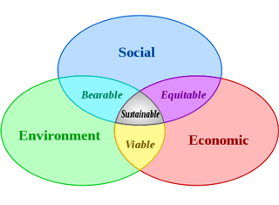
Pillars of Sustainable Development
Social development
Environmental Protection
Economic development

Slide 16
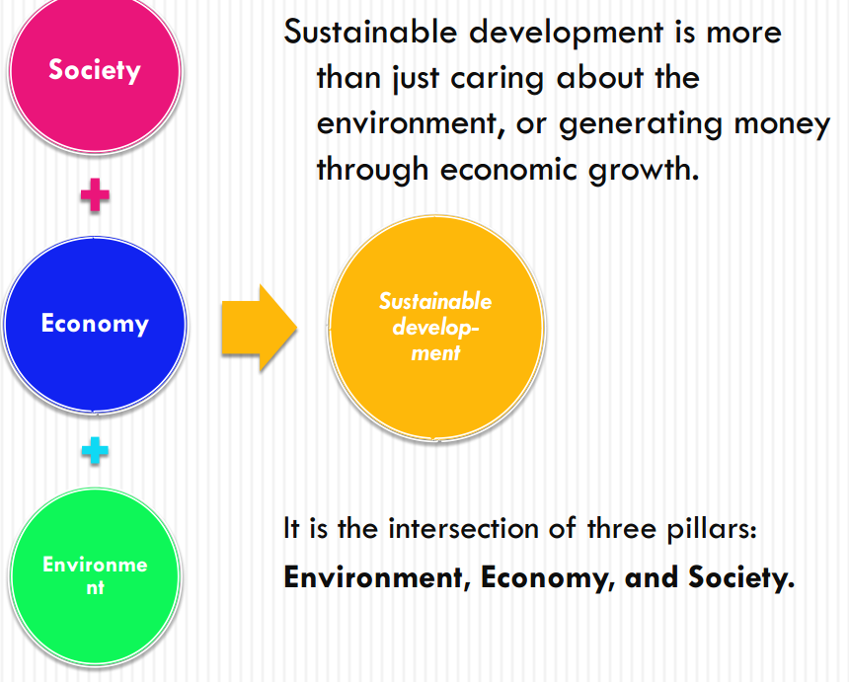

Slide 17
Social Development
The ability of a community to develop processes and structures which not only meet the needs of its current members but also support the ability of future generations to maintain a healthy community.

Slide 18
Environmental Protection
A state in which the demands placed on the environment can be met without reducing its capacity to allow all people to live well, now and in the future

Slide 19
Economic Development
The use of various strategies for employing existing resources optimally so that a responsible and beneficial balance can be achieved over the longer term.

Slide 20
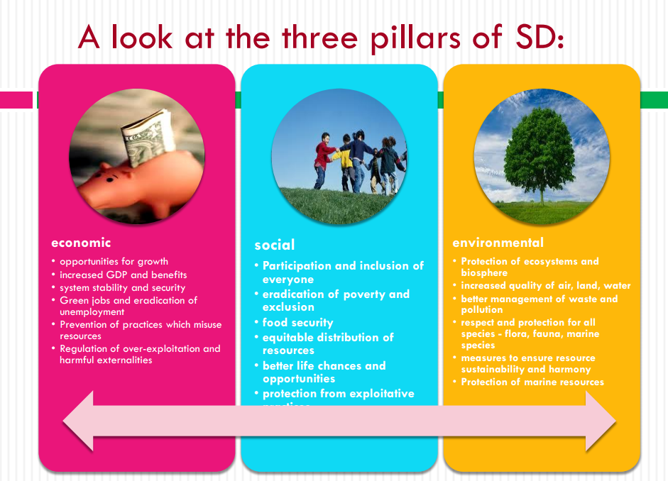

Slide 21
Indicators of sustainable development
Commission on Sustainable Development (CSD) approved following Indicators of Sustainable Development in 1995.
Chapter 40 of Agenda 211 , the action plan adopted in 1992 at the United Nations Conference on Environment and Development in Rio de Janeiro, calls on countries, as well as international, governmental and non-governmental organizations, to develop indicators of sustainable development that can provide a solid basis for decision-making at all levels. Agenda 21 also calls for the harmonization of efforts to develop such indicators.
In 2005, the Division of Sustainable Development started a process to review the CSD Indicators of Sustainable Development.

Slide 22
Commission on Sustainable Development (CSD) indicators themes
Poverty
Governance
Health
Education
Demographics
Natural hazards
Atmosphere
Land
Oceans, seas and coasts
Freshwater
Biodiversity
Economic development
Global economic partnership
Consumption and production patterns

Slide 23
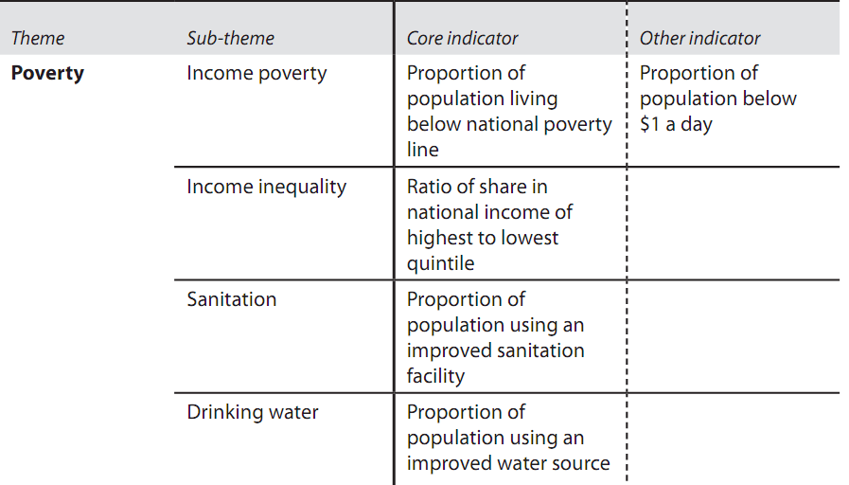
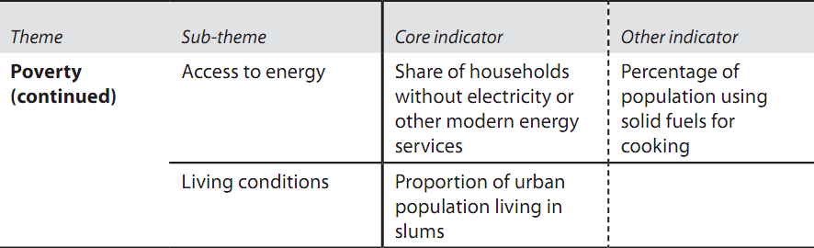
CSD indicators themes and indicators

Slide 24
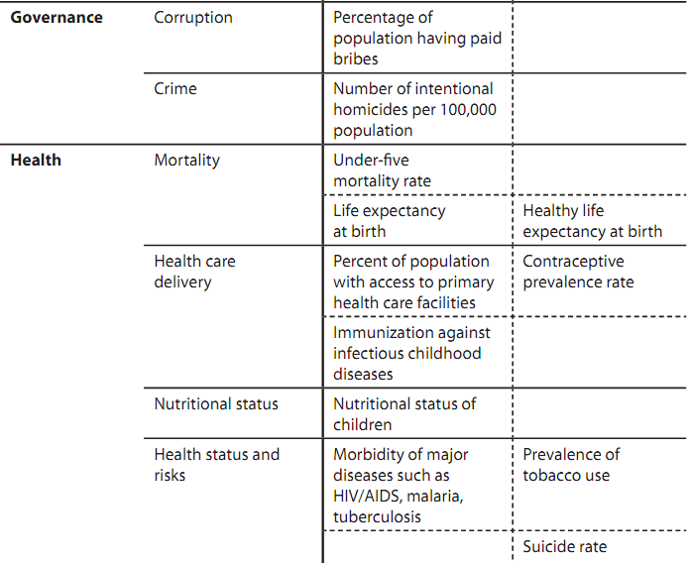
Contd….

Slide 25
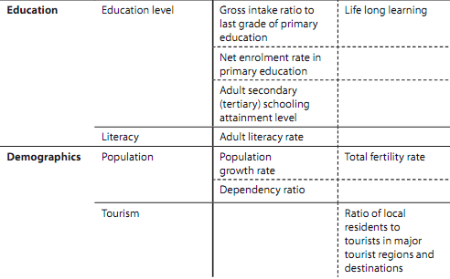
Contd…..

Slide 26
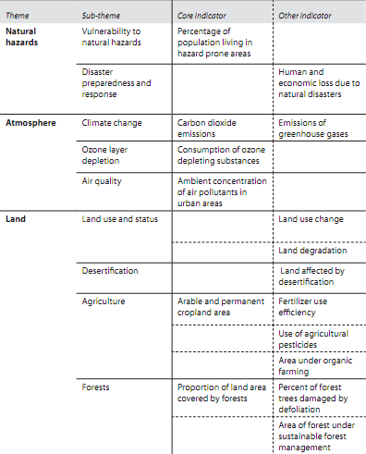
Contd….

Slide 27
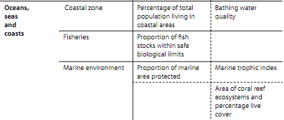
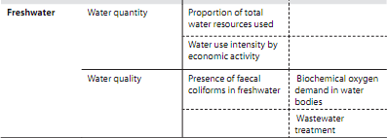
Contd…..

Slide 28
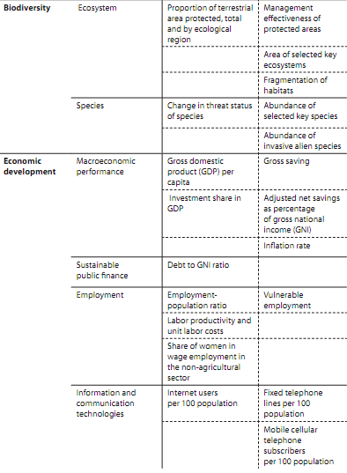
Contd….

Slide 29
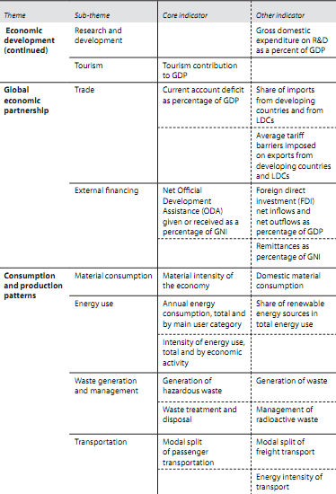

Slide 30
Sustainable development goals
The Sustainable Development Goals (SDGs), officially known as Transforming our world: the 2030 Agenda for Sustainable Development is a set of 17 "Global Goals" with 169 targets

Slide 31
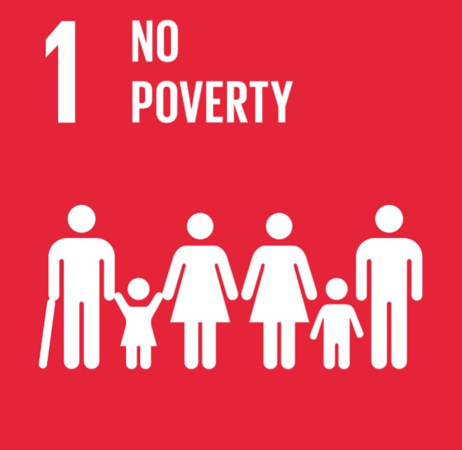
SUSTAINABLE DEVELOPMENT GOALS
THERE ARE 17 GOALS OF SUSTAINABLE DEVELOPMENT THEY ARE :

Slide 32
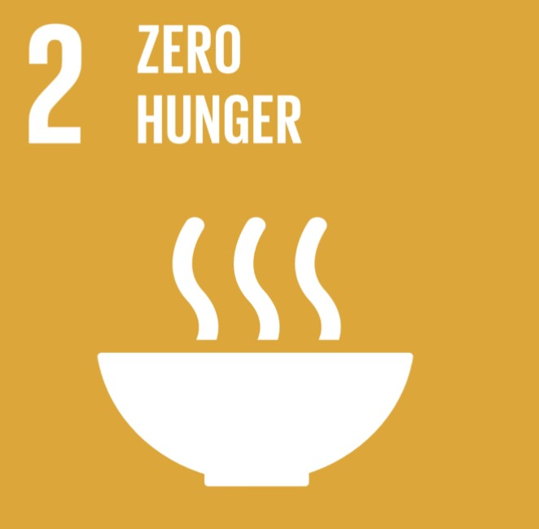




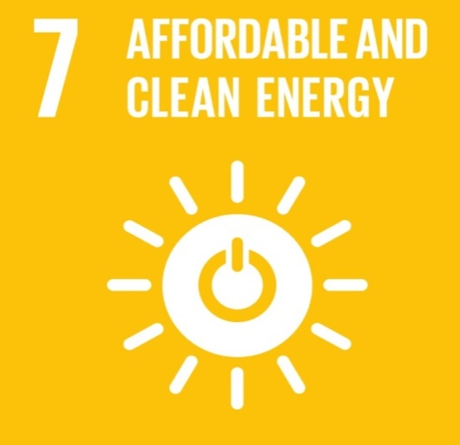


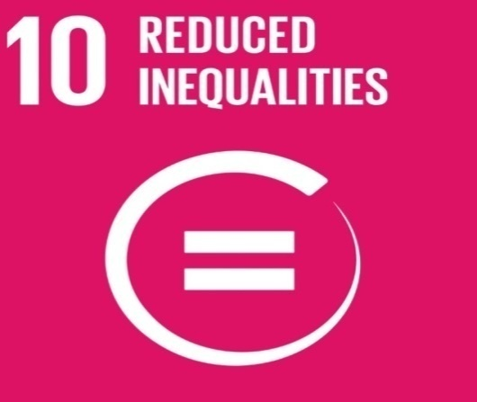
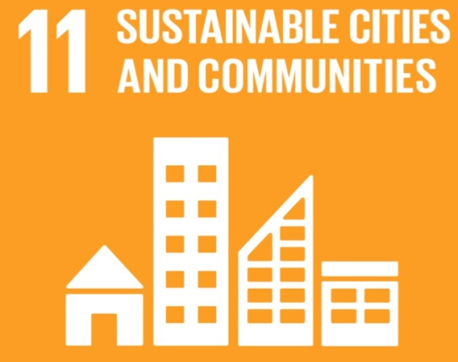
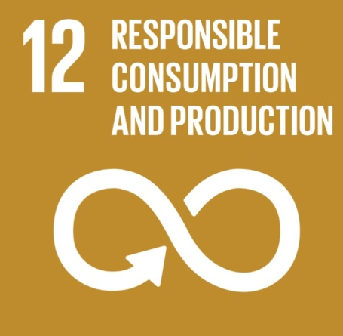
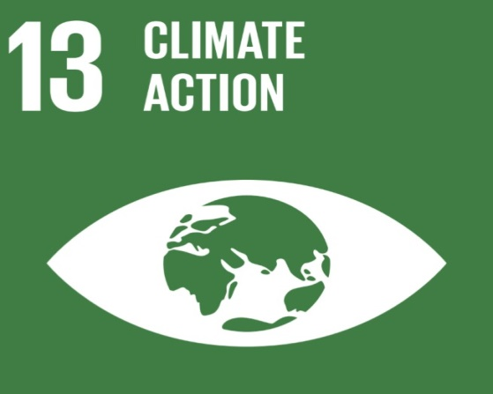

Slide 33
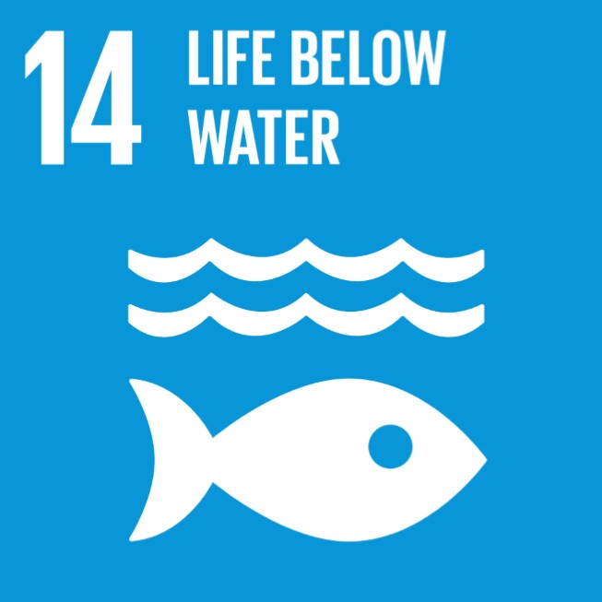
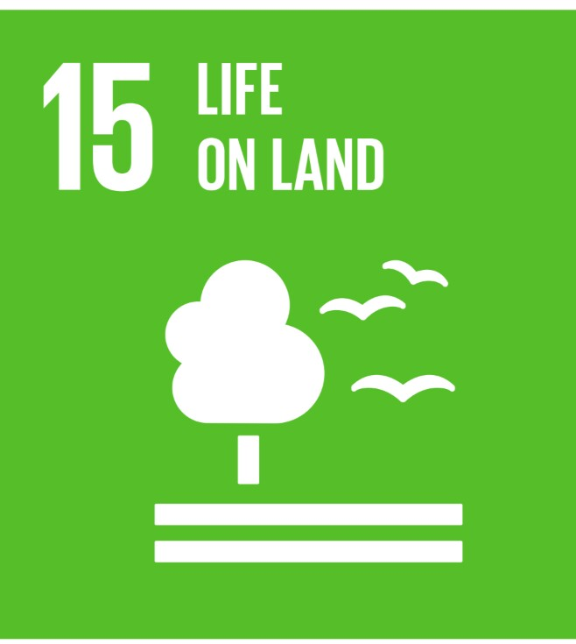



Slide 34
Evolution of Sustainable Development

Slide 35
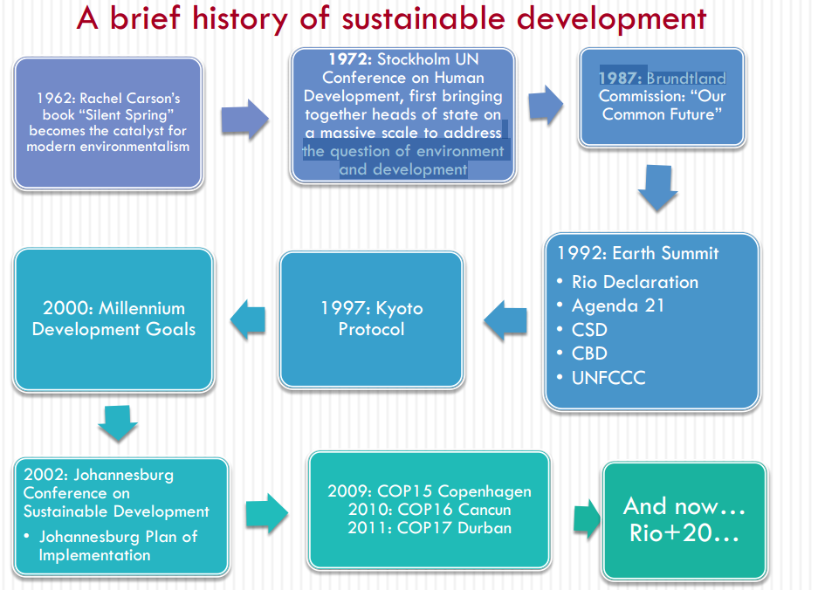

Slide 36
A Short History of Sustainable Development
Concept of sustainable development could begin with the US government’s National Environmental Policy Act (NEPA) of 1969.
It was the product of greater societal attention to the consequences of industrial pollution, awareness of which was promoted by the 1962 publication Silent Spring by Rachael Carson.

Slide 37
Contd….
The Environmental Protection Agency (EPA) opened its doors in 1970, promoting protection of the environment through research, standard-setting, and monitoring.
The next step in the growth of sustainable development as a mainstream concept and practice was the 1972 United Nations Conference on the Human Environment, in Stockholm, Sweden. This conference “brought the industrialized and developing nations together to delineate the ‘rights’ of the human family to a healthy and productive environment.

Slide 38
Contd….
The World Commission on Environment and Development (WCED) was tasked by the Secretary General of the UN, in 1983, to “re-examine critical environmental and development problems around the world and formulate realistic proposals to address them.”
This culminated in the 1987 Bruntland Report’s publication of “Our Common Future”, which established a suggested path for sustainable development on a global level and served to bring the concept of sustainability into the foreground on an international level.

Slide 39
Contd….
A ground-breaking step came in 1992 with the first UN Conference on Environment and Development (UNCED) in Rio de Janeiro. At this conference, an agenda called Agenda 21 was adopted, which “recognized each nation’s right to pursue social and economic progress and assigned to States the responsibility of adopting a model of sustainable development.

Slide 40
Contd…
Another notable international protocol designed to guide the international community towards sustainable development, in this case particularly environmental, was the Kyoto Climate Agreement in 1997.
The Kyoto Protocol adopted in December 1997 and the Conferences of the Parties (COPs), held over the years, have made some advances relating to clarification of various aspects of financing and implementing sustainable development globally.

Slide 41
BACKGROUND ON THE SDG GOALS
The Sustainable Development Goals (SDGs) were born at the United Nations Conference on Sustainable Development in Rio de Janeiro in 2012.
One of the principal outcomes of Rio+20 was the call to produce a set of universally applicable sustainable development goals (SDGs) that balance the environmental, social and economic dimensions of sustainable development.
The objective was to produce a set of universal goals that meet the urgent environmental, political and economic challenges facing our world.

Slide 42
Cont.…
The SDGs replace the Millennium Development Goals (MDGs), which started a global effort in 2000 to tackle the indignity of poverty.
The MDGs established measurable, universally-agreed objectives for tackling extreme poverty and hunger, preventing deadly diseases, and expanding primary education to all children, among other development priorities

Slide 43
Cont.….
For 15 years, the MDGs drove progress in several important areas:
Reducing income poverty, providing much needed access to water and sanitation, driving down child mortality and drastically improving maternal health.
They also kick-started a global movement for free primary education, inspiring countries to invest in their future generations.
Most significantly, the MDGs made huge strides in combatting HIV/AIDS and other treatable diseases such as malaria and tuberculosis.

Slide 44
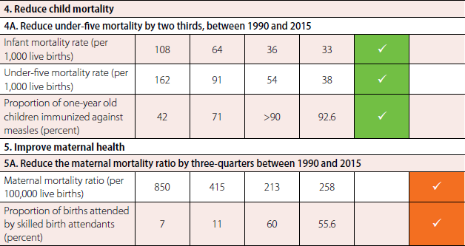
Key MDG achievements
More than 1 billion people have been lifted out of extreme poverty (since 1990)
Child mortality dropped by more than half (since 1990)
The number of out of school children has dropped by more than half (since 1990)
HIV/AIDS infections fell by almost 40 percent (since 2000)

Slide 45
Cont.….
The legacy and achievements of the MDGs provide us with valuable lessons and experience to begin work on the new goals.
But for millions of people around the world the job remains unfinished.
The SDGs are also an urgent call to shift the world onto a more sustainable path.

Slide 46
Contd…
The SDGs are a bold commitment to finish what had been started, and tackle some of the more pressing challenges facing the world today.
All 17 Goals interconnect, meaning success in one affects success for others.
Dealing with the threat of climate change impacts how we manage our fragile natural resources, achieving gender equality or better health helps eradicate poverty, and fostering peace and inclusive societies will reduce inequalities and help economies prosper.
In short, this is the greatest chance we have to improve life for future generations

Slide 47
Implementation of SDG
On 1 January 2016, the world officially began implementation of the 2030 Agenda for Sustainable Development: the transformative plan of action based on 17 Sustainable Development Goals: to address urgent global challenges over the next 15 years.

Slide 48
Environmental Issues and Sustainable Development

Slide 49
Environmental Issue
Urbanization
Tourism
Agriculture
Pollution by Wastewater
Pollution by Solid Waste and Marine Litter
Industrial Emissions
Maritime Traffic and Oil Spills
Fisheries and Aquacultures
Transport

Slide 50
Health Issues
Old and New Problems Occurring Simultaneously
Health hazards such as inadequate and unsafe food and water, microbiological contamination of the environment and poor sanitation and environmental hygiene are still prevalent.
In addition, new environment and development problems have emerged, some of which appear to threaten the entire ecosystem.
Many of the “newer” hazards associated with chemical contamination of the environment are as significant for developing countries as they are for industrialized countries.

Slide 51
Cont.…
In industrialized countries, typical health and environmental problems include outdoor air pollution, radon in homes and schools, the “sick building” syndrome, toxic chemicals in drinking-water, non-ionizing electromagnetic radiation and pesticide residues in food.
In developing countries, health and environmental problems are often related to poverty and arise largely as a result of such factors as rapid, uncontrolled urbanization and agricultural and land-use practices.
In addition to hazards related to pollution, vector-borne environmental diseases may be prevalent as well as health and environmental problems associated with a lack of proper shelter, water and sanitation or poor food hygiene.

Slide 52
Cont.…
For example, pesticides and faeces may contaminate the same water supplies and air pollution may stem simultaneously from burning dirty household fuels and industrial use of fossil fuels.

Slide 53
From Local to Global environmental Issues
Health concerns associated with air and water pollution
Water supply and sanitation
Waste disposal or chemicals and food may be particularly relevant at the local or micro level (for example, lead in household dust or environmental tobacco smoke)
Depletion of the ozone layer
Global climate change
Long-range transport of air pollution or marine pollution).

Slide 54
From Rural to Urban Dimensions
Urban growth has exposed populations to serious environmental hazards and has outstripped the capacity of municipal and local governments to provide even basic health services.

Slide 55
Poverty
The poor live in unsafe and overcrowded housing, often in underserved rural areas or peri-urban slums which lack access to safe water or to sewerage.
They are also more likely than the wealthy to be excessively exposed to pollution, traffic and industrial and other risks at home, at work or in their communities.
Poor children are particularly affected – in the poorest regions of the world, one in five children dies before his or her first birthday, mostly from environment-related diseases such as acute respiratory infections, diarrhoea and malaria.

Slide 57
Linking Environmental issues with SDGs
Sustainable development has been defined as “development that meets the needs of the present without compromising the ability of future generations to meet their own needs”.
Agenda 21 highlights, among many aspects, the need for more appropriate management of human settlements, and places particular emphasis on the need to take health considerations into account in planning for sustainable development.

Slide 58
NEED FOR HOLISTIC APPROACHES
Increasing need to form partnerships, to work across sectors such as the environment, transport, energy and housing, to involve communities more closely in decision-making and to transfer decision-making to the lowest possible level.
Need for harmonized global, national and local strategies.

Slide 59
SDG Goals related to Environment
Goal 6. Ensure availability and sustainable management of water and sanitation for all
6.1 By 2030, achieve universal and equitable access to safe and affordable drinking water for all
6.2 By 2030, achieve access to adequate and equitable sanitation and hygiene for all and end open defecation, paying special attention to the needs of women and girls and those in vulnerable situations

Slide 60
Goal 11. Make cities and human settlements inclusive, safe, resilient and sustainable
11.1 By 2030, ensure access for all to adequate, safe and affordable housing and basic services and upgrade slums
11.2 By 2030, provide access to safe, affordable, accessible and sustainable transport systems for all, improving road safety, notably by expanding public transport, with special attention to the needs of those in vulnerable situations, women, children, persons with disabilities and older persons.
11.5 By 2030, significantly reduce the number of deaths and the number of people affected and substantially decrease the direct economic losses relative to global gross domestic product caused by disasters, including water-related disasters, with a focus on protecting the poor and people in vulnerable situations

Slide 61
Contd…
11.7 By 2030, provide universal access to safe, inclusive and accessible, green and public spaces, in particular for women and children, older persons and persons with disabilities.
11.b By 2020, substantially increase the number of cities and human settlements adopting and implementing integrated policies and plans towards inclusion, resource efficiency, mitigation and adaptation to climate change, resilience to disasters, and develop and implement, in line with the Sendai Framework for Disaster Risk Reduction 2015-2030, holistic disaster risk management at all levels.

Slide 62
Contd..
Goal 13. Take urgent action to combat climate change and its impacts
  13.3 Improve education, awareness-raising and human and institutional capacity on climate change mitigation, adaptation, impact reduction and early warning.

Slide 63
ECO VILLAGE- INTRODUCTION
Eco-villages are traditional or intentional communities whose goal is to become more socially, culturally, economically and ecologically sustainable.
Eco villages are consciously designed by locally owned, participatory processes to regenerate and restore their social and natural environments.

Slide 64
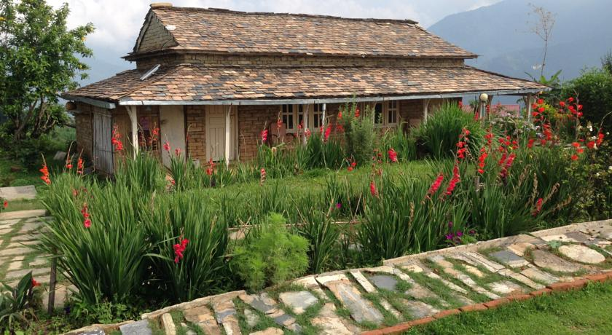
Annapurna Eco Village

Slide 65
Contd…
Most eco-village range from a population of 50 to 150 individuals, although some are smaller, and traditional.
Eco villages are often much larger. Larger eco villages often exist as networks of smaller sub communities.
Certain eco villages have grown by the addition of individuals, families, or other small groups.
Eco villagers are united by shared ecological, social, economic and cultural, spiritual values.

Slide 66
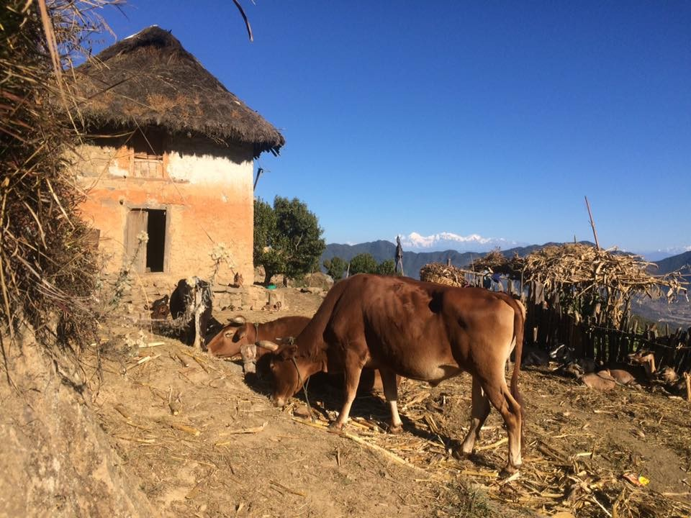
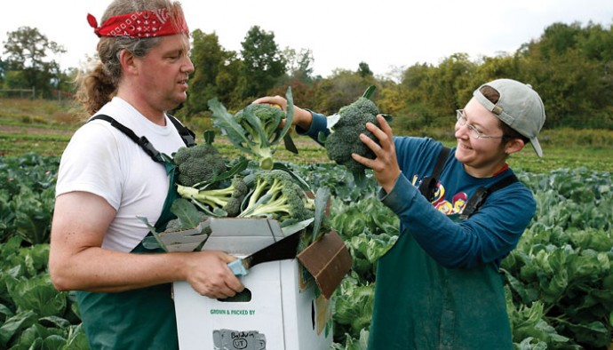
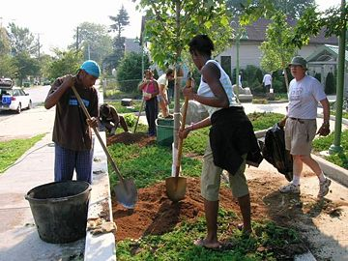
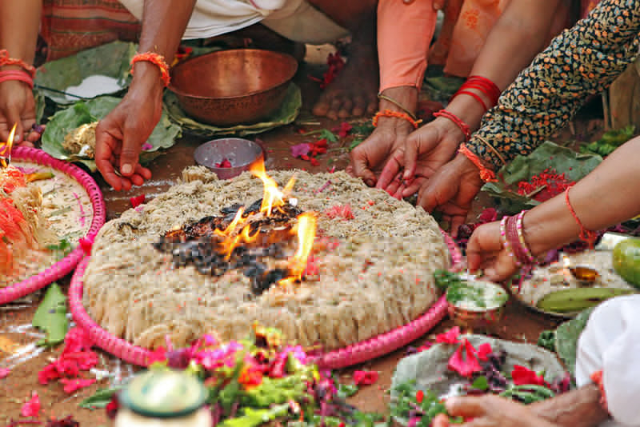
Eco village - Culture

Slide 67
Eco-villagers seek alternatives to ecologically destructive electrical, water, transportation, and waste-treatment systems, as well as the larger social systems that mirror and support them.
Eco-villages offer small-scale communities with minimal ecological impact or regenerative impacts as an alternative. However, such communities often cooperate with peer villages in networks of their own.

Slide 68
Definition
Eco Village : Intentional, traditional, rural or urban community that is consciously designed through locally owned, participatory processes in all four dimensions of sustainability (social, culture, ecology and economy) to regenerate their social and natural environments.

Slide 69
Eco village Development
What is Eco Village
Development???

Slide 70
Concept
The Eco-Village Development concept involves the implementation at village-level of appropriate, inexpensive renewable-energy technology and capacity-building activities for climate change adaptation and mitigation.
It takes a collaborative approach by involving community members deeply in planning and implementation.
Eco village Development is an integrated approach of creating development-focused, on low carbon communities of practice in existing villages.

Slide 71
The bundle of practices includes mitigation technologies like small, household-sized biogas plants, smokeless stoves, solar-energy technology, improved water mills to generate electric power, and solar-powered drying units.
It also includes adaptation technologies such as organic farming, roof-water harvesting, water-lifting technologies like hydraulic ram pumps.

Slide 72
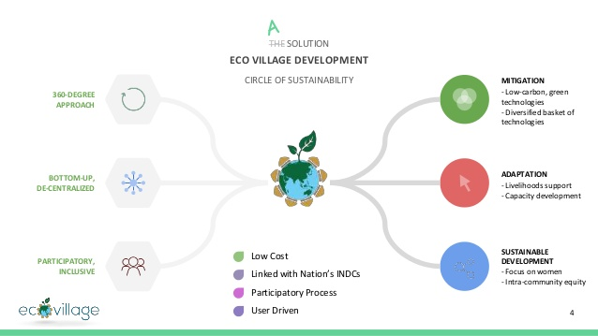

Slide 73
Development of Eco village
Steps:
Inviting & participating
Planning & Integrating
Training & Implementing
Measuring & Evaluating
Refining & Scaling

Slide 74
Ecocity- Introduction
An Ecocity is a human settlement modeled on the self-sustaining resilient structure and function of natural ecosystems.
An ecocity seeks to provide healthy abundance to its inhabitants without consuming more renewable resources than it replaces.
It seeks to function without producing more waste than it can recycle for new uses or than nature can dilute and absorb harmlessly, and without being toxic to itself or neighboring ecosystems.
Its inhabitants’ ecological impacts reflect planetary supportive lifestyles
Its social order reflects fundamental principles of fairness, justice, reasonable equity and consensus at ample levels of happiness.

Slide 75
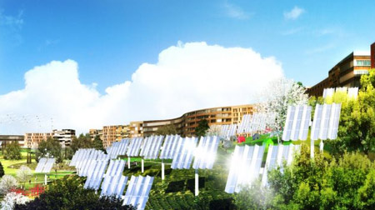
Eco city Structure

Slide 76
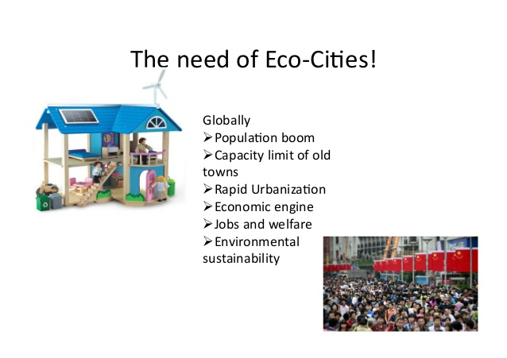

Slide 77
Development of Ecocity
Steps:
Preservation of Phytoplankton & Aquatic life
Proper solid, liquid waste management
Promote Cycling, Use public vehicles, parks & Playground
Practice Scientific agriculture

Slide 78
Natural resources and sustainable livelihood

Slide 79
Natural Resources
Energy
  Coal
  Petroleum
  Nuclear Power
  Natural Gas
  Sources of Renewable Energy
Nonfuel Minerals
  Ocean mining
  New technology

Slide 80
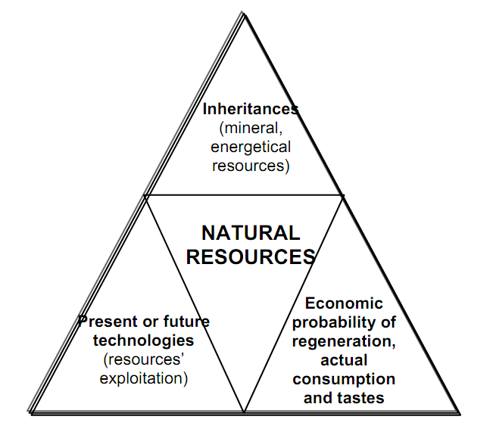
Natural Resources

Slide 81
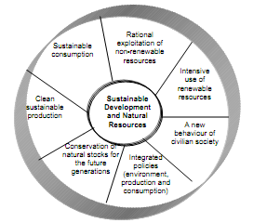
Contd….
Sustainable livelihood and business
Aspects to be addressed
  Trade and market liberalization
  Eco-efficiency
  Financial world
  Subsidies
    Perverse subsidies
  New product markets
  Production and consumption patterns
Figure: Sustainable development and natural resources – interdependences and connections

Slide 82
Environmental Ethics and global view on sustainable earth

Slide 83
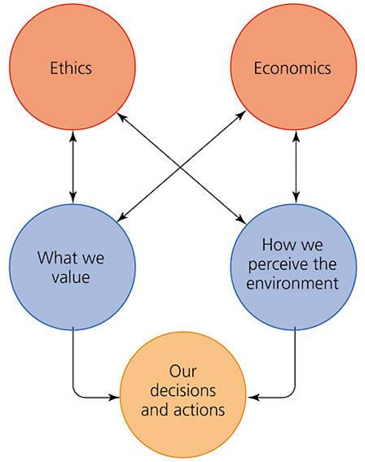
Ethics
Ethics is a discipline that deals with how we value and perceive our environment.
Ethics influence our decisions and actions.

Slide 84
What is Environmental Ethics?
A systematic and critical study of practices, beliefs, and rules applied to the environment that are considered moral, i.e., good/bad, right/wrong, and virtuous/vicious.

Slide 85
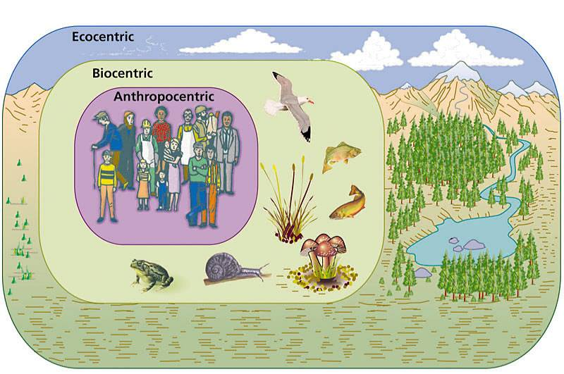
Three ethical worldviews

Slide 86
Terms Explained
Anthropocentric: Centered around humans. (Comes from Greek word anthrop which means human)
  Humans are the central or sole inhabitants of the moral community
Non-anthropocentric: Not centered around humans
  Center could be non human living things or larger wholes such as species, ecosystems, and the biotic community as the organized systems of all living things.

Slide 87
Environmental Perspectives
Biocentrism
Life centered, all organisms have some intrinsic values and rights. Biodiversity is the highest ethical value in nature. Individuals and populations are the basic units of biodiversity.

Slide 88
Environmental Perspectives
Ecocentrism
Ecologically centered
Evolution, adaptation, and biogeochemical cycles are really more important than individuals.
The whole ecosystem is more important than the individuals and populations that make up the ecosystem.
Moral values for ecological process and systems

Slide 89
Environmental Ethics Rectangle
 | Anthropocentric | Non-anthropocentric
Holistic | Agrarianism: Humans transform nature for agriculture but understand farm as ecosystem | Ecocentrism: “A thing is good if it promotes the integrity, beauty, and stability of the biotic community.” Focus on biotic community conceived holistically
Individualistic | Extensionism: Individualistic ethical approaches such as Utilitarianism and Deontology are extended to cover non-humans. (Singer for Utilitarianism and Regan for Deontology) | Biocentrism: Duties not to interfere with teleological centers of a life. Basic , non-human telos can trump non-basic and even basic human interests.

Slide 90
Thank you

